Slide 1
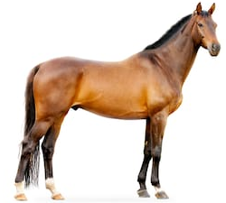
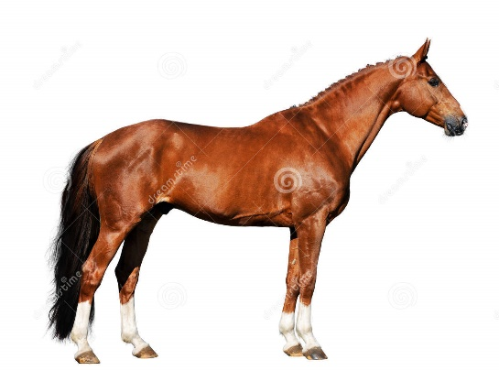

Tronador
Narrate
Northern Sea
Caro
Gold Digger
Mr. Prospector
La Morita

