Slide 1
Confidence
Jasmine Belfrage, Ignacio Iturralde, Marcel Graetz
1.6.18

Slide 2
Examples
Presentations
Social anxiety
rejection
Workload
Illnesses

Slide 3
Aim
Modelling potential behavior of an agent trying to control the environment
Simulation
No actual data (yet)

Slide 4
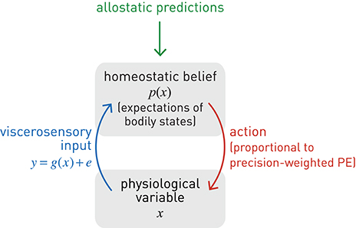
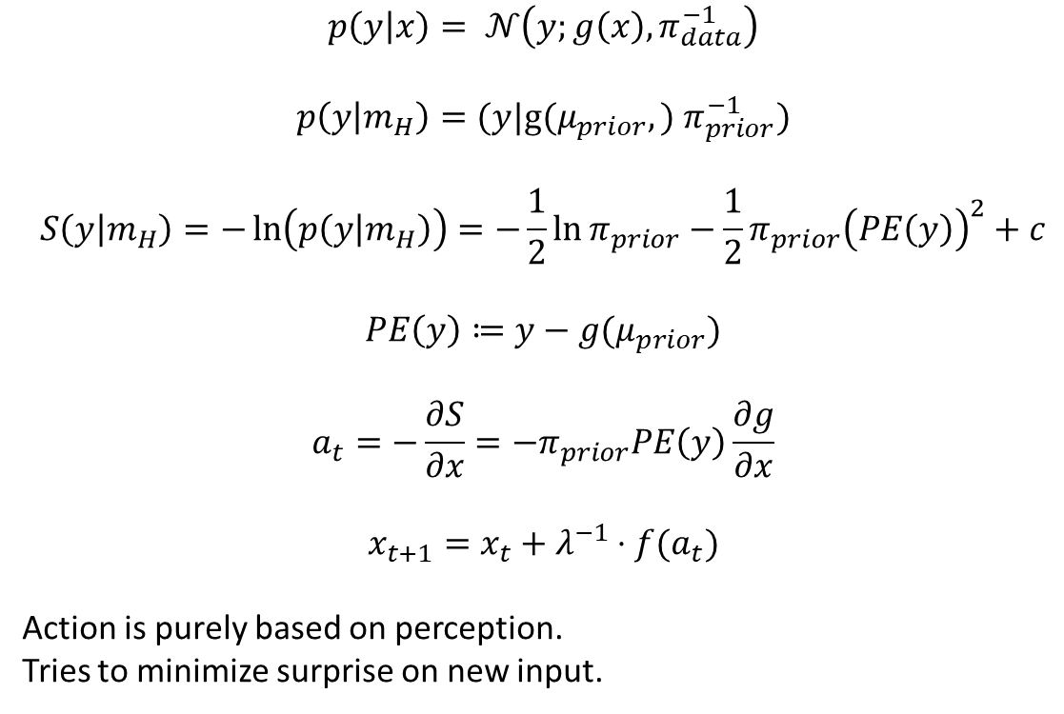
Allostatic control
$$p\left(y | x\right)= 𝒩\left(y;g\left(x\right), π_{data}^{−1}\right)$$
$$p\left(y | m_{H}\right)=(y|\text{g}\text{(}μ_{prior},) π_{prior}^{−1})$$
$$S\left(y | m_{H}\right)=−\ln\left(p\left(y | m_{H}\right)\right)=−\frac{1}{2}\ln{π_{prior}−\frac{1}{2}π_{prior}{\left(PE\left(y\right)\right)}^{2}}+c$$
$$PE\left(y\right)≔y−g(μ_{prior})$$
$$a_{t}=−\frac{∂S}{∂x}=−π_{prior}PE\left(y\right)\frac{∂g}{∂x}$$
$$x_{t+1}=x_{t}+{λ^{−1}⋅f(a}_{t})$$
Action is purely based on perception.
Tries to minimize surprise on new input.

Slide 5
Problems in allostatic control
Action is based only on the input
No model of the world
(equation: no precision of model, only of desire)
=> reacting to sensory noise (image!)

Slide 6

Simple perceptual inference
$μ_{t+1}=μ_{t}+\frac{π_{data}}{π_{t}+ π_{data}}\left(y_{t}−g\left(μ_{t}\right)\right)$
$π_{t+1}=π_{t}+π_{data}$

Slide 7
Problems with this kind of learning
Only adaptive for stable environments
Precision of prior belief increases monotonically
Not adaptive if environment changes

Slide 8
Solution?

Slide 9
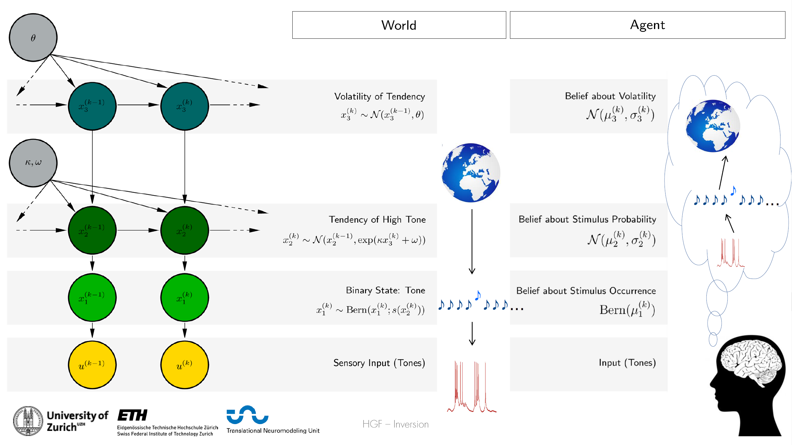

Slide 10
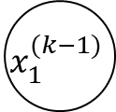
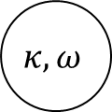
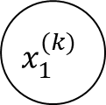
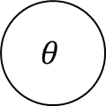
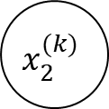
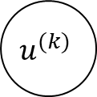
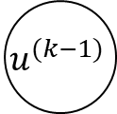
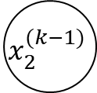
In our case:
$$θ$$
$$x_{2}^{(k−1)}$$
$$x_{2}^{(k)}$$
$$κ, ω$$
$$x_{1}^{(k−1)}$$
$$x_{1}^{(k)}$$
$$u^{(k−1)}$$
$$u^{(k)}$$

Slide 11
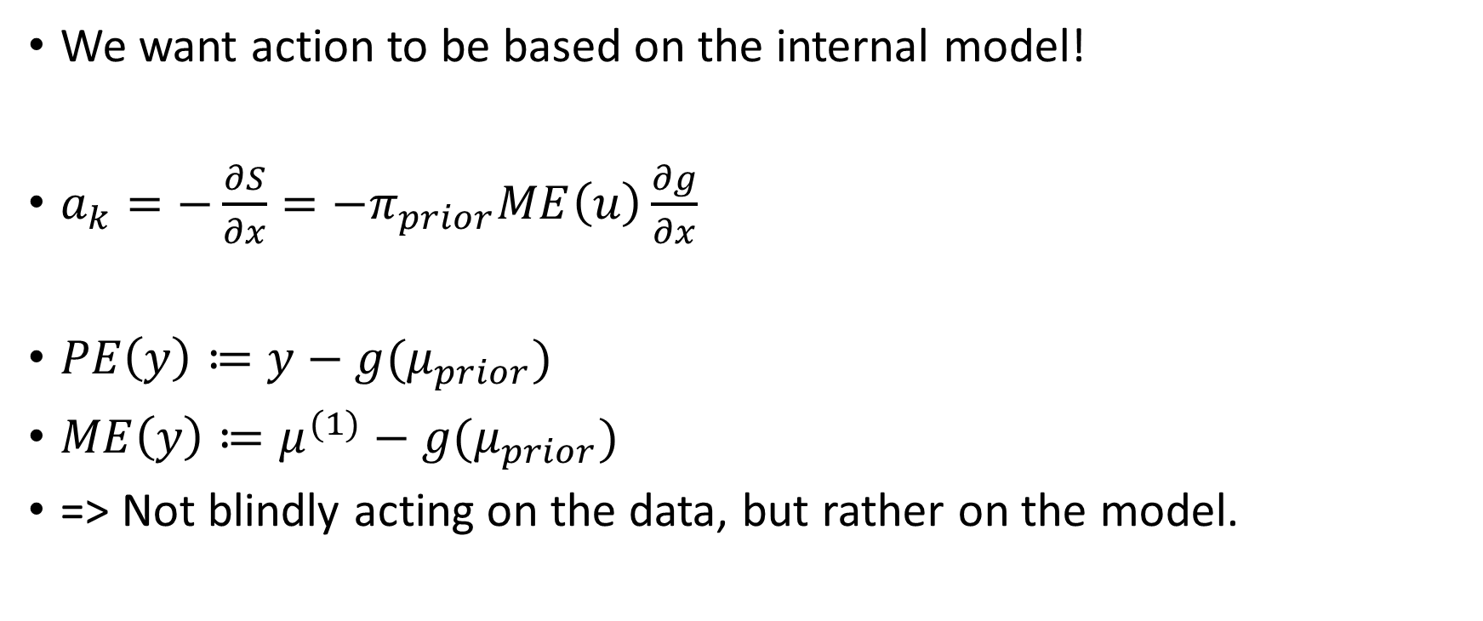
Implementing action
We want action to be based on the internal model!
$a_{k}=−\frac{∂S}{∂x}=−π_{prior}ME\left(u\right)\frac{∂g}{∂x}$
$PE\left(y\right)≔y−g(μ_{prior})$
$ME\left(y\right)≔μ^{(1)}−g(μ_{prior})$
=> Not blindly acting on the data, but rather on the model.

Slide 12
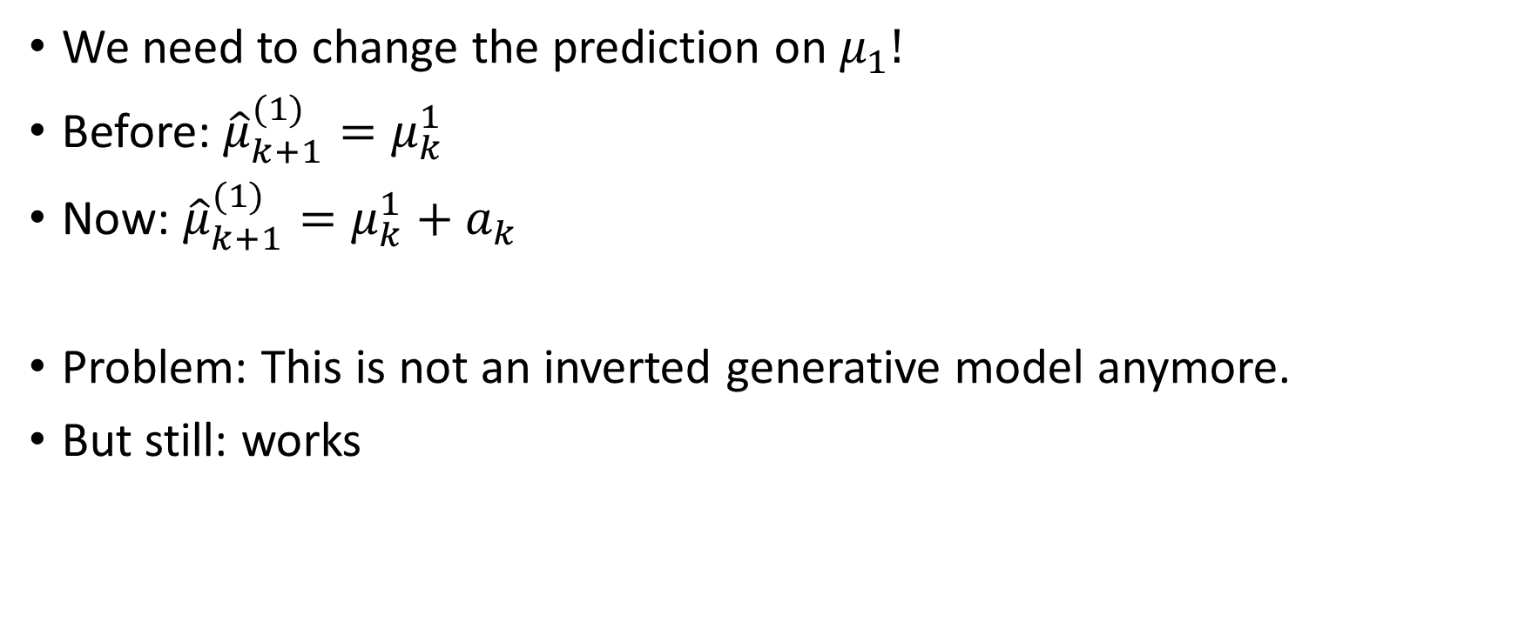
A good agent knows about her actions.
We need to change the prediction on $μ_{1}!$
Before: ${\hat{μ}}_{k+1}^{(1)}=μ_{k}^{1}$
Now: ${\hat{μ}}_{k+1}^{(1)}=μ_{k}^{1}+a_{k}$
Problem: This is not an inverted generative model anymore.
But still: works

Slide 13

Confidence
How to bring in confidence?
Before: ${\hat{μ}}_{k+1}^{(1)}=μ_{k}^{1}$
Now: ${\hat{μ}}_{k+1}^{(1)}=μ_{k}^{1}+a_{k}$
And now: ${\hat{μ}}_{k+1}^{(1)}=μ_{k}^{1}+{λ^{−1}⋅a}_{k}$
$λ^{−1}$ is the confidence score!

Slide 14
Application
Depression
Social anxiety
Narcissism
=> more generally: deviations from “standard” self-efficacy feeling

Slide 15
Demo

Slide 16
Strengths of our approach
Learning and acting simultaneously
Action based on internal model
Space for improvement
HGF has many more parameters that can be used.

Slide 17
Weaknesses
Not an inverted generative model anymore.
Loss of one of the core strengths of HGF
BUT: In principle, this model is invertible, isn‘t it?

Slide 18
What would have been next?
Testing if this model works on actual data.
Self-efficacy ratings on a simple task
Compare performance to model

Slide 19
What about these problems?
How does the brain build those models?
We must have to capacity to build many of those models at once and also compare them.
How?

