Slide 1
Simplification of numeric variables for PLC model checking
Dr. Jean-Charles Tournier (CERN)
Dr. Borja Fernandez Adiego (CERN)
Dr. Juan A. Rodríguez-Aguilar (IIIA-CSIC)
Dr. Enrique Blanco Viñuela (CERN)
Ignacio D. Lopez-Miguel (CERN)
20/11/2021

Slide 2
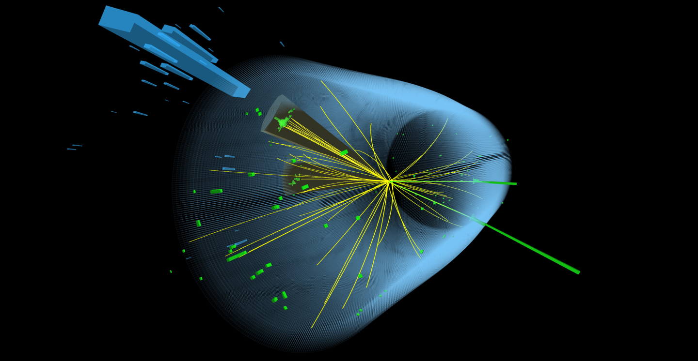
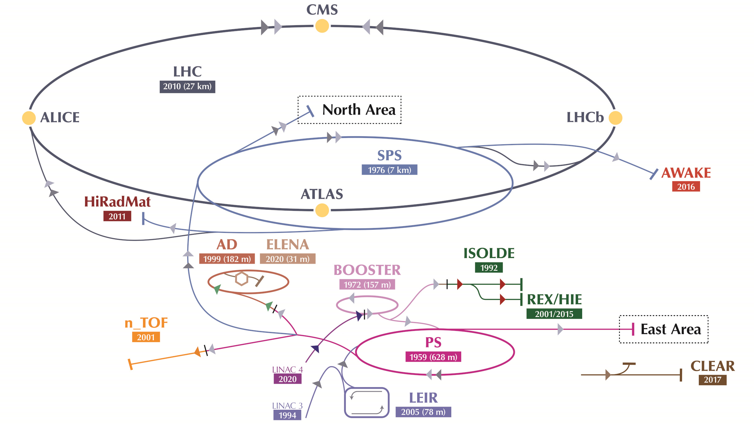
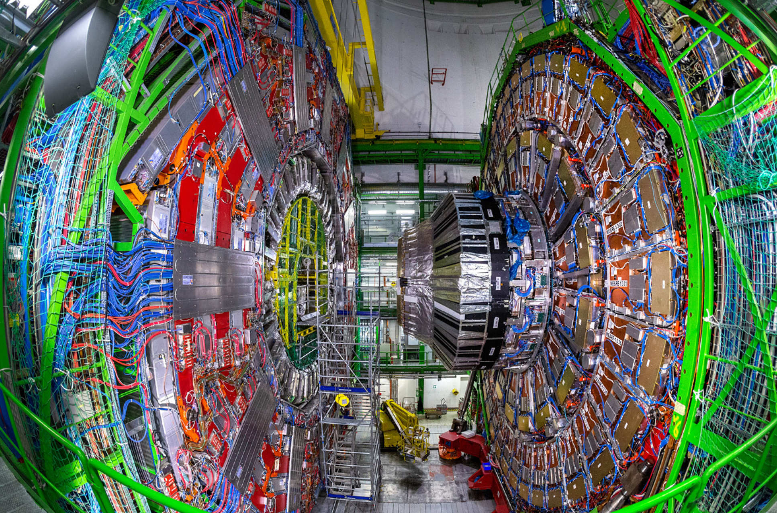
Context – European Organization for Nuclear Research (CERN)
Basic science: fundamental structure of the particles.
Technology: world's largest and most complex scientific instruments.

Slide 3
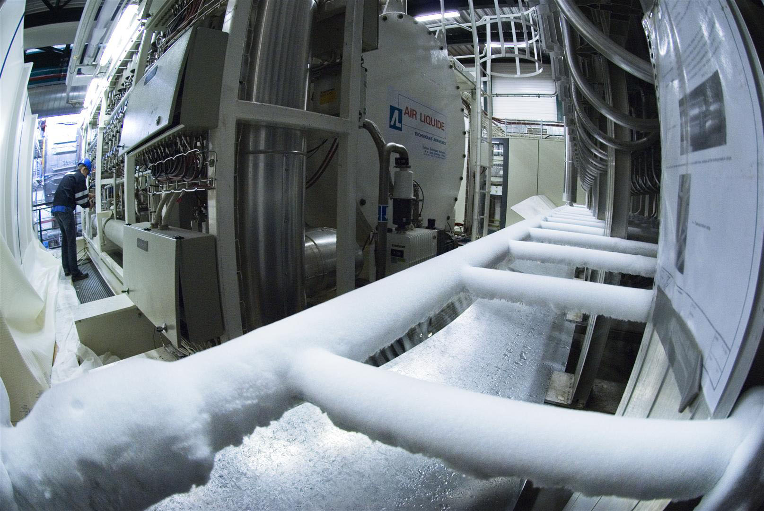
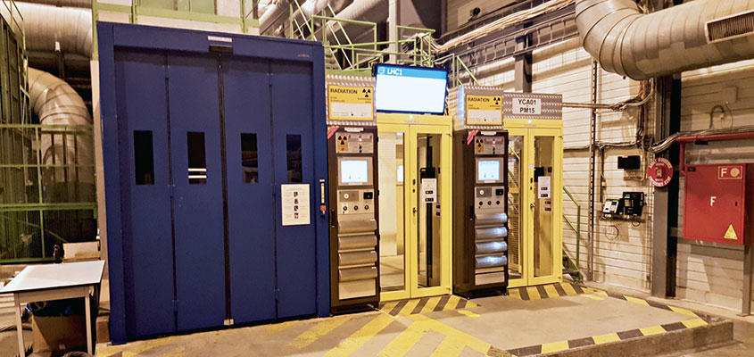
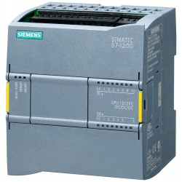
Context – Safety-critical industrial applications
Cryogenics
Access control and Protection systems
These systems use PLCs (Programmable Logic Controllers) as a control device
An error could cause a disaster
Guarantee safety: Test every single possibility

Slide 4






Context – Model Checking for PLCs
Input1
PLC program
Input2
Output1
Input3
Output2
Input4
Sensors
Actuators
Functionality requirement
Safety requirement
If Input1 is False, then Output2 is False
If Output1 is False, then Output2 is True
4 Integer (16-bit) input variables → 2^{16⋅4} ≈ 1.8⋅10¹⁹ combinations
Solution: Model checking
Problem: state-space explosion
Goal: Simplification of numeric variables

Slide 5
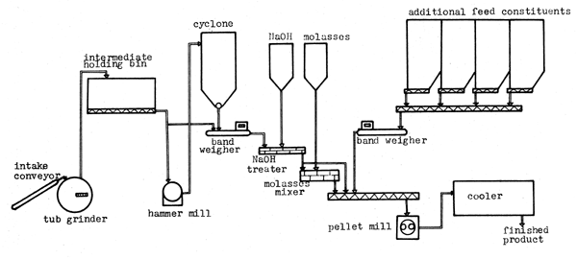



Model Checking for PLCs – Standard workflow
Formal model
Specifications
Formal requirement
Real System
(software)
Control-flow automaton (CFA)
PLCverif
Hides the complexity of using formal methods
init
Temporal Logic
in ← IntNonDet()
in>10
l0
in≤10
Model Checker
Solver
l1
l2
out1 ← False
out1 ← True
✗
✓
out2 ← True
out2 ← False
l3
Property failed
Counterexample
Property OK
20/09/2021

Slide 6
Model checking challenges – Variable simplification
Formal specification
Requirement formalization
Several variables
A lot of interaction among variables
Big data types
Integers
Reals
Words
Counterexample analysis
State-space explosion

Slide 7
Variable simplification – State of the art
Deficiencies
Predicate abstraction
Counterexample-guided abstraction refinement (CEGAR)
Refinement needed
Specific to the model checker
Manual
One single counterexample given
Not widely used for PLC programs
Satisfiability Modulo Theories (SMT)
Manual boundary setting

Slide 8
Variable simplification – Contribution
CFA structural patterns analysis
Variable discretization
CFA transformation
Family of transformations
Agnostic to the model checker
No refinement needed
Richer counterexamples
Experimental results

Slide 9
Variable simplification – Conditional pattern example
PLC program
Original CFA
Transformation
Transformed CFA
FUNCTION_BLOCK example
VAR_INPUT
x : INT;
END_VAR
VAR_OUTPUT
y : INT;
END_VAR
BEGIN
IF x>0 THEN
IF x>50 THEN
y := 3;
ELSE
y := 2;
END_IF;
ELSE
IF x<-50 THEN
y := 0;
ELSE
y := 1;
END_IF;
END_IF;
//#ASSERT (y=0 AND x>20);
END_FUNCTION_BLOCK
$$x←NonDet(Int)$$
$$X←NonDet(\{0,1,2,3,4\})$$
Init
$$x>0$$
Init
$$X∈\{2,3,4\}$$
$$else$$
$$else$$
0
1
2
3
4
x
$$else$$
$$else$$
$$else$$
$$else$$
$$y←1$$
$$y←2$$
$$y←1$$
$$y←2$$
$$x<−50$$
$$x>50$$
-50
0
20
50
x
$$X∈\{0\}$$
$$X∈\{4\}$$
$$y←0$$
$$y←3$$
$$y←0$$
$$y←3$$
$$else$$
$$y=0∧x>20$$
$$else$$
$$y=0∧x∈\{3,4\}$$
Error
Error
x has 2¹⁶=65536 possible values
From 65536 possible values to 5
X has 5 possible values

Slide 10

Variable simplification – Assignment pattern example
PLC program
Original CFA
Node duplication
Assignment removal
FUNCTION_BLOCK example2
VAR_IN_OUT
x : INT;
END_VAR
VAR_OUTPUT
y : INT;
END_VAR
BEGIN
IF x>0 THEN
x := x-1;
IF x>50 THEN
y := 3;
ELSE
y := 2;
END_IF;
ELSE
x := x+1;
IF x<-50 THEN
y := 0;
ELSE
y := 1;
END_IF;
END_IF;
//#ASSERT (y=0 AND x>20);
END_FUNCTION_BLOCK
$$x←NonDet(Int)$$
$$x←NonDet(Int)$$
$$x←NonDet(Int)$$
Init
$$x>0$$
Init
Init
$$else$$
$$else$$
$$x>0$$
$$else$$
$$x>0$$
$$x′←x+1$$
$$x′←x−1$$
$$x′←x+1$$
$$x′←x−1$$
$$else$$
$$else$$
$$else$$
$$else$$
$$else$$
$$else$$
$$y←1$$
$$y←2$$
$$y←1$$
$$y←2$$
$$y←1$$
$$y←2$$
$$x′<−50$$
$$x′>50$$
$$x′<−50$$
$$x′>50$$
$$x<−51$$
$$x>51$$
$$y←0$$
$$y←3$$
$$y←0$$
$$y←3$$
$$y←0$$
$$y←3$$
$$else$$
$$y=0∧x′>20$$
$$y=0∧x′>20$$
$$y=0∧x>19$$
$$else$$
$$y=0∧x′>20$$
$$else$$
$y=0∧x>2$1
Error
$$else$$
Error
$$else$$
Error
0
1
2
3
4
5
x
Conditional pattern
From 65536 possible values to 6
-51
0
19
21
51
x

Slide 11
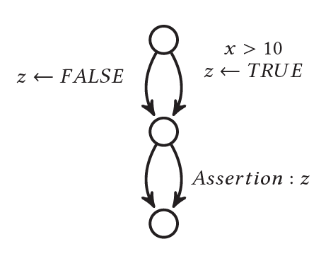
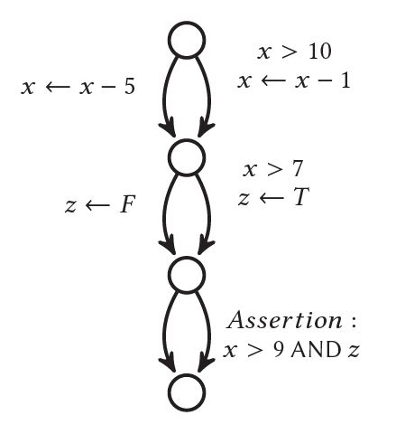


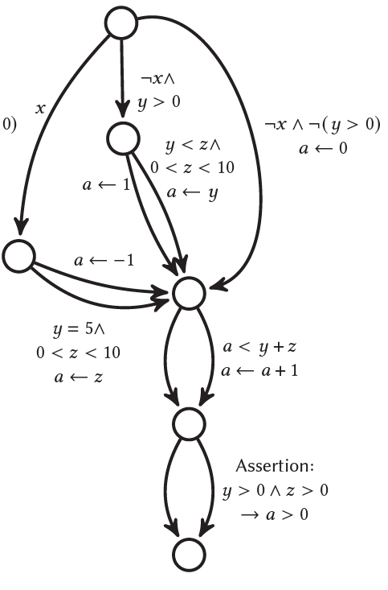
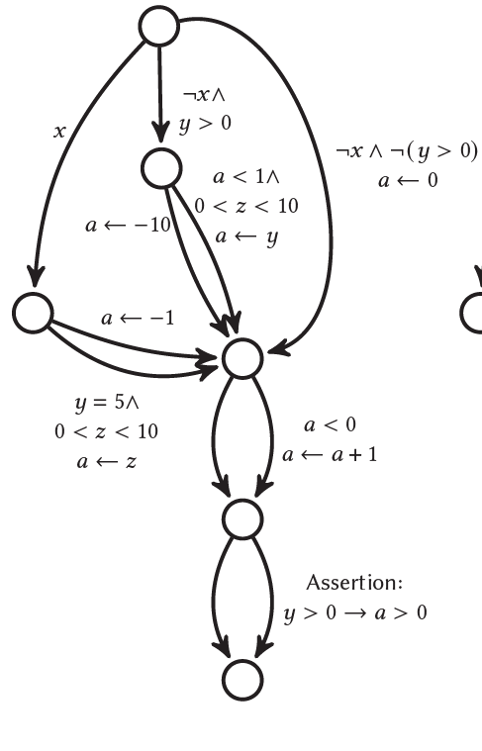

Variable simplification – Experiments
Three state-of-the-art model checkers
BDD
Different CFAs
Theta
SMT, CEGAR
Several executions to have significant results
SAT

Slide 12
Conclusions – Results
0
1
2
3
4
x
Richer counterexamples.
init
-50
0
20
50
x
in ← IntNonDet ()
in>10
l0
in≤10
l1
l2
Agnostic to the model checker.
out1 ← False
out1 ← True
out2 ← True
out2 ← False
l3
Speed-ups of two orders of magnitude.
Terminating now programs that timed out.
Theta
Speed-ups of up to 17x when the property is satisfied
Small speed-ups
Worse results when the CFA includes complex patterns

Slide 13
Conclusions – Future work
Implement in PLCverif
Other
Automate the transformation
Estimate the computational cost
More efficient discretization encoding
Extend it to other programming languages
Study it for unbounded loops
Include this technique in other fields:
Formal verification of neural networks
Safe reinforcement learning

Slide 14
Thank you

Slide 15
Index
Context
CERN
Safety-critical industrial applications
Model checking for PLCs
Motivation
Standard workflow
Variable transformation
Model checking challenges
State of the art
Contribution
Conditional pattern example
Experiments
Conclusions
Results
Future work
Remark
Appendix

Slide 16
Model Checking for PLCs - PLCverif
Formal model
✗
PLC program
Intermediate Model
Model checker
✓
Control Flow Automaton
FUNCTION_BLOCK test
VAR_INPUT
in : INT;
END_VAR
VAR_OUTPUT
out1 : BOOL;
out2 : BOOL;
END_VAR
BEGIN
IF in>10 THEN
out1 := False;
out2 := True;
ELSE
out1 := True;
out2 := False;
END_IF;
END_FUNCTION_BLOCK
Formal requirement
init
✗
in ← IntNonDeterministic()
l0
Property failed
Trace leading to the violation
in>10
in≤10
l1
l2
out1 ← False
out1 ← True
out2 ← True
out2 ← False
l3
Non-deterministic input variables
Theta
✓
Requirements
Formalized requirements
If Out1 is FALSE
then Out2 is TRUE
Property OK
AG (!Out1 → Out2)

Slide 17
Model checking – Example (SAT-based)
1. Program graph
¬x
x
y ← False
y ← True
y
¬y
x = BoolNonDeterministic()
if x=True then
y := False
else
y := True
Assert: y=True
2. Satisfiable (SAT) formula
Conjunctive Normal Form
2 variables (x, y)
2 clauses (¬y, x)
(x AND ¬y AND ¬y) OR (¬x AND y AND ¬y)
(¬y) AND (x)
CNF
3. Check satisfiability (DPLL)
2. Make True the second clause.
- Set x=True
If not possible, go to step 1 and choose another variable.
If not possible, formula unsatisfiable.
1. Make True the first clause.
- Set y=False
3. All clauses are True
(¬y) AND (x)
(¬y) AND (x)
Counterexample: x=True, y=False

Slide 18
Model checking – Example (SMT-based)
1. Program graph
x>10
x≤10
Theta
y ← False
y ← True
¬(x<0) OR y
¬(¬(x<0) OR y)
x = IntNonDeterministic()
if x>10 then
y := False
else
y := True
Assert: x<0 → y=True
2. SMT (Satisfiability Modulo Theories) formula
(x>10 AND ¬y AND ¬(¬(x<0) OR y)) OR (x≤10 AND y AND ¬(¬(x<0) OR y))
p:= x>10
q:= x<0
(p AND ¬y AND ¬(¬q OR y)) OR (¬p AND y AND ¬(¬q OR y))
CNF
Bool encoding of clauses
SAT formula
3 variables
4 clauses
(¬(x<0) OR y)
3. Check satisfiability
(¬y) AND (q) AND (p OR y) AND
(¬p OR ¬y) AND
¬(p AND q AND ¬y)
DPLL
(¬y) AND (q) AND (p OR y) AND (¬p OR ¬y)
Theory-solver
Find a value for x that makes p=True and q=True
Invalid counterexample
No solution found
Property satisfied
Not possible
Find another candidate solution adding the constraint:
¬(p AND q AND ¬y)

Slide 19
Model checking – Example (BDD-based)
x = BoolNonDeterministic()
if x=True then
y := False
else
y := True
Assert: y=True
1. Transition system
2. Formula
3. BDD
Binary Decision Diagram
end
x
end=False
x=False
y=False
(((¬end AND ¬x AND ¬y) AND (end’ AND x’ AND ¬y’))
OR ((¬end AND ¬x AND ¬y) AND (end’ AND ¬x’ AND y’)))
AND (end’ AND ¬y’)
y
end'
y’
end=True
x=True
y=False
end=True
x=False
y=True
x'
True
False

