Slide 1






Convolutional Neural Network Transfer for Automated Glaucoma Identification
José Ignacio Orlando^{1,2}, Elena Prokofyeva^{3,4}, Mariana del Fresno^{1,5} and Matthew B. Blaschko⁶
¹ Instituto Pladema, UNCPBA, Tandil, Argentina
² Consejo Nacional de Investigaciones Científicas y Técnicas, CONICET, Argentina
³ Scientific Institute of Public Health (WIV-ISP), Brussels, Belgium
⁴ Federal Agency for Medicines and Health Products, Brussels, Belgium
⁵ Comisión de Investigaciones Científicas de la Provincia de Buenos Aires, CIC-PBA, Argentina
⁶ ESAT-PSI-Visics, KU Leuven, Leuven, Belgium

Slide 2
Glaucoma
Fundus images
Convolutional Neural Networks
Our approach
Results
Conclusions

Slide 3
Glaucoma
Fundus images
Convolutional Neural Networks
Our approach
Results
Conclusions

Slide 4
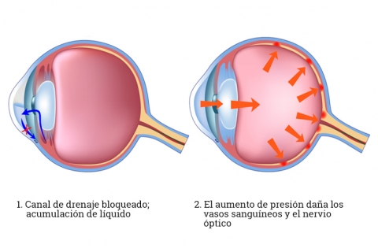
Leading cause of preventable blindness in Western population
glaucoma
Asymptomatic in its early stages
Effective screening of glaucoma using automated methods is valuable
Half of patients with glaucoma remain undiagnosed
More than half of patients undergoing treatment do not have the disease

Slide 5
Glaucoma
Fundus images
Convolutional Neural Networks
Our approach
Results
Conclusions

Slide 6
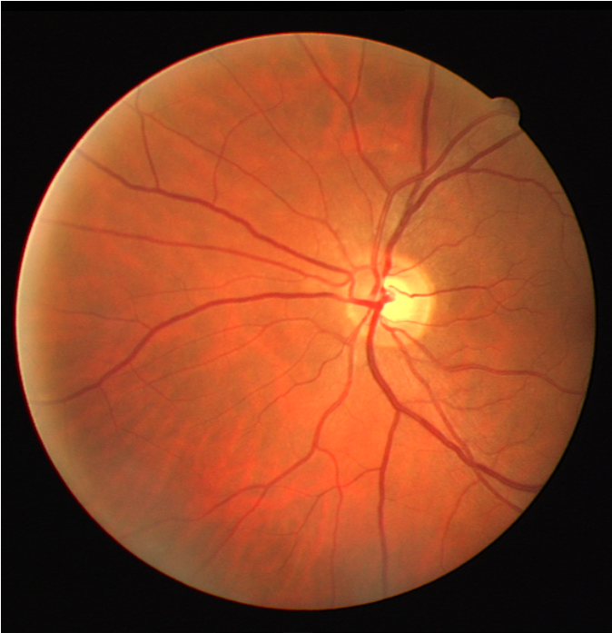
Cheapest, non-invasive imaging modality for inspecting the retina
Glaucoma is usually screened by measuring the cup-to-disc ratio (CDR)
Current automated methods are based on overall or segmentation based features
Hand crafted methods require a significant effort to develop
Segmentation based systems are influenced by segmentation performance
Fundus images

Slide 7
Glaucoma
Fundus images
Convolutional Neural Networks
Our approach
Results
Conclusions

Slide 8
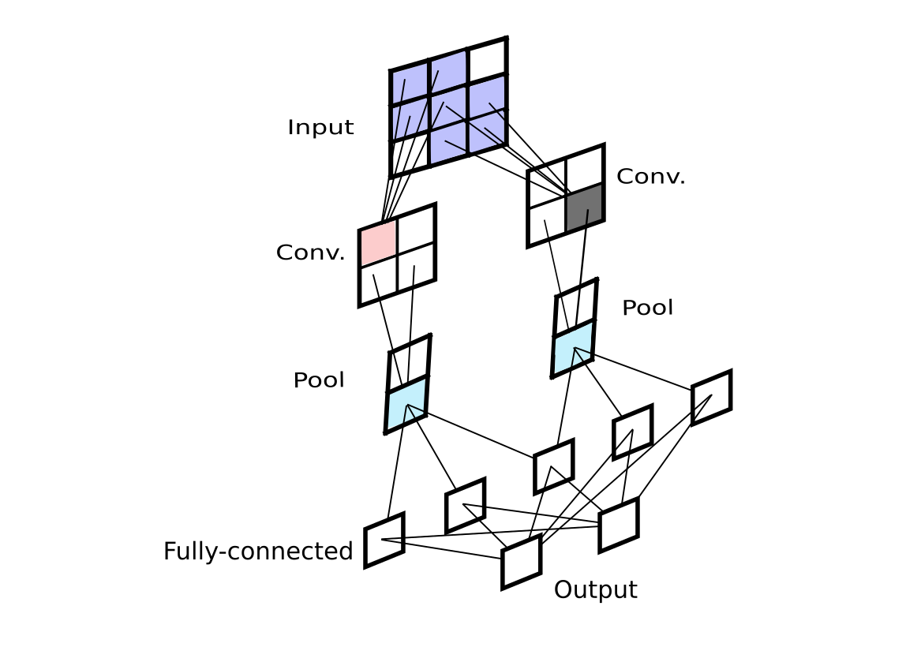
Powerful technique for solving computer vision tasks such as image classification
Data-driven approach that learn deep properties of the images usually ignored by hand tuned methods
This is achieved at the cost of learning from extremely large annotated training sets
Having such an amount of data is usually complex for solving medical imaging problems
convnets

Slide 9
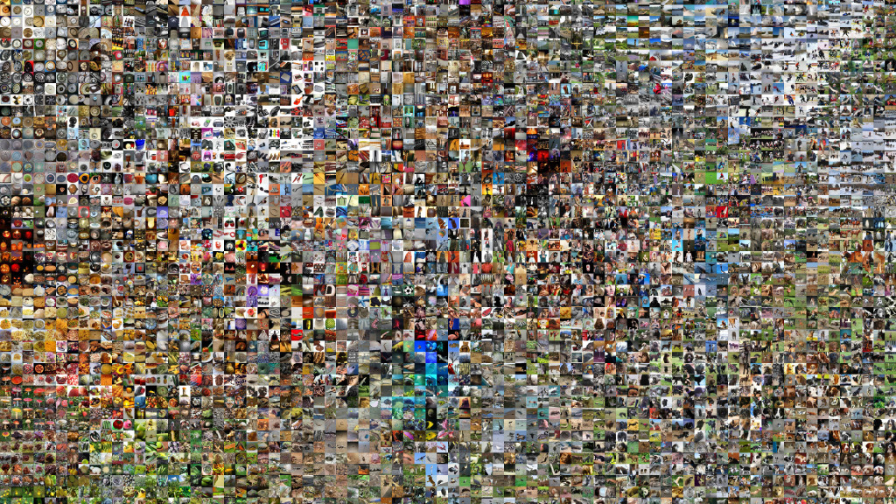
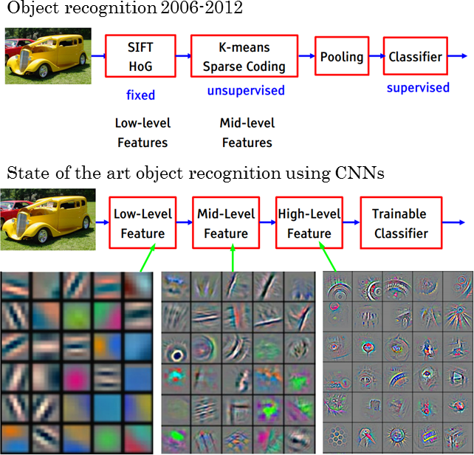
convolutional neural network
Low level features
Mid level features
High level features
Trainable classifier
transfer learning

Slide 10
convolutional neural network
Low level features
Mid level features
High level features
Trainable classifier
Trainable classifier
transfer learning

Slide 11
Glaucoma
Fundus images
Convolutional Neural Networks
Our approach
Results
Conclusions

Slide 12
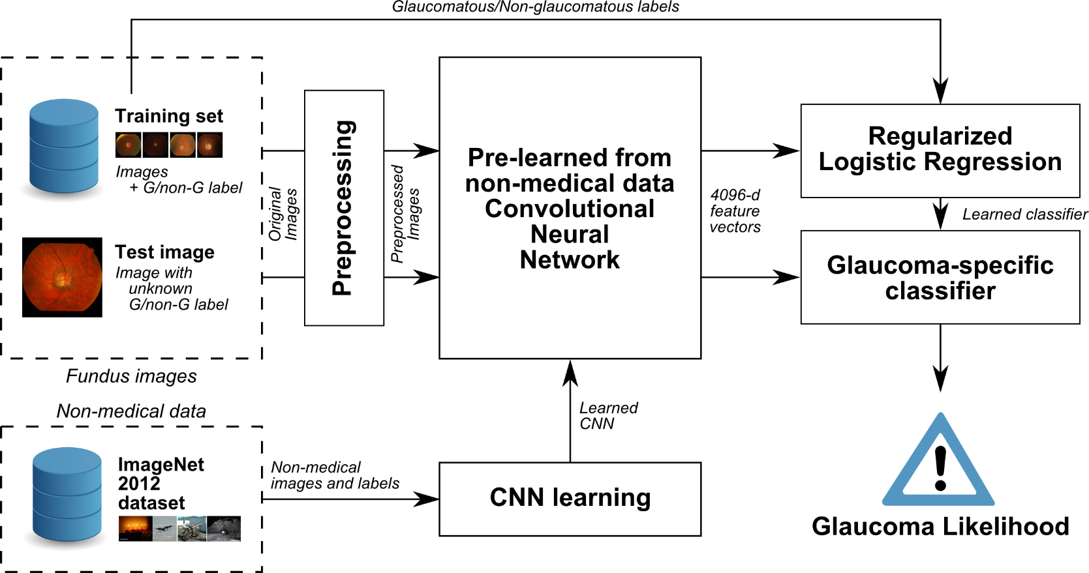
our approach

Slide 13
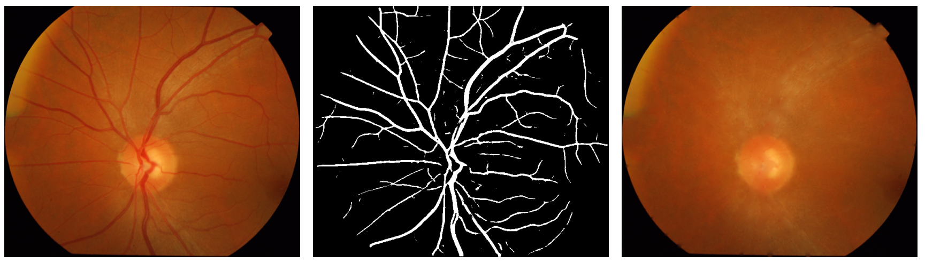
vessel segmentation
Orlando et al., Learning fully-connected CRFs for blood vessels segmentation in retinal images, MICCAI 2014.
Orlando et al., A discriminatively trained fully connected conditional random field model for blood vessel segmentation in fundus images, IEEE TBME 2016.
original image
vessel segmentation
inpainted image
preprocessing

Slide 14
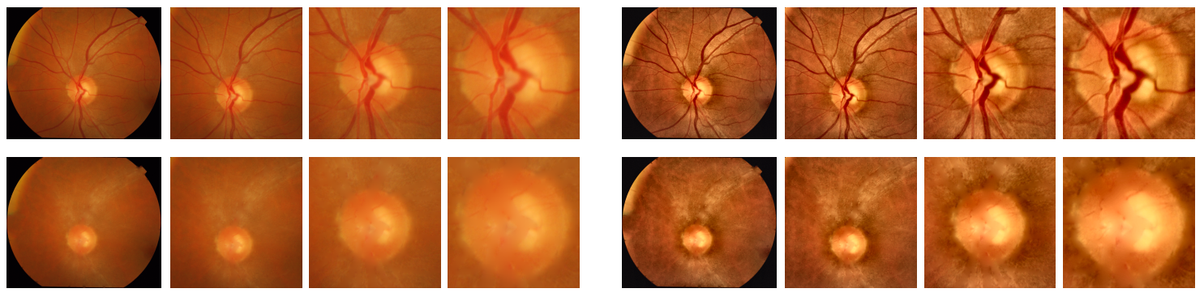
Original intensities
different zooms around the ONH
inpainting
preprocessing

Slide 15
CLAHE contrast enhancement
different zooms around the ONH
inpainting
preprocessing

Slide 16
to increase the amount of training data and reduce overfitting
flippings &
rotations at 90º
… (8x)
flippings &
rotations at 45º
… (16x)
augmentation

Slide 17
OverFeat architecture
convnets
Sermanet et al., OverFeat: Integrated Recognition, Localization and Detection using Convolutional Networks, arXiv 2013.
4096-d feature vector
VGG-S architecture
Chatfield et al., Return of the Devil in the Details: Delving Deep into Convolutional Nets, BMVC 2014.

Slide 18


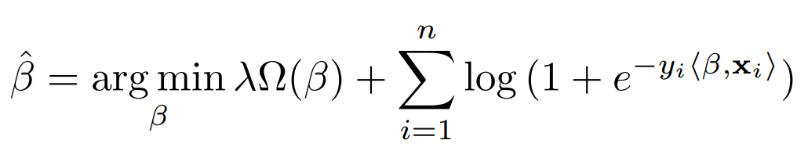
L1:
L2:
regularizer
loss function
logistic regression

Slide 19
Glaucoma
Fundus images
Convolutional Neural Networks
Our approach
Results
Conclusions

Slide 20
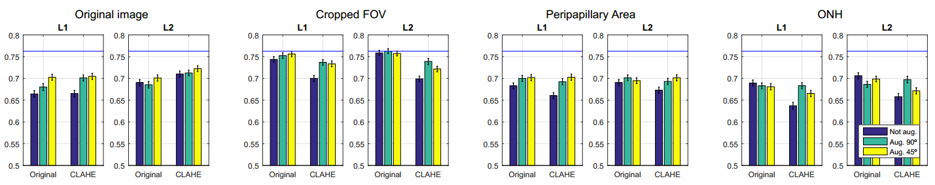
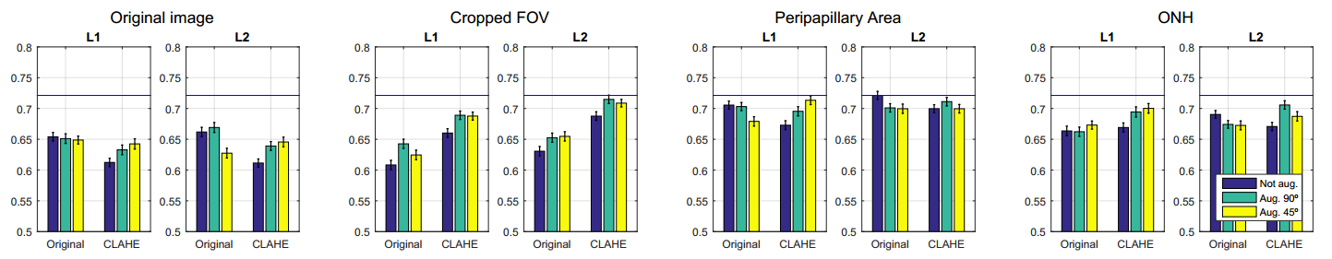
Drishti-GS1
publicly available data set of 101 glaucoma & healthy fundus images
without vessel inpainting
with vessel inpainting

Slide 21
Glaucoma
Fundus images
Convolutional Neural Networks
Our approach
Results
Conclusions

Slide 22
instead of hand-crafting overall image features, we proposed to use a pre-trained, off-the-shelf CNN to characterize the images
CNN is transfer by preprocessing the images using standard techniques such as contrast enhancement, zooming and vessel inpainting
best results were obtained using Overfeat features with L2 regularized logistic regression on FOV cropped images without vessel inpainting or CLAHE
average AUC = 0.7626 is competitive with strategies evaluated on this data set (AUC = 0.78)
further experiments on larger data sets for other retinal diseases such as diabetic retinopathy will be made in the future

Slide 23
Thank you!
Any questions?
This work is partially funded by
Internal Funds KU Leuven, FP7-MC-CIG 334380 and ANPCyT PICT 2014-1730

Slide 24
Convolutional Neural Network Transfer for Automated Glaucoma Identification
José Ignacio Orlando^{1,2}, Elena Prokofyeva^{3,4}, Mariana del Fresno^{1,5} and Matthew B. Blaschko⁶
¹ Instituto Pladema, UNCPBA, Tandil, Argentina
² Consejo Nacional de Investigaciones Científicas y Técnicas, CONICET, Argentina
³ Scientific Institute of Public Health (WIV-ISP), Brussels, Belgium
⁴ Federal Agency for Medicines and Health Products, Brussels, Belgium
⁵ Comisión de Investigaciones Científicas de la Provincia de Buenos Aires, CIC-PBA, Argentina
⁶ ESAT-PSI-Visics, KU Leuven, Leuven, Belgium

