Slide 1
Synthesis Data Scientist Recruitment Challenge
- Jasraj Singh

Slide 2
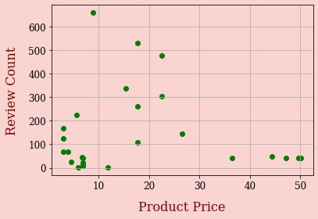
Market Scenario
There are 27 products being sold on the iHerb website.
Masks with price in the range of $8 to $23 have higher sales.
People tend to trust products with higher reviews more than those with lower reviews.
Notes:
There are 27 products being sold on the iHerb website. The graph on the right shows a scatter plot between the product price and the number of reviews. We notice that those in the middle of the price range have higher sales. This can be explained by the fact that cheaper products use less resources in production, and expensive ones cannot be afforded by most.

Slide 3
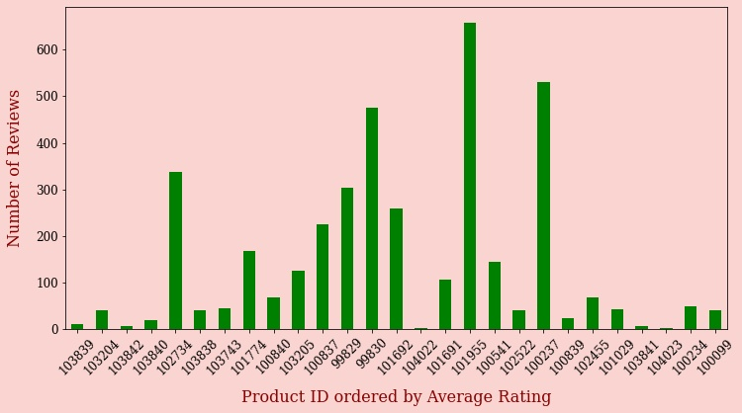
Leading Sellers in the Market
The bar plot on the right models the number of reviews on each product. The products are sorted in descending order of their average rating. Clearly, average rating is not a good indicator of market competition.
Notes:
We plot analyze a bar graph of products with the number of reviews. The products are ordered in descending order of their average rating. It is clear to see that average rating is not a good indicator of competition, as can be seen that the top 4 in average rating have lesser than 100 sales combined. From this graph, we choose to analyze products with IDs 102734, 99829, 99830, 101955 and 100237.

Slide 4
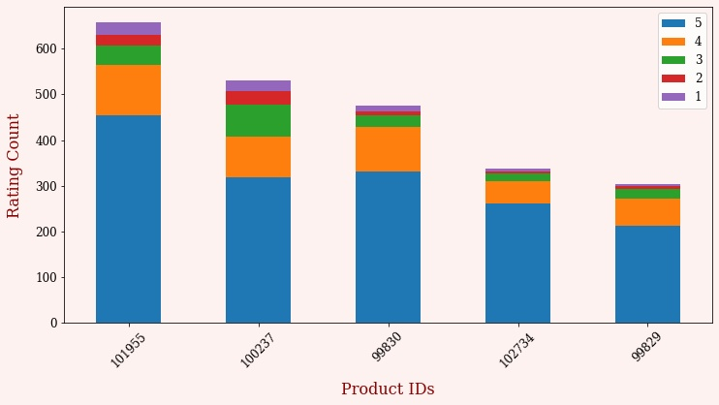
Leading Sellers in the Market
Product ID | Product Price
99829 | 22.44
99830 | 22.44
100237 | 17.72
102734 | 15.35
101955 | 8.86
Notes:
The stacked bar plot on the right gives the number of ratings for each of the top 5 products. Interestingly, products 99829 and 99830 have the same price, yet there is a stark difference in their sales. This pair can be beneficial in analyzing and deciding on production choices, since resources employed are similar. Similar is the case for products 100237 and 102734, which have almost equal prices. Product 101955 has the highest sales, and the highest average rating amongst the chosen 5. However, it can be largely attributed to its cheap price.

Slide 5
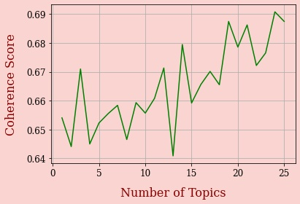
Topic Modelling using LDA
Topic modelling using LDA was performed, and topic coherence measure was used to determine the optimal choice for the number of topics.
Graph on the right suggested using N = 14, since score changes minimally after that.
Notes:
Next we performed topic modelling using Latent Dirichlet Allocation (LDA), which is a popular tool for text analysis, providing both a predictive and latent topic representation of the corpus. We trained the model with several different values of the parameter number of topics. We use the topic coherence as our evaluation metric to fix a value for number of topics. It works by measuring the degree of semantic similarity between high scoring words in a topic.
Simply put, the model gives us a bunch of different topics which are talked about in the comments and the relevant keywords used. The coherence measure is used to find the optimal number of such clusters we should make to minimize cluster impurity and maximize interpretability. The plot shown above gave us the optimal value for the number of topics to cluster with. We made word clouds from the topics outputted by the LDA model and drew inference about user likes and dislikes from it.

Slide 6
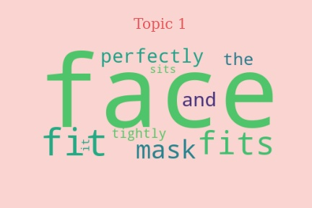
Topic Word Clouds
Topics 1 and 3 discuss how well the mask fits.
Direct research towards different mask sizes in demand in the market.
Set up production process to cater to a large consumer base.
Notes:
Topic 1 discusses how well the mask fits – if it’s tight or too big, or if it is perfect. Building on this, the client should direct their research on different mask sizes that are in demand in the market. This could help them in serving a bigger consumer base. Accordingly, they could set up their production process in order to maximize profits.

Slide 7
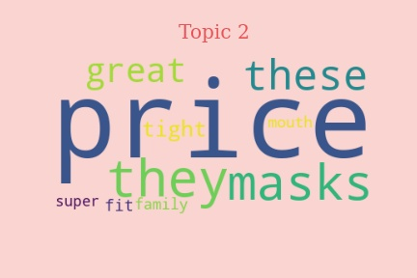
Topic Word Clouds
Topics 2 and 6 discuss the price of the masks, amongst other topics.
Cheap and disposable masks or if the price is high, they should be durable and reusable.
Notes:
Topics 2 and 6 discuss the price of the mask amongst other topics. In general, people like cheap and disposable masks. Market research can be targeted towards prices of disposable masks and reusable masks, and the client can price their products accordingly.

Slide 8
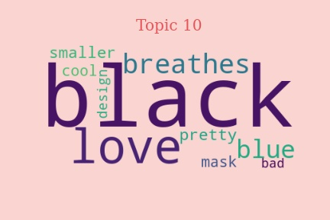
Topic Word Clouds
Colors
Design
Layering in the masks
Fogging of glasses
Masks start smelling after a while of use.
Notes:
Other topics discussed by users many different requirements including colors, design, layering in the masks, fogging of glasses and how some masks start smelling after a while of use. The client could look into these areas – perform analysis on user tastes and design masks accordingly, look into material used for producing masks, if they can somehow tackle the mentioned issues.

Slide 9
Consumer Profiles
Cheap buyers – A section of the consumers are looking for cheap and disposable masks. These masks need not be of the highest quality or durable even.
Affluent buyers – There is another section of buyers who are less concerned about the price and look for other attributes like design.
There are others who are willing to compromise between price and design or material.
There are people with sensitive skin who require more sensitive material for their skin.
There are people who like to wear something out of ordinary, be it with funky colors or unconventional deigns.

Slide 10
Going Forward
Research with facemasks designs and cost analysis
Research on consumer preferred materials and materials which cause irritation to skin
Work with an additional dataset with facemask images
Work with actual masks sales data instead of just reviews
Look into ways to prevent fogging of glasses with masks

