Slide 1
Synthesis
Data Scientist Recruitment Challenge
Jasraj Singh

Slide 2
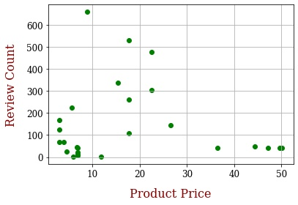
Market Scenario
There are 27 products being sold on the iHerb website.
Masks with price in the range of $8 to $23 have higher sales.
People tend to trust products with higher reviews more than those with lower reviews.
Notes:
There are 27 products being sold on the iHerb website. Their price goes up to $50. We notice that those in the middle have higher sales. This can be explained by the fact that cheaper products use less resources in production, and expensive ones cannot be afforded by most. The graph on the right shows a scatter plot between the product price and the number of reviews. Consumers tend to go though reviews before purchasing a product, in order to get an idea about why the product is worth buying and what might be the possible defects. Higher sales also boosts consumer confidence. Therefore, we should be looking at those companies which have high average rating, but at the same time have high sales.

