Slide 1
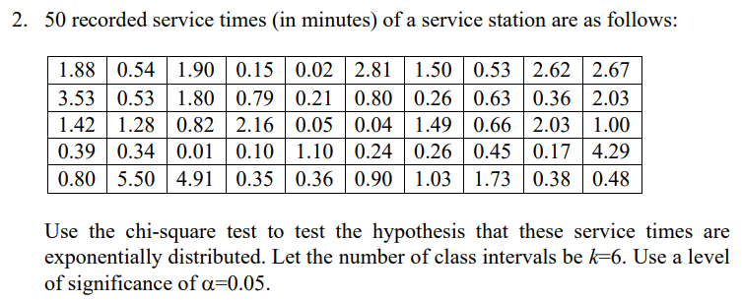
Notes:
Firstly, since we have 50 data points, it’s a good choice to use the chi2 test with 5-10 intervals.

Slide 2
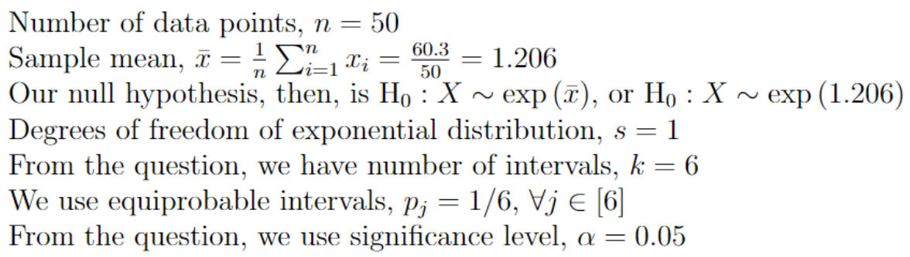

Slide 3
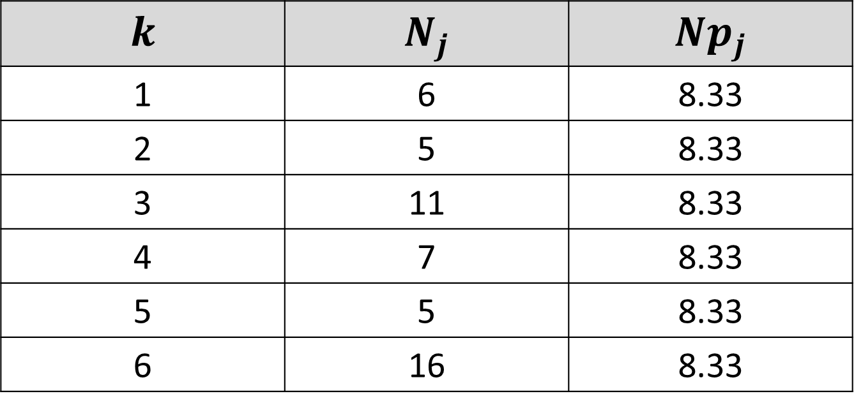
$$k$$ | $$N_{j}$$ | $$Np_{j}$$
1 | 6 | 8.33
2 | 5 | 8.33
3 | 11 | 8.33
4 | 7 | 8.33
5 | 5 | 8.33
6 | 16 | 8.33
Notes:
Before calculating the test statistic, we calculate the number of points in the 6 intervals from the data, and the expected number of points in these intervals.

Slide 4
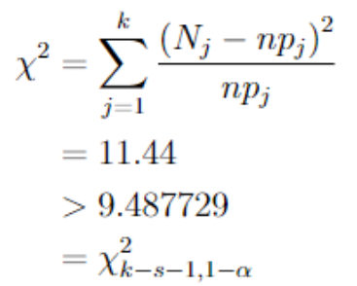
Notes:
Next, we calculate our chi2 test statistic, and not that this value is greater than the 0.05 upper percentile point for chi2 distribution with 4 degrees of freedom. Hence, at significance level \alpha, we reject the null.

Slide 5
