Slide 1
Dataset
Before understanding how the model works, we need to understand how the data would be fed to it.
Training set – The model parameters are fit on a training set, which consists of pairs of input vector and the corresponding output vector. The current model makes a prediction for the true output. The quality of the prediction is then quantified, and the model is updated.
Question: Can you think of an example of a multi-output problem?
Validation set – Validation set is used to provide an unbiased evaluation of a model which has been fit on the training dataset. They can be used for regularization be early stopping, a technique used to reduce the variance of the model. The model parameters are not fit to the validation set.
Testing set – The model never “sees” the testing dataset until it is finalized. The testing dataset is used to provide an unbiased evaluation of the final model. It is used to analyze how well the model does on a dataset that has had no influence on its selection.

Slide 2
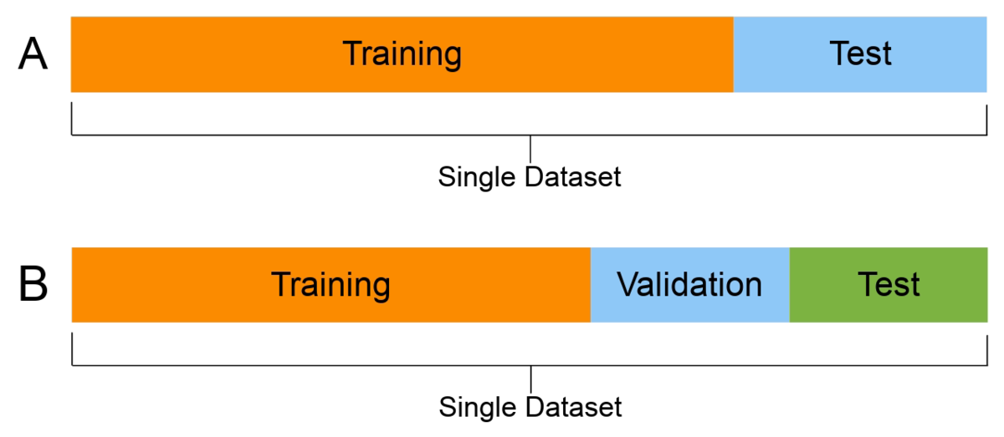
Dataset
It is important to remember to shuffle the dataset before inputting it into the dataset. However, be careful, that might not always be the case. A general practice while splitting the dataset is to make a 60-20-20 split or a 70-20-10 split.
Question: Can you think of any kind of dataset in which you would not want to shuffle it?
Some practitioners choose to do away with a test set and only use a training set and a validation set. In this case, a 70-30 or an 80-20 split is often used.

Slide 3
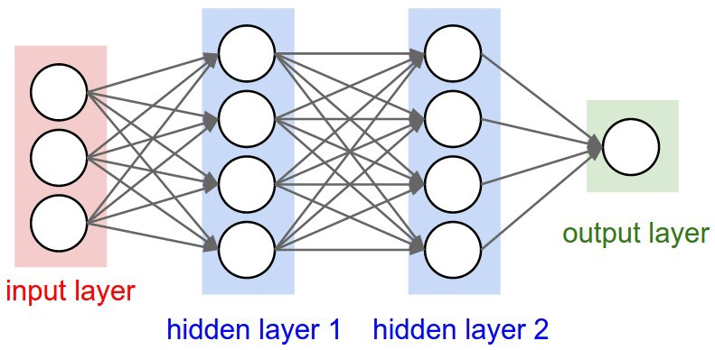
Forward Propagation
A MLP consists of connections, each connection providing the output of one neuron as an input to another neuron in the following layer. Each connection is assigned a weight that represents its relative importance.

Slide 4
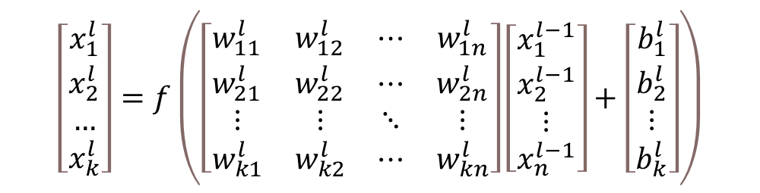
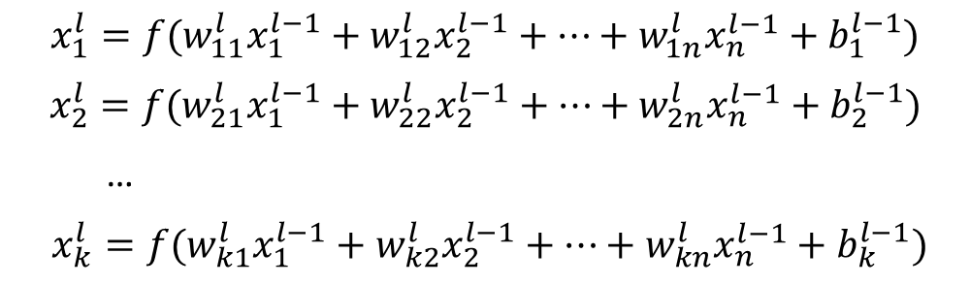
Forward Propagation
$$x_{1}^{l}={f(w}_{11}^{l}x_{1}^{l−1}+w_{12}^{l}x_{2}^{l−1}+…+w_{1n}^{l}x_{n}^{l−1}+b_{1}^{l−1})$$
$$x_{2}^{l}={f(w}_{21}^{l}x_{1}^{l−1}+w_{22}^{l}x_{2}^{l−1}+…+w_{2n}^{l}x_{n}^{l−1}+b_{2}^{l−1})$$
…
$x_{k}^{l}={f(w}_{k1}^{l}x_{1}^{l−1}+w_{k2}^{l}x_{2}^{l−1}+…+w_{kn}^{l}x_{n}^{l−1}+b_{k}^{l−1})$
$$\left[\begin{matrix}x_{1}^{l} \\ x_{2}^{l} \\ … \\ x_{k}^{l}\end{matrix}\right]=f\left(\left[\begin{matrix}w_{11}^{l} & w_{12}^{l} & ⋯ & w_{1n}^{l} \\ w_{21}^{l} & w_{22}^{l} & ⋯ & w_{2n}^{l} \\ ⋮ & ⋮ & ⋱ & ⋮ \\ w_{k1}^{l} & w_{k2}^{l} & ⋯ & w_{kn}^{l}\end{matrix}\right]\left[\begin{matrix}x_{1}^{l−1} \\ x_{2}^{l−1} \\ ⋮ \\ x_{n}^{l−1}\end{matrix}\right]+\left[\begin{matrix}b_{1}^{l} \\ b_{2}^{l} \\ ⋮ \\ b_{k}^{l}\end{matrix}\right]\right)$$
Here, f is the activation function we use to introduce non-linearity

Slide 5
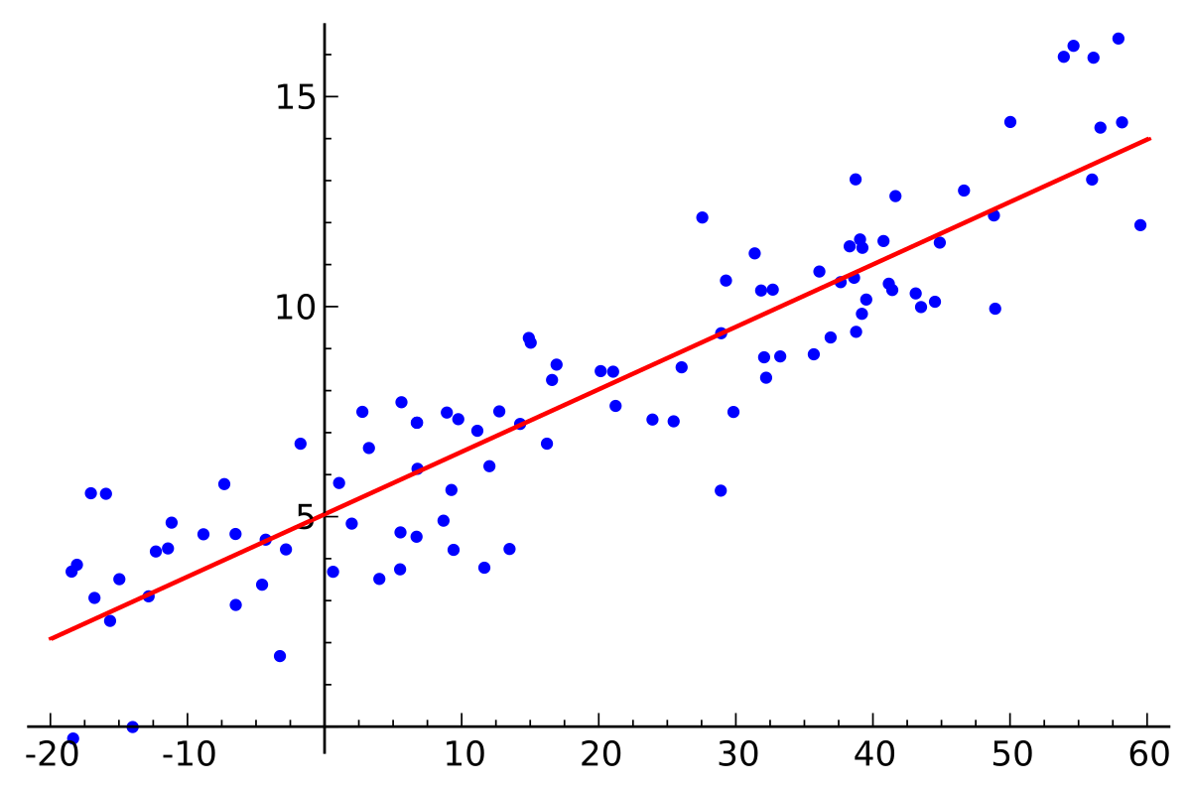
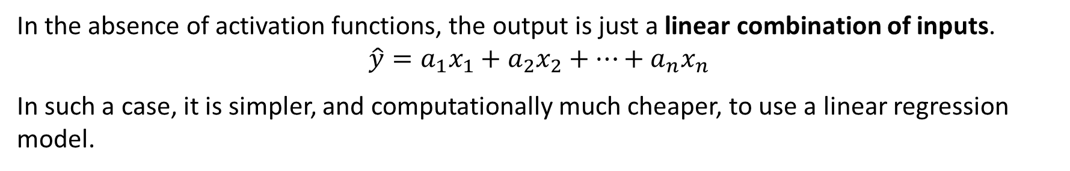
Activation Functions
In the absence of activation functions, the output is just a linear combination of inputs.
$$\hat{y}=a_{1}x_{1}+a_{2}x_{2}+…+a_{n}x_{n}$$
In such a case, it is simpler, and computationally much cheaper, to use a linear regression model.

Slide 6
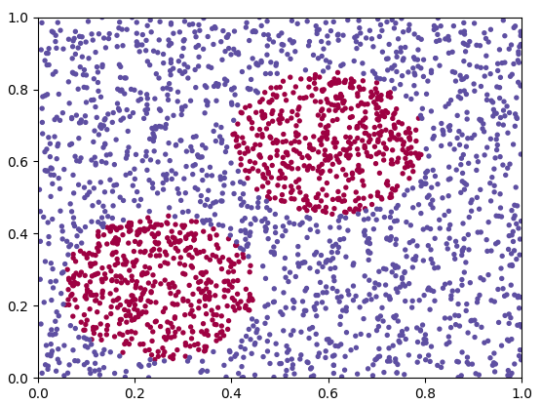
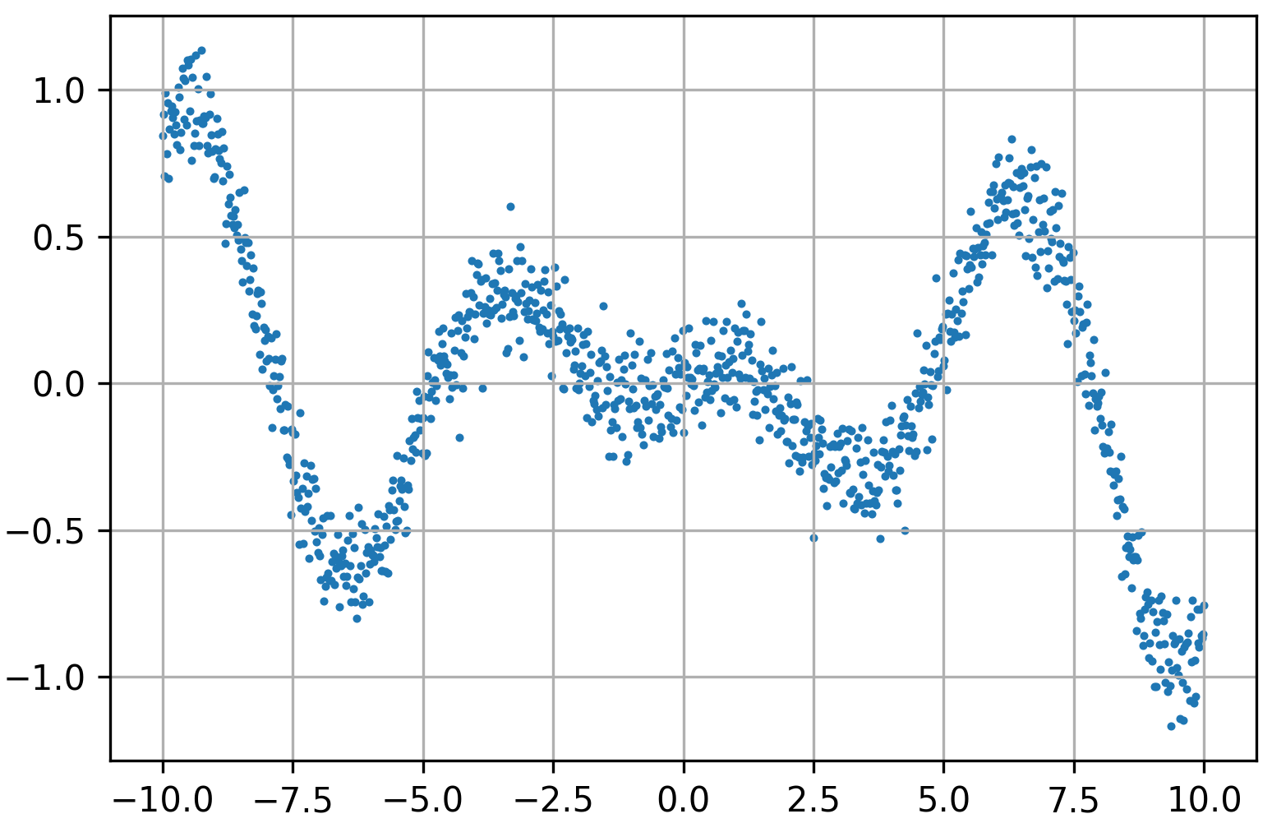
Activation Functions
However, often we are required to incorporate non-linearity in the model to complete a task.
Regression
Classification

Slide 7
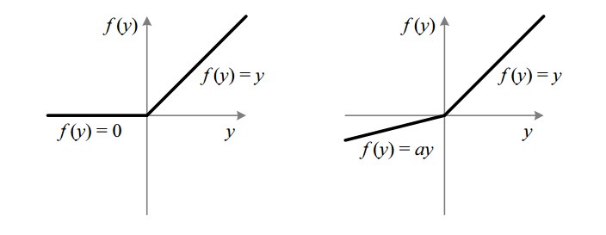
Activation Functions
ReLU – Rectified Linear Unit
Leaky ReLU (a ≈ 0.01)

Slide 8
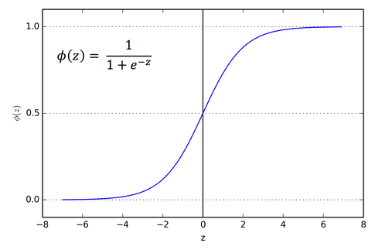
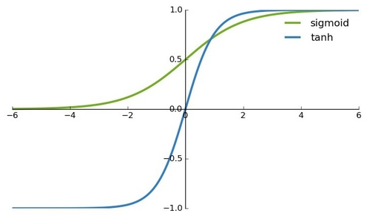
Activation Functions
Sigmoid
Hyperbolic Tangent (tanh)

Slide 9
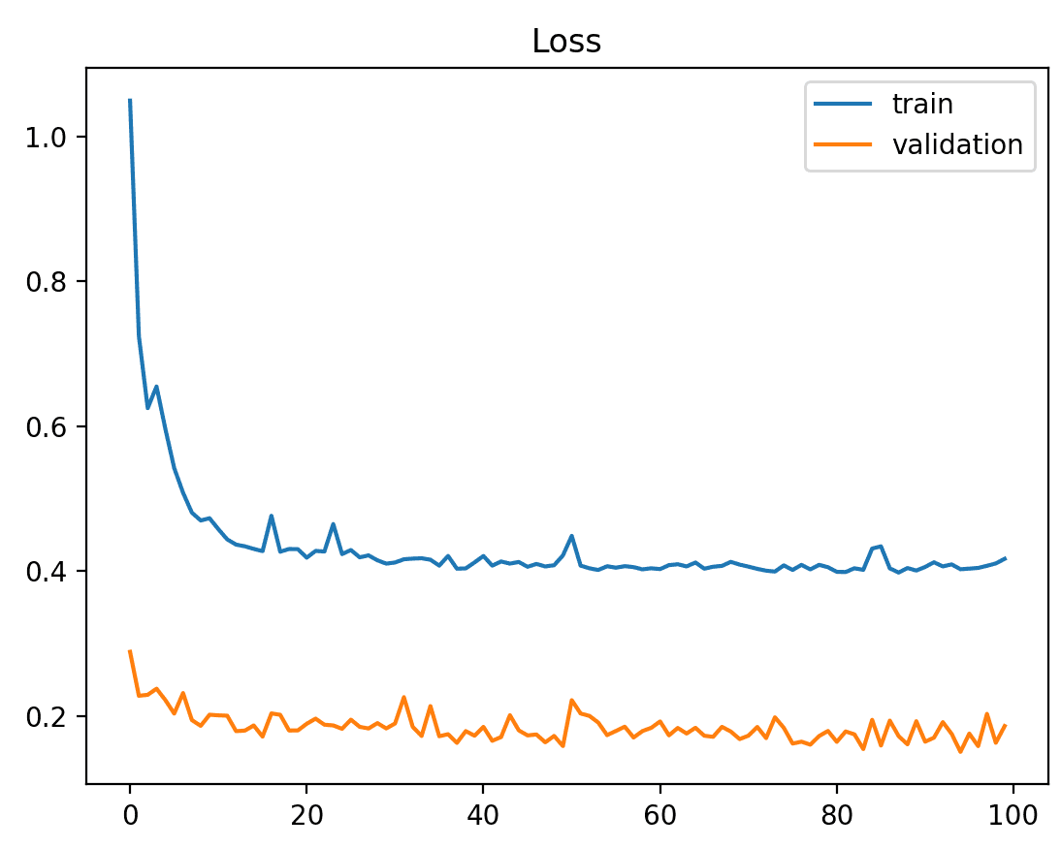
Loss Functions
In calculating the error of the model during the optimization process, a loss function must be chosen.
They are helpful in quantifying how far off the model’s predictions are.
We aim to minimize the value of the loss function over the parameter space to obtain a candidate solution.

Slide 10
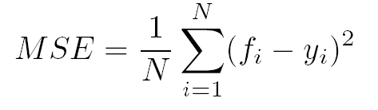
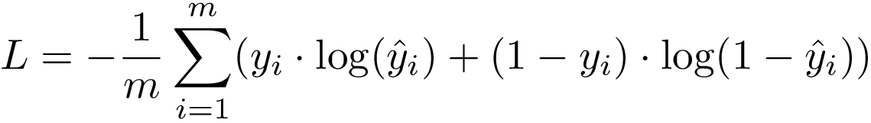
Loss Functions
Regression: Mean Squared Error (MSE)
Classification: Cross-Entropy Loss

Slide 11
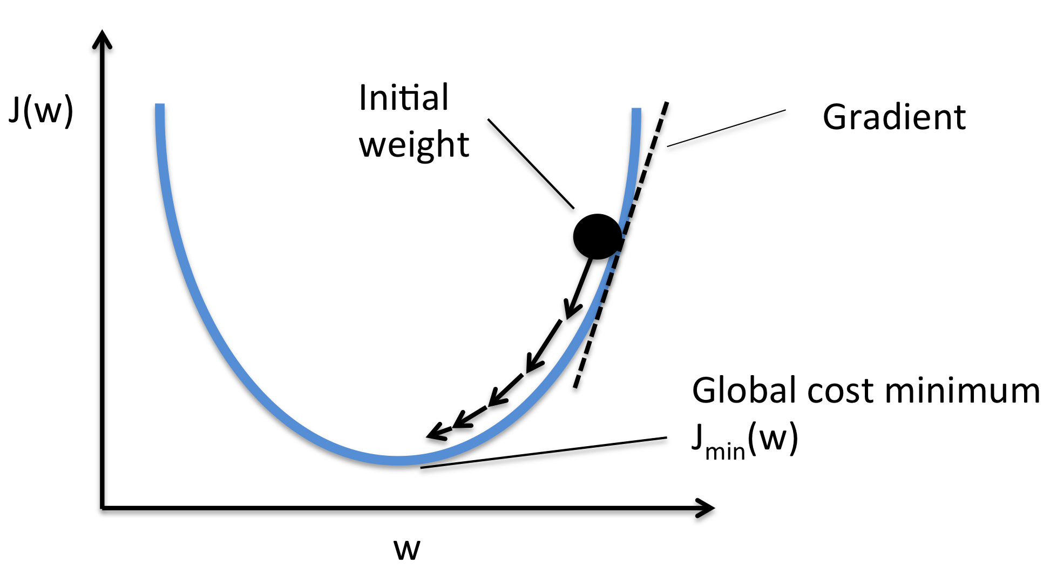
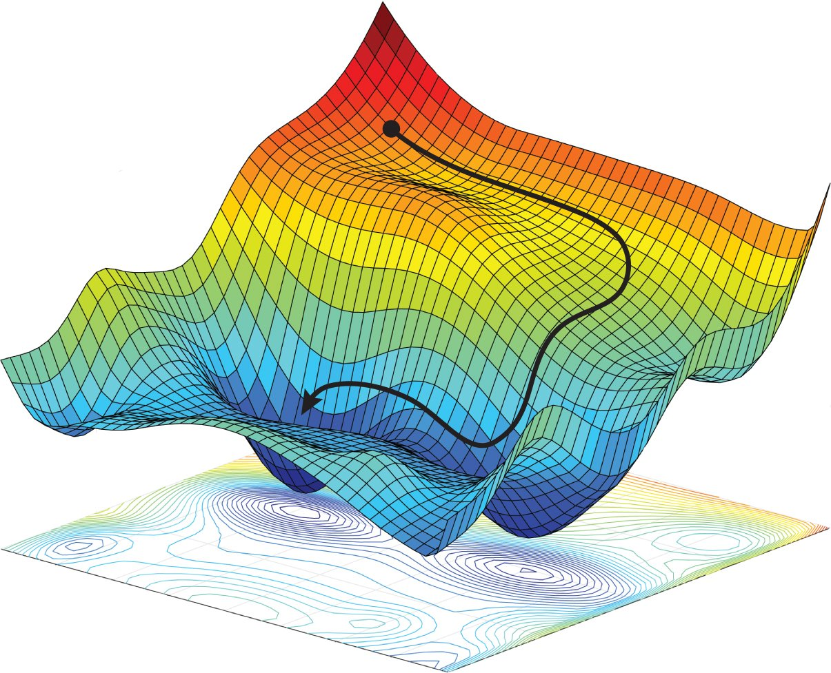
Gradient Descent
Gradient descent is an iterative optimization algorithm to find the optimal combination of parameters which minimizes the loss function.
The idea is to take repeated steps in the opposite direction of the gradient of the function at the current point, because it is the direction of steepest descent.

Slide 12

Gradient Descent
The algorithm works by calculating the loss as a function of the parameters of the model.
The, we calculate the partial derivative of the loss with respect to each of the parameters and update them accordingly.
$$w^{′}=w−η\frac{∂L\left(w\right)}{∂w}$$
η here is a parameter called the learning rate. Careful considerations need to be made while choosing the learning rate.

Slide 13
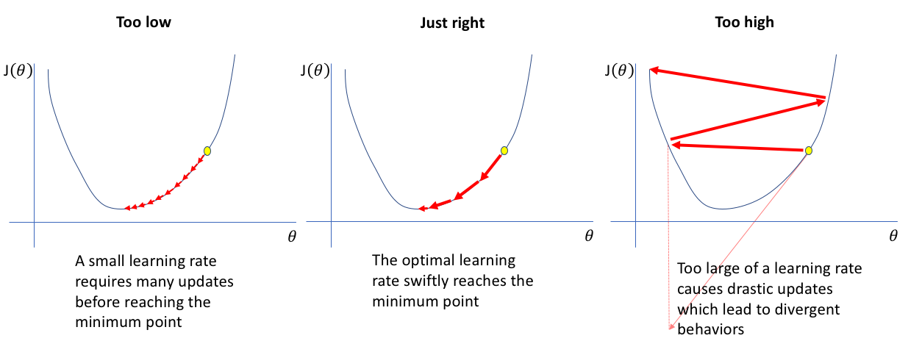
Learning Rate
Generally, the choice of the learning rate is in the order of 1e-5.

Slide 14
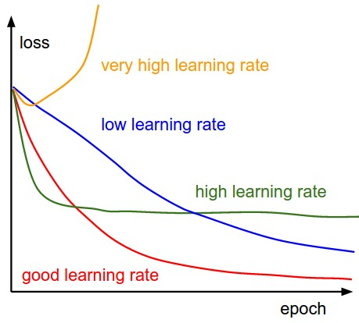
Learning Rate vs Epochs

Slide 15
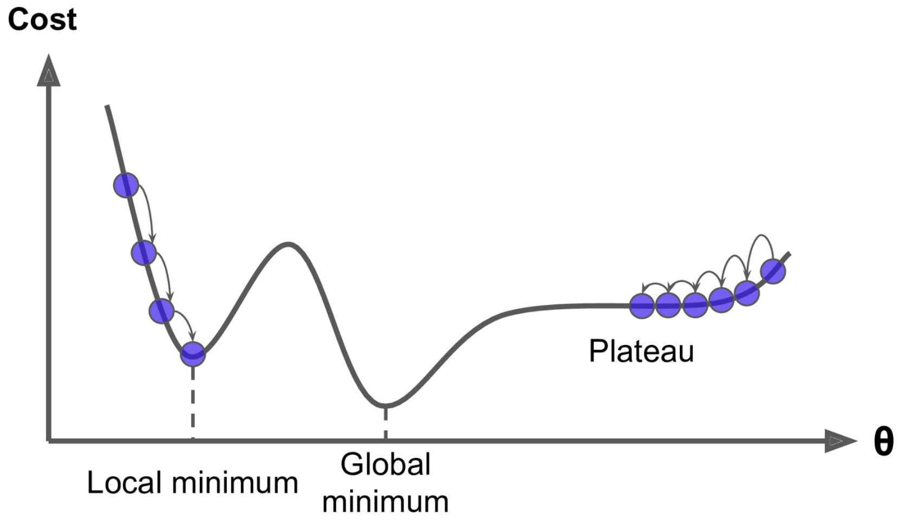
Problems with Gradient Descent
One of the problems with gradient descent is the possibility of it getting stuck in a local minimum. In such a case we get a suboptimal combination of parameters.
Another problem is getting stuck on a plateau. This means that the gradient is non-zero, but too small for the algorithm to make big jumps and perform a significant update.

Slide 16
Back Propagation
Back propagation algorithm is used to minimize the loss or error function using gradient descent.
The key steps in back propagation are:
Initialize the weights and biases.
Propagate the inputs forward and compute the predicted output for each input.
Calculate the error for each prediction as a function of the prediction and the true output.
Iteratively calculate the gradients for all the parameters by going backward from the last layer to the first.
Update the parameters with an appropriate learning rate.

Slide 17
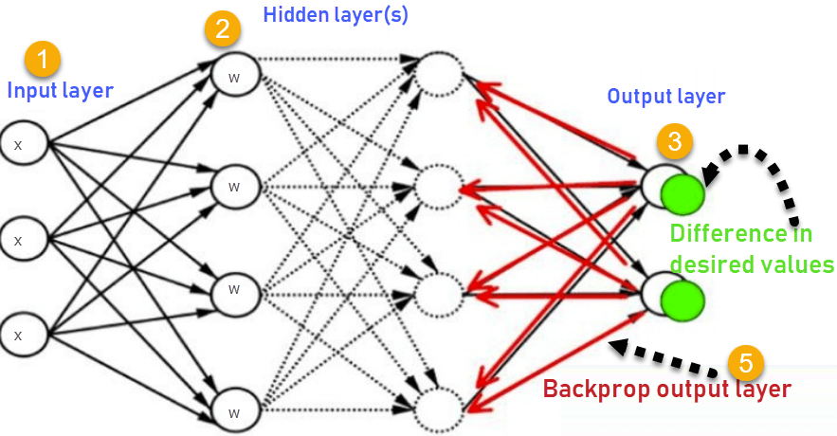
Back Propagation
“Iteratively calculate the gradients for all the parameters by going backward from the last layer to the first.”
What does that mean?

Slide 18
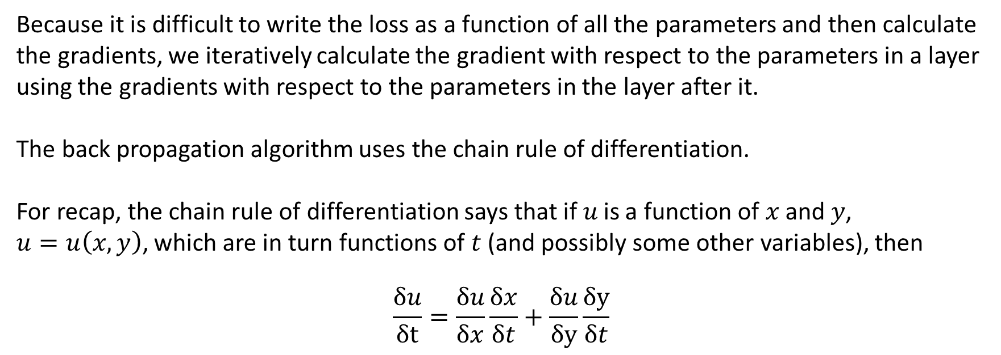
Back Propagation
Because it is difficult to write the loss as a function of all the parameters and then calculate the gradients, we iteratively calculate the gradient with respect to the parameters in a layer using the gradients with respect to the parameters in the layer after it.
The back propagation algorithm uses the chain rule of differentiation.
For recap, the chain rule of differentiation says that if $u$ is a function of $x$ and $y$,
$u=u\left(x,y\right)$, which are in turn functions of $t$ (and possibly some other variables), then
$$\frac{δu}{δt}=\frac{δu}{δx}\frac{δx}{δt}+\frac{δu}{δy}\frac{δy}{δt}$$

