Slide 1
DATA LINK LAYER
Notes:
In this topic, we will study the design principles for the second layer in our model, the data link layer. This study deals with algorithms for achieving reliable,
efficient communication of whole units of information called frames (rather than individual bits, as in the physical layer) between two adjacent machines. By adjacent, we mean that the two machines are connected by a communication channel that acts conceptually like a wire (e.g., a coaxial cable, telephone line, or wireless channel).

Slide 2
DATA LINK LAYER
(Defination):-
Data link layer is the second layer in OSI reference model and lies above the physical layer.
The data link layer performs many of functions
Recall: (OSI-The Open Systems Interconnection model (OSI model) is a conceptual model that characterizes and standardizes thecommunication functions of a telecommunication or computing system without regard to their underlying internal structure and technology)
Notes:
It is the second OSI layer that is responsible to hide the underlying hardware details and acts as a medium to communicate for upper layers.

Slide 3
Data Link Layer and its Functions
Framing
It receives packets from network layer and encapsulates them into frames, which is send on hardware bit by bit.
On receiver, it gets signals from hardware and assembles them into frames.
Addressing
It provides hardware addressing mechanism which is unique and encoded into hardware at the time of manufacturing. NIC
Synchronization
It synchronizes both computers when sending data frames on the link for successful transfer.
Error Control
It helps in detecting errors and recovering actual data bits.
It provides error reporting mechanism to the sender.
Multi Access
It provides mechanism for accessing shared media among multiple systems reducing data collision.
Flow Control
It ensures flow control to enable both devices to exchange data on same speed.

Slide 4
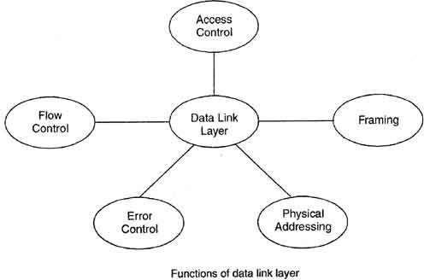
Functions:-
Network layer services
Framing
Error control
Flow control
•
Notes:
The data link layer uses the services of the physical layer to send and receive bits over communication channels. It has a number of functions, including:
1. Providing a well-defined service interface to the network layer.
2. Dealing with transmission errors.
3. Regulating the flow of data so that slow receivers are not swamped by fast senders.
To accomplish these goals, the data link layer takes the packets it gets from the network layer and encapsulates them into frames for transmission. Each frame contains a frame header, a payload field for holding the packet, and a frame trailer

Slide 5
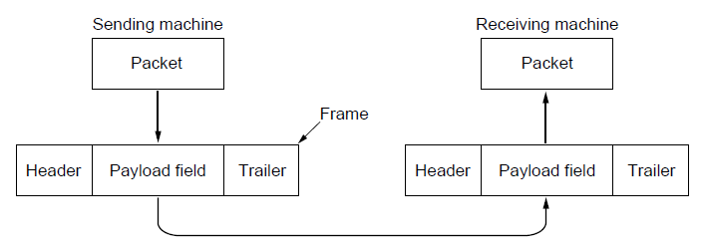
Packets and Frames
Relationship between packets and frames.
Notes:
The function of the data link layer is to provide services to the network layer.
The principal service is transferring data from the network layer on the source machine to the network layer on the destination machine. On the source machine is an entity, call it a process, in the network layer that hands some bits to the data link layer for transmission to the destination. The job of the data link layer is to transmit the bits to the destination machine so they can be handed over to the network layer there
On sending end, it converts data stream to signals bit by bit and sends over the underlying hardware.
On receiving end, it picks up data from hardware in the form of signals, assembles them in a recognizable frame format and hands over to upper layer.

Slide 6
Data link layer has two sub-layers :-
Logical Link Control - LLC
Media Access Control - MAC
Notes:
It has two sub layers – logical link control and media access control.
The logical link control is a sublayer of data link layer whose main function is to manage traffic, flow and error control. This layer also acts as an interface between MAC layer and network layer.
Media access control (MAC) deals with transmission of data packets to and from the network-interface card, and also to and from another remotely shared channel.

Slide 7
Services Provided To Network Layer
Network layer is the layer 3 of OSI model and lies above the data link layer. Data link layer provides several services to the network layer.
The one of the major service provided is the transferring the data from network layer on the source machine to the network layer on destination machine.
On source machine data link layer receives the data from network layer and on destination machine pass on this data to the network layer as shown in Fig.
Notes:
What the physical layer does is accept a raw bit stream and attempt to deliver it to the destination. If the channel is noisy, as it is for most wireless and some wired links, the physical layer will add some redundancy to its signals to reduce the bit error rate to a tolerable level. However, the bit stream received by the data link layer is not guaranteed to be error free.
bits may have different values and the number of bits received may be less than, equal to, or more than the number of bits transmitted. It is up to the data link layer to detect and, if necessary, correct errors.

Slide 8
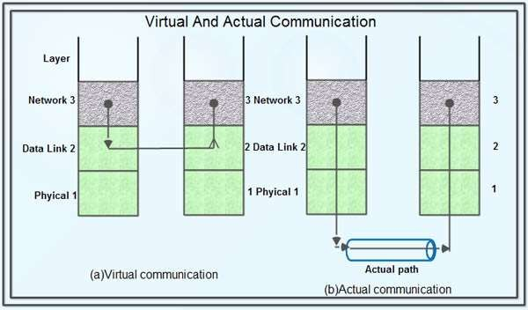
The path shown in fig (a) is the virtual path. But the actual path is Network layer -> Data link layer -> Physical layer on source machine, then to physical media and thereafter physical layer -> Data link layer -> Network layer on destination machine.

Slide 9
The three major types of services offered by data link layer are:
Unacknowledged connectionless service.
Acknowledged connectionless service. 3.Acknowledged connection oriented service.
Notes:
The data link layer can be designed to offer various services. The actual services that are offered vary from protocol to protocol. Three reasonable possibilities that we will consider in turn are:

Slide 10
1.Unacknowledged connectionless service
In this type of service source machine sends frames to destination machine but the destination machine does not send any acknowledgement of these frames back to the source. Hence it is called unacknowledged service.
There is no error control i.e. if any frame is lost due to noise on the line, no attempt is made to recover it.
This type of service is used when error rate is low.
It is suitable for real time traffic such as speech.
Notes:
Unacknowledged connectionless service consists of having the source machine send independent frames to the destination machine without having the
destination machine acknowledge them. Ethernet is a good example of a data link layer that provides this class of service. No logical connection is established beforehand or released afterward. If a frame is lost due to noise on the line, no attempt is made to detect the loss or recover from it in the data link layer. This class of service is appropriate when the error rate is very low, so recovery is left to higher layers. It is also appropriate for real-time traffic, such as voice, in which late data are worse than bad data.
Losses are taken care of at higher layers
Used on reliable medium like coax cables or optical fiber, where the error rate is low.
Appropriate for voice, where delay is worse than bad data.

Slide 11
2. Acknowledged connectionless service
When the sender sends the data frames to destination, destination machine sends back the acknowledgement of these frames.
This type of service provides additional reliability because source machine retransmit the frames if it does not receive the acknowledgement of these frames within the specified time.
This service is useful over unreliable channels, such as wireless systems.
Notes:
When this service is offered, there are still no logical connections used, but each frame sent is individually acknowledged. In this way, the sender knows
whether a frame has arrived correctly or been lost. If it has not arrived within a specified time interval, it can be sent again. This service is useful over unreliable channels, such as wireless systems. 802.11 (WiFi) is a good example of this class of service.
Useful on unreliable medium like wireless.
Acknowledgements add delays.
Adding ACK in the DLL rather than in the NL is just an optimization and not a requirement. Leaving it for the NL is inefficient as a large message (packet) has to be resent in that case in contrast to small frames here.
On reliable channels, like fiber, the overhead associated with the ACK is not justified.

Slide 12
3. Acknowledged connection oriented service
This service is the most sophisticated service provided by data link layer to network layer.
In this service, data transfer has three distinct phases:-
Connection establishment
Actual data transfer
Connection release
Here, each frame being transmitted from source to
destination is given a specific number acknowledged by the destination machine.
.
and is
Notes:
Getting back to our services, the most sophisticated service the data link layer can provide to the network layer is connection-oriented service. With this service, the source and destination machines establish a connection before any data are transferred. Each frame sent over the connection is numbered, and the data link layer guarantees that each frame sent is indeed received. Furthermore, it guarantees that each frame is received exactly once and that all frames are received in the right order. Connection-oriented service thus provides the network layer processes with the equivalent of a reliable bit stream. It is appropriate over long, unreliable links such as a satellite channel or a long-distance telephone circuit. If acknowledged connectionless service were used, it is conceivable that lost acknowledgements could cause a frame to be sent and received several times, wasting bandwidth.
Most reliable,
Guaranteed service –
Each frame sent is indeed received
Each frame is received exactly once
Frames are received in order
Special care has to be taken to ensure this in connectionless services

Slide 13
Functionality of Data-link Layer
Framing:-
Data-link layer takes packets from Network Layer and encapsulates them into Frames.Then, it sends each frame bit-by-bit on the hardware.
At receiver’ end, data link layer picks up signals from hardware and assembles them into frames.
The four framing methods that are widely used are:-
Character count
Starting and ending characters, with character stuffing
Starting and ending flags, with bit stuffing
Physical layer coding violations
Notes:
The usual approach is for the data link layer to break up the bit stream into discrete frames, compute a short token called a checksum for each frame, and include the checksum in the frame when it is transmitted. When a frame arrives at the destination, the checksum is recomputed. If the newly computed checksum is different from the one contained in the frame, the data link layer knows that an error has occurred and takes steps to deal with it (e.g., discarding the bad frame and possibly also sending back an error report).

Slide 14
Character Count:-
When the data link layer at the destination sees the character count,it knows how many characters follow, and hence where the end of the frame is.
The disadvantage is that if the count is grabbed by a transmission error, the destination will lose synchronization and will be unable to locate the start of the next frame.
So, this method is rarely used.
Notes:
The first framing method uses a field in the header to specify the number of bytes in the frame. When the data link layer at the destination sees the byte count, it knows how many bytes follow and hence where the end of the frame is. This technique is shown in Figure below (a) for four small example frames of sizes 5, 5, 8, and 8 bytes, respectively.

Slide 15
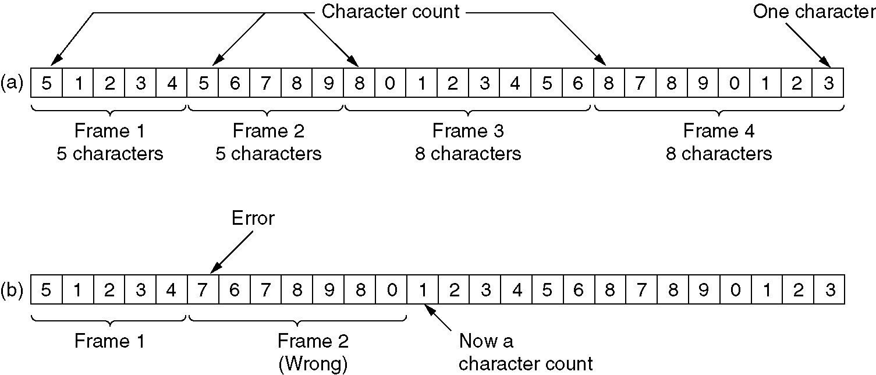
Framing with Character Count
A character stream. (a) Without errors. (b) With one error.
Notes:
Problem with Framing with CC
What if the count is garbled
Even if with checksum, the receiver knows that the frame is bad there is no way to tell where the next frame starts.
Asking for retransmission doesn’t help either because the start of the retransmitted frame is not known
No longer used

Slide 16
Bit and Byte stuffing:-
While sending data over network, the data link layer divide into frames. Framing have several advantages than send raw very large data.
It reduces the probability of error and reduces the amount of retransmission needed.
There exist two general methods for framing: fixed size framing and variable size framing.
In fixed size framing, the data divided into fixed size frames and send over the transmission media.
In fixed-size framing, there is no need for defining the boundaries of the frames; the size itself can be used as a delimiter.
ATM network use fixed size packets called cells.
Notes:
The second framing method gets around the problem of resynchronization after an error by having each frame start and end with special bytes. Often the same byte, called a flag byte, is used as both the starting and ending delimiter.
Two consecutive flag bytes indicate the end of one frame and the start of the next. Thus, if the receiver ever loses synchronization it can just search for two flag bytes to find the end of the current frame and the start of the next frame.
However, there is a still a problem we have to solve. It may happen that the flag byte occurs in the data, especially when binary data such as photographs or songs are being transmitted. This situation would interfere with the framing. One way to solve this problem is to have the sender’s data link layer insert a special escape byte (ESC) just before each ‘‘accidental’’ flag byte in the data. Thus, a framing flag byte can be distinguished from one in the data by the absence or presence of an escape byte before it.

Slide 17
In variable size framing, the data divided into variable size frames.
Two protocols are used for this purpose: character oriented protocol and bit oriented protocol.
In character-oriented protocol, we add special characters (called flag) to distinguish beginning and end of a frame. Usually flag has 8-bit length
While using character–oriented protocol another problem is arises, pattern used for the flag may also part of the data to send.
If this happens, the destination node, when it encounters this pattern in the middle of the data, assumes it has reached the end of the frame.
To deal with this problem, a byte stuffing (also known as character stuffing)
Notes:
Flag byte with byte stuffing is one of the methods that is used to make it easy for the receiver to find the start of new frames while using little of the channel bandwidth.
It may happen that the flag byte occurs in the data, especially when binary data such as photographs or songs are being transmitted. This situation would interfere with the framing. One way to solve this problem is to have the sender’s data link layer insert a special escape byte (ESC) just before each ‘‘accidental’’ flag byte in the data. Thus, a framing flag byte can be distinguished from one in the data by the absence or presence of an escape byte before it. The data link layer on the receiving end removes the escape bytes before giving the data to the network layer. This technique is called byte stuffing.

Slide 18
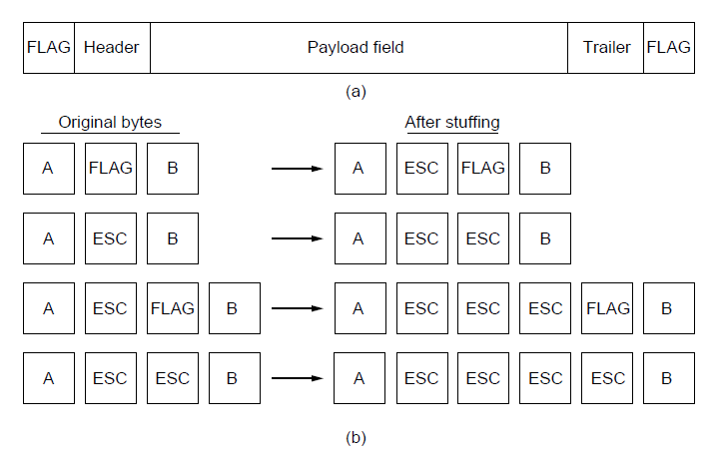
Framing (Byte-Stuffing)
A frame delimited by flag bytes.
Four examples of byte sequences before and after byte stuffing.
Notes:
Problem with Byte-stuffing : fixed character size : assumes character size to be 8 bits : can’t handle heterogeneous environment.

Slide 19
Bit-Oriented Protocols:-
In a bit-oriented protocol, the data to send is a series of bits.
In order to distinguish frames, most protocols use a bit pattern of 8-bit length (01111110) as flag at the beginning and end of each frame.
Here also cause the problem of appearance of flag in the data part to deal with this an extra bit added.
This method is called bitstuffing.
In bit stuffing, if a 0 and five successive 1 bits are encountered, an extra 0 is added.
The receiver node removes the extra-added zero
Notes:
The third method of delimiting the bit stream gets around a disadvantage of byte stuffing, which is that it is tied to the use of 8-bit bytes. Framing can be also be done at the bit level, so frames can contain an arbitrary number of bits made up of units of any size.
Each frame begins and ends with a special
bit pattern, 01111110 or 0x7E in hexadecimal. This pattern is a flag byte. Whenever the sender’s data link layer encounters five consecutive 1s in the data, it automatically stuffs a 0 bit into the outgoing bit stream. This bit stuffing is analogous
to byte stuffing, in which an escape byte is stuffed into the outgoing character stream before a flag byte in the data. It also ensures a minimum density of transitions that help the physical layer maintain synchronization. USB (Universal Serial Bus) uses bit stuffing for this reason.
When the receiver sees five consecutive incoming 1 bits, followed by a 0 bit, it automatically destuffs (i.e., deletes) the 0 bit. Just as byte stuffing is completely transparent to the network layer in both computers, so is bit stuffing. If the user data contain the flag pattern, 01111110, this flag is transmitted as 011111010 but stored in the receiver’s memory as 01111110. Figure 3-5 gives an example of bit
stuffing.

Slide 20
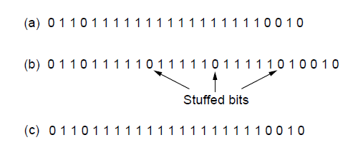
Framing (3)
Bit stuffing. (a) The original data. (b) The data as they appear on
the line. (c) The data as they are stored in the receiver’s memory after destuffing.
Notes:
Bit stuffing
(a) The original data.
(b) The data as they appear on the line.
(c) The data as they are stored in receiver’s memory after destuffing.

Slide 21
Physical layer coding violations:-
The final framing method is physical layer coding violations and is applicable to networks in which the encoding on the physical medium contains some. Redundancy.(no longer needed and not useful)
In such cases normally, a 1 bit is a high-low pair and a 0 bit is a low-high pair.
The combinations of low-low and high-high which are not used for data may be used for marking frame
boundaries.

Slide 22
Error Control:-
The bit stream transmitted by the physical layer is not guaranteed to be error free. The data link layer is responsible for error detection and correction.
The most common error control method is to compute and append some form of a checksum to each outgoing frame at the sender's data link layer and to recompute the checksum & verify it with the received checksum at the receiver's side.
The checksums may be of two types:
Error detecting : Receiver can only detect the error in the frame and inform the sender about it.
Error detecting and correcting : The receiver can not only detect the error but also correct it.
Consist of Hamming Code and CRC
Notes:
Positive and Negative feedback
Timers : what happens when a frame completely vanishes : receiver neither sends a +ack nor –ack … then timer comes to help.
It may result in a frame being sent more than once and received more than once :
solution : assign sequence numbers to frames\\
Having solved the problem of marking the start and end of each frame, we come to the next problem: how to make sure all frames are eventually delivered to the network layer at the destination and in the proper order.

Slide 23
Flow Control:-
Consider a situation in which the sender transmits frames faster than the receiver can accept them.
If the sender keeps pumping out frames at high rate, at some point the receiver will be completely swamped and will start losing some frames.
This problem may be solved by introducing flow control.
Most flow control protocols contain a feedback mechanism to inform the sender when it should transmit the next frame.
Notes:
Another important design issue that occurs in the data link layer (and higher layers as well) is what to do with a sender that systematically wants to transmit frames faster than the receiver can accept them. This situation can occur when the sender is running on a fast, powerful computer and the receiver is running on a slow, low-end machine.
Clearly, something has to be done to prevent this situation. Two approaches are commonly used. In the first one, feedback-based flow control, the receiver sends back information to the sender giving it permission to send more data, or at least telling the sender how the receiver is doing. In the second one, rate-based flow control, the protocol has a built-in mechanism that limits the rate at which senders may transmit data, without using feedback from the receiver.
Various feedback-based flow control schemes are known

Slide 24
Flow Control
Flow control coordinates the amount of data that can be sent before receiving acknowledgement
It is one of the most important functions of data link layer.
Flow control is a set of procedures that tells the sender how much data it can transmit before it must wait for an acknowledgement from the receiver.
Receiver has a limited speed at which it can process incoming data and a limited amount of memory in which to store incoming data.
Receiver must inform the sender before the limits are reached and request that the transmitter to send fewer frames or stop temporarily.
Since the rate of processing is often slower than the rate of transmission, receiver has a block of memory (buffer) for storing incoming data until they are processed.

Slide 25
Error Control
Error control includes both error detection and error correction.
It allows the receiver to inform the sender if a frame is lost or damaged during transmission and coordinates the retransmission of those frames by the sender.
Error control in the data link layer is based on automatic repeat request (ARQ). Whenever an error is detected, specified frames are retransmitted.

Slide 26
Error Detection and Correction
In some cases it is sufficient to detect an error and in some, it requires the errors to be corrected also. For eg.
On a reliable medium : ED is sufficient where the error rate is low and asking for retransmission after ED would work efficiently
In contrast, on an unreliable medium : Retransmission after ED may result in another error and still another and so on. Hence EC is desirable.
Notes:
Stop-and-Wait
Go-Back-N ARQ
Selective-Repeat ARQ

Slide 27
Stop and Wait Protocol:
This is the simplest file control protocol in which the sender transmits a frame and then waits for an acknowledgement, either positive or negative, from the receiver before proceeding.
If a positive acknowledgement is received, the sender transmits the next packet; else it retransmits the same frame.
However, this protocol has one major flaw in it.
If a packet or an acknowledgement is completely destroyed in transit due to a noise burst, a deadlock will occur because the sender cannot proceed until it receives an acknowledgement.

Slide 28
Sliding Window Protocols:-
Inspite of the use of timers, the stop and wait protocol still suffers from a few drawbacks.
Firstly, if the receiver had the capacity to accept more than one frame, its resources are being underutilized.
Secondly, if the receiver was busy and did not wish to receive any more packets, it may delay the acknowledgement.
However, the timer on the sender's side may go off and cause an unnecessary retransmission.
These drawbacks are overcome by the sliding window protocols.

Slide 29
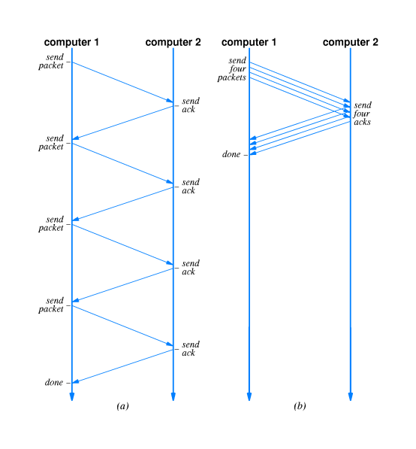
Fig. 16.7
Stop and go
Sliding windows

Slide 30
Go Back 'n‘
If a frame is lost or received in error, the receiver may simply discard all subsequent frames, sending no acknowledgments for the discarded frames.
In this case the receive window is of size 1. Since no acknowledgements are being received the sender's window will fill up, the sender will eventually time out and retransmit all the unacknowledged frames in order starting from the damaged or lost frame.
The maximum window size for this protocol can be obtained as follows. Assume that the window size of the sender is n. So the window will initially contain the frames with sequence numbers from 0 to (w-1).
Consider that the sender transmits all these frames and the receiver's data link layer receives all of them correctly.

Slide 31
Selective Repeat
In this protocol rather than discard all the subsequent frames following a damaged or lost frame, the receiver's data link layer simply stores them in buffers.
When the sender does not receive an acknowledgement for the first frame it's timer goes off after a certain time interval and it retransmits only the lost frame.
Assuming error - free transmission this time, the sender's data link layer will have a sequence of a many correct frames which it can hand over to the network layer.
Thus there is less overhead in retransmission than in the case of Go Back n protocol.
In case of selective repeat protocol the window size may be calculated as follows.

Slide 32
Sliding Window Protocols
There are variations within a windowing protocol.
Go-back-n: packets must be received in the order they were transmitted. Receiver rejects any packet other than “the next one.”
Selective repeat: packets can arrive out of order, the receiver holds them and orders them before passing them to higher layer.

Slide 33
Comparing Protocols
In Go-Back-N, if the timer set by sender expires without an acknowledgement, the protocol resends every outstanding frame in the window.
In Selective Repeat, if timer expires only one packet must be sent. Allows for out-of-order packets. But requires more work on receiver’s part.

Slide 34
The Medium Access Sublayer (MAC)
This section deals with broadcast networks and their protocols.
The basic idea behind broadcast networks
is how to determine who gets to use the channel when many users want to transmit over it.
The protocols used to determine who goes next on a multiaccess channel
belong to a sublayer of the data link layer called MAC. Pure ALOHA
Slotted ALOHA
Nonpersistent CSMA (Carrier Sense Multiple Access)
1-Persistent CSMA/CD (Carrier Sense Multiple Access with Collision Detection)

Slide 35
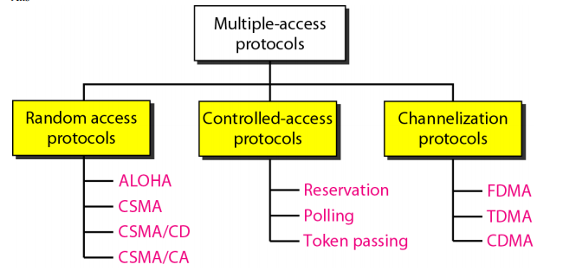
Notes:
The three categories of multiple access protocols are random access, controlled access, and channelization.
In controlled access methods, the stations consult one another to find which station has the right to send. A station cannot send unless it has been authorized by other stations.
We discuss three popular controlled-access methods: reservation, polling, and token passing. In random access methods, there is no access control (as there is in controlled access methods) and there is no predefined channels (as in channelization). Each station can transmit when it desires. This liberty may create collision.
In a random access method, the whole available bandwidth belongs to the station that wins the contention; the other stations needs to wait. In a channelization method, the available bandwidth is divided between the stations. If a station does not have data to send, the allocated channel remains idle.

Slide 36
TEST QUESTIONS
What are the functions of data link layer?
The data link layer is responsible for
framing data bits
providing the physical addresses of the sender/receiver
data rate (flow) control
detection and correction of damaged and lost frames

Slide 37
TEST QUESTIONS
Differentiate between Flow control and Error control.
Flow control refers to a set of procedures used to restrict the amount of data that the sender can send before waiting for acknowledgment. Error control refers to a set of procedures used to detect and recover from errors encountered during information (frames) transmission.

Slide 38
TEST QUESTIONS
Explain different protocols for noisy channels
the Stop-and-Wait ARQ,
the Go-Back-N ARQ, and
the Selective-Repeat ARQ.

Slide 39
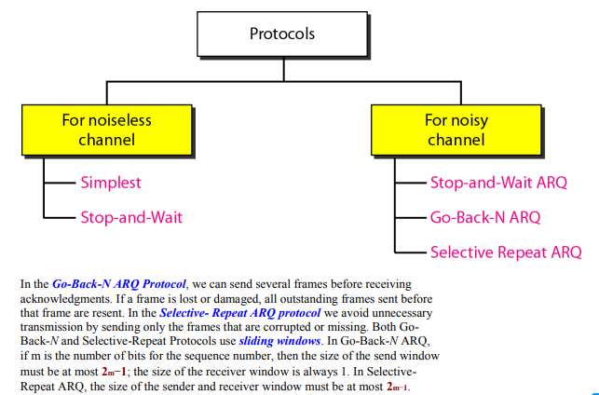

Slide 40
TEST QUESTIONS
Which one of the following task is not done by data link layer?
a) framing
b) error control
c) flow control
d) channel coding

Slide 41
TEST QUESTIONS
Which one of the following task is not done by data link layer?
a) framing
b) error control
c) flow control
d) channel coding
Notes:
Channel coding is the function of physical layer. Data link layer mainly deals with framing, error control and flow control.

Slide 42
TEST QUESTIONS
Which sublayer of the data link layer performs data link functions that depend upon the type of medium? a) logical link control sublayer b) media access control sublayer c) network interface control sublayer d) none of the mentioned
Notes:
Channel coding is the function of physical layer. Data link layer mainly deals with framing, error control and flow control.

Slide 43
TEST QUESTIONS
Which sublayer of the data link layer performs data link functions that depend upon the type of medium? a) logical link control sublayer b) media access control sublayer c) network interface control sublayer d) none of the mentioned
Notes:
Media access control (MAC) deals with transmission of data packets to and from the network-interface card, and also to and from another remotely shared channel.

Slide 44
TEST QUESTIONS
Header of a frame generally contains a) synchronization bytes b) addresses c) frame identifier d) all of the mentioned
Notes:
Media access control (MAC) deals with transmission of data packets to and from the network-interface card, and also to and from another remotely shared channel.

Slide 45
TEST QUESTIONS
Header of a frame generally contains a) synchronization bytes b) addresses c) frame identifier d) all of the mentioned
Notes:
Explanation: In computer networks, the header is a part of the data that contains all the required information about the transmission of the file. It contains information like synchronization bytes, addresses, frame identifier etc.

Slide 46
TEST QUESTIONS
Automatic repeat request error management mechanism is provided by a) logical link control sublayer b) media access control sublayer c) network interface control sublayer d) none of the mentioned
Notes:
Explanation: In computer networks, the header is a part of the data that contains all the required information about the transmission of the file. It contains information like synchronization bytes, addresses, frame identifier etc.

Slide 47
TEST QUESTIONS
Automatic repeat request error management mechanism is provided by a) logical link control sublayer b) media access control sublayer c) network interface control sublayer d) none of the mentioned
Notes:
Explanation: The logical link control is a sublayer of data link layer whose main function is to manage traffic, flow and error control. This layer also acts as an interface between MAC layer and network layer.

Slide 48
TEST QUESTIONS
The data link layer takes the packets from _________ and encapsulates them into frames for transmission. a) network layer b) physical layer c) transport layer d) application layer
Notes:
Explanation: The logical link control is a sublayer of data link layer whose main function is to manage traffic, flow and error control. This layer also acts as an interface between MAC layer and network layer.

Slide 49
TEST QUESTIONS
The data link layer takes the packets from _________ and encapsulates them into frames for transmission. a) network layer b) physical layer c) transport layer d) application layer
Notes:
Explanation: In computer networks, the data from application layer is sent to transport layer and is converted to segments. These segments are then transferred to the network layer and these are called packets. These packets are then sent to data link layer where they are encapsulated into frames. These frames are then transferred to physical layer where the frames are converted to bits.

Slide 50
THANKYOU

