Slide 1


DEPARTMENT OF COMPUTER SCIENCE AND ENGINEERING
20CS8504 - PROJECT WORK
END SEMESTER PRACTICAL EXAMINATION- APRIL / MAY - 2026
Batch No.:18
Date:30/03/2026
Session: AN

Slide 2
Lung-TransNet: A Transfer Learning-Based CNN Framework for Multi-Class Lung Disease Prediction
Guide Name:
Mrs. VALLI PRIYADHARSHINI K,M.E.,(Ph.D).,
Team Members:
DHASHINESH K(811722104031)
IGNATIUSS J (811722104055)
INFANT ALAN L (811722104057)

Slide 3
OBJECTIVE OF THE PROJECT
To develop an efficient AI-based lung disease classification system using chest X-ray images that supports early and accurate diagnosis.
To apply transfer learning with the Xception CNN architecture, along with image preprocessing and data augmentation, to enhance feature extraction and improve classification performance for multiple lung diseases such as pneumonia, tuberculosis, lung cancer, and COVID-19.
To evaluate the proposed system by comparing its performance with other deep learning models using metrics like accuracy, precision, recall, and F1-score.

Slide 4
INTRODUCTION
Lung diseases such as pneumonia, tuberculosis, lung cancer, and COVID-19 require early and accurate diagnosis for effective treatment.
Chest X-ray imaging is widely used, but manual interpretation is time-consuming and error-prone, depending on expert analysis.
Recent advancements in Artificial Intelligence (AI) and Deep Learning, especially CNN-based Transfer Learning (Xception), enable automated feature extraction and accurate multi-class classification of lung diseases.

Slide 5
LITERATURE SURVEY
TITLE | AUTHORS | PUBLISHER | TECHNOLOGY USED
LIME-Enabled Investigation of Convolutional Neural Network Performances in COVID-19 Chest X-Ray Detection | Cervantes, Eduardo Gasca | IEEE | Convolutional neural network
Lung Tumor Classification and Detection from CT Scan Images using Deep Convolutional Neural Networks (DCNN) | Mohanapriya, N., B. Kalaavathi | IEEE | Deep Convolutional neural network
Conventional Neural Network approach for the Diagnosis of Lung Tumor | Agrawal, Vijay L | IEEE | MLP Neural Network with quick propagation (QP)
Deep learning to distinguish COVID-19 from other lung infections, pleural diseases, and lung tumors | Serener, Ali, and Sertan Serte | IEEE | Deep learning architectures
An Automatic Lung Cancer Detection and Classification (ALCDC) System Using Convolutional Neural Network | Abdul, Wadood | IEEE | Profound learning techniques
Convolutional Neural Network approach for the Classification and Recognition of Lung Nodules | Sachin Bhat | IEEE | Convolutional neural network
Classification and Segmentation Techniques for Detection of Lung Cancer from CT Images | Prenitha Lobo | IEEE | Segmentation technique

Slide 6
EXISTING SYSTEM
Manual Diagnosis by Radiologists: Chest X-rays (CXR) and CT scans are analyzed manually to detect lung diseases.
Rule-Based CAD Systems: Use edge detection and texture analysis with predefined rules to identify abnormalities.
Machine Learning Approaches: Models like SVM, Random Forest, and k-NN use handcrafted features for classification.

Slide 7
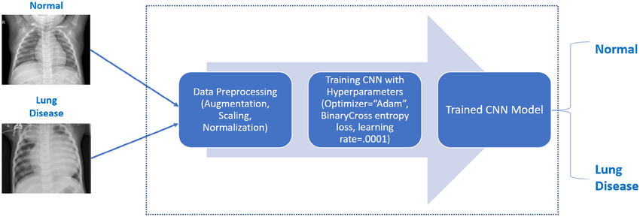
EXISTING SYSTEM

Slide 8
PROBLEM IDENTIFIED
Time-consuming and prone to human error, especially in high-volume settings.
Dependence on expert availability, which is limited in rural or resource-constrained areas.
Limited ability to capture complex patterns in medical images.
Poor generalization to diverse datasets.
Requires significant domain expertise for feature engineering.

Slide 9
PROPOSED SYSTEM
The proposed system for lung disease classification using the Xception CNN is designed to enhance the accuracy and efficiency of pneumothorax diagnosis.
In the initial phase, a comprehensive dataset of chest X-ray images is collected and preprocessed, ensuring uniformity and optimal data quality.
The Xception CNN architecture is selected for its capacity to effectively learn intricate image features.
Transfer learning is applied using pre-trained weights from a general image dataset, expediting model training.

Slide 10
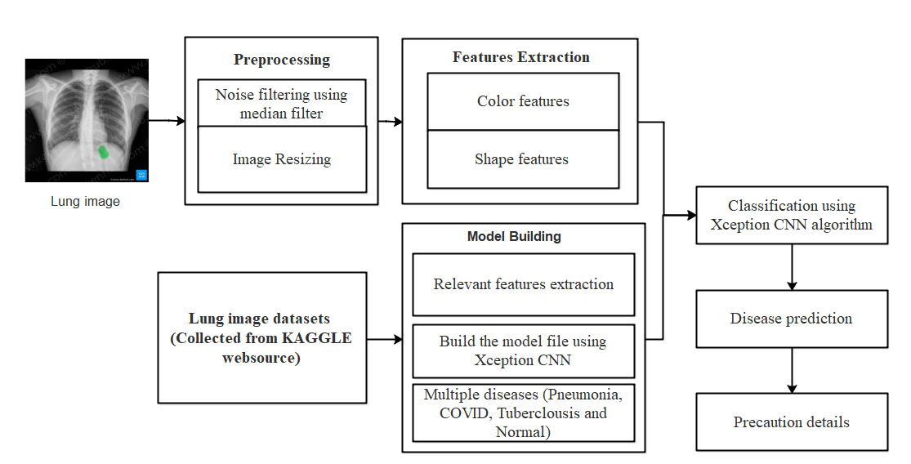
PROPOSED SYSTEM ARCHITECTURE

Slide 11
SOFTWARE AND HARDWARE REQUIREMENTS
HARDWARE
Processor : Intel processor 2.6.0 GHZ
RAM : 4 GB
Hard disk : 160 GB
Compact Disk : 650 Mb
Keyboard : Standard keyboard
Monitor : 15 inch color monitor
SOFTWARE
Server Side : Python 3.7.4(64-bit) or (32-bit)
Client Side : HTML, CSS, Bootstrap
IDE : Flask 1.1.1
Back end : MySQL 5.
Server : WampServer 2i
OS : Windows 10 64 –bit

Slide 12
MODULES
DATA COLLECTION
IMAGE ENHANCEMENT
CONTOUR EXTRACTION
TISSUES CLASSIFICATION
DIAGNOSIS DETAILS

Slide 13
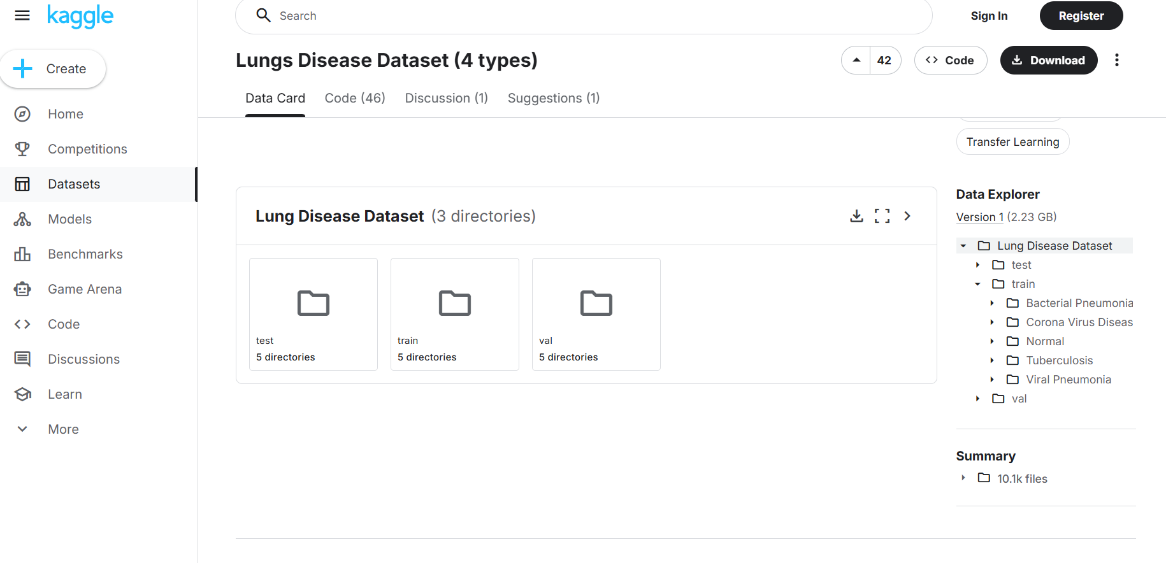
MODULE-1
DATA COLLECTION
Chest x-rays are taken into account in concert of the simplest strategies to diagnose the pneumonic nodules.
In this module, we can upload the X-ray scan images with various size and format.
This can be collected from KAGGLE website

Slide 14
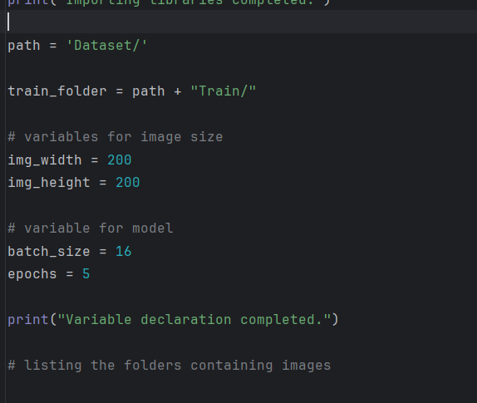
MODULE-2
IMAGE ENHANCEMENT
Pre-processing is a common name for operations with images at the lowest level of abstraction both input and output are intensity images.
In this module, resize the scan image for future process and also implement median filtering algorithm to remove the noises in images

Slide 15
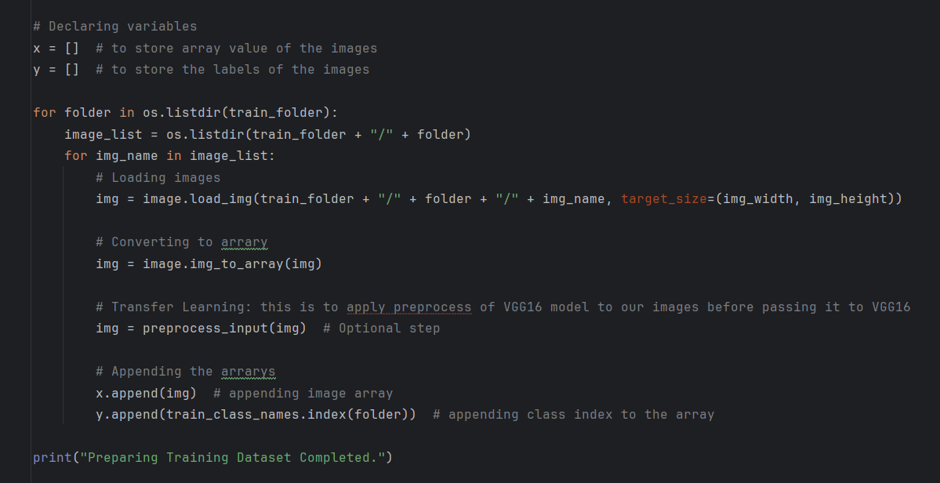
MODULE-3
CONTOUR EXTRACTION
In this module, image features are prepared for deep learning
Images are loaded, resized, and converted into numerical arrays
Preprocessing techniques are applied for better feature extraction
Data is structured and labeled for training the CNN model

Slide 16
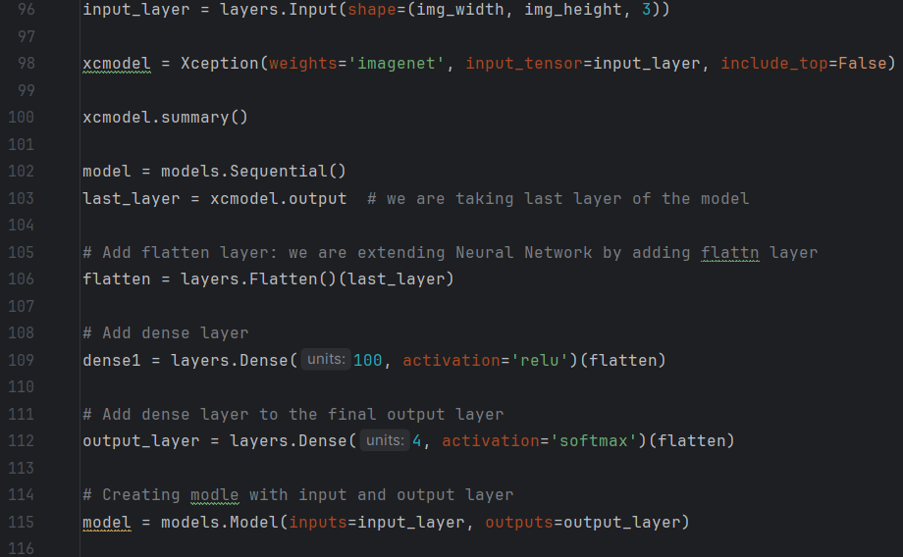
MODULE-4
TISSUES CLASSIFICATION
The classification is the final step of the system
Lung diseases are classified using CNN (Xception model)
Deep features are automatically extracted from images
Softmax layer classifies images into multiple classes

Slide 17
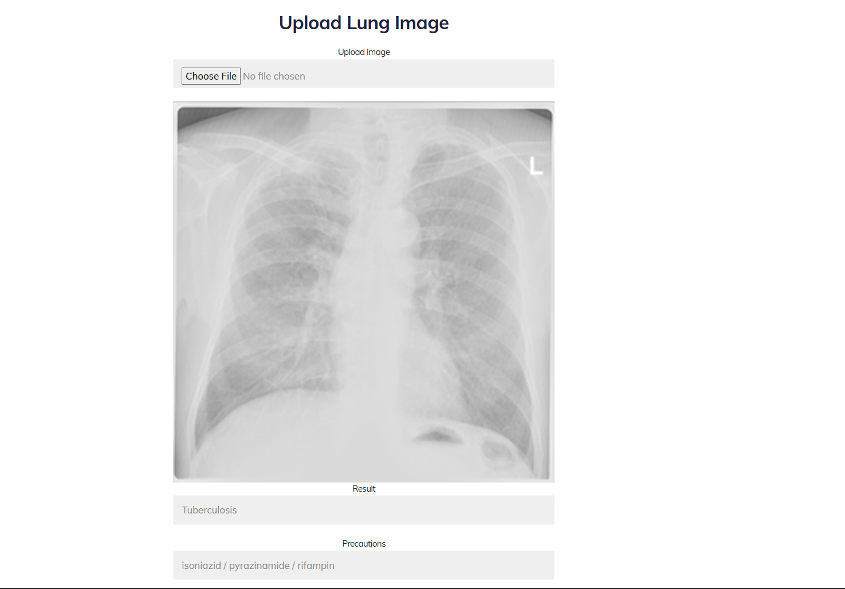
MODULE-5
DIAGNOSIS DETAILS
The trained CNN model predicts lung disease from input chest X-ray images.
The system classifies images into categories such as COVID-19, Pneumonia, Tuberculosis, and Normal.
Based on the prediction, the system displays the diagnosis result along with recommended precautions.

Slide 18
CONCLUSION
The system uses a CNN-based Xception model to classify chest X-ray images.
It accurately detects COVID-19, Pneumonia, Tuberculosis, and Normal cases.
The model provides fast prediction with precaution support, improving diagnosis efficiency.

Slide 19
FUTURE ENHANCEMENTS
Extend the system to support real-time clinical deployment with web/mobile integration.
Implement encryption techniques to protect patient data and ensure model security.
Use blockchain technology for secure, transparent, and privacy-preserving data sharing.

