Slide 1
Banking in the Cloud Age: Challenges and Opportunities
by Yi Liang Dong

Slide 2
A Quick Overview of Cloud Computing

Slide 3
What is Cloud Computing
Cloud computing is a model for enabling ubiquitous, convenient, on-demand network access to a shared pool of configurable computing resources (e.g., networks, servers, storage, applications, and services) that can be rapidly provisioned and released with minimal management effort or service provider interaction.
National Institute of Standards and Technology

Slide 4
The Characteristic of Cloud Computing
On-demand self-service.
Broad network access.
Resource pooling.
Rapid elasticity.
Measured service.
Notes:
On-demand self-service. A consumer can unilaterally provision computing capabilities, such as server time and network storage, as needed automatically without requiring human interaction with each service provider.
Broad network access. Capabilities are available over the network and accessed through standard mechanisms that promote use by heterogeneous thin or thick client platforms (e.g., mobile phones, tablets, laptops, and workstations).
Resource pooling. The provider’s computing resources are pooled to serve multiple consumers using a multi-tenant model, with different physical and virtual resources dynamically assigned and reassigned according to consumer demand. There is a sense of location independence in that the customer generally has no control or knowledge over the exact location of the provided resources but may be able to specify location at a higher level of abstraction (e.g., country, state, or datacenter). Examples of resources include storage, processing, memory, and network bandwidth.
Rapid elasticity. Capabilities can be elastically provisioned and released, in some cases automatically, to scale rapidly outward and inward commensurate with demand. To the consumer, the capabilities available for provisioning often appear to be unlimited and can be appropriated in any quantity at any time.
Measured service. Cloud systems automatically control and optimize resource use by leveraging a metering capability1 at some level of abstraction appropriate to the type of service (e.g., storage, processing, bandwidth, and active user accounts). Resource usage can be monitored, controlled, and reported, providing transparency for both the provider and consumer of the utilized service.

Slide 5
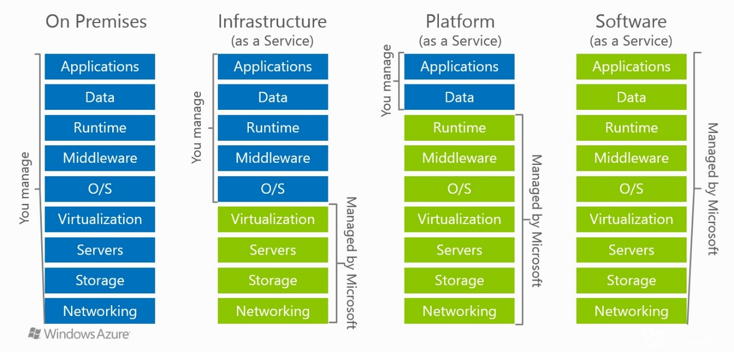
The Cloud Models
Notes:
Use the example of
Self constructed office building
Building management
Company rental
Customer who do business with the company

Slide 6
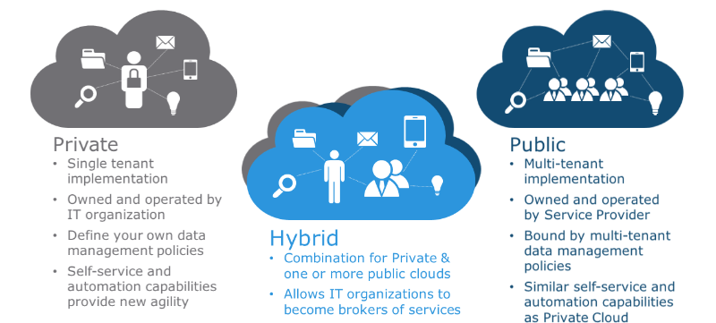
Public Cloud vs. Private Cloud vs. Hybrid Cloud

Slide 7
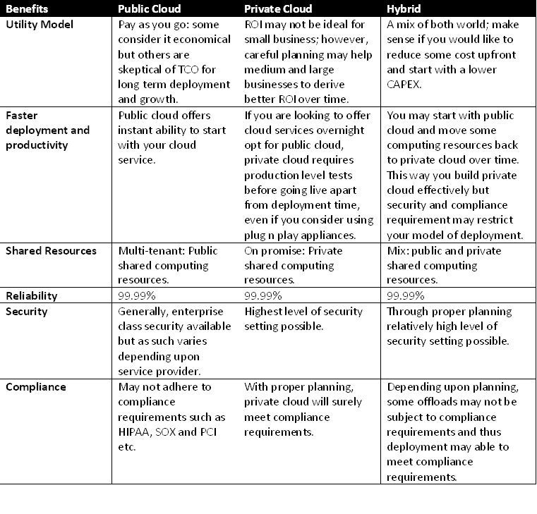
Public Cloud vs. Private Cloud vs. Hybrid Cloud

Slide 8
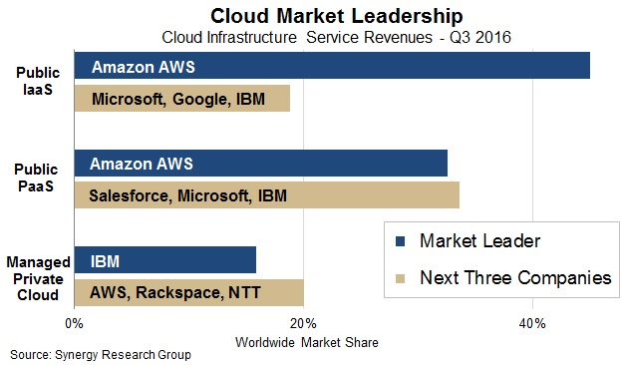
Top Cloud Provider

Slide 9
Banks are challenged from two fronts
Operational
The cost of maintaining legacy system on prime compounded by ever increasing demand for ad-hoc customization is prohibitively high. Redesign and Re-platforming Banking Systems becomes the inevitable choice.
Business
The rise of Fintech companies challenges the traditional Retail Banks on all fronts : Payment, Landing, Insurance , Wealth Management and Block Chain, armed with Cloud technology, they are able to provide alternative banking experience with nimbleness and agility.

Slide 10
The Challenges

Slide 11
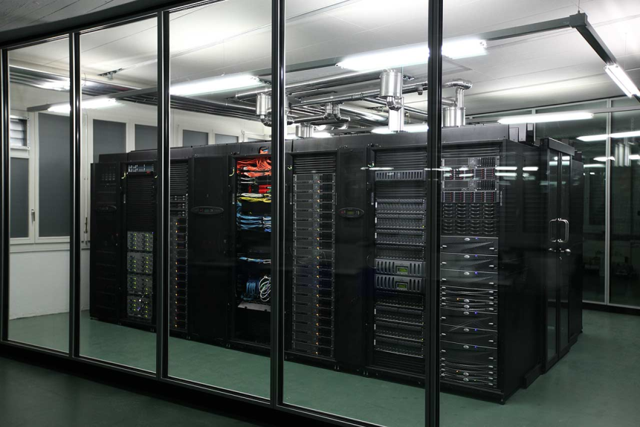
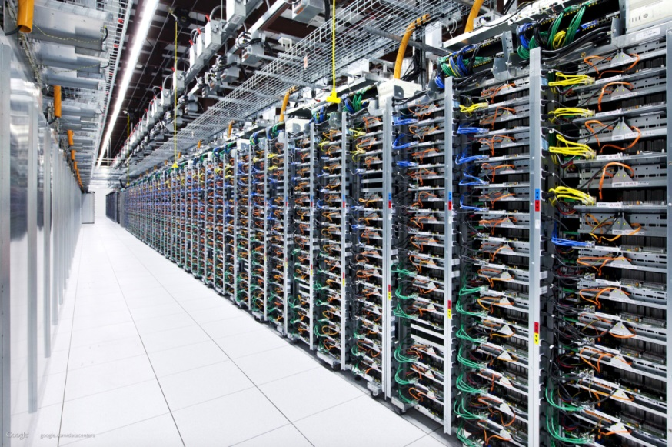
Operational Challenges- Cost of running traditional Data Centers
Heterogeneous hardware and software from different vendors, costly to maintain, even more expensive to grow. (80 percent of total operational cost goes to maintenance, 40 percent are labor cost)
Bank Data Center
Cloud Data Center

Slide 12
Operational Challenges- Lengthy and Costly provisioning process
Provision a typical Java EE Web Application Environment with Database Access:
On-Premise Provisioning | Cloud Provisioning
Purchase Server Hardware Install Hardware Wiring Configure OS Install Web Server Install App Server Purchase Database Hardware Install Hardware Wiring Configure OS Install Database Purchase Load Balancer Install and Configure Load Balancer Configure DNS, VIP, Firewalls, Proxies Configure Message gateways, HSM, NAS…. Do everything again for Dev, QA, PTE, DR. 24x7 support if mission critical | Select & Launch Web Server Instance Select & Launch App Server Instance Select & Launch Database Server Instance Select & Launch Load Balancer Set Up Internet Gateway Configure VPC and DNS Rerun Provisioning Script for Dev, QA, PTE, DR
Total Initial Cost: 1.5M – 2 M On-going Cost: 500K Duration: 2-3 Month | Total Cost : 100K On-going Cost: 50K Duration: 2 – 3 hours

Slide 13
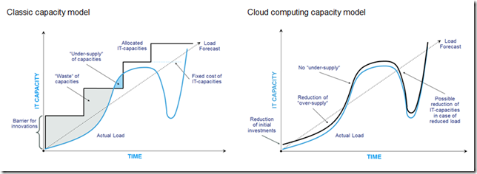
Operational Challenges - Inefficient Capacity Management

Slide 14
Business Challenges- the Rise of Fintech Companies
Financial technology, also known as FinTech, is an industry composed of companies that use new technology and innovation with available resources in order to compete in the marketplace of traditional financial institutions and intermediaries in the delivery of financial services. Financial technology companies consist of both startups and established financial and technology companies trying to replace or enhance the usage of financial services of incumbent companies. The main characteristics of Fintech Companies including:
Laser sharp focus on single business functional area
Rapid delivery, shorter time to market
Cloud based hosting model
Providing Open APIs for third party integration

Slide 15
Business Challenges- the Rise of Fintech Companies
Core Banking Services | Fintech Disruptors
Payment | Apple Pay(43%), Samsung Pay, Android Pay, Square, Paypal, Ugo Wallet
Landing | Avant (£3.5b), Landing Club($24b),DianRong.com (€24b), Landing Loop(CA)
High Interest Saving | EQ Bank (CAD), Atom Bank (UK)
Insurance | Cuvva(UK),Cyene(US),Lemonade(US), Oscar(US)
Wealth Management | Betterment, Wealth Front, Motif, Folio, Wealth Simple
BlockChain | Pymnts, Coinbase, Ripple, R3 CEV
Majority of Fintech Companies are deploying their solution in Cloud, AWS has launched Competency Program for Financial Services Partners.

Slide 16
How to Address the Challenges

Slide 17
Addressing Operational Challenges
Embrace Cloud Computing
Key concern need to be addressed: Security
Hosting their own private Cloud
Streamlining Provisioning, Deployment and Integration Process
Creating Hybrid Cloud, move part of the infrastructure to Public Cloud
Utilizing Cloud Services, why reinvent the Wheel?
Build Cloud friendly Applications

Slide 18
Addressing the Challenges – Change the Application landscape
Change the Bank’s Enterprise Information System landscape from LOB focused to Business Function focused
Current State Banking EIS
Future State Banking EIS
Thin/Thick Client
IVR System
Browser Mobile App
Thin/Thick Client
Thin/Thick Client
Omni Channel Clients (Thick, Thin, Browser, Mobile, Voice, External System etc.)
Branch
System
Contact Center
System
Online & Mobile System
Landing
System
Wealth Mgmt System
API Gateway
Search customer
Search customer
Search customer
Search customer
Search customer
Customer
Profile
Bill Payment
Fund Transfer
Open Account
Inquiry
Pay Bills
Pay Bills
Pay Bills
Apply Loans
Open Account
Transfer Funds
Transfer Funds
Transfer Funds
Transfer Funds
Quote
Open Account
Open Account
Remote Deposit
Open Account
Trade
Deposit
Credit Check
Mortgage Application
Quote
Trade
Deposit
Inquiry
E-transfer
Credit Check
Transfer Funds
ESB/EMB
ESB/EMB
Customer
Profile
Accounts
Credit Cards
Financial
Txn
System
Other Products
Customer
Profile
Accounts
Credit Cards
Financial
Txn
System
Other Products

Slide 19
Addressing the Challenges – Breaking down the Monolithic Apps
Breaking down monolithic legacy applications and systems into Microservices
Microservices - also known as the microservice architecture - is an architectural style that structures an application as a collection of loosely coupled services.
Fine Grain Business Service
Uses Light Weight Protocol.
Enables parallel development by small autonomous teams
Independently deployable and scalable
Enables continuous delivery and deployment.
Branch System
Customer Profile
Search customer
Pay Bills
Pay Bills
Transfer Funds
Transfer Funds
Open Account
Open Account
Deposit
Deposit

Slide 20
Addressing Challenges – Embrace API Economy
An API(application programming interface economy ) is the code allows software components to communicate to each other.
API economy is a general term that describes the way APIs can positively affect an organization's profitability.
API management is the process of publishing, documenting and overseeing application programming interfaces (APIs) in a secure, scalable environment
Web Service API establishes standard communication protocol which allows systems based on different technologies to talk to each other via HTTP communication
Simple Object Access Protocol (SOAP)
Representational state transfer (RESTFul)
Banks need to partner up with FinTech companies, and an Open API Eco System is a must!

Slide 21
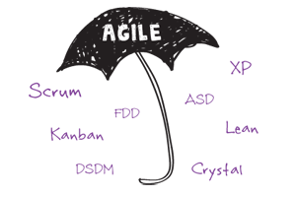
Addressing Challenges- Adopt Agile Methodologies
1. Active user involvement is imperative 2. The team must be empowered to make decisions 3. Requirements evolve but the timescale is fixed 4. Capture requirements at a high level; lightweight & visual 5. Develop small, incremental releases and iterate 6. Focus on frequent delivery of products 7. Complete each feature before moving on to the next 8. Apply the 80/20 rule 9. Testing is integrated throughout the project lifecycle – test early and often 10. A collaborative & cooperative approach between all stakeholders is essential
The Agile movement seeks alternatives to traditional project management. Agile approaches help teams respond to unpredictability through incremental, iterative work cadences and empirical feedback. Agilists propose alternatives to waterfall, or traditional sequential development.

Slide 22
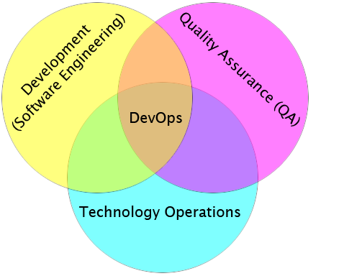
Addressing Challenges – Adopt DevOps Practice
DevOps is a term used to refer to a set of practices that emphasize the collaboration and communication of both software developers and information technology (IT) professionals while automating the process of software delivery and infrastructure changes. It aims at establishing a culture and environment where building, testing, and releasing software can happen rapidly, frequently, and more reliably
Benefit of DevOPs
significantly shortens the time to market
improved customer satisfaction
better product quality
more reliable releases
improved productivity and efficiency
DevOps Toolset
Code — Code development and review, version control tools, code merging; (Eclipse, Intellij, Visual Studio, SVN, Github…)
Build — Continuous integration tools, build status; (Maven, Gradle, Jenkins, Bamboo…)
Test — Test and results determine performance; (SOAPUI, Load Runner, Jmeter , Selenium …)
Package — Artifact repository, application pre-deployment staging; (Artifactories, Solaris Packaging, Nexus, Archiva…)
Release — Change management, release approvals, release automation; (Automic, BuildMaster, Puppet, Visual Studio…)
Configure — Infrastructure configuration and management, Infrastructure as Code tools; (Ansible, Chef, Puppet, SaltStack…)
Monitor — Applications performance monitoring, end–user experience. (Jprofiler, Dynatrace, Code Analyst…)

Slide 23
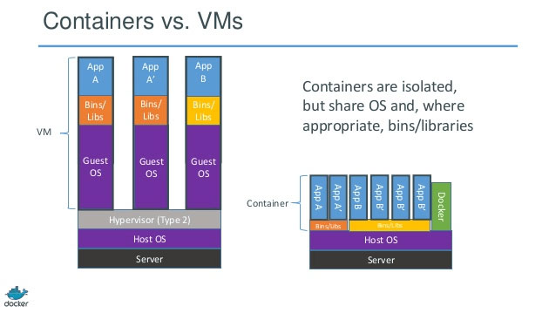
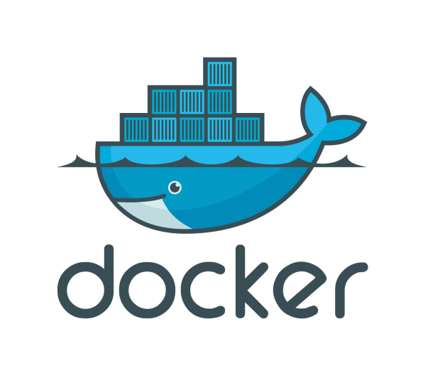
Addressing Challenges – Embrace Docker and Cloud
Container vs. VM
Virtualization enables workloads to be run in environments that are separated from their underlying hardware by a layer of abstraction. This abstraction allows servers to be broken up into virtualized machines (VMs) that can run different operating systems.
Container technology offers an alternative method for virtualization, in which a single operating system on a host can run many different applications from the cloud. One way to think of containers vs VMs is that while VMs run several different operating systems on one compute node, container technology offers the opportunity to virtualize the operating system itself.
Docker is a tool designed to make it easier to create, deploy, and run applications by using containers.

Slide 24
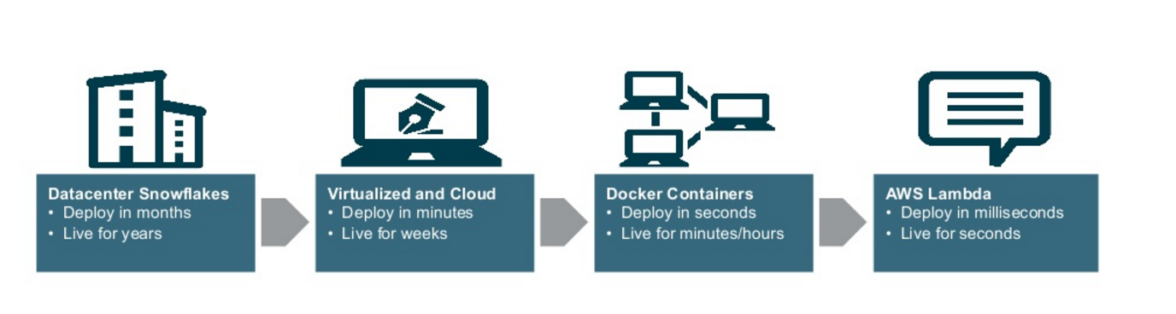
Addressing Challenges Embrace- Docker and Cloud
Why Dockers Containers?
It facilitates the adoption of Microservices
It is made for Continuous Integration and Continuous Deployment
It is born for Cloud – All major Cloud Vendors offers Docker integration as a PaaS Service.
The App Delivery Cycle Evolution:

Slide 25
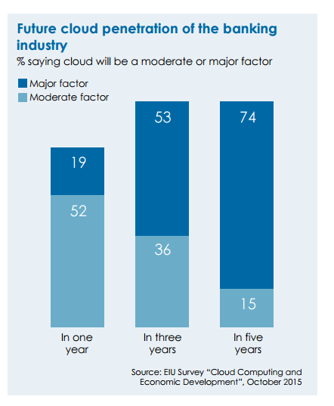
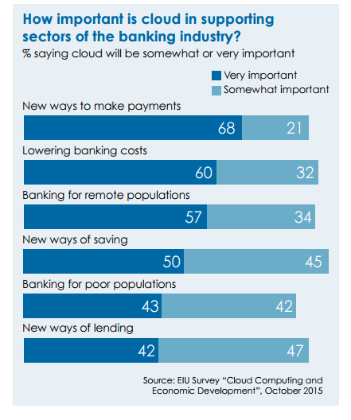
Cloud Adoption in Banking Industry
Source: https://www.eiuperspectives.economist.com

Slide 26
The Bank ‘s Dream Tech Team
Restful API Developer
Domain Driven Design and Microservices Application Designer
Agile methodology Mentor
Continuous Integration and Continues Deployment Devops
Container Management Expert
CLOUD ARCHITECT

Slide 27
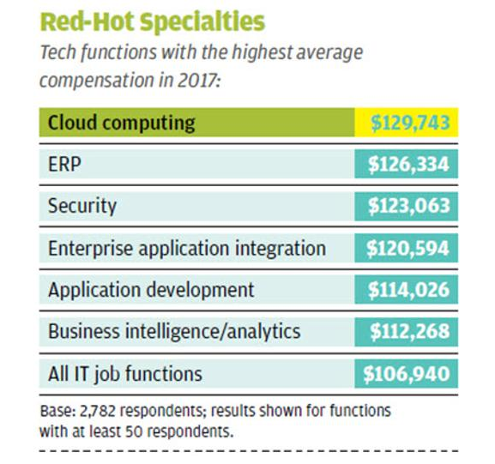
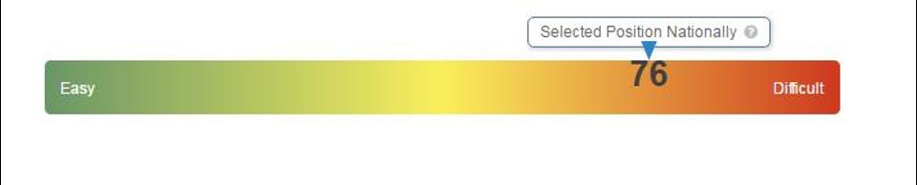
Cloud Computing Career Outlook
The Hiring Scale is 76 for jobs that require cloud computing skill sets, with the average job post staying open 47 days.
Average compensation for cloud computing jobs is $129,743 making it the most lucrative of all specialties in 2017
https://www.forbes.com/sites/louiscolumbus/2016/03/18/where-cloud-computing-jobs-are-in-2016/#2a7ef1f11a60
https://www.forbes.com/sites/louiscolumbus/2017/04/30/cloud-computing-skills-pay-the-most-according-to-computerworld/#5b78550e5183

Slide 28
The In-demand cloud skills in 2017
Application Security
Containers
Enterprise Cloud Migration
Cloud Enterprise Application Development
Database and Big Data
https://www.cloudcomputing-news.net/news/2017/feb/23/top-five-demand-cloud-skills-2017/

Slide 29
Top Cloud Computing Certificates
AWS Certification
Google Cloud Platform Cloud Academy
Microsoft Azure Certifications
IBM Certified Solution Advisor -- Cloud Computing Architecture
IBM Certified Solution Architect -- Cloud Computing Infrastructure
VMware Certified Professional (VCP)
Certified Cloud Professional (CCP)
http://searchcloudcomputing.techtarget.com/feature/Are-you-on-the-right-cloud-computing-career-path

Slide 30
AWS – the place where your Cloud Computing career takes off
Offers the most comprehensive Cloud Computing Platform and Cloud Computing Services
Offers the most user friendly GUI interface
Has the best documentations and learning resources
Offers one year of free access to most of the Platform Services, perfect for learning and practicing
Most recognized Certification System

Slide 31
Summary
Today, Banks and Financial Institutions are challenged by outdated Technology & Operation model
The Rise of Fintech poses further threats on Banks business model, and the their ability to react to the dynamics of the Market
Cloud Computing brings a new breed of Technologies, Application Design Patterns, and Operational Methodologies, becomes vital to Bank’s survival and growth

Slide 32
Keywords
VM (Virtual Machine)
Scale Up, Scale Out, Auto Scaling
HA (High Availability)
DR(Disaster Recovery)
VPC (Virtual Private Cloud)
Load Balancer
Container
Iaas, Paas, Saas, Caas
Proxy & Reverse Proxy
DNS
SSL
NAS
HSM

Slide 33
Keywords
Devops
Microservices
Domain Driven Design
Docker
Dockerhub
Openshift
Github
Chef
Chef recipe
Agile
Scrum
TDD(Test Driven Development)
CI (Continuous Integration)
CD(Continuous delivery)
Build System
Maven
Gradle
Restful API
API Gateway
Block Chain

