Slide 1
Amazon Web Services 101

Slide 2
Cloud Computing Characteristics
On-demand self-service.
A consumer can unilaterally provision computing capabilities, such as server time and network storage, as needed automatically without requiring human interaction with each service provider.

Slide 3
What is Cloud Computing
Cloud computing is a model for enabling ubiquitous, convenient, on-demand network access to a shared pool of configurable computing resources (e.g., networks, servers, storage, applications, and services) that can be rapidly provisioned and released with minimal management effort or service provider interaction.
-National Institute of Standards and Technology

Slide 4
Cloud Computing Characteristics
Broad network access.
Capabilities are available over the network and accessed through standard mechanisms that promote use by heterogeneous thin or thick client platforms (e.g., mobile phones, tablets, laptops, and workstations).

Slide 5
Cloud Computing Characteristics
Resource pooling.
The provider’s computing resources are pooled to serve multiple consumers using a multi-tenant model, with different physical and virtual resources dynamically assigned and reassigned according to consumer demand. There is a sense of location independence in that the customer generally has no control or knowledge over the exact location of the provided resources but may be able to specify location at a higher level of abstraction (e.g., country, state, or datacenter). Examples of resources include storage, processing, memory, and network bandwidth.

Slide 6
Cloud Computing Characteristics
Rapid elasticity.
Capabilities can be elastically provisioned and released, in some cases automatically, to scale rapidly outward and inward commensurate with demand. To the consumer, the capabilities available for provisioning often appear to be unlimited and can be appropriated in any quantity at any time.

Slide 7
Cloud Computing Characteristics
Measured service.
Cloud systems automatically control and optimize resource use by leveraging a metering capability1 at some level of abstraction appropriate to the type of service (e.g., storage, processing, bandwidth, and active user accounts). Resource usage can be monitored, controlled, and reported, providing transparency for both the provider and consumer of the utilized service

Slide 8
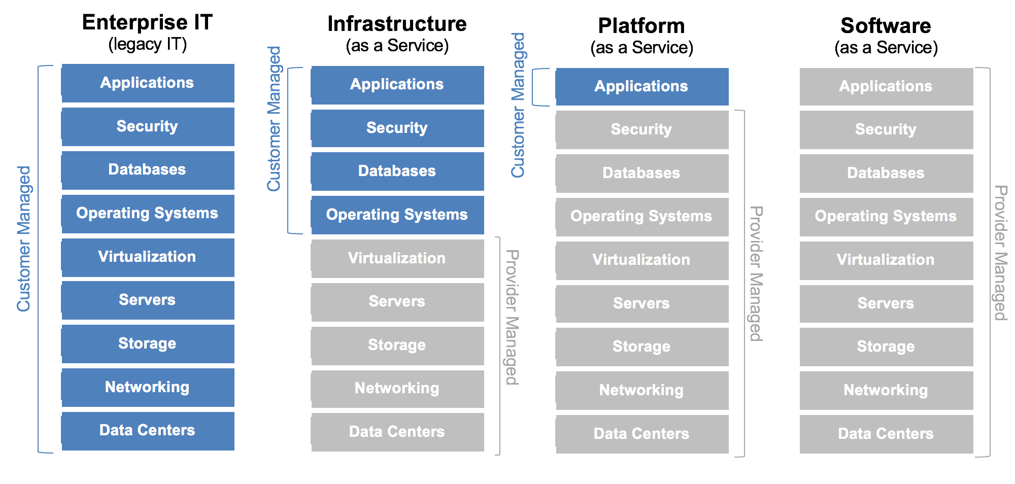
Cloud Computing Models

Slide 9
Cloud Computing Models
Infrastructure as a Service (IaaS).
The capability provided to the consumer is to provision processing, storage, networks, and other fundamental computing resources where the consumer is able to deploy and run arbitrary software, which can include operating systems and applications. The consumer does not manage or control the underlying cloud infrastructure but has control over operating systems, storage, and deployed applications; and possibly limited control of select networking components (e.g., host firewalls).

Slide 10
Cloud Computing Models
Platform as a Service (PaaS).
The capability provided to the consumer is to deploy onto the cloud infrastructure consumer-created or acquired applications created using programming languages, libraries, services, and tools supported by the provider. The consumer does not manage or control the underlying cloud infrastructure including network, servers, operating systems, or storage, but has control over the deployed applications and possibly configuration settings for the application-hosting environment.

Slide 11
Cloud Computing Models
Software as a Service (SaaS).
The capability provided to the consumer is to use the provider’s applications running on a cloud infrastructure. The applications are accessible from various client devices through either a thin client interface, such as a web browser (e.g., web-based email), or a program interface. The consumer does not manage or control the underlying cloud infrastructure including network, servers, operating systems, storage, or even individual application capabilities, with the possible exception of limited user specific application configuration settings.

Slide 12
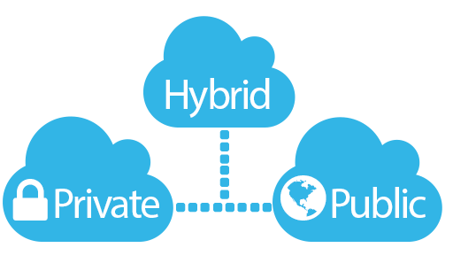
Cloud Deployment Model
Private cloud.
The cloud infrastructure is provisioned for exclusive use by a single organization comprising multiple consumers (e.g., business units). It may be owned, managed, and operated by the organization, a third party, or some combination of them, and it may exist on or off premises.

Slide 13
Cloud Deployment Model
Public cloud.
The cloud infrastructure is provisioned for open use by the general public. It may be owned, managed, and operated by a business, academic, or government organization, or some combination of them. It exists on the premises of the cloud provider

Slide 14
Cloud Deployment Model
Hybrid cloud.
The cloud infrastructure is a composition of two or more distinct cloud infrastructures (private, community, or public) that remain unique entities, but are bound together by standardized or proprietary technology that enables data and application portability (e.g., cloud bursting for load balancing between clouds).

Slide 15
A Brief History of Amazon Web Services
Started late 2003, Chris Pinkham and Benjamin Black presented the idea of selling Amazon’s internal standardized computing infrastructure as service to the external wold.
November 2004, Simple Queue Service (SQS) launched as first Amazon Web Service
2006, AWS officially launched
2007, 180,000 developers on board on the platform
2010, all amazon.com moved over to AWS
2012, first Re-Invent conference at Las Vegas
2013, AWS Certification launched
2015, AWS became profitable, generate $6B USD revenue per annum and 90% growth rate year over year
2016 $13B USD revenue
2016, Cisco, IBM, HP Enterprise, Dell EMC, Oracle, VMWare generated over $206B revenue, $15B reduction from 2012(3% shrinkage year over year)
Dec. 2016 AWS Canada opened first Canada Availability Center in Montreal

Slide 16
AWS Growth
82

Slide 17
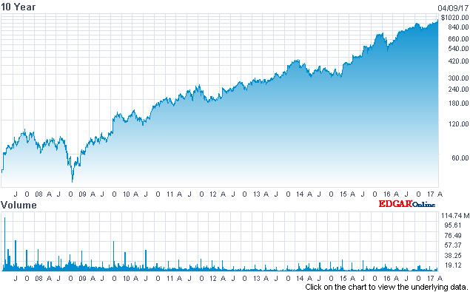
AWS Growth

Slide 18
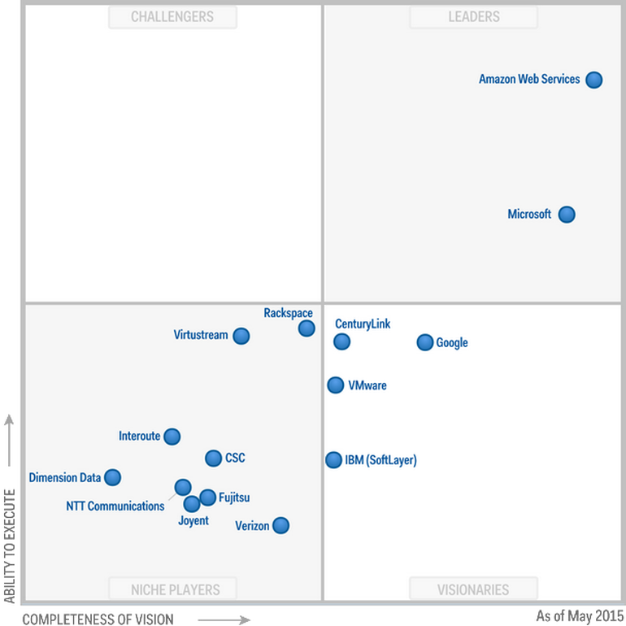
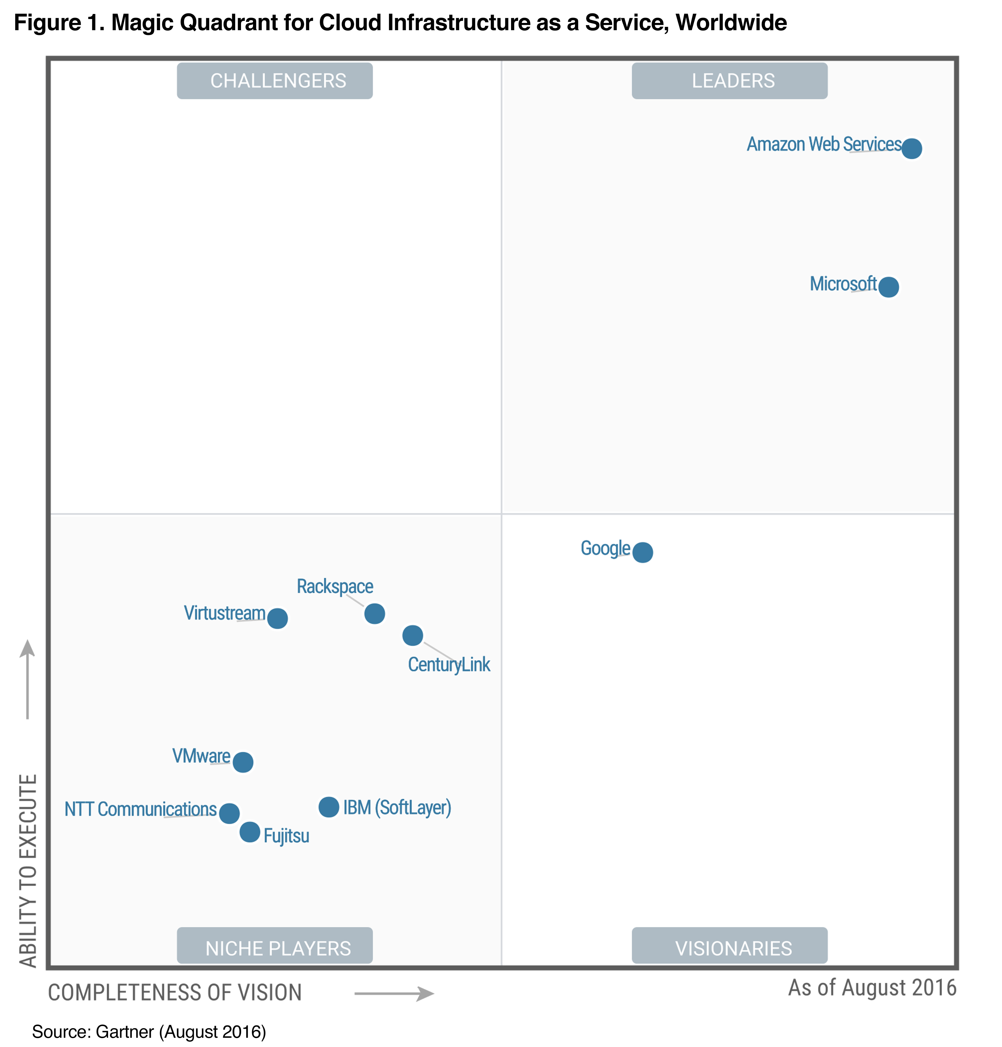
AWS Leadership
Gartner’s Magic Quadrant: Cloud Infrastructure As Service

Slide 19

Break for 15 minute

Slide 20
The AWS Platform
Game Development
Artificial Intelligence
Contact Center
Business Productivity
Internet Of Things
Desktop & App Streaming
Application Services
Developer Tools
Mobile Services
Analytics
Security, Identity & Compliance
Management Tools
Database
Migration
Messaging
Compute
Storage
Networking & Content Delivery
AWS Global Infrastructure

Slide 21
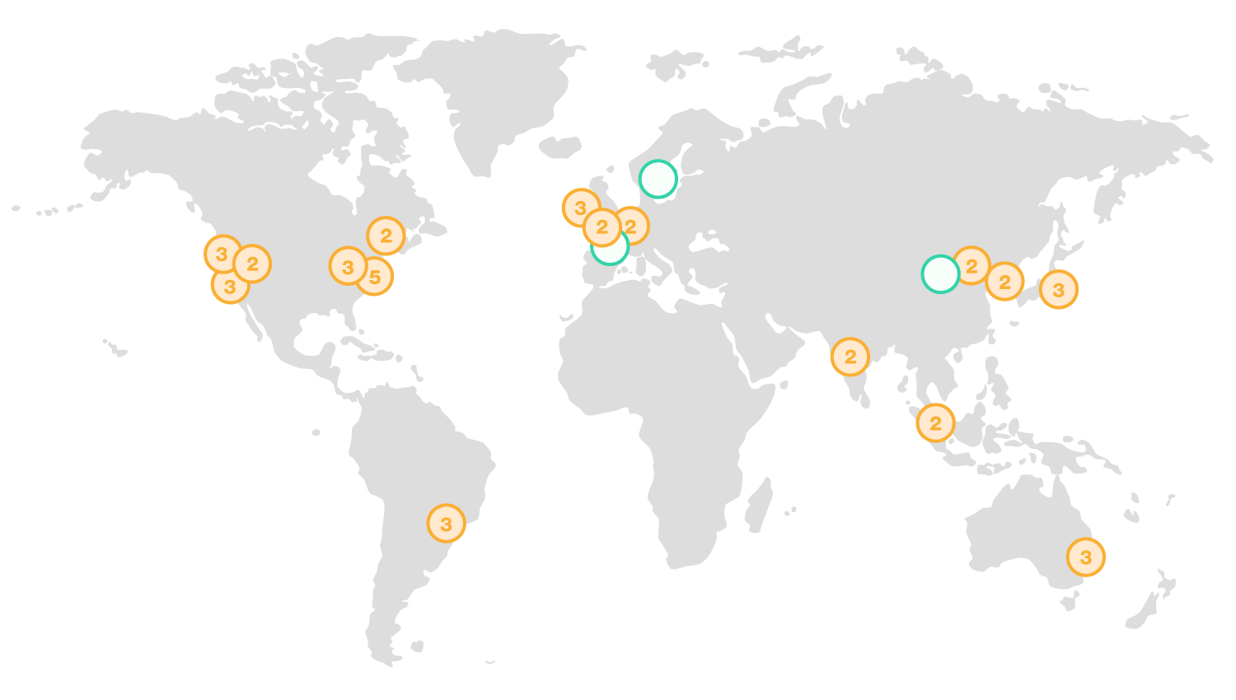
AWS Global Infrastructure
16 Regions
42 Availability Zones
3 More Regions to come
7 More Availability Zones to come

Slide 22
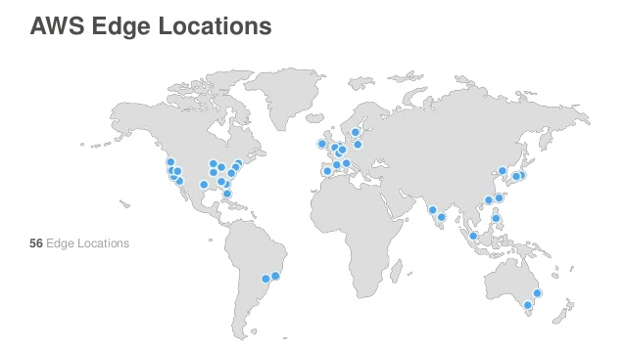
AWS Global Infrastructure
A Region is a physical location in the world where we have multiple Availability Zones.
Availability Zones(AZ) consist of one or more discrete data centers, each with redundant power, networking and connectivity, housed in separate facilities
Edge Location are Content Delivery Network End Points for CloudFront (Cache static content such as images and media files), currently there are over 66 edge locations
Region
AZ-1
AZ-2
AZ-3

Slide 23
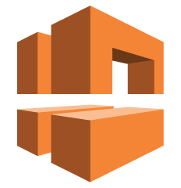

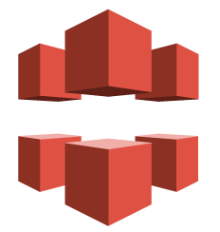

Networking & Content Delivery
VPC – Virtual Private Cloud enables you to launch AWS resources into a virtual network closely resembles a traditional network in a data center
Route 53 – AWS DNS Service (53 is the DNS port) is designed to provide a reliable and cost effective way to route end users to Internet applications by translating domain names like www.example.com into the IP addresses like 192.0.2.1.
Cloud Front – AWS global content delivery network (CDN) service that accelerates delivery of your websites, APIs, video content or other web assets.
Direct Connect - AWS Direct Connect makes it easy to establish a dedicated network connection from your premises to AWS.

Slide 24

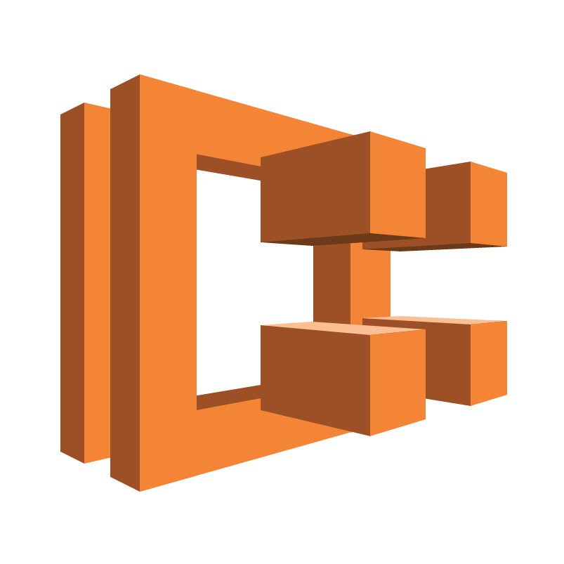

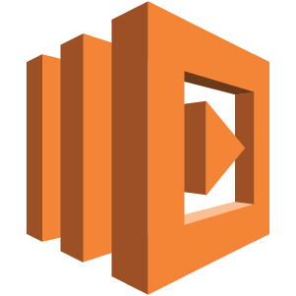

Compute
EC2 – Elastic Compute Cloud is a web service that provides scalable computing capacity in the AWS cloud. EC2 instances are virtual servers you can launch, configure, manage and scale in cloud on demand
ECS- EC2 Container Service is a highly scalable, high performance container management service that supports Docker containers and allows you to easily run applications on a managed cluster of Amazon EC2 instances
Elastic Beanstalk – Elastic Beanstalk automatically handles the complexity of AWS infrastructure setup so a developer simply uploads his/her application and runs it
Lambda - AWS Lambda is a serverless compute service that runs your code in response to events and automatically manages the underlying compute resources for you.
Lightsail- Amazon Lightsail provides developers compute, storage, and networking capacity and capabilities to deploy and manage websites and web applications in the cloud. Lightsail includes everything you need to launch your project quickly – a virtual machine, SSD-based storage, data transfer, DNS management, and a static IP – for a low, predictable monthly price.

Slide 25
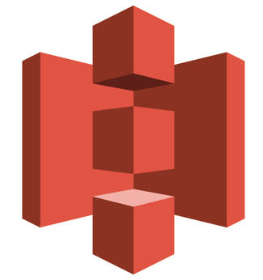


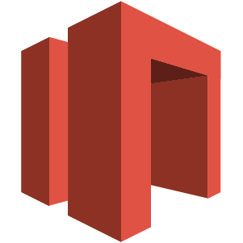
Storage
S3- Amazon Simple Storage Service is object storage with a simple web service interface to store and retrieve any amount of data from anywhere on the web.
EFS - Amazon Elastic File System provides simple, scalable file storage for use with Amazon EC2 instances in the AWS Cloud. With Amazon EFS, storage capacity is elastic, growing and shrinking automatically as files added or removed
Glacier- Amazon Glacier is a secure, durable, and extremely low-cost cloud storage for data archiving and long-term backup.
Storage Gateway - AWS Storage Gateway connects an on-premises software appliance with cloud-based storage to provide seamless integration with data security features between your on-premises IT environment and the Amazon Web Services (AWS) storage infrastructure.

Slide 26

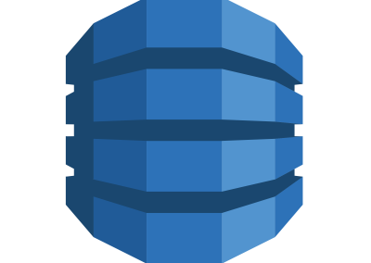

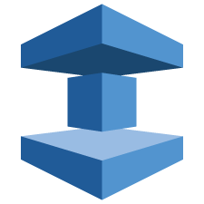
Database
RDS - Amazon Relational Database Service (Amazon RDS) is a web service that makes it easier to set up, operate, and scale a relational database in the cloud. It provides cost-efficient, resizeable capacity for an industry-standard relational database and manages common database administration tasks.
DynamoDB - Amazon DynamoDB is a fast and flexible NoSQL Database service for all applications that need consistent, single-digit millisecond latency at any scale. It is a fully managed cloud database and supports both document and key-value store models.
ElasticCache - ElastiCache is a web service that makes it easier to launch,
manage, and scale a distributed in-memory cache in the cloud.
Redshift - Amazon Redshift is a fast, fully managed, petabyte-scale data warehouse that makes it simple and cost-effective to analyze all your data using your existing business intelligence tools.

Slide 27
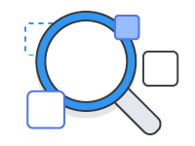

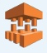
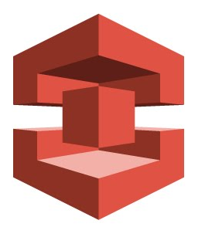
Migration
Application Discovery Service - helps Systems Integrators quickly and reliably plan application migration projects by automatically identifying applications running in on-premises data centers, their associated dependencies, and their performance profile.
DMS - AWS Database Migration Service helps you migrate databases to AWS easily and securely. The source database remains fully operational during the migration, minimizing downtime to applications that rely on the database. The AWS Database Migration Service can migrate your data to and from most widely used commercial and open-source databases.
SMS - AWS Server Migration Service (SMS) is an agentless service which makes it easier and faster for you to migrate thousands of on-premises workloads to AWS.
Snowball is a petabyte-scale data transport solution that uses secure appliances to transfer large amounts of data into and out of the AWS cloud.

Slide 28



Messaging
Simple Queue Service - Amazon Simple Queue Service (SQS) is a fully-managed message queuing service for reliably communicating among distributed software components and microservices - at any scale.
Simple Notification Service - Amazon Simple Notification Service (Amazon SNS) is a fast, flexible, fully managed push notification service that lets you send individual messages or to fan-out messages to large numbers of recipients.
SES - Amazon Simple Email Service (Amazon SES) is a cost-effective email service built on the reliable and scalable infrastructure that Amazon.com developed to serve its own customer base.

Slide 29



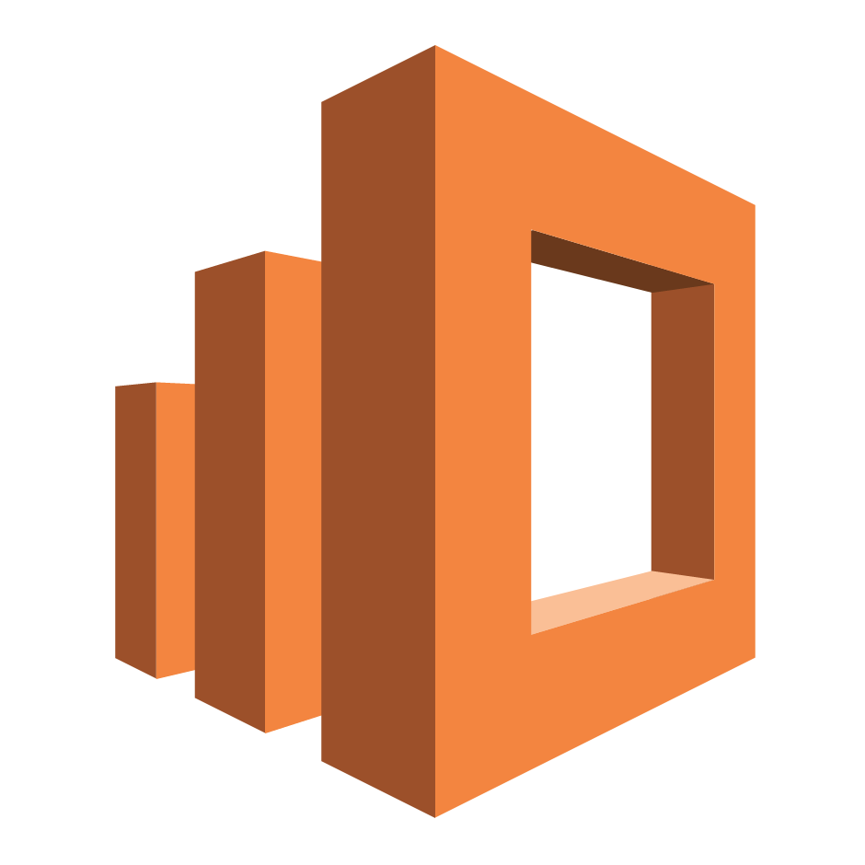



Analytics
Athena - Amazon Athena is an interactive query service that makes it easy to analyze data in Amazon S3 using standard SQL. Athena is serverless, so there is no infrastructure to manage, and you pay only for the queries that you run.
EMR – AWS Elastic Map Reduce provides a managed Hadoop framework that makes it easy, fast, and cost-effective to process vast amounts of data across dynamically scalable Amazon EC2 instances.
CloudSearch - Amazon CloudSearch is a managed service in the AWS Cloud that makes it simple and cost-effective to set up, manage, and scale a search solution for your website or application.
Elasticsearch Service - Amazon Elasticsearch Service makes it easy to deploy, operate, and scale Elasticsearch for log analytics, full text search, application monitoring, and more.
Kinesis - Amazon Kinesis Streams enables you to build custom applications that process or analyze streaming data for specialized needs.
Data Pipeline - AWS Data Pipeline is a web service that helps you reliably process and move data between different AWS compute and storage services, as well as on-premise data sources, at specified intervals.
QuickSight - Amazon QuickSight is a very fast, easy-to-use, cloud-powered business analytics service that makes it easy for all employees within an organization to build visualizations, perform ad-hoc analysis, and quickly get business insights from their data, anytime, on any device.

Slide 30

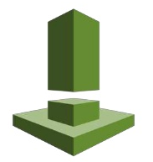




Security, Identity & Compliances
IAM - AWS Identity and Access Management (IAM) is a web service that helps you securely control access to AWS resources for your users.
Inspector - Amazon Inspector is an automated security assessment service that helps improve the security and compliance of applications deployed on AWS. Amazon Inspector automatically assesses applications for vulnerabilities or deviations from best practices.
Certificate Manager - AWS Certificate Manager (ACM) handles the complexity of provisioning, deploying, and managing SSL/TLS certificates for your AWS-based websites and applications.
Directory Service - AWS Directory Service for Microsoft Active Directory (Enterprise Edition), also known as AWS Microsoft AD, enables your directory-aware workloads and AWS resources to use managed Active Directory in the AWS Cloud.
WAF & Shield - AWS WAF is a web application firewall that lets you monitor the HTTP and HTTPS requests that are forwarded to Amazon CloudFront or an Application Load Balancer and lets you control access to your content. AWS Shield and Shield Advanced provides protection against DDoS attack
.
Compliance Report – AWS Compliance Report provides on-demand downloads of AWS security and compliance documents, such as AWS ISO certifications, Payment Card Industry (PCI), and Service Organization Control (SOC) reports.

Slide 31

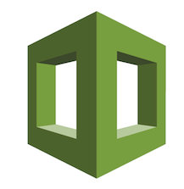
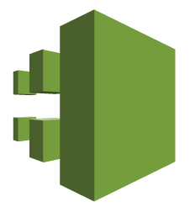
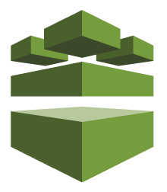


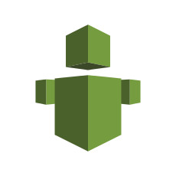
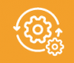
Management Tools
CloudWatch - Amazon CloudWatch is a monitoring service for AWS cloud resources and the applications you run on AWS.
CloudFormation - AWS CloudFormation gives developers and systems administrators an easy way to create and manage a collection of related AWS resources, provisioning and updating them in an orderly and predictable fashion.
CloudTrail - AWS CloudTrail is a service that enables governance, compliance, operational auditing, and risk auditing of your AWS account.
Config - AWS Config is a service that enables you to assess, audit, and evaluate the configurations of your AWS resources.
OpsWorks - AWS OpsWorks is a configuration management service that uses Chef, an automation platform that treats server configurations as code.
Service Catalog - AWS Service Catalog allows organizations to create and manage catalogs of IT services that are approved for use on AWS.
Trusted Advisor - An online resource to help you reduce cost, increase performance, and improve security by optimizing your AWS environment, Trusted Advisor provides real time guidance to help you provision your resources following AWS best practices.
Managed Service - AWS Managed Services provides ongoing management of your AWS infrastructure so you can focus on your applications.

Slide 32




Application Services
Step Functions - AWS Step Functions makes it easy to coordinate the components of distributed applications and microservices using visual workflows.
SWF - Amazon Simple Work Flow helps developers build, run, and scale background jobs that have parallel or sequential steps. You can think of Amazon SWF as a fully-managed state tracker and task coordinator in the Cloud.
API Gateway - Amazon API Gateway is a fully managed service that makes it easy for developers to create, publish, maintain, monitor, and secure APIs at any scale.
Elastic Transcoder - Amazon Elastic Transcoder lets you convert media files that you have stored in Amazon S3 into media files in the formats required by consumer playback devices.

Slide 33


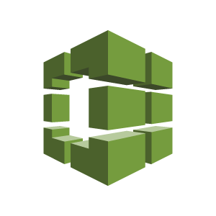

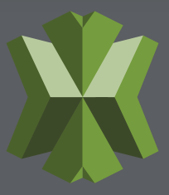
Developer Tools
CodeCommit – AWS CodeCommit is a fully-managed source control service that makes it easy for companies to host secure and highly scalable private Git repositories.
CodePipeline – AWS Code Pipeline is a continuous integration and continuous delivery service for fast and reliable application and infrastructure updates.
CodeBuild - AWS CodeBuild is a fully managed build service that compiles source code, runs tests, and produces software packages that are ready to deploy.
CodeDeploy – AWS CodeDeploy is a service that automates code deployments to any instance, including Amazon EC2 instances and servers running on-premises.
X-Rays – AWS X-Ray makes it easy for developers to analyze the behavior of their distributed applications by providing request tracing, exception collection, and profiling capabilities.

Slide 34




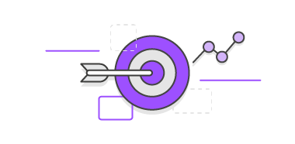
Mobile Services
Mobile Hub - AWS Mobile Hub guides you through feature selection and configuration, automatically provisions the AWS services required, and generates working code that helps you integrate the Mobile SDK with your app in minutes.
Cognito - Amazon Cognito lets you easily add user sign-up and sign-in and manage permissions for your mobile and web apps.
Device Farm – AWS Device Farm is an app testing service that enables you to test and interact with your Android, iOS, and Web apps on real, physical phones and tablets that are hosted by Amazon Web Services (AWS).
Mobile Analytics - AWS Mobile Analytics is a service for collecting, visualizing, and understanding app usage data at scale.
Pinpoint - Amazon Pinpoint is an AWS service that you can use to improve user engagement by reaching out to user segments through push notification campaigns.

Slide 35
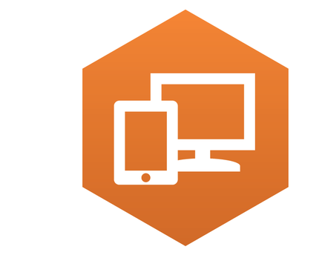
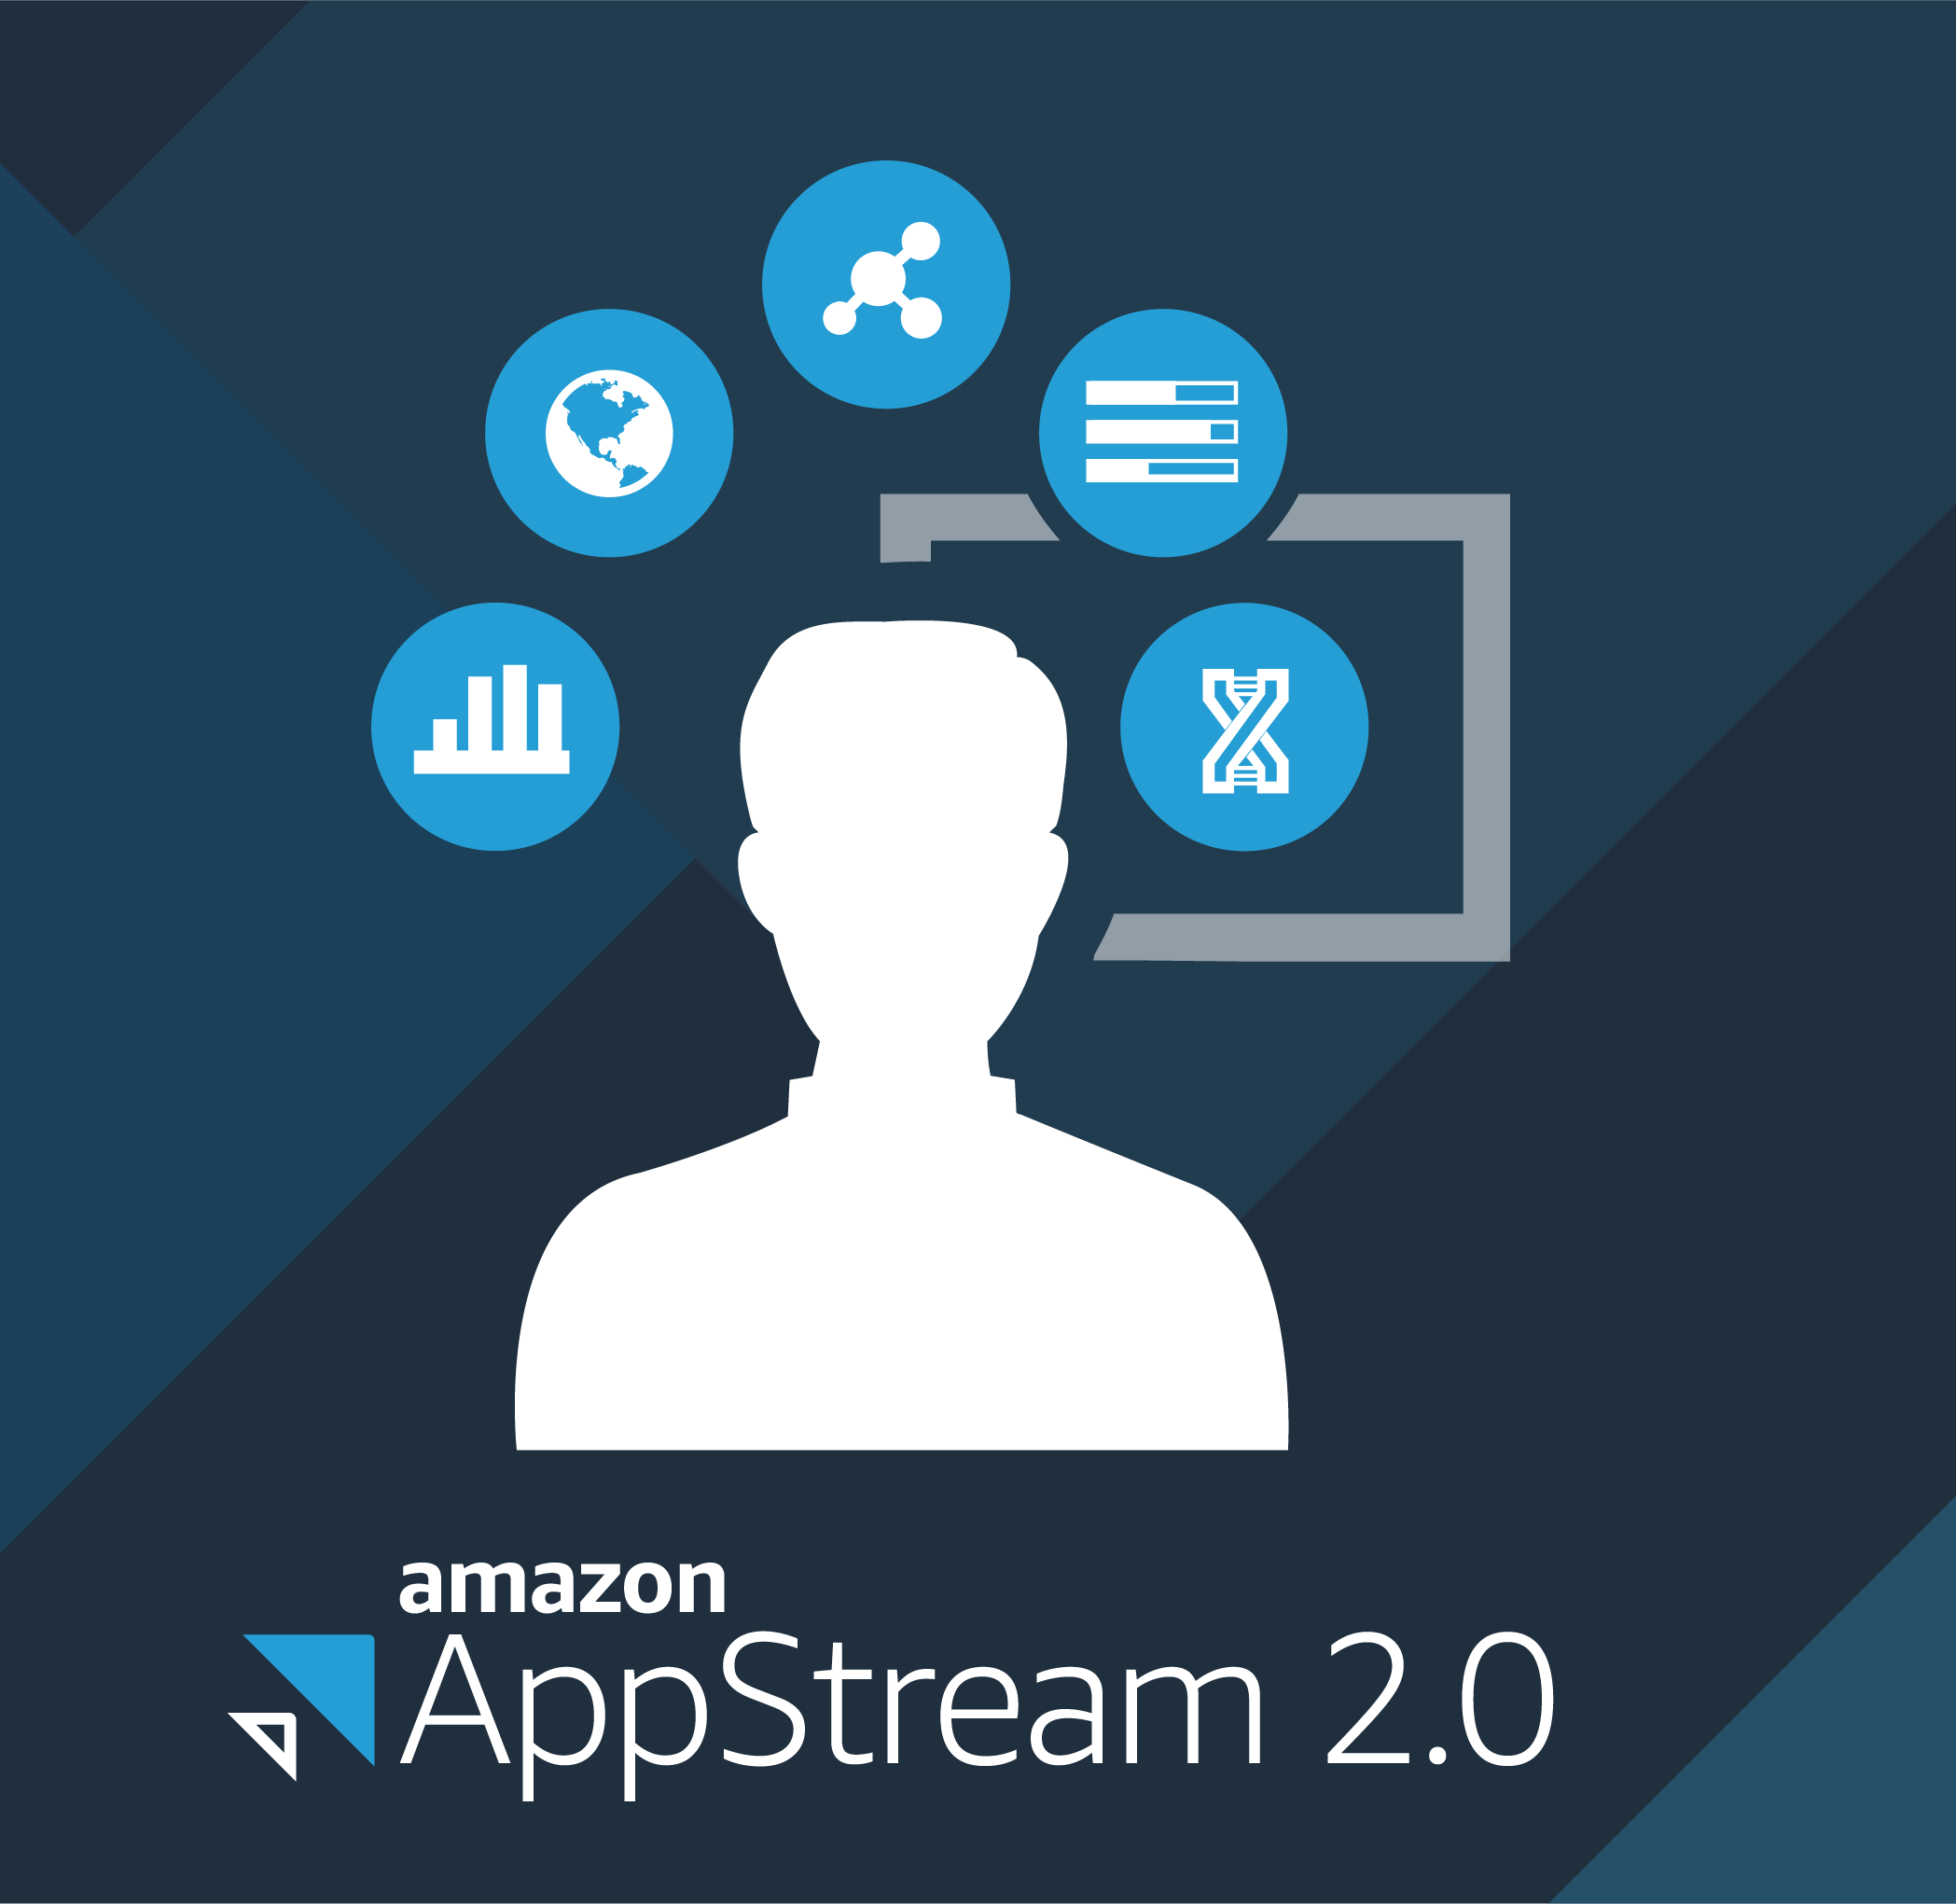

Desktop & App Streaming
WorkSpaces - Amazon WorkSpaces is a fully managed, secure desktop computing service which runs on the AWS cloud. WorkSpaces allows you to easily provision cloud-based virtual desktops and provide your users access to the documents, applications, and resources they need from any supported device.
AppStream 2.0 - Amazon AppStream 2.0 is a fully managed, secure application streaming service that allows you to stream desktop applications from AWS to any device running a web browser, without rewriting them.
Internet of Things
AWS IoT is a managed cloud platform that lets connected devices easily and securely interact with cloud applications and other devices.
AWS Greengrass is software that lets you run local compute, messaging & data caching for connected devices in a secure way.
The AWS IoT Button is a simple wifi enabled programmable button based on the Amazon Dash Button hardware.

Slide 36
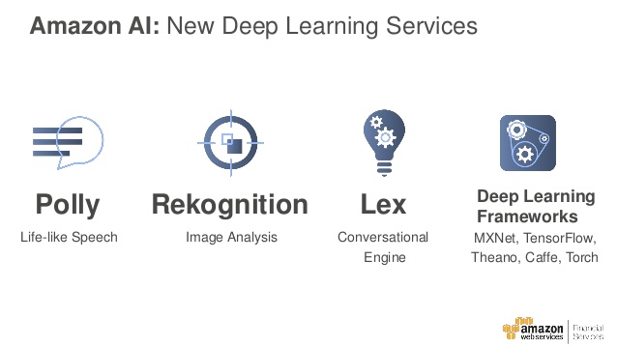
Artificial Intelligence
Lex - Amazon Lex is a service for building conversational interfaces into any application using voice and text. learning functionalities of automatic speech recognition (ASR) for converting speech to text, and natural language understanding (NLU) to recognize the intent of the text, to enable you to build applications with highly engaging user experiences and lifelike conversational interactions. Lex provides the advanced deep
Amazon Machine Learning is a service that makes it easy for developers of all skill levels to use machine learning technology. Amazon Machine Learning provides visualization tools and wizards that guide you through the process of creating machine learning (ML) models without having to learn complex ML algorithms and technology.
Amazon Rekognition is a service that makes it easy to add image analysis to your applications. With Rekognition, you can detect objects, scenes, and faces in images. You can also search and compare faces.
Polly - Amazon Polly is a service that turns text into lifelike speech. Polly lets you create applications that talk, enabling you to build entirely new categories of speech-enabled products.

Slide 37
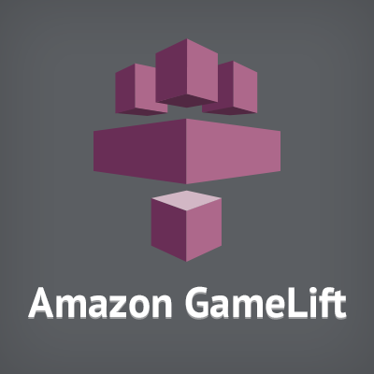
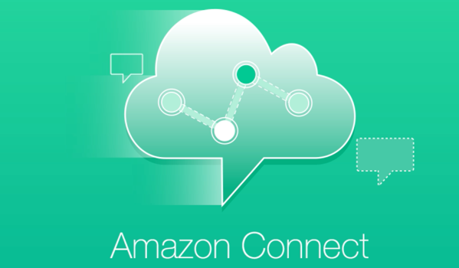
Game Development
Gamelift - Amazon GameLift is a managed service for deploying, operating, and scaling dedicated game servers for session-based multiplayer games.
Contact Center
Connect – Amazon Connect is a self-service, cloud-based contact center service that makes it easy for any business to deliver better customer service at lower cost.

