Slide 1
Amazon Web Services 101

Slide 2
About Me
My Name: Yi Liang Dong
My Job: Senior Solution Architect at BMO
Email: yiliang.dong@gmail.com
Wechat ID: eman_dyl
PPT Download Link:
https://s3.ca-central-1.amazonaws.com/ignis01/awsTraining/aws101.pptx

Slide 3
Class Agenda
Lesson 1: Cloud Computing and AWS Overview
Lesson 2: IAM and S3
Lesson 3: EC2 Part 1
Lesson 4: EC2 Part 2
Lesson 5: AWS Database Services
Lesson 6: VPC
Lesson 7: Route 53 and Application Services
Lesson 8: Put it all together

Slide 4
Lesson 2: IAM and S3

Slide 5
Agenda
IAM Overview
Identity Management 101
Users
Groups
Roles
Temporary Security Credentials
Access Management 101
Permissions
Polices
Lab 1: Set up Users with MFA and Create User, Group, Roles and Permissions
S3 101
Buckets, Folders and Objects
Consistency Model
Cross Region Replication
S3 Security and Encryption
Lifecycle Management and Glacier
Cloud Front CDN
Cloud Front Overview
Create a Cloud Front CDN
Storage Gateway and Snowball
Lab2: Create a static Website with S3

Slide 6
IAM Overview
What is IAM
AWS IAM manages Users and their level of access to AWS console.
IAM essentials
IAM is global
IAM is Completely free
Centralized control of your AWS account
Shared Access to your AWS account
Granular Permissions
Identity Federation (Including Active Directory, Facebook, Linkedin etc)
Multifactor Authentication (MFA)
Provide temporary access for users/devices and services where necessary
Set up password rotation policy
Integrate with many different AWS services
Supports PCI DSS compliance

Slide 7
Identity Management - Users
An IAM user is an entity that you create in AWS to represent the person or service that uses it to interact with AWS
User Identification:
A “friendly name” for the user(Bob or Alex)
An Amazon Resource Name (ARN) – arn:partition:service:region:account:resource
e.g. arn:aws:iam::account-id-without-hyphens:user/Bob (region is always blank)
Unique ID - AIDAJQABLZS4A3QDU576Q
Is not available from Console, can be retrieved via AWS CLI commands or IAM API calls
Credentials
Console password – Password Policy
Access keys
SSH Keys
Server Certificates
Multi-Factor Authentication(MFA)
Hardware Token Device
Virtual MFA Device
SMS

Slide 8
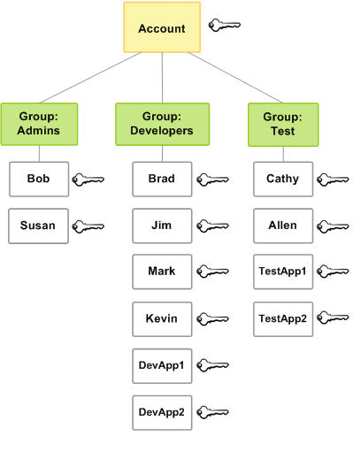
Identity Management - Groups
An IAM group is a collection of IAM users under one set of permissions
A group can contain many users, and a user can belong to many groups
Group cannot be nested, they can only contain users, not other groups
You can attach policy to an IAM group
AWS IAM has predefined groups

Slide 9
Identity Management - Roles
An IAM Role is an AWS identity with permission policies that determine what the identity can and cannot do in AWS
A role do not have any credentials(password or access key)
Can be assigned to an user in your AWS account
Can be assigned to an user in a different AWS account
Can be assigned to an user whose identity is defined outside of AWS (Corporate Active Directory)
Can be assigned to a AWS service to access AWS resources on your behalf

Slide 10
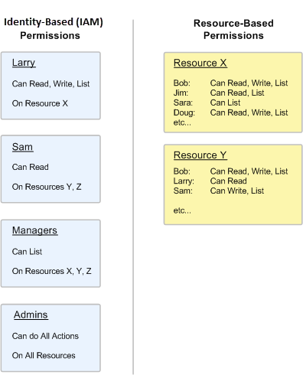
Access Management – Permissions
Permissions let you specify who has access to AWS resources and what actions they can perform on those resources.’
Identity-based or IAM permissions are attached to an IAM user, group, or role and let you specify what that user, group, or role can do
Resource-based permissions are attached to a resource (S3 buckets, Glacier vaults, SNS topics, SQS queues and AWS key management Service), let you specify who has access to the resources and what actions can be performed on.

Slide 11
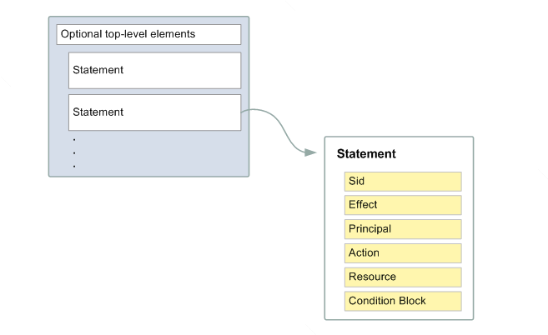
Access Management - Policies
A policy is a document that formally states one or more permissions
Create using JSON format
A policy basically specifies
Action: What action you will allow
Resources: Which resources you allow the action on
Effect : What the effect will be when the user request access (allow or deny)
{
"Version": "2012-10-17",
"Statement": {
"Effect": "Allow",
"Action": "s3:ListBucket",
"Resource": "arn:aws:s3:::example_bucket"
}
}

Slide 12
Identity Federation
You can manage your user identities in an external system outside if AWS and grant users who sign in from those systems access to perform AWS tasks and access AWS resources
Enterprise Identity Federation – authenticate users in a organization’s network and then provide those users access to AWS without creating new AWS identities and entering user name and password
Web Identity Federation – Let users sign in using a well-known third party provider such as Login with Amazon, Facebook, Google or any OpenID Connect 2.0 compatible provider and exchange for temporary permissions to use resources in AWS

Slide 13
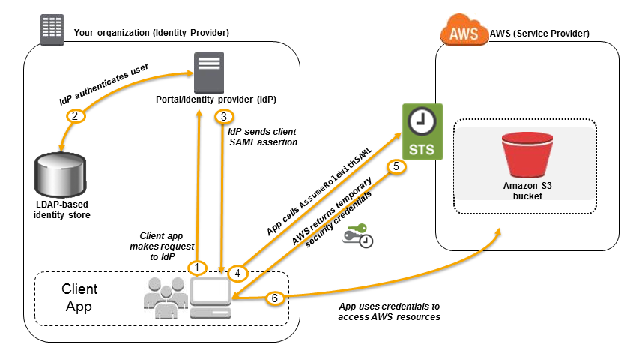
Identity Federation
Enterprise Identity Federation

Slide 14
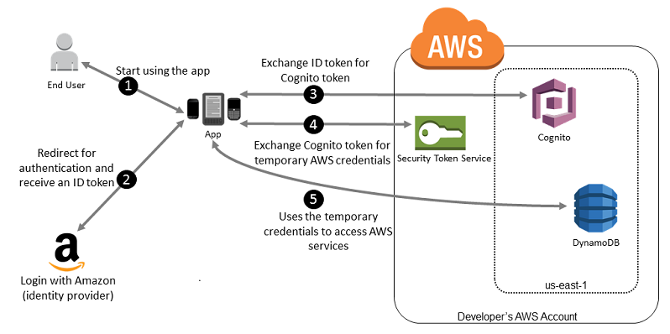
Identity Federation
Web Identity Federation

Slide 15
Lab 1: Set Up MFA and Create Users, Groups, Roles and Permissions

