Slide 1
Amazon Web Services 101

Slide 2
Cloud Computing Characteristics
On-demand self-service.
A consumer can unilaterally provision computing capabilities, such as server time and network storage, as needed automatically without requiring human interaction with each service provider.

Slide 3
What is Cloud Computing
Cloud computing is a model for enabling ubiquitous, convenient, on-demand network access to a shared pool of configurable computing resources (e.g., networks, servers, storage, applications, and services) that can be rapidly provisioned and released with minimal management effort or service provider interaction.
-National Institute of Standards and Technology

Slide 4
Cloud Computing Characteristics
Broad network access.
Capabilities are available over the network and accessed through standard mechanisms that promote use by heterogeneous thin or thick client platforms (e.g., mobile phones, tablets, laptops, and workstations).

Slide 5
Cloud Computing Characteristics
Resource pooling.
The provider’s computing resources are pooled to serve multiple consumers using a multi-tenant model, with different physical and virtual resources dynamically assigned and reassigned according to consumer demand. There is a sense of location independence in that the customer generally has no control or knowledge over the exact location of the provided resources but may be able to specify location at a higher level of abstraction (e.g., country, state, or datacenter). Examples of resources include storage, processing, memory, and network bandwidth.

Slide 6
Cloud Computing Characteristics
Rapid elasticity.
Capabilities can be elastically provisioned and released, in some cases automatically, to scale rapidly outward and inward commensurate with demand. To the consumer, the capabilities available for provisioning often appear to be unlimited and can be appropriated in any quantity at any time.

Slide 7
Cloud Computing Characteristics
Measured service.
Cloud systems automatically control and optimize resource use by leveraging a metering capability1 at some level of abstraction appropriate to the type of service (e.g., storage, processing, bandwidth, and active user accounts). Resource usage can be monitored, controlled, and reported, providing transparency for both the provider and consumer of the utilized service

Slide 8
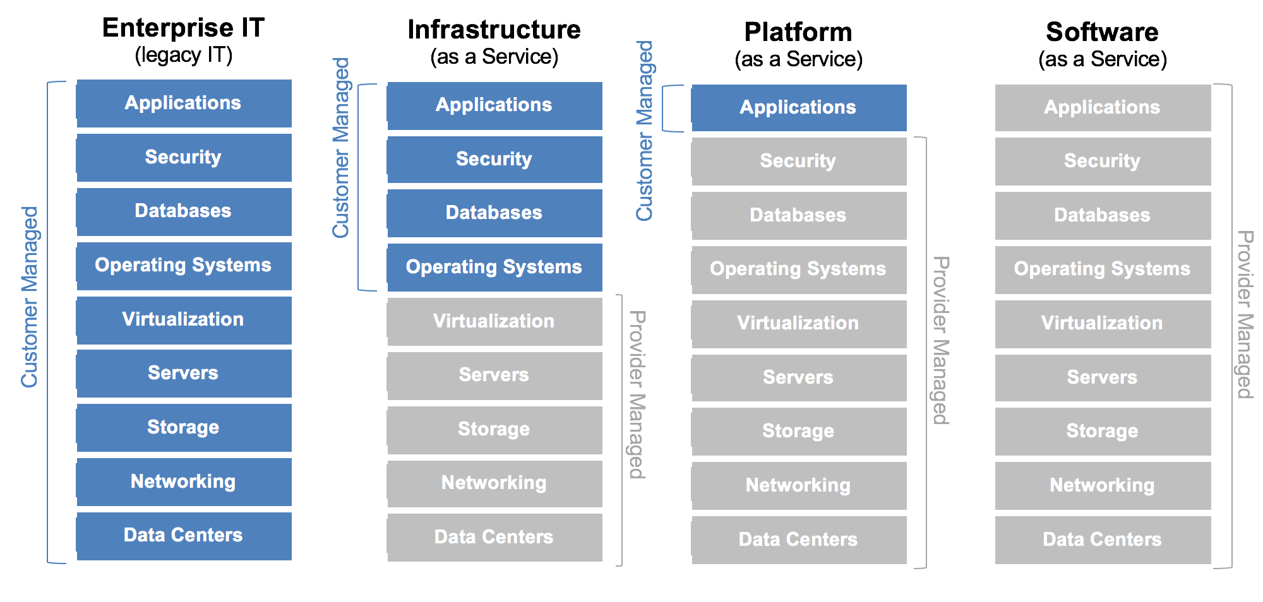
Cloud Computing Models

Slide 9
Cloud Computing Models
Infrastructure as a Service (IaaS).
The capability provided to the consumer is to provision processing, storage, networks, and other fundamental computing resources where the consumer is able to deploy and run arbitrary software, which can include operating systems and applications. The consumer does not manage or control the underlying cloud infrastructure but has control over operating systems, storage, and deployed applications; and possibly limited control of select networking components (e.g., host firewalls).

Slide 10
Cloud Computing Models
Platform as a Service (PaaS).
The capability provided to the consumer is to deploy onto the cloud infrastructure consumer-created or acquired applications created using programming languages, libraries, services, and tools supported by the provider. The consumer does not manage or control the underlying cloud infrastructure including network, servers, operating systems, or storage, but has control over the deployed applications and possibly configuration settings for the application-hosting environment.

Slide 11
Cloud Computing Models
Software as a Service (SaaS).
The capability provided to the consumer is to use the provider’s applications running on a cloud infrastructure. The applications are accessible from various client devices through either a thin client interface, such as a web browser (e.g., web-based email), or a program interface. The consumer does not manage or control the underlying cloud infrastructure including network, servers, operating systems, storage, or even individual application capabilities, with the possible exception of limited user specific application configuration settings.

Slide 12
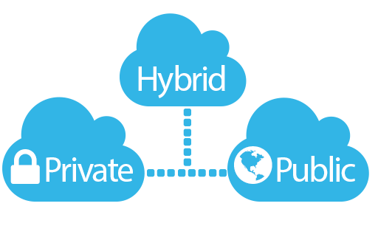
Cloud Deployment Model
Private cloud.
The cloud infrastructure is provisioned for exclusive use by a single organization comprising multiple consumers (e.g., business units). It may be owned, managed, and operated by the organization, a third party, or some combination of them, and it may exist on or off premises.

Slide 13
Cloud Deployment Model
Public cloud.
The cloud infrastructure is provisioned for open use by the general public. It may be owned, managed, and operated by a business, academic, or government organization, or some combination of them. It exists on the premises of the cloud provider

Slide 14
Cloud Deployment Model
Hybrid cloud.
The cloud infrastructure is a composition of two or more distinct cloud infrastructures (private, community, or public) that remain unique entities, but are bound together by standardized or proprietary technology that enables data and application portability (e.g., cloud bursting for load balancing between clouds).

Slide 15
A Brief History of Amazon Web Services
Started late 2003, Chris Pinkham and Benjamin Black presented the idea of selling Amazon’s internal standardized computing infrastructure as service to the external wold.
November 2004, Simple Queue Service (SQS) launched as first Amazon Web Service
2006, AWS officially launched
2007, 180,000 developers on board on the platform
2010, all amazon.com moved over to AWS
2012, first Re-Invent conference at Las Vegas
2013, AWS Certification launched
2015, AWS became profitable, generate $6B USD revenue per annum and 90% growth rate year over year
2016 $13B USD revenue
2016, Cisco, IBM, HP Enterprise, Dell EMC, Oracle, VMWare generated over $206B revenue, $15B reduction from 2012(3% shrinkage year over year)
Dec. 2016 AWS Canada opened first Canada Availability Center in Montreal

Slide 16
AWS Growth
82

Slide 17
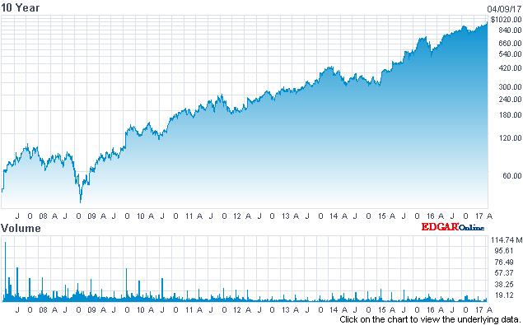
AWS Growth

Slide 18
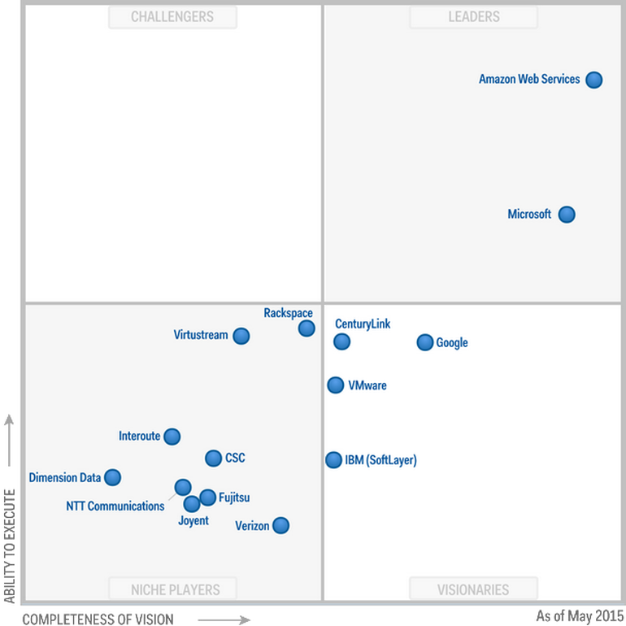
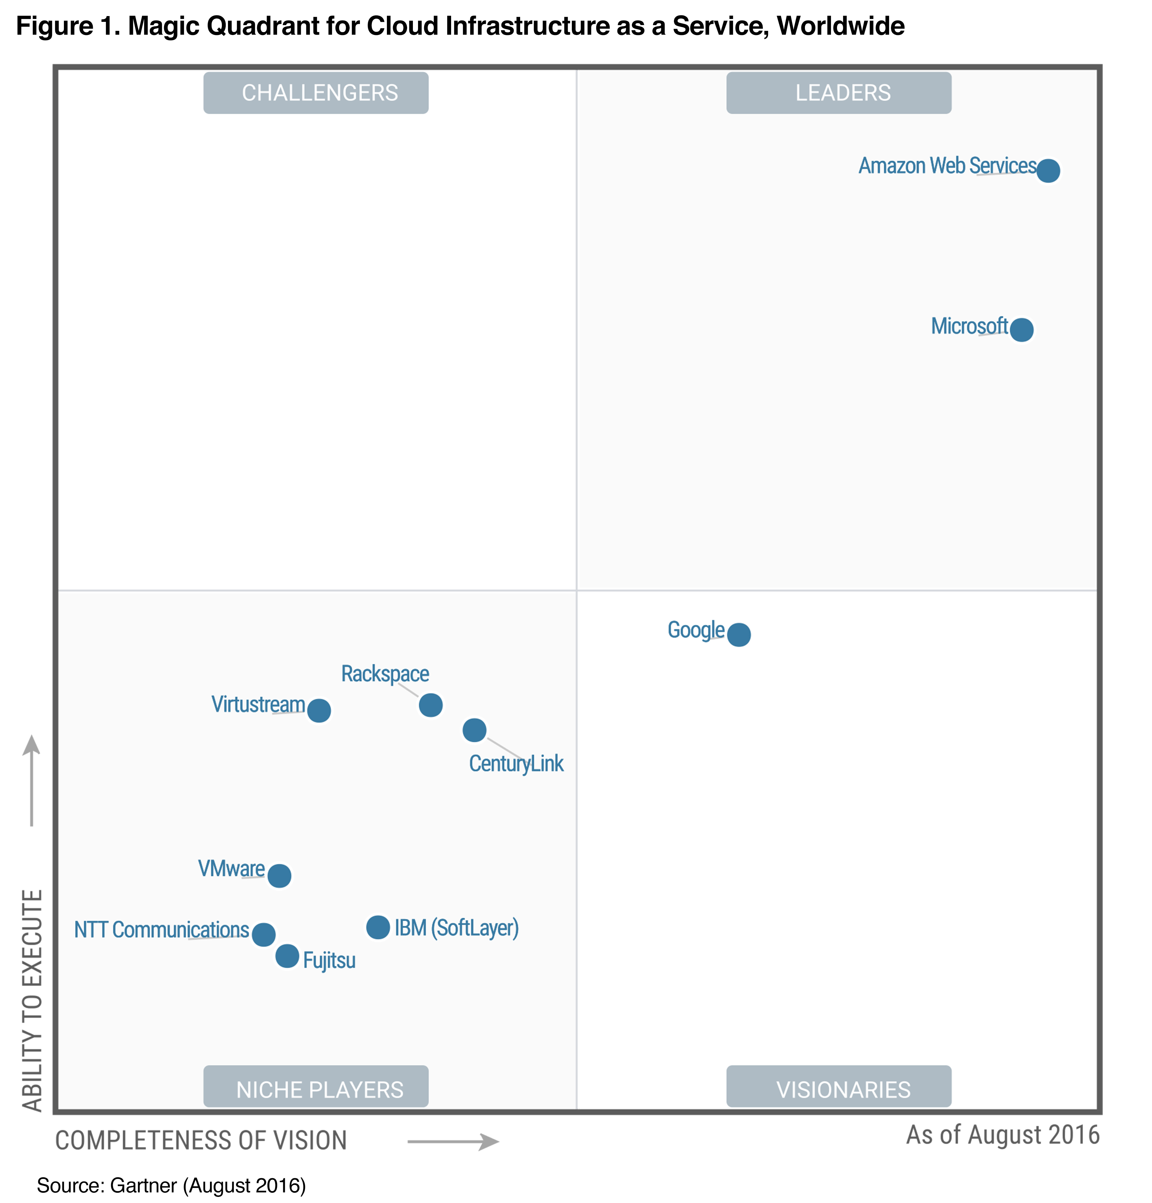
AWS Leadership
Gartner’s Magic Quadrant: Cloud Infrastructure As Service

Slide 19

Break for 15 minute

Slide 20
The AWS Platform
Game Development
Artificial Intelligence
Contact Center
Business Productivity
Internet Of Things
Desktop & App Streaming
Application Services
Developer Tools
Mobile Services
Analytics
Security & Identity
Management Tools
Database
Migration
Messaging
Compute
Storage
Networking & Content Delivery
AWS Global Infrastructure

Slide 21
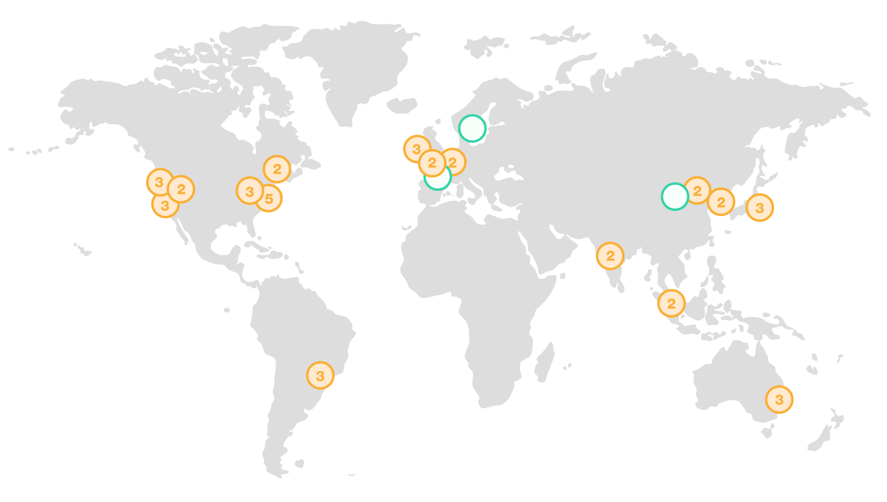
AWS Global Infrastructure
16 Regions
42 Availability Zones
3 More Regions to come
7 More Availability Zones to come

Slide 22
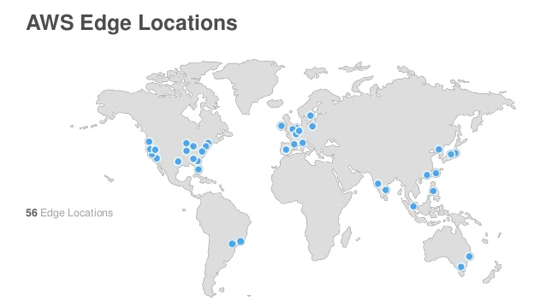
AWS Global Infrastructure
A Region is a physical location in the world where we have multiple Availability Zones.
Availability Zones(AZ) consist of one or more discrete data centers, each with redundant power, networking and connectivity, housed in separate facilities
Edge Location are Content Delivery Network End Points for CloudFront (Cache static content such as images and media files), currently there are over 66 edge locations
Region
AZ-1
AZ-2
AZ-3

Slide 23
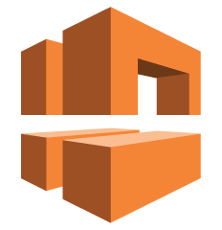

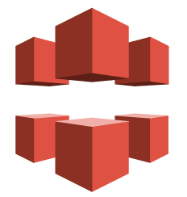

Networking & Content Delivery
VPC – Virtual Private Cloud enables you to launch AWS resources into a virtual network closely resembles a traditional network in a data center
Route 53 – AWS DNS Service (53 is the DNS port) is designed to provide a reliable and cost effective way to route end users to Internet applications by translating domain names like www.example.com into the IP addresses like 192.0.2.1.
Cloud Front – AWS global content delivery network (CDN) service that accelerates delivery of your websites, APIs, video content or other web assets.
Direct Connect - AWS Direct Connect makes it easy to establish a dedicated network connection from your premises to AWS.

Slide 24

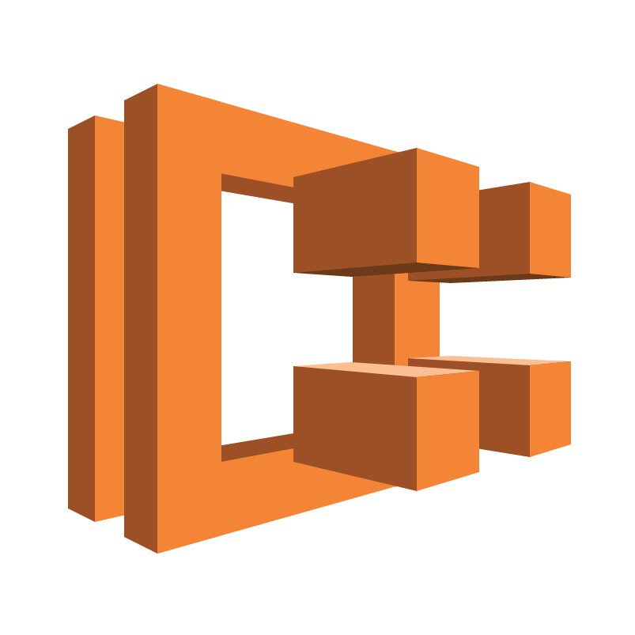


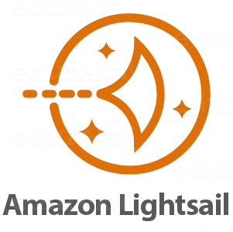
Compute
EC2 – Elastic Compute Cloud is a web service that provides scalable computing capacity in the AWS cloud. EC2 instances are virtual servers you can launch, configure, manage and scale in cloud on demand
ECS- EC2 Container Service is a highly scalable, high performance container management service that supports Docker containers and allows you to easily run applications on a managed cluster of Amazon EC2 instances
Elastic Beanstalk – Elastic Beanstalk automatically handles the complexity of AWS infrastructure setup so a developer simply uploads his/her application and runs it
Lambda
Lightsail

