Slide 1
ACADEMIC PROGRESSION & BACKLOG MANAGEMENT PLATFORM
BackTrack
Student backlog tracking, ordinance compliance, automated clearance and digital certificates in one place
Solo Project Developer | Academic Major Project | Python & React Full-Stack
Log Backlog
Meet Mentor
Remedial Tasks
Repeat Exam
Certified Clear

Slide 2
Problem Statement
2
Challenges in Legacy University Systems
• Backlog records are scattered across paper slips, departmental registers, and notice boards
• Manual calculation of CBCS promotion rules causes errors in detecting detained students
• Clearing an arrear requires weeks of physical sign-offs between teachers, HODs, and exam cell
• Faculty mentors discover academic arrears too late, missing the window for remedial guidance
Our Solution: BackTrack
BackTrack unifies backlog registration, CBCS ordinance verification, faculty mentorship tracking, repeat exam processing, and tamper-proof PDF certification into one secure, responsive platform.
Many Registers
One Platform
Faster Clearances
Think about it: how do you audit 500 backlog cases by hand across 8 departments without errors?

Slide 3
About BackTrack
3
1 For Students
Inspect active backlogs, monitor CGPA impact, apply for re-examinations, track multi-stage progress, and download official clearance certificates.
2 For Faculty Advisors
Monitor enrolled students with backlogs, evaluate remedial assignments, conduct guidance sessions, and submit improved internal scores.
3 Admin & Exam Cell
Central command center for auditing clearance applications, enforcing CBCS promotion rules, and exporting official university clearance gazettes.
4 Real-Time Notifications
In-app alerts and activity tracking ensure students, faculty, and administrators remain aligned throughout the clearance workflow.
Result: an end-to-end institutional solution for tracking and resolving student academic backlogs

Slide 4
Key Features of BackTrack
4
1 Centralized Backlog Registry
Single source of truth tracking active, pending, and cleared backlog papers across semesters and academic sessions.
2 Multi-Role RBAC Portals
Secure, role-based dashboards tailored specifically for Students, Faculty Evaluators, and Examination Administrators.
3 Automated PDF Certificates
Instant generation of official, university-formatted Backlog Clearance Certificates using Python's ReportLab engine.
4 CBCS Ordinance Rule Engine
Python business logic automatically checks maximum active backlogs, prerequisite dependencies, and grace mark allocations.
Core academic resolution workflow, from failure detection to certified clearance

Slide 5
Key Features of BackTrack
5
5 5-Stage Resolution Funnel
Tracks backlog status: 1. Logged -> 2. Faculty Consult -> 3. Remedial Tasks -> 4. Repeat Exam -> 5. Officially Cleared.
6 Responsive Multi-Tier Design
Frontend built with React 19, TailwindCSS, and Lucide icons; backend powered by high-throughput FastAPI and SQLAlchemy.
7 Gazette CSV / Excel Export
Uses Python Pandas to generate tabular university clearance ledgers and examination manifests for institutional controllers.
8 Interactive OpenAPI Swagger
Fully documented REST endpoints with live testing harness, schema definitions, and automated Pydantic data validation.
Communication, compliance, and academic recovery in one system

Slide 6
Feature Completion Status
6
01 · Completed ✓
Auth & RBAC System
02 · Completed ✓
Student Portal & Arrears
03 · Completed ✓
Backlog Stepper Pipeline
04 · Completed ✓
Academic Rule Engine
05 · Completed ✓
Grace Mark Allocation
06 · Completed ✓
Faculty Mentorship Desk
07 · Completed ✓
Remedial Verification
08 · Completed ✓
ReportLab PDF Engine
09 · Completed ✓
Admin Master Audit Queue
10 · Completed ✓
Gazette Data Export
11 · Completed ✓
Real-Time Notifications
12 · Completed ✓
SQLite Relational DB
All 12 planned institutional features are fully implemented and verified

Slide 7
Python in BackTrack: Core Architecture
7
FastAPI REST Gateway
Pydantic Schemas
Python Services Layer
SQLAlchemy ORM
SQLite Database
Implementation Modern Python 3.12 Backend
Uses asynchronous I/O, strict type hinting, and dependency injection to guarantee rapid execution and zero runtime type mismatch.
Backend Design Modular Service Architecture
Located in backend/app/, decoupling API routing (api/v1/), business services (services/), and data models (models/).
Data & Analytics Pandas Tabular Processing
Integrates pandas for data wrangling, multi-table joins, and instantaneous clearance gazette generation.
Document Synthesis Binary PDF Streaming
Leverages reportlab to generate formal A4 clearance certificates directly in memory without browser dependencies.
Python powers the core intelligence, business rules, and security of BackTrack

Slide 8
Python Feature 1: FastAPI REST Framework
8
HTTP Request
Uvicorn ASGI Loop
FastAPI Router
Pydantic Validation
JSON / PDF Stream
High Throughput Asynchronous Event Loop
FastAPI on Uvicorn handles concurrent requests asynchronously, delivering sub-15ms response times on local environments.
API Namespace Clean V1 REST Routing
Mounted in backend/main.py via app.include_router(api_v1_router), organizing routes across /auth, /backlogs, /students, and /faculty.
Automated Docs Interactive Swagger & OpenAPI
FastAPI automatically exposes complete interactive Swagger UI at /docs and ReDoc at /redoc with schema definitions.
Data Validation Pydantic Type Enforcement
Incoming JSON payloads are strictly validated against Pydantic models (schemas/backlog.py), preventing bad database writes.
FastAPI provides enterprise-grade asynchronous throughput with zero boilerplate

Slide 9
Python Feature 2: Academic Rule Engine
9
Marks Input
AcademicRuleEngine
CBCS Ordinances
Detention Check
Academic Standing
Detention Logic Year-Back Ceiling Enforcement
Codified in app/services/rule_engine.py. Automatically marks standing as 'Detained (Year Back)' if active arrears exceed 4 backlogs.
Grace Marks Borderline Failure Evaluation
Algorithmically evaluates borderline cases (within 3 marks of passing, max 5 per term), awarding grace marks according to university statutes.
Prerequisite Trees Curriculum Dependency Checks
Ensures students clear foundational courses (e.g., Programming in C) before enrolling in advanced subsequent subjects (Data Structures).
UGC CBCS Rules SGPA & CGPA Computation
Implements Choice Based Credit System grade calculations, converting numeric marks into letter grades and credit point sums.
Automated university ordinance compliance with zero manual calculation errors

Slide 10
Python Feature 3: Programmatic PDF Synthesis
10
Clearance Approval
ReportLab Canvas
In-Memory BytesIO
Security Stamp
Binary PDF Stream
ReportLab Engine Native Canvas Generation
Built in app/services/certificate_service.py using reportlab.pdfgen.canvas. Direct vector drawing ensures crisp printing at 300+ DPI.
Official Layout Institutional Exam Stationery
Draws formal slate double borders, university header, candidate USN, course title, cleared subject codes, and exam date.
Zero Disk Overhead In-Memory Stream Buffer
PDFs are compiled into an io.BytesIO stream and served via FastAPI's StreamingResponse with application/pdf MIME type.
Verification Digest Cryptographic Authenticity
Embeds automated serial numbers and verification timestamps, allowing external third parties to verify certificate validity.
Instant, programmatic PDF generation matching official university examination stationery

Slide 11
Python Feature 4: Tabular Analytics & Gazette
11
Relational Records
Pandas DataFrame
Cohort Analytics
Funnel Metrics
Master CSV Gazette
Pandas Export University Clearance Gazette
In app/services/export_service.py, executes multi-table relational joins across Students, Backlogs, and Subjects to export master CSV ledgers.
Resolution Funnel Conversion Analytics
In analytics_service.py, tracks drop-offs across: Logged -> Met Advisor -> Assignments Done -> Repeat Exam -> Clearance Certified.
Cohort Segmentation Academic Risk Tracking
Classifies student populations into Regular, At-Risk, and Backlog Candidates to help institutional deans allocate coaching resources.
Department Trends Failure Density Metrics
Computes pass-rate recovery velocity and identifies subject bottlenecks with abnormally high semester failure rates.
Enterprise data wrangling and gazette generation replacing hours of manual paperwork

Slide 12
Architecture Model
12
React 19 Frontend
FastAPI REST Gateway
Python Business Logic
SQLAlchemy ORM
SQLite Database
Presentation Tier React 19 Single Page App
Interactive dashboards, Tailwind CSS glassmorphism, Recharts visualization, and real-time state synchronization via backlogStore.js.
Gateway Tier FastAPI & Uvicorn ASGI
Exposes /api/v1/ REST routes, enforces CORS headers, validates request bodies, and signs JWT tokens.
Business Logic Tier Python Services & Engine
Houses AcademicRuleEngine, ReportLab certificate synthesis, Pandas gazette exports, and audit logging services.
Data Persistence Tier SQLite with SQLAlchemy 2.0
Eleven normalized relational tables with foreign keys, indexes, and transactional commits ensuring ACID compliance.
Robust 4-tier decoupled architecture separating presentation, logic, and data

Slide 13
Vision and Objectives
13
1 One Platform
Centralize backlog tracking across all university departments into a single source of truth.
2 Automated Clearances
Streamline the progression from backlog filing to verified certificate issuance.
3 Ordinance Compliance
Enforce CBCS credit policies, detention ceilings, and grace mark rules automatically.
4 Proactive Mentorship
Connect at-risk students with faculty mentors for structured remedial guidance.
5 Digital Certificates
Issue tamper-evident PDF clearance certificates immediately upon admin approval.
6 Zero Paperwork Lag
Eliminate physical paper slips and signatures between student, faculty, and exam cell.
Goal: replace manual paper clearance slips with an automated digital workflow

Slide 14
Target Audience
14
Students with Arrears
View active backlogs, CGPA impact, apply for re-exams, and download certificates.
Academic Mentors
Review student cohorts, verify remedial assignments, and submit improved internal marks.
Department HODs
Analyze failure bottlenecks and assign faculty advisors for targeted remedial coaching.
Examination Controllers
Audit clearance requests, verify exam eligibility, and issue official sign-offs.
University Deans
Access institutional KPIs, pass-rate trends, and departmental recovery statistics.
Academic Audit Cells
Export university-wide clearance gazettes for board of examination compliance.
Built for university students, faculty advisors, and institutional exam controllers

Slide 15
Comparison with Existing Systems
15
Traditional Notice Boards
• Relies on physical notice boards and paper clearance slips
• Records frequently misplaced between departments
• Manual calculation of CBCS rules causes promotion errors
• Students lack real-time visibility into their clearance progress
Generic Campus ERPs
• Designed for general fee collection and attendance
• Lack specialized backlog resolution funnel pipelines
• No codified rule engine for grace marks or detention
• Rigid architectures with steep learning curves
BackTrack Platform
• Specialized 5-stage academic resolution workflow
• Python rule engine enforces university ordinances
• Generates programmatic PDF clearance certificates
• Role-based portals for Students, Faculty, and Admin
The gap: generic ERPs track enrollment; BackTrack actively drives backlog resolution

Slide 16
Technology Stack & Setup
16
React 19 + Vite
TailwindCSS
FastAPI + Uvicorn
SQLAlchemy + SQLite
Frontend Stack Modern Reactive SPA
React 19, Vite bundler, Tailwind CSS for clean layout, Lucide React icons, and Recharts for interactive analytics.
Backend Stack High-Performance Python
Python 3.12, FastAPI, Uvicorn ASGI server, Pydantic data validation, PyJWT, and bcrypt security.
Data & Documents Persistence & PDF Engine
SQLite 3 with SQLAlchemy 2.0 ORM; ReportLab for instant binary PDF clearance certificate synthesis.
Testing & QA Comprehensive Verification
Unit tested rule engine boundaries, verified REST HTTP status codes, and validated responsive UI layouts.
Modern, responsive and interactive from client browser to relational backend

Slide 17
Hardware & Software Requirements
17
Hardware Specifications
• Processor: Dual-Core 2.0 GHz (Min) / Quad-Core i5/Ryzen 5 (Rec)
• RAM: 4 GB DDR4 (Min) / 8 GB or 16 GB (Recommended)
• Storage: 2 GB free disk space (10 GB NVMe SSD recommended)
• Display: 1280x720 HD (1920x1080 Full HD recommended)
• Network: Standard Ethernet or 2.4/5 GHz Wi-Fi
Software Environment
• Operating System: Windows 10/11, macOS, or Ubuntu Linux 22.04+
• Python Runtime: Python 3.10.x to 3.12.x (64-bit)
• Node.js Environment: Node.js v18.x or v20.x (LTS) & npm 10+
• Database Engine: SQLite 3.x (PostgreSQL ready)
• Web Browser: Google Chrome 110+, Firefox 110+, Microsoft Edge
Lightweight and cross-platform, runnable on standard laptops or cloud instances

Slide 18
Project Timeline & Execution
18
STEP 1 Requirement Analysis
• Identify backlog issues
• Study CBCS ordinances
• Define student/faculty roles
• Draft database schema
STEP 2 Frontend Development
• Landing page UI
• Student & Faculty desks
• Admin command center
• Responsive layout
STEP 3 Backend & Database
• FastAPI REST routes
• SQLAlchemy models
• JWT auth & bcrypt
• SQLite persistence
STEP 4 Rule Engine & PDF
• CBCS detention logic
• Grace marks algorithm
• ReportLab PDF engine
• Gazette CSV export
STEP 5 Testing & Deploy
• Rule boundary tests
• API endpoint testing
• Live screenshots
• Project documentation
From requirement analysis to full-stack verified deployment

Slide 19
Task Completion Status
19
Project Deliverables & Milestones
• Phase 1: Authentication & Role-Based Access Control — [✓ Completed 100%]
Secure JWT authentication with salted bcrypt password hashing and dedicated portals.
• Phase 2: Python Academic Rule Engine (CBCS Ordinances) — [✓ Completed 100%]
Automated 4-backlog detention calculation, grace mark awards, and prerequisite checks.
• Phase 3: ReportLab PDF Certificate & Gazette Export — [✓ Completed 100%]
Programmatic generation of A4 clearance certificates and pandas-powered CSV ledgers.
• Phase 4: Responsive UI & 5-Stage Resolution Stepper — [✓ Completed 100%]
End-to-end integration across Student, Faculty, and Admin interfaces with real-time feedback.
All 4 core development milestones are 100% complete and verified

Slide 20
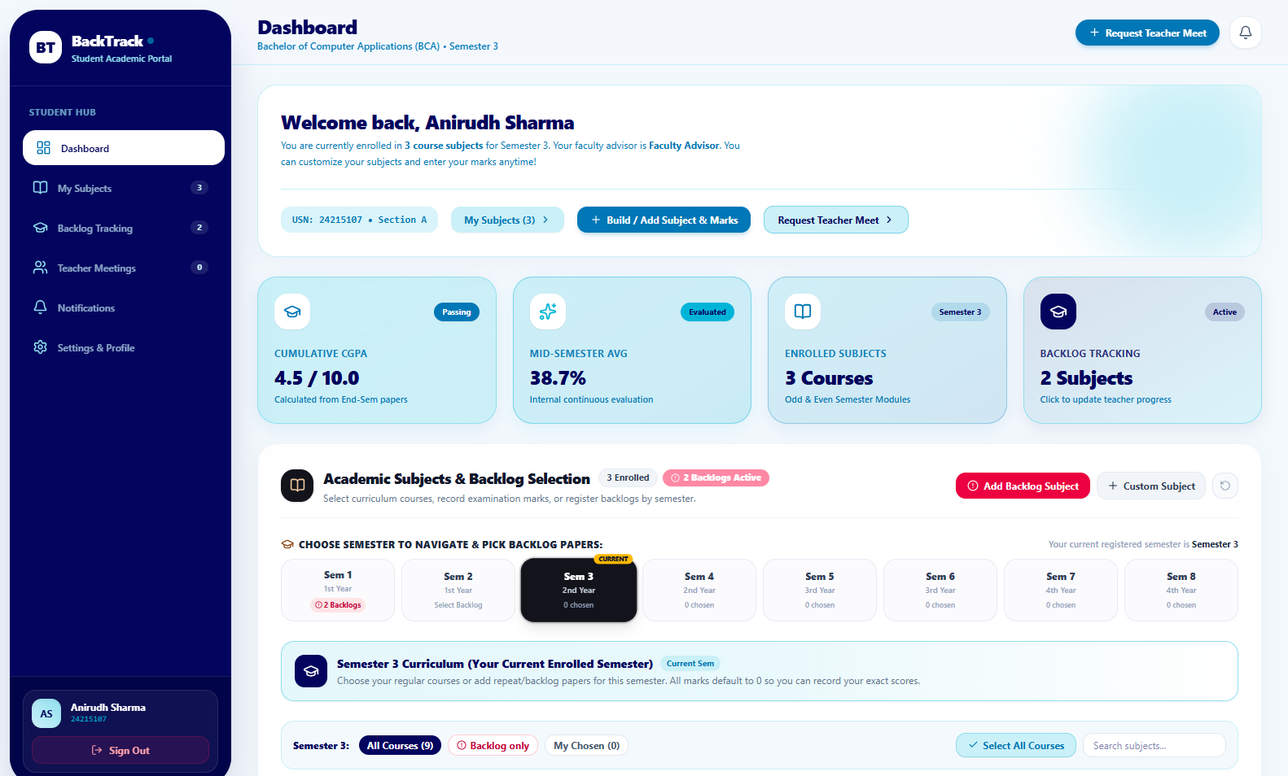
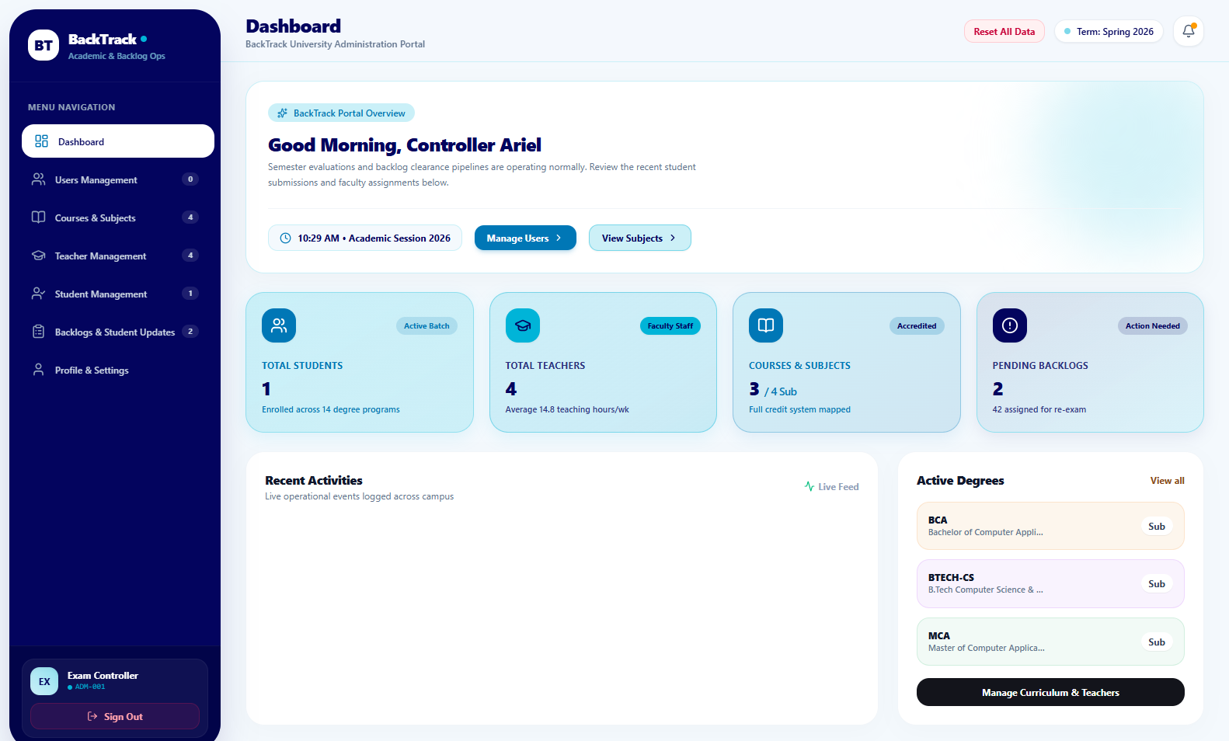
Live Application Screenshots
20
Student Portal: Active arrears tracker, CGPA, and course picker
Admin Portal: Academic session KPIs, enrolled degrees, and audit queue
Live screenshots captured directly from the running BackTrack application

Slide 21
Future Scope & Enhancements
21
1 Machine Learning Early-Warning Model
Integrate scikit-learn models to forecast student detention risks weeks before semester examinations, enabling timely remedial intervention.
2 National Academic Depository (NAD)
Direct API sync with India's Academic Bank of Credits (ABC) / DigiLocker to push cleared credits directly into national databases.
3 Cross-Platform Mobile Application
Develop companion React Native / Flutter apps for iOS and Android to send push notifications regarding repeat exams and clearance approvals.
4 Blockchain-Anchored Credentials
Issue cryptographic certificate hashes on an immutable distributed ledger for instant, tamper-proof verification by employers.
Extensible roadmap designed for institutional scaling and national ERP integration

Slide 22
CONCLUSION
Thank You
BackTrack delivers all 12 planned academic features, automates CBCS ordinance compliance, and replaces disconnected paper slips with a unified Python-powered digital platform.
Students
Faculty Mentorship
Exam Controller
Questions?

