Slide 1
Loot boxes in video games and their link to problem gaming
Jakub Bordáš

Slide 2
AGENDA
Introduction​
Problem statement
Results
Conclusion

Slide 3
Introduction
Loot boxes in video games and their link to problem gaming
A loot box is a catch-all term for a digital container of randomised rewards. They are implemented in most free-to-play games and sometimes in pay-to-play games because of their high revenue. They share significant psychological and structural similarities with gambling and are available to teens younger than 18. This raises the question of whether they should be regulated as regular gambling or banned entirely.

Slide 4
PROBLEM STATEMENT

Slide 5
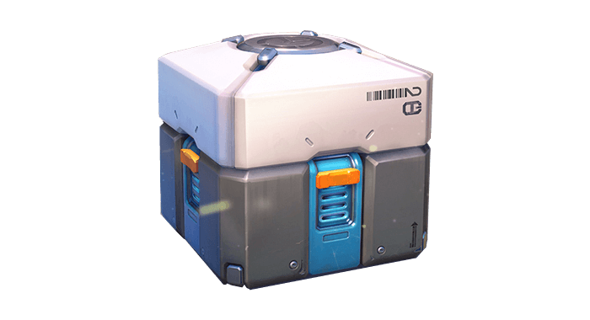
WHAT ARE LOOT BOXES
Loot boxes in video games and their link to problem gaming
Loot boxes are virtual containers in video games that contain one or more random rewards that alter the game in some way. Some can change avatar aesthetics, unlock new levels or improve in-game performance (e.g. via more powerful weapons or sets of armour). Possessing a unique avatar or powerful weapons is highly desirable.
They are available for players to buy in popular games like Rocket League, Counter-Strike: Global Offensive, and League of Legends. Even more and more games tend to sell these loot boxes for real-world currency. In 2018 alone, they generated approximately $30 billion. This strategy has become a leading business model for generating profit from video games.

Slide 6
CHART OF TOP PLAYED GAMES
Loot boxes in video games and their link to problem gaming
Game | Contains loot boxes | Cosmetic rewards | Gameplay advantage rewards | Player base
Counter-Strike: Global Offensive | Yes | Yes | No | 600 thousand daily average
League of Legends | Yes | Yes | No | 2 million daily average
PUBG: Battlegrounds | Yes | Yes | No | 350 thousand daily average
Dota 2 | Yes | Yes | No | 700 thousand daily average
Diablo Immortal | Yes | Yes | Yes | 100 thousand daily average

Slide 7

LOOT BOXES IN OVERWATCH 1

Slide 8
I think the mechanism is so close to gambling, when we talk about psychology and the way addiction and reward works, I think whether or not it means the strict definition of gambling, it's close enough and the impact is close enough.
“
Hawaii Rep. Sean Quinlan
”
Notes:
Hawaii House of Representatives

Slide 9
RESULTS

Slide 10
REGULATIONS
CURRENT
POSSIBLE SOLUTION
Belgian and The Netherlands banned loot boxes
This caused developers to alter their games or delete their games entirely from these regions
Belgian ban is not effective as 82% of 100 highest-grossing iPhone games still contain loot boxes
Issue an EU-wide regulation law on loot boxes in video games
Loot boxes should be available only to players older than 18
Developers should verify the age of players to unlock the possibility of purchasing loot boxes
Games containing loot boxes should have higher PEGI rating

Slide 11
CONCLUSION
Loot boxes in video games and their link to problem gaming
Research indicates that loot boxes are indeed somewhat linked to gambling. Most popular games contain loot boxes and are available to a younger audience. Current regulations are either non-effective or non-existent. Loot boxes should be regulated globally in European Union, making developers comply with EU laws.

Slide 12
THANK YOU
Jakub Bordáš
xbordas@stuba.sk

