Slide 1
SKY SIGHT
DEVANSH SINGH (200201540032 / CS(DS) / A)
SURYANSH PANDEY (2002900100159 / CSE / C)

Slide 2
Objective
1.Weather Forecast: The primary objective of SkySight is to deliver a reliable weather forecasts to user .User can quickly check the current weather report by selecting there city and location.
2.Visual Representation: SkySight is focused on presenting an interactive graphical representation and elements to present the current weather situation.
3.User-customization: This website allows users to customize their weather experience .They can personalize the app by selecting preferred units of measurement (Celsius,Fahrenheit).
4.User-friendly interface: Main objective of SkySight is to provide an user friendly interface for every user to easily navigate and understand the forecast.

Slide 3
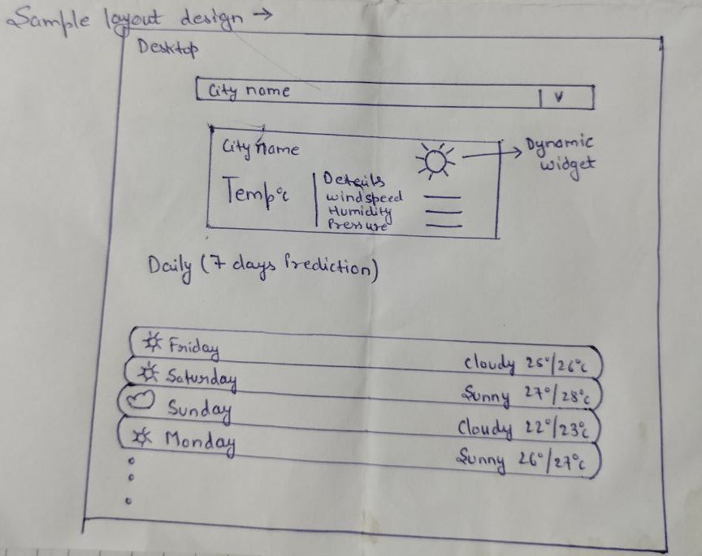
Layout

Slide 4
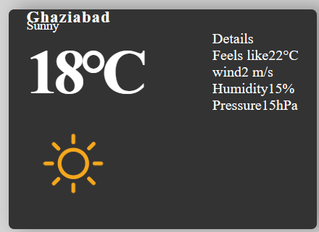
Layout Components

Slide 5
Details about component
1.Current-weather:
It is developed using html and css
we have used a current weather function in which all its details are described
In this we have a division for weather and more division which decribes the further details like humidity,pressure,temperature winds and feels like.
we will use an png image according to the weather and details
After this we will use export this current weather function

Slide 6
Details about component
Search bar
This is an react hook based component
In this we have used a single Usestate hook which is used to change the state of the application on user request
Here we will import usestate hook from react library
To search for the city we will use an API

Slide 7
Details about component
Icons
We will use various icons such as sunny,windy,rainy,stormy etc.
These icons will provide us better graphical and attractive view of the weather .
These will enhance our graphical representation of the website.

Slide 8
Details about component
Next-7day Prediction:
We will have a widget after the current day weather widget
If the next 7day weather updates are present then we will have the widget for next 7 day
In this we have basic three things first an icon,day of the week and the temperature high and low of that day

Slide 9
Details about component
API:
We will use api’s to get the data
Basically we have thought of using 2 api’s which will fetch the city
Second one will fetch the weather report for our websites
Open-weather and GeoDb are the two api we used to fetch the location and weather for report for that current location.

Slide 10


