Slide 1

Chronic Disease Indicators Analysis (U.S)
ALY 6015
Intermediate Analytics
Team Member: Zengyao Ding, Junhui Hu, Yawen Diao
Instructor: Zhi, He
06/24/2025

Slide 2
Overview
Introduction
Data Summary
Method 1 - Chi-Square Test
Method 2 – ANOVA Analysis
Method 3 – Logistics Regression Analysis
Conclusion & Recommendation
Reference

Slide 3

Data Summary
Why Analyze The Chronic Disease Indicators in the U.S?
Over 200,000+ records before filtering include multiple health topics
It is nationally standardized, enabling cross-state and cross-group comparisons.
It enables exploration of health disparities by gender, region, race, and time.
It supports public health planning, policy evaluation, and targeted interventions.
Source:
https://catalog.data.gov/dataset/u-s-chronic-disease-indicators

Slide 4
Method 1: Chi-Square Test of Independence
Objective
Association between gender, region, year and risk level of cancer (incidence/mortality)
Association between race and risk level for colorectal cancer mortality.
Data preparation
Age-adjusted rates used for fairness
Remove rows that data value is missing
Risk categorized as High (> median) or Low (≤ median)
Regions regrouped (East vs. West) for better statistical power
Notes:
After exploring the dataset, we noticed that variables like gender, region, year, and race were clearly categorized and relevant to public health questions.
These variables are also commonly studied in cancer, so we apply Chi-Square Test to examine whether these factors are associated with different risk levels of cancer
Why Age-adjusted rates : Cancer risk is strongly age-dependent, so it meaningful comparisons of cancer incidence and mortality across different groups
Because Chi-square tests require categorical variables rather than continuous variable, so we categorized the datavalue into high/low base on median
And Because Sample sizes at the individual state were often too small, to improve statistical power, we regroup the states to east and west

Slide 5
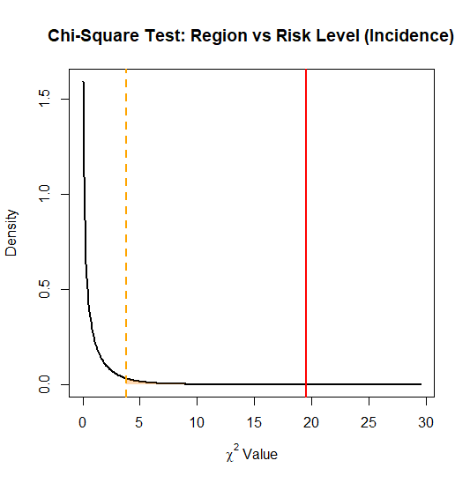
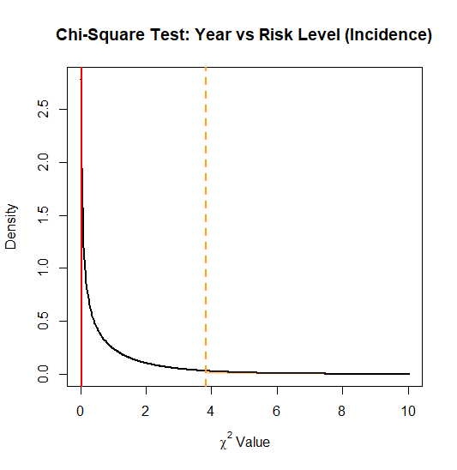
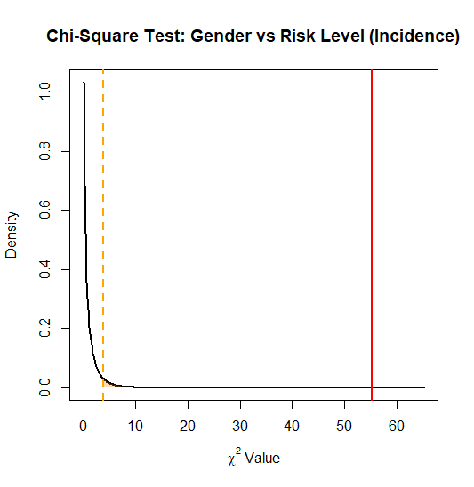
Invasive Cancer Incidence Analysis
Variable | Category | High Risk | Low Risk | Chi-Square
Gender | Male | 63 | 15 | X²=55.26 p=1.056e-13 <0.001 Significant
 | Female | 17 | 65
Region | East | 73 | 48 | X²=19.53 p=9.905e-06 <0.001 Significant
 | West | 7 | 32
Year | 2015/16 | Balanced | Balanced | X²=0.03 p=0.87 (NS)
Key findings:
Strong gender difference (male higher risk).
Regional disparity (West lower risk).
No significant year effect.
Notes:
The x-axis represents the possible Chi-Square values under the null hypothesis and The red vertical line shows our observed X² statistic.
The yellow line marks the critical value at Statistical significance=0.05
We have 82 for females and 78 for males in the record, X square value is much higher than the critical value, we can say Gender have a strong association with invasive cancer
Region same
Year does not seem to play a significant role in this case.

Slide 6
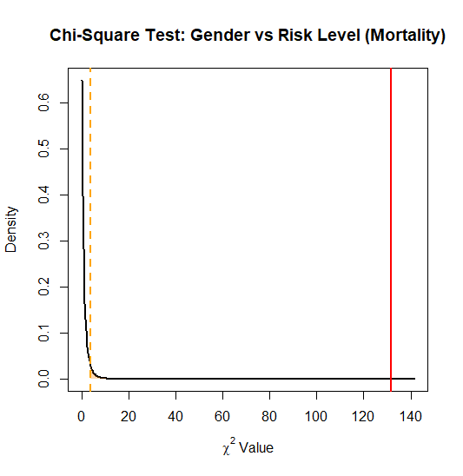
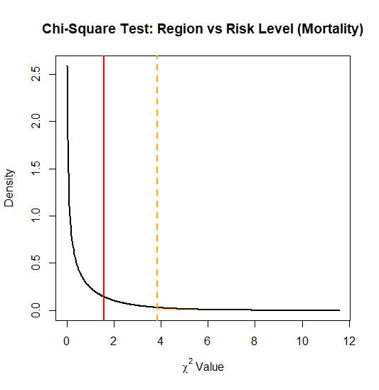
Invasive Cancer Mortality Analysis
Variable | Category | High Risk | Low Risk | Chi-Square
Gender | Male | 78 | 3 | X²=131.6 p<0.001 Extremely significant
 | Female | 3 | 76
Region | East/West | Balanced | Balanced | X²=1.58p=0.21 (NS)
Key findings:
Gender disparity intensified for mortality.
Region not significant for mortality.
Notes:
Would our results change with a larger dataset?
It depends. If the current trends are real and representative of the population, a larger sample size would likely have a smaller p-values, rather than change the direction of the result
However, if the current sample is biased a larger dataset might reverse some conclusions.

Slide 7
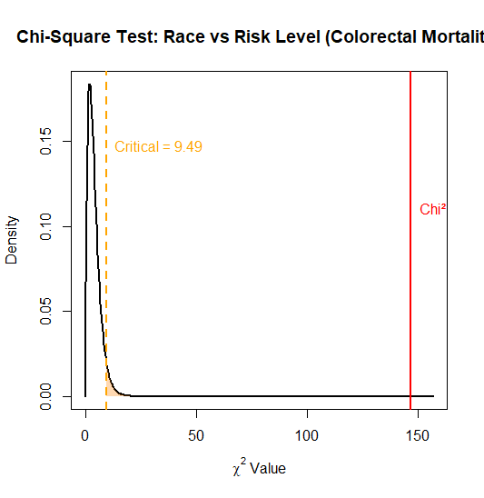
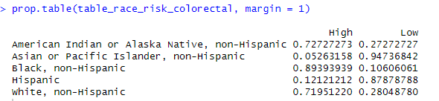
Colorectal Cancer Mortality
Race/Ethnicity vs. Colorectal Cancer Mortality
Chi-square: X²=147.1, df=4, p=2.2e-16 <0.001 (Highly significant).
Race/Ethnicity | Dominant Risk Level
Black, non-Hispanic | High risk
White, non-Hispanic | High risk
Asian/Pacific Islander, Hispanic | Low risk
American Indian/Alaska Native | Evenly distributed
Recommendation:
Prioritize targeted public health strategies addressing specific demographic disparities.
Notes:
Lastly, we analyzed colorectal cancer mortality by race
We ran a Chi-Square test and found a very strong association, with a p-value effectively zero
Since we know there are many race and we wonder which of them has the high Risk
Then we run a contingency table to see which race has high Dominant Risk Level
Recommendation:
Our analysis highlights that cancer risk is not evenly distributed. Public health strategies should shift from a one-size-fits-all model to focus more on specific groups

Slide 8
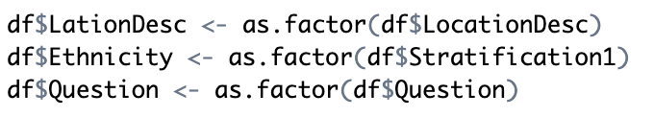
Method 2: ANOVA Analysis
Impact of State and Ethnicity on Cancer Incidence
Objective
Whether cancer incidence rates in the United States differ significantly across states and ethnic groups, and whether there is an interaction effect between these two factors.
Key Metrics
Invasive cancer (all sites combined), incidence from Question
Per 100,000 for DataValueUnit (removed 0 DataValue)
LocationDesc (state)
Stratification1 (used as Ethnicity)

Slide 9
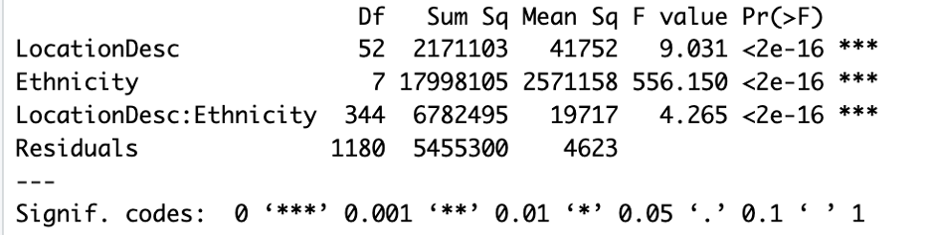
Method 2: ANOVA Analysis
Impact of State and Ethnicity on Cancer Incidence
Model Summary

Slide 10
Method 2: ANOVA Analysis
Impact of State and Ethnicity on Cancer Incidence
Model Explanation:
Both State and Ethnicity have significant effect on cancer incidence, and these differences are unlikely caused by random chance, but by those factors.
The interactive effect is also significant, suggesting the effect of ethnicity varies by state. This suggests that both geographic and demographic contexts jointly affect cancer risk, indicating the importance of localized public health strategies to improve cancer incidence rate.
Ethnicity has a stronger effect: The Mean Square (Mean Sq) for Ethnicity is much larger than that for LocationDesc (2,571,158 vs. 41,752), indicating that ethnicity explains a larger portion of the variation in cancer incidence than geographic location. This could reflect deep-rooted differences in lifestyle, healthcare access, socioeconomic status, and cultural health behaviors.

Slide 11
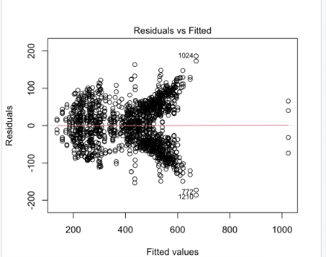
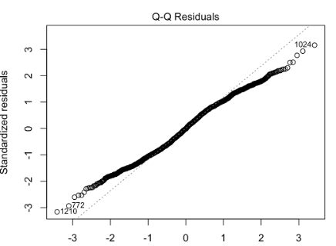
Method 2: ANOVA Analysis
Model Diagnosis
Residuals vs Fitted
Q-Q Plot
The residual distribution essentially satisfies the normality assumption, with only a few abnormal values.
Heteroscedasticity: Log Transformation
Notes:
图中呈现明显的“漏斗形”图案，说明残差的波动（方差）随拟合值的增大而增大。
这表示出现了异方差性（heteroscedasticity），即误差项的方差不是恒定的，违反了线性模型的基本假设之一。
点编号 1024、772 和 1210 明显偏离主群体，可能为异常值或高影响值。 2.Q-Q Plot（正态 Q-Q 图）: 分析解释：
大多数点都位于对角线附近，说明残差大致服从正态分布。
但在两端尾部存在轻微偏离，尤其是编号为 1024、772、1210 的点明显偏离。结论： 整体来看，残差分布基本满足正态性假设，只是少量极端值造成轻微偏差，可接受。如果要更严谨，可考虑进一步处理这些异常值。

Slide 12
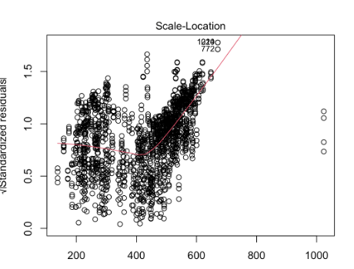
Method 2: ANOVA Analysis
Scale-Location Plot
Red Line Rising: Confirm Heteroscedasticity
Abnormal: 1024, 772
Notes:
纵轴是残差的标准化平方根，横轴为拟合值。
分析解释：
红色趋势线明显上升，说明标准化残差随拟合值增大而增大。
这进一步验证了异方差性的存在。
点 1024 和 772 再次表现异常。
结论： 该图再次说明模型存在非恒定方差问题，对数变换或使用**加权最小二乘法（WLS）或稳健估计（robust estimators）**是解决办法。

Slide 13
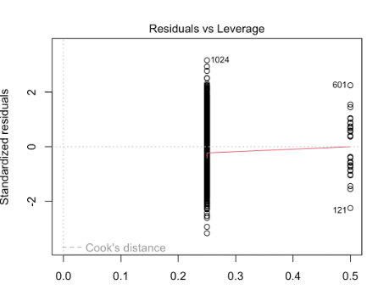
Method 2: ANOVA Analysis
Residuals vs Leverage
High Leverage Values: 601, 121(abnormal) -------> Cook's distance to further confirm and sensitive analysis

Slide 14
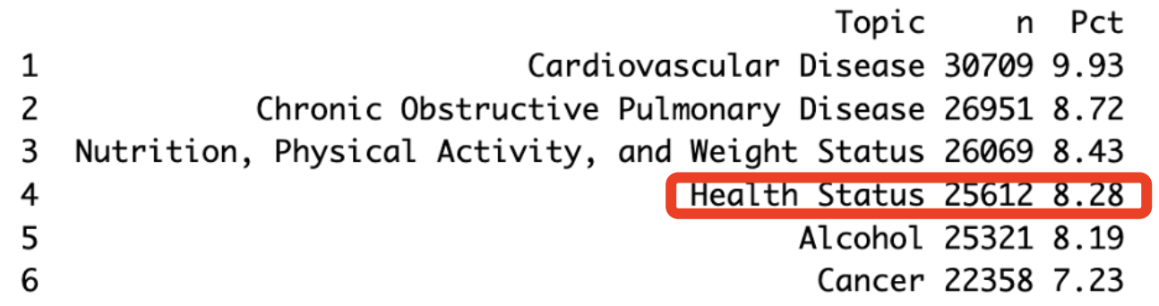
Method 3: Logistics Regression Analysis
Background & Motivation
CDC Chronic Disease Indicators: Tracks dozens of health metrics across the U.S.
Why “Health Status”: This topic accounts for 8.28% of records as a representative.
Our goal: Using survey indicators to predict whether an individual falls into ‘Very Healthy,’ ‘Moderately Healthy,’ or ‘Unhealthy. ’
Notes:
First, for the Health Status topic. We ranked the top six topics. And we chose the topic called health status

Slide 15
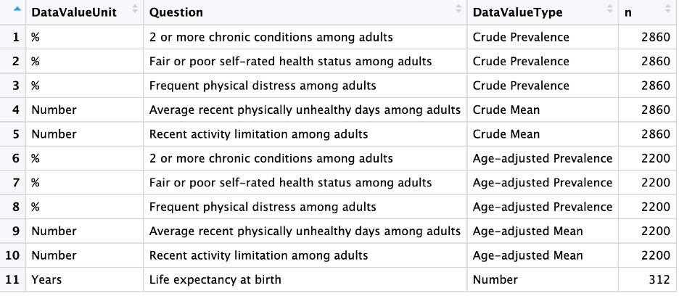
Data Overview & Exploration
Data Size & Types: Up to 25300 rows after extraction, divided by questions, data value type, and data value unit.
Health Status Subset: Chosen Crude Prevalence Value.
Notes:
Next, we grouped by DatavalueType and DataValueUnit, and we finally figured out the questions distribution.

Slide 16
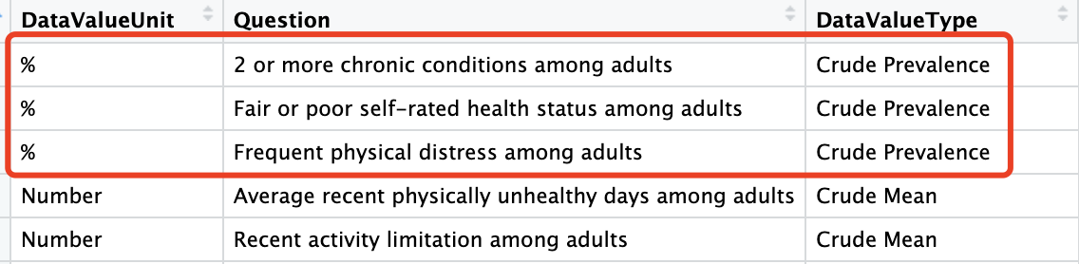
Data Overview & Exploration
Data Characteristics: A lower percentage always corresponds to better health. “Lower = Healthier.”
All values here are percentages of adults reporting an adverse condition.
Notes:
We determined that we focused on the crude prevalence measures—specifically, the percentage‐based metrics—because our model will include age as a covariate. One thing we need to mention is that for the data characteristics, smaller percentages mean better health.r health.

Slide 17
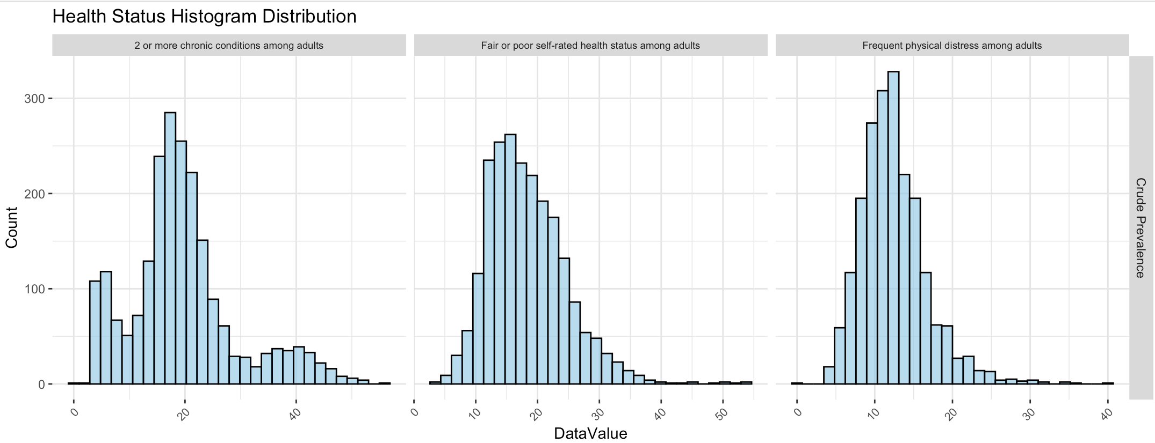
Data Overview & Exploration
Distribution Characteristics:
Unimodal & positively skewed: All indicators peak in the lower‐to‐mid percentage range but have a long right tail. Moreover, a single dominant bump indicating consistent measurement across states.
Concentration around 10–20 %: The bulk of observations fall between roughly 10 % and 20 %, mostly are healthy.
Notes:
Before our modeling part, we plotted histograms of those percentages and saw that each question is roughly unimodal with a right skew—most states cluster around 10–20%, it means most of the respondents are healthy.

Slide 18
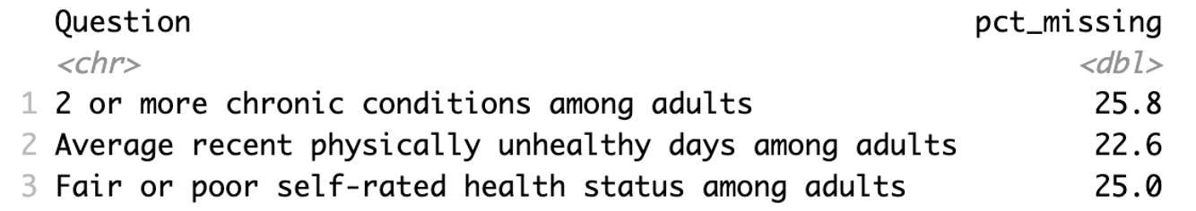
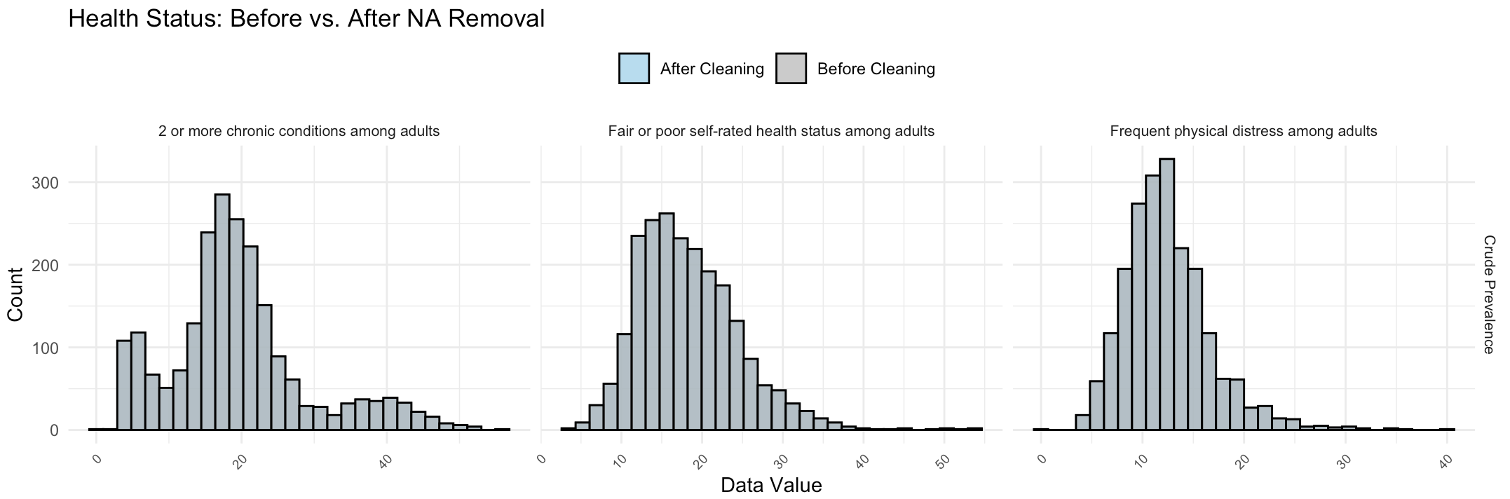
Missingness & Cleansing
Missing Rates: up to ~25% missing in these indicators
Cleaning Strategy: drop all rows with any missing DataValue
Distribution Check: overlay before/after histograms
Notes:
When we checked missingness, about 25% of the values were blank.
We tried a few approaches—imputation, filling with the mode or the median value —but found that simply dropping rows with missing values preserved the original skew and didn’t introduce bias.
Our before‐and‐after overlay plots confirmed that the distributions line up almost perfectly.

Slide 19
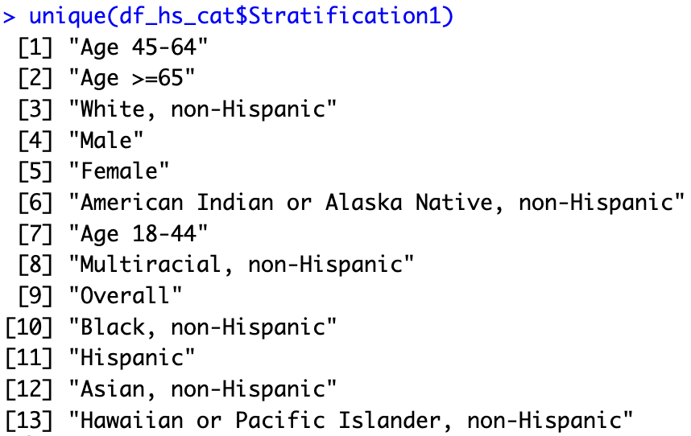
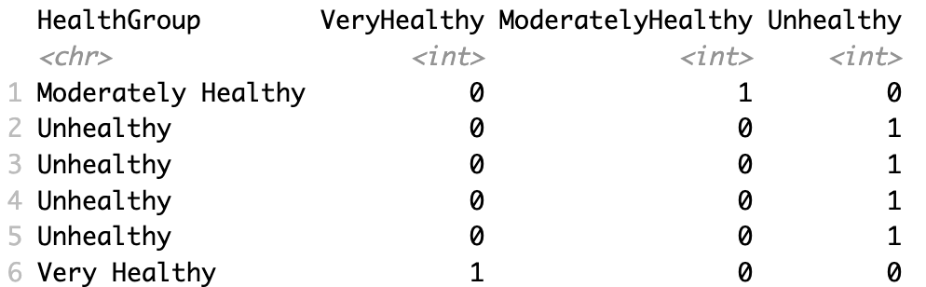
Model Specification
Outcome Binning: split crude-prevalence (%) into three groups by 1st/3rd quartiles
Predictors: one-hot encode gender, age groups, race/ethnicity (drop first level). Therefore, “Unhealthy” is a baseline for the reference level
Notes:
For model specification, we stratified our data into three democraphics groups—age, gender, and race/ethnicity—and binned the Health Status percentages by the 1st and 3rd quartile​, we seperated the three classes by quartiles
After that, we used one-hot encoding of the demographic factors, using Unhealthy as our baseline.

Slide 20
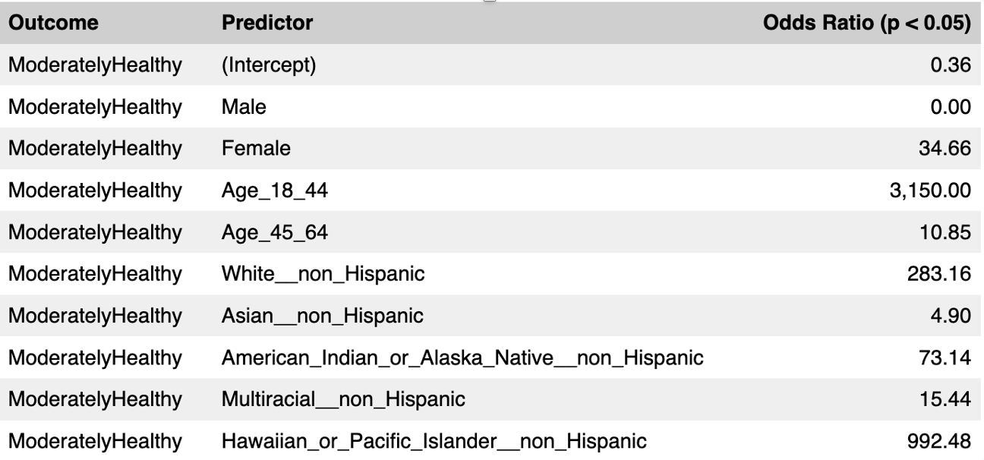
Regression Results Overview
Focus: Significant predictors (p < 0.05) only
Separate Tables: “Moderately Healthy” vs. “Very Healthy” Odds Ratios
Notes:
We then filtered for subgroups with p-values below our significance threshold, so we only interpret statistically significant effects. This means all odds ratios you’ll see compare either Moderately Healthy or Very Healthy back to that Unhealthy reference.

Slide 21
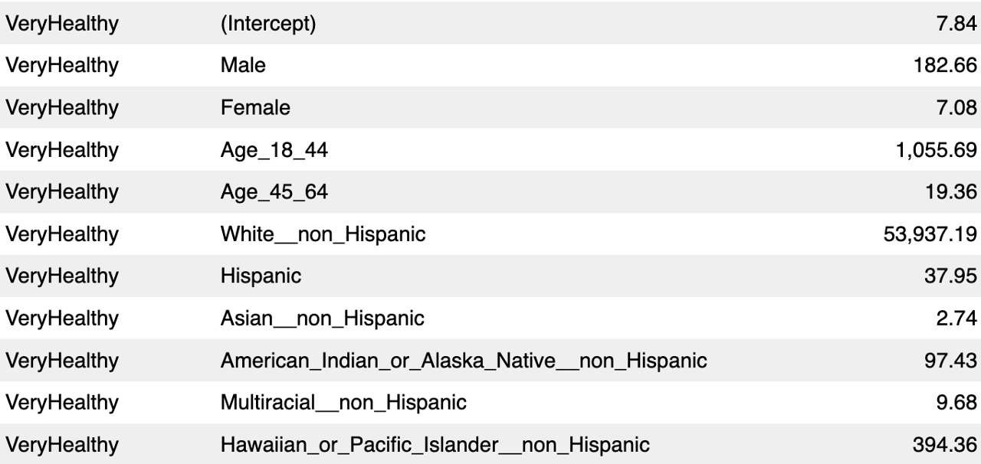
Regression Results Overview
Interpreting Odds Ratios：
An OR compares the odds of an outcome occurring in one group versus a reference group. Odds Ratio = (odds in group A) ÷ (odds in reference group)
Notes:
It‘s worth noting that the third column Odds Ratio compares the odds of an outcome occurring in one group versus a reference group.

Slide 22
Key Predictors Interpretation
Age
18–44 vs. 65+
Moderately Healthy: OR ≈ 3,150×, Very Healthy: OR ≈ 1,056×
Takeaway: Young adults are dramatically more likely to report good health than seniors.
45–64 vs. 65+
OR ≈ 10–20× for both Moderate & Very Healthy
Takeaway: Middle-aged adults still enjoy much better health odds than seniors.
Notes:
First, comparing 18–44 year-olds to those 65 and older, the odds ratio is dramatically higher than the reference group
Pratically speaking, young adults are overwhelmingly more likely to say they’re in good or very good health than seniors.
Even the 45–64 age group enjoys a major advantage compared to the 65+ group.

Slide 23
Key Predictors Interpretation
Gender
Female vs. Unhealthy
Moderately Healthy: OR ≈ 34.7×, Very Healthy: OR ≈ 7.1×
Insight: Women skew toward moderate health but have room to move up.
Male vs. Unhealthy
Moderately Healthy: OR ≈ 0.0×, Very Healthy: OR ≈ 182.7×
Insight: Men show an “all-or-nothing” pattern: few in moderate, many in very healthy.
Notes:
Next, we see distinct patterns for women versus men. Women, compared to the Unhealthy baseline, meaning they tend to cluster in that middle category but also have room to move up.
Men, on the other hand, show an almost “all-or-nothing” profile: In other words, when men do report good health, they overwhelmingly land in the highest tier, but few sit in the middle.

Slide 24
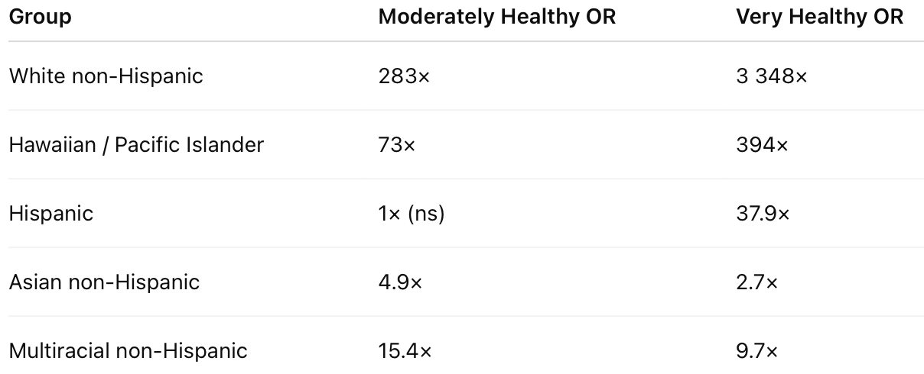
Key Predictors Interpretation
Findings: Clear stratification by race/ethnicity—some groups enjoy vastly higher odds of good health.
White non-Hispanics and Hawaiian/Pacific Islanders report the highest likelihood of both moderate and very good health, whereas Asian and Multiracial non-Hispanic residents show less dramatic rates than others.
Notes:
Finally, we observe clear stratification by race and ethnicity. White non-Hispanics and Hawaiian/Pacific Islanders top the chart, with the highest odds of both moderate and very good health. Asian non-Hispanics and multiracial respondents show less dramatic rates than others. These differences hint at underlying cultural, socioeconomic, or access-related factors.

Slide 25
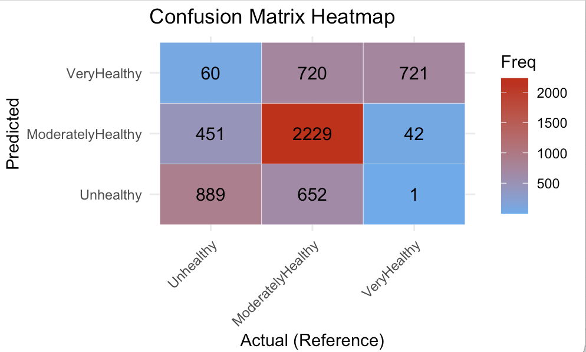
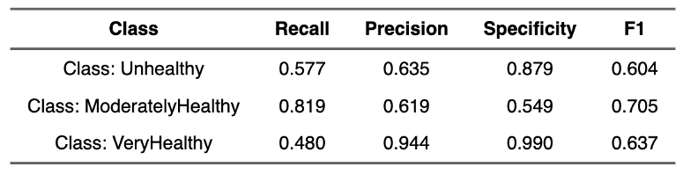
Model Performance
Unhealthy Group
Specificity = 0.879, Only 12% of healthy individuals are mislabeled as Unhealthy
Recall = 0.577, the model correctly identify 58% of true Unhealthy cases
Precision = 0.635, 64% of our “Unhealthy” predictions are correct
Notes:
Now let’s turn to how well our model actually performs in classifying each health group.
We evaluated model performance with a confusion-matrix heatmap, calculating metrics like recall, precision, and specificity.

Slide 26
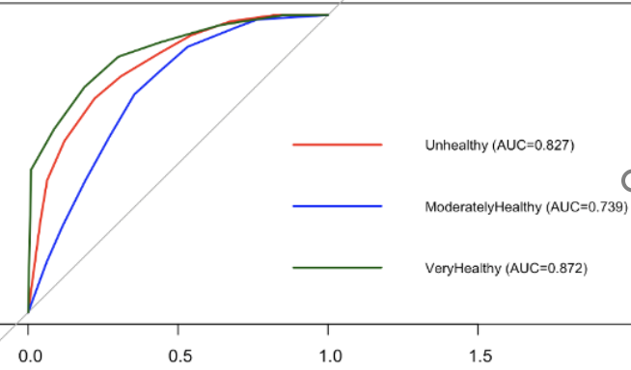
Model Performance
Very Healthy
Recall = 0.480, we detect only 48% of true Very Healthy individuals
Precision = 0.944, 94% of our “Very Healthy” predictions are correct
Specificity = 0.990, virtually no non-Very Healthy individuals are misclassified as Very Healthy
ROC, AUC: Very Healthy ≈ 0.87, Unhealthy ≈ 0.83,
Moderately Healthy ≈ 0.74
Moderately Healthy
Recall = 0.819, It captures 82% of actual Moderately Healthy cases
Precision = 0.619, 62% of our “Moderately Healthy” calls are accurate
Notes:
We also plotted ROC curves to visualize how well the model separates each class, and we confirmed that the model discriminates best at the extremes, with the middle category posing the greatest challenge.

Slide 27
Conclusion & Recommendation
Demographics as Strong Predictors
Age less than 65: Deploy app‐based challenges and social‐media campaigns to reinforce healthy behaviors early.
Age 65+: Introduce community‐center health workshops to reduce the risk of chronic conditions.
Women: Provide “Level-Up” programs that help move from moderate to very healthy—nutrition coaching, group fitness incentives.
Race/Ethnicity: Partner with community organizations in top-performing ethnic groups (White non-Hispanic, Hawaiian/Pacific Islander) to identify and replicate successful health practices.
Notes:
Age: Young adults show dramatically higher odds of both Moderately Healthy and Very Healthy status compared to seniors.
It achieves 94% precision for identifying Very Healthy individuals and 82% recall for the Moderately Healthy group, demonstrating strong performance, especially at the extremes.

Slide 28
Reference
Metadata, U.S. Chronic Disease Indicators, 2025. Retrieved from https://catalog.data.gov/dataset/u-s-chronic-disease-indicators
Chi-Square Test in R: A Complete Guide，datacamp,2024. https://www.datacamp.com/tutorial/chi-square-test-r
Hosmer, D. W., Lemeshow, S., & Sturdivant, R. X. (2013). Applied logistic regression (3rd ed.). Wiley.
Jylhä, M. (2009). What is self-rated health and why does it predict mortality? Towards a unified conceptual model. Social Science & Medicine, 69(3), 307–316. https://doi.org/10.1016/j.socscimed.2009.05.013
Chen, Y., Freedman, N. D., Albert, P. S., Huxley, R. R., Shiels, M. S., Withrow, D. R., ... & de González, A. B. (2016). Association between obesity and premature death among adults in the United States. New England Journal of Medicine, 373(8), 744–755. https://doi.org/10.1056/NEJMoa1503626

Slide 29
Thanks !

