Slide 1
Recipe Management Application
A Simple API-Driven Recipe Platform
Name : I Antony Gnanamuthu
Email Id : iantonygnanamuthu@gmail.com

Slide 2
Introduction
🔹 Overview:
A recipe management system that allows users to browse, store, and manage recipes.
Provides structured data for recipes, ingredients, and preparation steps.
Supports user authentication for personalized recipe management.
🔹 Core Functionalities:
1️⃣ User Management – Allows users to register, log in, and manage profiles. 2️⃣ Recipe Storage – Stores recipe details, including name, description, ingredients, and steps. 3️⃣ Ingredient Tracking – Provides a structured list of ingredients for each recipe. 4️⃣ Recipe Display – Presents recipes with images, background colors, and descriptions. 5️⃣ Mock API Support – Enables frontend applications to retrieve and display recipes dynamically.
🔹 Benefits:
✅ Users can store and access recipes conveniently. ✅ Provides a well-structured recipe collection for easy browsing. ✅ Can be expanded to support personalized features like favorites and recommendations.

Slide 3
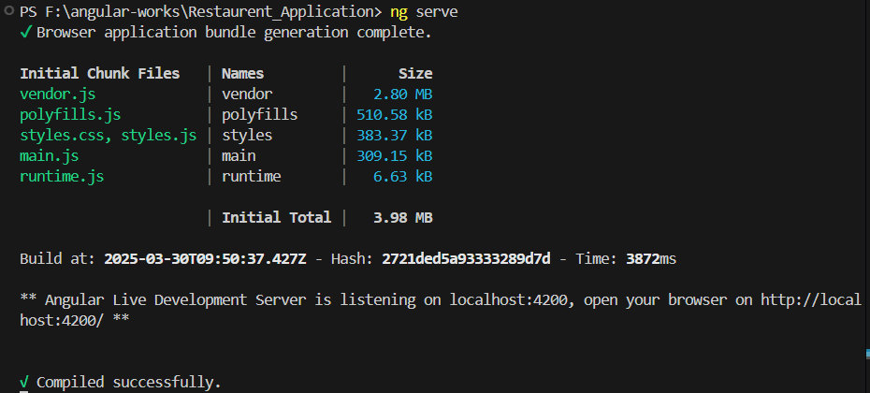
Running server on : http://localhost:4200 (ng serve)

Slide 4
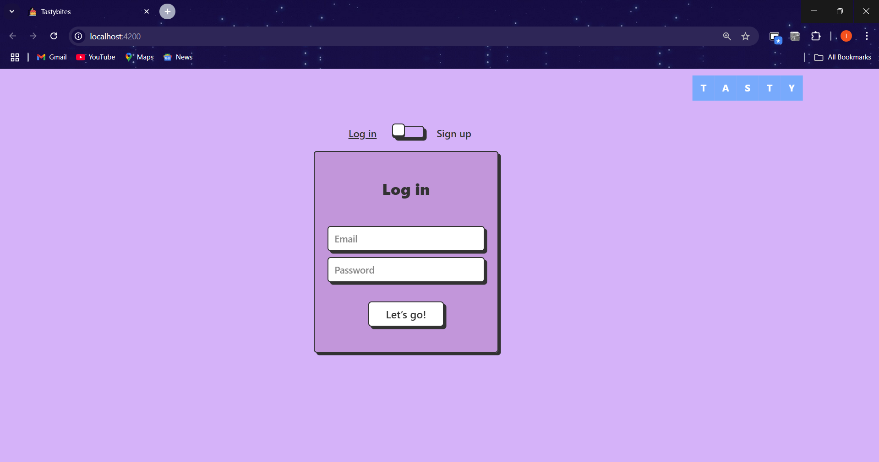
Login page

Slide 5
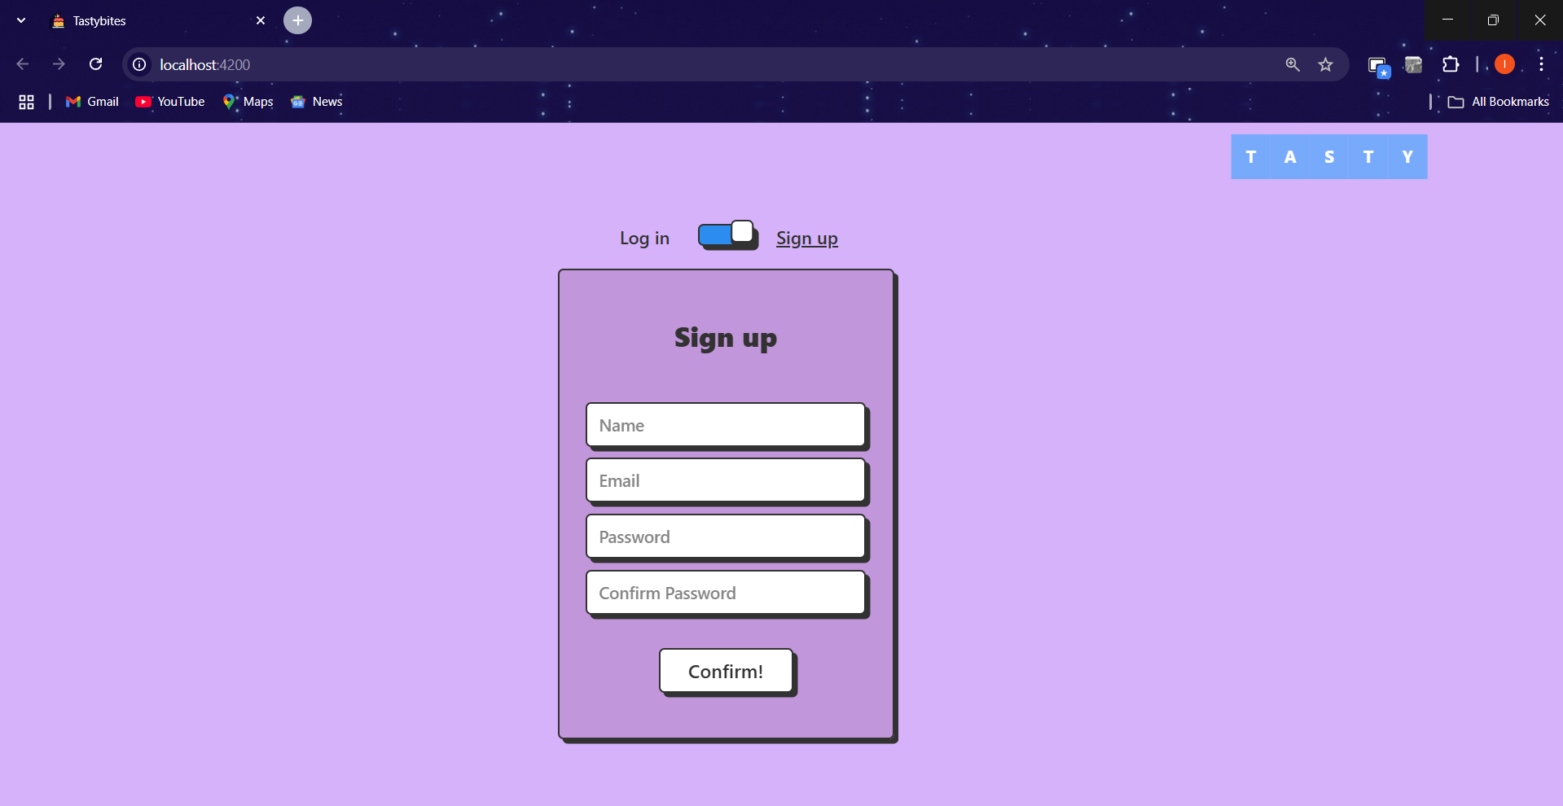
Sign- up page
Sign up if you are new user:

Slide 6
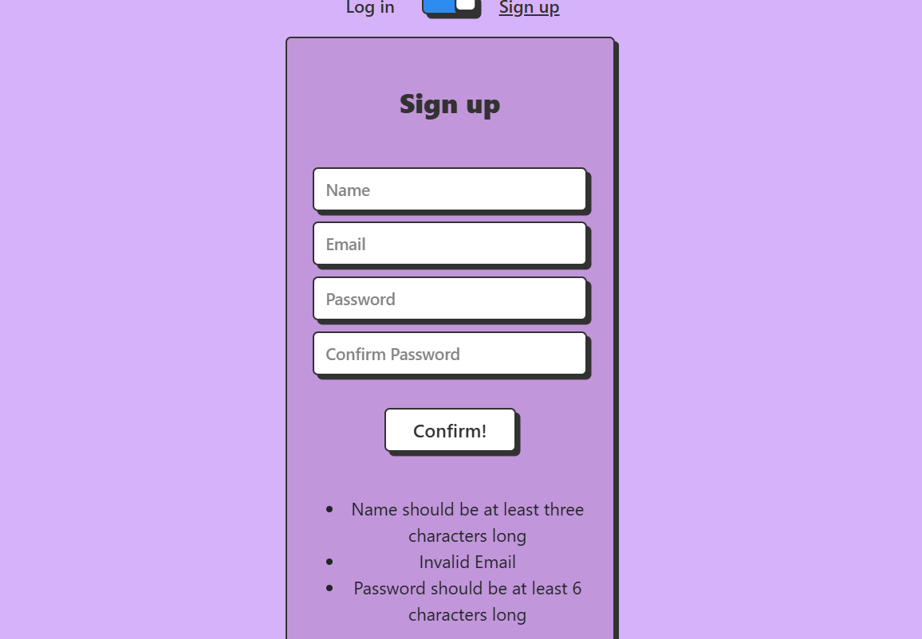
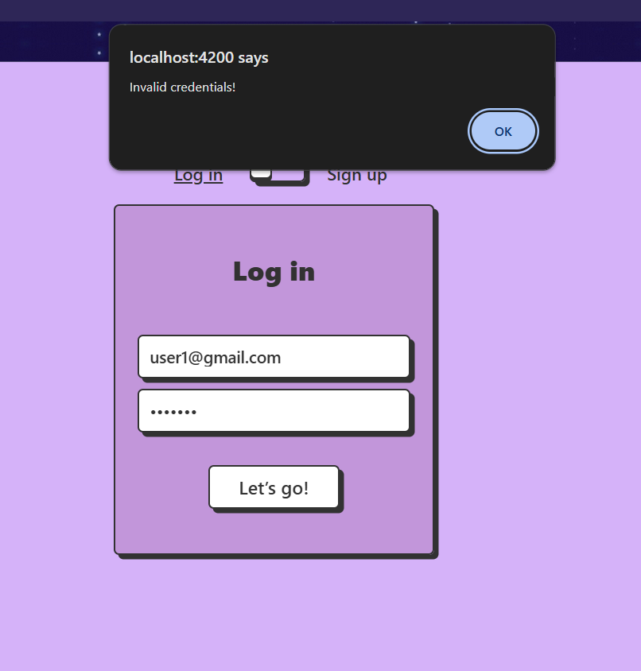

Slide 7
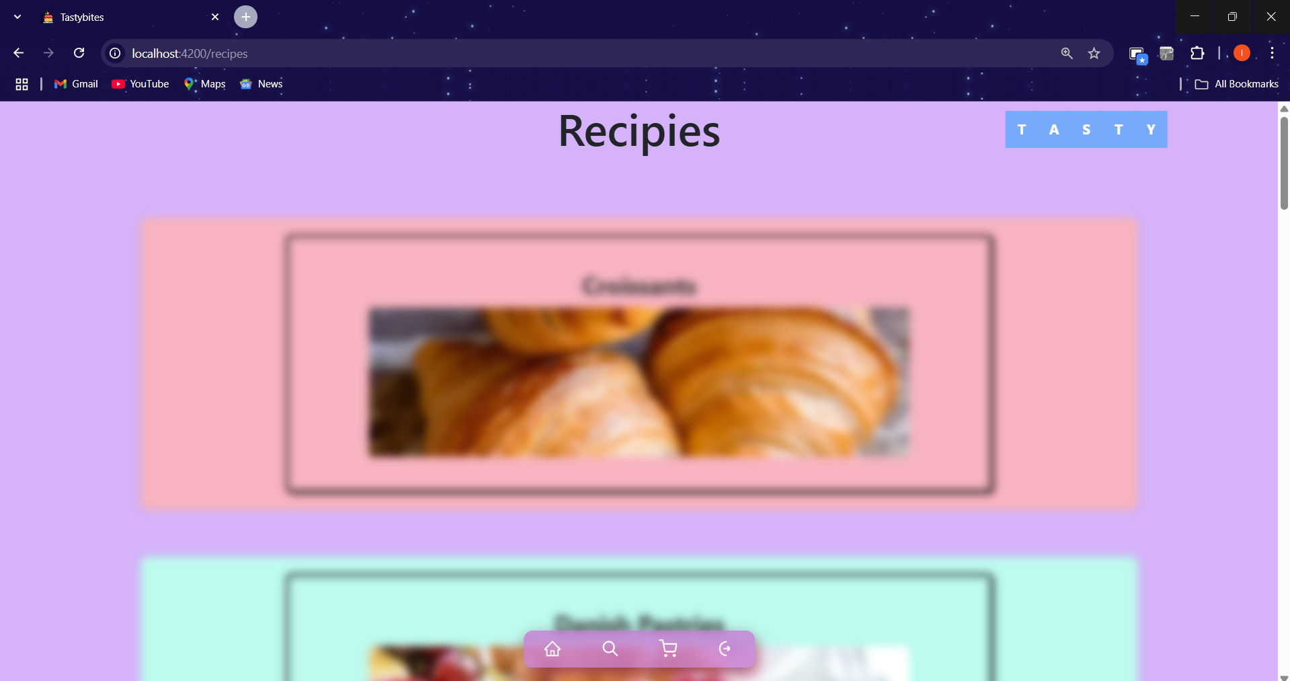
Home page:
After login redirecting to home page:

Slide 8
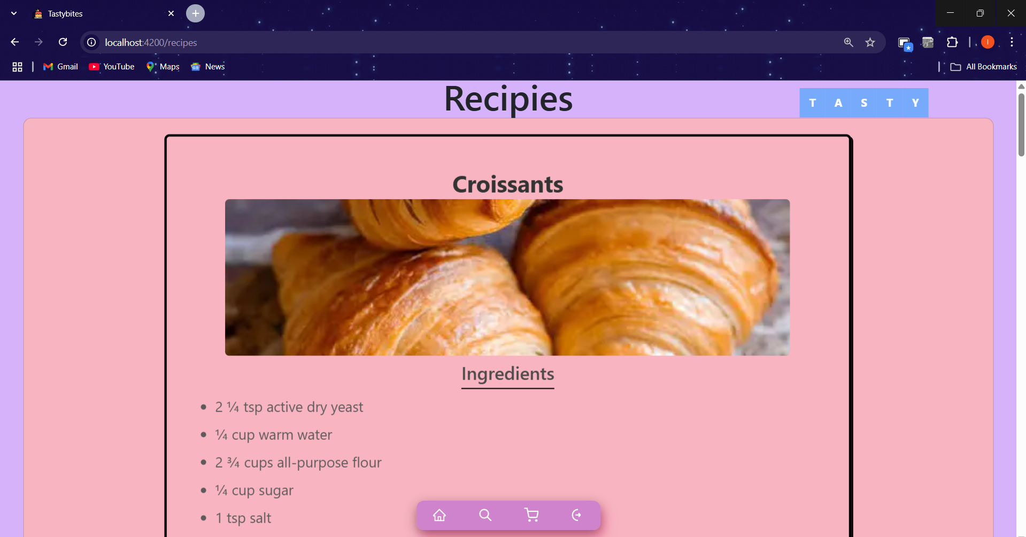

Slide 9
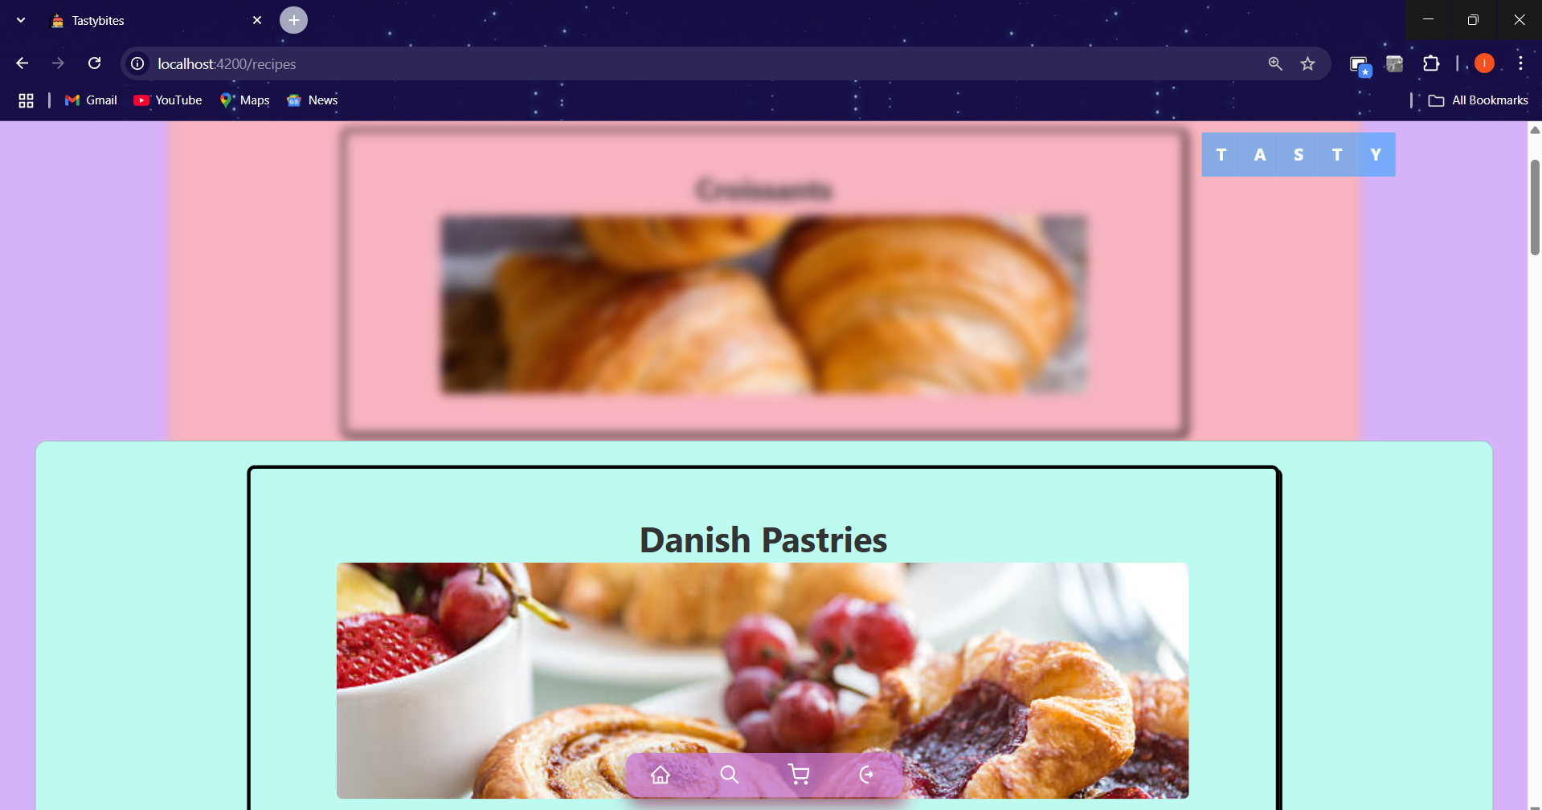

Slide 10
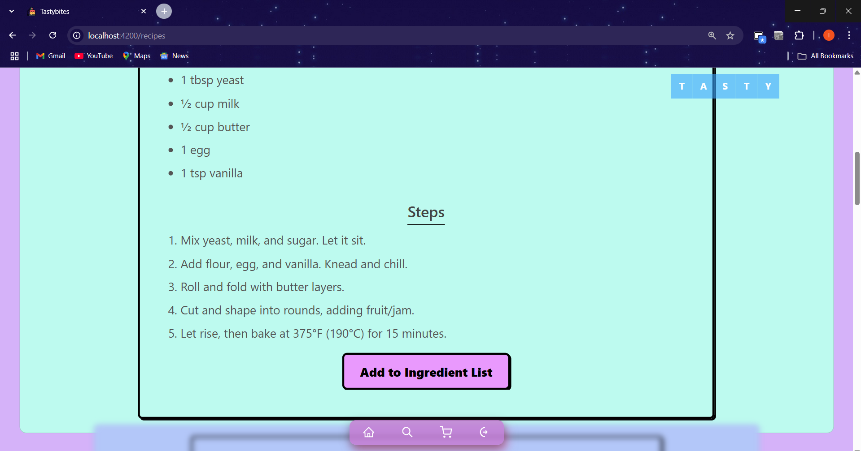

Slide 11

Navigation component
Home Page
Search Page
Ingredients page
Logout

Slide 12
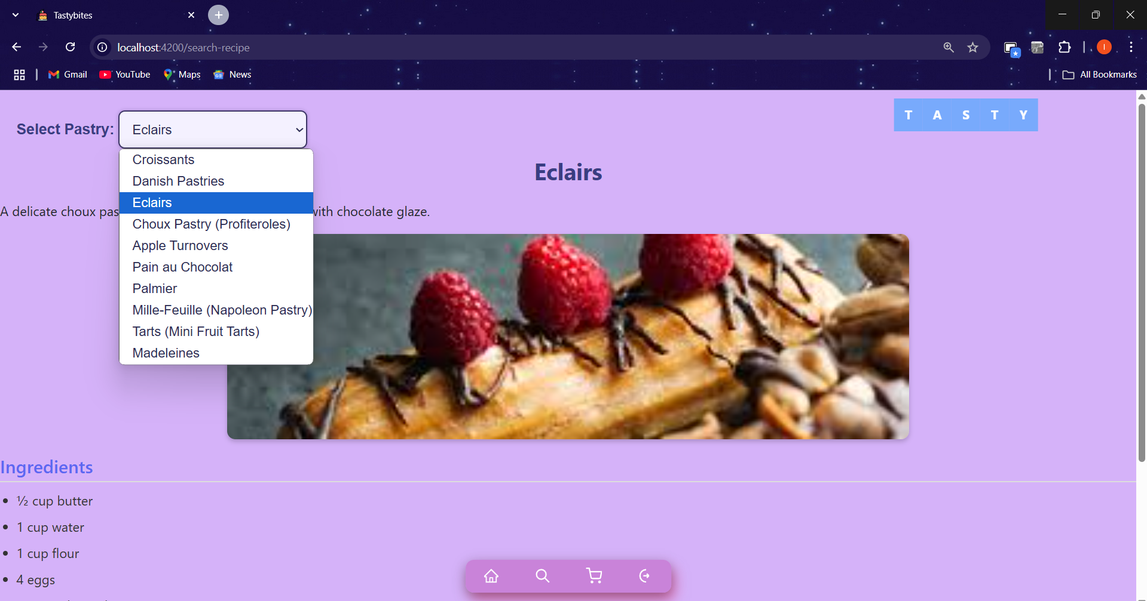
Search page:

Slide 13
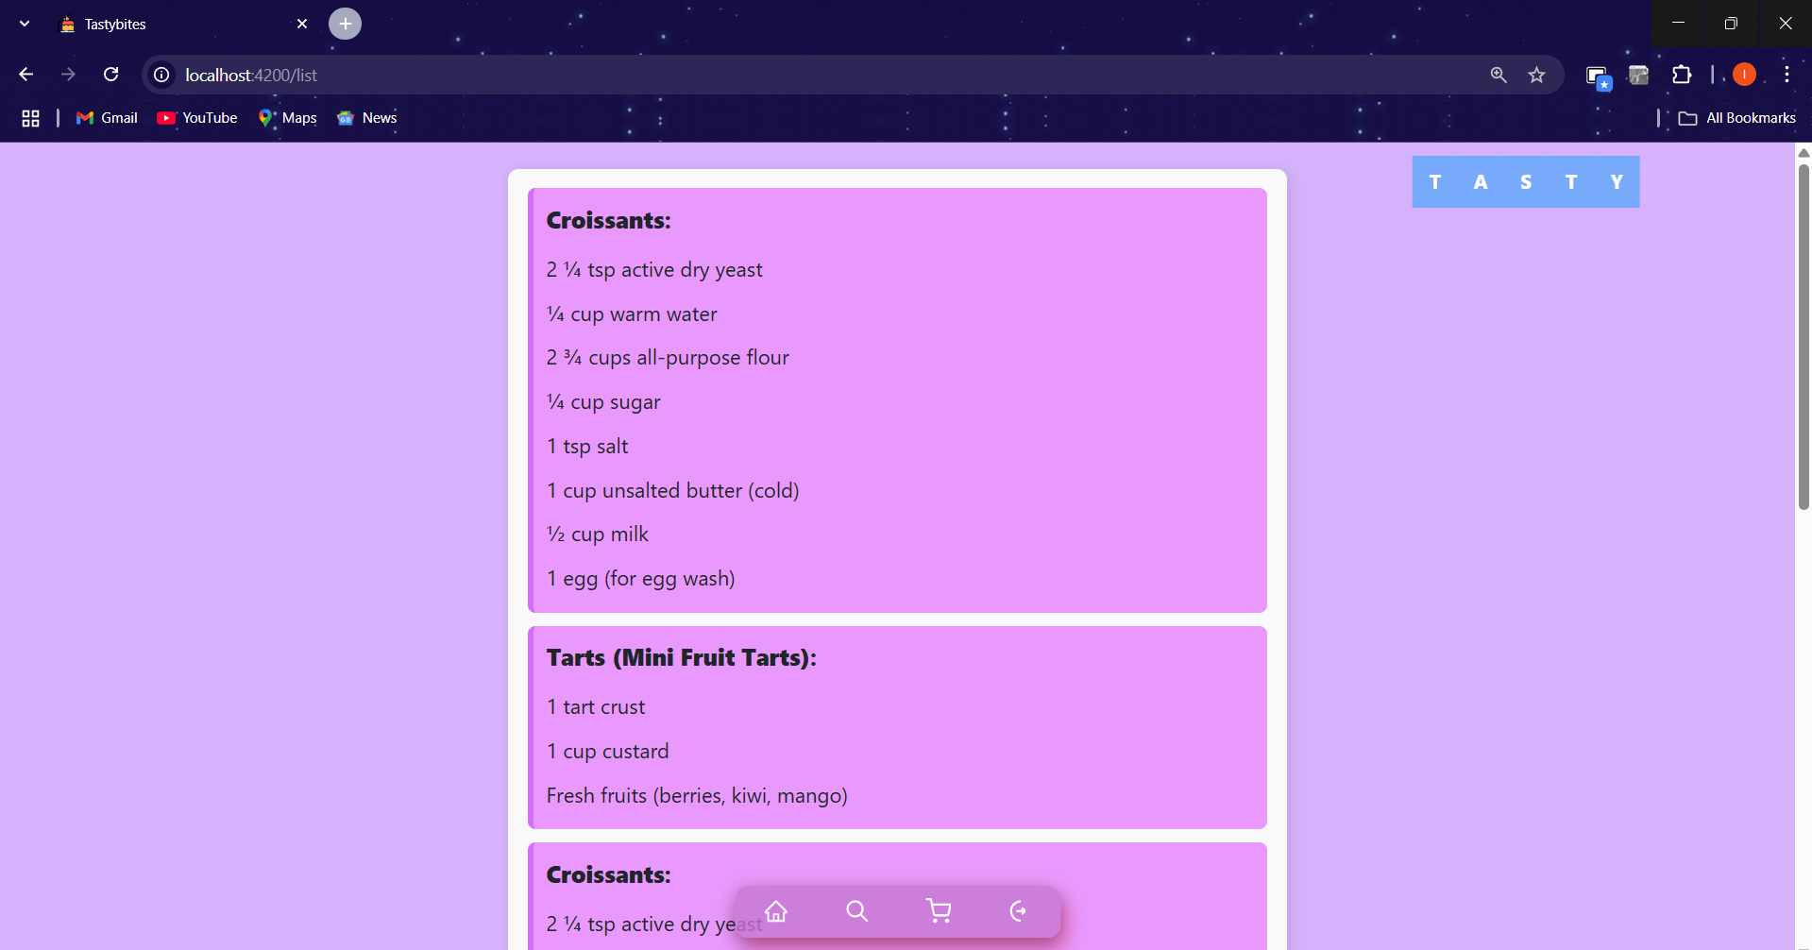
Ingredients Page:
This makes it easier for the user to purchase the necessary ingredients.

Slide 14
Key Takeaways
✅ Structured Data Management – The project provides a well-organized JSON-based dataset for recipes and users. ✅ Mock API for Frontend Development – It simulates real API calls, making it easy for developers to test frontend applications. ✅ User & Recipe Integration – Supports user authentication and recipe storage with details like ingredients, steps, and images. ✅ Scalability – Can be expanded into a full-fledged recipe platform with database and authentication support. ✅ Technology Flexibility – Works with multiple frontend frameworks like React, Angular, and Vue.

Slide 15
Future Directions
🚀 Database Integration – Migrate from JSON to a real-time database like Firebase or MongoDB. 🚀 User Authentication & Security – Implement JWT-based authentication for secure login. 🚀 Advanced Features – Add features like recipe ratings, user reviews, and personalized recommendations. 🚀 API Optimization – Refactor redundant data (e.g., streamline the ingredient list) for better efficiency. 🚀 Mobile App Support – Extend the project to a cross-platform mobile application using Flutter or React Native.

Slide 16
Thank You

