Slide 1

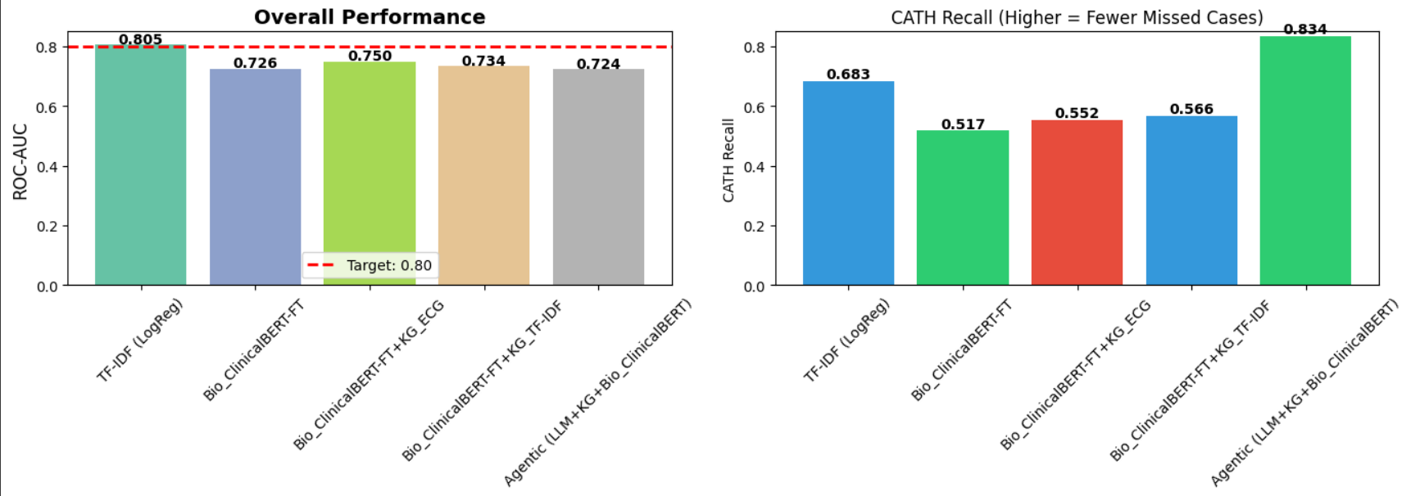
Towards Automated Cardiac Catheterization Laboratory Activation using Medical Text Classification
Ignasius Dwi Sagita Christy, Ngwaru Munodawafa
Stockholm University, The Department of Computer and Systems Sciences, DSV
Email: igch8514@student.su.se, munodawafan@gmail.com
Introduction
Ischaemic Heart Disease is the leading cause of death world-wide responsible for 13% of all deaths¹. Ischaemic Heart Disease presents in emergency cases as acute coronary syndromes (ACS). In ACS there is need to reduce the time from the patient getting through the hospital door to the time of definitive treatment with balloon catheterization² (door to balloon time). Artificial Intelligence systems have been implemented for automatic detection of ST elevated Myocardial Infarction (STEMI) from ECG only ³. Linking these platforms to notification systems has been demonstrated to reduce the door to balloon time³. However, to decide to send the patient for emergency cardiac catheterisation it is important to consider the patient’s presenting history, ECG results and the results of lab investigations. Our research looks at using a LLM to classify text in the Electronic Health Record (EHR) which includes the History of Presenting illness (HPI), Physical Examination, ECG report and lab results (Troponin results) to automatically make the decision and send a notification to the catheterisation lab. Essentially this is a two-class medical classification. Previous work has been done on classification of medical text using various Machine Learning models including gradient boosting with Text Frequency – Inverse Document Frequency (TF-IDF)⁵ and Transformers. BERT models were comparable to gradient boosted5. Recently LLMs have been shown to perform well in medical text classification^{6, 8}. We aim to improve the performance of simple transformer model (Bio_ClinicalBERT) with knowledge graph⁷. We further add an LLM as feature extraction tool.
Results
 | All Patients |  |  | Myocardial Infarction patients
 | Recall (Cath) | F 1 Score | ROC | Recall (Cath) | F 1 Score | ROC
TF – IDF plus Logistic Regression | 0.683 |  |  | 0.776
Bio_ClinicalBERT | 0.517 |  |  | 0.658
Bio_ClinicalBERT + Knowledge Graph | 0.552 |  |  | 0.711
Multi Agent | 0.834
Research Problem
Can transformer-based models predict which patients need cardiac catheterization using text-based classification methods using information in the patient Electronic Health Record ( HPI, Physical, ECG report, lab results) for patients with possible acute coronary syndromes. Do knowledge graphs and Multi Agent Systems improve performance of transformer classification for cardiac catheterization need for patients with possible acute coronary syndromes.
Conclusion
Inconclusion, we noticed that the simple model that used TF – IDF and logistic regression performed well but using a multi agent system and knowledge graph did yield improvements in recall which is important for this application.
Methods
The approach was to be able to classify patients on whether they needed cardiac catheterization or not based on information in the Electronic Health Record (EHR). We used the mimic-iv-ext-cardiac-disease-1.0.0 dataset from the MIT computational physiology lab. The dataset consisted of 4761 patients with heart conditions. Data cleaning included removing patients with possible data leak in the history and selecting patients with symptoms of acute coronary syndrome (e.g. chest pain). After data cleaning 1887 patient records were left of these 441 (23.3%) underwent cardiac catheterization and 1446 (76.7%) did not go for catheterization. The data was split into train and test sets with test size 20%. We used four methods to classify patients needed for cardiac catheterization based on the EHR text: Term Frequency - Inverse Document Frequency (TF-IDF) with Logistic regression Bio_ClinicalBERT Model with fine tuning with early stopping based on F 1 scores Bio_ClinicalBERT Model with fine tuning with early stopping based on F 1 scores plus Knowledge graph (with truncation of long input patient histories) Multi agent information retrieval Used LLM predictions of components of patient history (HPI, ECG report, lab results e.t.c .) as input to Bio_ClinicalBERT Model with fine tuning with early stopping based on F 1 scores .
References
1. Lindstrom, M., DeCleene, N., Dorsey, et al (2022). Global Burden of Cardiovascular Diseases and Risks Collaboration, 1990-2021. Journal of the American College of Cardiology, 80(25), 2372–2425. https://doi.org/10.1016/j.jacc.2022.11.001 2. Cannon CP, G. C. (2000). Relationship of Symptom-Onset-to-Balloon Time and Door-to-Balloon Time With Mortality in Patients Undergoing Angioplasty for Acute Myocardial Infarction. JAMA, 22(283), 2941–2947. Retrieved from doi:10.1001/jama.283.22.2941 3. Robert Avram, William F. Fearon. (2024, 7 1). NEJM AI, 1(7). doi:10.1056/AIe2400472 4. Sunil V. Rao, M. L. (2025). 2025 ACC/AHA/ACEP/NAEMSP/SCAI Guideline for the Management of Patients With Acute Coronary Syndromes: A Report of the American College of Cardiology/American Heart Association Joint Committee on Clinical Practice Guidelines. Circulation, 151(13). 5. Maarten Falter, Dries Godderis, Martijn Scherrenberg, et al, Using natural language processing for automated classification of disease and to identify misclassified ICD codes in cardiac disease, European Heart Journal - Digital Health, Volume 5, Issue 3, 2024, Pages 229–234, https://doi.org/10.1093/ehjdh/ztae008 6. Matos, J., Gallifant, J., Pei, J., Wong, A.I. (2025). EHRmonize: A Framework for Medical Concept Abstraction from Electronic Health Records using Large Language Models. In: Wu, S., Shabestari, B., Xing, L. (eds) Applications of Medical Artificial Intelligence. AMAI 2024. Lecture Notes in Computer Science, vol 15384. Springer, Cham. https://doi.org/10.1007/978-3-031-82007-6_20 7. Wang, H., Zu, Q., Lu, M., Chen, R., Yang, Z., Gao, Y., & Ding, J. (2022). Application of Medical Knowledge Graphs in Cardiology and Cardiovascular Medicine: A Brief Literature Review. Advances in therapy, 39(9), 4052–4060. https://doi.org/10.1007/s12325-022-02254-7 8. E. De Santis, A. Martino, F. Ronci and A. Rizzi, "From Bag-of-Words to Transformers: A Comparative Study for Text Classification in Healthcare Discussions in Social Media," in IEEE Transactions on Emerging Topics in Computational Intelligence, vol. 9, no. 1, pp. 1063-1077, Feb. 2025, doi: 10.1109/TETCI.2024.3423444.

