Slide 1
Apo Island
Map It: Building the Map
A group of fishing families has come together to understand why their situation keeps getting worse, and to find where they might be able to change it. The community is from Apo Island in the Philippines. They depend on the coral reef to live. The fish are disappearing.
Notes:
Set the scene before starting. This is a community mapping session; the room should understand that before the first slide. If participants don't know each other, brief introductions first.

Slide 2

Map It: Building the Map
Fewer Fish
That's where we start. We begin with one loss. Now we ask: what caused this?
Notes:
Start with one loss. Don't rush this. Let the fishing families' situation land before moving forward. The diagram builds from here.

Slide 3
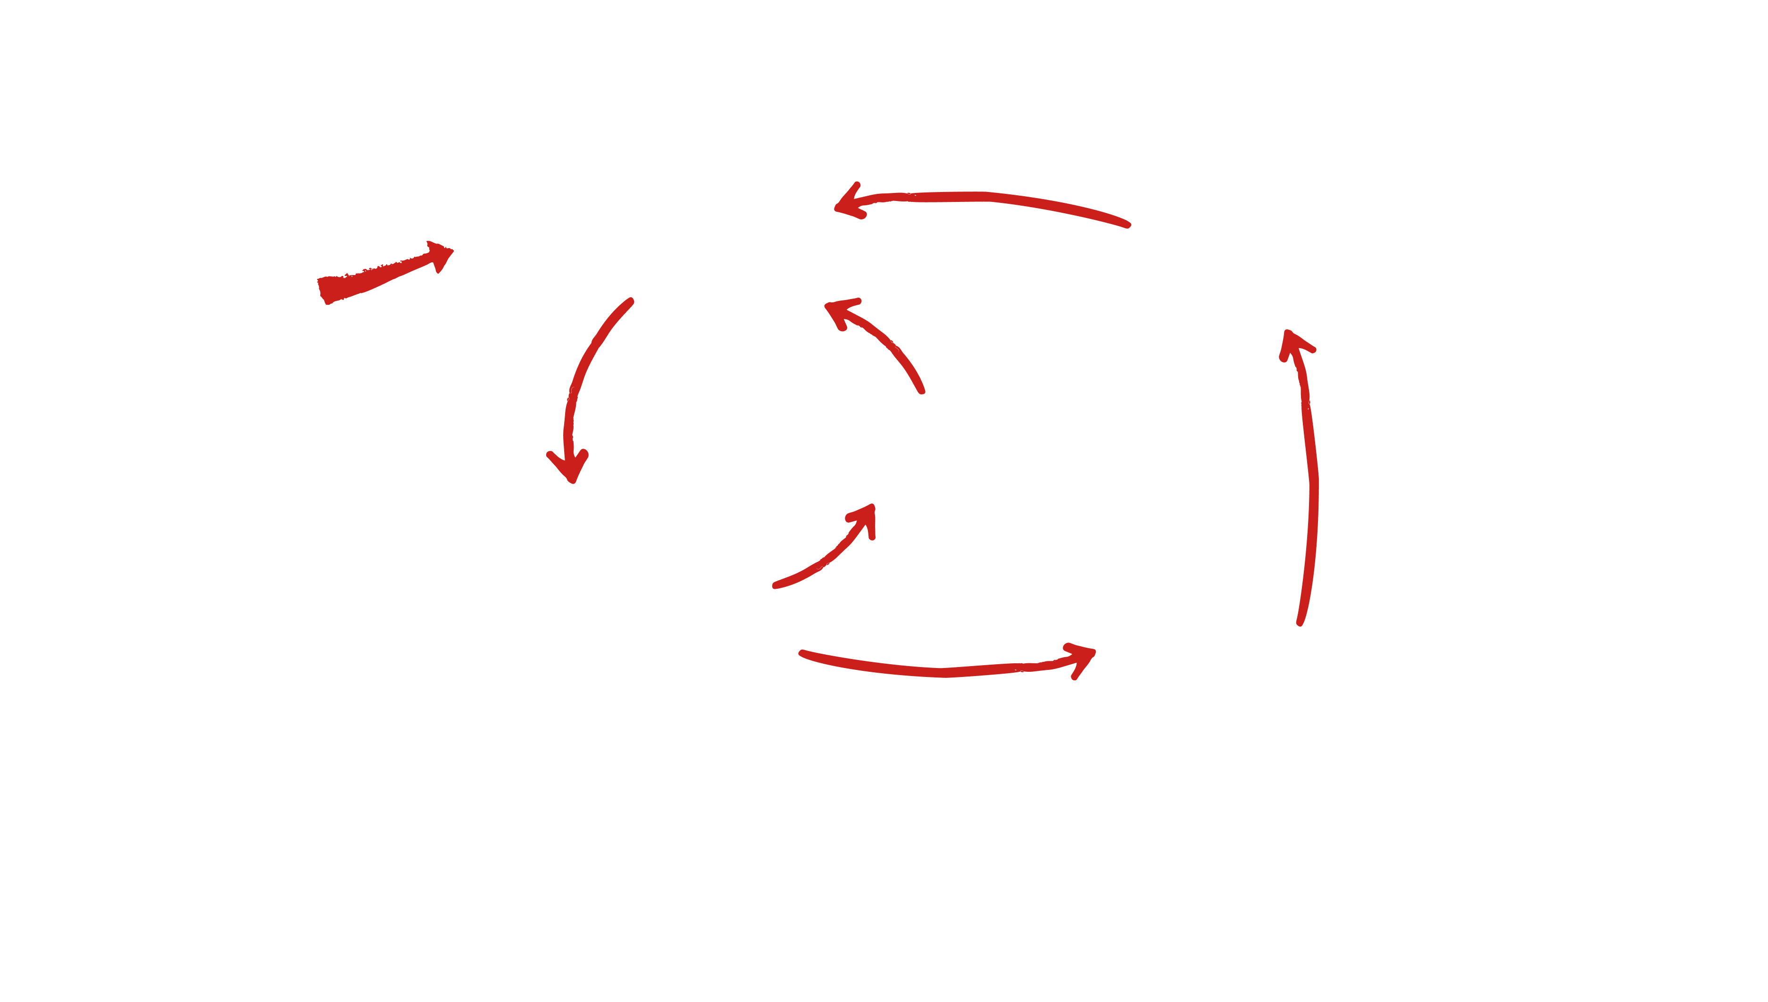

Map It: Building the Map
Fewer Fish
DIAGRAM KEY
More damaged coral habitat and less fish
= Negative Lever
= Action
= Result
Apo Islanders knew that the dying coral reefs meant not enough food for fish to thrive.
Notes:
At this point, the community was positioned to think about why this happened and what role they played.

Slide 4
Map It: Building the Map
More use of destructive fishing
Introduction of Destructive Fishing Methods
Fewer Fish
DIAGRAM KEY
More damaged coral habitat and less fish
= Negative Lever
= Action
= Result
Dynamite fishing had come to the Philippines. It caught a lot of fish fast. It destroyed the coral the fish depended on.
Notes:
Dynamite fishing is the lever. Name it clearly. The cause isn't vague decline; it's a specific action with a specific effect on the whole system.

Slide 5
Map It: Building the Map
More use of destructive fishing
Introduction of Destructive Fishing Methods
Fewer Fish
DIAGRAM KEY
More damaged coral habitat and less fish
= Negative Lever
= Action
= Result
Less coral. Fewer fish. And with fewer fish, the pressure to use dynamite only grew stronger.
Notes:
First loop forming. Trace it slowly: less coral, fewer fish, more pressure to use dynamite. One cause feeding the next.

Slide 6
Map It: Building the Map
More use of destructive fishing
Introduction of Destructive Fishing Methods
Fewer Fish
DIAGRAM KEY
More damaged coral habitat and less fish
= Negative Lever
= Action
= Result
That's the first vicious cycle. The worse things got, the worse it made everything else.
Notes:
Name the pattern explicitly: this is a vicious cycle. The worse things got, the worse it made everything else. Give that a moment before moving on.

Slide 7
Map It: Building the Map
More use of destructive fishing
Introduction of Destructive Fishing Methods
Fewer Fish
DIAGRAM KEY
More damaged coral habitat and less fish
Fishing further away from home
= Negative Lever
= Action
= Result
But there was more. As fish disappeared close to shore, fishermen had to travel further out to find them.
Notes:
Second cause entering the system. Fishermen traveling further out isn't just a symptom; it's a new pressure, and it feeds back into the first loop.

Slide 8
Map It: Building the Map
More use of destructive fishing
Less incentive for sustaining fishery
Introduction of Destructive Fishing Methods
Fewer Fish
DIAGRAM KEY
More damaged coral habitat and less fish
Fishing further away from home
= Negative Lever
= Action
= Result
Fishing far from home meant fishing in waters that weren't theirs to protect. The incentive to hold back disappeared. Now both cycles are feeding each other.
Notes:
Now both cycles are running. Point to where they connect. The diagram is getting more complex; that's the point.

Slide 9
Map It: Building the Map
More use of destructive fishing
Less incentive for sustaining fishery
Introduction of Destructive Fishing Methods
Fewer Fish
DIAGRAM KEY
More damaged coral habitat and less fish
Fishing further away from home
= Negative Lever
= Action
= Result
This is the map. Not a list of problems. A connected system. And somewhere in this system is the place where things could change.
Notes:
This is the full map. Not a list; a system. Pause here before moving to Rajasthan. Let the room see the whole thing before you complicate it.

Slide 10
Rajasthan
Map It: Building the Map
Some systems are more complex.
A farming community in Rajasthan watched their water disappear as the land dried out around them. What they were dealing with wasn't one loop; it was four, each one tightening the others. A map like this takes more time to build. It usually takes more voices too, because different people in the community will see different parts of it.
Notes:
Brief transition. Don't dwell. The point is that complexity is normal; a more tangled diagram isn't a sign something went wrong. Move on quickly.

Slide 11
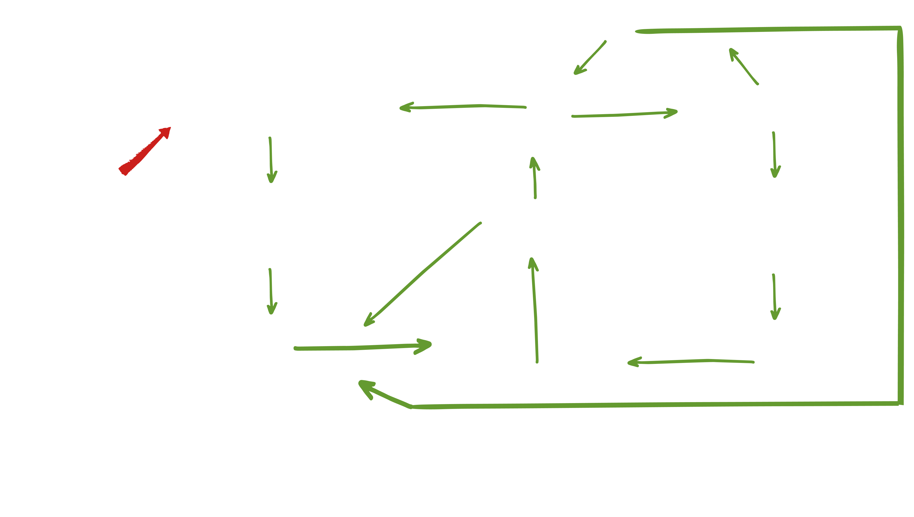
Map It: Building the Map
Drill Deeper wells
Less vegetation. More soil erosion and sediment flowing into ponds with rainfall runoff
Less water in the aquifer
Less water in wells
Logging
the forest
Less pond capacity. Less water transferred to aquifer
Less irrigation water. Less agricultural work and food production in village
More sediment in ponds. More labor required to maintain ponds
Less motivation, social organization and technology for ponds
Less village labor committed to maintaining ponds
More men migrate to cities for work to send money home
The Rajasthan map has the same basic structure: causes feeding losses, losses feeding more causes. But there are more loops, and they interact. The diagram gets harder to read. That's not a problem with the diagram. That's an accurate picture of what the community was facing.
Notes:
Don't walk through every connection. Point to the diagram as a whole. Then trace one loop to show how cycles feed each other. The idea to land: same structure, more cycles.

Slide 12
Map It: Building the Map
Look at what you have.
Where do causes loop back into losses?
Where does the system feed itself?
That's where the lever is likely to be, and in our next session, we’ll try to find it.
Notes:
Don't answer these questions for them. Let them sit with the diagram they built. If the room is quiet, that's fine. You're moving into the next phase. This slide is the handoff.

