Slide 1
Apo Island
Reverse It: Finding the Lever
The community has mapped how things got worse.
Now the question is: where could things change?
Notes:
Set the scene before starting. The room should know this is a community mapping session before the first slide. Brief introductions if participants don't know each other.

Slide 2
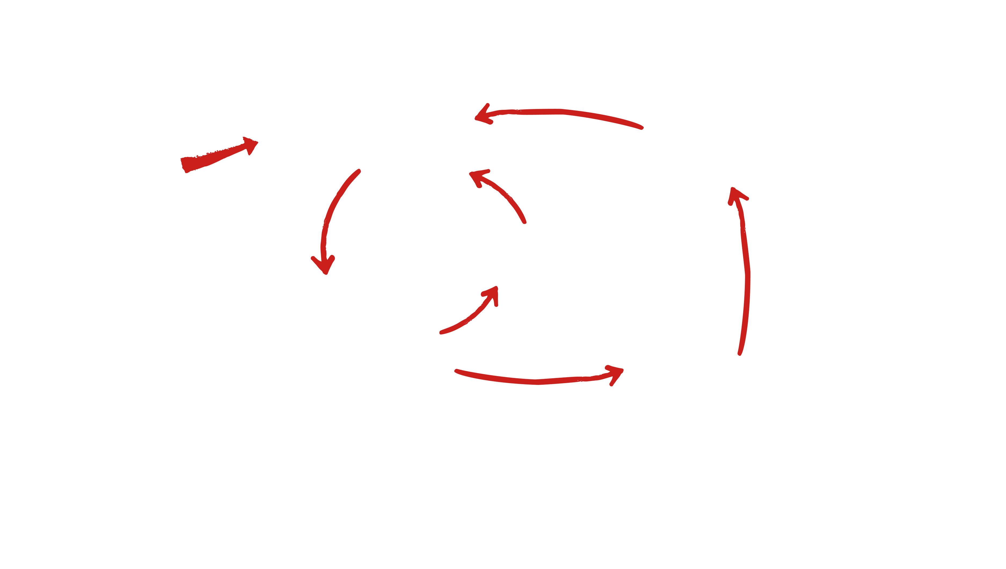


Reverse It: Finding the Lever
More use of destructive fishing
Less incentive for sustaining fishery
Introduction of Destructive Fishing Methods
Fewer Fish
DIAGRAM KEY
More damaged coral habitat and less fish
Fishing further away from home
= Negative Lever
= Action
= Result
The fishing families of Apo Island had mapped their situation. Two vicious cycles, feeding each other. Somewhere in this system is the place where things could change.
Notes:
Transition slide. Brief pause. The last mapping session produced a diagram; now this session uses it. Don't re-explain the mapping process.

Slide 3

Reverse It: Finding the Lever
Creation of a marine sanctuary
DIAGRAM KEY
= Positive Lever
= Action
= Result
The fishermen of Apo Island found their answer in the reef itself. A small no-fishing sanctuary along ten percent of the island's shoreline. That was the lever.
Notes:
The lever. Let the simplicity of it land; ten percent of the shoreline. Ask the room: does this feel too small to matter? Then move on.

Slide 4
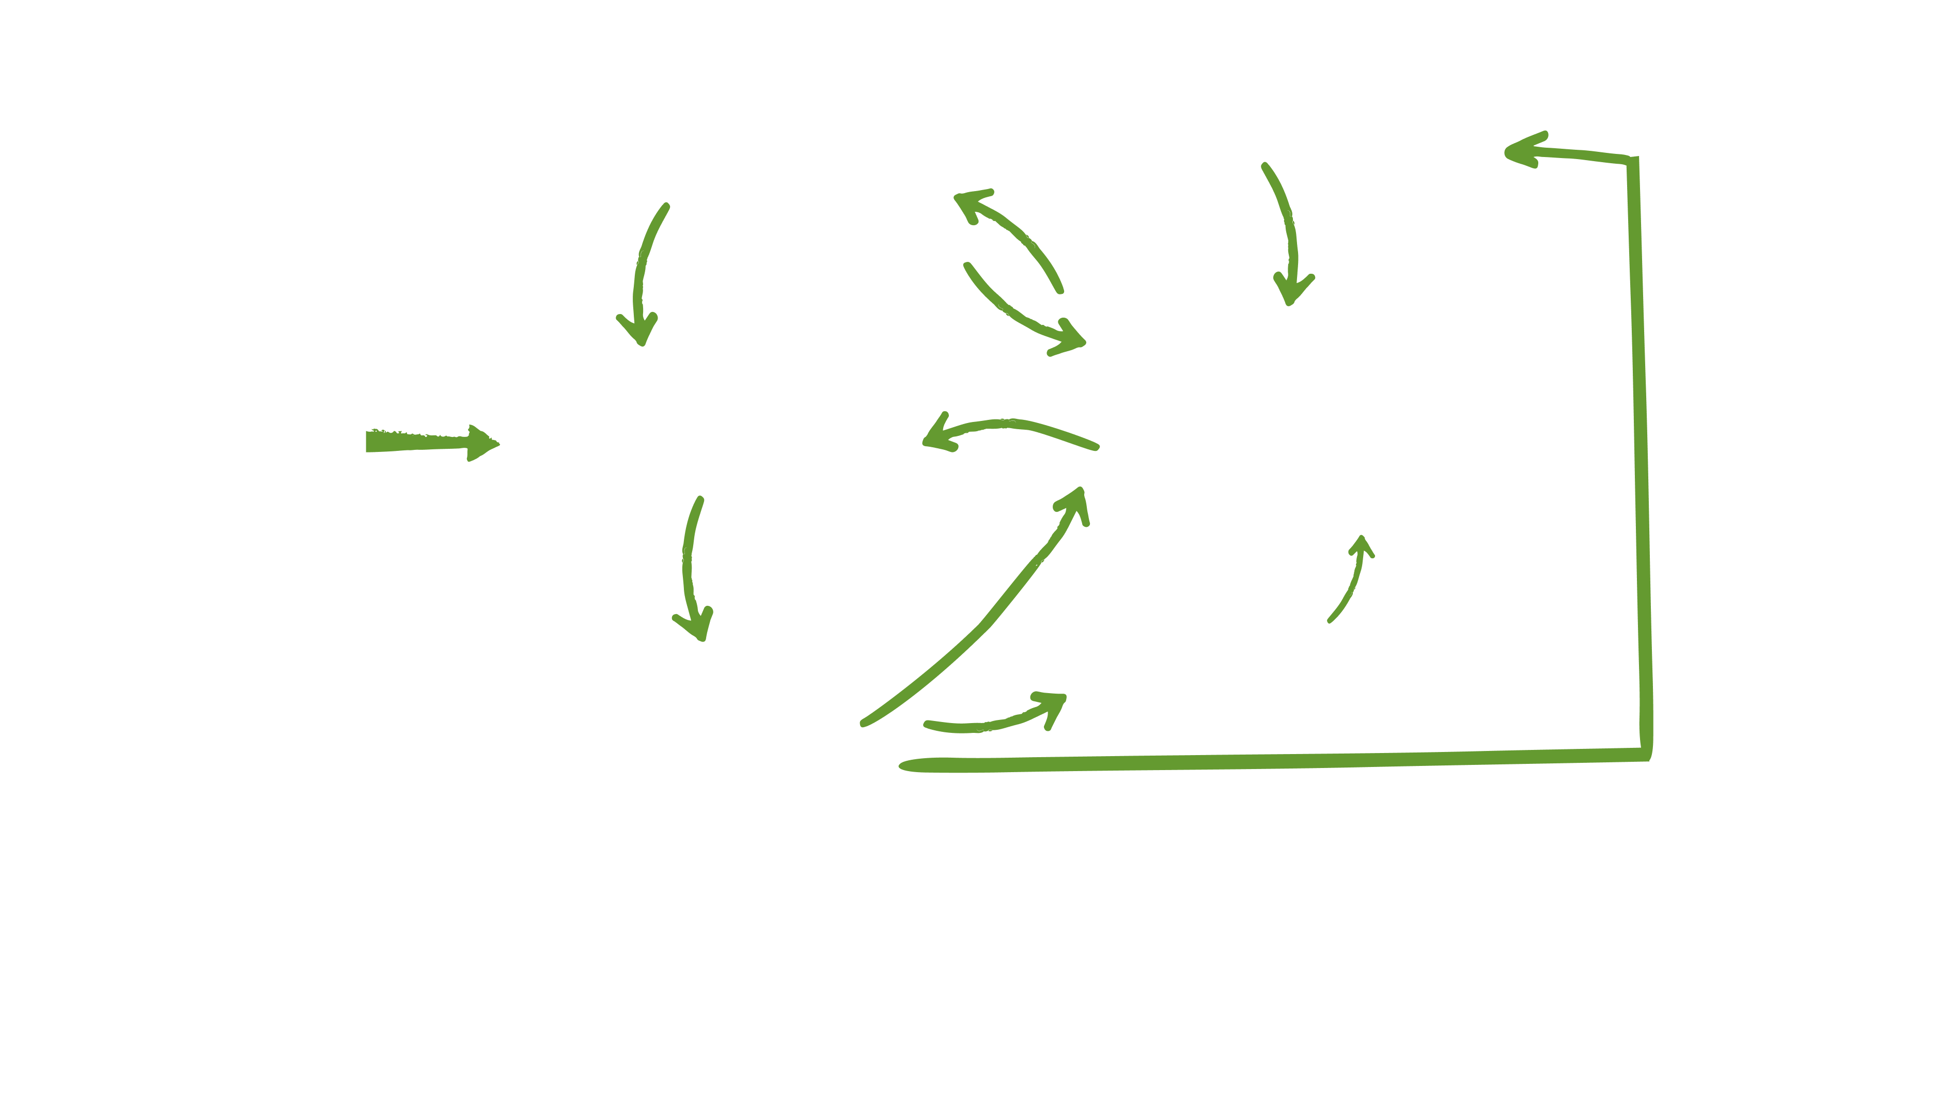
Reverse It: Finding the Lever
More experience, Knowledge, and commitment to sustainability of local marine ecosystem
Creation of a marine sanctuary
Less use of destructive fishing methods
More Coral Reef habitat and more fish
DIAGRAM KEY
= Positive Lever
= Action
= Result
Nature did the rest. Protected from fishing, the coral began to heal. Fish populations grew. As fish increased, the community's experience and commitment to protecting the reef grew with it.
Notes:
Point to where the sanctuary sits in the diagram. The lever doesn't have to be large; it has to be in the right place.

Slide 5
Reverse It: Finding the Lever
More experience, Knowledge, and commitment to sustainability of local marine ecosystem
Creation of a marine sanctuary
Less use of destructive fishing methods
More Coral Reef habitat and more fish
DIAGRAM KEY
= Positive Lever
= Action
= Result
That commitment fed back into everything. Less destructive fishing, a healthier reef and more fish. The first virtuous cycle.
Notes:
This is the first sign of a virtuous cycle. Something small, done consistently, beginning to change the conditions around it. Trace the loop with your finger. Show how each step feeds the next. This is what a virtuous cycle looks like in motion.

Slide 6
Reverse It: Finding the Lever
More effective management of the Island's fishing ground
More effective management of the Island's fishing ground
More experience, Knowledge, and commitment to sustainability of local marine ecosystem
Creation of a marine sanctuary
Less use of destructive fishing methods
More Coral Reef habitat and more fish
DIAGRAM KEY
= Positive Lever
= Action
= Result
More effective management increased experience and knowledge which in turn improved management. A second virtuous cycle.
Notes:
This second cycle comes out of the first. You don't plan it; you create conditions for it. Ask: 'What might a second cycle look like in your community's situation?'

Slide 7
Reverse It: Finding the Lever
More effective management of the Island's fishing ground
More experience, Knowledge, and commitment to sustainability of local marine ecosystem
Creation of a marine sanctuary
Less use of destructive fishing methods
More Coral Reef habitat and more fish
DIAGRAM KEY
= Positive Lever
= Action
= Result
More effective management increased experience and knowledge which in turn improved management. A third virtuous cycle.
Notes:
When the work is being carried out effectively and giving the community opportunities to learn about solutions, commitment increases.

Slide 8
Reverse It: Finding the Lever
More effective management of the Island's fishing ground
More experience, Knowledge, and commitment to sustainability of local marine ecosystem
Creation of a marine sanctuary
Less use of destructive fishing methods
More fishing at home fishing ground
More Coral Reef habitat and more fish
DIAGRAM KEY
= Positive Lever
= Action
= Result
Within two years, fish were spilling out of the sanctuary. Fishermen stopped traveling far out to fish in waters that weren't theirs to protect. There were enough fish at home. Fishing locally, where they had to live with the consequences, made the commitment stronger. A fourth virtuous cycle.
Notes:
Point out how the new virtuous cycle feeds back into the others and reinforces them.

Slide 9
Reverse It: Finding the Lever
More effective management of the Island's fishing ground
More Coral Reef tourism and education
More experience, Knowledge, and commitment to sustainability of local marine ecosystem
Creation of a marine sanctuary
Less use of destructive fishing methods
More fishing at home fishing ground
More Coral Reef habitat and more fish
DIAGRAM KEY
= Positive Lever
= Action
= Result
The reef's recovery brought something new: visitors. Tourism brought income. That income went into marine education and scholarships. More knowledge fed back into better management, which kept the reef healthy and brought more tourism. A fifth virtuous cycle.
Notes:
You cannot plan for everything that will create new virtuous cycles, but it will happen naturally if you direct gains from the success back into new efforts to serve the community.

Slide 10
Reverse It: Finding the Lever
More effective management of the Island's fishing ground
More Coral Reef tourism and education
More experience, Knowledge, and commitment to sustainability of local marine ecosystem
Creation of a marine sanctuary
Less use of destructive fishing methods
More fishing at home fishing ground
More Coral Reef habitat and more fish
DIAGRAM KEY
= Positive Lever
= Action
= Result
All of these cycles were now reinforcing each other. The vicious cycle that had driven the decline was being overpowered. The same system was now pushing toward recovery.
Notes:
This is a later-stage cycle; it couldn't have been planned at the start. Name that: each new virtuous cycle is a sign that recovery is deepening, not that the original plan was finished.

Slide 11
Reverse It: Finding the Lever
More effective management of the Island's fishing ground
More Coral Reef tourism and education
More experience, Knowledge, and commitment to sustainability of local marine ecosystem
Creation of a marine sanctuary
Less use of destructive fishing methods
More fishing at home fishing ground
More Coral Reef habitat and more fish
DIAGRAM KEY
= Positive Lever
= Action
= Result
This is what a tipping point looks like when it goes the other way. Locked in by experience, knowledge, and a community that understood what they had built.
Notes:
The key image before moving to Rajasthan: the system that made things worse is the same system, rearranged, that makes things better. Same structure. Direction changed.

Slide 12
Rajasthan
Reverse It: Finding the Lever
Some systems are more complex with no obvious fix. The lever is somewhere unexpected. Finding the lever takes patience; it takes more voices in the room.
Notes:
Brief transition. Don't dwell. The point is that complexity is normal; a more tangled situation doesn't mean the lever isn't there. Move on quickly.

Slide 13
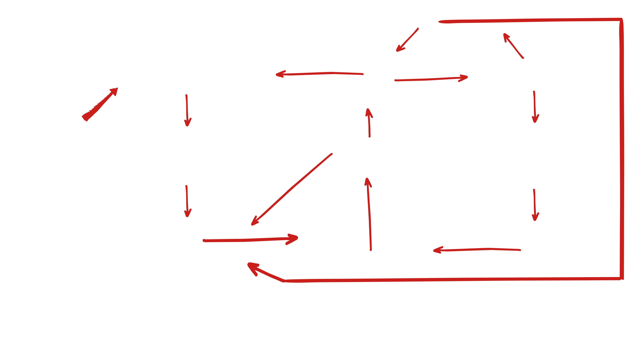
Reverse It: Finding the Lever
Drill Deeper wells
Less vegetation. More soil erosion and sediment flowing into ponds with rainfall runoff
Less water in the aquifer
Less water in wells
Logging
the forest
Less pond capacity. Less water transferred to aquifer
Less irrigation water. Less agricultural work and food production in village
More sediment in ponds. More labor required to maintain ponds
The original cause couldn't be reversed. The forests were gone. That door was closed.
DIAGRAM KEY
= Negative Lever
= Action
Less motivation, social organization and technology for ponds
Less village labor committed to maintaining ponds
More men migrate to cities for work to send money home
= Result
In Rajasthan, the map was more complicated. Finding the lever took longer. The Rajasthan map has four vicious cycles feeding into each other. When the community found the right lever, all four began to shift. Not all at once, and not without effort. But the direction changed.
Notes:
Don't walk through every connection. Point to the diagram as a whole. Then trace one loop to show how cycles feed each other. The idea to land: same structure, more cycles.

Slide 14
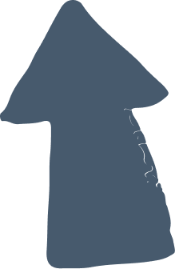
Reverse It: Finding the Lever
Drill Deeper wells
Less vegetation. More soil erosion and sediment flowing into ponds with rainfall runoff
Less water in the aquifer
Less water in wells
The root cause could not be reversed. The forests were gone. That door was closed.
Logging
the forest
Less pond capacity. Less water transferred to aquifer
Less irrigation water. Less agricultural work and food production in village
More sediment in ponds. More labor required to maintain ponds
The original cause couldn't be reversed. The forests were gone. That door was closed.
DIAGRAM KEY
= Negative Lever
= Action
Less motivation, social organization and technology for ponds
Less village labor committed to maintaining ponds
More men migrate to cities for work to send money home
= Result
In Rajasthan, the map was more complicated. Finding the lever took longer. The Rajasthan map has four loops. When the community found the right lever, all four began to shift. Not all at once, and not without effort. But the direction changed.
Notes:
They need to look at other spots where they can take action, and think about whether that action would be a powerful lever and workable for the community.

Slide 15
Reverse It: Finding the Lever
Drill Deeper wells
Less vegetation. More soil erosion and sediment flowing into ponds with rainfall runoff
Less water in the aquifer
Less water in wells
Logging
the forest
Migration to the cities can't be reversed when the agricultural work at home has dried up.
Less pond capacity. Less water transferred to aquifer
Less irrigation water. Less agricultural work and food production in village
More sediment in ponds. More labor required to maintain ponds
The original cause couldn't be reversed. The forests were gone. That door was closed.
DIAGRAM KEY
= Negative Lever
= Action
Less motivation, social organization and technology for ponds
Less village labor committed to maintaining ponds
More men migrate to cities for work to send money home
= Result
In Rajasthan, the map was more complicated. Finding the lever took longer. The Rajasthan map has four loops. When the community found the right lever, all four began to shift. Not all at once, and not without effort. But the direction changed.
Notes:
Although men returning might set change in motion, on it’s own it is not powerful enough to set nature on the path to restoring itself.

Slide 16
Reverse It: Finding the Lever
Drill Deeper wells
Less vegetation. More soil erosion and sediment flowing into ponds with rainfall runoff
Less water in the aquifer
Less water in wells
The community cannot stop drilling without making their water security even worse.
Logging
the forest
Less pond capacity. Less water transferred to aquifer
Less irrigation water. Less agricultural work and food production in village
More sediment in ponds. More labor required to maintain ponds
The original cause couldn't be reversed. The forests were gone. That door was closed.
DIAGRAM KEY
= Negative Lever
= Action
Less motivation, social organization and technology for ponds
Less village labor committed to maintaining ponds
More men migrate to cities for work to send money home
= Result
In Rajasthan, the map was more complicated. Finding the lever took longer. The Rajasthan map has four loops. When the community found the right lever, all four began to shift. Not all at once, and not without effort. But the direction changed.
Notes:
An action needs to be workable and effective.

Slide 17

Reverse It: Finding the Lever
Drill Deeper wells
Less vegetation. More soil erosion and sediment flowing into ponds with rainfall runoff
Less water in the aquifer
Less water in wells
Here is the lever that worked. The traditional rainwater collection ponds had silted up. Maintaining them was something the community could actually do. Once that started, the water table recovered, vegetation returned, men came back, and the other cycles began to follow.
Logging
the forest
Less pond capacity. Less water transferred to aquifer
Less irrigation water. Less agricultural work and food production in village
More sediment in ponds. More labor required to maintain ponds
DIAGRAM KEY
The original cause couldn't be reversed. The forests were gone. That door was closed.
= Negative Lever
= Action
= Result
Less motivation, social organization and technology for ponds
Less village labor committed to maintaining ponds
More men migrate to cities for work to send money home
In Rajasthan, the map was more complicated. Finding the lever took longer. The Rajasthan map has four loops. When the community found the right lever, all four began to shift. Not all at once, and not without effort. But the direction changed.
Notes:
The lever they found was workable, even if it took a lot of effort. It worked because it allowed nature to do the work (See Ingredients for success).

Slide 18
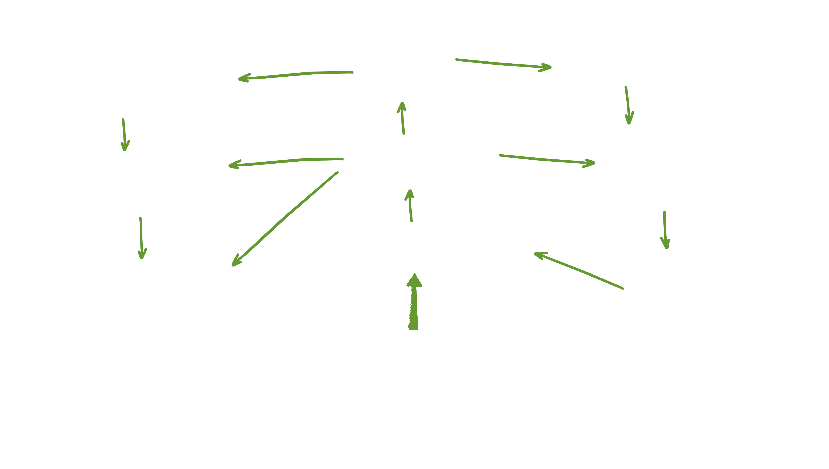
Reverse It: Finding the Lever
More water in the aquifer
More water in wells
More vegetation. Less soil erosion and sediment flowing into ponds with rainfall runoff
More pond capacity and more water transferred to aquifer
More irrigation water. More agricultural work and food production in village
Less sediment in ponds. Less
labor required to maintain ponds
More village labor committed to restoring and maintaining ponds
More motivation, social organization, and technology for the ponds
More men return to village
Restoring ponds and traditional village council
DIAGRAM KEY
= Positive Lever
= Action
= Result
The ponds were modest. The work was slow. But because the ponds sat at a place where several loops connected, maintaining them changed the conditions for everything else. This is what a lever can look like in a complex system. It often takes looking past the obvious answer.
Notes:
Use the same color coding as the negative diagram; participants should see the same loops, now running in the other direction. Point to the lever node. Trace one loop to show the direction has changed. Same system. Different direction.

Slide 19
Reverse It: Finding the Lever
Look at your diagram.
Where do the vicious cycles overlap?
Where could a change in one place affect more than one cycle?
That's a good place to start looking for the lever.
Notes:
Don't answer these questions for them. Let them sit with the diagram they built. If the room is quiet, that's fine. You're moving into brainstorming. This slide is the transition from example to their own problem.

