Slide 1
Introduction to stochasticity
Juan Vesga
with thanks to Neil Ferguson, Michael White, Déirdre Hollingsworth & James Truscott
Dept. of Infectious Disease Epidemiology
Faculty of Medicine
Imperial College

Slide 2
Plan & objectives
What are stochasticity and persistence and why are they important?
Some important consequences of stochasticity on disease dynamics:
  Variability
  Persistence and critical community size
  Fade out probability
Criterion for disease persistence: the SIR & SIS paradigms.
Formulating stochastic models.

Slide 3
Stochasticity
Deterministic models
  try to capture ‘average’ behaviour.
  …but in reality transmission/demographic processes are random.
Stochasticity
  Randomness.
  Disease transmission really a process of discrete, random infection/recovery and other events.
  Stochastic models generate ‘random’ output, so many independent runs are needed to calculate average behaviour, variances, correlations, etc.
Complicating factors
  Heterogeneity (behavioural, spatial, temporal).

Slide 4
Stochastic population processes
A stochastic model consists of a population and a number of event types.
The population may consist of individuals or of sub-populations in given states. E.g. susceptible, infected, ‘recovered’, etc.
Event types could be infection, recovery, death, etc.
Simple basic idea – in any time interval there is a certain probability of each type of event occurring (e.g. birth/death).
Deterministic models approximate by saying that in any time interval, the mean number of events of any particular type occur. They also assume population sizes to be real, not integer numbers.

Slide 5
Simple birth-death process (1)
Deterministically
- with solution
For ω>m, N grows exponentially. For ω <m, N decreases asymptotically to zero. For ω =m, N remains constant.
Here N(t) represents the average number of individuals alive at time t. Should be careful in interpreting it as the real number of people alive – since the model in that case tells you that a fraction of an individual can be alive, and a fraction dead.
50

Slide 6
Simple birth-death process (2)
We need a complete description of the stochastic model so we
can simulate it. For the present case:
Population: N identical individuals.
Name | What happens to population | Rate/individual
Birth | N →N + 1 | ω
Death | N →N - 1 | μ
So in a short time period, dt, and a population of size N,
For each individual the probability of a birth is ωdt
So the expected number of births is ωNdt
(we will discuss this later in the lecture)

Slide 7
Simple birth-death process (3)
Stochastically
Between time t at time t+dt a short time later, one of two events might happen:
  A birth – with probability ωdt per individual
  A death – with probability μdt per individual
Stochastic simulation involves picking these events randomly to generate a single realisation:

Slide 8
Population size and stochasticity
N₀=1000
N₀=100
N₀=10

Slide 9
Stochasticity and persistence
What is persistence?
  The ability of a disease to remain endemic.
Deterministic models tell us R₀>1 is only criterion for persistence.
In fact, random fluctuations often drive diseases to extinction.
Population size, N, a key issue (& space).
Stochastic effects can give fundamentally different dynamics – especially for cyclical epidemics.

Slide 10
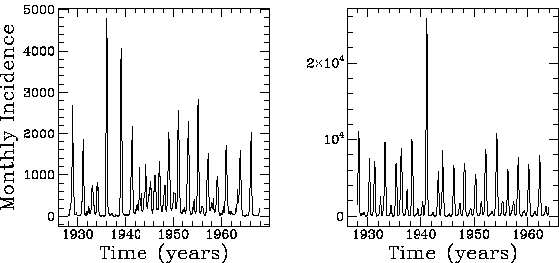
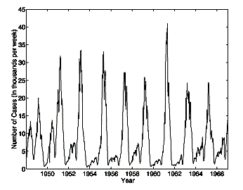
Measles dynamics
Predominantly biennial cycles, but strong annual & triennial components
UK
Copenhagen
New York

Slide 11
Deterministic model of Measles
Seasonally forced model – transmission varies annually.
Equivalent of equilibrium is limit cycle - sustained incidence oscillations - not necessarily of same period as forcing.
Cycles completely regular.

Slide 12
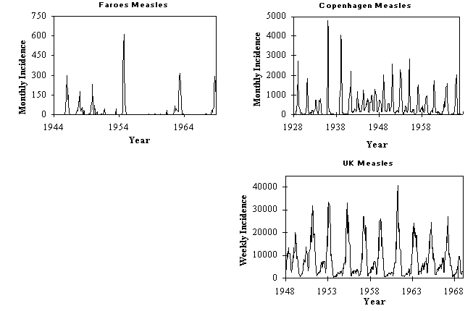
Effect of stochasticity
Disease extinction likely by random chance when number of infectives falls to very low numbers.
- so extinction more frequent as population size decreases.

Slide 13
Effect of stochasticity on SEIR dynamics
Phase space plots of biennial epidemics:
Stochastic
Deterministic
Y=Infective
X=Susceptible
Notes:
Y= Infective , X=Susceptible

Slide 14
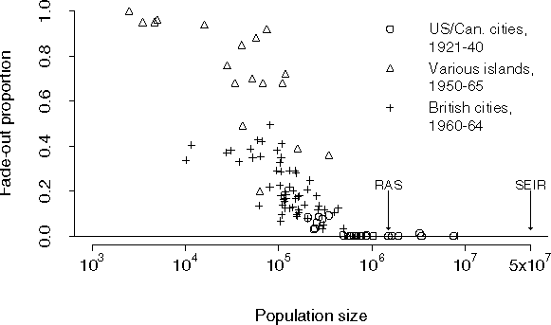
Critical community size
CCS = minimum population size at which fadeouts become rare.

Slide 15
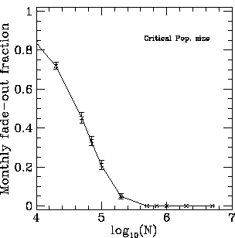
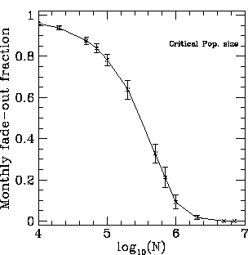
Modelling measles persistence
Age- and spatially- structured measles models reproduce observed pattern of extinction better than simple homogenous models.
Use constant importation of infectives as crude representation of spatial coupling.
For realistic importation levels, observed persistence behaviour is (nearly) reproduced - i.e. fade-outs in small populations, noisy time-series in city-sized communities, and predominately biennial cycles in larger populations.
Islands
Cities

Slide 16
Persistence
Epidemic prediction/control strategy design needs to take account of stochastic effects.
Different pathogens adopt different strategies to persist.
Key requirement is to keep prevalence of infectives, Y, at level where extinction becomes unlikely by chance.
Extinction
likely
Y*
Y*

Slide 17
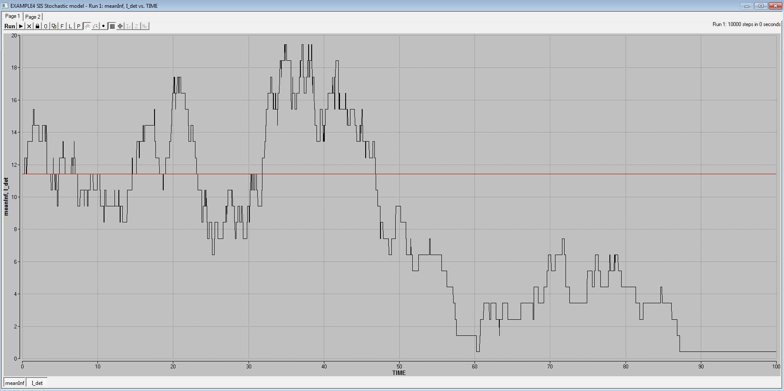
Persistence

Slide 18
Disease epidemiology and persistence:
a simple criterion for disease persistence
Given random fluctuations are approximately Poisson, their variance is proportional to N.
i.e. fluctuations have SD ~ √N
A disease goes extinct when the number of infectives (Y) falls to 0.
A crude rule of thumb is therefore that extinction will be unlikely if E[Y]>√N.
Thus diseases have an advantage if they can maintain the highest possible numbers of infectives for a given population size.
Infectious period and immunity are therefore key.

Slide 19
SIR/SIS persistence criteria
A lot can be inferred from just examining the relationship between prevalence and epidemiological parameters.
SIS (STDs etc)
SIR (measles etc)
Herd immunity threshold S< N/R0

Slide 20
SIR/SIS persistence criteria
What is value of N above which Y*> √N ? ➔ N_{crit}
SIS (STDs etc)
SIR (measles etc)

Slide 21
Critical community size
CCS = minimum population size at which fadeouts become rare.
Data: Bolker and Grenfell Phil Trans Roy Soc 1995

Slide 22
Mechanisms for enhancing persistence
Antigenic variation (or not generating permanent host immunity) clearly gives a large advantage – which is why STDs are found in even very small communities.
SIR diseases with short infectious periods like measles, rubella etc. need very large (>500,000) populations to be able to persist – otherwise they burn out the susceptible population too quickly.
A long infectious period (or disease recrudence, like chickenpox) compared with host lifespan is also an effective strategy – it pays to be chronic.
Disease like influenza fall between the SIR/SIS camps – antigenic drift requires fairly large populations to happen, but does allow disease persistence in smaller populations than measles.
Not just an abstract issue – critical to evaluations of how realistic disease eradication programmes might be.

Slide 23
Fade out probability
infecteds
infecteds
infecteds
time
time
time
In a deterministic model, if R₀ > 1 a seeded epidemic will never fade out. In reality, an epidemic may never take off due to chance events, for example the first infected case may never contact other individuals.
Stochastic models allow epidemic fade out (i.e. I = 0).
For an epidemic (R₀ > 1) beginning with a single case in a large population, it can be shown that:

Slide 24
The importance of
stochasticity during outbreaks
If the initial seeding of a new outbreak only infects very low numbers of people (1 or 2), then the probability of disease extinction by random chance in the establishment phase is significant, and the rate of early spread is quite variable.
Stochasticity also important in the tail of an epidemic

Slide 25
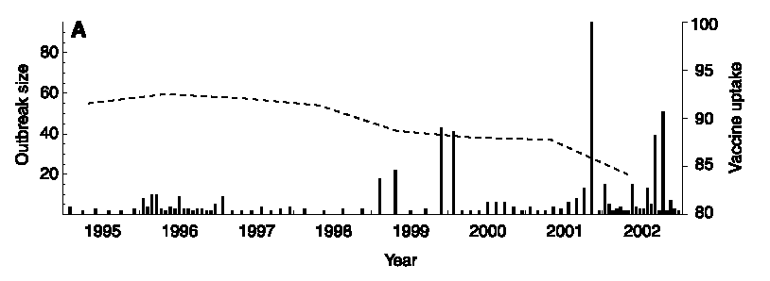
The impact of reduced MMR uptake:
an example of the use of stochastic models
The current concern about MMR uptake levels makes predicting the likelihood of a large measles outbreak a priority.
Can data on the current small outbreaks seen in the last few years tell us anything?
[Jansen, V.A.A. et al, Science (2002), 301:804]

Slide 26
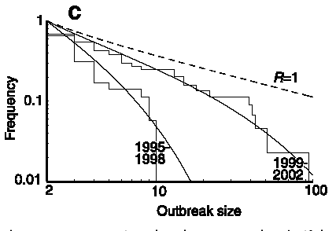
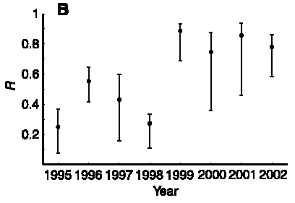
Inferring R from outbreak size distributions
For sub-critical transmission, possible to estimate R from the distribution of outbreak sizes (m=2/(1-R), where m is mean outbreak size).
This analysis shows a significantly increased level of transmission in the period 1999-2002 compared with 1995-98.
R is now dangerously close to 1 – meaning a major measles outbreak is due any time.
This is an intrinsically stochastic analysis – since outbreak size is a random variable.

Slide 27
Formulating a stochastic model

Slide 28
Formulations of a stochastic model
Individual based/agent based models
  Simulate each individual and events which happen to each individual
  Can include much realistic detail, but can be slow to simulate
Population or compartmental based models
  Only keep track of total number of individuals in each compartment
  Simulate the number of events that will happen to that group of individuals
  Faster to simulate

Slide 29
Hazard
The hazard is the probability per unit time of an event happening.
It is equivalent to the instantaneous per-capita rate used in a deterministic model.
E.g. If an infected person has a hazard or rate of recovery of σ:
Infected
Recovered
Probability of recovering in time dt is σdt, for small dt.
Notes:
SHOULD I TALK ABOUT MULTIPLE HAZARDS HERE OR LEAVE UNTIL LATER?

Slide 30
Hazard
If we have N individuals who are all identical (with respect to the process we’re talking about), the binomial distribution describes the distribution of the number of events in a given time.
N trials of something with probability p, number of successes is a binomially-distributed random number:
Binomial(p,N)
Infected
N
σ
Recovered
  Number of recoveries in dt is from Binomial(σdt, N)
Notes:
SHOULD I TALK ABOUT MULTIPLE HAZARDS HERE OR LEAVE UNTIL LATER?

Slide 31
Competing hazards
Consider a population of susceptibles which can become infected (rate: λ) but can also die (rate: μ). But they can’t do both at the same time!
In a time period, dt, how many die and how many become infected?
X
λ
Infected
μ
Death

Slide 32
Competing hazards
It turns out that we can add the rates of the different events to
get the total number to which anything happened.
Then we can decide which of the two things happened to each.
X
λ
Infected
μ
Death
  Total number of events:
  Split into H₁ and H₂:

Slide 33
Simple infection process
A stochastic model is completely described by two things:
The state of the population. E.g. the number of individuals in
susceptible, infected, recovered states, etc.
All possible events and their rates. E.g. infection rate, death rate,
recovery rate, etc.
For the present case:
Population: S identical susceptible individuals,
I identical infected individuals.
Name | What happens to population | Rate/individual
Infection | S →S – 1, I→I + 1 | λ
recovery | I →I - 1 | σ

Slide 34
Individually-based simulations
Treat every individual separately.
For synchronous update case, choose small update time-step, dt.
Only one event could happen to the individual – get infected (rate λ)
Every time-step, for each individual pick random number p (uniformly distributed between 0 and 1). If
  p<λdt - the individual has given become infected, so S→S-1, I → I+1.
  p>λdt - nothing happens.
0
λdt
1
p
Infection
Nothing happens

Slide 35
Multiple individuals-IBM
Infection
No infection or death
0 λΔt 1-λΔt 1
Each susceptible individual is ‘identical’
Could generate a random number for each (22 random numbers)
and discover if infection or death
e.g. 5 new infections, 17 no change

Slide 36
Multiple individuals-Compartment
Infection
No infection or death
0 λΔt 1-λΔt 1
22 individuals, probability of infection per individual λDt
Use Binomial to generate number of ‘sucesses’,
Infections = Binomial(λDt,S) = 7 infections (for example)

Slide 37
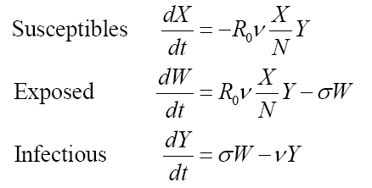
SEIR model
Hollingsworth et al (2006) Nature Medicine

Slide 38
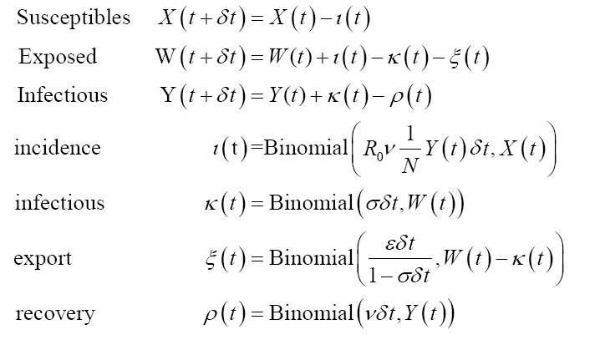
SEIR model
Hollingsworth et al (2006) Nature Medicine

Slide 39
SEIR model
Number moving from susceptible to exposed
Hollingsworth et al (2006) Nature Medicine

Slide 40
SEIR model
Number moving from susceptible to exposed
rate
Hollingsworth et al (2006) Nature Medicine

Slide 41
Summary
Stochastic effects important when considering
  persistence
  dealing with small populations (start and tail of epidemics)
  or spatial spread.
By chance can have outbreaks, even when R₀<1
By chance can have no outbreak when R₀>1
Stochastic models can be relatively simple to program, difficult to analyse.

Slide 42
Further reading
Books:
Renshaw, E., Modelling biological populations in space and time, Cambridge Univ. press, 1991
Bailey, N.T.J., The mathematical theory of infectious diseases and its applications, 2nd edition, Griffin, 1975
Papers:
Bartlett, M. S. (1957). "Measles periodicity and community size." J. Roy. Stat. Soc. A 120: 48-70.
Bolker, B. M. and B. T. Grenfell (1995). "Space, persistence and dynamics of measles epidemics." Proc. Roy. Soc. Lond. B 348: 308-320.
Jansen, V. A. A., N. Stollenwerk, et al. (2003). “Measles outbreaks in a population with declining vaccine uptake." Science 301(5634): 804-804.
Farrington, C. P., M. N. Kanaan, et al. (2003). "Branching process models for surveillance of infectious diseases controlled by mass vaccination." Biostatistics 4(2): 279-295.

Slide 43
The end

Slide 44
Population simulations
Individual based models can be very slow, and computing time increases as N.
If events are independent, the number of events of type i in a fixed time, Dt, can be simulated by sampling from a binomial distribution (it can also be simulated by sampling from a Poisson distribution). Hence in a population of size S, the number of events of type i, is given by
When there are multiple events competing with each other, binomial or multinomial approximations perform better than using sampling from several Poisson distributions, and allow more consistent model formulation.

Slide 45
Advanced: Binomial versus Poisson
Poisson distribution simulates the number of events that will happen in a small timestep = Poisson(ωΔtN(t))
Binomial formulation Binomial(ωΔt,N(t)) says there are N(t) tries, each with probability of success approximated by ωΔt, how many are successful?
  Can’t have more events than there are people
  For small timesteps won’t matter, since there won’t be many events
  Have to calculate multinomials when there are multiple competing hazards

Slide 46
Advanced: Synchronous versus asynchronous
Synchronous: at each timestep simulate all the events that could have occurred.
Asynchronous: simulate when the next event is, and move forward to that time point,
If there are many possible events each with a low probability of occurring, particularly in individual based simulations, its may be more efficient to have an asynchronous model

