Slide 1
Sensitivity and Uncertainty Analysis in Models
Juan Vesga
with thanks to Michael White & James Truscott
Dept. of Infectious Disease Epidemiology
Faculty of Medicine
Imperial College

Slide 2
The nature of the problem
Data
Model
Result
Raw data: incidence,
serological data, etc.
or parameter values
from other studies.
Property or statistic of
the system (Contact rate,
R₀, etc.)
Deterministic or
stochastic

Slide 3
Uncertainty
Data
Model
Result
?
Stochastic or
deterministic model
Data error
Uncertainty in result

Slide 4
Sensitivity
Data
Model
Result
For a deterministic model, two types:
Local sensitivity: change in result for given change in parameter.
Global sensitivity: how uncertainty in result is related to that of
any input parameter.

Slide 5
Model for illustration of parameter sensitivity
Outbreak of an SIR type in finite population, e.g. influenza, measles, Rubella,
Hepatitis A.
Scenario: introduce I₀ infectives into a population of N-I₀ susceptibles.
: rate /day,
: rate μ /day

Slide 6
Model for illustration of parameter sensitivity
The model can be described by the following system of equations:
R₀ = 2
I₀ = 100

Slide 7
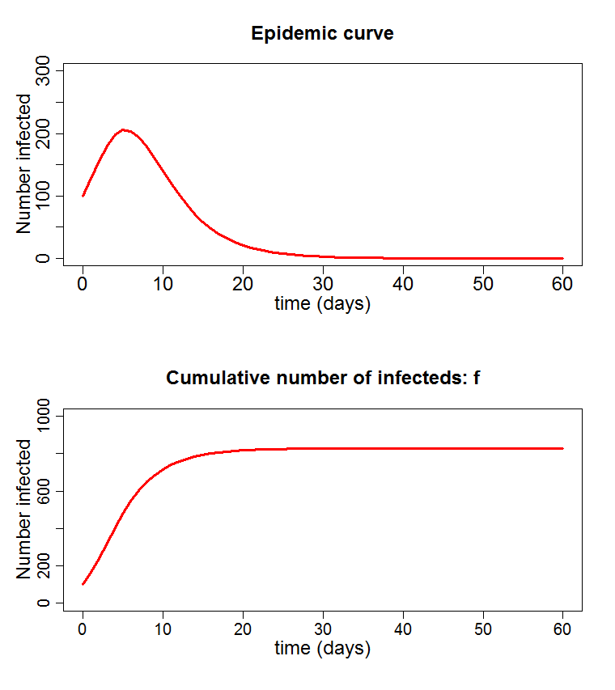
Model for illustration of parameter sensitivity
The model can be described by the following system of equations:
R₀ = 2
I₀ = 100

Slide 8
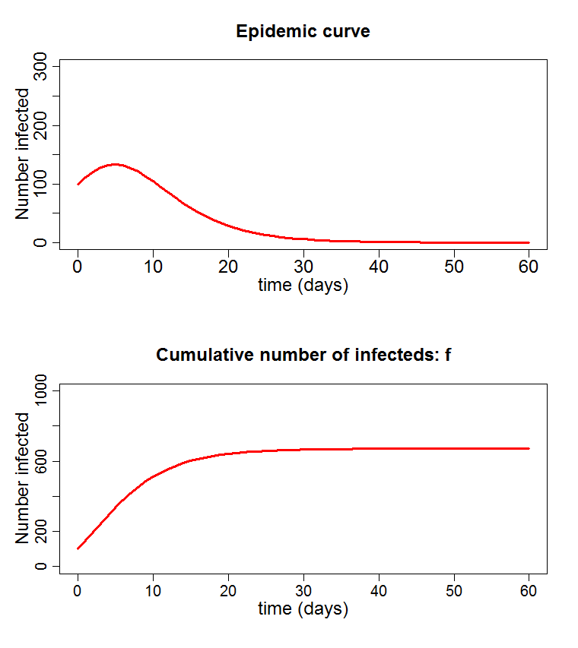
Model for illustration of parameter sensitivity
The model can be described by the following system of equations:
R₀ = 1.5
I₀ = 100

Slide 9
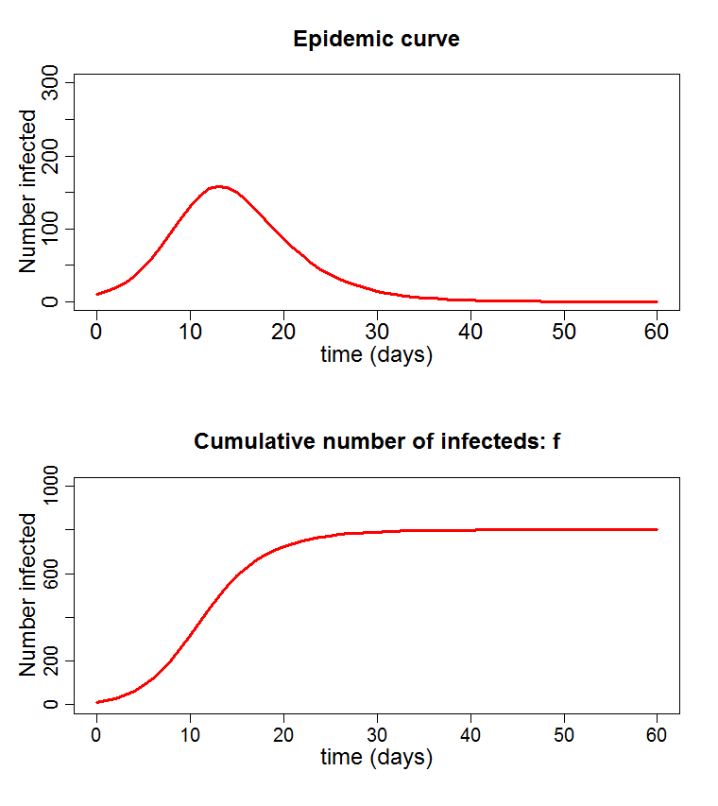
Model for illustration of parameter sensitivity
The model can be described by the following system of equations:
R₀ = 2
I₀ = 10

Slide 10
Model for illustration of parameter sensitivity
We are interested in the number of individuals infected over the course of the
epidemic, a.k.a. the final size, f, or attack rate, as it depends on I₀ and R₀.
For a deterministic model,

Slide 11
Model for illustration of parameter sensitivity
We are interested in the number of individuals infected over the course of the
epidemic, a.k.a. the final size, f, or attack rate, as it depends on I₀ and R₀.
For a deterministic model,
Sensitivity to variation in R₀:
I₀ | R₀ | f
100 | 1.25 | 544
100 | 1.5 | 671
100 | 2 | 828
100 | 3 | 948
100 | 4 | 982

Slide 12
Model for illustration of parameter sensitivity
We are interested in the number of individuals infected over the course of the
epidemic, a.k.a. the final size, f, or attack rate, as it depends on I₀ and R₀.
For a deterministic model,
Sensitivity to variation in I₀:
I₀ | R₀ | f
1 | 2 | 797
10 | 2 | 800
100 | 2 | 828
200 | 2 | 855
300 | 2 | 879

Slide 13
Model for illustration of parameter sensitivity
Local sensitivity looks at the change in the outcome of interest as params
are varied one at a time.
In our model, final size depends on reproduction number, R₀, and initial
infectives, I₀.
We can look at the sensitivity around R₀=2, I₀=100, say.
Doesn’t tell us how different parameters combine to affect the result.

Slide 14
Local uncertainty: delta method
Can translate variance in parameters into variance in outcome using the
slope of the graph.
For this case, delta method gives
Method is easily expandable to many parameters.
Takes into account correlations between parameters as well.

Slide 15
Local uncertainty : delta method
What about the sensitivity of f on both R₀ and I₀?
We know var(R₀) and var(I₀). What is var(f), approximately?
Delta method gives
Given no correlation between R₀ and I₀,
Problems:
Need to be able to work out the slope of the function
Function needs to be quite linear.

Slide 16
Uncertainty in deterministic model
The values of the parameters of our deterministic model are only known as
distributions:
p(R₀)
p(I₀)
1.5
2
2.5
R₀
I₀
All statistical quantities come from integrating across all possible
parameter values:
Expected:
Variance:
How do we calculate these kinds of things?

Slide 17
Direct calculation
The simplest way:
Final size
Probability
I₀
I₀
R₀
R₀
Can split the range of the parameters into small, equally sized bits.
For each square, i, calculate final size, f_{i} and probability, p_{i}.

Slide 18
Direct calculation
Can now calculate various statistical quantities as weighted sums:
E.g. mean final size:
Variance:
Mean final size = 760, Standard deviation = 108.
Advantages: very simple, robust.
Disadvantages: possibly very inefficient if calculation of f is expensive.
: need to know the shape of the probability distribution.

Slide 19
A more efficient method
Probability
R₀
R₀₁
R₀₂
R₀₃
Chop the range of the parameter into equally-likely segments.
Area under p.d.f. of each segment is the same.
Pick representative value for each one.
Note the higher probability, closer together the values are.

Slide 20
A more efficient method
1
Each choice of a pair of an I₀ value
and an R₀ value as ‘likely’ as any other.
Sample from all possible pairs or
randomly to get a series of parameter
sets:
2
3
4
I_{o}
5
6
7
8
9
10
R₀₁
R₀₂
R₀₃
R₀₄
…..
f₁
f₂
f₃
R₀
= 778
Standard deviation = 95
Need to be able to do subdivision easily (uniform, triangular, normal(?))

Slide 21
Latin hypercube sampling
If evaluation expensive, don’t want to go through all values.
LHC is a method of picking a subset of points that ‘span’ the region.
parameter 2: I₀
parameter 1: R₀

Slide 22
Latin hypercube sampling
If evaluation expensive, don’t want to go through all values.
LHC is a method of picking a subset of points that ‘span’ the region.
parameter 2: I₀
parameter 1: R₀

Slide 23
Latin hypercube sampling
If evaluation expensive, don’t want to go through all values.
LHC is a method of picking a subset of points that ‘span’ the region.
parameter 2: I₀
parameter 1: R₀

Slide 24
Latin hypercube sampling
If evaluation expensive, don’t want to go through all values.
LHC is a method of picking a subset of points that ‘span’ the region.
parameter 2: I₀
parameter 1: R₀

Slide 25
Latin hypercube sampling
If evaluation expensive, don’t want to go through all values.
LHC is a method of picking a subset of points that ‘span’ the region.
parameter 2: I₀
parameter 1: R₀

Slide 26
Latin hypercube sampling
If evaluation expensive, don’t want to go through all values.
LHC is a method of picking a subset of points that ‘span’ the region.
parameter 2: I₀
parameter 1: R₀

Slide 27
Latin hypercube sampling
If evaluation expensive, don’t want to go through all values.
LHC is a method of picking a subset of points that ‘span’ the region.
From previous example:
1
X
2
X
choose an
R₀
3
X
4
X
Increasing size
I_{o}
5
X
6
X
for each
I₀
7
X
8
X
9
X
10
X
R₀₁
R₀₂
R₀₃
R₀₄
…..
10X10 cube: mean = 780, s.d. = 86
R₀
Each parameter value appears once and only once.
Can repeat the process to get further sets.

Slide 28
Monte Carlo Markov chain
MCMC is a way of generating a sequence of parameter sets which appear to
have come from distribution.
Each new set generated from previous one, hence ‘chain’, by a rule.
Metropolis Algorithm
First, create a way of randomly picking a new set of params from the old.
(must be symmetrical. E.g. Add normal deviate to each).
From last point, (x₁,x₂), generate new point,
Calculate A, where
Get a random number, u, between [0,1].
If u<A, accept new point. Otherwise use old one again.
N.B. successive points are not independent!

Slide 29
Stochastic and probabilistic models: likelihood
Stochastic models incorporate the randomness of the processes they represent,
e.g. infection, recovery, death, etc.
Hence each run of the model will produce different results from the same
parameters.
Consider an epidemic model: we want to know what values of β produce an
observed final epidemic size.
observed
Model
Many runs
final size
Questions:
What is the ‘best’ value for β?
What range of values of β are acceptable?

Slide 30
Likelihood
Likelihood of data,
given parameters
Probability that the observed data is
generated by the model, given the parameters
=
observed
Model
Many runs
final size
By repeating for a range of β’s,
we can generate a graph of
likelihood against β.
The peak indicates the ‘best’ value, called
the maximum likelihood estimator (MLE).

Slide 31
Log likelihood and confidence interval
The shape of the log of the likelihood curve gives us the range of values of β
that fit well.
If we measure down Q from top of the curve,
This defines the 95% confidence for the parameter values.
Q

Slide 32
Uncertainty arising from data
Consider sampling a population to estimate the proportion seropositive for a malaria antigen. Assume that:
Individuals sampled = N
Individuals seropositive = k
Need to estimate the proportion seropositive p.
We use a binomial likelihood function:

Slide 33
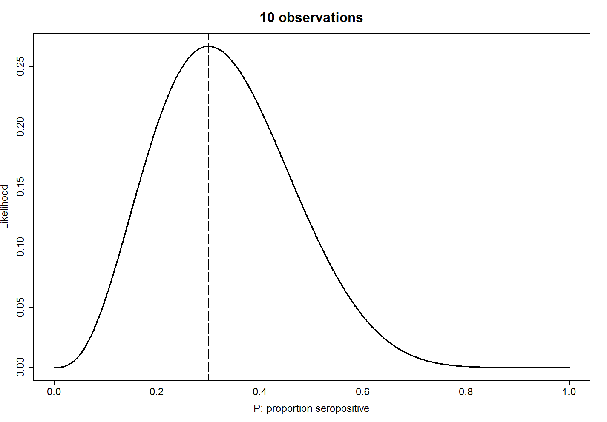
Uncertainty arising from data

Slide 34
Uncertainty arising from data
maximum
likelihood
estimate

Slide 35
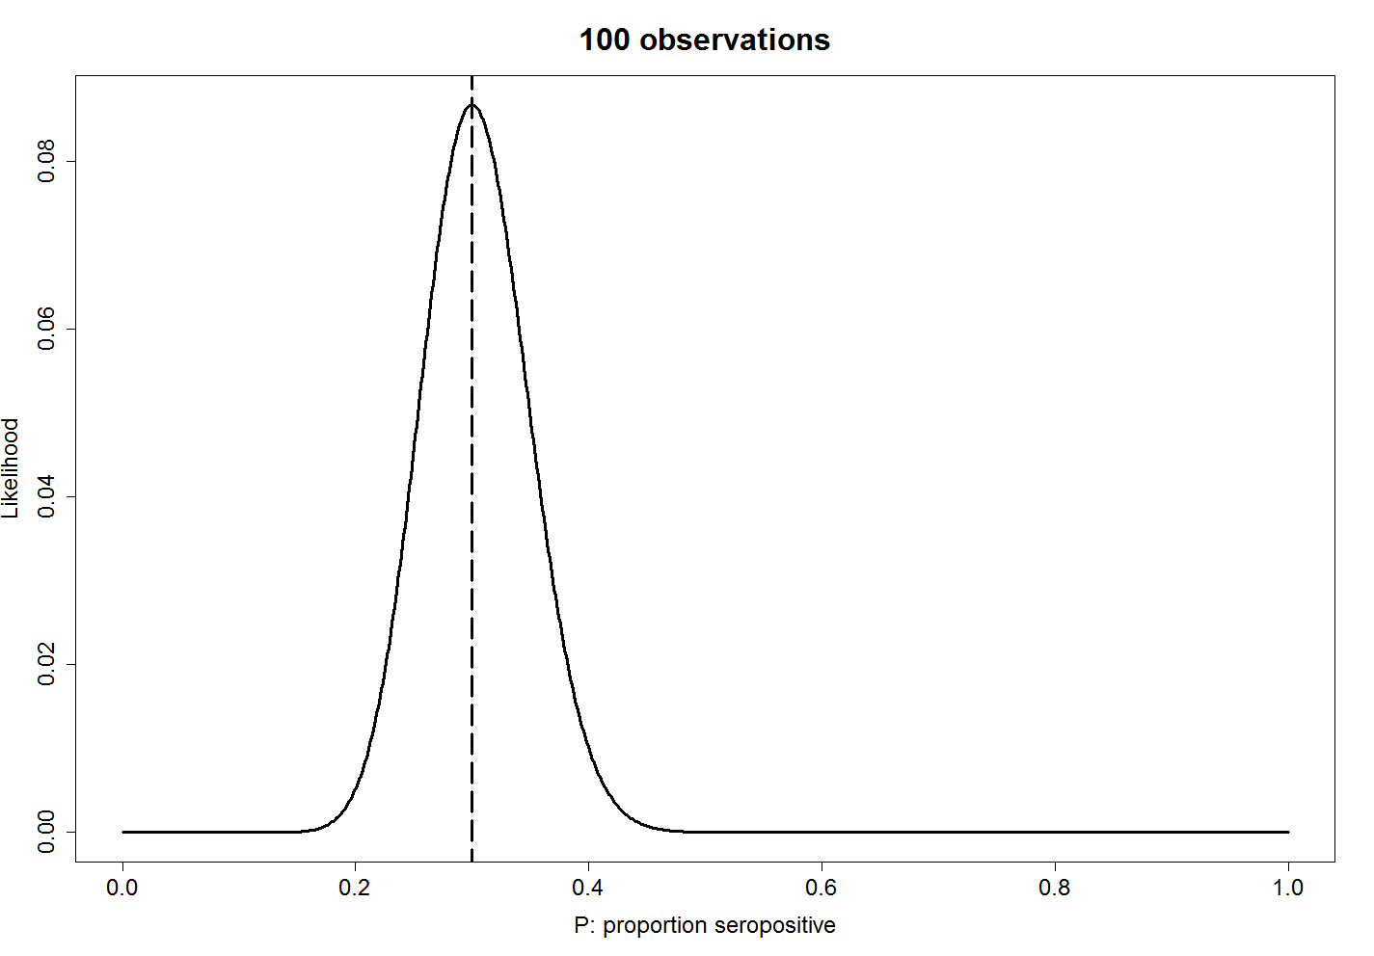
Uncertainty arising from data

Slide 36
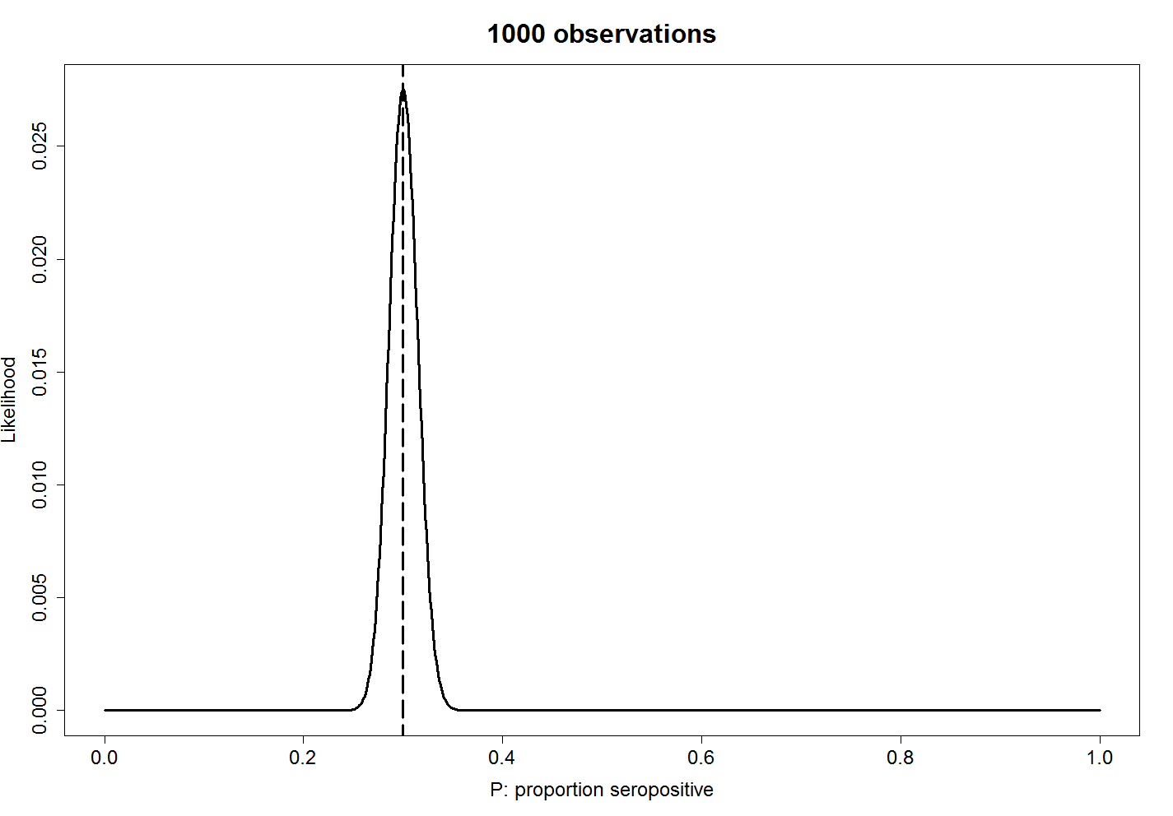
Uncertainty arising from data

Slide 37
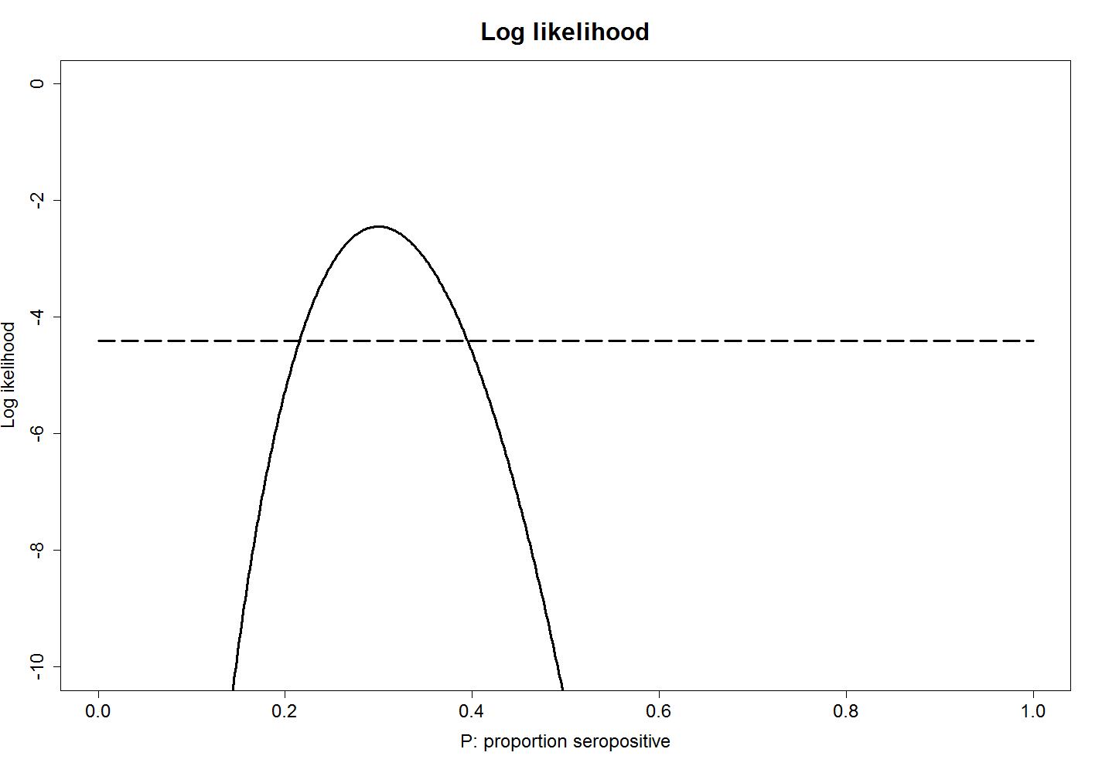
Uncertainty arising from data
maximum
likelihood
estimate

Slide 38
Uncertainty arising from data

Slide 39
Uncertainty arising from data
maximum
likelihood
estimate
1.92

Slide 40
Uncertainty arising from data
maximum
likelihood
estimate
1.92
95% confidence
intervals

Slide 41
Uncertainty arising from data
maximum
likelihood
estimate
1.92
95% confidence
intervals

Slide 42
Uncertainty arising from data
In general:
more data => less uncertainty
more data => narrower confidence intervals
Can depend on the choice of model, e.g. a badly chosen model will not be helped by more data.

Slide 43
Summary
Looked at a number of ways to explore possible parameter values and
estimate the distribution and sensitivity of outcome variables.
Another method for generating parameter set for analysis is through
Monte Carlo Markov Chain algorithms. Very simple and robust algorithm
in common use.
Likelihood methods very powerful for finding parameter ranges
corresponding to observed data. Calculating the likelihood becomes more
difficult with more complicated data sets, e.g. incidence curves.
The more data you have, the more accurate your parameter estimate.
If the model’s no good, you can still get a best fit, so check it’s not nonsense.

Slide 44
Uncertainty: sero-prevalence example

Slide 45
Catalytic models
λ
seronegative:
1 - P
seropositive:
P
ρ
Participants seroconvert at rate:
Participants serorevert at rate:

Slide 46
Catalytic models
λ
seronegative:
1 - P
seropositive:
P
ρ
Participants seroconvert at rate:
Participants serorevert at rate:
Proportion seropositive (P) given by:

Slide 47
Catalytic models
λ
seronegative:
1 - P
seropositive:
P
ρ
Participants seroconvert at rate:
Participants serorevert at rate:
Proportion seropositive (P) given by:
which can be solved to give:

Slide 48
Catalytic models

Slide 49
Uncertainty in parameters of catalytic models
λ = 0.13, ρ = 0.06

Slide 50
Uncertainty in parameters of catalytic models
λ = 0.12, ρ = 0.05

Slide 51
Uncertainty in parameters of catalytic models
λ = 0.14, ρ = 0.07

Slide 52
Uncertainty in parameters of catalytic models
λ = 0.39, ρ = 0.05

Slide 53
Uncertainty in parameters of catalytic models
λ = 0.03, ρ = 0.10

Slide 54
Uncertainty in parameters of catalytic models
Profile likelihood plots

