Slide 1
Session plan
Session 2: Language processing
  Language processing
    lexical analysis
    syntax analysis
  Syntax definition
    grammars
    BNF and EBNF
    ambiguity
    abstract and concrete syntax
  Lexical syntax (token) definition
    regular expressions
  Introduction to the tools
    regular expressions in the tools

Slide 2
Language definition
syntax
  rules defining what a legal program looks like when written down or stored in a file
semantics
  an expression of the “meaning” of a syntactically legal program
  formal semantics are mathematical
  informal semantics are in natural language
programming and computation models
  a language design implies a computation model
  models and languages invented to “raise level of abstraction”:
    to improve general programming practice (eg modularity, re-use by OO)
    to program particular design patterns and exploit new architectures (eg distributed programming, mobility)
    for specialised applications (eg VRML, Perl)

Slide 3
Language processing and implementation
Source program
text stream
Analysis (syntax, type-checking, …)
representation (eg abstract syntax tree)
Code generation
Interpretation (eg a tree walking interpreter)
real machine code
virtual machine code
Execution
Interpretation (eg a byte-code interpreter)

Slide 4
More language processing
source code
lexical analysis
lexical items (tokens)
syntactic analysis
abstract syntax tree
symbol table
semantic analysis
(eg type-checking)
other tables
annotated tree or
intermediate code
optimisation
optimised intermediate
code
code generation
object code from
other compilations
(eg libraries)
object code (for virtual or real
machine)
linking and loading
executable object code

Slide 5
Lexical analysis
Our programming language TPL,example program:
int n; int fact; read n; fact = 1;
while (n > 1) { fact = fact * n; n = n - 1;}
write fact;
Lexical analysis converts text stream into a token stream, where tokens are the most basic symbols (words and punctuation):
int n ; int fact ; read n ; fact = 1 ; while ( n > 1 ) ...
Each box is a lexical item or token, perhaps
represented:
<KEYINT> <IDENTIFIER n> “;” <KEYINT> <IDENTIFIER fact> “;” <KEYREAD> <IDENTIFIER n> “;” <IDENTIFIER fact> “=“ <INTEGER_LITERAL 1> ...

Slide 6
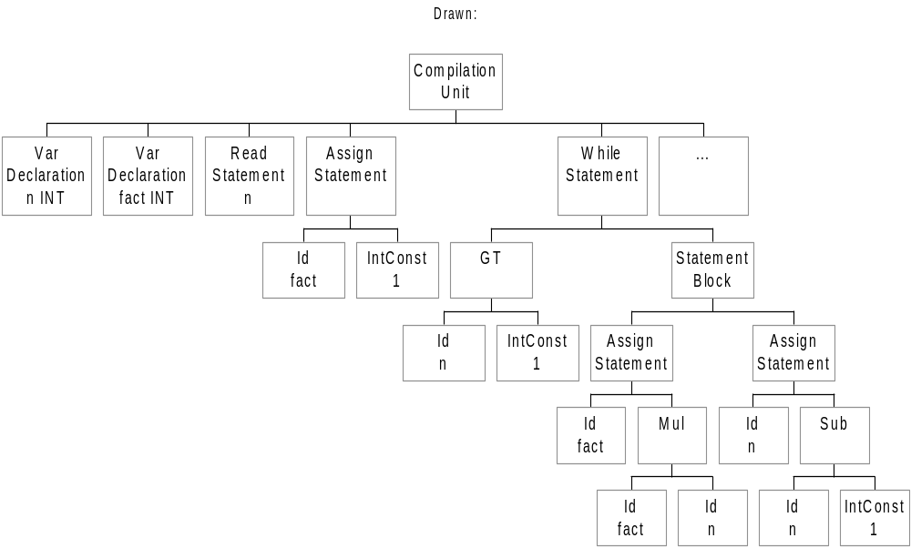
Syntax analysis
Converts a token stream into a useful abstract
representation (here an abstract syntax tree):
CompilationUnit
VarDeclaration n INT
VarDeclaration fact INT
ReadStatement n
AssignStatement
Id fact
IntConst 1
WhileStatement
GT
Id n
IntConst 1
StatementBlock
AssignStatement
Id fact
Mul
Id fact
Id n
AssignStatement
Id n
Subtract
Id n
IntConst 1
WriteStatement fact

Slide 7
Syntax definition
BNF rules used for syntax definition (a grammar):
Statement → IfStatement | WhileStatement | …
ifStatement → if ( Expression ) StatementBlock |
if ( Expression ) StatementBlock else StatementBlock
StatementBlock → { StatementSeq }
StatementSeq → Statement | Statement StatementSeq
| “or” - separates alternatives
→“is defined as”
IfStatement, WhileStatement non-terminals
if, (, { terminals (tokens)
Each definition called a production; many productions define a grammar
repetition by recursive definition, or...

Slide 8
Extended BNF
a few additional operators to shorten definitions:
  e1 | e2 | e3 | ... : choice of e1, e2, e3, etc as before
  (…) bracketting allowed
  [...] : the expression in […] may be omitted
    (may also be written as (...)? ).
  ( e )+ : One or more occurrences of e
  ( e )* : Zero or more occurrences of e
  Note that these may be nested within each other, so we can have
    (( e1 | e2 )* [ e3 ] ) | e4
examples:
IfStatement → if ( Expression ) StatementBlock [ else StatementBlock ]
StatementBlock → { (Statement)+ }

Slide 9
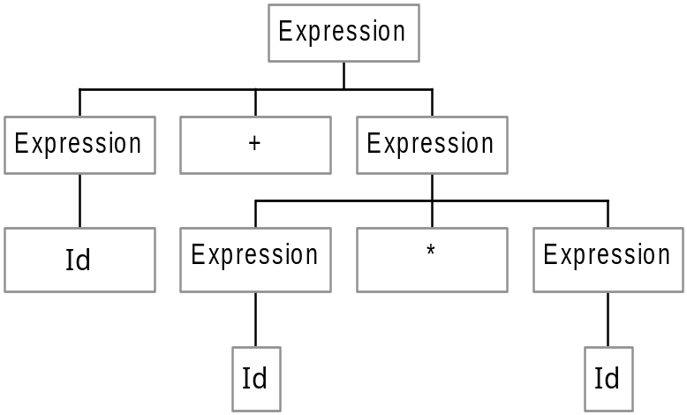
Concrete syntax derivations and parse trees
Expression → Expression + Expression | Expression * Expression | Id | Lit
Leftmost derivation of Id + Id * Id :
Expression
⇒ Expression * Expression
⇒ Expression + Expression * Expression
⇒ Id + Expression * Expression
⇒ Id + Id * Expression
⇒ Id + Id * Id
Concrete syntax tree
(parse tree):

Slide 10
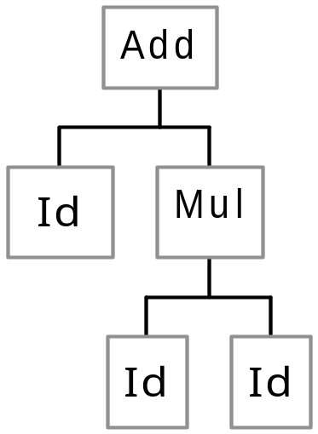
Abstract syntax trees
Abstract syntax definition:
Expression → Add Expression Expression
| Mul Expression Expression
| Id
| Lit
Abstract syntax tree:
Id + Id * Id :

Slide 11

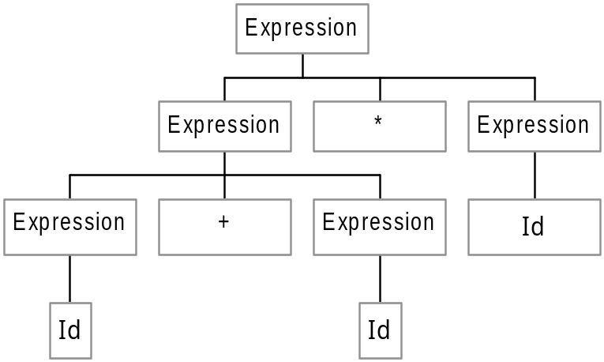
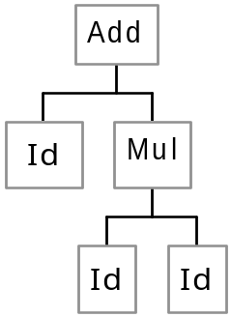
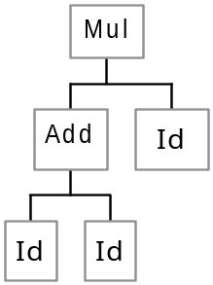
Ambiguous grammars
Expression → Expression + Expression | Expression * Expression | Id | lit
Two concrete and abstract trees for Id + Id * Id

Slide 12
Disambiguating the grammar 1
Expression → Expression + Expression | Expression * Expression | Id | Lit
In BNF:
Expression → Expression + MultExpression
| MultExpression
MultExpression → MultExpression * PrimaryExpression | PrimaryExpression
PrimaryExpression → Id | Lit
Or in EBNF:
Expression → MultExpression ( + MultExpression )*
MultExpression → PrimaryExpression ( * PrimaryExpression )*
PrimaryExpression → Id | Lit

Slide 13
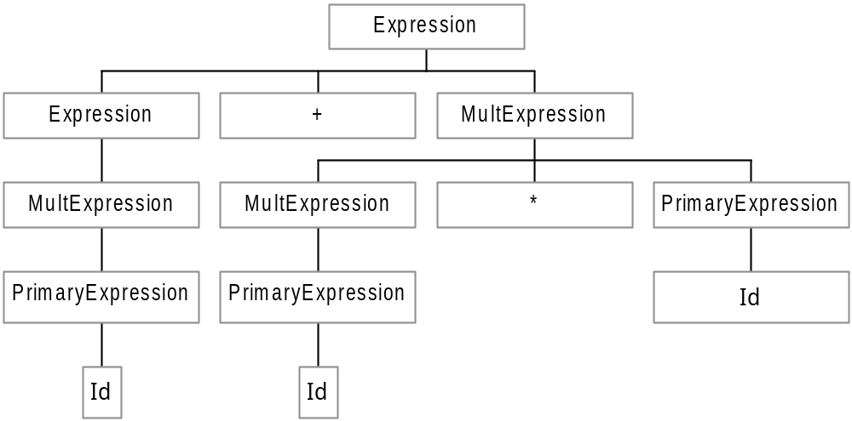

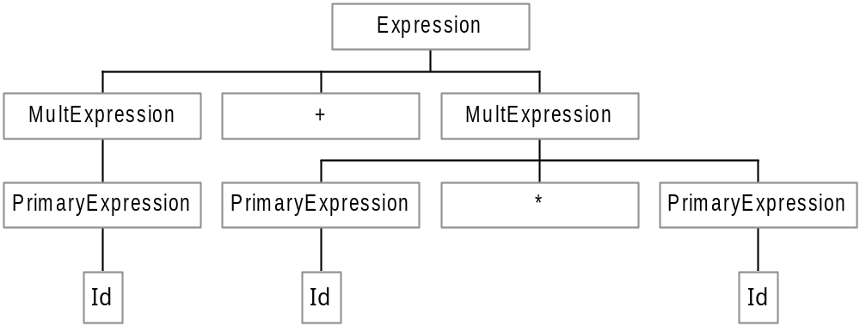
Disambiguating the grammar 2
Only one tree now possible from BNF:
AST:
And from EBNF:

Slide 14
Lexical syntax (token) definition
Regular expressions over alphabet A (Chomsky type 3 languages):
  the empty string is a regular expression (often ε)
  if α is a symbol in A then α is a regular expression
  if r and s are regular expressions then so are:
    rs ( r followed by s)
    r | s (r or s)
    r* (zero or more occurences of r)
    ( r ) (brackets for grouping)
Examples:
  letter → a | b | c | … | z
  digit →0 | 1 | 2 | 3 | 4 | 5 | 6 | 7 | 8 | 9
  Id →letter ( letter | digit )*
  IntConst →digit (digit)*

Slide 15
Recognising tokens - lexical analysis
tokens defined by regular expressions are recognised by finite state automata (FSA) (see any text on formal languages or compilers)
fortunately, we don’t have to draw out a FSA and implement it to recognise tokens, because given regular expressions, tools can produce a token matcher program for us
in our case, given token definitions, our tool JavaCC will produce a lexical analysis function which simulates a FSA and matches tokens and sends them to the parser

Slide 16
JavaCC and JJTree
JavaCC is a parser generator. Given as input a set of token definitions, a syntax grammar, and a set of actions, produces a Java program which will perform lexical analysis to find tokens and parse the tokens according to the grammar and execute the actions as appropriate.
JJTree is a preprocessor for JavaCC that, given an annotated grammar input file in JJTree format, inserts tree building actions at various places in emitted JavaCC source. The output of JJTree is run through JavaCC to create the tree-building parser.
Obviously you can then add code to traverse the tree and perform, eg interpretation or calculation

Slide 17
JavaCC and JJTree
JJTree specification
jjtree
JavaCC specification
javacc
Parsing class files
AST node class files
javac
parser and tree builder

Slide 18
JavaCC token regular expressions
characters and strings must be quoted, eg:
  “;” “int” “while”
character lists […] provide a shorthand for |, eg:
  [“a”-”z”] matches “a” through “z”, [“a”,”e”,”i”,”o”,”u”] matches any single vowel, and [“a”-”z”,”A”-”Z”] any letter
repetition shorthand with +, eg:
  [“a”-”z”,”A”-”Z”]+ matches one or more letters
shorthand with ? provides for optional expr, eg:
  (“+”|”-”)?[“0”-”9”]+ matches signed and unsigned integers
tokens can be named
  TOKEN : { < IDENTIFIER: <LETTER> (<LETTER>|<DIGIT>)* >}
  TOKEN : {< LETTER: [ "a"-"z", "A"-"Z" ] > | < DIGIT: [ "0"-"9"] >}
  now <IDENTIFIER> can be used later in defining syntax

