Slide 1
Session plan
Session 3: Language processing and implementation
  parsing
    what it is
    using JavaCC/JJTree to do it
  ASTs
    what is produced by JJTree
    how to access ASTs
  contextual analysis
    identification
    typechecking
  implementation
    code generation
    interpretation

Slide 2
Syntax recognition - parsing
BNF grammars describe context-free languages (Chomsky type 2)
recognised by pushdown automata (PDA) (see any text on formal languages or compilers)
recognition is implemented in many ways
involves (implicitly or explicitly) building the concrete syntax tree, matching against the tokens produced by the lexical analyser
building the tree can be top-down or bottom-up
once again, tools can produce a parser for us
given a grammar, JavaCC will produce a parser

Slide 3
Parsing
S → c A d input: c a d
A → ab | a
S S S
/|\ /|\ /|\
c A d c A d c A d
/ \ |
a b a
PROC S PROC A PROC match (t)
match (c); match (a); IF current token = t
call A; IF token = b THEN move onto next token
match (d) THEN match (b); ELSE illegal token, report error
report S matched report A matched END
END END

Slide 4
JJTree/JavaCC grammars 1
JJTree allows us to annotate a JavaCC grammar
with instructions to produce abstract syntax trees
void IfStatement() : /* By default will create ASTIfStatement nodes. */
{}
{
<KEYIF> "(" Expression() ")"
StatementBlock()
[ <KEYELSE> StatementBlock() ]
}
void StatementBlock() : /* By default will create ASTStatementBlock nodes. */
{}
{
"{" ( Statement() )+ "}"
}

Slide 5
JJTree/JavaCC grammars 2
void MultiplicativeExpression() #void : /* #void=produce no default node. */
{}
{
PrimaryExpression()
(
"*" PrimaryExpression() #Mul(2) /* produce an ASTMul node. */
|
"/" PrimaryExpression() #Div(2) /* produce an ASTDiv node. */
)*
}
#Mul(2) means produce an ASTMul node with the last two created nodes as children (here they will be those created by the PrimaryExpression()s )

Slide 6
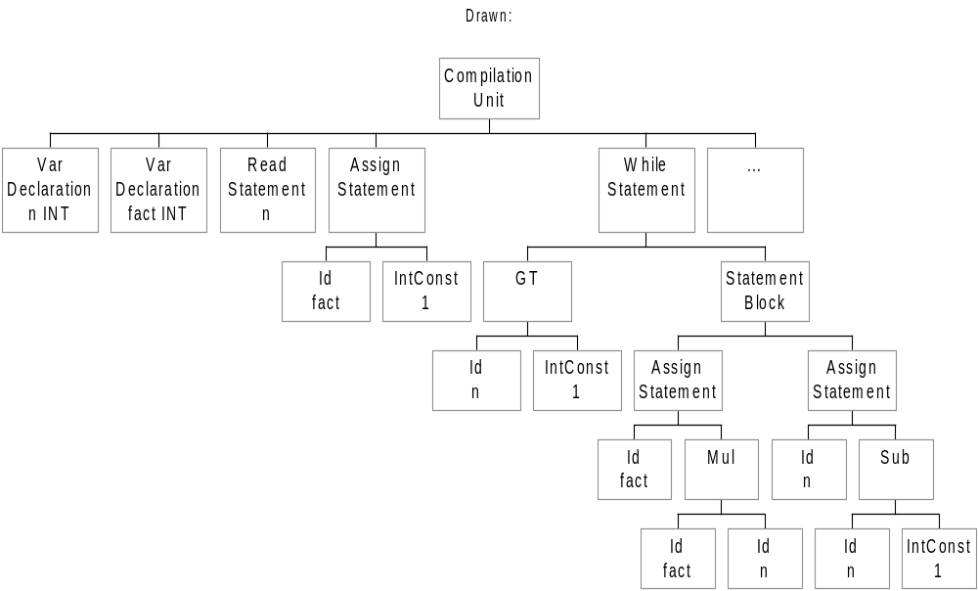
ASTs from JJTree
CompilationUnit
VarDeclaration n INT
VarDeclaration fact INT
ReadStatement n
AssignStatement
Id fact
IntConst 1
WhileStatement
GT
Id n
IntConst 1
StatementBlock
AssignStatement
Id fact
Mul
Id fact
Id n
AssignStatement
Id n
Subtract
Id n
IntConst 1
WriteStatement fact

Slide 7
AST Class definitions
skeleton definitions are created by JJTree:
may then be modified to perform useful functions over the tree (eg type-checking)
public class ASTIfStatement extends SimpleNode {
public ASTIfStatement(int id) {
super(id);
}
public ASTIfStatement(TPLParser p, int id) {
super(p, id);
}
}

Slide 8
JJTree Nodes and State
all AST nodes implement interface Node
  ours extend class SimpleNode, which implements Node
  useful methods provided include:
    public void jjGetNumChildren() which returns the number of children
    public void jjtGetChild(int i) which returns the i’th child
the `state’ is in a parser field called jjtree
  the root is at Node rootNode()
  so you can display the tree with
    ((SimpleNode)parser.jjtree.rootNode()).dump("");
  method dump() is defined in class SimpleNode

Slide 9
Contextual or semantic analysis
Parsing does not find all the legal programs
  some rules are context dependent
  depend on non-syntactic aspects of the program
  eg the expression (0=1)+2 is not well-formed although it is legal in our TPL syntax, because it does not typecheck
Identification
  applying the scope and binding rules of the language to find applied occurences of identifiers (eg variable names in expressions) and relating to the appropriate declarations
Type checking
  infer the type of each expression and check that it matches the expected type
(Usually separated in practice, but combined in a formal view.)

Slide 10
Identification
collect all identifiers in a symbol table with attributes like name, type, scope level, etc
uses declaration ASTs
  to identify names and types and place in table, perhaps with initial value
  to identify scope level (depth of nesting), if necessary
traverses ASTs
  checking that applied occurrences of identifiers have related declarations (are in table) at appropriate scope level
for TPL:
  static Hashtable of IdSymbols, declared in SimpleNode
  traverse AST by writing identification() method for each node type, called initially on rootNode()

Slide 11
Type checking
traverse AST from bottom up inferring type of each expression
  check that an inferred type is of expected type
    eg boolean in if statement condition
    eg an actual parameter matches a formal parameter
  check that two inferred types conform (not necessarily equal)
    eg equality operator is valid for both booleans and ints
    eg may be possible to assign an int to a float
for TPL
  traverse AST by writing typecheck() method for each node type, initially called on rootNode()
  this method stores the inferred type in each node
  checks the inferred type for children’s nodes against expected types, issuing appropriate error messages

Slide 12
Implementation - code generation
traverse AST producing code
eg at a while statement node, given this syntax (ie such a node has two children):
  while ( Expression ) StatementBlock
  it is necessary to emit code to:
  label the start of the loop (LSTART, say)
  compute the Expression
  jump to the end of the loop if expression is false (LEND, say)
  peform the actions of the statements in the StatementBlock
  jump to LSTART
  label the end of the loop (LEND)
code for the children Expression and StatementBlock is produced by traversing their trees, of course

Slide 13
Implementation - interpretation
traverse AST interpreting according to rules for evaluating parts of the program
need a state vector to track the values of variables
declarations initialise state’s variables
expressions must be evaluated bottom-up
statements have structure
  eg the while statement node must be continually reinterpreted until the Expression interprets to false
for TPL
  the state vector is the symbol table (has place for values)
  we use a stack for expression evaluation

Slide 14
Interpretation rules
CU→ D ; S [ interpret D then interpret S with D’s names ]
D → D₁ ; D₂ [ interpret D₁ then interpret D₂ ]
[interpreting D_{n} means creating a state (name,type,value) entry ]
S → I = E [ eval E, store in state for id I ]
| S₁ ; S₂ [ interpret S₁ then interpret S₂ ]
| if E { S₁ } [ eval E interpret S₁ if true, else do nothing ]
| if E { S₁ } else {S₂} [ eval E interpret S₁ if true, else interpret S₂ ]
| while E {S} [ eval E interpret S if true, and repeat,
else do nothing ]
| skip [ do nothing ]
E → N [ value is the n constant ]
| B [ value is the b constant ]
| I [ value is value of I’s Id from the state ]
| E₁ + E₂ [ eval E₁ eval E₂ add ]
| E₁ = E₂ [ eval E₁ eval E₂ equal ]
| E₁ <= E₂ [ eval E₁ eval E₂ less than or equal ]
| E₁ and E₂ [ eval E₁ if false value is false else
eval E₂ value is E₂ ]

Slide 15
Interpreting TPL ASTs
If statement node example:
  public class ASTIfStatement extends SimpleNode { ...
  public void interpret () {
  jjtGetChild(0).interpret();
  if (((Boolean)stack.pop()).booleanValue())
  jjtGetChild(1).interpret();
  else if (jjtGetNumChildren() == 3)
  jjtGetChild(2).interpret();
  }
Add node example:
  public class ASTAdd extends SimpleNode { …
  public void interpret () {
  int left, right;
  jjtGetChild(0).interpret();
  jjtGetChild(1).interpret();
  right = ((Integer)stack.pop()).intValue();
  left = ((Integer)stack.pop()).intValue();
  stack.push(new Integer(left+right));
  }

