Slide 1
Session Plan
Session 6: Java concurrency and threads
  what Java has
    class Thread, interface Runnable
    threads
    synchronisation
      synchronized methods
      wait() and notify()
  other Java thread operations
  critique of Java concurrency framework
  some examples

Slide 2
Concurrency in Java - Threads
class Thread
  can extend, and override method run()
  class MyThread extends Thread { …
  public void run() { … }
  }
  then create a new Thread, and call start() method
  MyThread t = new MyThread();
  t.start();
suffers from usual Java problem of single inheritance, so…

Slide 3
Interface Runnable
interface Runnable
  implement Runnable, implementing the run() method
  class MyRun implements Runnable { …
  public void run() { … }
  }
  then create a new thread with a Runnable object as argument
  MyRun r = new MyRun();
  new Thread(r).start();
Thread.start() causes Thread.run() or Runnable.run() to commence in a new thread

Slide 4
Thread object life cycle
creation allocates an empty Thread object
  Thread t = new Thread(r); or MyThread t = new MyThread();
Thread method start() is special in the JVM
  t.start(); next statement…
    start() allocates new JVM resources to thread
    schedules the thread for running (makes it runnable)
    calls run() method (here of Runnable r or Thread t)
    now two threads
      one executing t.run()
      one executing next statement…
threads are not runnable
  when sleep() is called (see later)
  when wait() is called (see later)
  when blocking on IO
threads normally terminate by ending run()

Slide 5
Synchronization (1)
usually, it is possible for several threads to execute the same code from a class on the same target object apparently simultaneously by interleaving statements:
  MyRun r = new MyRun();
  new Thread(r).start(); new Thread(r).start();
Java code can be synchronized on an object:
  synchronized (anyObject) { anyCode }
then statements from the anyCode will not be interleaved by different threads
thread gains exclusive access to anyCode
  the thread is said to have the lock on the object anyObject
  other threads are said to be blocked
so synchronized provides monitor-like mechanism

Slide 6
Synchronization (2)
whole methods can be synchronized:
  synchronized send() {
  while (stored == N)
  wait(); /* until not full */
  place data in buffer;
  if (stored++ == 0)
  notifyAll(); /* signal if was empty */
  }
equivalent to preceding the method code with synchronised(this)
so synchronized methods provide exclusive access to (obtain the lock, or “monitor”, on) the current object (the target of the method call)
multiple synchronized methods in a class can provide a monitor structure on any shared data in the class

Slide 7
Waiting and notification
method wait():
  is called from synchronized code
  suspends the thread in which it is called
  places thread in the wait queue associated with target object
  releases the lock on the object
method notify():
  chooses an arbitrary suspended thread on the wait queue for the target object of the notify() call
  removes it from the wait queue and makes it runnable
  this thread may then become next to proceed, from the point at which the wait() was called, but
    only when the synchronized code or method containing the notify() finishes (because it has the lock), and
    only if another thread does not obtain the lock first
notifyAll() notifies all threads in wait queue

Slide 8
Other Thread methods
stop() terminates a thread; no restart
destroy() terminates a thread with no cleanup
suspend() temporarily halts thread until resume()
sleep(n) causes a thread to suspend for n ms
join() waits for the target thread to terminate
interrupt() aborts a sleep(), wait() or join() with an InterruptedExceptiion, which can be caught
isAlive() is true if a thread is started and not terminated
setPriority() changes thread priority
  JVM is preemptive on priorities
  may not be fair on equal priorities
yield() relinquishes control

Slide 9
So Java concurrency…
is a mixture of language primitive
  synchronized keyword for blocks of code and methods
and library API classes
  class Thread and its methods
  interface Runnable
and library API methods, provided for all objects
  wait()
  notify(), notifyAll()
  defined for all objects in class Object
obviously these parts of API interact with the JVM definition, since JVM spawns new threads on a call to start(), and manages their execution

Slide 10
Critique of Java primitives
classes may contain both synchronised and unsynchronised methods
  no notion of a class which is a monitor
fairness is not guaranteed
  runnable equal priority threads chosen to run arbitrarily
unlike monitor, no named condition variables
  usually must notifyAll()
  cannot direct signal to particular threads waiting for resource
condition rechecks essential
  use a while loop in case another thread acquired lock between notify() unsuspending the wait() and next statement after the wait() being executed:
    while (condition) try {wait(); next statement} catch (…) {}

Slide 11
Sequential SimpleMessagePrinter
public class SimpleMessagePrinter implements Runnable {
protected String msg_; // The message to print
protected TextArea txt_; // The place to print it
… // code omitted
public void run() {
txt_.appendText(msg_); // display the message
}
}
public class SequentialApplet extends Applet { … // code omitted
… // code omitted
public SequentialApplet() { …
hello_ = new SimpleMessagePrinter("Hello\n", txt_);
goodbye_ = new SimpleMessagePrinter("Goodbye\n", txt_);
}
public void start() {
hello_.run();
goodbye_.run();
}
}

Slide 12
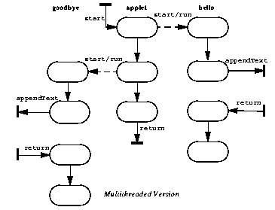
ThreadedApplet Interaction diagram
public class ThreadedApplet extends SequentialApplet {
public void start() {
new Thread(hello_).start();
new Thread(goodbye_).start();
}
}

Slide 13
AlternatingMessagePrinter
public class AlternatingMessagePrinter extends SimpleMessagePrinter {
protected AlternatingMessagePrinter next_; // the other object
protected AlternatingMessagePrinter turn_; // go if turn==this
public AlternatingMessagePrinter(String m, TextArea txt) {
super(m, txt);
turn_ = null; // it's nobody's turn until told otherwise
next_ = null; // don't know yet who next is
}
// called by applet to establish other object
public synchronized void setNext(AlternatingMessagePrinter p){
next_ = p;
}
// called by another object telling you that it is your turn
public synchronized void turn() {
turn_ = this;
notifyAll(); // signal thread wait()ing in run() (… see over … )
}
public synchronized void run() { … see over … }
}

Slide 14
run() method
public synchronized void run() {
for (;;) {
while (turn_ != this) { // wait until turn
try { wait(); } // woken up from turn method
catch (InterruptedException ex) { return; }
}
txt_.appendText(msg_); // take turn
// alert next
turn_ = null;
next_.turn();
try { // do nothing for a while
long delay = (long)(Math.random() * 10000.0);
Thread.currentThread().sleep(delay);
}
catch (InterruptedException e) { return; }
}
}

Slide 15
AlternatingApplet
public class AlternatingApplet extends ThreadedApplet {
public AlternatingApplet() {
txt_ = new TextArea(4, 40);
AlternatingMessagePrinter h =
new AlternatingMessagePrinter("Hello\n", txt_);
AlternatingMessagePrinter g =
new AlternatingMessagePrinter("Goodbye\n", txt_);
// initialize inherited instance variables
hello_ = h;
goodbye_ = g;
// initialize next links and turn
h.setNext(g);
g.setNext(h);
h.turn();
}
}

Slide 16
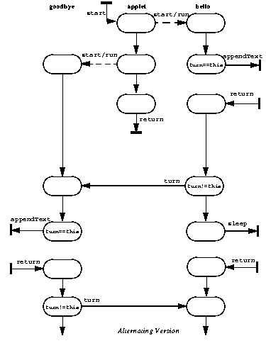
Interaction diagram

Slide 17
Interface BoundedCounter
public interface BoundedCounter {
public static final long MIN = 0; // minimum allowed value
public static final long MAX = 5; // maximum allowed value
public long value(); // invariant: MIN <= value() <= MAX
// initial condition: value() == MIN
public void inc(); // increment only when value() < MAX
public void dec(); // decrement only when value() > MIN
}

Slide 18
Class BoundedCounter
public class BoundedCounter implements BoundedCounter {
protected long count_ = MIN;
public synchronized long value() { return count_; }
public synchronized void inc() {
while (count_ == MAX)
try { wait(); } catch(InterruptedException ex) {};
if (count_++ == MIN)
notifyAll(); // signal if was bottom value
}
public synchronized void dec() {
while (count_ == MIN)
try { wait(); } catch(InterruptedException ex) {};
if (count_-- == MAX)
notifyAll(); // signal if was top value
}
}

