Slide 1
IN2009 - Language Processors
Week 8
Typechecker & Interpreter
Igor Siveroni
City University London
Week 8

Slide 2
Session plan
JJTree
  Traversal of ASTs
  Example: Calculator of arithmetical expressions
The SIMPLE Programming Language
  Syntax
  JJTree specification
Semantic Analysis
  Identification
  Typechecking
Execution of SIMPLE programs
  Interpreter implementation
Week 8

Slide 3
JJTree
A preprocessor for JavaCC that :
  Inserts abstract syntax tree (AST) building actions at various places in the JavaCC source.
  It generates:
    A JavaCC file (.jj) from a .jjt file.
    Java classes that implement the AST, including the Node interface and SimpleNode superclass.
  The generated AST classes can be extended with:
    New fields e.g. to store the numeric value of a node.
    New methods e.g. Tree traversals that implement print operations (dump), semantics analysis (typecheck) or execution (interpret)
Week 8

Slide 4
JJTree specification
Let’s consider the syntax for arithmetical expressions used in Lab 6 (week 7):
E → T ( “+” T | “-” T )*
T → F ( “*” F | “/” F )*
F → <NUM> | “(“ E “)”
The JJTree specification for E:
void E() : // default – generates an ASTE node
{ }
{ T() ( "+“ T()
| "-" T()
)*
}
Generates AST nodes with one or more subnodes, depending on the number of T()‘s matched.
There is no way of knowing if it came from an addition or subtraction!!
Week 8

Slide 5
JJTree specification
JJTree annotations override the default. We can decide the names of the AST nodes, and where they are generated. For example:
void E() #void : // #void produces no default node.
{ }
{ T() ( "+“ T() #PlusExp(2) // produces an ASTPlusExpNode
| "-" T() #MinusExp(2) // produces an ASTMinusNode
)*
}
Generates ASTPlusExp and MinusExp nodes, depending on the operator matched by the parser. Each Node has 2 subnodes (children), corresponding to the last T()’s matched.
Week 8

Slide 6
JJTree nodes and state
all AST nodes implement interface Node
  The generated AST nodes extend class SimpleNode, which implements Node.
  useful methods provided include:
    public void jjGetNumChildren() which returns the number of children
    public void jjtGetChild(int i) which returns the i’th child
the `state’ is in a parser field called jjtree
  the root is at Node rootNode()
  so you can display the tree with
    ((SimpleNode)parser.jjtree.rootNode()).dump("");
  method dump() is defined in class SimpleNode
Week 8

Slide 7
Extending JJTree class definitions
JJTree AST class definitions can be modified to include new fields and methods.
For example, let’s consider an initial specification of F:
void F() #void : // No ASTF node is created
{ Token t; }
{ <NUM> #NumExp // produces ASTNumExp node (no children)
| "(" E() ")“
}
Produces an ASTNumExpNode if the token <NUM> is matched.
Problem: We have lost the value associated to the number!!
Week 8

Slide 8
... continued
In order to store the value associated with <NUM> we need to:
  Add a field to ASTNumExp.java to store the numeric value of <NUM>:
  class ASTNumExp extends SimpleNode {
  ...
  public int val; // new field declaration
  }
  Update the JJTree spec to initialise the new field:
  void F() #void :
  { Token t; }
  { (t=<NUM> { jjtThis.val = Integer.parseInt(t.image);}) #NumExp
  | "(" E() ")“
  }
Week 8

Slide 9
... continued
We can also add a new method that evaluates the arithmetical expression represented by the AST.
Let’s call this new method int evaluate()
We need to:
  Declare the new method in interface Node.java
  public int evaluate();
  Give a default implementation in SimpleNode.java:
  public int evaluate()
  { return 0; // default }
Week 8

Slide 10
... continued
And provide implementations of evaluate to each ASTxxxx.java:
public class ASTNumExp extends SimpleNode {
...
public int evaluate() {
return val;
}
}
public class ASTPlusExp extends SimpleNode {
......
public int evaluate() {
return jjtGetChild(0).evaluate() + jjtGetChild(1).evaluate();
}
}
Week 8

Slide 11
The SIMPLE Programming Language
SIMPLE → CompilationUnit
CompilationUnit → (VarDeclaration “;”)* Statement*
VarDeclaration → ( “boolean” | “int”) <ID>
Statement →
SkipStatement | AssignStatement |
IfStatement | WhileStatement |
ReadStatement | WriteStatement
SkipStatement → “skip” “;”
AssignStatement → <ID> “=“ Expression “;”
IfStatement → “if” “(“ Expression “)” StatementBlock
[ “else” StatementBlock ]
WhileStatement → “while” “(“ Expression “)” StatementBlock
ReadStatement → “read” <ID> “;”
WriteStatement → “write” <ID> “;”
StatementBlock → “{“ Statement+ “}”
Week 8

Slide 12
The SIMPLE Programming Language
Expression → OrExp
OrExp → AndExp (“or” AndExp)*
AndExp → EqExp (“and” EqExp)*
EqExp → RelExp (( “==“ | “!=“ ) RelExp)*
RelExp → AddExp ((“<“ | “>” | “<=“| “>=“) AddExp)*
AddExp → MultExp ((“+” | “-”) MultExp)*
MultExp → PrimExp ((“*” | “/”) PrimExp)*
PrimExp → Literal | <ID> | “(“ Expression “)”
Literal → <INT>
BooleanLiteral → > “true” | “false”
Week 8

Slide 13
SIMPLE JJTree: Example
void VarDeclaration() : /* By default will create ASTVarDeclaration nodes. */
{ Token t; }
{ ( /* `type' declared in ASTVarDeclaration.java. */
<KEYBOOL> { jjtThis.type = TPLTypes.boolType; }
|
<KEYINT> { jjtThis.type = TPLTypes.intType; }
) t = <IDENTIFIER> { jjtThis.name = t.image; }
/* `name' declared in ASTVarDec.java - ‘image' is the text of the token. */
}
The JJTree specification above assumes that ASTVarDeclaration.java has been extended with two fields:
  Field ‘type’ type TPLTypes (boolType or IntType). Required for typechecking.
  Field ‘name’ of type String.
Week 8

Slide 14
SIMPLE JJTree: Example
void MultiplicativeExpression() #void : /* #void=produce no default node. */
{}
{
PrimaryExpression()
(
"*" PrimaryExpression() #Mul(2) /* produce an ASTMul node. */
|
"/" PrimaryExpression() #Div(2) /* produce an ASTDiv node. */
)*
}
void Literal() #void :
{ Token t;}
{ ( t=<INTEGER_LITERAL> { jjtThis.val = Integer.parseInt(t.image); } )
#IntConst /* Create an ASTIntConst leaf (note no children). */
| BooleanLiteral()
}
With field `val' declared in ASTIntConst.java.
Week 8

Slide 15
SIMPLE Example
For example, the string
“ int n; int fact;
read n;
fact = 1;
while (n > 1) {
fact = fact * n; n = n – 1;
}
write n;”
Is a valid SIMPLE program i.e. It satisfies its syntax.
Given the JJTree specification shown in the previous slides (an extract of the spec given in your coursework), the result of a call to dump, and the representation of the AST generated by JavaCC for the program above is ….
Week 8

Slide 16
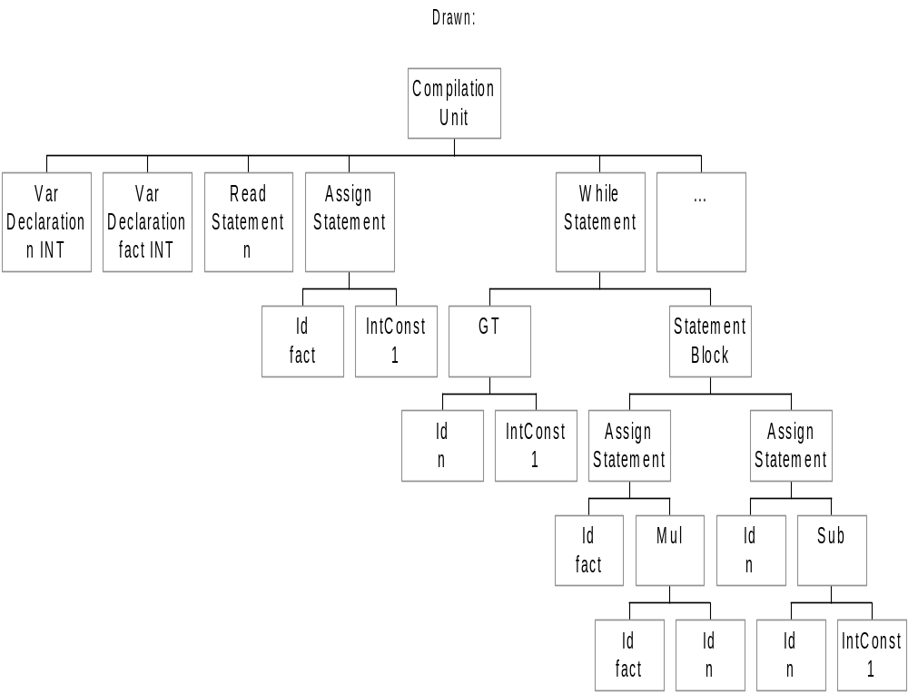
ASTs from JJTree
CompilationUnit
VarDeclaration n INT
VarDeclaration fact INT
ReadStatement n
AssignStatement
Id fact
IntConst 1
WhileStatement
GT
Id n
IntConst 1
StatementBlock
AssignStatement
Id fact
Mul
Id fact
Id n
AssignStatement
Id n
Subtract
Id n
IntConst 1
WriteStatement fact
Week 8

Slide 17
Contextual or Semantic Analysis
Parsing does not find all the legal programs
  some rules are context dependent
  depend on non-syntactic aspects of the program
  eg the expression (0=1)+2 is not well-formed although it is legal in our TPL syntax, because it does not typecheck
We will perform two analyses:
  Identification:
  Applying the scope and binding rules of the language to find applied occurences of identifiers (eg variable names in expressions) and relating to the appropriate declarations.
  Output: Symbol table.
  Type checking:
  infer the type of each expression and check that it matches the expected type
  The symbol table is used by other semantics analyses e.g. type checking, and processes e.g. code generation.
MSc PPL Session 3

Slide 18
Identification
collect all identifiers in a symbol table with attributes like name, type, scope level, etc
uses variable declaration ASTs to:
  Identify types and variable names, and them to the symbol table, perhaps with initial value.
  Identify scope level (depth of nesting), if necessary
traverses ASTs
  checking that applied occurrences of identifiers have related declarations (are in table) at appropriate scope level.
for SIMPLE:
  static Hashtable of IdSymbols, declared in SimpleNode
  traverse AST by writing identification() method for each node type, called initially on rootNode()
MSc PPL Session 3

Slide 19
Identification in SIMPLE
Method void identification()
In Node.java:
public void identification (); // now, part of the interface
In SimpleNode.java
protected static java.util.Hashtable symtab = new java.util.Hashtable();
/* This will be overridden by those AST nodes doing identification. */
public void identification () { /* Do nothing. */ }
In ASTCompilationUnit.java
public void identification ()
{ int i, k = jjtGetNumChildren();
for (i = 0; i < k; i++)
jjtGetChild(i).identification();
} // visits each declaration and statement
Week 8

Slide 20
Identification in SIMPLE
The hash table stores
  The name of the variable, of type String (the key).
  A pair made of the variable’s type and initial value, stored in an object of class IdSymbol.
In ASTVarDeclaration.java
public void identification () {
if (type == TPLTypes.boolType)
symtab.put (name, new IdSymbol (type, false));
else
symtab.put (name, new IdSymbol (type, 0));
}
populates the symbol table.
Week 8

Slide 21
Identification in SIMPLE
The rest of the AST nodes call identification on their children i.e. Tree traversal.
With the exception of ASTId.java:
public void identification () {
if (!(symtab.containsKey(name))) { /* Insert if not declared. */
System.out.println("TPL Identification: "+name+" not declared.");
symtab.put (name, new IdSymbol (TPLTypes.intType, 0));
} }
which checks if a variable has been declared by looking up the symbol table. If not, a warning message is displayed and the symbol table is updated with the defaults (type int and value 0).
Week 8

Slide 22
Type checking
traverse AST from bottom up inferring type of each expression
  check that an inferred type is of expected type
    eg boolean in if statement condition
    eg an actual parameter matches a formal parameter
  check that two inferred types conform (not necessarily equal)
    eg equality operator is valid for both booleans and ints
    eg may be possible to assign an int to a float
    Eg subtyping, inheritance
for SIMPLE
  traverse AST by writing typecheck() method for each node type, initially called on rootNode()
  this method stores the inferred type in each node
  checks the inferred type for children’s nodes against expected types, issuing appropriate error messages
MSc PPL Session 3

Slide 23
Typechecking of SIMPLE programs
Each node will contain a type and a method that implements type checking. In SimpleNode.java:
public void typecheck () { /* Error if this is executed */
System.out.println("TPL Typechecker: Simple Node version panic");
}
public int NodeType; // the type assigned to the node
public int GetNodeType () { return NodeType; }
where NodeType can be any of the four values declared in TPLTypes.java:
public static final int intType = 0, boolType = 1,
decType =2, stmType = 3;
Week 8

Slide 24
Typechecking of SIMPLE programs
In ASTIntConst.java.java
public void typecheck () {
NodeType = TPLTypes.intType;
}
the type of an ASTIntConst is intType!!
In ASTTrue.java.java
NodeType = TPLTypes.boolType; // yes, a boolean
In ASTId.java:
NodeType = ((IdSymbol)symtab.get(name)).type;
the typechecker looks up the type of the variable in the symbol table.
Week 8

Slide 25
Typechecking of SIMPLE programs
In ASTAssignStatement:
public void typecheck () {
jjtGetChild(0).typecheck(); // typecheck identifier
jjtGetChild(1).typecheck(); // typecheck expression
if (jjtGetChild(0).GetNodeType() == TPLTypes.intType) {
if (jjtGetChild(1).GetNodeType() != TPLTypes.intType)
System.out.println("TPL Typechecker: assign of non-int exp
to int var."); }
else if (jjtGetChild(0).GetNodeType() == TPLTypes.boolType) {
if (jjtGetChild(1).GetNodeType() != TPLTypes.boolType)
System.out.println("TPL Typechecker: assign of non-bool exp
to bool var.");
}
NodeType = TPLTypes.stmType;
}
Rule: Typecheck children nodes and make sure that the identifier and expression (right hand side) have the same type
Week 8

Slide 26
Typechecking of SIMPLE programs
In ASTWhileStatement.java
public void typecheck () {
jjtGetChild(0).typecheck(); // typecheck conditional
jjtGetChild(1).typecheck(); // typecheck body
if (jjtGetChild(0).GetNodeType() != TPLTypes.boolType)
System.out.println("TPL Typechecker: while statement
condition non-bool");
NodeType = TPLTypes.stmType;
}
Rule: Typecheck all children and make sure that the type of the conditional expression is boolType.
Task: Figure out the typechecking rules of SIMPLE by looking at the rest of the code (given as part of the lab/coursework)
Week 8

Slide 27
Implementation of SIMPLE
We want to write a program that executes SIMPLE programs. This can be done by writing:
  An Interpreter: Parses the SIMPLE program and executes each of its nodes by traversing the AST.
  A compiler: Parses a SIMPLE program and generates code that can be executed separately e.g. Machine code.
We will implement a SIMPLE interpreter: a program that takes as input a file/string that encodes a SIMPLE program, and executes it.
Recall the SIMPLE code extract shown previously. Our interpreter should be able to read that program, typecheck it, ask for a number and write its factorial.
The interpreter should do this for any SIMPLE program!
Week 8

Slide 28
Implementation - Interpretation
traverse the AST, interpreting each node according to pre-defined evaluation rules (SIMPLE semantics)
need a state vector to track the values of variables
declarations initialise state’s variables
expressions must be evaluated bottom-up
statements have structure
  eg the while statement node must be continually reinterpreted until the Expression interprets to false
for SIMPLE
  the state vector is the symbol table (has place for values)
  we use a stack for expression evaluation
MSc PPL Session 3

Slide 29
Interpretation rules: Summary
CU→ D ; S [ interpret D then interpret S with D’s names ]
D → D₁ ; D₂ [ interpret D₁ then interpret D₂ ]
[interpreting D_{n} means creating a state (name,type,value) entry ]
S → I = E [ eval E, store in state for id I ]
| S₁ ; S₂ [ interpret S₁ then interpret S₂ ]
| if E { S₁ } [ eval E interpret S₁ if true, else do nothing ]
| if E { S₁ } else {S₂} [ eval E interpret S₁ if true, else interpret S₂ ]
| while E {S} [ eval E interpret S if true, and repeat,
else do nothing ]
| skip [ do nothing ]
E → N [ value is the n constant ]
| B [ value is the b constant ]
| ID [ value is value of ID from the state (stable) ]
| E₁ + E₂ [ eval E₁ eval E₂ add ]
| E₁ = E₂ [ eval E₁ eval E₂ equal ]
| E₁ <= E₂ [ eval E₁ eval E₂ less than or equal ]
| E₁ and E₂ [ eval E₁ if false value is false else
eval E₂ value is E₂ ]
Week 8

Slide 30
Interpreting SIMPLE ASTs
ASTVarDeclaration.java:
  public class ASTVarDeclaration extends SimpleNode { ...
  public void interpret () {
  // do nothing – symbol table is initialised by identification method
  }
ASTAssignStatement:
  public class ASTAAssignStatement extends SimpleNode { …
  public void interpret() { /* Overwrite the symbol value appropriately. */
  IdSymbol i;
  jtGetChild(1).interpret(); // The right-hand side Expression
  i = (IdSymbol)symtab.get(((ASTId)jjtGetChild(0)).name);
  if (i.type == TPLTypes.intType)
  i.intvalue = ((Integer)stack.pop()).intValue();
  else
  i.boolvalue = ((Boolean)stack.pop()).booleanValue(); }
  }
  The method replaces the old value stored in the symbol table with the new computed value (left on top of the stack by interpreter)
Week 8

Slide 31
Interpreting SIMPLE ASTs
If statement node example:
  public class ASTIfStatement extends SimpleNode { ...
  public void interpret () {
  jjtGetChild(0).interpret();
  if (((Boolean)stack.pop()).booleanValue())
  jjtGetChild(1).interpret();
  else if (jjtGetNumChildren() == 3)
  jjtGetChild(2).interpret();
  }
Add node example:
  public class ASTAdd extends SimpleNode { …
  public void interpret () {
  int left, right;
  jjtGetChild(0).interpret();
  jjtGetChild(1).interpret();
  right = ((Integer)stack.pop()).intValue();
  left = ((Integer)stack.pop()).intValue();
  stack.push(new Integer(left+right));
  }
Week 8

Slide 32
Putting all together
The Java cide below executes the two analyses and interpreter after parsing a valid SIMPLE program:
parser.CompilationUnit();
((SimpleNode)parser.jjtree.rootNode()).dump("”);
parser.jjtree.rootNode().identification();
parser.jjtree.rootNode().typecheck();
parser.jjtree.rootNode().interpret();
Week 8

