Slide 1
Translation to Intermediate Representation
Week 10

Slide 2
Session Plan
Session 7: Translation to intermediate representation
Intermediate representation
Assembly language - a recap
Why use IR
Definition of an IR using trees
Example translations
See book for while-loops, for-loops, functions, declarations

Slide 3
Intermediate representation
Semantic analysis
  converts abstract syntax to abstract machine code (an intermediate rep)
why an intermediate representation…?

Slide 4
Intermediate representation
n source languages
m target machines
portable compiler
Java
Sparc
Java
Sparc
ML
JVM
ML
Pascal
JVM
Pentium
Pascal
IR
C
Pentium
C
C++
Alpha
Alpha
C++
n.m
n+m

Slide 5
Assembly Language - a recap
We’ve briefly considered Processor architecture and memory.
We’ve briefly considered two architectures
  Z80A
  MIPS
Details of the register sets of each...

Slide 6
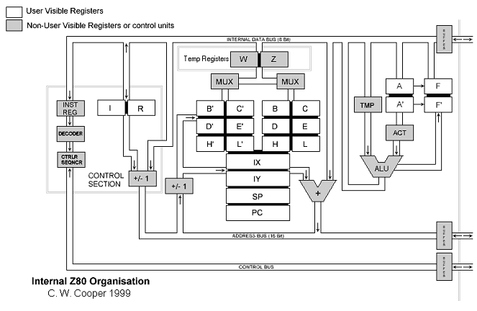
Zilog Z80 (8-bit)

Slide 7
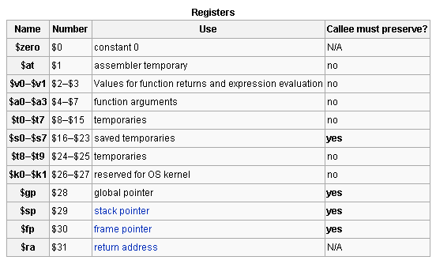
MIPS R3000 (32-bit)
Microprocessor without Interlocked Pipeline Stages

Slide 8
Intermediate representation
We represent the immediate output of the compilation using an intermediate language - an abstract machine language
  Express target machine operations, but without machine-specific details
  Source-language independent

Slide 9
Intermediate representation
Compiler
  front end: lexical analysis, parsing, semantic analysis
  back end:
    optimisation of IR (rewrite IR so as to improve execution speed)
    translation to real machine language
    (in case of Java, to another abstract machine language JVM)
Many IRs
  Appel uses simple expression trees

Slide 10
Real life IR and ILs
A wide variety - for example gcc supports (amongst others):
  RTL (register transfer language), GENERIC (tree-based), GIMPLE (a static single assignment language).
Eiffel uses a simplified form of C.
Java produces byte code.
Microsoft .NET uses CIL.
Other languages operate on pseudo-assembler or generic trees.

Slide 11
Intermediate representation
Any good representation:
  must be convenient for semantic analysis phase to produce.
  must be convenient to translate to real (or virtual) machine language for target machines.
  must have simple meaning for each construct that leads to simple operations on the IR to rewrite parts of it for optimisation etc.

Slide 12
Intermediate representation
In any IR
  individual components describe simple operations on the abstract machine represented by the IR instructions
  each element of the complex abstract syntax is translated into a set of simple IR abstract machine instructions
  groups of IR instructions will be grouped and regrouped to form real machine instructions

Slide 13
What does the IR abstract machine have?
i.e. what do the trees represent/operate on?
  integer constants
  memory
  registers [temporaries in the translation - infinite number in IR]
  instruction set
  sequential execution
  labels and jumps

Slide 14
IR: tree expression operators
CONST(i)
  integer constant
NAME(n)
  symbolic constant (an assembly lang label)
TEMP(t)
  abstract register...infinite number!
BINOP(o,e1,e2)
  Where o = PLUS, MINUS, MUL, DIV, AND, OR, XOR, LSHIFT, RSHIFT, ARSHIFT

Slide 15
IR: tree expression operators
MEM(e)
  contents of wordSize bytes starting at addr e (means “store” if left child of move, else “fetch”)
CALL(f,l)
  procedure call, applies f to list l
ESEQ(s,e)
  eval s for side-effects, eval e for result

Slide 16
IR: statements
MOVE(TEMP t,e)
  eval e & move into temp t
MOVE(MEM(e1,k),e2)
  eval e1 ( ⇒ addr a); eval e2 & store results into k bytes of mem starting at a
EXP(e)
  eval e & discard the result
perform side effects
& control flow
No provision for procedure and & function defs - just body of each function

Slide 17
IR: statements
JUMP(e,labs)
  transfer control to addr e; labs specifies list of all poss locations e can eval to
CJUMP(o,e1,e2,t,f)
  eval e1 then e2, compare result with relational op o; if true jump to t else to f
SEQ(s1,s2)
  ???
LABEL(n)
  defines const n to be current machine code address

Slide 18
Example translation
a > b | c < d translates to
SEQ(CJUMP(GT,a,b,t,z),
SEQ(LABEL z, CJUMP(LT,c,d,t,f))) with t,f labels
SEQ
SEQ
CJUMP
GT
a
b
t
z
LABEL
CJUMP
z
LT
c
d
t
f

Slide 19
Simple variables translation
Simple variable v in current procedure or function stack frame
  k: offset of v in frame
  TEMP fp: frame pointer register
MEM
BINOP
PLUS
TEMP fp
CONST k
MEM(BINOP(PLUS,TEMP fp, CONST k))

Slide 20
Conditionals
Use CJUMP
  x < 5 translates to CJUMP(LT, x, CONST(5), t, f)
  for labels t, f
if x < 5 then a > b else 0

Slide 21
Conditionals
SEQ(CJUMP(LT,x,CONST(5),z,f),
SEQ(LABEL z,
CJUMP(GT,a,b,t [pick up val of a>b],f [pick up val 0])))
SEQ
SEQ
CJUMP
LABEL
CJUMP
LT
x
CONST
z
f
z
GT
a
b
t
f
5

Slide 22
What you should do now
See book for other translations
  while-loops
  for-loops
  functions
  declarations
Complete the May 2006 exam paper before next week!

Slide 23
Final Questions?
Everything crystal clear…?
Really…?

Slide 24
Schedule
Module Summary & Exam Revision
Monday 14th April, 2008
  11:00 - 12:50
  C.343

