Slide 1
Session Plan
Session 3: Parsing (syntax analysis)
  syntax definition
    context free grammars (BNF)
  parsing
  ambiguous grammars
  removal of left recursion
  top down recursive descent parsing
  extended BNF (EBNF)
  parsing using JavaCC

Slide 2
Syntax definition
need to recognise structures like expressions with parentheses, or nested statements:
  (109+23) (1+(250+3)) if (…) then if (…) stms… else … else …
tempting to attempt to use regular expressions
  digits = [0-9]+
  sum = expr “+” expr
  expr = “(” sum “)” | digits
but remember that regular expression abbreviations like digits are only abbreviations and are substituted directly (they are macros), so we would get
  expr = “(” expr “+” expr “)” | digits (substituting sum, and then…)
  expr = “(” ( “(” expr “+” expr “)” | digits ) “+” expr “)” | digits
if we try such definitions, and an automaton cannot be created from such definitions

Slide 3
Syntax definition
what we need is a notation where the recursion does not mean abbreviation and substitution, but instead means definition
then, (1+(250+3)) can be recognised by our recursive definitions
  expr => “(” sum “)” | digits
  => “(” expr “+” expr “)” (using the sum definition)
  => “(” digits “+” expr “)” (using the expr definition)
  => “(“ 1 “+” expr “)”
  => “(“ 1 “+” “(“ sum “)” “)”
  => “(“ 1 “+” “(“ expr “+” expr “)” “)”
  => “(“ 1 “+” “(“ digits “+” expr “)” “)”
  => “(“ 1 “+” “(“ digits “+” digits “)” “)”
  => “(“ 1 “+” “(“ 250 “+” digits “)” “)”
  => “(“ 1 “+” “(“ 250 “+” 3 “)” “)”

Slide 4
Syntax definition
alternation within definitions is then not needed, since
  r = ab(c|d)e is the same as n = (c|d) with r = abne
  or even n = c with n = d with r = abne, so alternation not needed at all
  we will however retain alternation at the top level of definition
repetition via Kleene closure * is not needed, since
  e= (abc)* is the same as e=(abc)e with e=ε
this recursive notation is called context-free grammars or BNF (see Session 1)
  recognised by pushdown automata (PDA); recognition is implemented in many ways
  involves (implicitly or explicitly) building the concrete syntax (parse) tree, matching against the tokens produced by the lexical analyser
  building the tree can be top-down or bottom-up
  once again, a tool can produce a parser for us

Slide 5
Context-free grammars
A language is a set of strings
Each string is a finite sequence of symbols taken from a finite alphabet
For parsing: symbols = lexical tokens, alphabet = set of token types returned by the lexical analyser
A grammar describes a language
A grammar has a set of productions of the form
  symbol → symbol symbol … symbol
Zero or more symbols on RHS
Each symbol either a terminal from the alphabet or a non-terminal (appears on LHS of some productions)
No token ever on LHS of production
One non-terminal distinguished as start symbol of the grammar

Slide 6
Syntax for straight-line programs
1 S → S ; S
2 S → id := E
3 S → print ( L )
4 E → id
5 E → num
6 E → E + E
7 E → (S , E )
8 L → E
9 L → L , E
a context-free grammar
terminal symbols (tokens):
id print num , ( ) := ; +
non-terminal symbols:
S E L
start symbol S

Slide 7
Derivations
S
S ; S
S ; id := E
id := E ; id := E
id := num ; id := E
id := num ; id := E + E
id := num ; id := E + (S , E)
id := num ; id := id + (S , E)
id := num ; id := (id := E , E)
id := num ; id := (id := E + E , E)
id := num ; id := (id := E+E, id)
id := num ; id := (id := num+E, id)
id := num ; id := (id := num + num, id)
a := 7 ;
b := c + (d:= 5+6, d)

Slide 8
Parsing
S → c A d input: c a d
A → ab | a
S S S
/|\ /|\ /|\
c A d c A d c A d
/ \ |
a b a
bottom-up or top-down

Slide 9
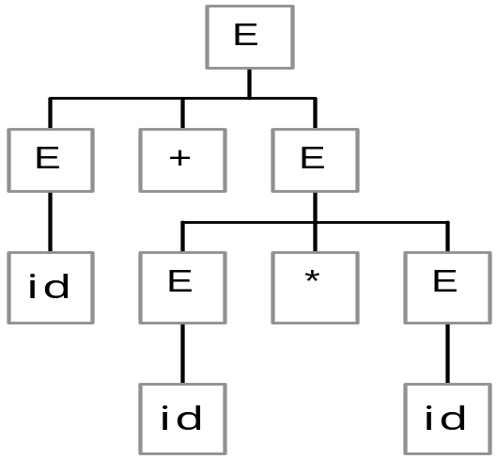
Concrete syntax derivations and parse trees
E → E * E | E / E | E + E | E - E | ( E ) | id | num
Leftmost derivation of id + id * id :
E
⇒ E * E
⇒ E + E * E
⇒ id + E * E
⇒ id + id * E
⇒ id + id * Id
Concrete syntax tree
(parse tree):

Slide 10
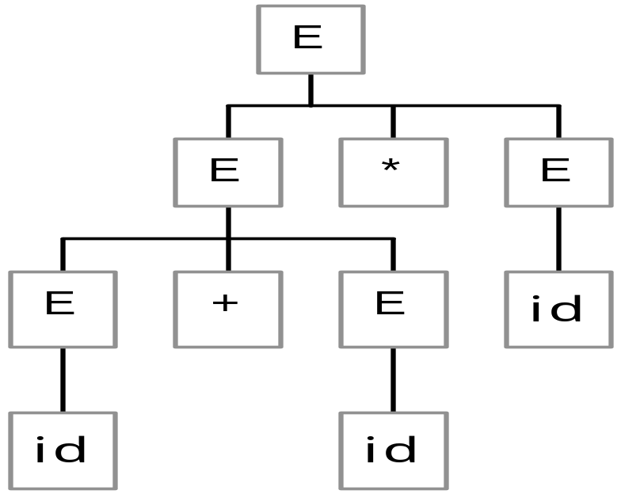

Ambiguous grammars
E → E * E | E / E | E + E | E - E | ( E ) | id | num
Two parse trees for id + id * id

Slide 11
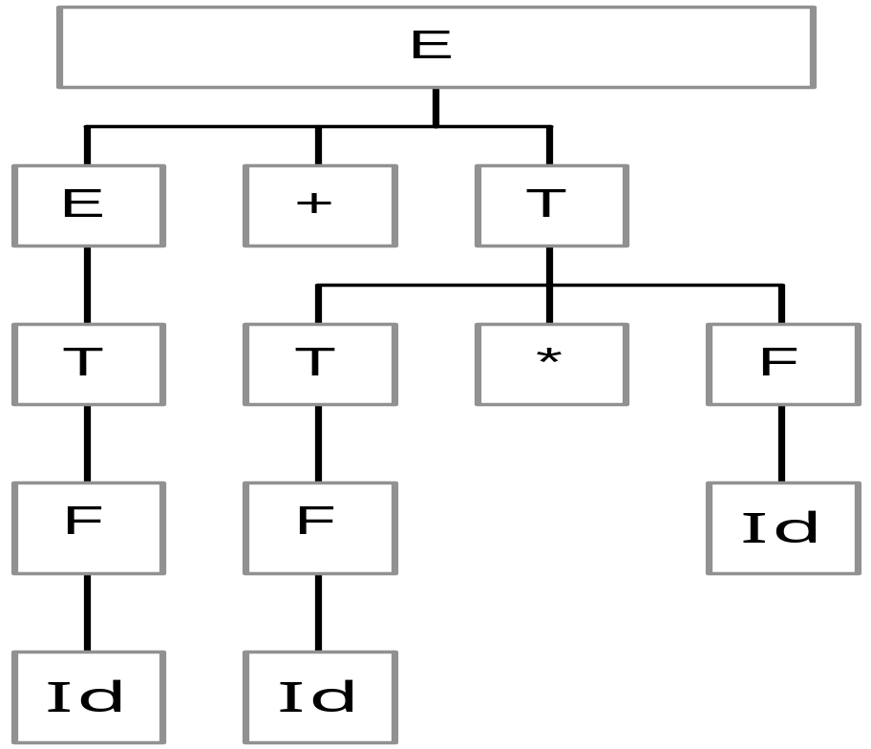
Disambiguating the grammar
E → E + T
E → E - T
E → T
T → T * F
T → T / F
T → F
F → id
F → num
F → (E)
Only one tree now possible
from this BNF for input string
id + id * id

Slide 12
Recursive descent (top-down) parsing
Each grammar production turns into one clause of a recursive function
Only works on grammars where the first terminal symbol of each grammatical construct provides enough information to choose the production

Slide 13
Recursive descent parsing (p46, Gram 3.11)
S → if E then S else S
S → begin S L
S → print E
L → end
L → ; S L
E → num = num
void S() {
switch (tok) {
case IF:
eat(IF); E(); eat(THEN);
S(); eat(ELSE); S(); break;
case BEGIN: eat(BEGIN); S(); L(); break;
case PRINT: eat(PRINT); E(); break;
}
void E() { eat(NUM); eat(EQ); eat(NUM); }
void eat(int t) { if tok==t advance()
else error();
}

Slide 14
But... (p46, Gram 3.10)
if we try to implement a recursive descent parser for the disambiguated expression grammar…
E → E + T
E → E - T
E → T
T → T * F
T → T / F
T → F
F → id
F → num
F → (E)
void E() { switch (tok) {
case ???: E(); eat(PLUS); T(); break;
case ???: E(); eat(MINUS); T(): break;
case ???: T(); break;
…
TWO problems:
  no initial terminal symbol to tell us which production to choose
  left-recursion means E() is called immediately…

Slide 15
Eliminating left recursion
X → α X’
X’ → γ X’
X’ →
X → X γ
X → α
can always be rewritten
S → E $
E → T E’
E’ → + T E’
E’ → - T E’
E’ →
T → F T’
T’ → * F T’
T’ → / F T’
T’ →
F → id
F → num
F → (E)

Slide 16
Sketch of resulting recursive descent parser
S → E $
E → T E’
E’ → + T E’
E’ → - T E’
E’ →
T → F T’
T’ → * F T’
T’ → / F T’
T’ →
F → id
F → num
F → (E)
void E() { T(); E’(); }
void E’() { switch (tok) {
case PLUS: eat(PLUS); T(); E’(); break;
case MINUS: eat(MINUS); T(); E’(); break;
default: /* empty – that’s ok */ break;
}
}

Slide 17
Extended BNF (EBNF)
a few additional operators to shorten definitions:
  e1 | e2 | e3 | ... : choice of e1, e2, e3, etc
  (…) bracketting allowed
  [...] : the expression in […] may be omitted
    (may also be written as (...)? ).
  ( e )+ : One or more occurrences of e
  ( e )* : Zero or more occurrences of e
  Note that these may be nested within each other, so we can have
    (( e1 | e2 )* [ e3 ] ) | e4
examples:
IfStatement → if ( Expression ) StatementBlock [ else StatementBlock ]
StatementBlock → { (Statement)+ }

Slide 18
Expression grammar in EBNF
E → E + T
E → E - T
E → T
T → T * F
T → T / F
T → F
F → id
F → num
F → (E)
Original
F → id
F → num
F → (E)
E → T E’
E’ → + T E’
E’ → - T E’
E’ →
T → F T’
T’ → * F T’
T’ → / F T’
T’ →
Left-recursion
eliminated
F → id
F → num
F → (E)
E → T ( + T | - T )*
T → F ( * T | / T )*
EBNF

Slide 19
JavaCC – parser and lexical analysis
fortunately, we don’t have to hand-code parsers…
given an (E)BNF grammar, software tools like JavaCC will produce a parser for us
reminder – lexical analysis:
  tokens defined by regular expressions are recognised by finite state automata (FSA) (see previous session)
  fortunately, we don’t have to draw out a FSA and implement it to recognise tokens, because, given regular expressions, tools can produce a token matcher program for us
  in our case, given token definitions, our tool JavaCC will produce a lexical analysis method which simulates a FSA and matches tokens and sends them to the parser…

Slide 20
JavaCC
JavaCC specification
(includes both token specifications and
grammar, possibly with actions)
javacc
Parsing and lexical
analysis Java class files
(with actions if specified)
javac
combined token matcher and parser (executing actions if specified)

Slide 21
JavaCC
JavaCC is a parser generator. Given as input a set of token definitions, a programming language syntax grammar, and a set of actions written in Java, it produces a Java program which will perform lexical analysis to find tokens and then parse the tokens according to the grammar and execute the actions as appropriate
it works on LL(1) grammars (no need to understand this definition), which are similar to those that recursive descent works for
it requires a non-ambiguous grammar with left-recursion removed, so we use the techniques from earlier this session

Slide 22
JavaCC BNF example
E → T E’
E’ → + T E’
E’ → - T E’
E’ →
T → F T’
T’ → * F T’
T’ → / F T’
T’ →
F → num
F → (E)
void E() :
{}
{
T() Eprime()
}
void Eprime() :
{}
{
( "+" T() Eprime() )
| ( "-" T() Eprime() )
| {} /* empty */
}
void T() :
{}
{
F() Tprime()
}
void Tprime() :
{}
{
( "*" F() Tprime() )
| ( "/" F() Tprime() )
| {} /* empty */
}
void F() :
{}
{
<NUM>
| "(" E() ")"
}
TOKEN :
{
< NUM: (["0"-"9"])+ >
}

Slide 23
JavaCC EBNF example
E → T ( + T | - T )*
T → F ( * T | / T )*
F → num
F → (E)
void E() :
{}
{
T() ( "+" T() | "-" T() )*
}
void T() :
{}
{
F() ( "*" F() | "/" F() )*
}
void F() :
{}
{
<NUM>
| "(" E() ")"
}
TOKEN :
{
< NUM: (["0"-"9"])+ >
}

Slide 24
JavaCC input file format (.jj)
Parser-name must be the
same in all three places
PARSER_BEGIN(Parser-name)
class Parser-name { }
PARSER_END(Parser-name)
/* Lexical items (ie token definitions) – see previous examples */
Token-definitions
/* Grammar rules – in a stylised form of EBNF (see next slide). */
Syntax-definitions

Slide 25
JavaCC Syntax-definitions
A BNF production: non-terminal-name -> right-hand-side is written:
java_return_type non-terminal-name ( java_parameter_list ) : (1)
java_block (2)
{ expansion_choices } (3)
gives the name of the non-terminal being defined
The rest of (1) looks like a Java method declaration. Using this feature we can cause values to be passed up and down the parse tree while the parse takes place (up via return values and down via parameters).
(2) (java_block) introduces some Java code which is usually used to declare variables for use in the production
(3) is the EBNF definition and actions…see next slide

Slide 26
JavaCC EBNF expansion_choices
expansion | expansion | ... where the `|' separates alternatives.
expansion expansion ... matches first expansion then second and so on
( expansion_choices )* matches zero or more expansion_choices
( expansion_choices )+ matches one or more expansion_choices
( expansion_choices )? matches expansion_choices or empty string
[ expansion_choices ] ditto (ie same as ?)
regexp matches the token matched by the regexp
java_id = regexp ditto, assigning token to java_id
non-terminal-name (…) matches the non-terminal
java_id = non-terminal-name (…) ditto, assigning returned value to java_id
The java_id will usually be declared in the java_block.
Any of these expansions may be followed by some Java code written
in {...} and this code (often called an action) will be executed when the
generated parser matches the expansion.

Slide 27
What you should do now…
Read, digest and understand chapter 3
  don’t worry about parsing tables and table generation
Understand the JavaCC document and how to write token regular expressions and EBNF definitions in JavaCC
take a first look at the MiniJava language
  we’ll be using this through the rest of the module

Slide 28
JavaCC example – Exp.jj file
PARSER_BEGIN(Exp)
public class Exp {
}
PARSER_END(Exp)
SKIP :
{
" " | "\t" | "\r"
}
TOKEN :
{
< NUM: (["0"-"9"])+ > | < EOL: "\n" >
}
void S() :
{}
{
E() <EOL>
| <EOL>
| <EOF>
}
void E() :
{}
{
T() ( "+" T() | "-" T() )*
}
void T() :
{}
{
F() ( "*" F() | "/" F() )*
}
void F() :
{}
{
<NUM>
| "(" E() ")"
}

Slide 29
JavaCC example – Main.java file
class Main {
public static void main(String args[]) throws ParseException {
Exp parser = new Exp(System.in);
try {
System.out.println("Type in an expression on a single line.");
parser.S();
System.out.println("Expression parser - parse successful");
} catch (ParseException e) {
System.out.println("Expression parser - error in parse");
}
}
}

