Slide 1
Session Plan
Session 5: Semantic analysis
  symbol tables
    environments
    hash tables
    symbol table for MiniJava
  typechecking

Slide 2
Semantic analysis (1)
connects variable (and type/class, and function) definitions to their uses
checks that each use matches an appropriate declaration
  must also use scope rules of language…
checks that each expression/part of the program is of correct type
translates abstract syntax into simpler representation suitable for generating machine code

Slide 3
Semantic analysis (2)
collect all identifiers in symbol table(s) with attributes such as: type; scope; for a function or method, parameter types & return type
  by traversal of declaration ASTs
check that applied occurrences of identifiers have related declarations (are in table) at right scope
  by traversal of rest of program ASTs
check that types of (sub-)expressions and parts of statements are of expected type
  by traversal of rest of program ASTs and collecting types
  eg actual param matches type of formal; in A+B, A,B are ints

Slide 4
Symbol tables (environments)
map identifiers to their types & locations
identifiers (variable names, function or method names, type or class names) are bound to "meanings" (bindings) in symbol tables
  eg type of variable name
  eg number and type of parameters of function
  eg scope
perform lookup in symbol table when there is a use (non-defining occurrence) of identifier
scope for each local variable in which it is visible:
  class X { int y;… }
  local variable in a Java method?
discard identifier bindings local to scope at end of scope analysis
Environment is a set of bindings →
e.g.
σ₀ = {g → string,a → int}

Slide 5
Example
class C {
int a; int b; int c;
public void m() {
System.out.println(a+c);
int j = a+b;
String a = "hello"
System.out.println(a);
System.out.println(j);
System.out.println(b);
}
}
1 σ₀ is starting environment
2 σ₁ = σ₀ +{a→int,b→int,c→int}
3
4 lookup ids a,c in σ₁
5 σ₂ = σ₁ + {j→int}
6 σ₃ = σ₂ + {a→string}
7 lookup a in σ₃
8 lookup j in σ₃
9 lookup b in σ₁
10 discard σ₃ revert to σ₁
11 discard σ₁ revert to σ₀
Need to deal with clashes (different bindings for same symbol)
σ₂ : a→int , σ₃ : a→string
prefer most recent binding so as to implement scope rules of language

Slide 6
Imperative implementation style
modify σ₁ to σ₂
undo modification to get back to σ₁
use hash tables
σ' = σ + {a→τ} Implement by inserting τ into hash table with key a
simple hash table with external chaining: i th bucket = linked list of all elements whose keys hash to i mod SIZE
java.util.Hashtable implements this for us, and a hashtable will be used for storing classes, and within them two hashtables will store the global variables (fields) and methods, and within methods a hashtable will store the local variables

Slide 7
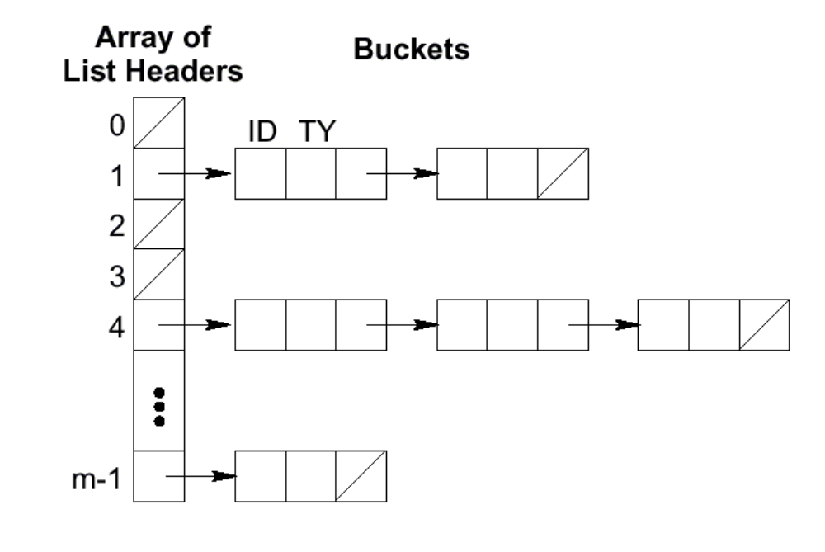
Hashing with external chaining
ID Binding

Slide 8
Symbol table for MiniJava
Method
Class
class B {
C f; int [] j; int q;
public int start(int p, int q) {
int ret; int a;
...
return ret;
}
public boolean stop(int p) {
…
return false;
}
class C { … }
PARAMS
p int
q int
FIELDS
(GLOBALS)
f C
j int []
q int
LOCALS
(VARS)
ret int
a int
B
C
METHODS
start int
stop bool
PARAMS
p int
…
LOCALS
(VARS)

Slide 9
MiniJava symbols and typechecking
each variable name and formal parameter bound to its type
each method name bound to its formal parameters, result type, and local variables
each class name bound to its variable (field) and method declarations
typechecking:
  first build the symbol table
  then typecheck the statements and expressions in the AST, consulting the symbol table for each identifier found

Slide 10
Symbol table implementation
class SymbolTable {
public SymbolTable();
public boolean addClass(String id, String parent);
public Class getClass(String id);
public boolean containsClass(String id);
public Type getVarType(Method m, Class c, String id);
public Method getMethod(String id, String classScope);
public Type getMethodType(String id, String classScope);
public boolean compareTypes(Type t1, Type t2);
}
SymbolTable contains a hashtable of Class objects…

Slide 11
Symbol table implementation
getVarType(Method m, Class c, String id)
  in c.m, find variable id
  may be…
    local variable in method
    parameter in formal parameters in method
    variable in the class
    variable in a parent class
getMethod(), getMethodType()
  may be defined in the parent classes
compareTypes()
  primitive types IntegerType, BooleanType, IntegerArrayType
  IdentifierTypes (class types) stored as strings, returns true if identical or if equals a parent

Slide 12
Symbol table class Class
class Class {
public Class(String id, String parent);
public String getId();
public Type type();
public boolean addMethod(String id, Type type);
public Method getMethod(String id);
public boolean containsMethod(String id);
public boolean addVar(String id, Type type);
public Variable getVar(String id);
public boolean containsVar(String id);
public String parent();
}
Class contains a hashtable of global variables (fields) and a hashtable of methods

Slide 13
Symbol table variable representation
class Variable {
public Variable(String id, Type type);
public String id();
public Type type();
}

Slide 14
Symbol table method representation
class Method {
public Method(String id, Type type);
public String getId();
public Type type();
public boolean addParam(String id, Type type);
public Variable getParamAt(int i);
public boolean getParam(String id);
public boolean containsParam(String id);
public boolean addVar(String id, Type type);
public Variable getVar(String id);
public boolean containsVar(String id);
}
Method contains a vector of parameters (formals) and a hashtable of (local) variables, and a return type

Slide 15
Implementation
is by visitors, just like the pretty printer
  interfaces Visitor is as before
  a new visitor interface TypeVisitor is just the same but its methods return a Type
  general classes DepthFirstVisitor and TypeDepthFirstVisitor implement these interfaces and traverse the AST depth-first visiting each node, but taking no action
building the symbol table
  BuildSymbolTableVisitor extends TypeDepthFirstVisitor, overriding methods so as to add classes, methods, vars, etc
typechecking
  TypeCheckVisitor extends DepthFirstVisitor overriding methods so as to check statements, TypeCheckExpVisitor extends TypeDepthFirstVisitor overriding methods so as to check expressions

Slide 16
BuildSymbolTableVisitor
Note that some checks are done as the table is built, eg for variable declarations (see below) a check is made on whether the variable is already declared
public class BuildSymbolTableVisitor extends TypeDepthFirstVisitor {
…
private Class currClass;
private Method currMethod;
…
// Type t;
// Identifier i;
public Type visit(VarDecl n) {
Type t = n.t.accept(this);
String id = n.i.toString();

Slide 17
BuildSymbolTableVisitor continued
if (currMethod == null){
if (!currClass.addVar(id,t)){
System.out.println(id + "is already defined in "
+ currClass.getId());
}
} else {
if (!currMethod.addVar(id,t)){
System.out.println(id + "is already defined in "
+ currClass.getId() + "." +
currMethod.getId());
}
}
return null;
}

Slide 18
TypeCheckVisitor
public class TypeCheckVisitor extends DepthFirstVisitor {
static Class currClass;
static Method currMethod;
static SymbolTable symbolTable;
public TypeCheckVisitor(SymbolTable s){
symbolTable = s;
}
…

Slide 19
TypeCheckVisitor continued
…
// Identifier i;
// Exp e;
public void visit(Assign n) {
Type t1 = symbolTable.getVarType(currMethod,currClass,n.i.toString());
Type t2 = n.e.accept(new TypeCheckExpVisitor() );
if (symbolTable.compareTypes(t1,t2)==false){
System.out.println("Type error in assignment to "+n.i.toString());
}
}
…

Slide 20
TypeCheckVisitor continued
…
// Type t;
// Identifier i;
// FormalList fl;
// VarDeclList vl;
// StatementList sl;
// Exp e;
public void visit(MethodDecl n) {
n.t.accept(this);
String id = n.i.toString();
currMethod = currClass.getMethod(id);
Type retType = currMethod.type();
for ( int i = 0; i < n.fl.size(); i++ ) { n.fl.elementAt(i).accept(this); }
for ( int i = 0; i < n.vl.size(); i++ ) { n.vl.elementAt(i).accept(this); }
for ( int i = 0; i < n.sl.size(); i++ ) { n.sl.elementAt(i).accept(this); }
if (symbolTable.compareTypes(retType, n.e.accept(new TypeCheckExpVisitor()))==false) {
System.out.println("Wrong return type for method "+ id);
}
}

Slide 21
TypeCheckExpVisitor
public class TypeCheckExpVisitor extends TypeDepthFirstVisitor {
…
// Exp e1,e2;
public Type visit(Plus n) {
if (! (n.e1.accept(this) instanceof IntegerType) ) {
System.out.println("Left side of Plus must be of type integer");
}
if (! (n.e2.accept(this) instanceof IntegerType) ) {
System.out.println("Right side of Plus must be of type integer");
}
return new IntegerType();
}
…

Slide 22
Method Calls e.i(el₁,el₂,…)
Lookup method in the SymbolTable to get parameter list and result type
Find i in class e
The parameter types in the parameter list for the method must be matched against the actual arguments el₁, el₂, …
Result type becomes the type of the method call as a whole

Slide 23
TypeCheckExpVisitor continued
…
// Exp e;
// Identifier i;
// ExpList el;
public Type visit(Call n) {
if (! (n.e.accept(this) instanceof IdentifierType)){
System.out.println("method "+ n.i.toString()+ "called on something that is not a class or Object.");
}
String mname = n.i.toString();
String cname = ((IdentifierType) n.e.accept(this)).s;
Method calledMethod = TypeCheckVisitor.symbolTable.getMethod(mname,cname);
for ( int i = 0; i < n.el.size(); i++ ) {
Type t1 =null;
Type t2 =null;
if (calledMethod.getParamAt(i)!=null)
t1 = calledMethod.getParamAt(i).type();
t2 = n.el.elementAt(i).accept(this);
if (!TypeCheckVisitor.symbolTable.compareTypes(t1,t2)){
System.out.println("Type Error in arguments passed to " +cname+"." +mname);
}
}
return TypeCheckVisitor.symbolTable.getMethodType(mname,cname);
}

Slide 24
What you should do now…
read and digest chapter 5
  you don’t need functional implementation styles or mutiple tables
get ready further to develop the MiniJava typechecker

