Slide 1
Population Growth effects on Car Accidents
Iulia Goike

Slide 2
Motivation
Motor Vehicle Crashes cause significant social harm and economic losses.
On average, there are 6.75 million car accidents in the U.S. every year. That’s roughly ​18,510 per day. Around 38,000 people die in automobile crashes on annual basis and an additional 3 million are injured or disabled.
Leaving in Metro Nashville area, you often hear people talk about the constant traffic accidents and how so many people are moving here every day. That made me wonder if it’s something worth looking into, if there’s any interesting patterns that can be found by combining population data with car accident reports.

Slide 3
Data Sources
U.S Census Bureau website
County Population Totals: 2010-2020
Annual Estimates of the Resident Population for Counties from April 1, 2010, to July 1, 2019, for individual states
Annual Estimates of the Resident Population for Counties from April 1, 2020, to July 1, 2021, for individual states
Core based statistical areas (CBSAs), metropolitan divisions, and combined statistical areas (CSAs)
Crash Data Files
TN Department of Safety & Homeland Security
Texas Department of Transportation
Georgia Department of Transportation (GDOT)
Florida Highway Safety and Motor Vehicles (FLHSMV)
North Carolina Department of Transportation (NCDOT)

Slide 4
Data Analysis
Python
Analyzed “County Population totals from 2010-2020”, to identify states with the largest number of counties that fall into the top 25% of total population growth category, that are also a part of a Metropolitan Statistical Area
Utilized RegEx and PDFPlumber to pull crash data from state crash reports
Merged crashed dataframes with county population and CBSA data
Pandas dataframe.corr() to determine if there’s a correlation between population growth and total crashes
Excel
Data Storing
Tableau
Created interactive dashboard for a more detailed overview of the data

Slide 5
Data Question’s
Is there correlation between population growth and number of car accidents?
Does population growth affect Metropolitan and Micropolitan the number of injury crashes and car accident fatalities?

Slide 6
Data Limitations and Challenges
It’s important to note, that there’s multiple factors that can affect car accident crash data, however this analyses only reviews one of them.
Census population data used in this analysis is estimate based so the final numbers might be slightly off.
Analysis only covers 5 states.
Data for year 2020 was excluded from correlation heatmap due to unusual behavior when included.
Locating crash data broken down by county.
Crash reporting differ from state to state, not to mention that some states adopted different report formatting over the years, so I had to develop an individual approach for data extraction for almost every single report.

Slide 7
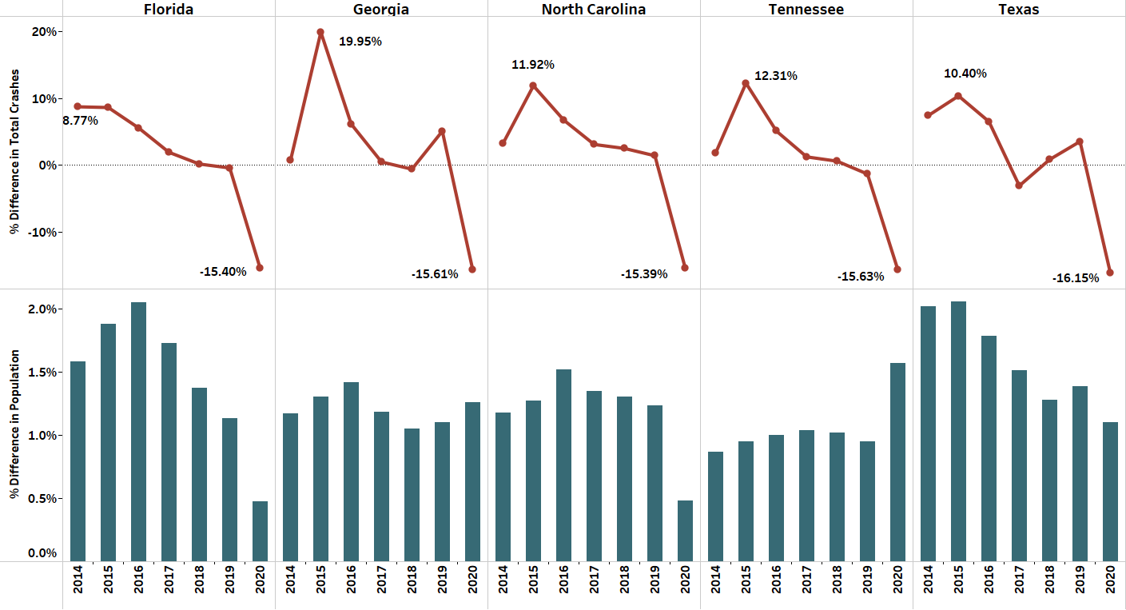
% Difference in Population and Total Crashes in Metropolitan Areas from previous year

Slide 8
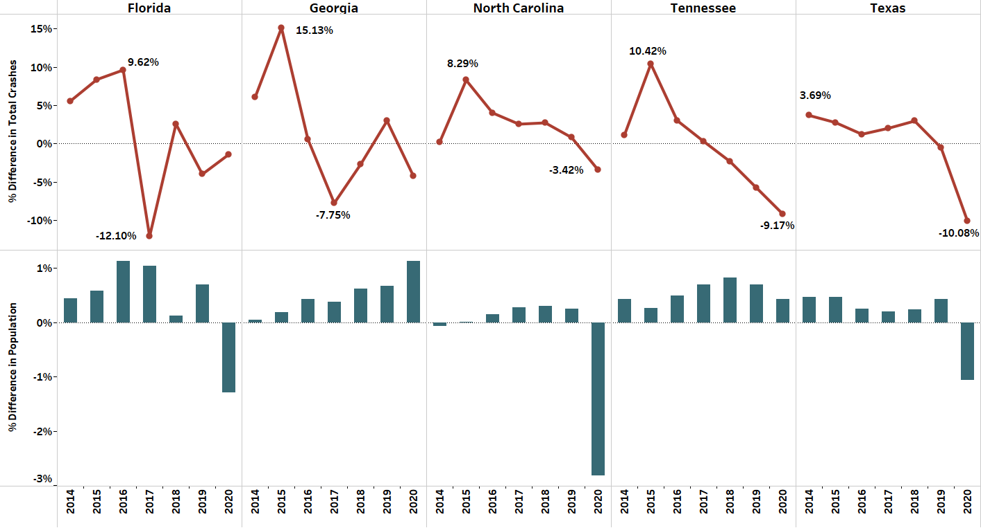
% Difference in Population and Total Crashes in Micropolitan Areas from previous year

Slide 9
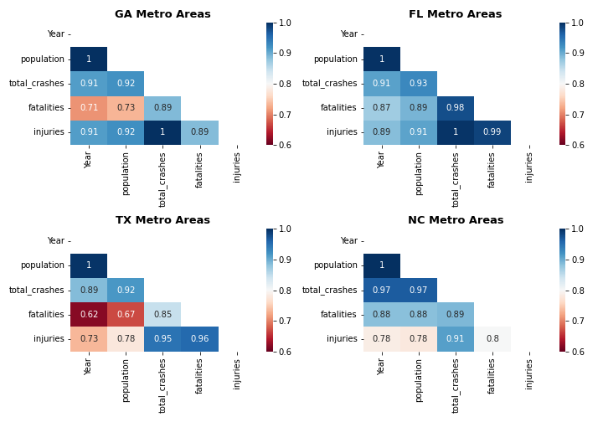
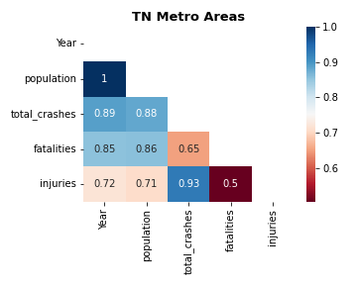
Correlation between Crash Data and Population increase in Metro Areas

Slide 10
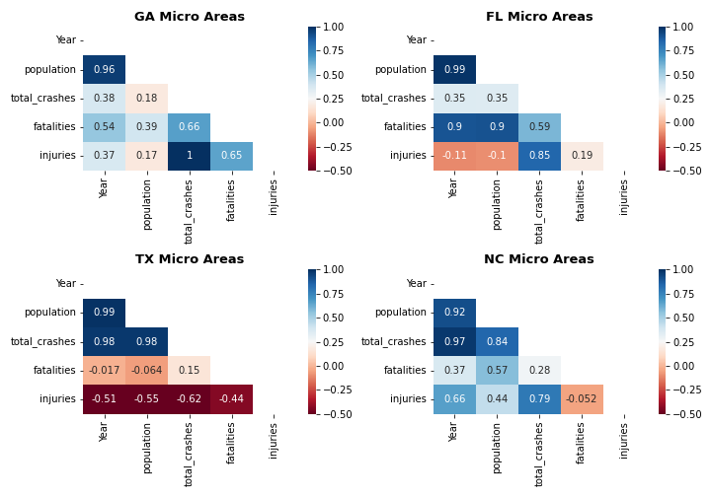
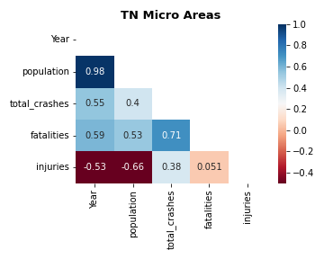
Correlation between Crash Data and Population increase in Micro Areas

Slide 11
Key Takeaways

