Slide 1
Title Layout
Subtitle

Slide 2
Data Analysis
Python
Analyzed “County Population totals from 2010-2020”, to identify states with the largest number of counties that fall into the top 25% of total population growth category, that are also a part of a Metropolitan Statistical Area
Utilized RegEx and PDFPlumber to pull crash data from state crash reports
Merged crashed dataframes with county population and CBSA data
Pandas dataframe.corr() to determine if there’s a correlation between population growth and total crashes

Slide 3
Data Sources
U.S Census Bureau website
County Population Totals: 2010-2020
Annual Estimates of the Resident Population for Counties from April 1, 2010, to July 1, 2019, for individual states
Annual Estimates of the Resident Population for Counties from April 1, 2020, to July 1, 2021, for individual states
Core based statistical areas (CBSAs), metropolitan divisions, and combined statistical areas (CSAs)
Crash Data Files
TN Department of Safety & Homeland Security
Texas Department of Transportation
Georgia Department of Transportation (GDOT)
Florida Highway Safety and Motor Vehicles (FLHSMV)
North Carolina Department of Transportation (NCDOT)

Slide 4
Data Limitations
It’s important to note, that there’s multiple factors that can affect car accident crash data, however this analyses only reviews one of many.
Census population data is estimate based so the numbers

Slide 5
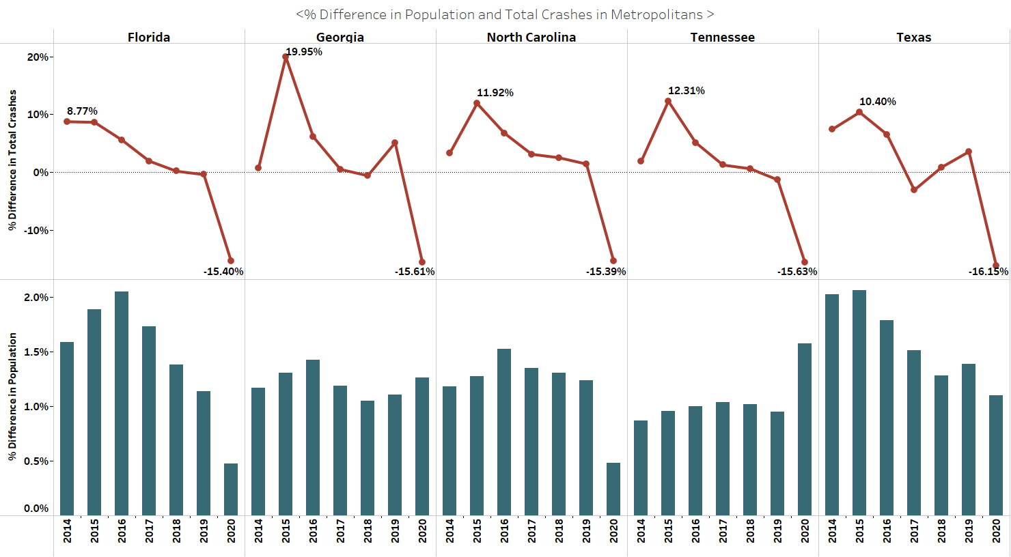

Slide 6
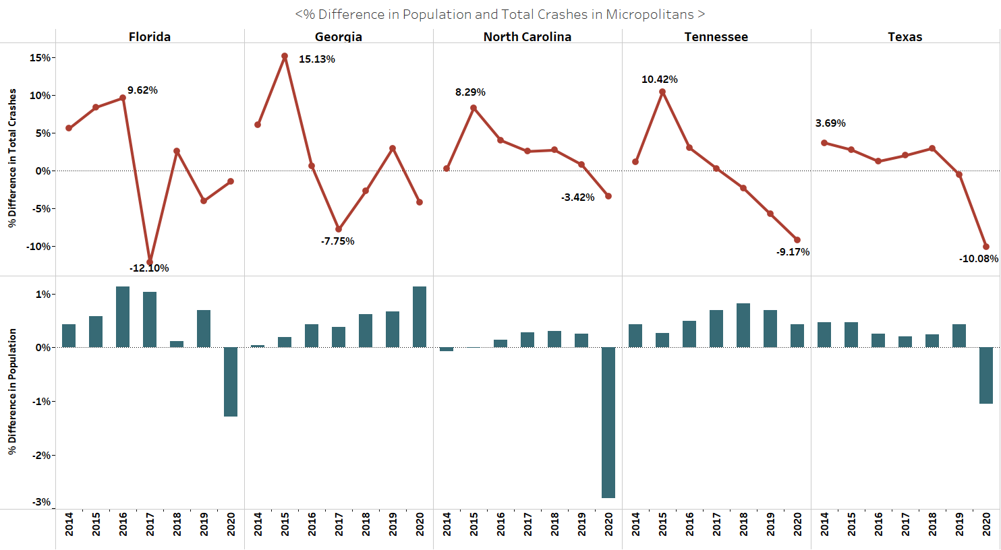

Slide 7
Add a Slide Title - 2

Slide 8
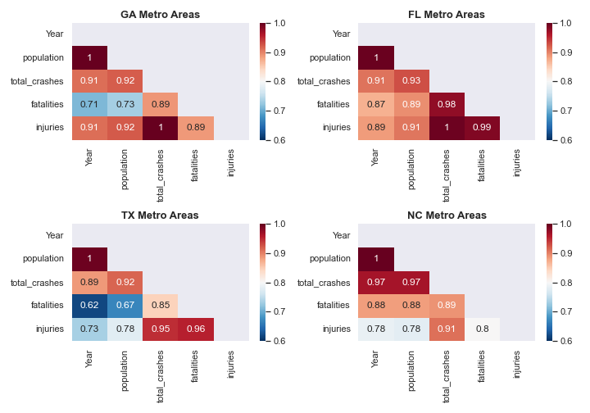
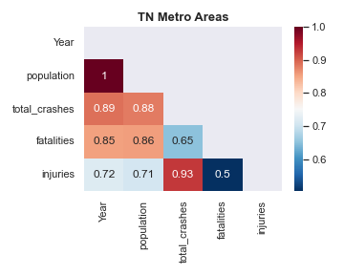
Correlation between Crash Data and Population increase in Metro Areas

Slide 9
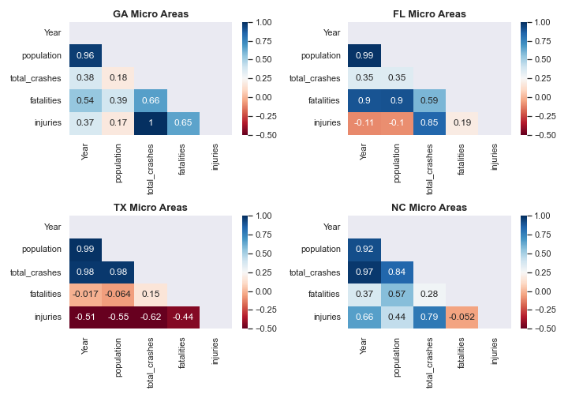
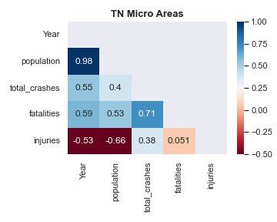
Correlation between Crash Data and Population increase in Micro Areas

Slide 10
Add a Slide Title - 4

Slide 11
Add a Slide Title - 5

