Slide 1


PANIMALAR ENGINEERING COLLEGE
DEPARTMENT OF COMPUTER SCIENCE AND ENGINEERING
CS8811 PROJECT WORK
REVIEW NO:1
Implementing Core Functionalities of PDS using Hyperledger Fabric
Guide Name: Dr. G. Senthil Kumar M.E., Ph.D.,
Team Members with Reg. No.
BATCH NO: E18 Gokul E (211418104066)
Hemanth S (211418104085)
Hari N (211418104074)

Slide 2

Introduction
1. Public Distribution System is an essential scheme envisioned for distribution of food commodities to the public at subsidized rate.
2. Central Government and State Government shares the responsibility for distribution by procuring from farmers, processing, storing and selling to consumers at subsidized rate through Fair Price Shops.
3. PDS has leakages and many shortcomings.
4. The project is aimed to eradicate leakages and diversions in the scheme with the help of asset tracking using RFID and distributed immutable ledger.

Slide 3
Literature Survey
Author | Title | Source | Findings
Satoshi Nakamoto (2008) | Bitcoin: A Peer-to-Peer Electronic Cash System | www.bitcoin.org | In Bitcoin, Blockchain is used to store the transactions in various public peers by reaching consensus through proof of work where every peer competes each other to append block of transactions to the ledger
Melanie Swan (2015) | Blockchain Blueprint for a New Economy | O’Reilly Media | Blockchain acts as a trustful system between various parties which helps in various use cases for eliminating redundancy and unnecessary intermediaries.
GUIDO PERBOLI, STEFANO MUSSO, MARIANGELA ROSANO (2018) | Blockchain in Logistics and Supply Chain: A Lean Approach for Designing Real-World Use Cases | IEEE | GUEST (GO, UNIFORM, EVALUATE, SOLVE AND TEST) methodology can be applied to formulate blockchain designs for specific Supply Chain Management and Logistics use case
Reshma Kamath (2018) | Food Traceability on Blockchain: Walmart’s Pork and Mango Pilots with IBM | The JBBA | Walmart is solving the challenges in logistics and supply network using IBM’s blockchain solution. It successfully tried two blockchain test pilots on pork from China and mangoes from America.
Giorgio Alessandro Motta, Bedir Tekinerdogan and Ioannis N. Athanasiadis (2020) | Blockchain Applications in the Agri-Food Domain: The First Wave | www.frontiersin.org | Tuna Tracking and Certification by Provenance, Olive Oil Tracking by Ambrosus, Celeia Dairy by OriginTrail, Pork Meat Traceability by TE-Food, FoodCoin and Wine Blockchain by EZLab. Ambrosus architecture is based on Amber.
Kok Yong Chan,Johari Abdullah,Adnan Shahid Khan (2019) | A Framework for Traceable and Transparent Supply Chain Management for Agri-food Sector in Malaysia using Blockchain Technology | IJACSA | Research was conducted in Malaysia to design and test traceable supply chain management system for pepper. The blockchain system was designed to encompass various actors like Farmers, Processors, Distributors, Retailers, Customers, and it was code-named as Prochain.
Table 1. Literature Survey Table on Blockchain

Slide 4
Problem Statement
Accountability of consignment is not ensured, and essential supplies are sold in black market to other districts
Traditional system is built using JSP and Struts framework. SMS gateway of NIC is interfaced with this system.
In 4G era, GPRS and SMS is still used in existing tracking facility. GSM spoofing (or) misuse of registered mobile number can lead to malfunction of this traditional system.
This is a manual process prone to human errors and inaccuracies. Accountability and Trust of the systems involved in the process can be breached

Slide 5
Development Environment (S/W & H/W)
Hyperledger Fabric Framework for setting up permissioned blockchain network and running chain code in the peer nodes.
Go/NodeJS for writing chain code and setting up REST APIs.
RFID Tags and Receiver for Asset Creation and Identification.
Embedded HTML forms for accessing REST APIs to CRUD assets.
ESP8266 and RC522 for IoT Implementation.

Slide 6
System Architecture
Based on extensive literature review and observed research gaps, a blockchain framework has been proposed to connect Ministry of Food and PDS , FCI, central, state and leased warehouses, FPSs throughout India and the beneficiaries.
The permissioned blockchain system, where consensus is controlled by participants and read permission is with participants only will be appropriate.
The consensus protocol refers to the method of verifying the legitimacy of the block of transactions. Consensus protocol of Proof of Authority could be used where the authority to verify the blocks will be with specified participants such as FCI, Ministry, warehouses and registered FPS

Slide 7
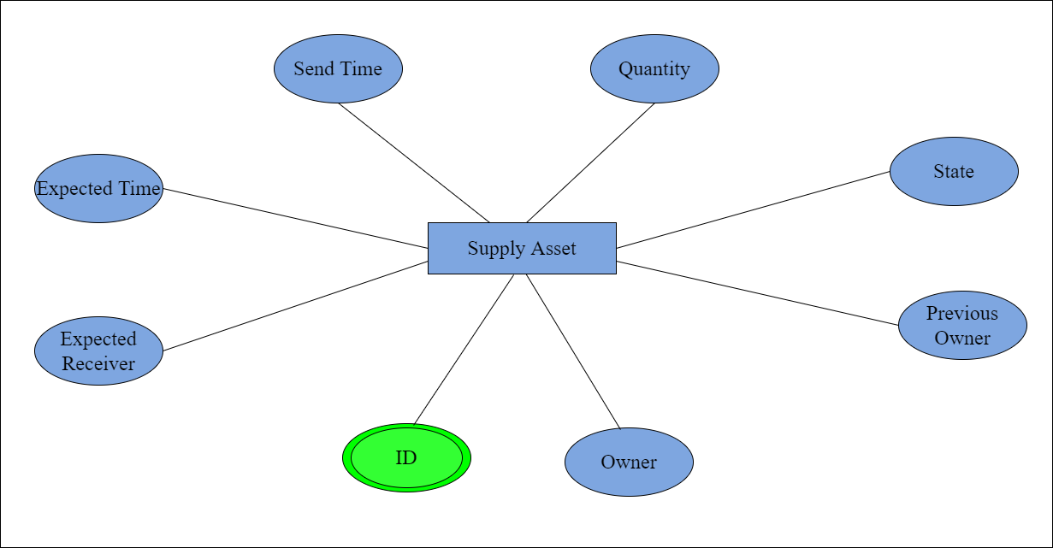
System Design (ER Diagram)
Figure 1. ER Diagram

Slide 8
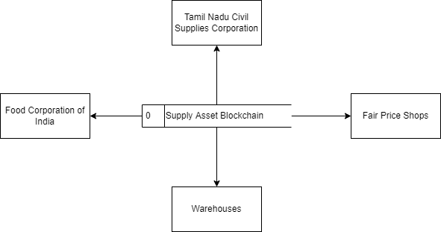
System Design (DFD Diagram)
Figure 2. DFD Diagram

Slide 9
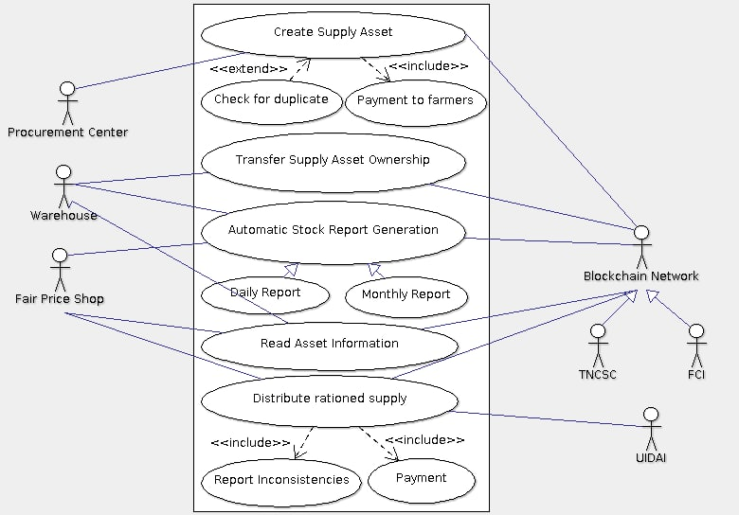
System Design (Use Case Diagram)
Figure 3. Use Case Diagram

Slide 10
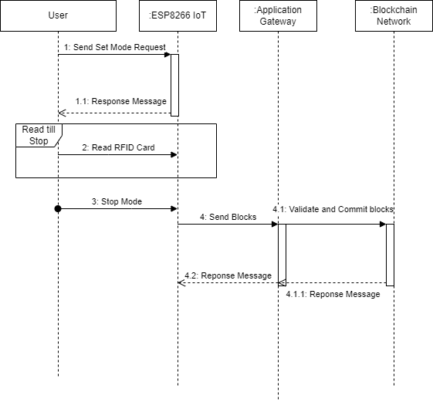
System Design (Sequence Diagram)
Figure 4. Sequence Diagram

Slide 11
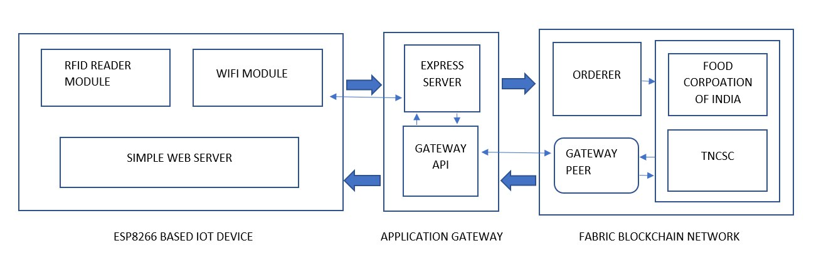
Module Description
Figure 5. Overall Module Diagram

Slide 12
Module Description
Three Important Modules are discussed below with the explanation of sub modules confined within those main modules.
ESP8266 BASED IOT DEVICE
APPLICATION GATEWAY
FABRIC BLOCKCHAIN NETWORK

Slide 13
Module Description
ESP8266 Based IoT Device:
ESP8266 is a low-cost micro controller with inbuilt Wi-Fi transceiver module.
ESP8266 is immensely useful because it can get the RFID information and call Chain code API to add the assets in the blockchain because ESP8266 is connected to Wi-Fi, and it can handle asynchronous requests.
Program is written to communicate with RC522 to get the RFID tag information. RC522 is interfaced with help of SPI communication

Slide 14
Module Description
There are four pins involved in this Serial Peripheral Interfacing. They are Master Out Slave In (MOSI), Master In Slave Out (MISO), Serial Clock (SCK), Signal Input. There are three other pins used for connecting to Power Supply (VCC, GROUND, RESET).
RC522 is a low-cost RFID reader which reads RFID Tags with the help of 13.56Mhz EM waves.
Web Server is deployed on ESP8266 to host a simple web page. This is used to set various modes on IoT device (Create, Transfer Ownership, Read).
Mobile/PC can connect with this website for CRUD operations

Slide 15
Module Description
Application Gateway:
Application Gateway is required to make a way for IoT devices to connect with Blockchain Framework SDK.
It is designed in a form of REST API endpoints, and this makes sure that it is stateless and highly scalable as it is of microservice architecture.
This acts like a barrier because IoT doesn’t directly interact with Fabric SDK, and this ensures that malicious requests are avoided before reaching Fabric

Slide 16
Module Description
Fabric Blockchain Network:
Hyperledger Fabric is a permission blockchain framework through which multiple parties can collaborate and transact with the help of distributed immutable ledger.
This framework is used to form a distributed network of peers across multiple organizations and these peers will be running smart contract and maintaining the blockchain.
Fabric Blockchain is deployed in every peer, and it is composed of World State and Ledger.

Slide 17
Module Description
Trust and Consensus between several peers is reached using Crash Fault Tolerance Protocol (CFT).
Ordering Service is an integral part of CFT protocol which will be validating the block of transactions before getting appended into the ledger.
Execute-Order-Validate architecture is used in Fabric framework instead of Order-Execute. Transaction proposal is sent from application to peers to get validated so that peers execute and sends endorsed transaction response. Endorsed transactions collected from the peers are send to ordering service by application.

Slide 18
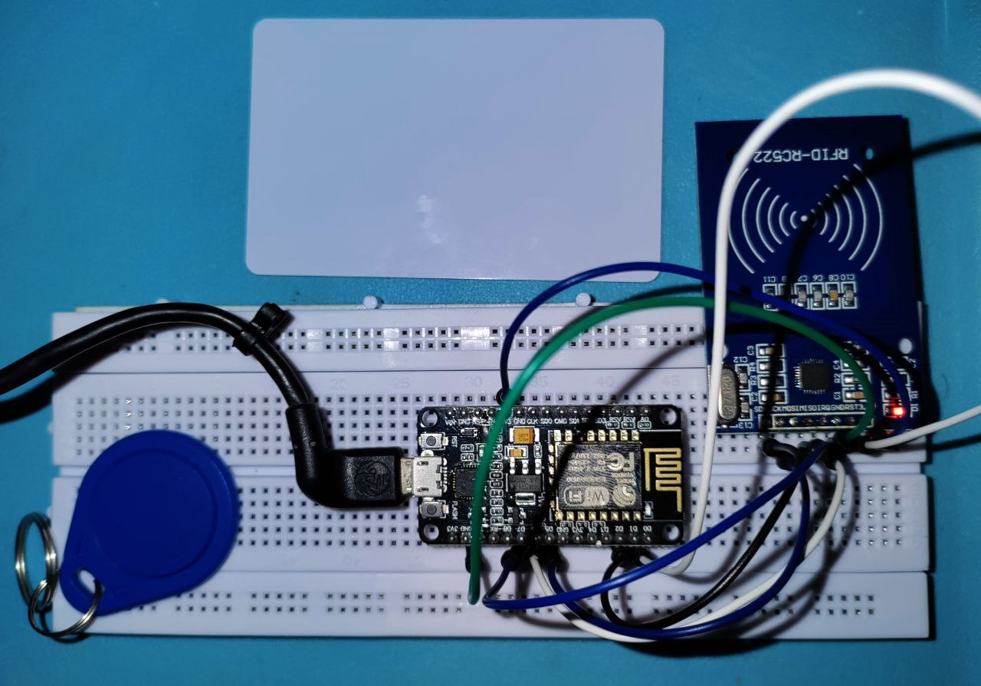
Results
From the obtained test cases and results above, we could infer that the proof of concept made possible using Hyperledger Fabric is working as expected.
Figure 6. ESP8266 IoT Setup

Slide 19
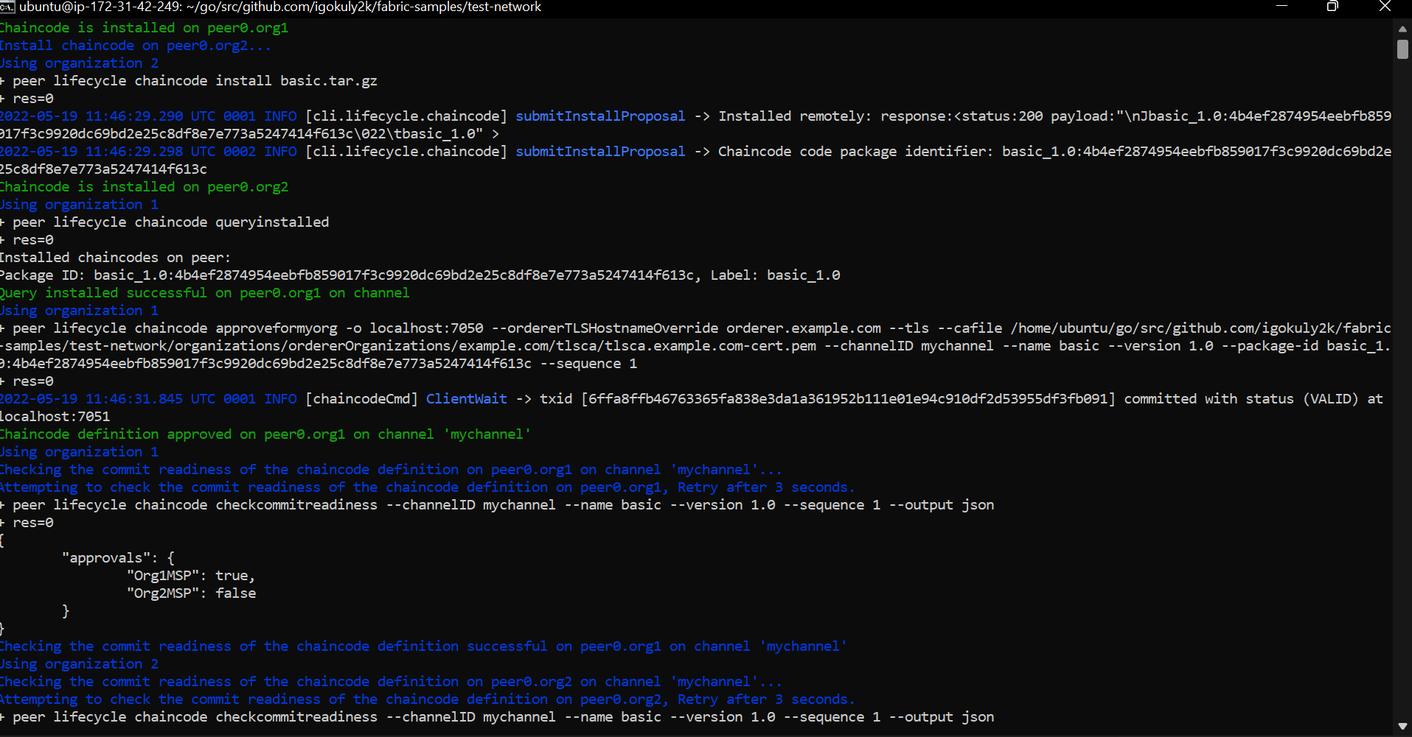
Screenshots
Figure 7. Chain code installed on peers of organizations

Slide 20
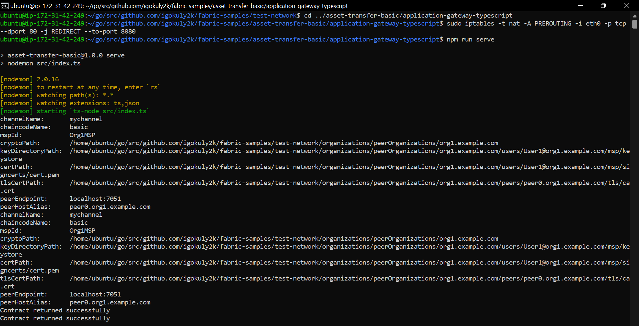
Screenshots
Figure 7. Running Application Gateway

Slide 21
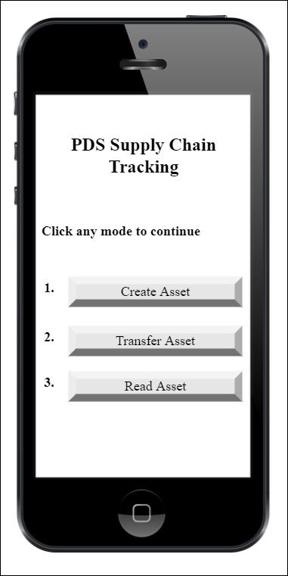
Screenshots
Figure 8. Modes to select for IoT device connected

Slide 22
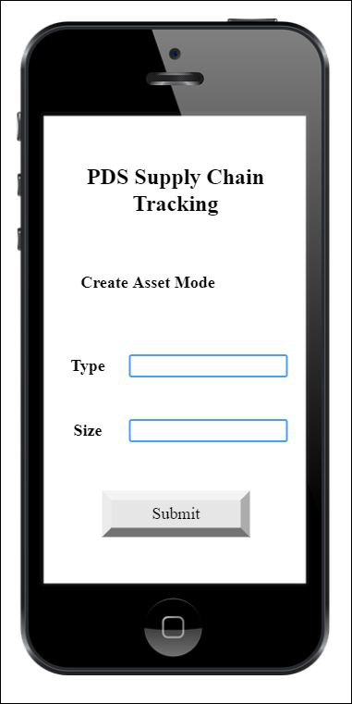
Screenshots
Figure 9. Create Asset Form

Slide 23
Conclusion
Proof of Concept on functionalities of PDS using Hyperledger Fabric makes us to confirm that Permissioned Blockchain Infrastructures are helpful in inducing more transparency, traceability and accountability in food logistics and supply chain industry.
Blockchain would fortify trust among organizations involved in the chain and consumers would be aware of the product and its lifecycle.
This prototype can be made possible into a real time project by using Far Range UHF Passive RFID technology. Tags are inexpensive and RFID reader’s proximity can range up to 12 meters.
Validation and authentication must be focused more in upcoming steps.

Slide 24
References
[1] Satoshi Nakamoto,"Bitcoin: A Peer-to-Peer Electronic Cash System",www.bitcoin.org., 2008
[2] Melanie Swan,"Blockchain Blueprint for a New Economy",Published by O’Reilly Media, Inc.,2015
[3] GUIDO PERBOLI, STEFANO MUSSO, MARIANGELA ROSANO,"Blockchain in Logistics and Supply Chain: A Lean Approach for Designing Real-World Use Cases”, IEEE,2018
[4] Reshma Kamath,"Food Traceability on Blockchain: Walmart’s Pork and Mango Pilots with IBM", The JBBA,2018
[5] Giorgio Alessandro Motta, Bedir Tekinerdogan and Ioannis N. Athanasiadis,"Blockchain Applications in the Agri-Food Domain: The First Wave",Frontiers in Blockchain,2020
[6] Kok Yong Chan,Johari Abdullah,Adnan Shahid Khan,"A Framework for Traceable and Transparent Supply Chain Management for Agri-food Sector in Malaysia using Blockchain Technology”, IJACSA,2019
[7] Rocha T, Costa P, Sousa V,Coelho P, Sousa F, Cardoso N,"SmartAgriChain: A Blockchain Based Solution for Agri food Certification and Supply Chain Management",International Journal of Environment, Agriculture and Biotechnology,2021
[8] Malni Kumarathunga,"Improving Farmers’ Participation in Agri Supply Chains with Blockchain and Smart Contracts”, IEEE,2020
[9] Sini V. Pillai, Vipin H., Anand Mohan, Shruthi Dileep A,"Infusing Blockchain in Supply Chain Operations
of a Public Distribution System",Journal of Supply Chain Management Systems,2020
[10] Sandeep Kumar Singh, Mamata Jenamani , Diptiman Dasgupta & Suman Das,"A conceptual model for Indian public distribution system using consortium blockchain with on-chain and off-chain trusted data",Information Technology for Development,2020
[11] Himani Mishra,Prateek Maheshwari,"Blockchain in Indian Public Distribution System: a conceptual framework to prevent leakage of the supplies and its enablers and disablers",ResearchGate,2021
[12] R Gayatri, “SMS based monitoring system for Fair Price Shops in Tamilnadu”, Informatics NIC, July 2014

Slide 25
Plagiarism Report

