Slide 1
Intro to Web Components
How each API is used to create Web Components.
Iván Gómez Alonso - 05-10-2020

Slide 2
Index
What is a Web Component?
APIs:
Custom Elements
Shadow DOM
ES Modules
HTML Template
lit-html
LitElement
Other mentions
Questions

Slide 3
Web Components

Slide 4
What is a Web Component?
A Web Component is a set of APIs available in the browser which allow us to create custom, reusable, encapsulated components without any library like Vue, React, Angular…
And the best of all this is that we can use these components inside those libraries mentioned earlier.

Slide 5
Web APIs used

Slide 6
Custom Elements
They are written using ES 2015 class syntax.
It gives us lifecycle callbacks:
connectedCallback
disconnectedCallback
adoptedCallback
attributeChangedCallback with the observedAttributes method
It provides us with a way to register custom elements with the CustomElementRegistry.

Slide 7
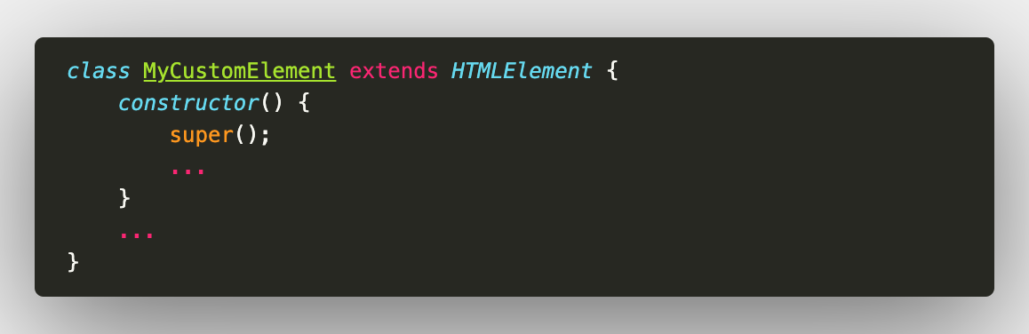
ES 2015 class syntax

Slide 8
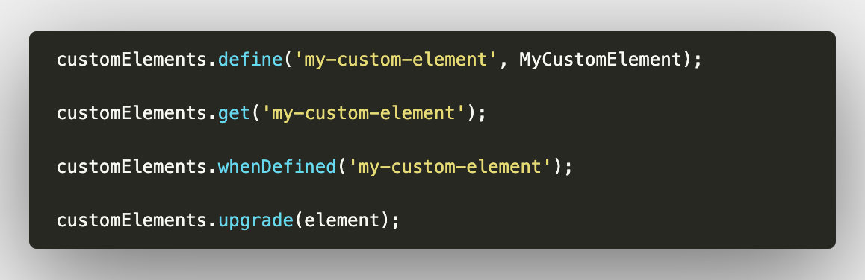
CustomElementRegistry
The names must have a hyphen.
You cannot register two elements with the same name.

Slide 9
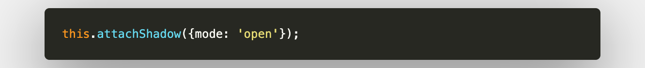
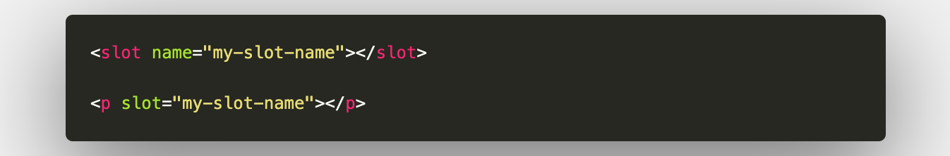
Shadow DOM
It allows us to encapsulate our styles and templates.
Slots

Slide 10
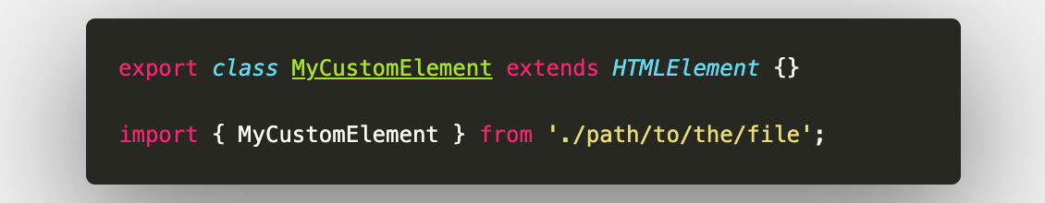
ES Modules
With them we can load and reuse JS documents.
Note: previously HTML imports were used in the version 0 of the standard

Slide 11
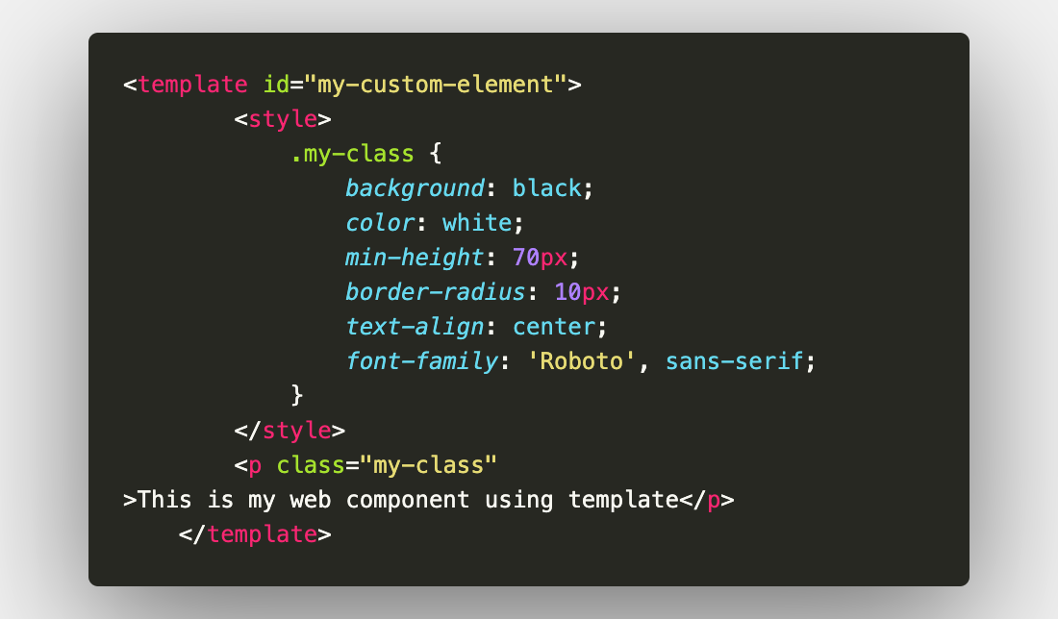
HTML Template
We declare fragments of our markup so we can instantiated it later (insert it in a document using a script).

Slide 12
lit-html

Slide 13
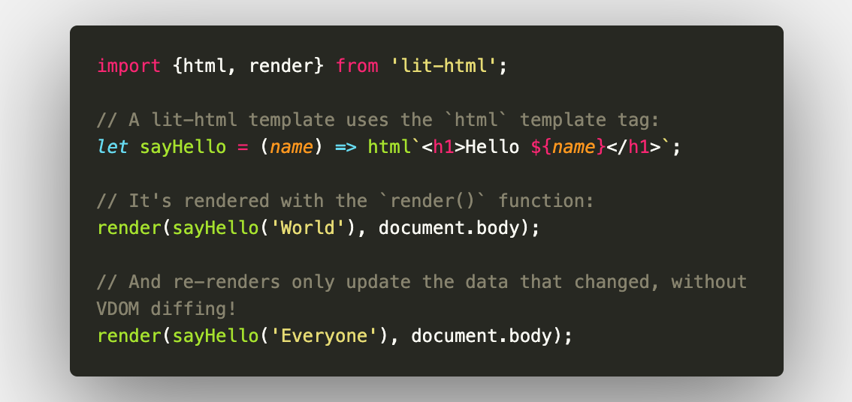
lit-html
We can create HTML Templates in JavaScript!!!!

Slide 14
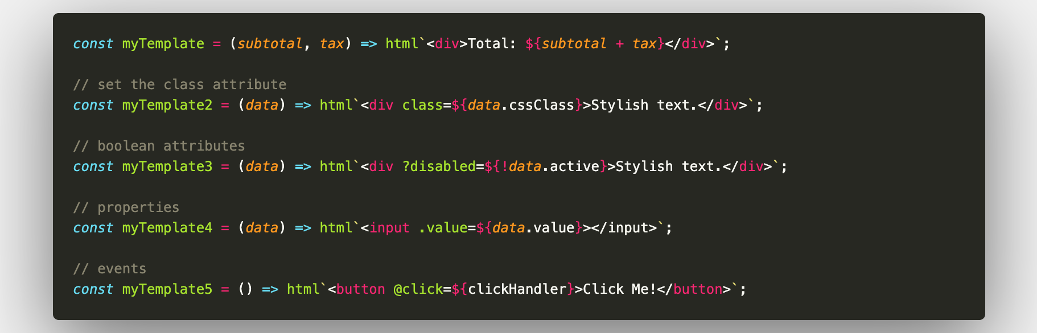
Bindings

Slide 15
LitElement

Slide 16
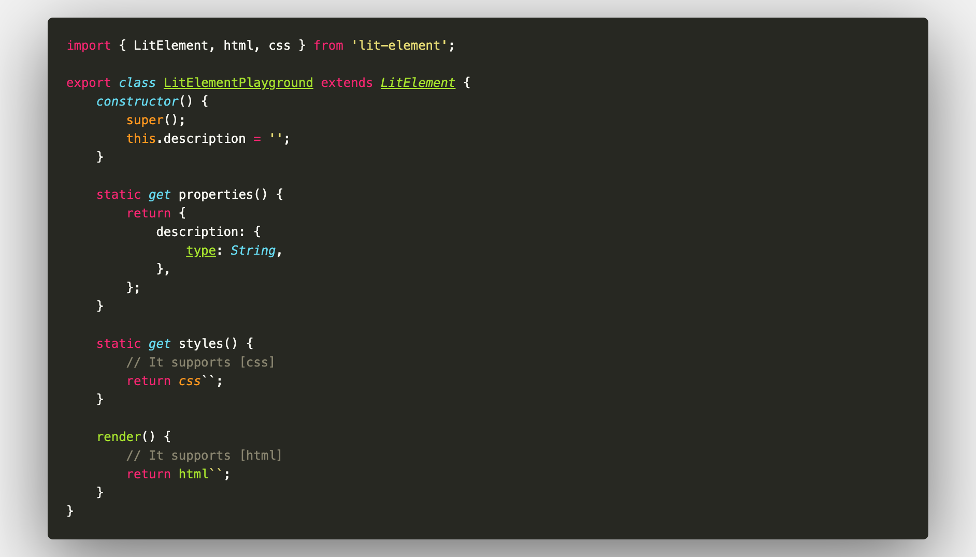
LitELement
A base class to create our Web Components

Slide 17
Other mentions

Slide 18
Other mentions
Open WC
Stencil
Lion Web Components
Polymer
Slim.js
Shoelace

Slide 19
Questions?

