Slide 1
PROJECT REPORT ON Iot enabled radar using Arduino nano and node mcu with zigbee interface
BY
Gopala Krishna Abba

Slide 2
INSPIRATION
MILITARY SURVEILLANCE APPLICATIONS: Terrestrial Wireless Sensor Networks (WSNs) are used in military environments for region surveillance, healthcare systems for soldiers, and, smart transport, and logistics, etc. In surveillance applications, the sensor nodes are deployed randomly in the field to observe the events of interest, movement of humans, or vehicles. In these sensor networks, the image or video is captured by the camera module.
PERIMETER INTRUSION DETECTION IN AIRPORTS: Perimeter intrusion detection systems (PIDS) are designed to secure airport perimeters against all threats, protect travelers and business assets, and ensure return on investment for years to come. Specifically designed to prevent and disrupt perimeter intrusions, these end-to-end systems deploy and overlay perimeter surveillance devices, such as thermal and visible cameras, radar, and artificial intelligence (AI-enabled video analytics), to create system redundancy and ensure superior situational awareness.

Slide 3
objective
We aim to develop a low-cost IOT radar system that uses Arduino Nano and Node MCU for data processing and communication respectively, and employs Zigbee interface to transmit data to a remote monitoring station.
This project is designed to showcase the feasibility of using IOT technology for Radar applications and demonstrate real-time monitoring capabilities.

Slide 4
INTRODUCTION
An intrusion detection system (IDS) or to put it properly a perimeter intrusion detection system (PIDS) is a device or sensor that detects the presence of an intruder attempting to breach the physical perimeter of a property, building, or other secured area. A PIDS is typically deployed as part of an overall security system and is often found in high-security environments such as correctional facilities, airports, military bases, and nuclear plants.

Slide 5
Project Explanation
We are developing an integrated radar sensing system with CNN-based orientation object detection and material identification that combines advanced hardware design with cutting-edge software capabilities to enhance our objective of detection.
As part of hardware development we are implementing a customized amplifier circuit to enhance the efficiency and sensitivity of our radar sensing system.

Slide 6
Project Explanation
The Hardware component ensures optimal signal processing and maximizes system’s detection capabilities using Arduino Nano, Node MCU, HB100 radar. Using an amplifier circuit we aim to increase the range of detection. Then we try to process and manipulate the input information we get from HB100 sensor so that we can identify material of object in our range.
As part of software, for internal processing of sensing and material detection we worked with MATLAB software using CNN modelling. Various features were considered in our input data. A static frontend containing graphs indicating object detection and material of object is made to equip users with valuable insights.

Slide 7
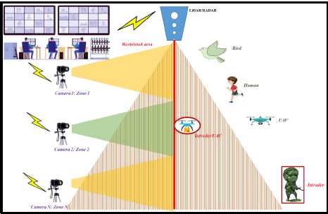
System model

Slide 8
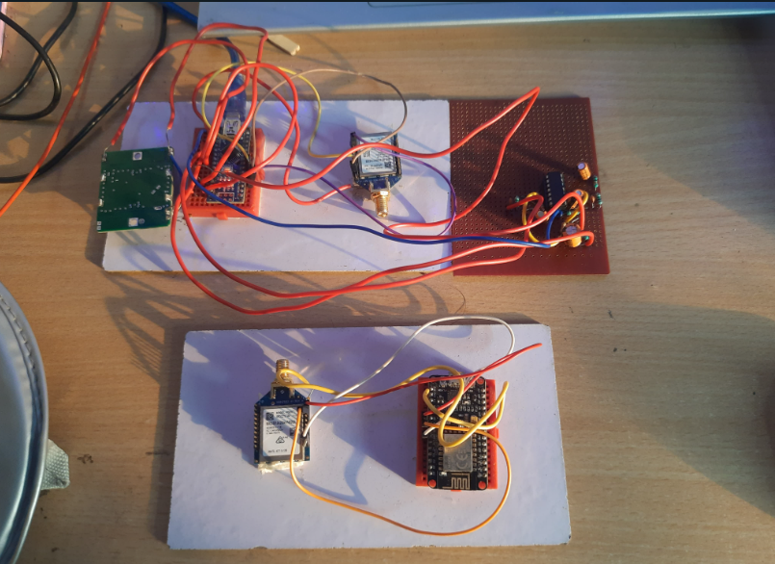
Hardware SETUP

Slide 9
Radar
RADAR stands for Radio Detection and Ranging System. It is an electromagnetic system used to detect the distance and location of an object from the RADAR transmitter. RADAR works on the principle of reflection where radio waves are transmitted through space onto the object and the echoes or reflections are monitored. Radio signals are transmitted through a transmitter from the RADAR system. The radio waves are radiated via an antenna attached to the transmitter. Once the signals strike the object, they are reflected back to the transmitter through the antennae and the data is then used to calculate the details of the object.

Slide 10
Radar - advantages
It can penetrate mediums such as clouds, fog, mist and snow
RADAR signal can penetrate insulators
It can give the exact position of an object
It can determine the velocity and distance of an object
It can tell the difference between stationery and moving targets
RADAR signals do not require a medium of transportation
RADAR signals can target several objects simultaneously
It is wireless and does not rely on wire connectivity
High operating frequency allows for the storage of large amounts of data
It covers a wider geographical area
It allows for repetitive coverage

Slide 11
Radar - disadvantages
RADAR takes more time to lock on an object
It is not able to detect smaller objects
It cannot track if an object is decelerating at more the 1mph/s
Large objects that are close to the Transmitter can saturate the receiver
It cannot distinguish or resolve multiple targets
It cannot resolve targets that are obstructed by a conducting material
It is not very stable and is susceptible to external interference
It cannot be used beyond the ionosphere

Slide 12
Xbee
XBEE is a short-range wireless communication protocol that operates in the 2.4GHz frequency band and built on IEEE 802.15.4. It uses the Zigbee protocol, which is a low-power wireless communication protocol designed for use in industrial and home automation applications. The XBEE modules consist of a microcontroller, a transceiver, and an antenna.
The microcontroller is responsible for processing the data to be transmitted and received. The transceiver is responsible for transmitting and receiving the data over the radio frequency. The antenna is used to receive and transmit the radio frequency.

Slide 13
Xbee - advantages
Low cost
Multi hope data transmission
Power effective
Less complex than Bluetooth
Easy to install
Zigbee supports a large number of nodes

Slide 14
Xbee - disadvantages
Short range
Low data speed
High maintenance cost
Lack of total solution
Slow materialization
Low transmission
Low network stability

Slide 15
BAckend
The backend work starts with training a CNN model using deep learning and machine learning modelling and architecture building using standard testing and training datasets.
For this we chose standard SeMg dataset, segregating proper ratio of testing, training, and validation sets.
The dataset is in form of excel sheets.
The CNN model is trained in MATLAB software, importing the database in excel file tabular form.
As soon as the hardware detects on time to time basis and updates the database in excel sheet form, the model in MATLAB comprehends the material detection and sends the data for visualization.

Slide 16
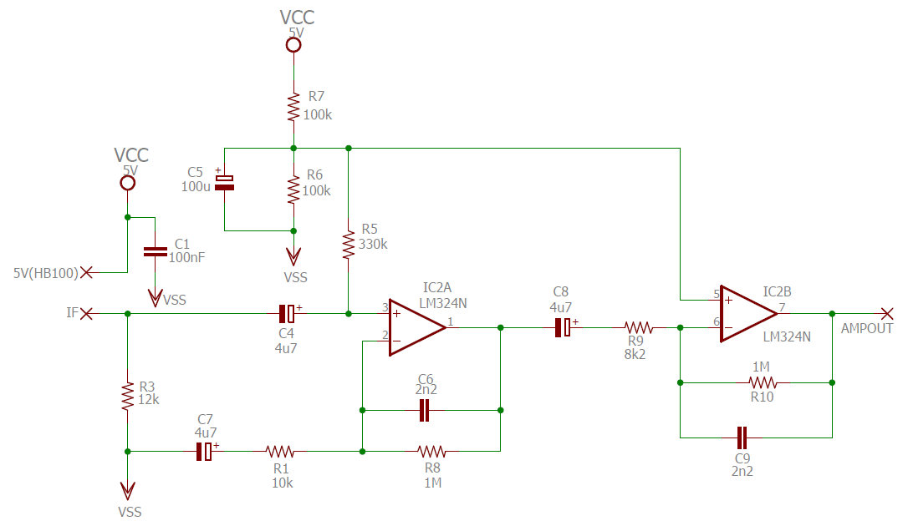
AMPLIFIER CIRCUIT

Slide 17
THINGSPEAK
ThingSpeak is an open-source Internet of Things (IoT) platform that allows users to collect, analyze, and visualize data from various sensors and devices. Users can send data to ThingSpeak channels using devices like Arduino, Raspberry Pi, or any sensor-equipped hardware. Once the data is on ThingSpeak, users can perform real-time analytics, create visualizations such as charts and graphs, and set up alerts based on specific conditions. For our project, the type of material detected can be stored. ThingSpeak's simplicity and versatility make it a popular choice for IoT projects, enabling seamless monitoring and control of connected devices and systems.
Once the channel is created we note down the channel number, API keys and code to upload to NodeMCU and read field data for displaying on frontend.

Slide 18
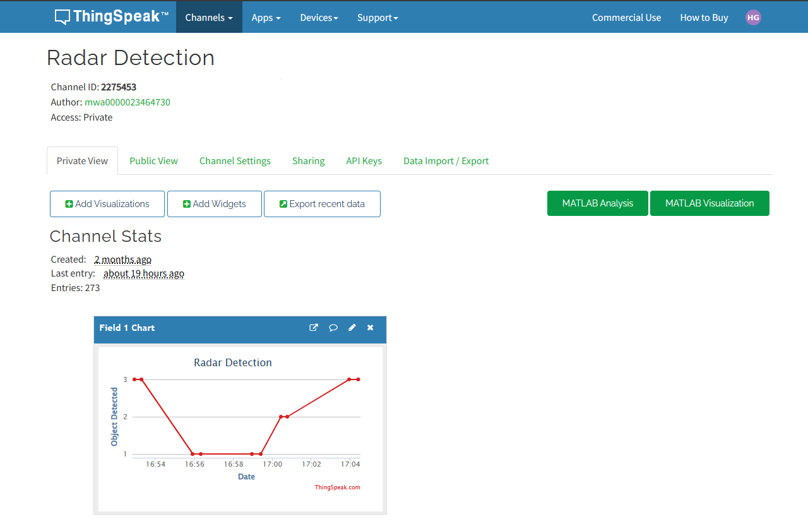
THINGSPEAK CHANNEL MAIN VIEW

Slide 19
Pcb DESIGN
Schematic Design:
Create a visual representation of the electronic circuit using EDA software, including component symbols and wire connections.
Component Selection:
Choose electronic components based on their datasheets, ensuring they meet project requirements.
PCB Layout:
Arrange components on the PCB, considering signal paths, thermal management, and mechanical constraints.
Design Validation:
Perform design rule checking (DRC), signal integrity analysis, and thermal analysis to address potential issues.
Gerber Files:
Generate Gerber files that describe the PCB's design, including copper traces, component placements, and other details.

Slide 20
Specifications
S.NO | Item | Specifications
1. | Node MCU ESP 8266 | Microcontroller : Tensilica 32-bit RISC CPU Xtensa LX106 Operating Voltage : 3.3 V Input Voltage : 7 - 12 V Digital I/O pins : 16 Analog input pins : 1 UARTs : 1 SPIs : 1 I2Cs : 1 Flash memory : 4 MB SRAM : 64KB Clock Speed : 80 MHz
2. | XBEE Explorer Board | Power Requirements : 5V Operating Temperature : -40º C to 70º C Communication : Serial pass-through to XBee module/USB to Host PC

Slide 21
Specifications
S.NO | Item | Specifications
3. | XBEE Pro S2C Module | Transmission Frequency : 2.4 – 2.5 GHz Indoor / Urban Range : 200ft Outdoor RF line -of- sight range : up to 4000ft RF Data Rate : 250,000 bps Operating temperature : -40º C to 85º C
4. | HB 100 Microwave Module | Frequency Range : 10.52 – 10.53 GHz Supply Voltage : 5V Current Consumption : 30 mA Operating Temperature : -15º C to 55º C
5. | Arduino Nano | Microcontroller : ATmega328 Operating Voltage : 5V Flash Memory : 32 KB SRAM : 2 KB Clock Speed : 16 MHz

Slide 22
Specifications
S.NO | Item | Specifications
6. | Antenna | Frequency : Up to 18 GHz Impedance : Up to 50Ω Operating Voltage : Up to 500 V VSWR : 1.15 +0.1f
7. | USB A to B Cable | USB 1.1/2.0 High–Speed Compatible Max speed : 480 MB/s RoHS Compliant

Slide 23
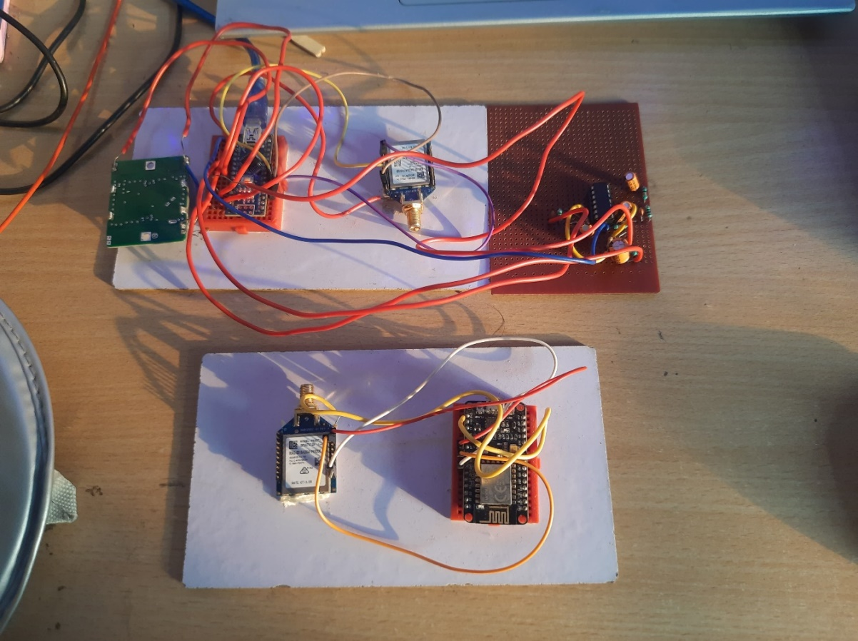
HARDWARE SETUP

Slide 24
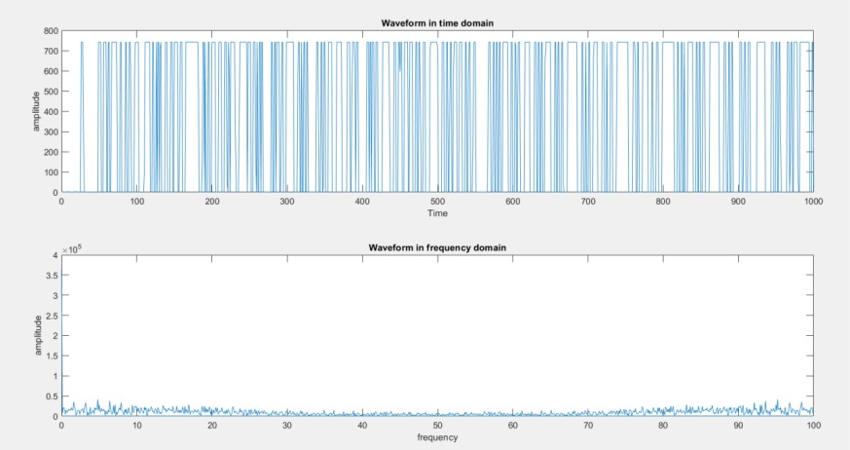
OUTPUTS
FFT WAVEFORM OF MATLAB:

Slide 25
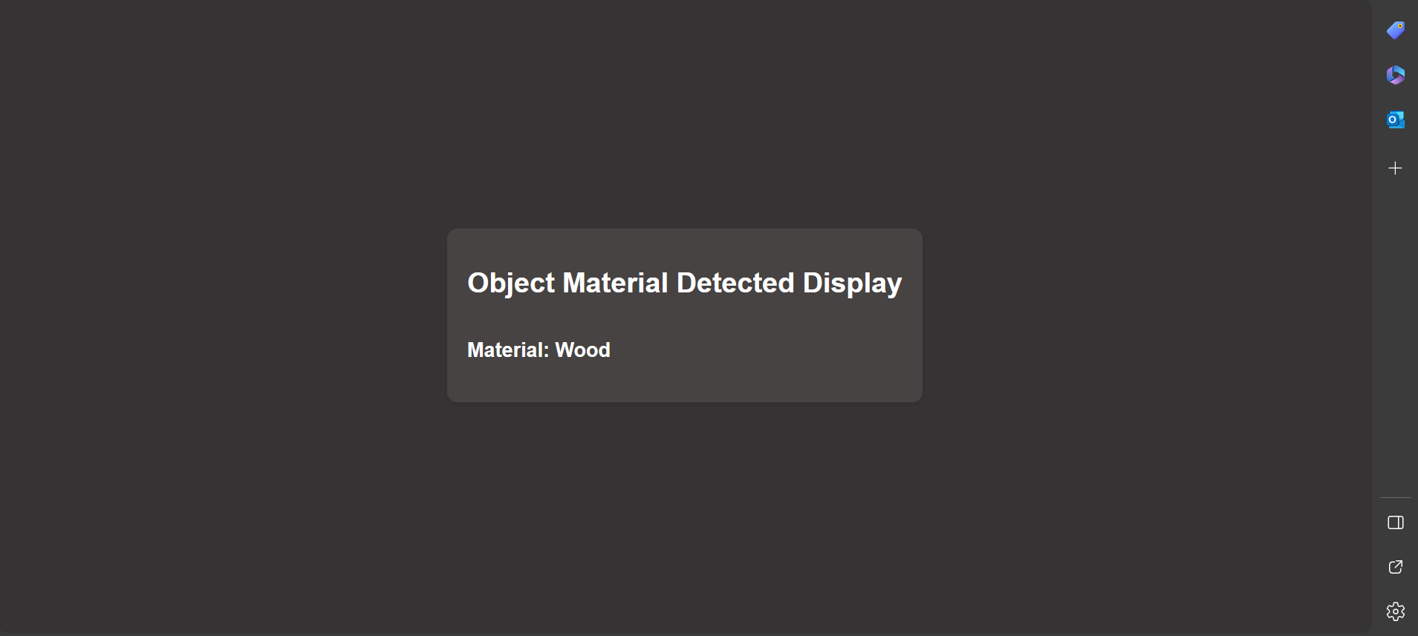
REACT PAGE OUTPUT

Slide 26
conclusion
In conclusion, our project successfully demonstrated the use of radar sensor technology having large scope of usage and improvisation in accordance to various projects and developments in vast range of industries.
Through extensive testing, modelling and analysis, we found that our system was highly effective at detecting any object presence and accurately distinguishing one from other objects through pattern recognition, detecting the type of object material in our target region. This technology has the potential to significantly improve security systems in a variety of settings, from a residential home to high-security areas.
Additionally, the low cost IoT radar system using Arduino Nano and Node MCU for data processing and communication makes this an accessible option for a wide range of users. Overall, our project highlights the potential of radar sensor technology as a valuable tool for enhancing security and efficacy of detection.

Slide 27


