Slide 1
2D Shape Matching
Computer Vision
Exercise session 9
TA: Yawei Li

Slide 2
Assignment Tasks:
Shape Matching
Shape based Image Classification
Hand-out: 23-11-2017
Hand-in: 08-12-2017 13:00

Slide 3
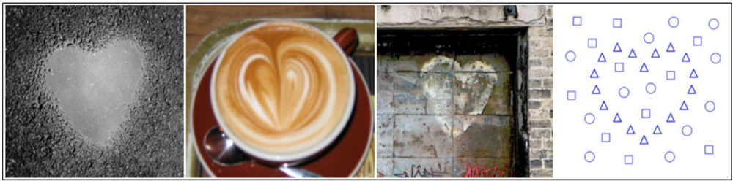
Task 1: Shape Matching
Objectives
Compute shape context descriptors
2. Match a template shape to a target set of points using shape contexts
Task 1

Slide 4
Overview of Algorithm
Given a set of template and target points:
Compute shape context descriptors for both sets of points
Estimate cost matrix between two sets of descriptors
Use cost matrix to solve the correspondence problem between two sets of descriptors (e.g. with Hungarian algorithm)
From the correspondence, estimate a transformation from template to target points (e.g. with Thin Plate Splines) and perform this transformation on the template points
e. Iterate steps a-d.
Task 1

Slide 5
Overview of Algorithm
Given a set of template and target points:
Compute shape context descriptors for both sets of points
Estimate cost matrix between two sets of descriptors
Use cost matrix to solve the correspondence problem between two sets of descriptors (e.g. with Hungarian algorithm)
From the correspondence, estimate a transformation from template to target points (e.g. with Thin Plate Splines) and perform this transformation on the template points
e. Iterate steps a-d.
Task 1

Slide 6
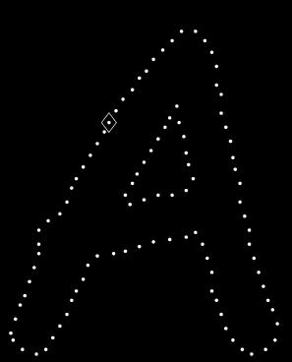
Shape Context Descriptor
Count number of points inside each bin
Compact representation of distribution of points relative to each point
Count = 4
Model
Count = 10
Task 1
Belongie, et al, PAMI 2002, Shape matching and object recognition using shape contexts

Slide 7
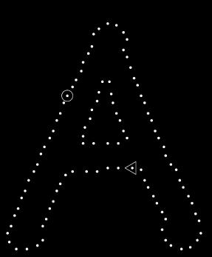
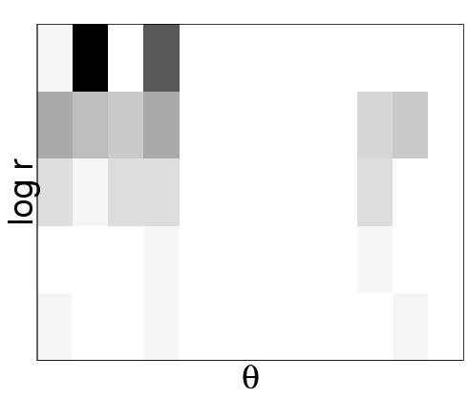
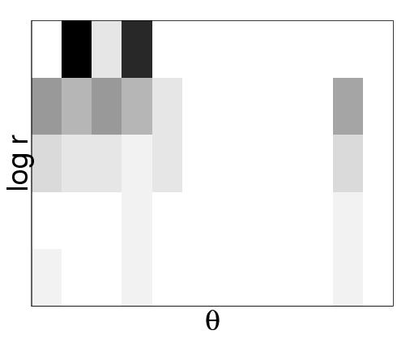
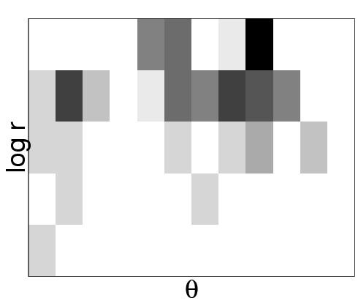
Shape Context Descriptor (2)
Task 1
Belongie, et al, PAMI 2002, Shape matching and object recognition using shape contexts
Notes:
Image from: http://www.cs.berkeley.edu/~malik/

Slide 8
Overview of Algorithm
Given a set of template and target points:
Compute shape context descriptors for both sets of points
Estimate cost matrix between two sets of descriptors
Use cost matrix to solve the correspondence problem between two sets of descriptors (e.g. with Hungarian algorithm)
From the correspondence, estimate a transformation from template to target points (e.g. with Thin Plate Splines) and perform this transformation on the template points
e. Iterate steps a-d.
Task 1

Slide 9
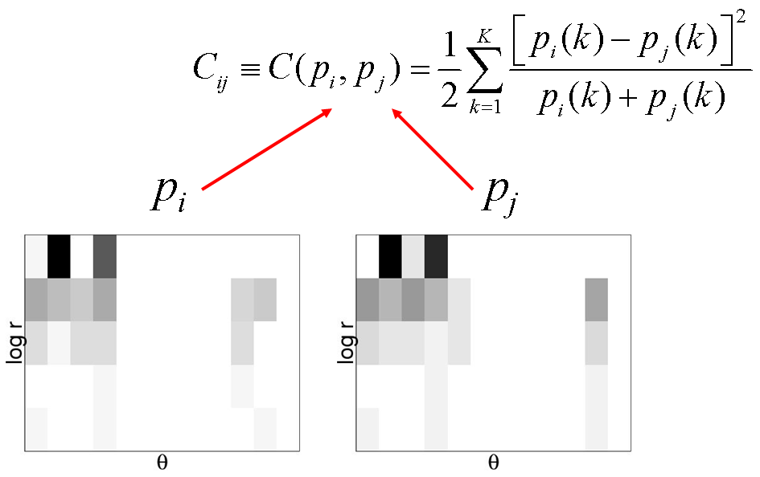
Matching Costs
Chi-squared distance between descriptors i and j.
Task 1
Belongie, et al, PAMI 2002, Shape matching and object recognition using shape contexts
Notes:
Image from: http://www.cs.berkeley.edu/~malik/

Slide 10
Overview of Algorithm
Given a set of template and target points:
a. Compute shape context descriptors for both sets of points
b. Estimate cost matrix between two sets of descriptors
Use cost matrix to solve the correspondence problem between two sets of descriptors (e.g. with Hungarian algorithm)
From the correspondence, estimate a transformation from template to target points (e.g. with Thin Plate Splines) and perform this transformation on the template points
e. Iterate steps a-d.
Task 1

Slide 11
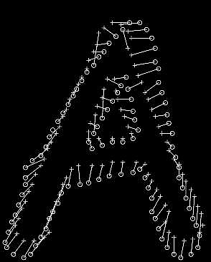
Correspondence Problem
Minimize total cost of matching such that matching is one-to-one
E.g. with Hungarian algorithm
Task 1
Belongie, et al, PAMI 2002, Shape matching and object recognition using shape contexts

Slide 12
Overview of Algorithm
Given a set of template and target points:
a. Compute shape context descriptors for both sets of points
b. Estimate cost matrix between two sets of descriptors
c. Use cost matrix to solve the correspondence problem between two sets of descriptors (e.g. with Hungarian algorithm)
From the correspondence, estimate a transformation from template to target points (e.g. with Thin Plate Splines) and perform this transformation on the template points
e. Iterate steps a-d.
Task 1

Slide 13
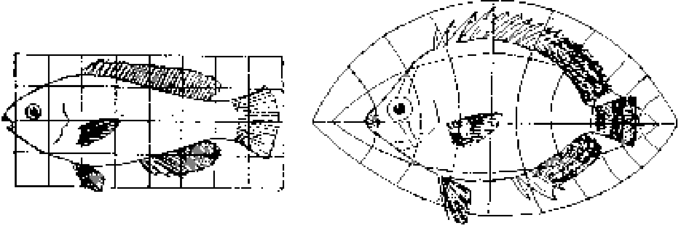
Transformation
Model
Target
Task 1
Belongie, et al, PAMI 2002, Shape matching and object recognition using shape contexts

Slide 14
Thin Plate Splines(1)
A
T
B
We are given a set of correspondences
We want to estimate the function T: R² →R² that transforms A into B
Task 1
Belongie, et al, PAMI 2002, Shape matching and object recognition using shape contexts

Slide 15
Thin Plate Splines(2)
A
T
B
From the correspondences, we get a displacement:
=
+
Vertical Horizontal
Each component (vertical and horizontal) is a single function
that we want to interpolate with a TPS.
Task 1

Slide 16

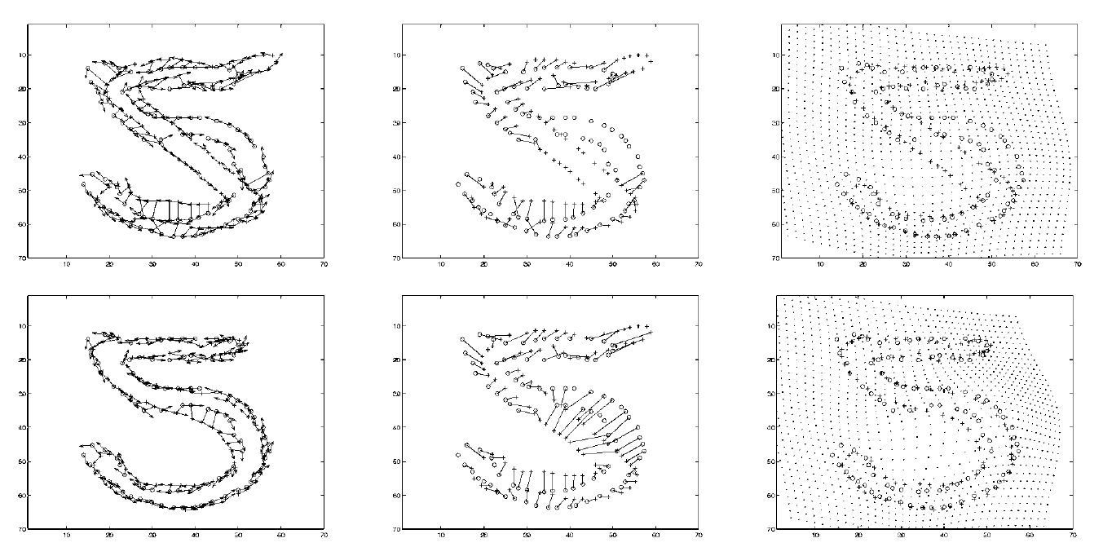
Thin Plate Splines(3)
Task 1
Belongie, et al, PAMI 2002, Shape matching and object recognition using shape contexts

Slide 17
Overview of Algorithm
Given a set of template and target points:
a. Compute shape context descriptors for both sets of points
b. Estimate cost matrix between two sets of descriptors
c. Use cost matrix to solve assignment problem between two sets of descriptors (e.g. with Hungarian algorithm)
d. From the assignment, estimate a transformation from template to target points (e.g. with Thin Plate Splines)
e. Iterate steps a-d.
Task 1

Slide 18
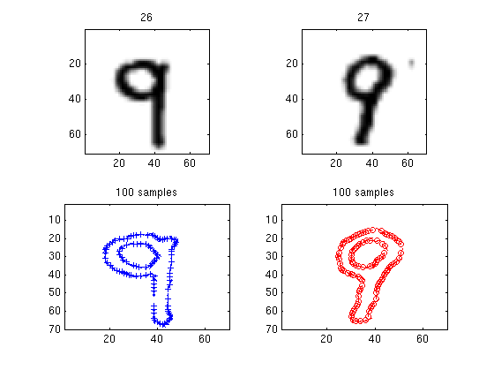
Example 1 - Numbers
Task 1
Belongie, et al, PAMI 2002, Shape matching and object recognition using shape contexts

Slide 19
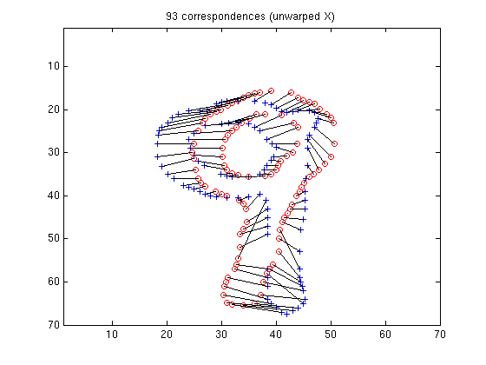
Example 1 - Numbers
Task 1
Belongie, et al, PAMI 2002, Shape matching and object recognition using shape contexts

Slide 20
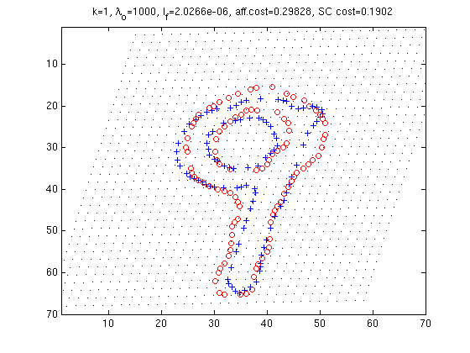
Example 1 - Numbers
Task 1
Belongie, et al, PAMI 2002, Shape matching and object recognition using shape contexts

Slide 21
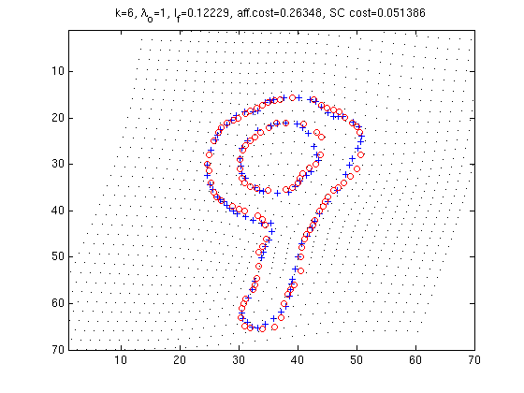
Example 1 - Numbers
Task 1
Belongie, et al, PAMI 2002, Shape matching and object recognition using shape contexts

Slide 22
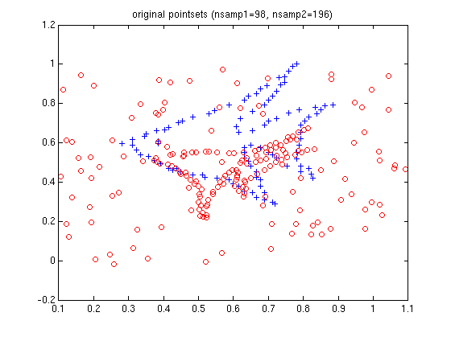
Example 2 - Fish
Task 1
Belongie, et al, PAMI 2002, Shape matching and object recognition using shape contexts

Slide 23
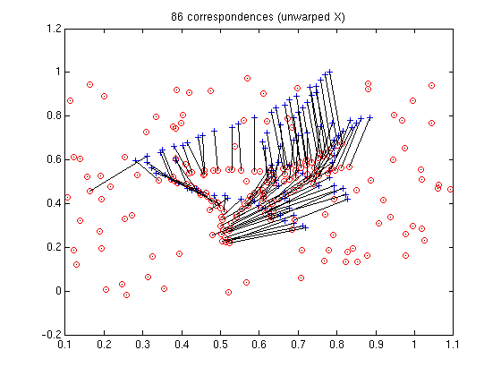
Example 2 - Fish
Task 1
Belongie, et al, PAMI 2002, Shape matching and object recognition using shape contexts

Slide 24
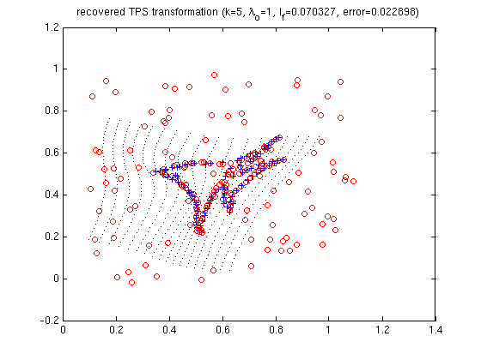
Example 2 - Fish
Task 1
Belongie, et al, PAMI 2002, Shape matching and object recognition using shape contexts

Slide 25
Task 2: Shape based Image Classification
Objectives
Design a k-nearest-neighbour classifier
Perform shape based image classification
  using the k-nearest-neighbour classifier
  leave-one-out cross validation scheme
Task 2

Slide 26















Dataset
15 images containing instances of 3 classes:
  heart,
  fork
  watch
Task 2

Slide 27
Design a k-nearest-neighbour classifier
2D shape matching for a considered image shape with all the other 14 image shapes
compute the bending energies E₁, …, E₁₄
define the k-nearest-neighbours of the image shape based on E₁, …, E₁₄
classify the considered image using the labels of the k-nearest-neighbours
Task 2

Slide 28
Shape based Image Classification
for every image in the dataset (15 images)
  k-nearest-neigbour classifier using the other 14 images (labels are known)
  classification performance:
  inferred label = ground truth label?
Task 2

Slide 29
Send your reports
  explain main steps of your implementation
  comment the results
  answer the questions
  yawli@vision.ee.ethz.ch
  Theme: Exercise 9: Shape Context + your name

