Slide 1
Aurora Internal AI Assistant Proposal
Technical & Financial Scoping Presentation Igor Kan

Slide 2
Executive Summary

Slide 3
The Vision: A Private “Tax Brain” for Aurora
Private, Secure AI Assistant for Aurora’s 15–17 tax professionals.
Answers complex VAT, Corporate Tax, IFRS, and regulatory questions.
Grounded in UAE tax law and Aurora’s internal SOPs.
100% Data Sovereignty: All data and processing stay in the UAE.
Notes:
We are building a private knowledge system for Aurora to handle their daily tax operations safely and accurately.

Slide 4
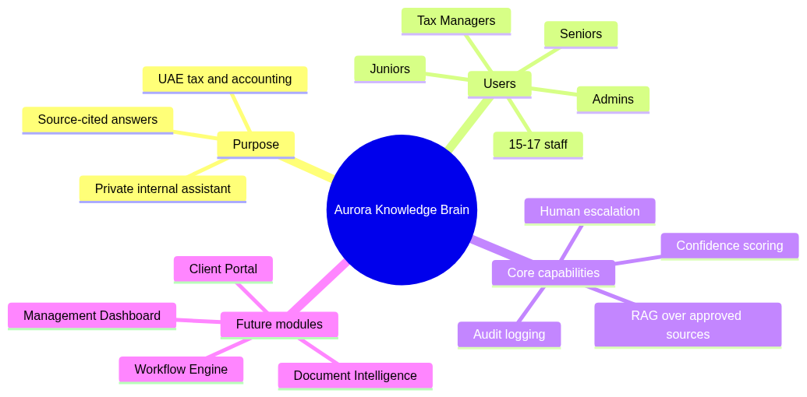
What Makes This Proposal Different
Key Pillars of the Aurora AI Brain

Slide 5
What the Team Will See

Slide 6
Streamlined User Experience (Chat UI)
┌──────────────────────────────────────────────────────────────────┐ │ 🔒 Aurora AI Assistant (Admin) │ │ ─────────────────────────────────────────────────────────────── │ │ 👤 Can we recover VAT on a hotel invoice for a business trip? │ │ │ │ 🤖 No. Input VAT on hotel accommodation for business travel │ │ outside the UAE is not recoverable under the UAE VAT law. │ │ │ │ 📎 Sources: │ │ [1] VAT Executive Regulations, Art. 54(1) ▸ │ │ [2] FTA Public Clarification VATP012 ▸ │ │ │ │ Confidence: ████████████░░ 92% (High) │ │ 👍 Correct 👎 Incorrect ⚠️ Needs Improvement │ └──────────────────────────────────────────────────────────────────┘

Slide 7
Core Client Capabilities
Instant Answers: Responses generated in 3–10 seconds.
Mandatory Source Citations: Links directly to laws/articles/SOPs.
Confidence Scoring: Low confidence flags for human review.
Escalation Protocols: High-risk topics go to senior staff.
Self-Service Admin Console: Upload documents and manage users.

Slide 8
Technical Architecture

Slide 9
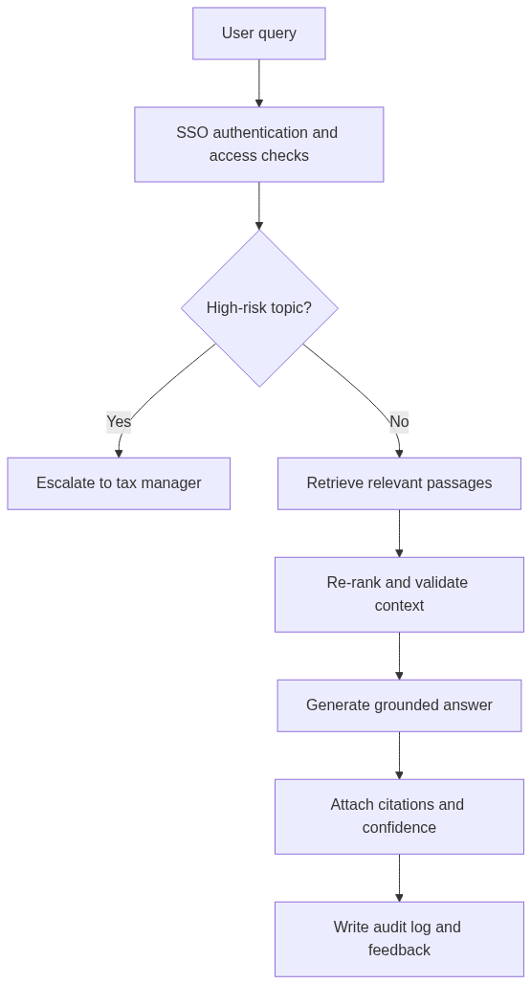
Retrieval-Augmented Generation (RAG) Flow
RAG Retrieval & Guardrail Pipeline

Slide 10
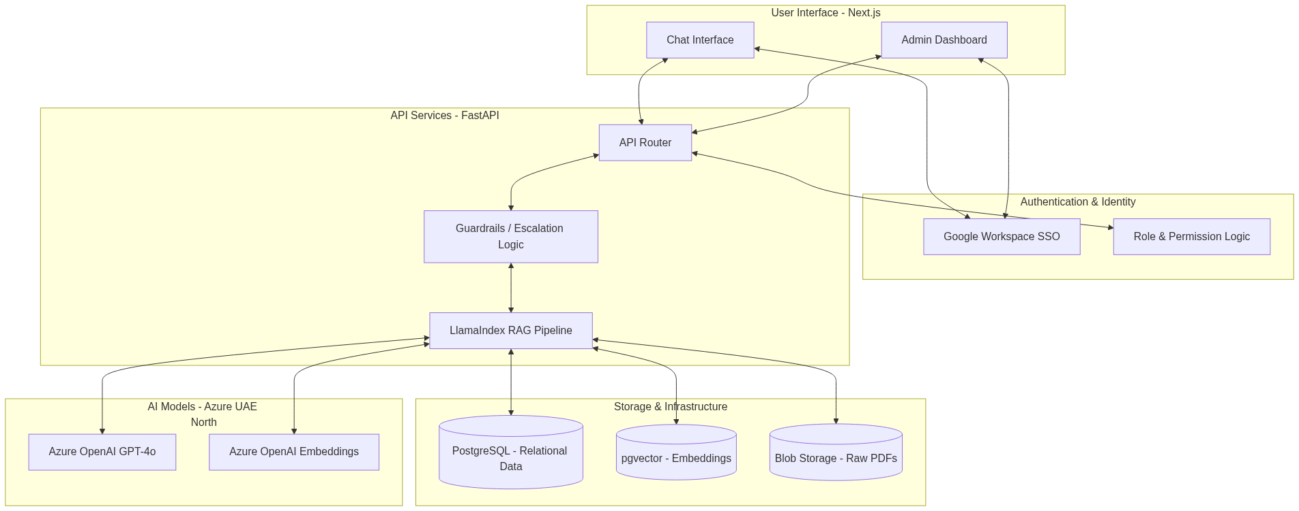
Full System Integration
Comprehensive System Architecture

Slide 11
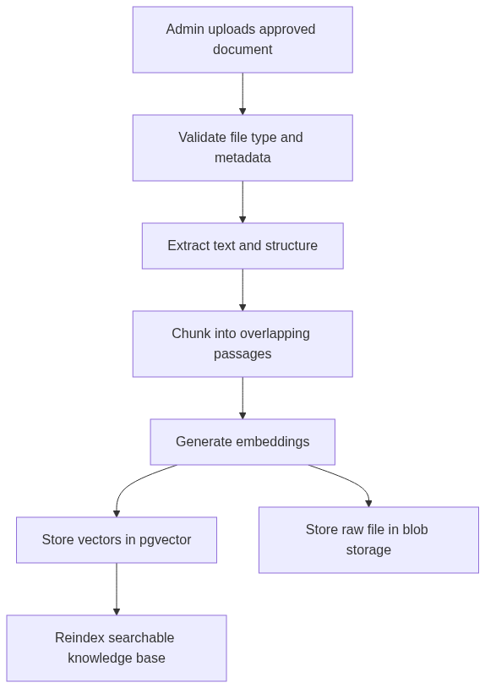
Document Ingestion Flow (Self-Service)
Admin Self-Service Document Ingestion

Slide 12
Google Workspace Integration
The system integrates directly with Aurora’s Google ecosystem:
Single Sign-On (SSO): Log in using existing @aurora.ae accounts.
MFA Policies: Google Workspace Multi-Factor Auth applies automatically.
Access Revocation: Disabling Google account instantly cuts off app access.
Future Google Drive Sync: Auto-ingest files from shared Drive folders.

Slide 13
Phased Delivery Plan

Slide 14
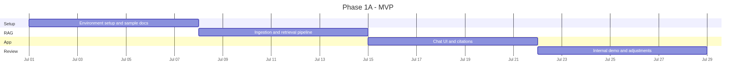
Phase 1A — MVP (Weeks 1–4)
Goal: Basic Q&A on core VAT/CT, Google SSO, and source citations.
Phase 1A Gantt Schedule

Slide 15
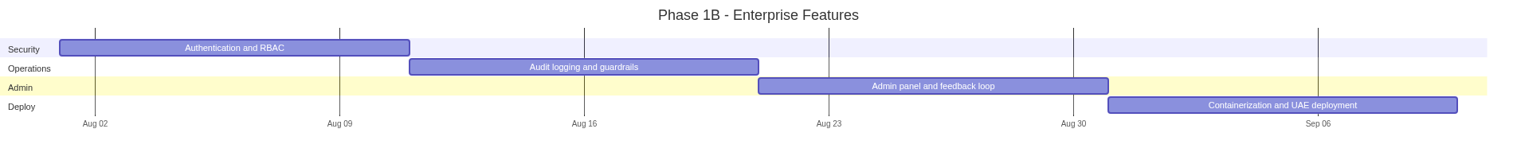
Phase 1B — Enterprise (Weeks 5–10)
Goal: Streaming answers, admin console, audit logging, and Azure deployment.
Phase 1B Gantt Schedule

Slide 16
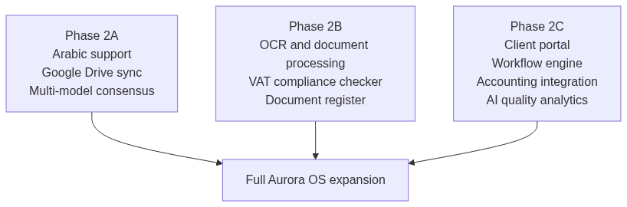
Phase 2 — Future Expansion Roadmap
Aurora OS Modular Modules

Slide 17
Financial & Scoping Comparison

Slide 18
Phase 1 Development Pricing
Phase | Scope | Duration | Market Rate (USD) | Our Price (USD) | Our Price (AED) | Savings
Phase 1A | Core RAG, Google SSO, Citations, Escalation, MVP Demo | 4 weeks | $7,500 – $13,200 | $720 | 2,644 | ~90–95%
Phase 1B | Streaming, Admin panel, Audit logging, Azure UAE deployment | 6 weeks | $8,000 – $14,000 | $720 | 2,644 | ~91–95%
Total | Complete Phase 1 Production System | 10 weeks | $15,500 – $27,200 | $1,440 | 5,288 | ~90–95%

Slide 19
Note on Development Tool Expenses
These prices cover labor only. Ongoing monthly infrastructure costs and self-funded dev tools are billed directly to their respective accounts.

Slide 20
Phase 2 Optional Expansion Modules
Module | Scope | Duration | Market Rate (USD) | Our Price (USD) | Our Price (AED) | Savings
Phase 2A | Arabic, Google Drive sync, consensus, advanced analytics | 6 weeks | $8,000 – $15,000 | $670 | 2,460 | ~91–96%
Phase 2B | OCR/document processing, VAT compliance check, doc register | 8 weeks | $10,000 – $20,000 | $890 | 3,268 | ~91–96%
Phase 2C | Client portal, workflow engine, accounting API, QA analytics | 12 weeks | $15,000 – $30,000 | $1,340 | 4,921 | ~91–96%
Total | Full Aurora OS Platform | ~26 weeks | $33,000 – $65,000 | $2,900 | 10,650 | ~91–96%

Slide 21
Real Infrastructure & Monthly Costs
Service | SKU / Details | Monthly Cost (USD) | Monthly Cost (AED) | Rationale
Azure OpenAI | GPT-4o pay-as-you-go | $30 – $90 | 110 – 331 | Based on 15 users, 30–80 queries/day
Azure OpenAI | text-embedding-3-small | <$1 | <4 | Vector search model costs
Container Apps | Compute (0.5 vCPU / 1 GiB) | $0 – $15 | 0 – 55 | Serverless, scale-to-zero
Azure PostgreSQL | B1ms server + 32 GiB storage | $15 – $20 | 55 – 73 | Burstable DB for user info and logs
Azure Storage | Blob Storage Hot tier (~1 GB) | $0.50 – $1 | 2 – 4 | raw PDFs + logs storage
Domain & TLS | custom domain TLS cert | $1 – $3 | 4 – 11 | HTTPS custom routing
Total Monthly |  | $47 – $130 | 173 – 477 | Conservative cost estimate
These are standard cloud costs paid directly to Microsoft Azure:

Slide 22
Security, Compliance & Setup

Slide 23
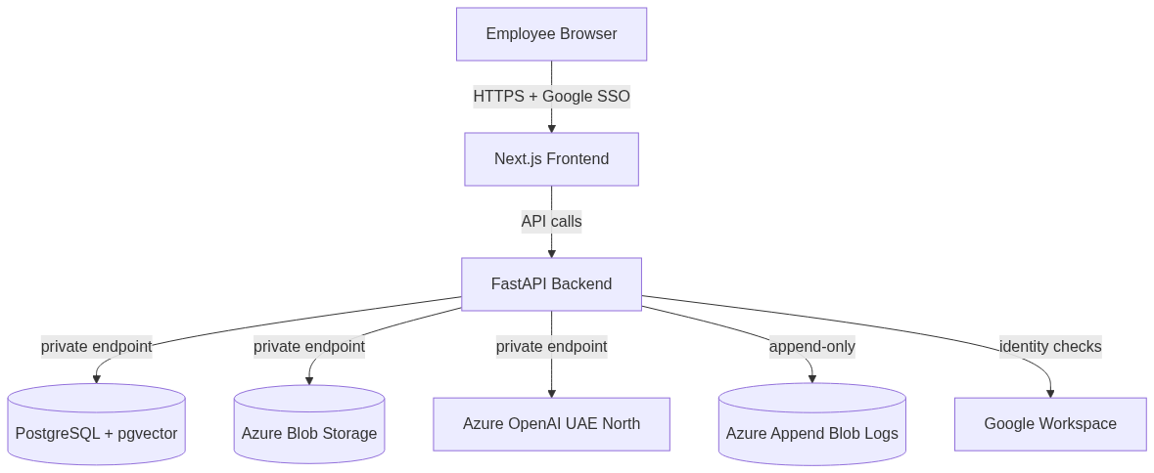
Network Security Design
Secured Azure VNet Architecture

Slide 24
Security Mapping Checklist
Project Brief Requirement (§6) | Our Implementation Strategy
No model training on Aurora data | Azure OpenAI Enterprise terms guarantee zero data retention.
Encryption in Transit & Rest | TLS 1.3 for connections; AES-256 for PostgreSQL, Blobs, and Logs.
Role-Based Access Control | Admin, Tax Manager, Senior, Junior, Auditor roles.
Tamper-Evident Audit Logs | Implemented using Azure Immutable Blob Storage.
Data Residency | All resources hosted in Azure UAE North data center (Dubai).
Immediate Revocation | Workspace account termination disables system access instantly.

Slide 25
Current Prototype Readiness
We are starting with a fully functional prototype, not from scratch:
Backend API: Python FastAPI (5+ routes) is ready.
RAG Pipeline: LlamaIndex and pgvector indexing is functional.
Frontend UI: Next.js Chat, Admin, and Audit pages are built.
SSO & RBAC: Auth.js with Google login and 5 roles is wired.
Testing: 7 end-to-end automated tests are passing.

Slide 26
Next Steps

Slide 27
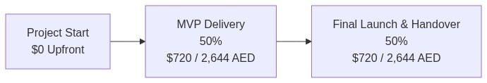
Contract Terms & Timeline
IP Ownership: 100% ownership transferred to Aurora upon final payment.
Support: 2–3 months post-launch support included.
Payment Schedule: 0% upfront (infra/tools direct) / 50% at MVP ($720 / 2,644 AED) / 50% at Launch ($720 / 2,644 AED).
Milestones & Payment Structure

Slide 28
Action Items
Approve proposal and confirm budget ($1,440 Phase 1).
Sign mutual NDA.
Provide initial 50–80 files (PDFs/DOCXs).
Provision Azure subscription for UAE North deployment.
Onboard staff list (emails and roles).

