Slide 1
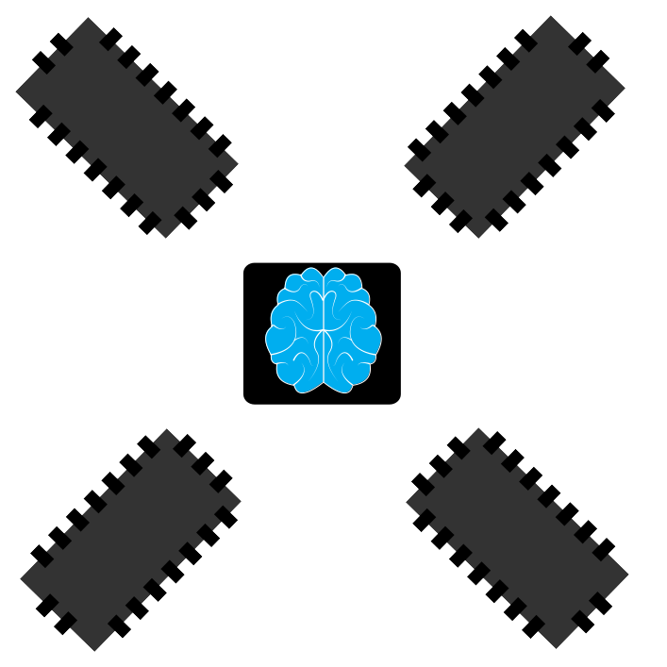
AI and Machine Learning
2 hour primer
Igor Krawczuk
BayesMill
Consulting for:
Data Science
Analytics
Artificial Intelligence
inquiries@bayesmill.com

Slide 2
Who am I?
Igor Krawczuk
Msc. Electrical and Computer Engineering
Specialization: AI, Machine Learning and neurmorphic Hardware for Machine Learning
Consulting:
  Data Science (Modelling and Pipelines)
  Machine Learning Prototyping
  AI and Automation advisory
  AI,Machine Learning and Coding Training

Slide 3
What this workshop...
doesn‘t offer:
In depth examination
Academically rigorous definitions
In depth insight into State of the art(SOA)
Deep,Hidden knowledge – you can google most of this stuff
offers:
Quick overview
Intuitive explanations
Foundations and small tastes of SOA
A chance to ask somebody who already did the googling

Slide 4

Toys!
Python & Javascript examples to follow along the workshop under:
https://github.com/igor-krawczuk/mm-aiprimer
Developed mostly by people smarter
than me :-)
Feel free to explore during the talky bits
  Install guide in same repository
  Notebooks today also accessible at: http://163.172.188.213:28801
    Username+Password: manage+more
    => don‘t kill my server please, prefer local/javascript

Slide 5
Plan
Quick history and definitions
Presentation non-machine learning AI
Machine Learning
Discussion (iff time)
    Applications
    Business considerations
    AI risk
    Technical questions

Slide 6
Rules
Ask questions!
Feel free to play around with the examples while I‘m talking/discussing !
Interrupt me! Raise your hands and ask questions!

Slide 7
What is AI?
„The automation of machines that perform functions that require intelligence when performed by people“(Bellman, 1978)
„The study of computations that make it possible to perceive, reason and act“(Winston,1992)
„The art of creating machines that perform funciton that require intelligence when performed by people.“(Kurzweil,1990)
„Computational Intelligence is the study of the design of intelligent agents.“(Poole,et.al.,1998)

Slide 8
What is machine learning?
The subfield of AI concerned with learning systems
Machine learning is the subfield of computer science that "gives computers the ability to learn without being explicitly programmed" (Arthur Samuel, 1959)

Slide 9
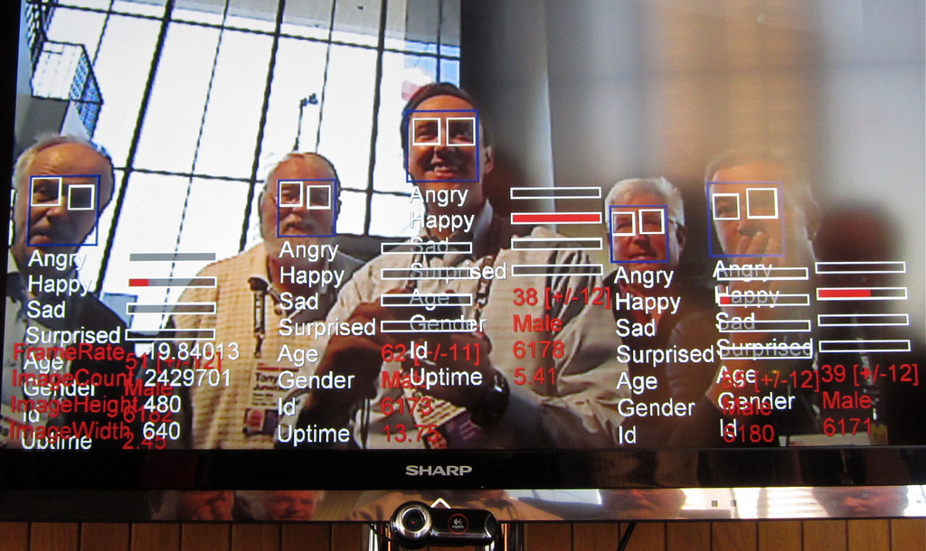
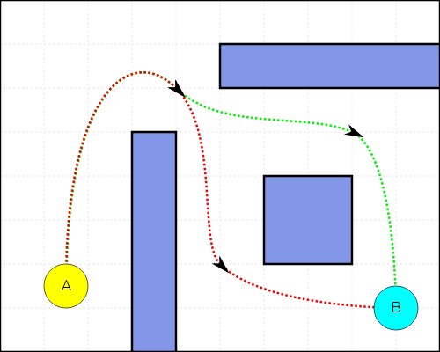

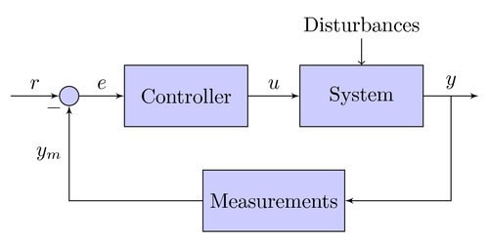
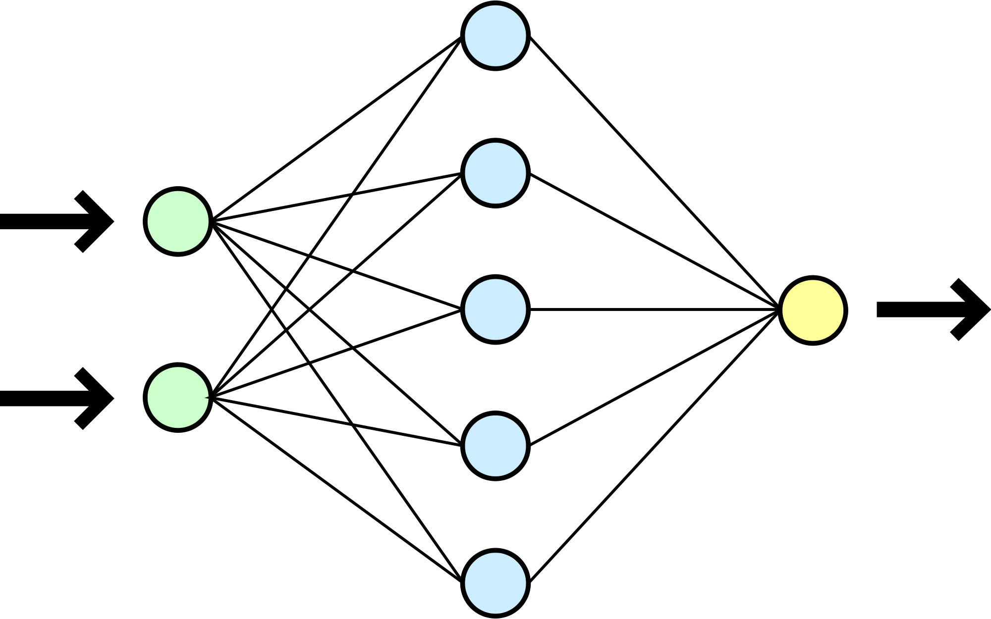
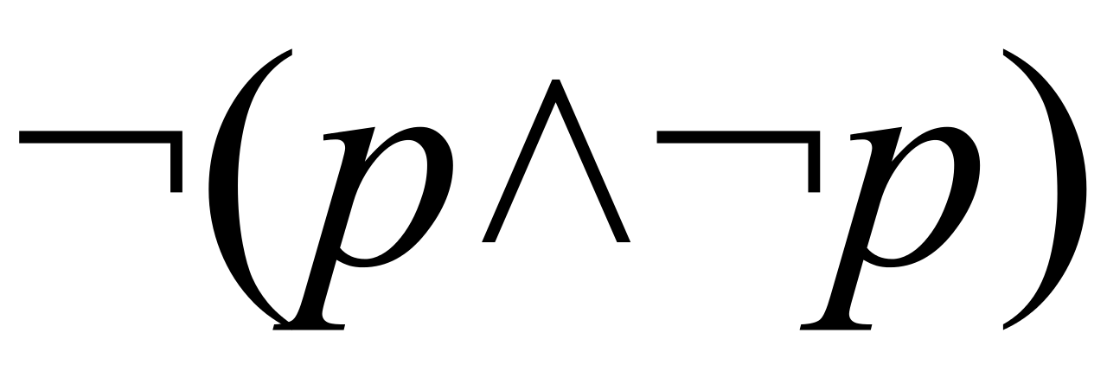
AI Categories
Learning
Reasoning
Knowledge
Perception
Planning
Control
Logic
symbolic Inference
Storing
Querying
Sharing
Vision
Hearing
Reading
Plan actions
Find routes
Scheduling
Reactions
Stabilisation
Noise canceling
Information extraction
Estimation
Prediction
s
Notes:
Reasoning (logical deductions, symbolic inference)
Knowledge Representation and Querying
Perception (computer vision, NLP, data mining,system 1)
Control (real time decision making)
Planning and Optimization (System 2, analytical thought)
Learning (finding structure in inputs)

Slide 10
AI Hierarchy
Learning
Reasoning
Knowledge
Perception
Planning
Control
Logic
symbolic Inference
Storing
Querying
Sharing
Vision
Hearing
Reading
Plan actions
Find routes
Scheduling
Reactions
Stabilisation
Noise canceling
Information extraction
Estimation
Prediction
s

Slide 11
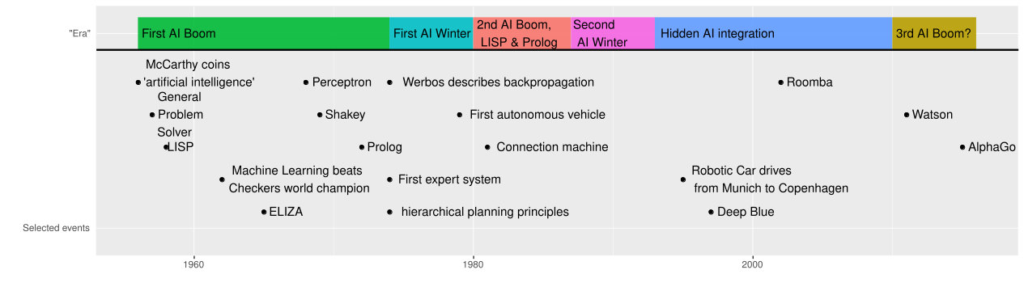
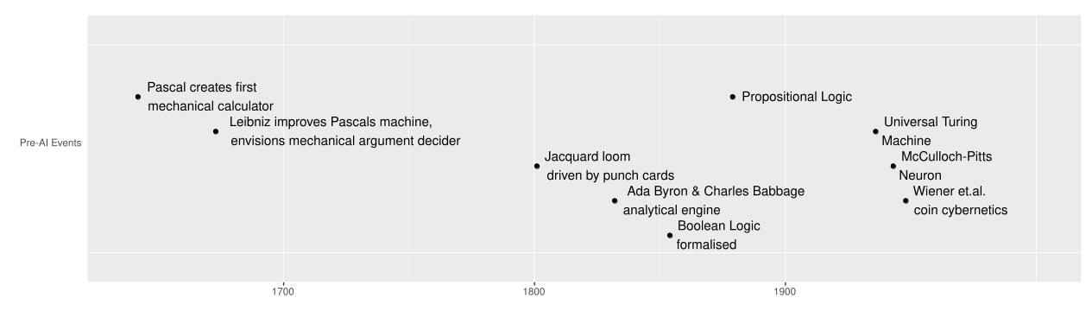
History of AI

Slide 12
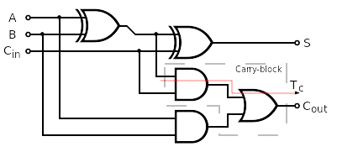
Reasoning:Boolean Logic
Basic Logic in Computers
  We know 1,0 and the operations AND, OR, NOT
  Can (probably) express every possible computation through this(Church-Turing Thesis)
Example:
  Addition: XOR and Carry
A | B | OR | AND
1 | 0 | 1 | 0
1 | 1 | 1 | 1
0 | 0 | 0 | 0

Slide 13
Reasoning: Symbolic Logic
Propositional Logic: And, OR,XOR,NOT,iff
  Formal system, defined by set of axioms
    P => ¬ Q
    P
    => ¬Q
    What cannot be determined => False(Closed World assumption)
First Order Logic: add quantifiers
  ∀Q∀E:¬ Q ∧E
  Either is tested (false if Q∧E found) or restricts choices for other solutions

Slide 14
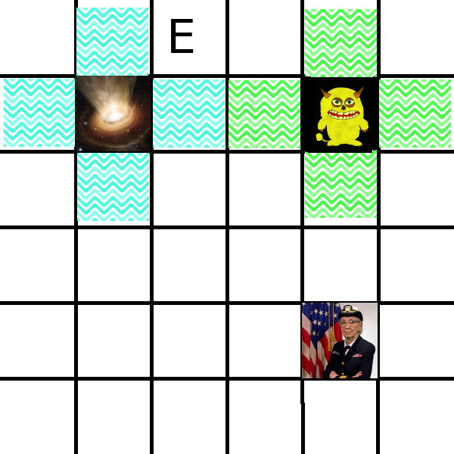
Reasoning Example:
Wumpus Hunt
Wumpus
  Eats player if in same chamber
  Stinks=> can be smelled from adjacent rooms
Pits
  Kill player if he enters room
  Drafty => can be felt from adjacent room
Goal: Escape without dying

Slide 15
Reasoning: Limits to
Symbolic Knowledge
Combinatorial explosion
Real world not formally specifiable
  Fuzzy states
  Unkown variables (open world)
  Gödels incompleteness theorem

Slide 16
Knowledge Representation(KR)
Prolog encodes knowledge as propositions(facts) and inferences(rules)
  friends(a,b).
  friends(b,c).
  friendOfFriend(X,Y):-friends(X,Z) ,friends(Z,Y).
  =>friendOfFriend(a,X)=> X=c
Problems:
  Ambiguitiy and Redundance: friends(X,Y) != friends(Y,X)
  Definitions and hierarchies: friends <=> acquaintance <=> relationship?
  Scopes: Pizza is food or fastfood?
Main Problem: no consistent representation

Slide 17
Knowledge Representation(KR)
Solution: Ontologies
  Collections of knowledge in standardised formats
  Formats: RDF (Resource Description Framework), OWL (Web Ontology Language)
  Example: Cyc
Problems:
  Ambiguity, Scope, Definitions and hiearchy still there...but at least only once
  LOTS of manpower necessary to create and maintain
  Challenge: Ontology unification (compatibility)
=>Humans don‘t need this (as much). We‘ll talk about ontology learning later

Slide 18

KR: Cyc Project
Ontology of „everyday common sense knowledge“
500e3 concepts,
17e3 types of relations,
7e6 relations
Further reading:
Survey of Ontologies

Slide 19
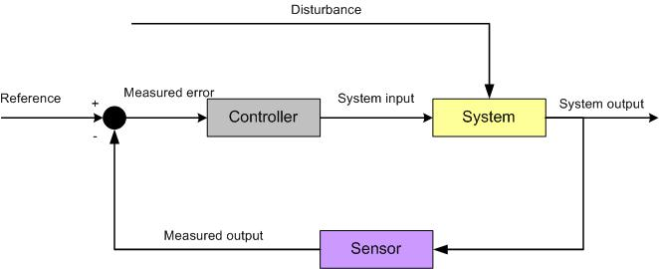
Control
Real time decision making based on imperfect data to achive a goal

Slide 20
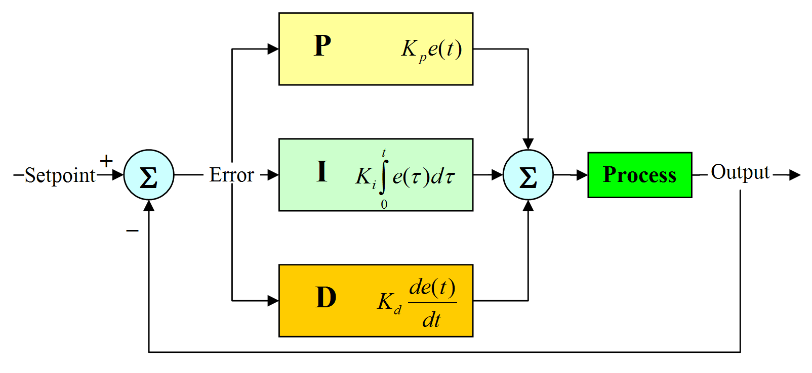
Control Theory 101 in two Slides:
1. PID

Slide 21
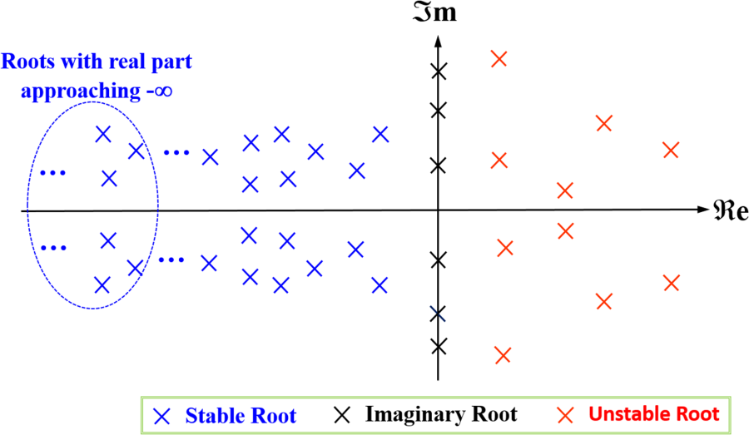
Control Theory 101 in three Slides:
2. Stability

Slide 22
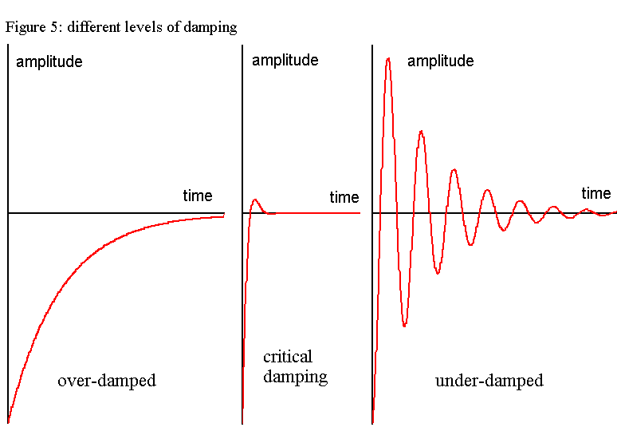
Control Theory 101 in three Slides:
3. Dampening

Slide 23
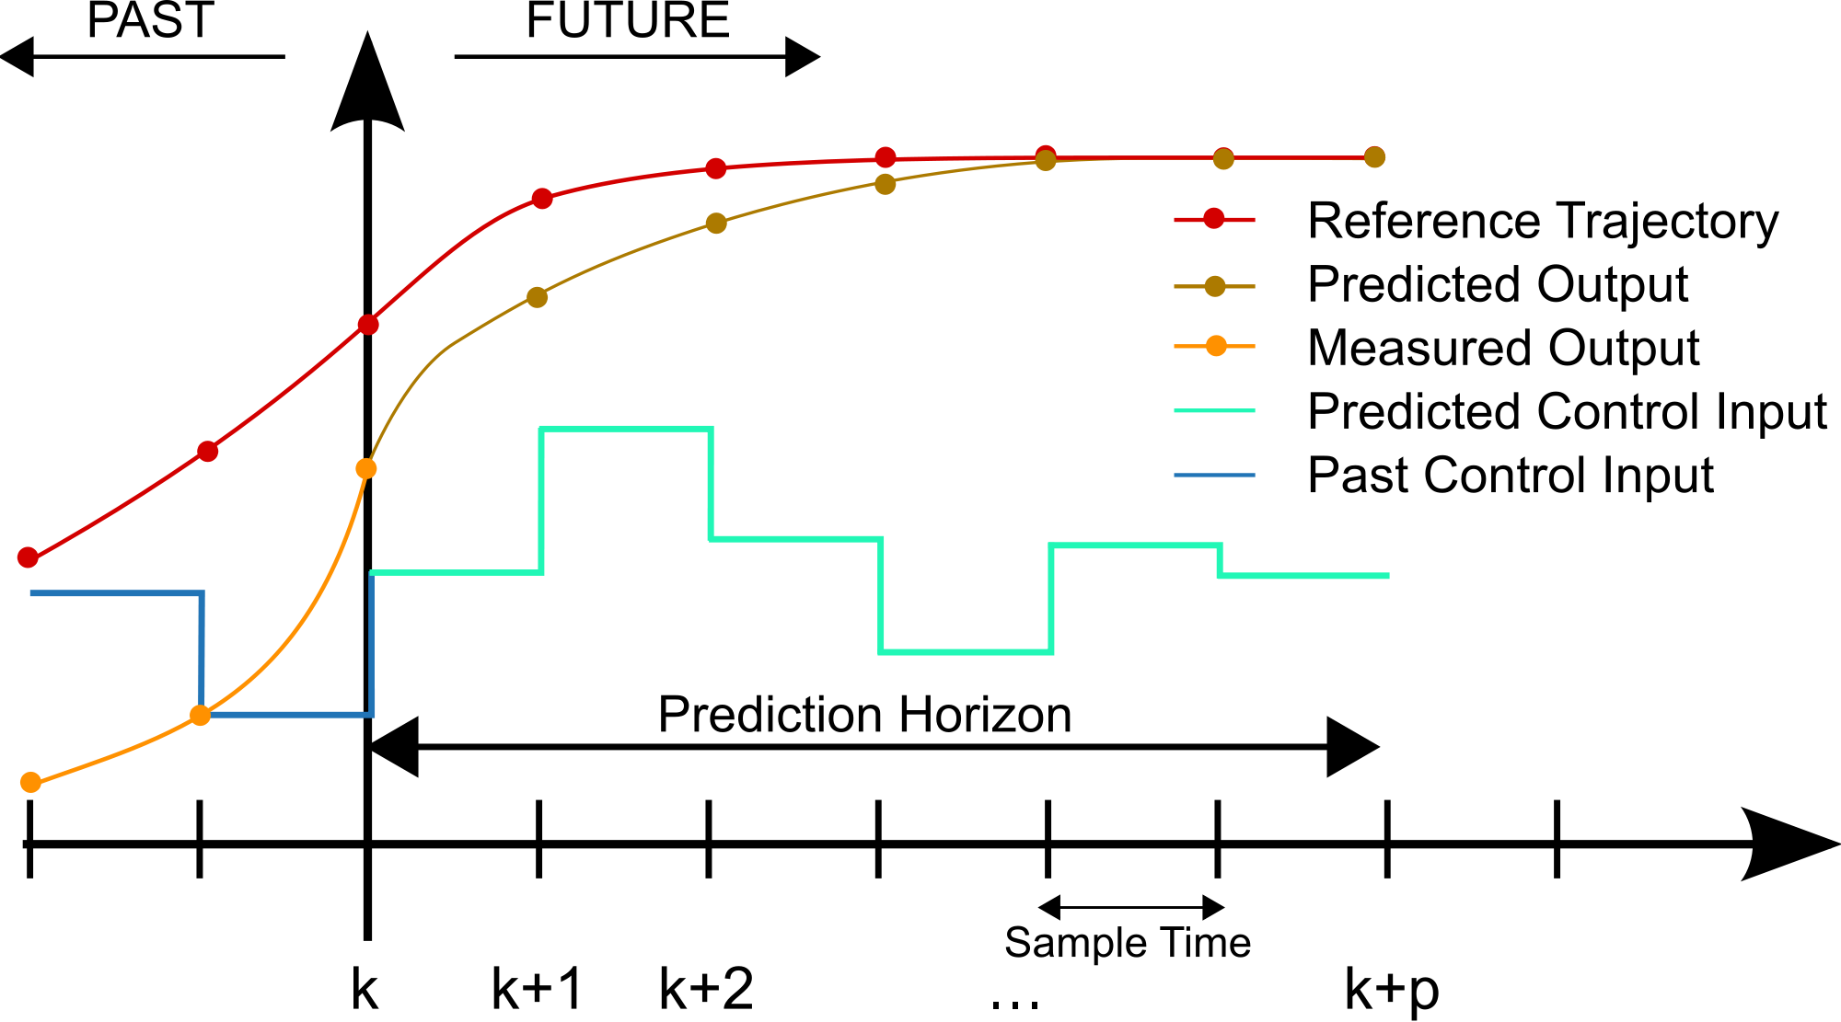
Control Theory 201:MPC
Notes:
Predictive control: based on model, adjust feedback „in advance“

Slide 24
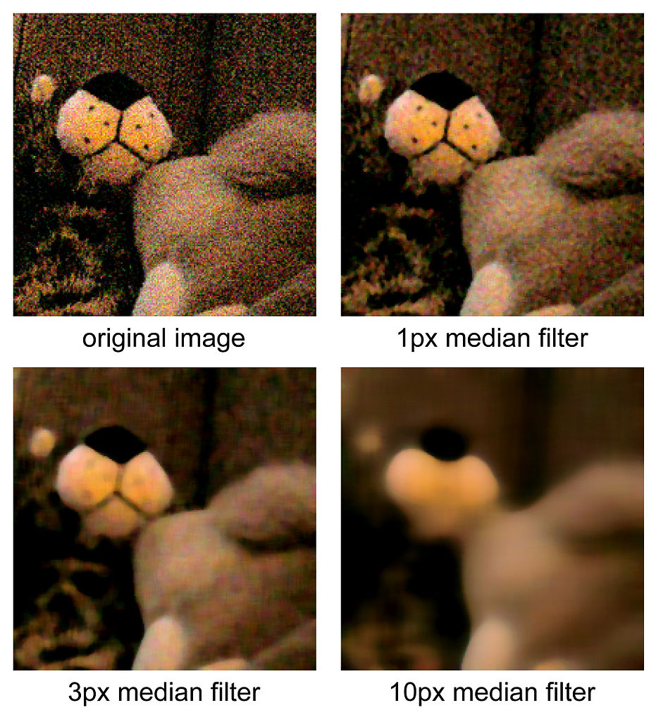
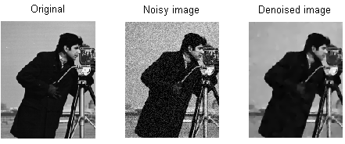
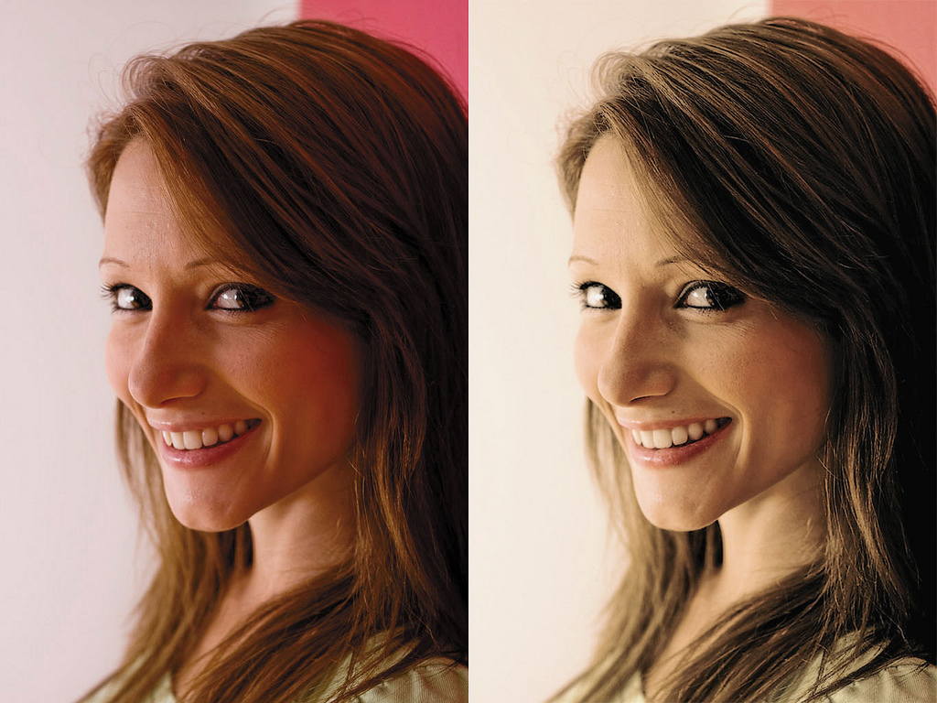
Computer Vision:Processing
Notes:
Denoisuing
Colour corrections
Photoshop...

Slide 25
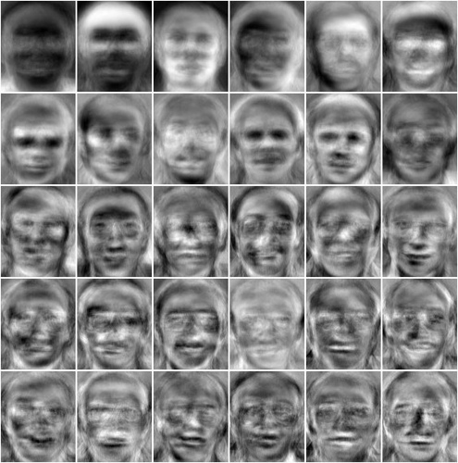
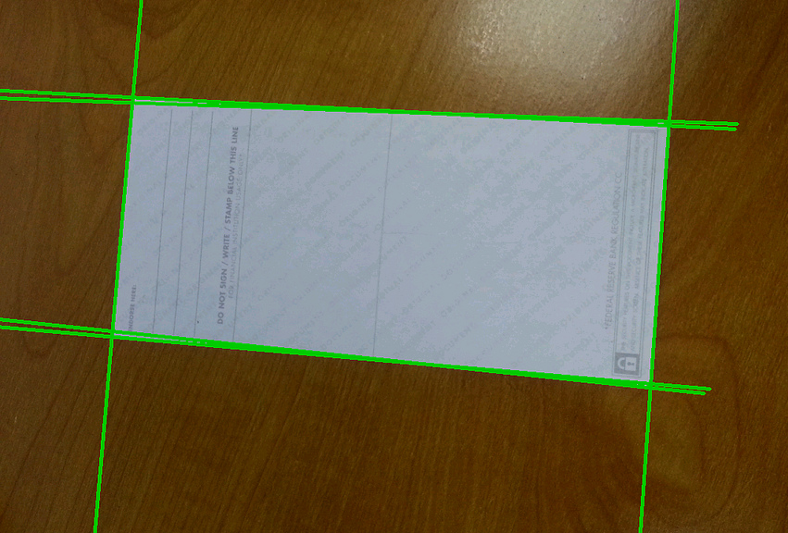
Computer Vision:
Recognition
Notes:
Eigenface example in notebooks
Corner detection

Slide 26


Computer Vision:Motion
https://inspirit.github.io/jsfeat/sample_oflow_lk.html
=> Optic flow
https://inspirit.github.io/jsfeat/sample_haar_face.html
=> Face Tracking

Slide 27
Perception: Computer Audition
No time for details sorry :(
Speech recognition
  Identify phonemes
  Machine transcription
Source separation
  Identify different speakers, instruments, noises...
Musical analysis
  Detect beat
  Detect voices, chords..
Notes:
Footnote: speech recongition + NLP = machine speech interface

Slide 28


Perception: Natural Language Processing (NLP)
Understanding of unstructured text
Unstructured vs structured (table vs description of data)
Sample Tasks:
  Summarization
  Machine translation
  Machine reading (extraction of facts form text: concepts, named entities, events, relationships…)
  Natural language generation
Approaches:
  Grammars and parsing
  Statistical approaches
https://demos.explosion.ai/displacy/
http://nlp-compromise.github.io/website/

Slide 29
Planning
Want to find „good“ solution quickly
Can‘t use inference because of
  Combinatorial explosion
  Fuzzy goals
  Unkown states (Open world)
2 „Dominant“ models: Search & Optimization
  Can (almost always) be transformed into each other
Search: given a graph structure, find a path, or a certain node
Optimization: given a number of hard(must have) and soft(nice to have) objectives, increase a target score

Slide 30
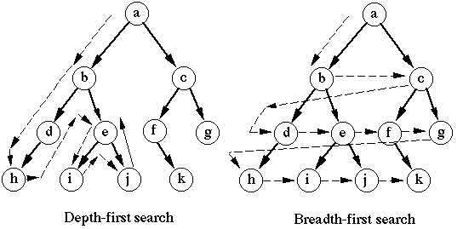
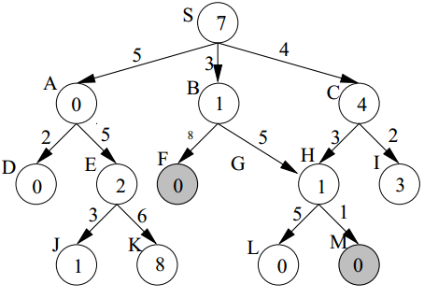
Planning:Search
Notes:
DFS,BFS, A*
Show how problems can be reduced to Graph search
Show problems: heuristic selection, backtracking, explosion

Slide 31
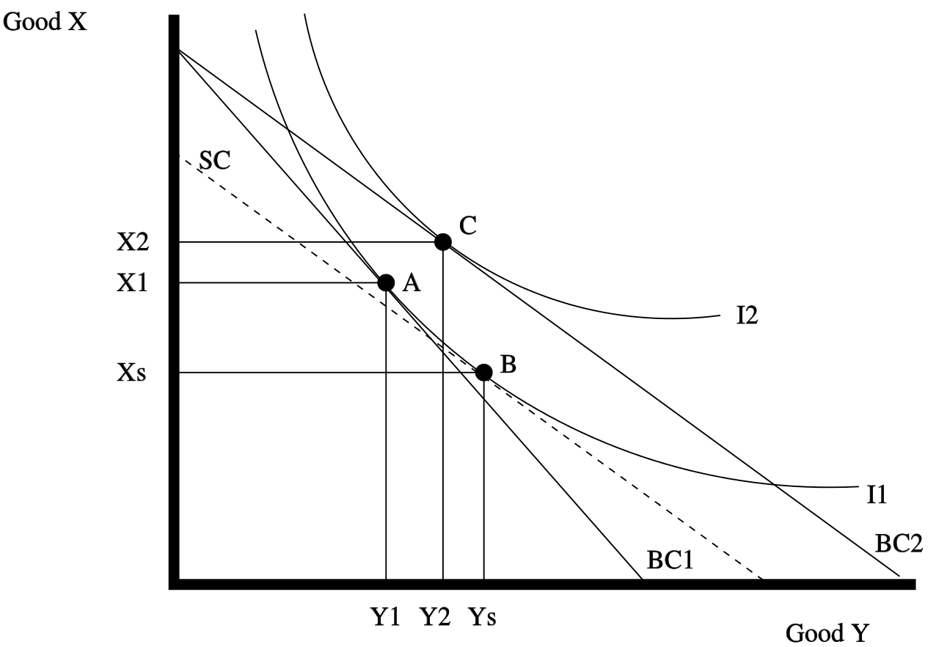
Planning:Optimization
Notes:
Explain linear, quadratic programming
Explain satisfiability program, constraint maximization, integer and floating point optimization
Examples: simplex, manage and more matching
Applications: philae lander, resource allocation
Bwler kennen simplex/quadratic programming

Slide 32
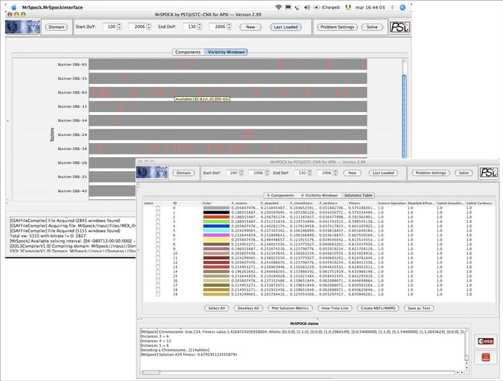
Planning: Optimization at ESA

Slide 33

Learning
DADADA-DAM!

Slide 34
Learning
All other fields have „expert knowledge“ encoded
This is how systems can get that knowledge with explicitlcy encoding
Personal opinion: we work the same way
Spectrum: Supervised <=> Unsupervised

Slide 35
Learning: „Classical“ Machine Learning
Clustering:
  K means
  Self organizing/Kohonen maps
  Flame…
Classification:
  SVM
  Random Forests
Parameter Learning:
  Bayesian Network
  Conditional Random Fields
Dimensionality Reduction
  Technically not learning per se but uses
  LDA
  SVD
Expert knowledge:
  Preprocessing/labeling data
  Model/method selection very important

Slide 36
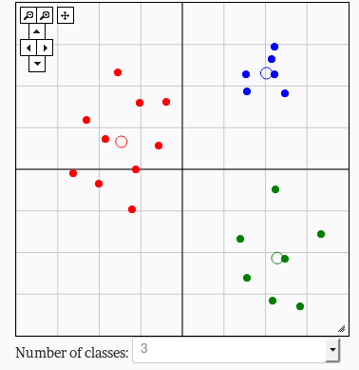

Learning: Clustering
http://util.io/k-means

Slide 37
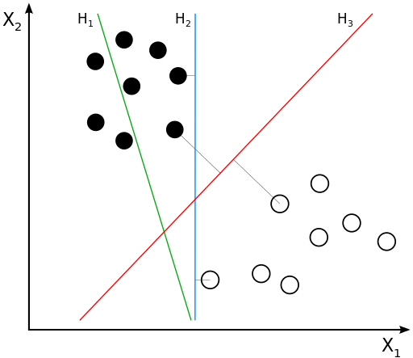

Learning: Classification
http://vision.stanford.edu/teaching/cs231n/linear-classify-demo/

Slide 38
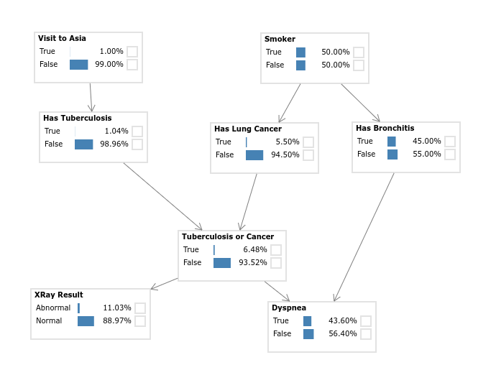

Learning: Model Learning
http://www.bayesserver.com/Live.aspx

Slide 39
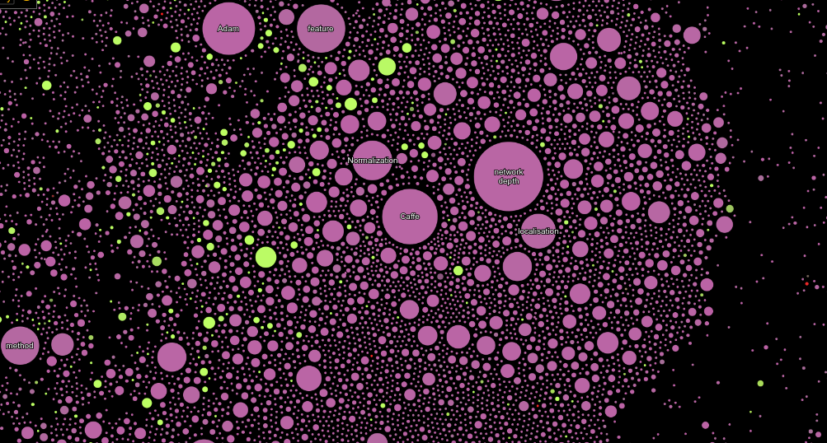
Learning: Dimensionality Reduction
View of „Computer Science“ on http://paperscape.org/

Slide 40
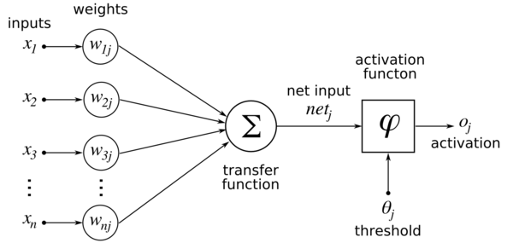

Learning:Neural Networks
http://playground.tensorflow.org
Notes:
Basic principle:
Function approximators
Aggregate weighted inputs into nonlinear activation function
Weights updated via error backpropagation
Expert knowledge:
Data labeling, but less
Feature selection can be reduced/eliminated (DNN)
Architecture still important, but exact model less so

Slide 41
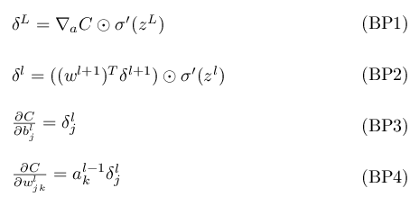
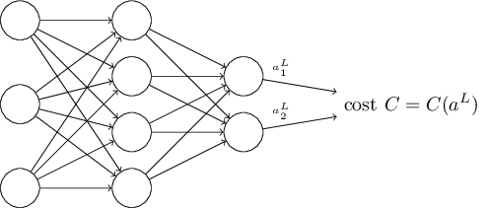
Learning:Neural Networks
Quick intro to backpropagation
Easy right? ;-)
Notes:
Basic principle:
Function approximators
Aggregate weighted inputs into nonlinear activation function
Weights updated via error backpropagation
Expert knowledge:
Data labeling, but less
Feature selection can be reduced/eliminated (DNN)
Architecture still important, but exact model less so

Slide 42
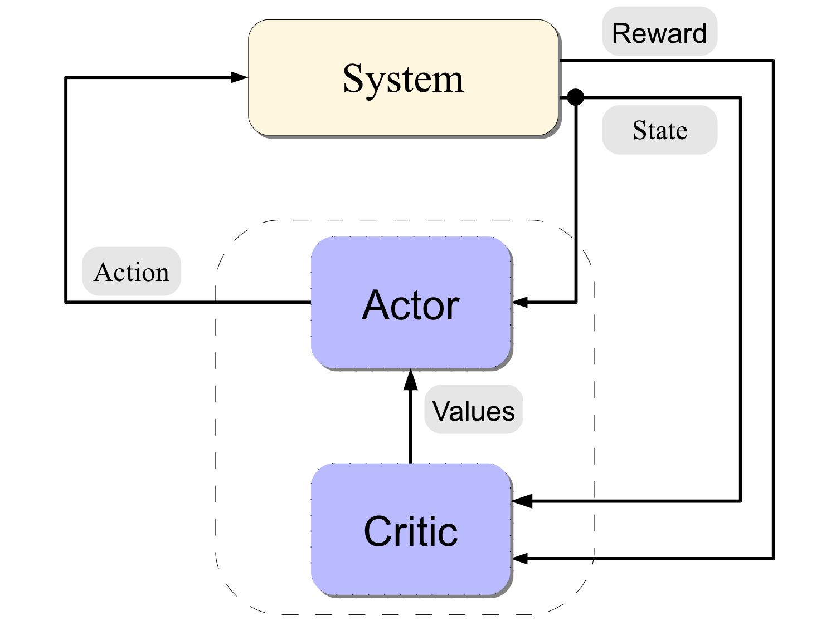
Learning: Reinforcement Learning

Slide 43
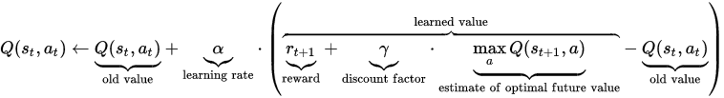

Learning: Reinforcement Learning
Iterative Reward Function update
Almost always approximated somehow
Stichwort: Deep Q Learning
http://cs.stanford.edu/people/karpathy/reinforcejs/index.html

Slide 44
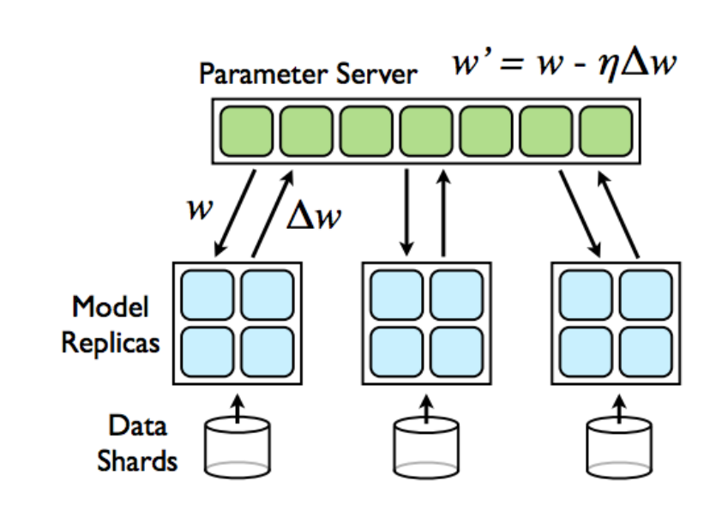
Learning: Where is the hard part?
Basic deal always:
  Error minimisation through backpropagation
  Need to:
    Avoid overfitting
    Build surrounding infrastructure
    Model problems in very indirect ways
Need LOADS of data (or trials in RL)
Need processing power (and/or time)
Model might be large (RAM!)
Probably needs to be distributed
  Distributed gradient
  Data and code parallelism

Slide 45
Hungry Machine learning
Learning is eating NLP, Knowledge, Computer Vision,Planning...with conditions
  Needs loads of processing power and good data
  The more complex the learning task, the better the data needs to be
  Domain knowledge required for best models
If any condition poses restrictions, „classic“ AI wins
  PID Controllers => manual tuning, but established and optimised
  Template NLP => faster and better than training...for now

Slide 46
Thanks for attending!
Feel free to contact
me at
inquiries@bayesmill.com
with any questions or
if you need consulting

Slide 47
Sources
„Artificial Intelligence: A modern Approach“(Pears,3rd Edition,Russel,Norvig et.al)
„An Introduction to Machine Learning“(Cambride Univeristy Press,Smola and Vishwanathan)
Computer Vision:Algorithms and Applications (Richard Szeliski, http://szeliski.org/Book)

