Slide 1

IBM Bob
Modernizing Legacy Java Application
From Java 8 to Java 21 in hours, not months
IBM Bob + Java modernization mode
Igor Olikh
AI Solutions Architect
Notes:
Ankit

Slide 2
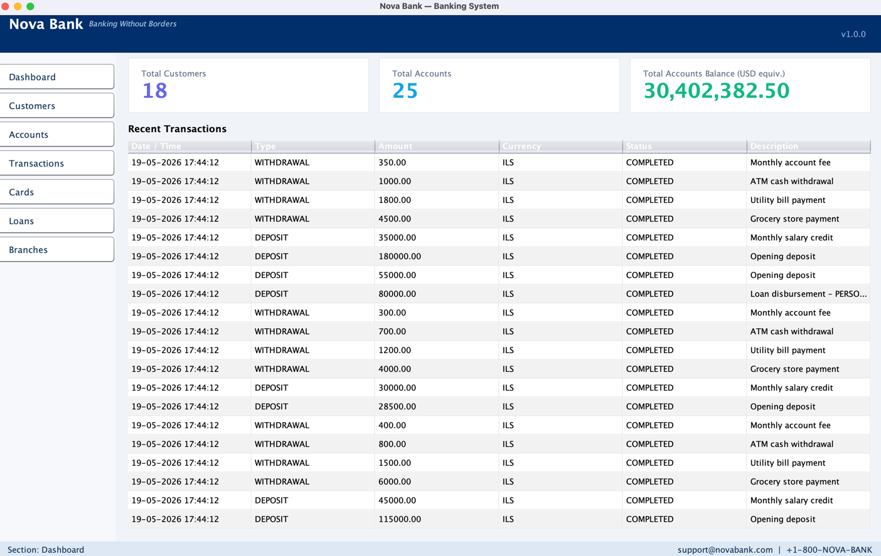
Java isn't legacy. It powers most of the world's enterprise systems
JAVA
Java 8 still runs over 50% of enterprise Java workloads
Banking, telecom and government heavily rely on Java 8
Java 21 LTS (Sept 2023) brings Records, Sealed Types, Virtual Threads
Notes:
Ankit

Slide 3
Why IBM BOB?
Specialized Java and Modernization Expertise
This project required deep understanding of:
Modern Java syntax: Records, Sealed Types, Pattern Matching, Virtual Threads
Maven build lifecycle (pom.xml, dependency management, compiler plugins)
Enterprise Java patterns (Swing UI, layered MVC, in-memory repositories, exception hierarchies)
Native IBM Product Understanding:
- Specialized /java-modernization mode trained for Java 8 → Java 21+ migration
- IBM Cloud and Code Engine deployment patterns and best practices
- Integration with the IBM watsonx Orchestrate ecosystem
- Understanding of IBM's enterprise Java tooling (Open Liberty, Semeru)
- Access to IBM MCP servers
Notes:
Ankit

Slide 4
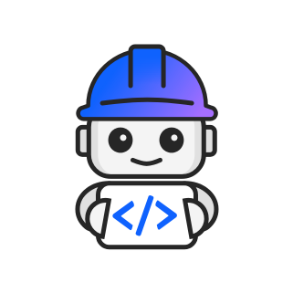
Why a Mode — not just hand-coding?
You can modernize one class by hand. The value is the whole estate — identically, safely, in hours, not months.
Dimension | By hand — developer alone | With /java-modernization mode
Scale | One class is quick; the whole system is weeks of toil | Hundreds of files in hours — one shared playbook
Consistency | Fatigue creeps in; 5 developers → 5 styles | Identical rules applied to every file
Expertise | Needs a senior who knows the traps | Senior-level know-how baked into the mode
Risk | Missed call sites, silent behavior changes | Build stays green, behavior preserved, full diff audit
Portfolio | Re-learned for each application | Written once → reused across the whole Java estate
It isn't Bob vs the developer — it's developer + Bob. The judgment stays human; the toil disappears.

Slide 5
AI alone vs AI + Bob
Bob isn't a different AI — it's the same model, made enterprise-ready.
AI alone — a generic assistant
• Improvises per prompt — output varies with phrasing
• No enterprise methodology or guardrails
• Generic — no access to your systems or the IBM stack
• Black box — no built-in review or audit trail
• Stateless — you re-explain the context every time
AI + Bob — enterprise-ready
+ Specialized modes & playbooks (e.g. /java-modernization)
+ Skills & MCP servers — TechZone, watsonx Orchestrate, web
+ Native IBM stack — Liberty, Semeru, IBM Cloud, Code Engine
+ Per-file approval, build-green discipline, full diff audit
+ Knowledge baked in, reused across the whole estate
Same AI horsepower — plus the methodology, tools, and governance an enterprise needs.

Slide 6
IBM about Bob
Faster innovation, higher productivity — built for scale, security and governance.
20–80%
90%+
20–40%
~40%
productivity gains
across SDLC tasks
time savings on
repetitive work
faster on complex
engineering work
lower AI
compute spend
▪ Scale
Orchestrates planning, execution and verification across the full SDLC.
▪ Security-first
Detects vulnerabilities during code authoring — not after the fact.
▪ Governance
Auditable guardrails and audit-readiness embedded at authoring time.
IBM's own positioning — ship faster, modernize continuously, stay secure and governed.
Source: ibm.com/products/ai-coding-agent — IBM official figures

Slide 7
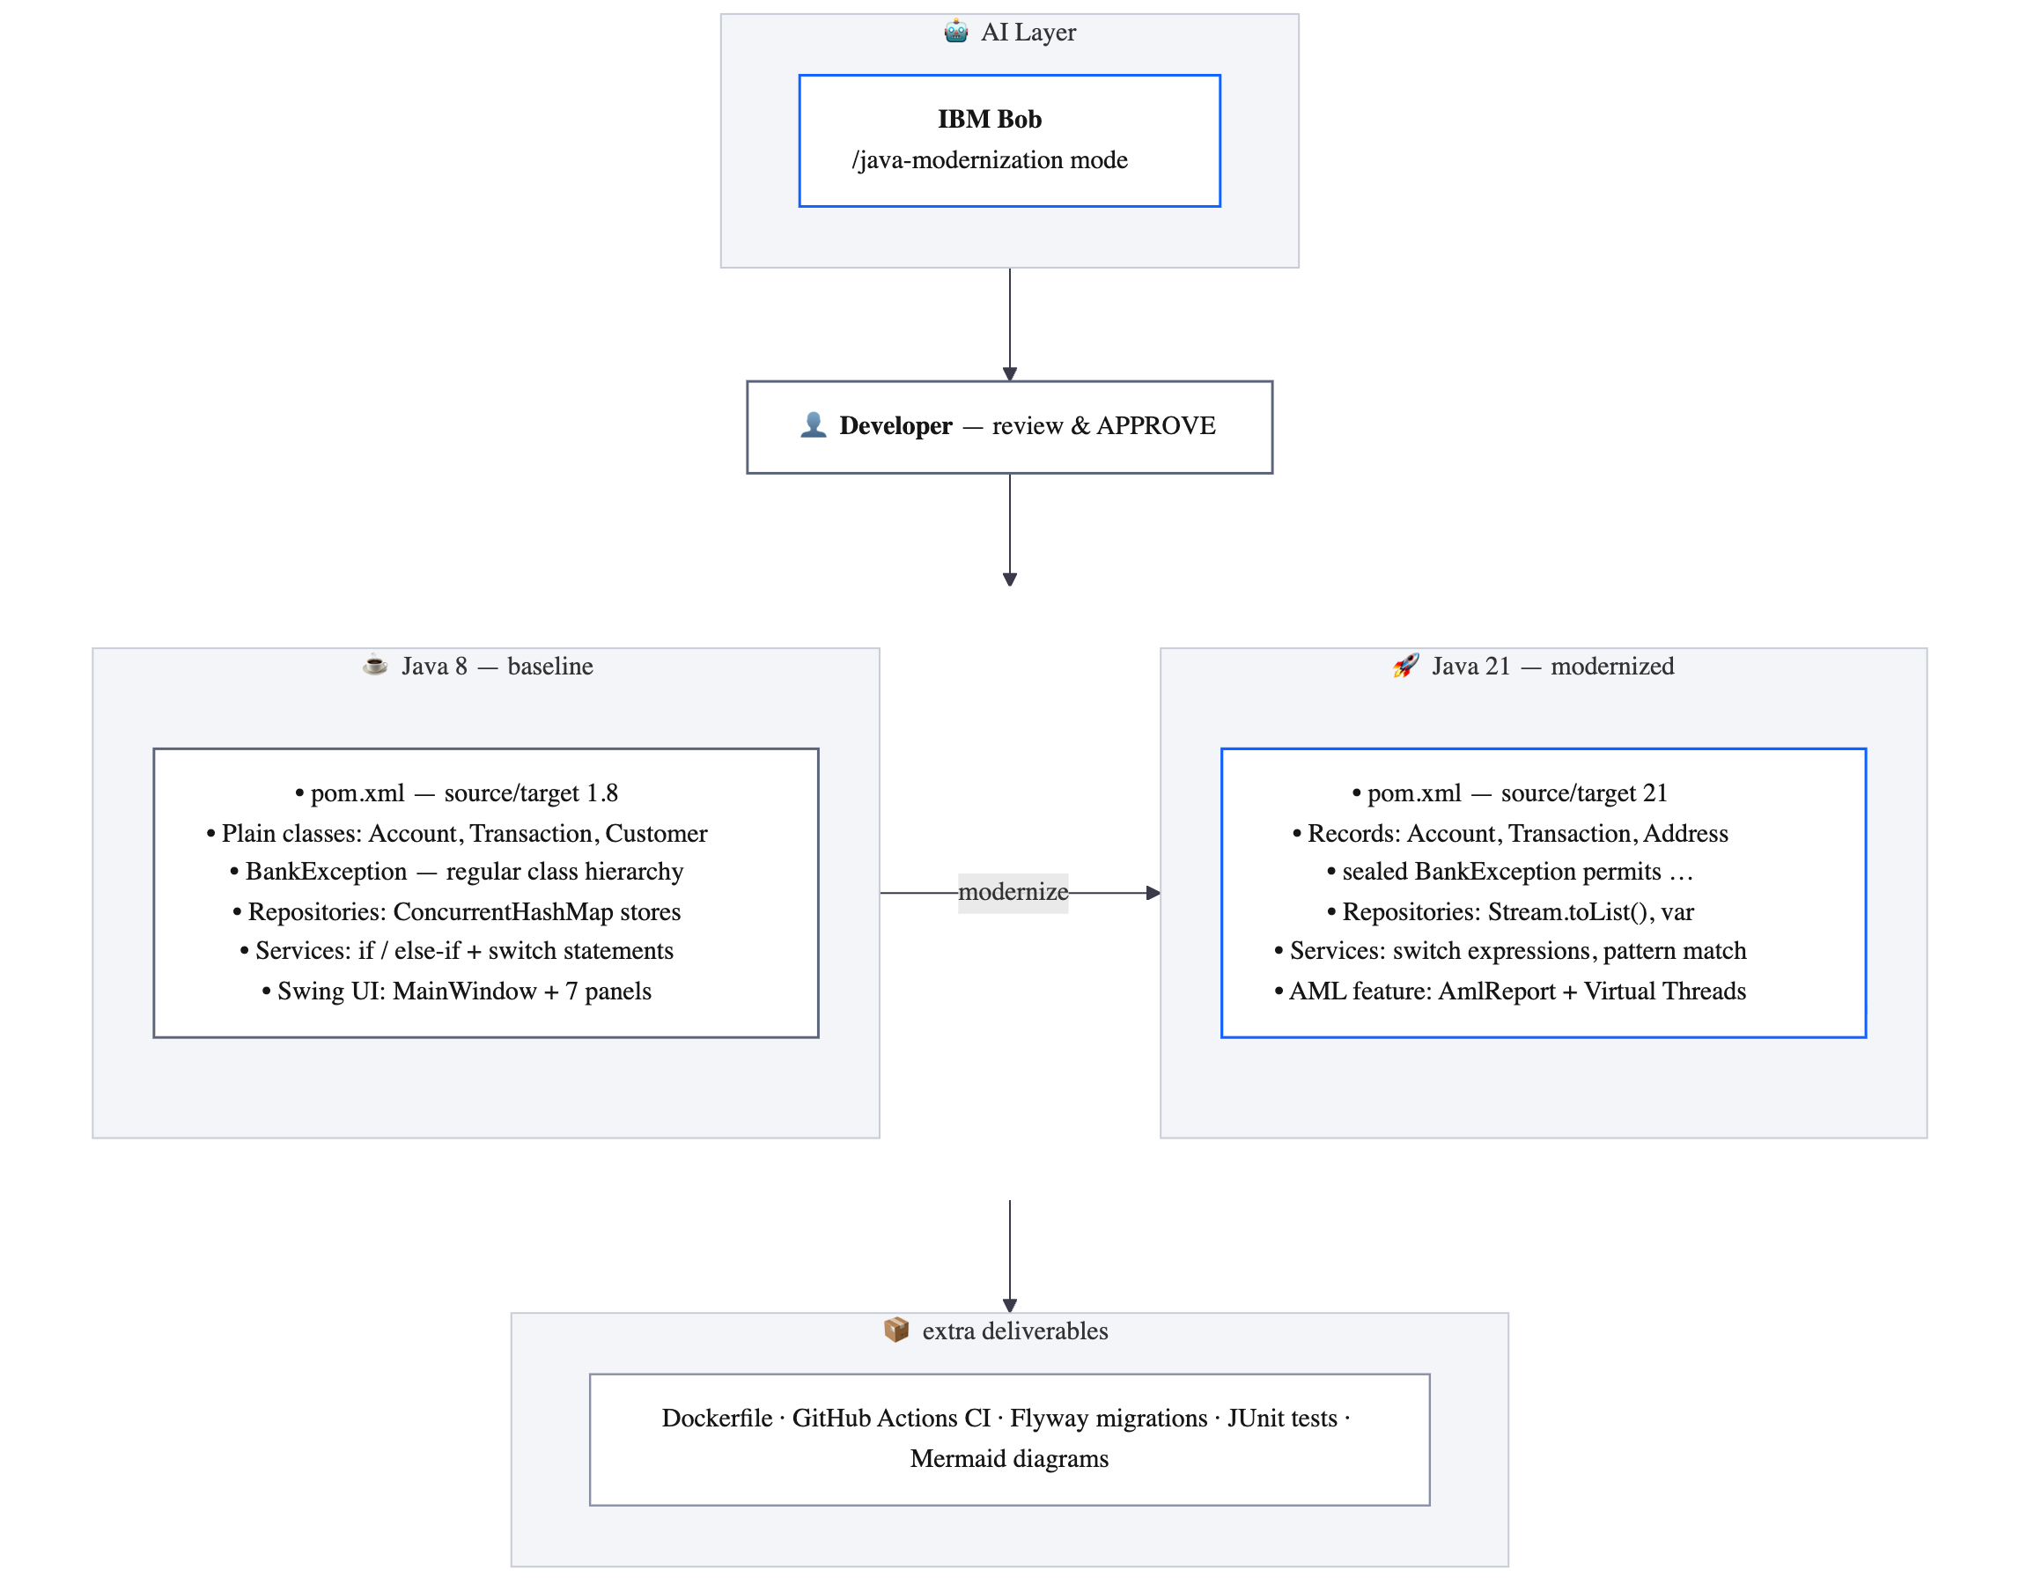
Architecture Diagram
Notes:
Ankit

Slide 8
Demo
Notes:
Ankit

Slide 9
Q & A

