Slide 1
Introduction to MongoDB
By Igor Huk

Slide 2
Agenda
SQL vs NoSQL
Intro into MongoDB
CRUD queries in MongoDB
Intro into Aggregation framework
Query optimization
Sharding and replication
Integration with programing languages

Slide 3
SQL vs NoSQL
Feature | SQL | NoSQL
Type | Relational | Document oriented, wide colums, graph databases, etc.
Data structure | Strongly defined, hard to change. Uses rows in tables with relations between them. | Easy to modify, agile friendly. Graphs(defines entities as nodes with relations) Key-Value, Documents with embedded data (JSON, XML, etc.)
Scalability | Bad scaling using sharding. Some benefits of relational structure could be lost. | Easy to spread data over multiple servers due to data storage mechanisms.
Transactional | Full support | Document level, database level – depends on paticular db.
Consistency | Can be configured | Depends on product
Data manipulation | SQL | Object oriented API

Slide 4
What is MongoDB
Data stored using BSON documents
Data manipulation by object oriented queries
No joins and transactions
Configurable read consistency
Indexes support
Sharding and replication support
Almost Schemeless

Slide 5
DDL in MongoDB
Command | Description
use <db name> | Selects database
db.collection.drop() | Removes collection from db
db.collection.insert() | Creates db after first insertion
db.collection.createIndex() | Creates index
db.collection.dropIndex() | Removes specified index
db.collection.dropIndexes() | Removes all index
db.collection.reIndex() | Rebuilds all indexes on a collection.

Slide 6
CRUD Operations in MongoDB

Slide 7
Find operations in MongoDB
db.collection.find() | Returns cursor populated with documents.
db.collection.findOne() | Returns single document.
db.collection.findAndModify() | Finds document, updates it and returns modified.
db.collection.findOneAndReplace() | Replaces single document.
db.collection.findOneAndUpdate() | Updates single document.
db.collection.findOneAndDelete() | Deletes single document.

Slide 8
find() and findOne()
Has two prams (filter and projection)
Filter = SQL's WHERE statement
Projections = SELECT params
db.bios.find(
{ },
{ name: 1, contribs: 1, _id: 0 }
)

Slide 9
findAndModify()
db.collection.findAndModify({
query: <document>,
sort: <document>,
remove: <boolean>,
update: <document>,
new: <boolean>,
fields: <document>,
upsert: <boolean>,
bypassDocumentValidation: <boolean>,
writeConcern: <document>
});

Slide 10
findOneAndDelete()
db.collection.findOneAndDelete(
<filter>,
{
projection: <document>,
sort: <document>,
maxTimeMS: <number>,
}
)

Slide 11
findOneAndReplace()
db.collection.findOneAndReplace(
<filter>,
<replacement>,
{
projection: <document>,
sort: <document>,
maxTimeMS: <number>,
upsert: <boolean>,
returnNewDocument: <boolean>
}
)

Slide 12
findOneAndUpdate()
db.collection.findOneAndUpdate(
<filter>,
<update>,
{
projection: <document>,
sort: <document>,
maxTimeMS: <number>,
upsert: <boolean>,
returnNewDocument: <boolean>
}
)

Slide 13
Filter operators
Comparison
Logical
Validation
Array specific
Element
Geospatial
Bitwise

Slide 14
Filter operators (Comparison)
Oparator | Description
$eq, $ne | Equal/Not equal to value
$gt, $gte | Greater or Greater and equal than value
$lt, $lte | Less or Less and equal then value
$in, $nin | Value in/not in array of values
db.persons.find({“age” : {“$gte” : 18}})

Slide 15
Filter operators (Logical)
Oparator | Description
$or | Joins query clauses using OR operator { $or: [ { <expression1> }, ... , { <expressionN> } ] }
$and | Joins query clauses using AND operator { $and: [ { <expression1> }, ... , { <expressionN> } ] }
$not | Inverts clause result { $not: { <operator-expression> } }
$nor | Returns all documents that fail to match both clauses. { $nor: [ { <expression1> },... { <expressionN> } ] }

Slide 16
Filter operators (Validation)
Operator | Description
$mod | Performs a modulo operation and selects documents with a specified result.
$regex | Matches documents by regular expression
$text | Performs text serch
$where | Matches documents that satisfy a JavaScript expression.

Slide 17
Filter operators (Array specific)
Operator | Description
$all | Selects document if array contains all values given in $all condition
$elemMatch | Selects document if array fields matches all given conditions
$size | Selects documents if given array has given size.

Slide 18
Filter operators (Element)
Operator | Description
$exists | Selects document if document has field
$type | Selects document if given field type matches type in condition (BSON type specification is used)

Slide 19
Insert oprations
Operation | Description
db.collection.insert() | Inserts one document or array of documents. Returns number of documents inserted
db.collection.insertOne() | Inserts one document. Returns id of inserted document and persistence status of document.
db.collection.insertMany() | Inserts array of documents Returns array of inserted id's and persistence status

Slide 20
db.collection.insert()
Consumes | Produces
db.collection.insert( <document or array of documents>, { writeConcern: <document>, ordered: <boolean> } ) | WriteResult({ "nInserted" : 1 })

Slide 21
db.collection.insertOne()
Consumes | Produces
db.collection.insertOne( <document>, { writeConcern: <document> } ) | { "acknowledged" : true, "insertedId" : ObjectId("56fc40f9d735c28df206d078") }

Slide 22
db.collection.insertMany()
Consumes | Produces
db.collection.insertMany( { [ <document 1> , ... ] }, { writeConcern: <document>, ordered: <boolean> } ) | { "acknowledged" : true, "insertedIds" : [ ObjectId("562a94d381cb9f1cd6eb0e1a"), ObjectId("562a94d381cb9f1cd6eb0e1b"), ObjectId("562a94d381cb9f1cd6eb0e1c") ] }

Slide 23
db.collection.update()
Consumes | Produces
db.collection.update( <query>, <update>, { upsert: <boolean>, multi: <boolean>, writeConcern: <document> } ) | WriteResult({ "nMatched" : 1, "nUpserted" : 0, "nModified" : 1 })

Slide 24
db.collection.updateOne()
Consumes | Produces
db.collection.updateOne( <filter>, <update>, { upsert: <boolean>, writeConcern: <document> } ) | { "acknowledged" : true, "matchedCount" : 1, "modifiedCount" : 1 }

Slide 25
db.collection.updateOne()
db.collection.updateMany()
Consumes | Produces
db.collection.updateOne( <filter>, <update>, { upsert: <boolean>, writeConcern: <document> } ) | { "acknowledged" : true, "matchedCount" : 1, "modifiedCount" : 1 }

Slide 26
Update operators (Arrays)
Operator | Description
$ | Acts as a placeholder to update the first element that matches the query condition in an update.
$push | Adds element to array.
$pop | Removes element from start or end of array.
$pull | Removes all array elements that match a specified query.
$pullAll | Removes all matching values from an array.
$addToSet | Adds elements to array if value is not present

Slide 27
Update operators (Fields)
Operator | Description
$setOnInsert | Sets default value
$inc | Increments field by given value
$mul | Multipies field value
$rename | Renames field
$set | Sets the value of a field in a document.
$unset | Removes the field from a document.
$min | Updates the field if the value is less than the existing field value.
$max | Updates the field if the value is greater than the existing field value.
$currentDate | Sets field date to current time

Slide 28
Update operators (Modifiers)
Operator | Description
$each | Modifies the $push and $addToSet operators to append multiple items for array updates.
$splice | Modifies the $push operator to limit the size of updated arrays.
$sort | Modifies the $push operator to reorder documents stored in an array.
$position | Modifies the $push operator to specify the position in the array to add elements.

Slide 29
db.collection.remove()
Consumes | Produces
db.collection.remove( <query>, { justOne: <boolean>, writeConcern: <document> } ) | WriteResult({ "nRemoved" : 4 })

Slide 30
db.collection.deleteOne()
db.collection.deleteMany()
Consumes | Produces
db.collection.deleteMany( <filter>, { writeConcern: <document> } ) | { "acknowledged" : true, "deletedCount" : 1 }

Slide 31
db.collection.replaceOne()
Consumes | Produces
db.collection.remove( <query>, { justOne: <boolean>, writeConcern: <document> } ) | { "acknowledged" : true, "matchedCount" : 0, "modifiedCount" : 0, "upsertedId" : 4 }

Slide 32
db.collection.bulkWrite()
Consumes | Produces
db.collection.bulkWrite( [ { insertOne : <document> }, { updateOne : <document> }, { updateMany : <document> }, { replaceOne : <document> }, { deleteOne : <document> }, { deleteMany : <document> } ], { writeConcern : <document>, ordered : <boolean> } ) | { "acknowledged" : true, "deletedCount" : 1, "insertedCount" : 2, "matchedCount" : 2, "upsertedCount" : 0, "insertedIds" : { "0" : 4, "1" : 5 }, "upsertedIds" : { } }

Slide 33
Write concern
{
w: <value>,
j: <boolean>,
wtimeout: <number>
}

Slide 34
Write concern options
Option | Values | Definition
w | 0, 1, ..., “majority” | Request acknowledgement after changes will be written on nodes.
j | true, false | Reauest acknowledgement after changes written to journal.
wtimeout | Integer | This option specifies a time limit, in milliseconds, for the write concern. wtimeout is only applicable for w values greater than 1.

Slide 35
Intro to Aggregation Framework
db.collection.aggregate( [ { <stage> }, ... ] )

Slide 36
Aggregation pipeline stages
Stage | Description
$project | Transforms object schema
$match | Applies filter to documents
$group | Performs Aggregeation by given aggregation operators
$sort | Performs sorting
$limit | Allows to limit output
$skip | Allows to skip documents
$unwind | Data normalization
$out | Allows to write result to collection

Slide 37
$group operators
Operator | Description
$sum | Sum accumulator
$avg | Average accumulator
$first | Returns first element of collection
$last | Returns last element of collection
$max | Returns maximum in group
$min | Returns minimum in group
$push | Adds value to array
$addToSet | Adds value to array if value not exists in array

Slide 38
$group example
db.grades.aggregate([{
"$group": { "_id": { "class_id": "$class_id", "student_id": "$student_id" },
"average": { "$avg": "$score" }
}},
{"$group": { "_id": "$_id.student_id",
"average": {"$avg": "$average"}
}}]);

Slide 39
Indexes and execution plans
db.collection.createIndex()

Slide 40
Index types
Field indexes
Compound indexses
Multikey indexes
Text indexes
Geospatial indexes
Partial indexes
Unique indexes
TTL indexes
Sparse indexes

Slide 41
Execution plan
db.collection.find().explain()

Slide 42
Replication and sharding

Slide 43
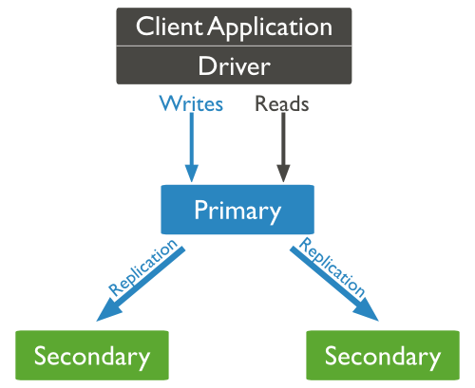
Replication

Slide 44
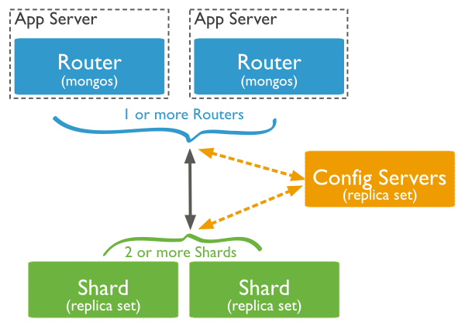
Sharding

Slide 45
Integration with programming languages
Java : MongoDB Driver, Morphia, Spring Data MongoDB
C# : MongoDB Driver, NoRM
JavaScript : MongoDB Driver
Python : Mongoengine, PyMongo, MongoDB driver.

Slide 46
Lynks and info
https://docs.mongodb.com
https://university.mongodb.com/
https://github.com/igor38848/mongo-intro/

