Slide 1
A benchmark of health informatics in dental schools
ICARB-D ANNUAL SURVEY OF DENTAL SCHOOLS
HI
IS
AI
RO
BI
SW
Health informatics in dentistry: AI · Robotics · Bioinformatics · Software development
A guide for teachers and decision makers in dentistry
Questionnaire version 3.0.0
Notes:
This deck explains what the survey is for, what health informatics covers, who answers, and what each group of questions is meant to achieve. It ends with how the benchmark and the checklist are used.

Slide 2
The main goal: a benchmark
Build a benchmark: one comparable number, from 0 to 100, that measures how mature each US dental school is in health informatics, with a score for each of its areas.
What the survey is for
1
MAIN GOAL
2
PRACTICAL CONCLUSION
3
SECONDARY
Where does each US dental school stand in health informatics? Every school gets a number built from its departments and courses, with a score for each area. The same questions also work as a checklist of what each course or department is missing to reach the maturity it wants: a guide for decision makers.
If a grant for health informatics in dentistry were available, which university would have the best chance of using it well?
How do schools compare with each other, and, where schools in other countries answer the same survey, how do US schools compare with them?
Notes:
The survey is not mainly a ranking. Its first purpose is a benchmark: a number that defines the maturity of each school in health informatics. With it, a funder can see which university has the best chance of using a grant well. Comparisons between schools, and with other countries that use the same survey, come after.

Slide 3
Health informatics is the umbrella
The benchmark measures health informatics as a whole. AI, robotics, bioinformatics and software development are areas inside it, next to its core: the information systems of the clinic.
Health informatics in dentistry · benchmark score 0–100
IS
AI
RO
BI
SW
Health information systems
Artificial intelligence
Robotics and digital dentistry
Bioinformatics
Software development for health
Electronic records, imaging archives, coding, teledentistry and analytics
AI tools, AI teaching and generative AI
Robots, simulators, scanners, CAD/CAM and 3D printing
Omics laboratories, pipelines and biological data
Building, testing and maintaining health software
Foundations Infrastructure, data and privacy, people, governance, and implementation and sustainability. Every area depends on them.
Notes:
Health informatics is the highest level of aggregation. Its areas each get a score, and all of them rest on the same foundations: computers and networks, data and privacy, trained people, governance, and the ability to turn pilots into lasting practice.

Slide 4
Who answers: the head of each course
University
Each course director answers one form for their course: nobody knows it better.
Department score = mean of its courses.
University benchmark = its departments, weighted by the number of courses.
Many respondents per school make the benchmark more robust, and show where inside a school the strengths are.
For shared resources (computers, clinic records, policies), directors answer for what their course can use; "Don't know" is allowed.
Department A
Department B
Department C
Course 1.1 · 1 form
Course 2.1 · 1 form
Course 3.1 · 1 form
Course 1.2 · 1 form
Course 2.2 · 1 form
Course 3.2 · 1 form
Course 2.3 · 1 form
Course director answers
Notes:
The hierarchy is university, then departments, then courses inside each department. The ideal respondent is the head of each course. Department and university scores are calculated from the courses, so the benchmark reflects what is actually taught and used.

Slide 5
Why map maturity now
1
2
3
AI has reached the clinic
Schools move at different speeds
Evidence to plan
AI reads radiographs, digital workflows replace analogue ones, and students use generative AI every day.
Investment, training and rules vary widely, and no shared measure says who is ready or where the gaps are.
A common, yearly measure lets deans and faculty plan, learn from the best prepared, and see progress.
Notes:
Stress that the survey is not a test of individual teachers. It is a shared measure that helps schools plan, and it is repeated every year.

Slide 6
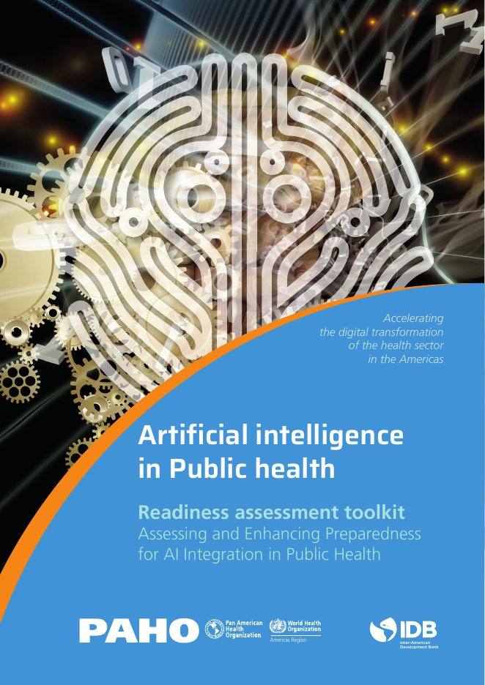
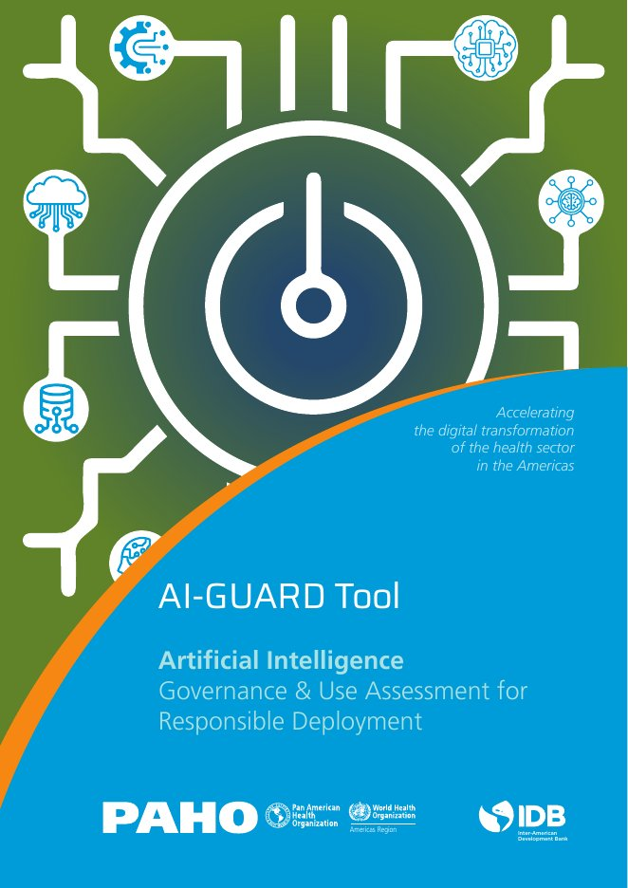

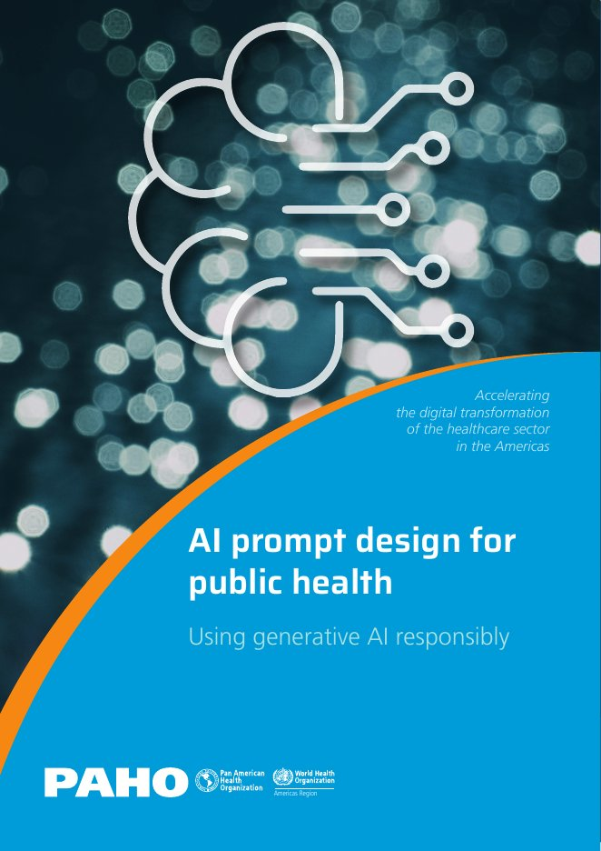
Inspired by four PAHO publications
The Pan American Health Organization built a questionnaire to measure how ready public health institutions are to use AI. This survey adapts it to dental schools. Click a cover to open it on PAHO's website.
AI in Public Health:
Readiness Toolkit
AI-GUARD Tool
Bias-free AI in Health
AI Prompt Design
for Public Health
PAHO and IDB · 2024
PAHO and IDB · 2026
PAHO · 2026
PAHO · 2025
Main inspiration: the dimensions, the maturity scale and the analysis steps
Governance checklist for AI tools (items F06 and J11)
Data representativeness and bias teaching (items C15 and J06)
Prompt design and checking AI outputs (items F04–F05)
Notes:
Links: Artificial Intelligence in Public Health: Readiness Assessment Toolkit (PAHO and IDB, 2024): https://www.paho.org/en/documents/artificial-intelligence-public-health-readiness-assessment-toolkit | AI-GUARD Tool: Artificial Intelligence Governance & Use Assessment for Responsible Deployment (PAHO and IDB, 2026): https://www.paho.org/en/documents/ai-guard-tool-governance-use-assessment-responsible-deployment | Bias-free Artificial Intelligence in Health: Dos and Don'ts for Developing and Implementing Algorithms (PAHO, 2026): https://iris.paho.org/items/76d5aca8-85a7-4427-b097-783d6361da33 | AI Prompt Design for Public Health: Using Generative AI Responsibly (PAHO, 2025): https://www.paho.org/es/documentos/ai-prompt-design-public-health-using-generative-ai-responsibly. Cover images belong to PAHO and are shown only to identify the publications.

Slide 7
Thirteen groups of questions
180 questions in 13 parts. Part A is completed with the research team; parts B to M by the respondent, in about 45–60 minutes.
Who and what
Resources
Teaching
Areas of health informatics
Rules and lasting change
Self-view
A
Profile of the course
B
Context
C
Physical resources
D
Human resources
E
AI curriculum
F
Generative AI
G
Information systems and software
H
Robotics and digital dentistry
I
Bioinformatics and omics
J
Governance and ethics
K
Implementation and sustainability
L
Collaboration
M
Self-assessment
Notes:
The next slides take one group at a time: the goal we want to achieve with it, and what its questions cover.

Slide 8
Part A · Profile of the course
A
GOAL
Place each course in its department and university, and record who answers for it, so every score can be traced, compared and followed from year to year.
16
What the questions cover
Country, state and university
Department and course (code and title)
Training level and the respondent's role
Survey year, consent and last year's code
questions
Completed with the research team
Who and what
Notes:
Part A. Profile of the course (completed by the research team). Goal: Place each course in its department and university, and record who answers for it, so every score can be traced, compared and followed from year to year. What this part captures: Places the course in the hierarchy university → department → course (with country, state and training level), records who answers and their consent. These fields are the keys used to build department and university scores, compare states and countries, and follow the same course from one annual wave to the next.

Slide 9
Part B · Context
B
GOAL
Measure the size of the course, so every count becomes a fair ratio (per student, per faculty member, per year).
11
What the questions cover
Students and faculty (headcount and full-time equivalent)
Academic calendar and terms per year
Course hours and the areas of health informatics it touches
questions
Answered by the respondent
Who and what
Notes:
Part B. Context of the course. Goal: Measure the size of the course, so every count becomes a fair ratio (per student, per faculty member, per year). What this part captures: Describes the size and structure of the course (students, faculty, calendar, hours) and which areas of health informatics it touches. These numbers are denominators: they turn raw counts (e.g., computers, trained faculty, teaching hours) into comparable ratios.

Slide 10
Part C · Physical resources
C
GOAL
Know what the course has today: computing, software, AI tools, data, privacy and security.
22
What the questions cover
Computers, GPUs, cloud access and dedicated spaces
Software and the AI tools students actually use
Datasets, data quality and representativeness
Privacy, security, connectivity and IT support
questions
Answered by the respondent
Resources
Notes:
Part C. Physical resources: computing, AI tools and data. Goal: Know what the course has today: computing, software, AI tools, data, privacy and security. What this part captures: Pictures the physical and digital resources that every technology domain depends on: computers and GPUs, cloud access, dedicated spaces, software, AI tools actually used by students, datasets, data quality, privacy, connectivity, interoperability and security. It answers "what does this course have today?"

Slide 11
Part D · Human resources
D
GOAL
Know who can teach, build and support these technologies, and what holds them back.
16
What the questions cover
Faculty able to teach AI, and faculty doing AI research
Training received and planned
Partners and technical staff
Openness to change and the main barriers
questions
Answered by the respondent
Resources
Notes:
Part D. Human resources and expertise (AI and data science). Goal: Know who can teach, build and support these technologies, and what holds them back. What this part captures: Pictures the people: how many faculty can teach AI, who does AI research, what training they received, which partners and technical staff support them, and what holds them back. Equipment without trained people does not change teaching; this part measures that capacity.

Slide 12
Part E · AI curriculum
E
GOAL
Know what students actually learn about AI, at which level and for how many hours.
24
What the questions cover
Hours per year, by teaching format and by 16 topics
Programming and formal AI model development
Named predoctoral and graduate courses
Assessment, materials and planned changes
questions
Answered by the respondent
Teaching
Notes:
Part E. AI curriculum and teaching. Goal: Know what students actually learn about AI, at which level and for how many hours. What this part captures: Measures what students are actually taught about AI and for how long: hours per term by format and by 16 topics (including programming and formal model development), named undergraduate and graduate courses, assessment, materials and planned changes. Hours are converted to hours per year (with B05) to build an international benchmark.

Slide 13
Part F · Generative AI
F
GOAL
Know whether generative AI is used with clear rules, real skills and working safeguards.
8
What the questions cover
Policy and permitted uses for students and faculty
Prompt design and checking AI outputs
Safeguards in place (adapted from PAHO AI-GUARD)
questions
Answered by the respondent
Teaching
Notes:
Part F. Generative AI in teaching and learning. Goal: Know whether generative AI is used with clear rules, real skills and working safeguards. What this part captures: Captures how the course governs and teaches generative AI: policies, permitted uses, prompt-design and verification skills, and safeguards (adapted from PAHO "AI prompt design" and AI-GUARD Tier 1). Generative AI spread faster than any earlier technology, so this part is tracked closely year to year.

Slide 14
Part G · Information systems and software
G
GOAL
Know whether the clinic produces reliable digital data, and whether the course can build and maintain its own health software.
16
What the questions cover
Electronic records, imaging archives, coding and teledentistry
Access to clinical data, teaching hours and informatics staff
Software development for health: what is built and how
Teaching students to design and build health software
questions
Answered by the respondent
Areas of health informatics
Notes:
Part G. Health information systems and software development. Goal: Know whether the clinic produces reliable digital data, and whether the course can build and maintain its own health software. What this part captures: Measures the digital backbone of the clinic and how informatics is taught: electronic records, imaging archives, coding, teledentistry, analytics and research data access, plus teaching hours and staff. It also measures software development for health: whether the course builds, tests and maintains its own tools, and whether students learn to do so. Information systems produce the structured data that AI and research depend on.

Slide 15
Part H · Robotics and digital dentistry
H
GOAL
Know what robotic and digital equipment exists, and whether students really use it.
10
What the questions cover
Number of robots, simulators, scanners, CBCT, milling units and 3D printers
How students get hands-on access
Digital workflow, maintenance and trained faculty
Teaching hours and research
questions
Answered by the respondent
Areas of health informatics
Notes:
Part H. Robotics and digital dentistry. Goal: Know what robotic and digital equipment exists, and whether students really use it. What this part captures: Takes an inventory of the physical equipment for robotics and digital dentistry (how many units of each), how students access it, how digital workflows are used, who can teach and maintain it, teaching hours and research. Counted every year, it shows how equipment and skills spread across schools.

Slide 16
Part I · Bioinformatics and omics
I
GOAL
Know whether the course can produce, analyse and share biological data.
10
What the questions cover
Laboratories, sequencing, biobanks and computing
Pipelines and people with bioinformatics skills
Teaching hours and research areas
How data are shared (FAIR principles)
questions
Answered by the respondent
Areas of health informatics
Notes:
Part I. Bioinformatics and omics. Goal: Know whether the course can produce, analyse and share biological data. What this part captures: Pictures laboratory and computing resources for omics research (sequencing, biobanks, pipelines), the people with bioinformatics skills, teaching hours and data-sharing practices. It shows which schools can contribute biological data to future multi-modal AI that links images, records and biology.

Slide 17
Part J · Governance and ethics
J
GOAL
Know whether technology is used safely, ethically and under clear responsibility.
12
What the questions cover
Written plan, leadership and oversight
Ethics and bias teaching
Standards and guidance in use (ADA, CODA, HIPAA, FDA, NIST)
Patient consent and a governance checklist for AI tools
questions
Answered by the respondent
Rules and lasting change
Notes:
Part J. Governance, ethics, bias and regulation. Goal: Know whether technology is used safely, ethically and under clear responsibility. What this part captures: Captures the rules around technology use: strategic plans, leadership, oversight, ethics and bias teaching, use of national and professional guidance, patient consent, a governance checklist for AI tools (PAHO AI-GUARD) and stakeholder involvement. Strong governance is what makes technology use safe and trustworthy.

Slide 18
Part K · Implementation and sustainability
K
GOAL
Know whether projects move from pilot to routine use, are evaluated, and can last.
14
What the questions cover
Pilot projects and whether they scale
Metrics, evaluation and feedback
Cost-benefit and sustainability
Funding sources, budget and grants
questions
Answered by the respondent
Rules and lasting change
Notes:
Part K. Implementation, evaluation and sustainability. Goal: Know whether projects move from pilot to routine use, are evaluated, and can last. What this part captures: Measures whether initiatives move from pilots to routine use and whether they last: pilots, scalability, workflow integration, metrics, evaluation, feedback, cost-benefit, sustainability and funding (PAHO/WHO readiness toolkit). It separates one-off enthusiasm from lasting change.

Slide 19
Part L · Collaboration
L
GOAL
Know whether the course is ready to share data and work with other institutions on AI.
8
What the questions cover
Interest in multi-institution AI projects
De-identified data that could be shared
Preferred ways to collaborate
What stands in the way
questions
Answered by the respondent
Rules and lasting change
Notes:
Part L. Collaboration and the open dental AI model. Goal: Know whether the course is ready to share data and work with other institutions on AI. What this part captures: Maps which departments could contribute data, annotation, validation, teaching or grant work to the consortium's free dental AI model, under which conditions, and what stands in the way. It turns the survey into a practical plan for collaboration.

Slide 20
Part M · Self-assessment
M
GOAL
Compare how the course sees itself with what its answers show, and record its most urgent needs.
13
What the questions cover
Overall maturity in health informatics and each of its areas
Main barriers and facilitators
The single most urgent need
Innovative practice and the vision for 2030
questions
Answered by the respondent
Self-view
Notes:
Part M. Self-assessment and open response. Goal: Compare how the course sees itself with what its answers show, and record its most urgent needs. What this part captures: Asks the respondent for an overall judgement of maturity in health informatics as a whole and in each of its areas, the main barriers and facilitators, and open comments. Self-ratings are compared with the scores computed from Parts C–K, and open answers explain the numbers.

Slide 21
From items to one number
Items are rated from 1 to 4 ("Don't know" is never counted as zero). Each domain becomes a 0–100 index, and the domain indices combine into the benchmark: course → department → university.
4
3
Established
Routine, documented and supported.
2
Developing
In place in part, or not yet routine.
1
Initial
Interest or informal, isolated efforts.
Absent
Nothing in place yet.
Notes:
Level 4 describes what "established" looks like for each item. That is what turns the survey into a checklist.

Slide 22
Who could best use a grant?
If a grant for health informatics in dentistry were available, the results point to the universities most likely to use it well.
1
2
★
+
=
Benchmark
Funding readiness
Best placed to invest
How mature the school already is in health informatics (0–100), with a score for each area.
The strength of its foundations: infrastructure, data, people, governance, and turning pilots into practice.
Schools strong on both are the most likely to turn new money into lasting results.
Comparing schools, and comparing US schools with universities abroad that use the same survey, are secondary uses of the same numbers.
Notes:
The funding readiness index is the mean of the five foundation domains. It does not replace the benchmark; together they show where new money is most likely to make a lasting difference.

Slide 23
After the survey: a checklist for improvement
A guide for decision makers: the same items become 91 checkpoints that show what each course or department is missing. For each one, the target is level 4 and the next step is level 3.
1
2
3
4
5
Answer
See where you stand
Choose a target
Tick the checklist
Measure again
Each course director completes the survey for their course.
Read the benchmark and the score for each area.
Decide the level you want to reach, area by area.
Mark what is already true; the rest are your next steps.
Answer next year and see the progress.
The full checklist is online in the questions guide and in chapter 4 of the questionnaire (PDF).
Notes:
Encourage schools to use the checklist in curriculum or strategy meetings, and to set a realistic target level for each field.

Slide 24
One number, every year
HI
IS
AI
RO
BI
SW
Open the form
igoralves1.github.io/AI-assessment-DS-2026
Demonstration code DEM-TRY: for trying the form only, answers are not part of the study
Every question explained
igoralves1.github.io/AI-assessment-DS-2026/#/questions
Notes:
Respondents receive a personal access code from the research team. Questions about the survey go to the team member who sent the invitation.

