Slide 1



Linux basics
Internship Spring 2025

Slide 2

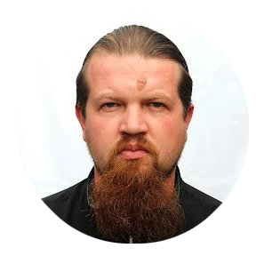
Meet the speaker
Igor Bannicov
Senior DevOps Consultant @ Endava

Slide 3

01
02
03
04
05
06
07
08
09
10
11
Operating systems
Linux system architecture
Linux file system
Package managers
Processes in Linux
User management
Terminal/ssh/scp
Command for learning commands
Moving through file tree
Working with files
Working with file content
Notes:
Agenda
General Template Guidance: Information to help you make good presentations.
Standard / Static Slides: Some key Endava slides/lockups that, in general, should only be modified by marketing.
Template Slides: A selection of template slides for use in Endava presentations.
Larger Format Template Slides: Template slides with larger content.
Icon Library: A selection of hundreds of icons to use in Endava presentations.

Slide 4

agenda
Operating systems
Linux system architecture
Linux file system
Package managers
Processes in Linux
User management
Terminal/ssh/scp
Command for learning commands
Moving through file tree
Working with files
Working with file content

Slide 5
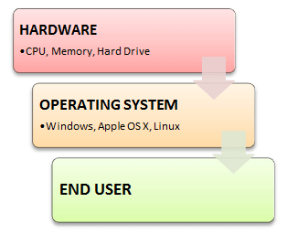
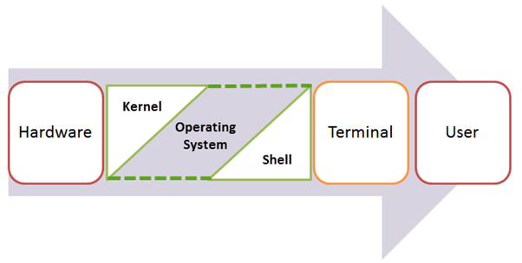
Operating systems
Features of Operating System
Protected and supervisor mode
Allows disk access and file systems Device drivers Networking Security
Program Execution
Memory management Virtual Memory Multitasking
Handling I/O operations
Manipulation of the file system
Error Detection and handling
Resource allocation
Information and Resource Protection

Slide 6
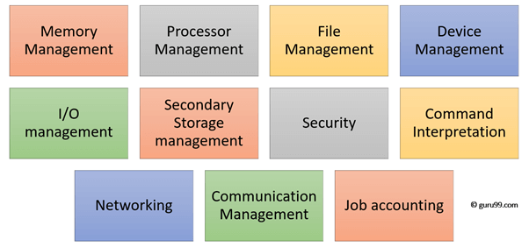
Functions of an Operating System

Slide 7
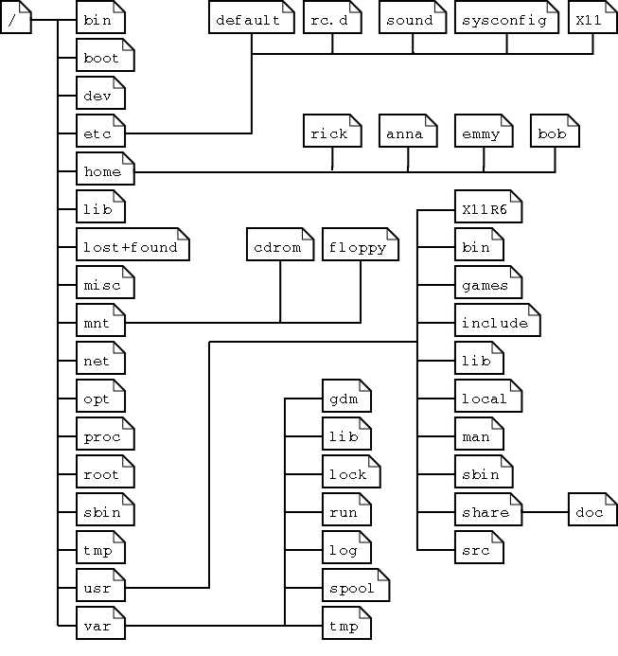
Linux file system
Main folDers
/ - root folder for fs
/boot – bootable files
/bin – common programs
/dev – references to the devices
/etc - configs
/home – users home folders
/lib – kernel modules
/mnt – standard mount point
/proc – system resources info
/opt – 3rd party and extra software
/root – home folder for root user
/run - processes
/usr – user`s program
/var – variables and temporary data
/sys – system information
/sbin – system binaries

Slide 8

Package managers
Package types
Package tools:
rpm– Debian, Mint, Ubuntu
dpkg/deb – APT, Synaptic
Package managers:
yum - RedHat, Fedora, SUSE
apt - Debian, Ubuntu
pacman, yaourt - Arch
Source-based – Slackware, Gentoo
Working with Packages
apt-get update -
apt-get upgrade
apt-get install <app name>
apt-cache search <package name>
apt-cache showpkg <package name>

Slide 9
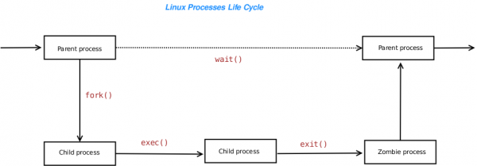
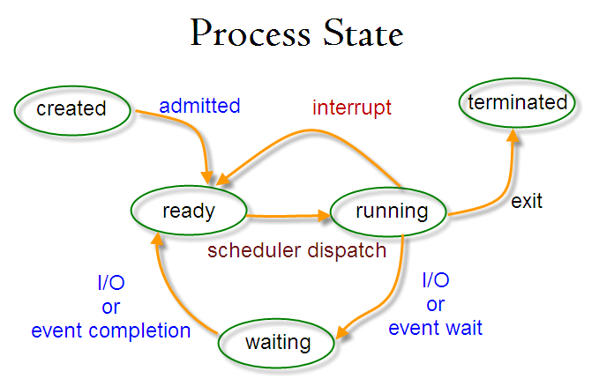
Processes
Running –it is the current process in the system.
Waiting – in this state, a process is waiting for an event to occur or for a system resource.
Stopped – in this state, a process has been stopped, usually by receiving a signal.
Zombie – here, a process is dead, it has been halted but it’s still has an entry in the process table.

Slide 10
USER Management
Read =100
Write =010
eXecute=001
Command | Description
sudo adduser username | Adds a user
sudo passwd -l 'username' | Disable a user
sudo userdel -r 'username' | Delete a user
sudo usermod -a -G GROUPNAME USERNAME | Add user a to a usergroup
sudo deluser USER GROUPNAME | Remove user from a user group
whoami | prints your user name
chown <username>:<groupname> | Change file owner and group

Slide 11
Command for learning commands
- Man, I don`t know a command <abc>
- Just ask MAN, dude
man == manual pages
man <command> - manual about <command>
man <config.file> - manual about <config.file>
man <daemon> - manual about <daemon>
I don`t wanna read to much
whatis – shows the first line of manual
whereis – the location of manual page info – just like man but in the info format

Slide 12
Moving through file tree
Lets walk
pwd – Print Working Directory
cd – Change Directory
ls - LiSt
mkdir – MaKe DIRectory
I`m just to tired to type all of these letters
Use Tab key for autocomplete !!!!!
And remember shortcuts!!
. – current directory
.. – a parent directory
~ - home directory
And about absolute and relative paths
/…/…/…. - Absolute path
…/.../... – Relative path.

Slide 13
Working with files
Remember next rules
Case sensitivity !
Everything is a file !
So what can we do with files?!
file – determines the file type
touch – create an empty file
rm – ReMove file
cp – CoPy file
mv – MoVe. Or Rename))
rename – Rename multiple files according to the regexp

Slide 14
Working with file content
OK. So what`s next ?
head – show the first 10 lines of file
tail – show the last 10 lines of file
cat – an universal tool to work with files
tac – an opposite for cat command
more / less– prints file on screen
strings – prints readable strings from (binary) files
nano – simple text editor
emacs – powerful and customizable text editor
vi / vim – most powerful text editor you`ve ever seen ;)

Slide 15
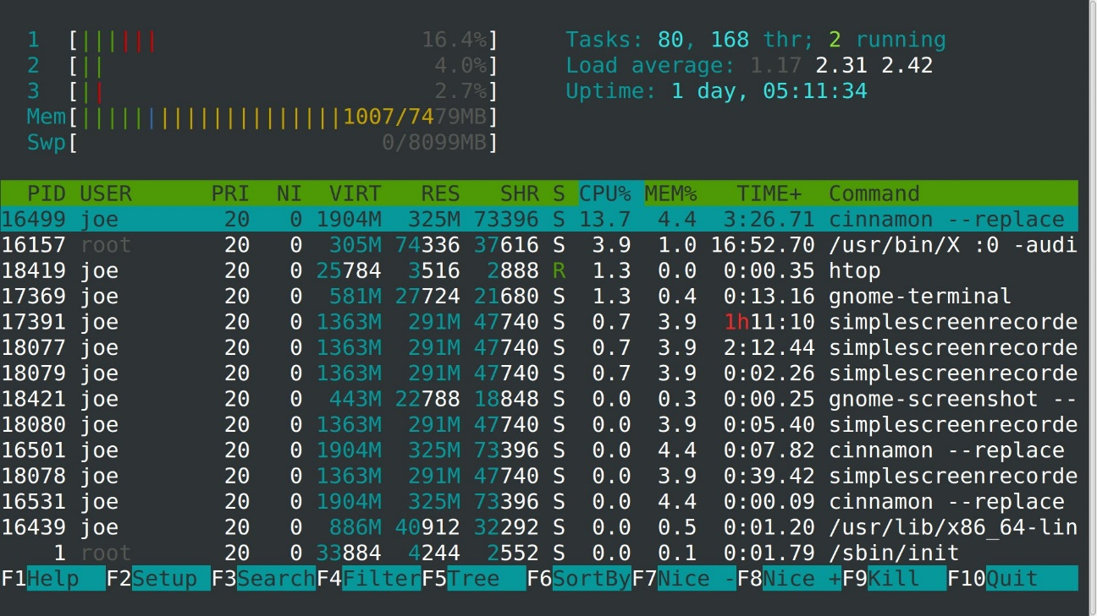
Processes in Linux
What is using my cpu ?!
ps – Process Status
ps -ef / ps aux – see every process
ps axjf – build a process tree
ps o pid,user,command
top/htop/atop – list of all working processes
Well… I need to kill something
kill – kill the process
kill <pid> - try to kill a process
kill -9 <pid> - kill a process with SIGTERM
kill -<signal> <pid>

Slide 16
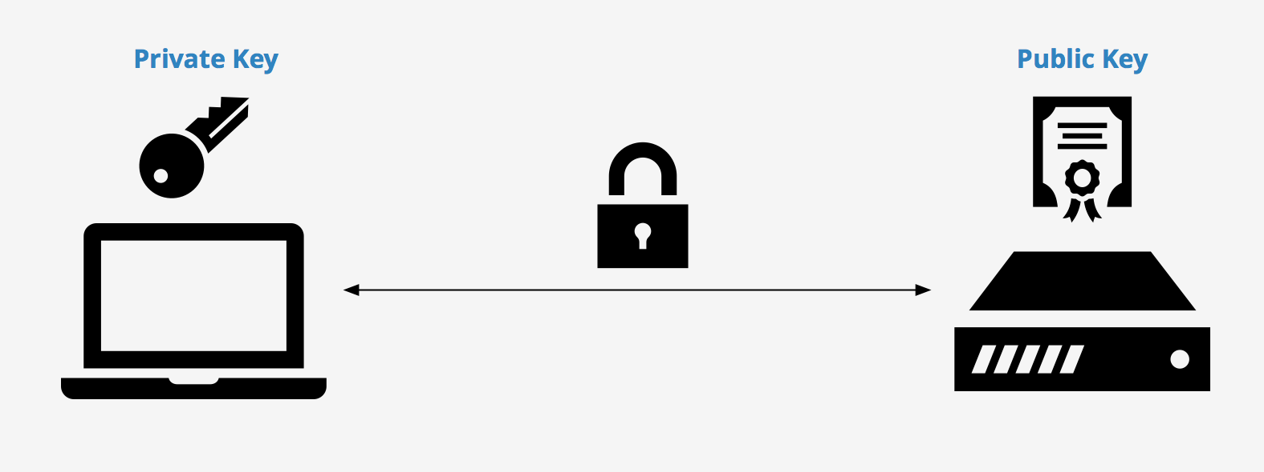
SSH/SCP
What about remotes?
ssh = Secure SHell
ssh-keygen – generate a ssh key
ssh -p <port> <ip>
How can I send files without GUI ?
scp = Secure CoPy
scp <remote_host>:<file> <local destination>
scp <local source> <remote host>:<remote destination>
scp <remote host1>:<remote dest1> <remote host 2>:<remote dest2>

Slide 17
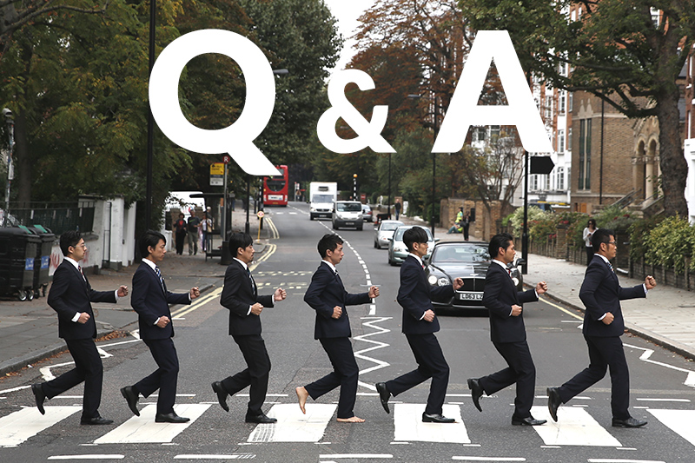

Slide 18

dionis moldovan
Senior DEVOPS Engineer

