Slide 1
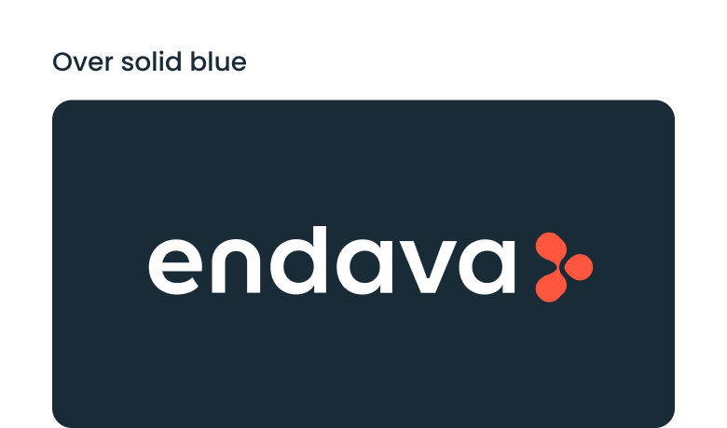


Slide 2


Introduction to DevOps
Internship
Spring 2025

Slide 3
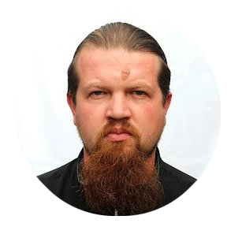
Who am I?
Igor Bannicov
Senior DevOps Consultant
Igor.bannicov@endava.com
Notes:
Presentation Principles
This slide provides a handful of key ideas to help you make great presentations.
It can also be used as a template slide. Change the header (and footer) to reflect the client, presentation name, and chapter title. To change the header and footer, click “edit master” and change the header and footer on all the master slides to have the same client and presentation name across all pages.

Slide 4


Agenda
01
02
03
04
05
06
07
DevOps timelines
Define DevOps
What does a DevOps do?
What should a DevOps know?
DevOps toolset
DevOps mindset
Q&A
Notes:
Agenda
General Template Guidance: Information to help you make good presentations.
Standard / Static Slides: Some key Endava slides/lockups that, in general, should only be modified by marketing.
Template Slides: A selection of template slides for use in Endava presentations.
Larger Format Template Slides: Template slides with larger content.
Icon Library: A selection of hundreds of icons to use in Endava presentations.

Slide 5

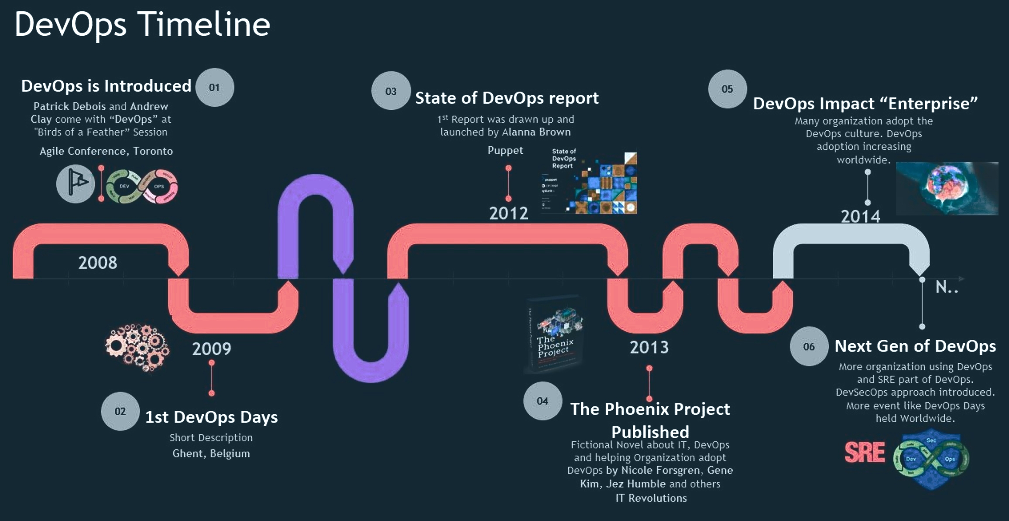
DevOps Timelines
01

Slide 6
DevOps milestones
1
Pre-DevOps Era (pre-2000s)
Dev and Ops were totally siloed.
Waterfall model ruled – slow, rigid releases.
"It works on my machine" was a lifestyle 😅
2
Agile Manifesto (2001)
Agile dev sparked the idea of collaboration and iteration.
Started to break down walls between teams.
3
Flickr Deploys 10x a Day (2009)
John Allspaw & Paul Hammond's legendary talk at Velocity Conf: “10+ Deploys per Day: Dev and Ops Cooperation.”
Massive influence – showed dev+ops working together was possible.
4
DevOps Term is Born (2009)
Patrick Debois coined “DevOps” while organizing the first DevOpsDays in Belgium.
A community-driven movement begins.
5
CI/CD Goes Mainstream (2010s)
Jenkins, GitLab CI, Travis CI, CircleCI take off.
Pipelines become the heart of modern delivery.
6
Docker Launches (2013)
Huge for packaging apps reliably.
Containers start dominating deployment stories.
Kubernetes + Cloud-Native Boom (2014–2018)
Kubernetes (from Google) becomes the container orchestration king.
Cloud-native patterns reshape infrastructure thinking.
7
8
DevSecOps Rises (~2017+)
Security shifts left — integrated early in the pipeline.
Tools like Snyk, Aqua, and policy-as-code grow.
9
GitOps, AIOps, Platform Engineering (2020s)
Git becomes the source of truth for everything (GitOps).
Observability and automation get smarter (AIOps).
Platform teams support devs like product teams.

Slide 7
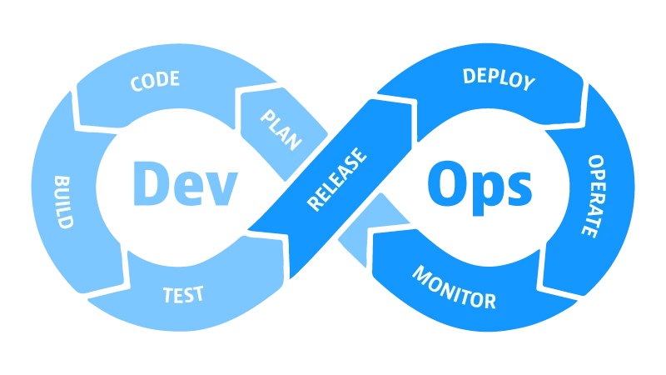
Define DevOps
02
DevOps is everything that happens to the code from developers IDE to the customer.

Slide 8
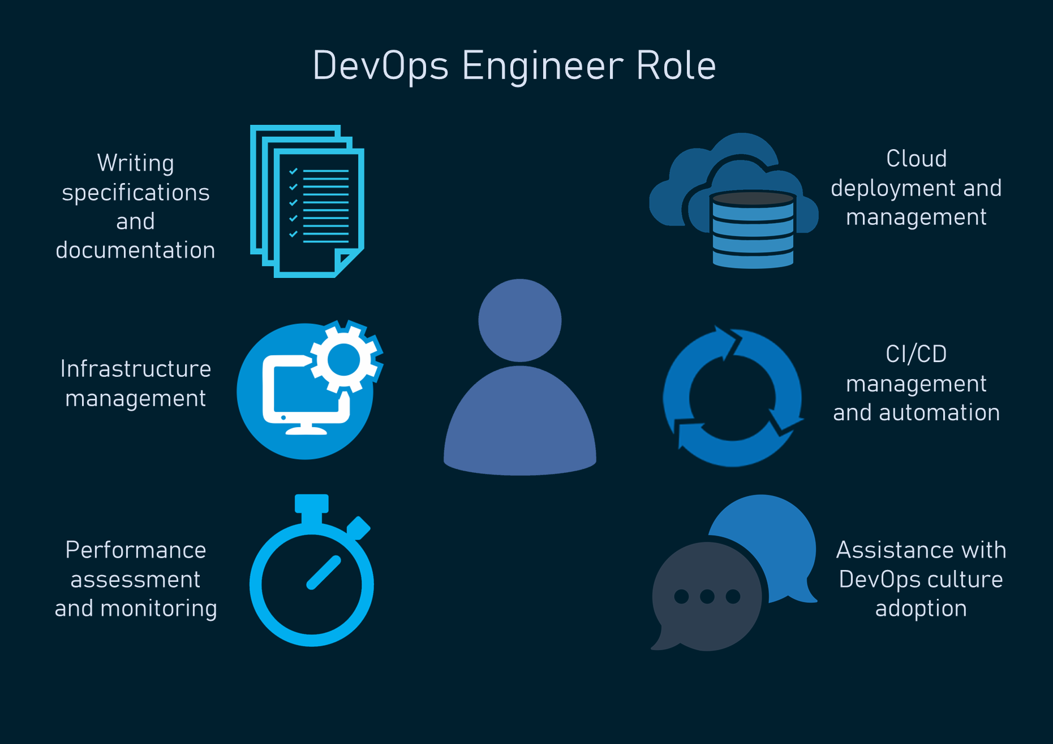
What should a DevOps do?
03
CI/CD pipeline building – automate code build, test, and deploy
Infrastructure as Code (IaC) – write infra using tools like Terraform, Ansible
Cloud management – AWS, Azure, GCP, etc. setup & optimization
Monitoring & alerting – set up tools like Prometheus, Grafana, ELK
Automation everywhere – from testing to backups and scaling
Containerization – Docker images, Kubernetes deployments
Version control support – manage Git workflows, branching strategies
Security & compliance – integrate security in the pipeline (DevSecOps)
Incident response – logs, debugging, and fixing prod issues fast
Collaboration – work closely with devs, QA, and ops teams
Performance tuning – find bottlenecks, optimize systems
Documentation & knowledge sharing – make sure stuff isn’t tribal knowledge

Slide 9
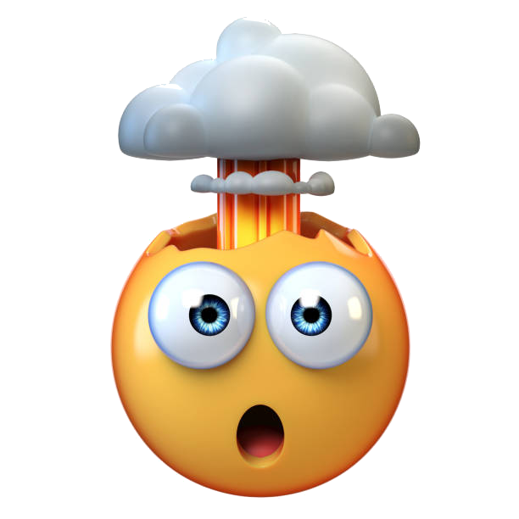
What should a DevOps know?
04
Linux fundamentals – shell scripting, networking, file permissions
Git & version control – Git workflows, branching, GitOps concepts
CI/CD tools – Jenkins, GitLab CI, GitHub Actions, ArgoCD
Containers & orchestration – Docker, Kubernetes (and Helm)
Infrastructure as Code (IaC) – Terraform, Ansible, Pulumi
Cloud platforms – AWS, Azure, GCP basics & core services
Monitoring & logging – Prometheus, Grafana, ELK, Loki
Security basics – secrets management, access control, DevSecOps mindset
Networking knowledge – DNS, TCP/IP, load balancing, firewalls
Automation scripting – Bash, Python, or Go
Agile/DevOps culture – collaboration, feedback loops, fail fast
Incident response & troubleshooting – logs, metrics, system recovery
Tooling ecosystem – know what's out there & how to choose tools wisely

Slide 10
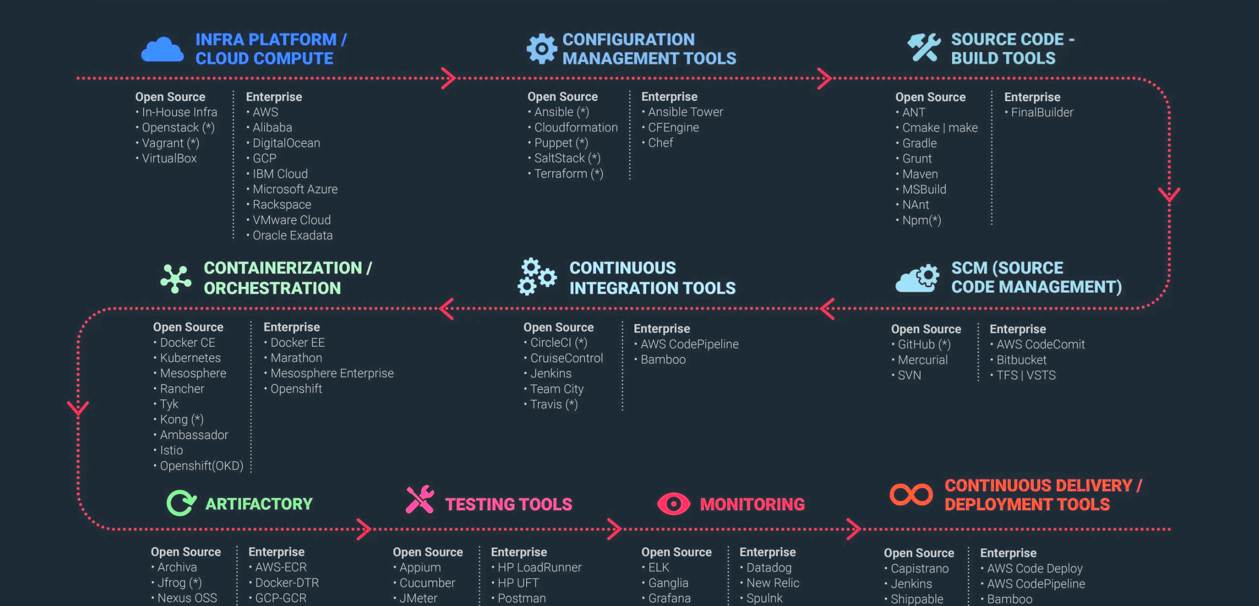
DevOps Toolset
05

Slide 11

DevOps Mindset
06
Collaboration over silos – devs, ops, QA, and security = one team
Automate everything – manual work is fragile and slow
Fail fast, recover faster – embrace failure, build for resilience
Continuous improvement – always look for ways to optimize
Measure what matters – metrics drive decisions, not gut feelings
Customer-focused – the end goal is delivering value, not just uptime
Own it end-to-end – from code to prod, you’re responsible
Security is everyone's job – bake it in from the start
Keep it simple – complexity kills maintainability
Learn & adapt – tech moves fast, stay curious and humble
Feedback loops – short cycles for code, infra, and processes
Documentation is part of the product – don’t gatekeep knowledge

Slide 12
Q&A

Slide 13

Thank you!
Notes:
Presentation Matters
This slide provides justification for caring about how your presentations look and feel.
It can also be used as a template slide. Change the header (and footer) to reflect the client, presentation name, and chapter title. To change the header and footer, click “edit master” and change the header and footer on all the master slides to have the same client and presentation name across all pages.

