Slide 1



sample_financial
View in Power BI
Last data refresh:
14/10/2024 17:40:57 UTC
Downloaded at:
14/10/2024 18:12:37 UTC

Slide 2
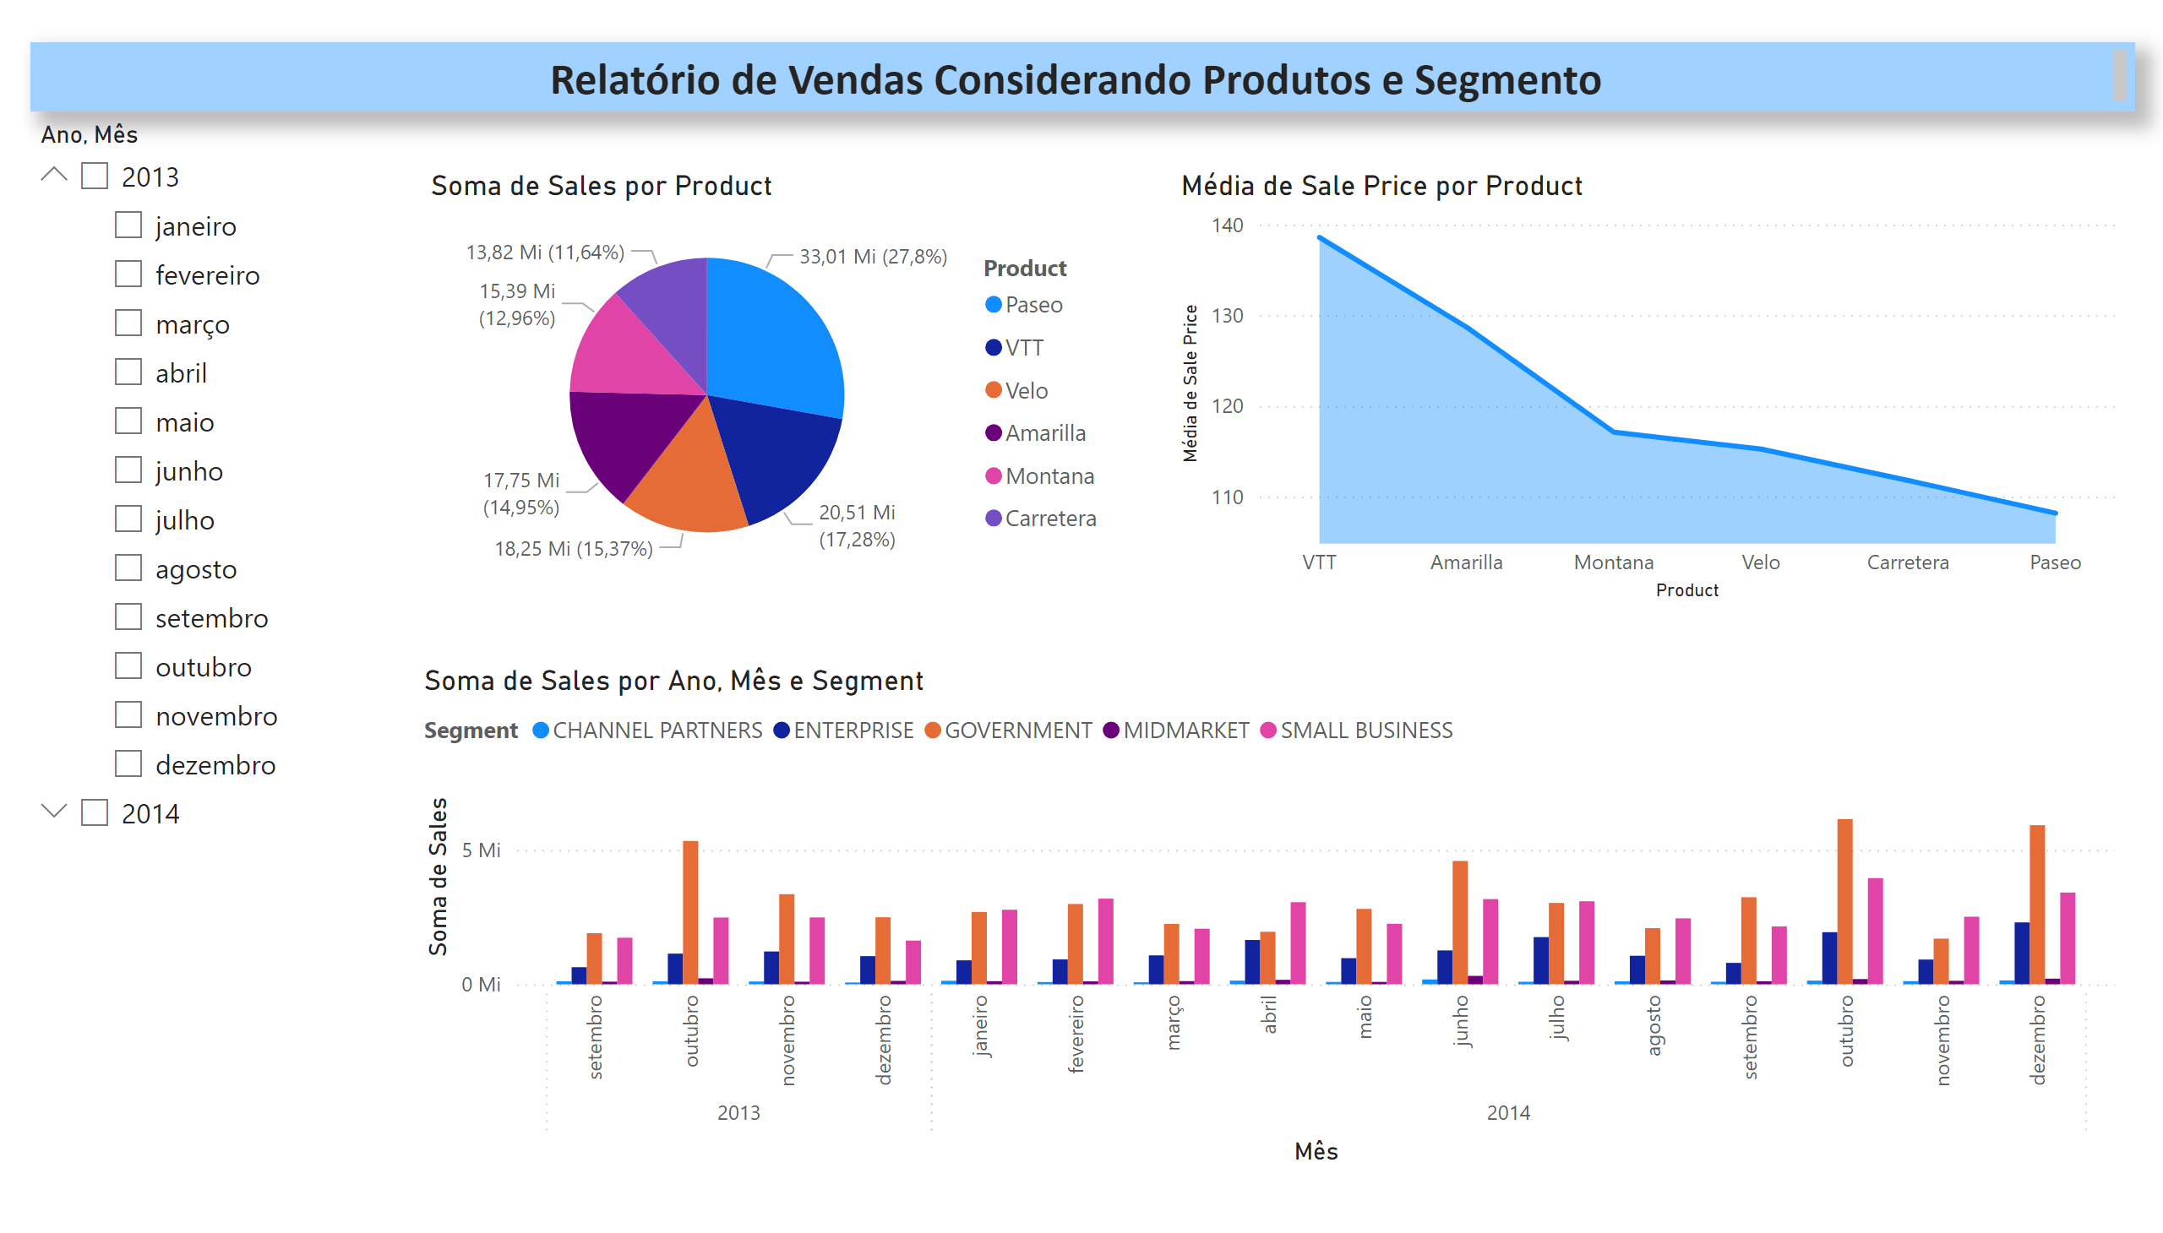
Página 1
Notes:
pieChart
No alt text provided
areaChart
No alt text provided
clusteredColumnChart
No alt text provided
slicer
No alt text provided
textbox
No alt text provided

Slide 3
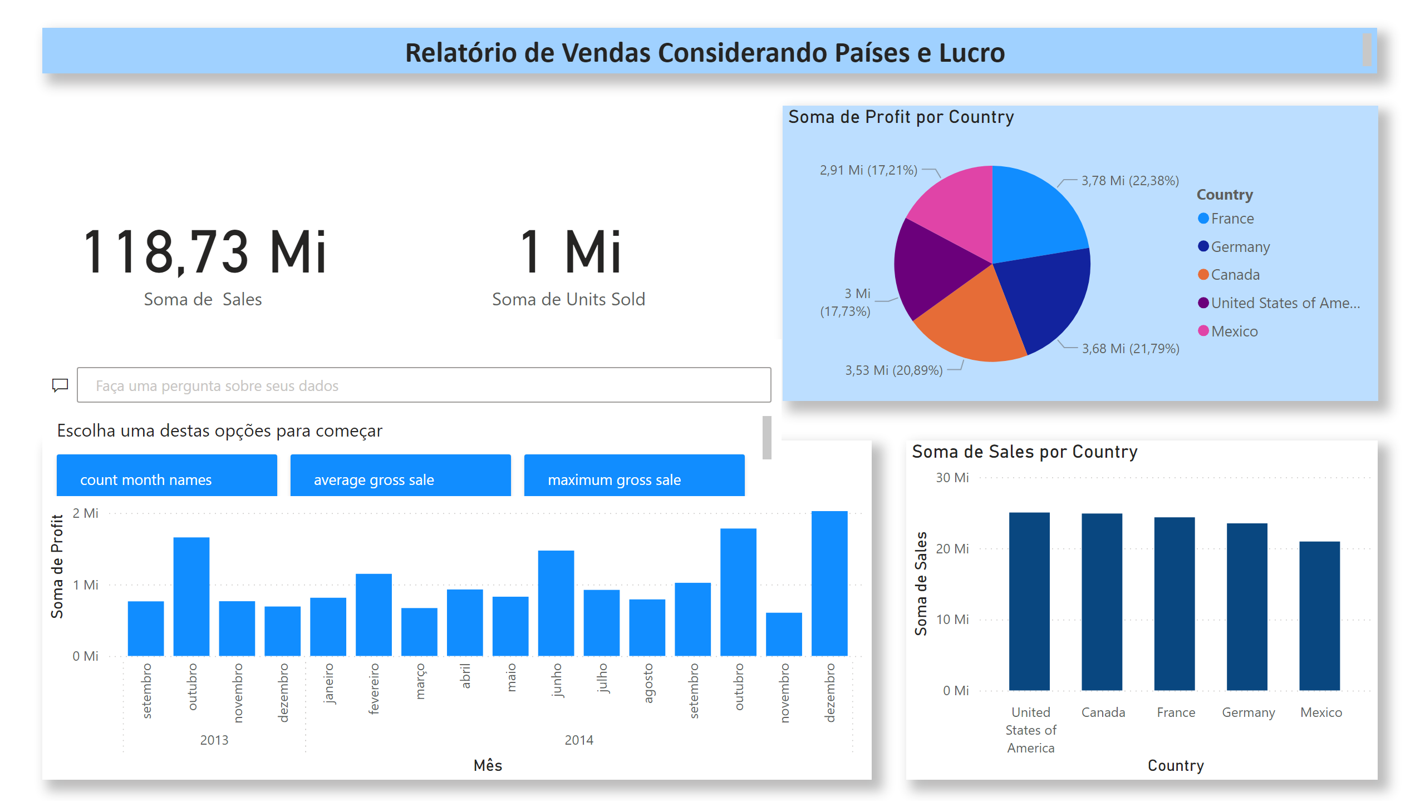
Página 2
Notes:
textbox
No alt text provided
card
No alt text provided
card
No alt text provided
pieChart
No alt text provided
clusteredColumnChart
No alt text provided
clusteredColumnChart
No alt text provided
qnaVisual
No alt text provided

Slide 4
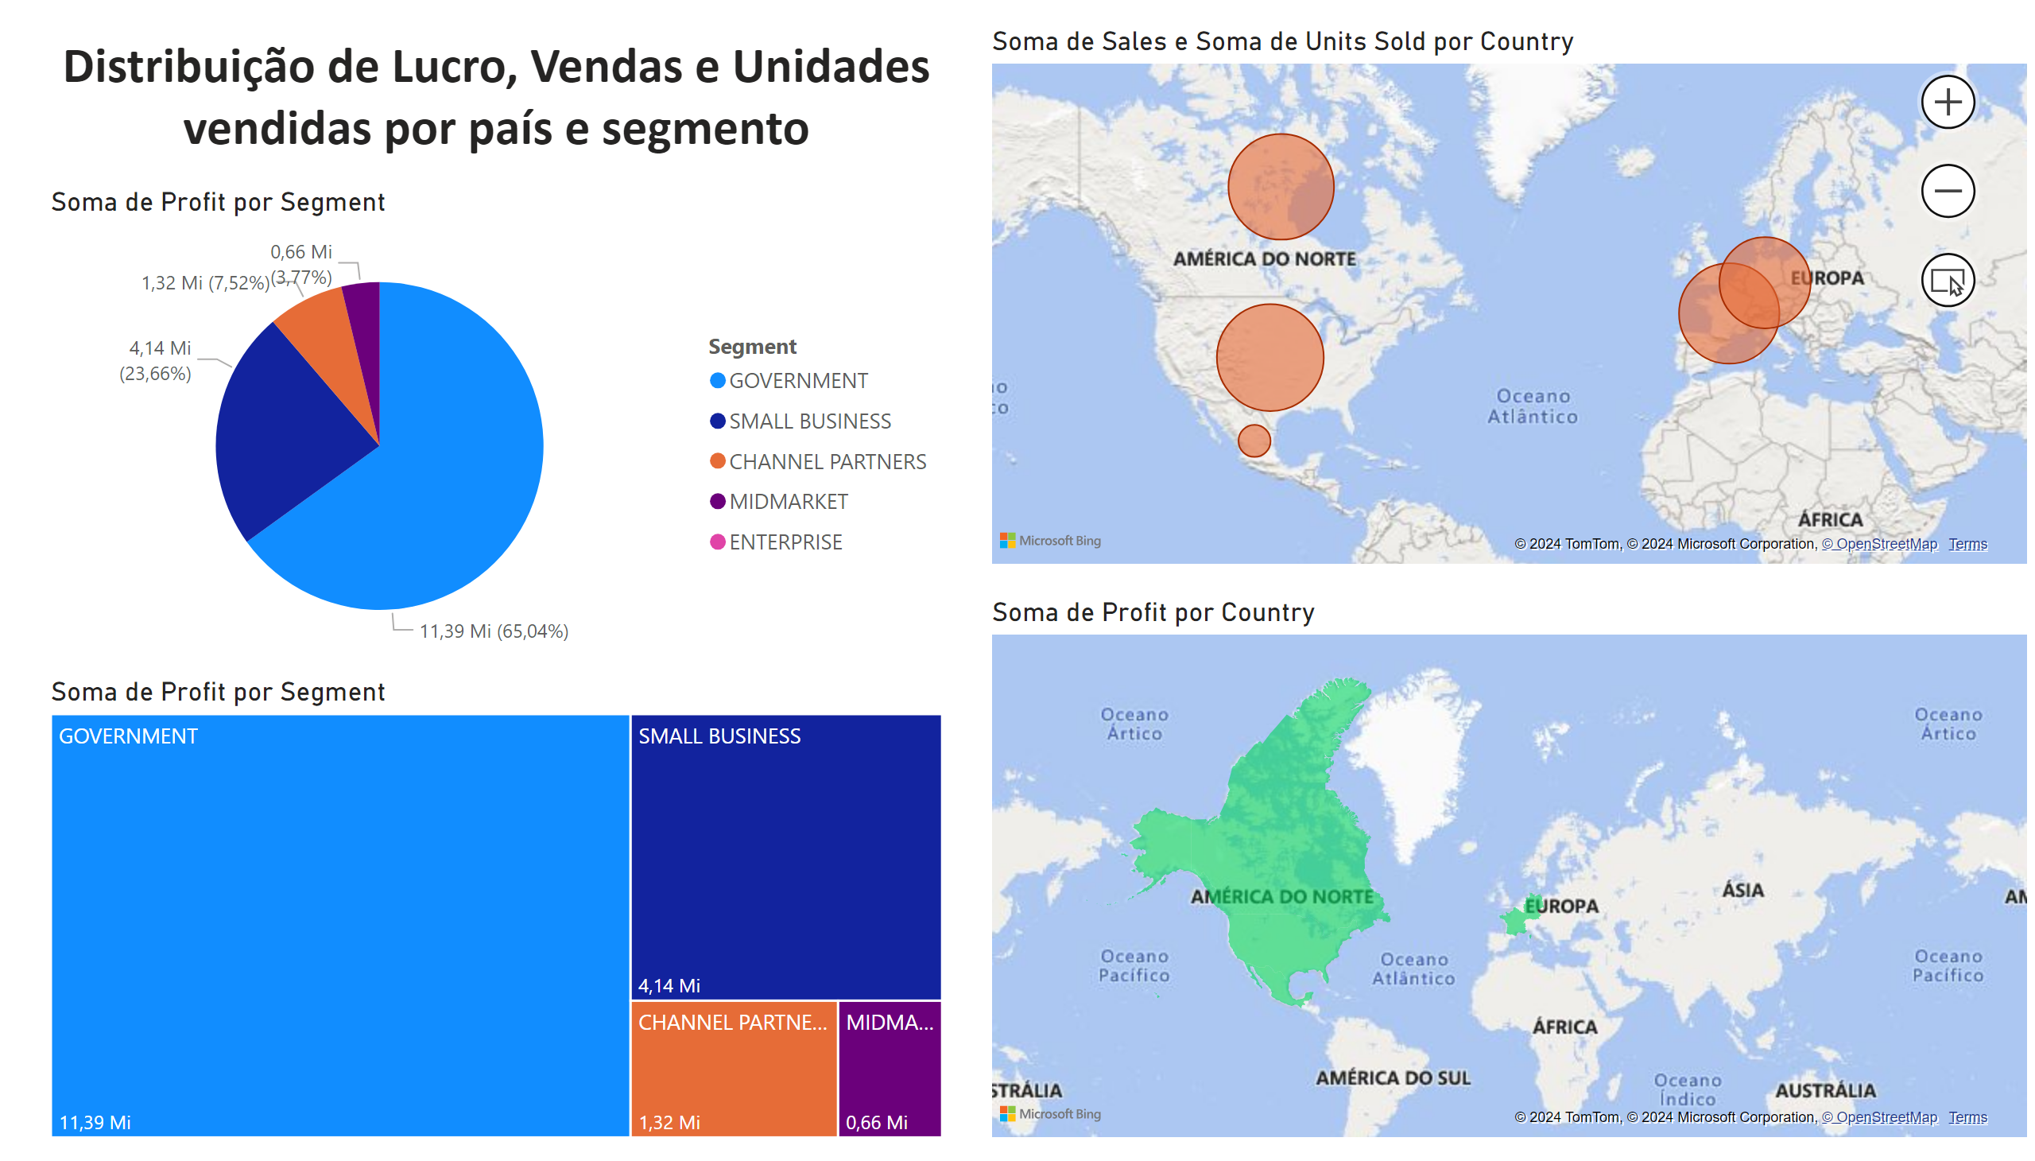
Página 3
Notes:
pieChart
No alt text provided
map
No alt text provided
filledMap
No alt text provided
textbox
No alt text provided
treemap
No alt text provided

Slide 5
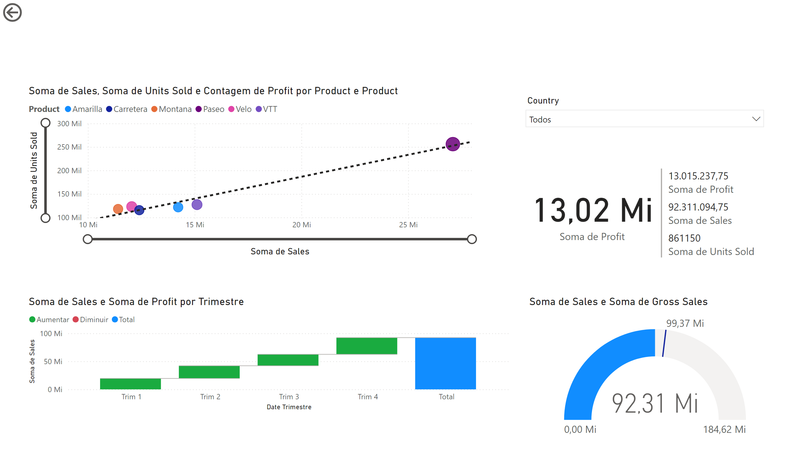
Página 4
Notes:
card
No alt text provided
multiRowCard
No alt text provided
actionButton
No alt text provided
waterfallChart
No alt text provided
scatterChart
No alt text provided
slicer
No alt text provided
gauge
No alt text provided

Slide 6
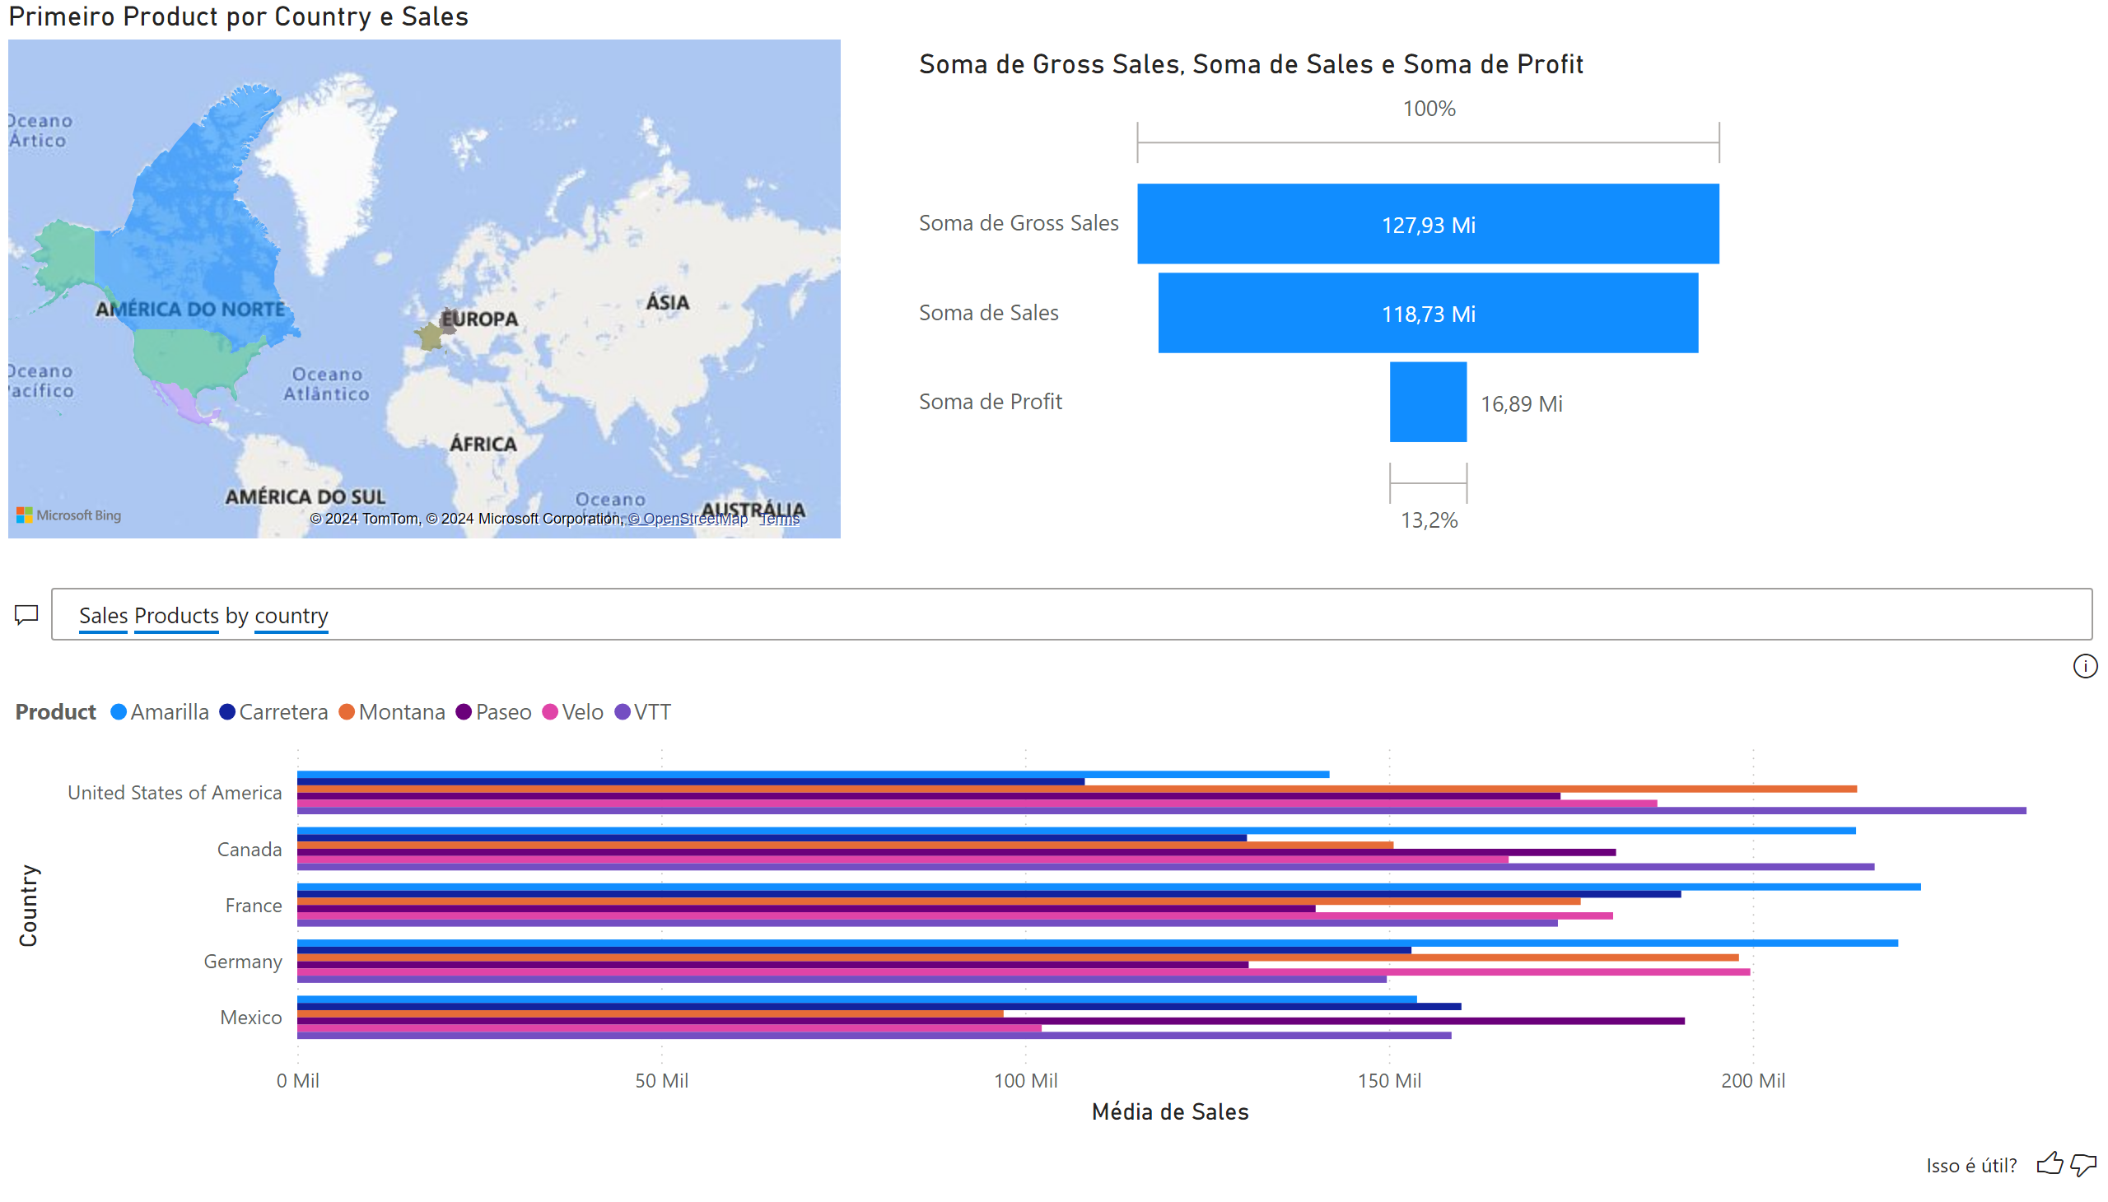
Página 5
Notes:
filledMap
No alt text provided
funnel
No alt text provided
qnaVisual
No alt text provided

Slide 7
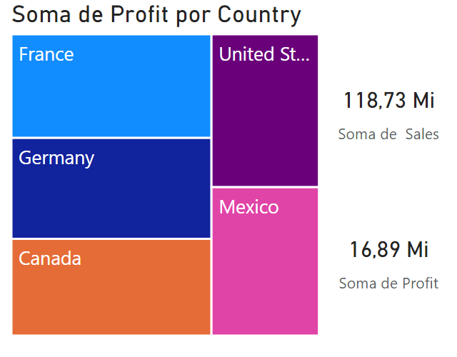
dica de ferramenta
Notes:
treemap
No alt text provided
card
No alt text provided
card
No alt text provided

Slide 8
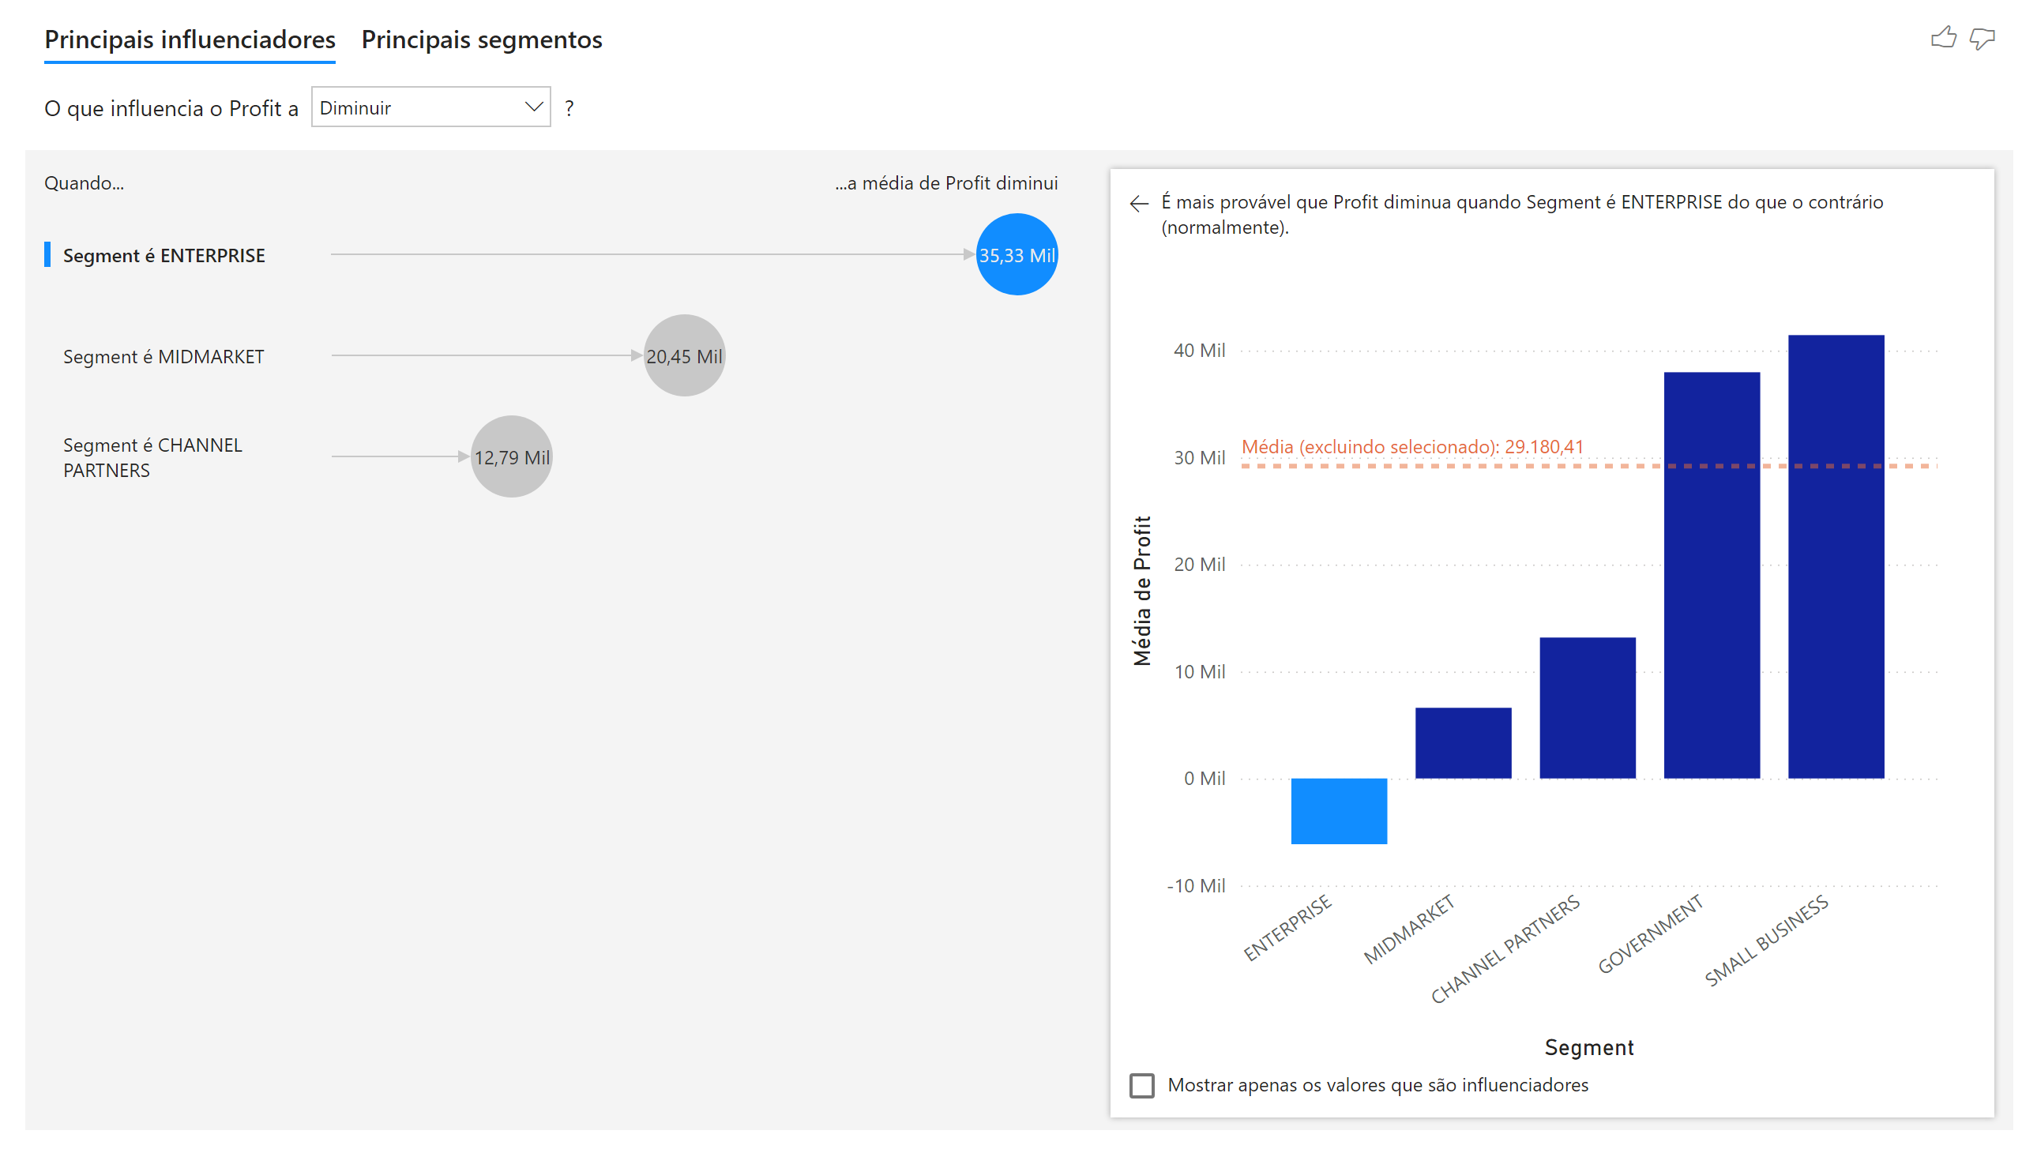
Página 6
Notes:
keyDriversVisual
No alt text provided

Slide 9
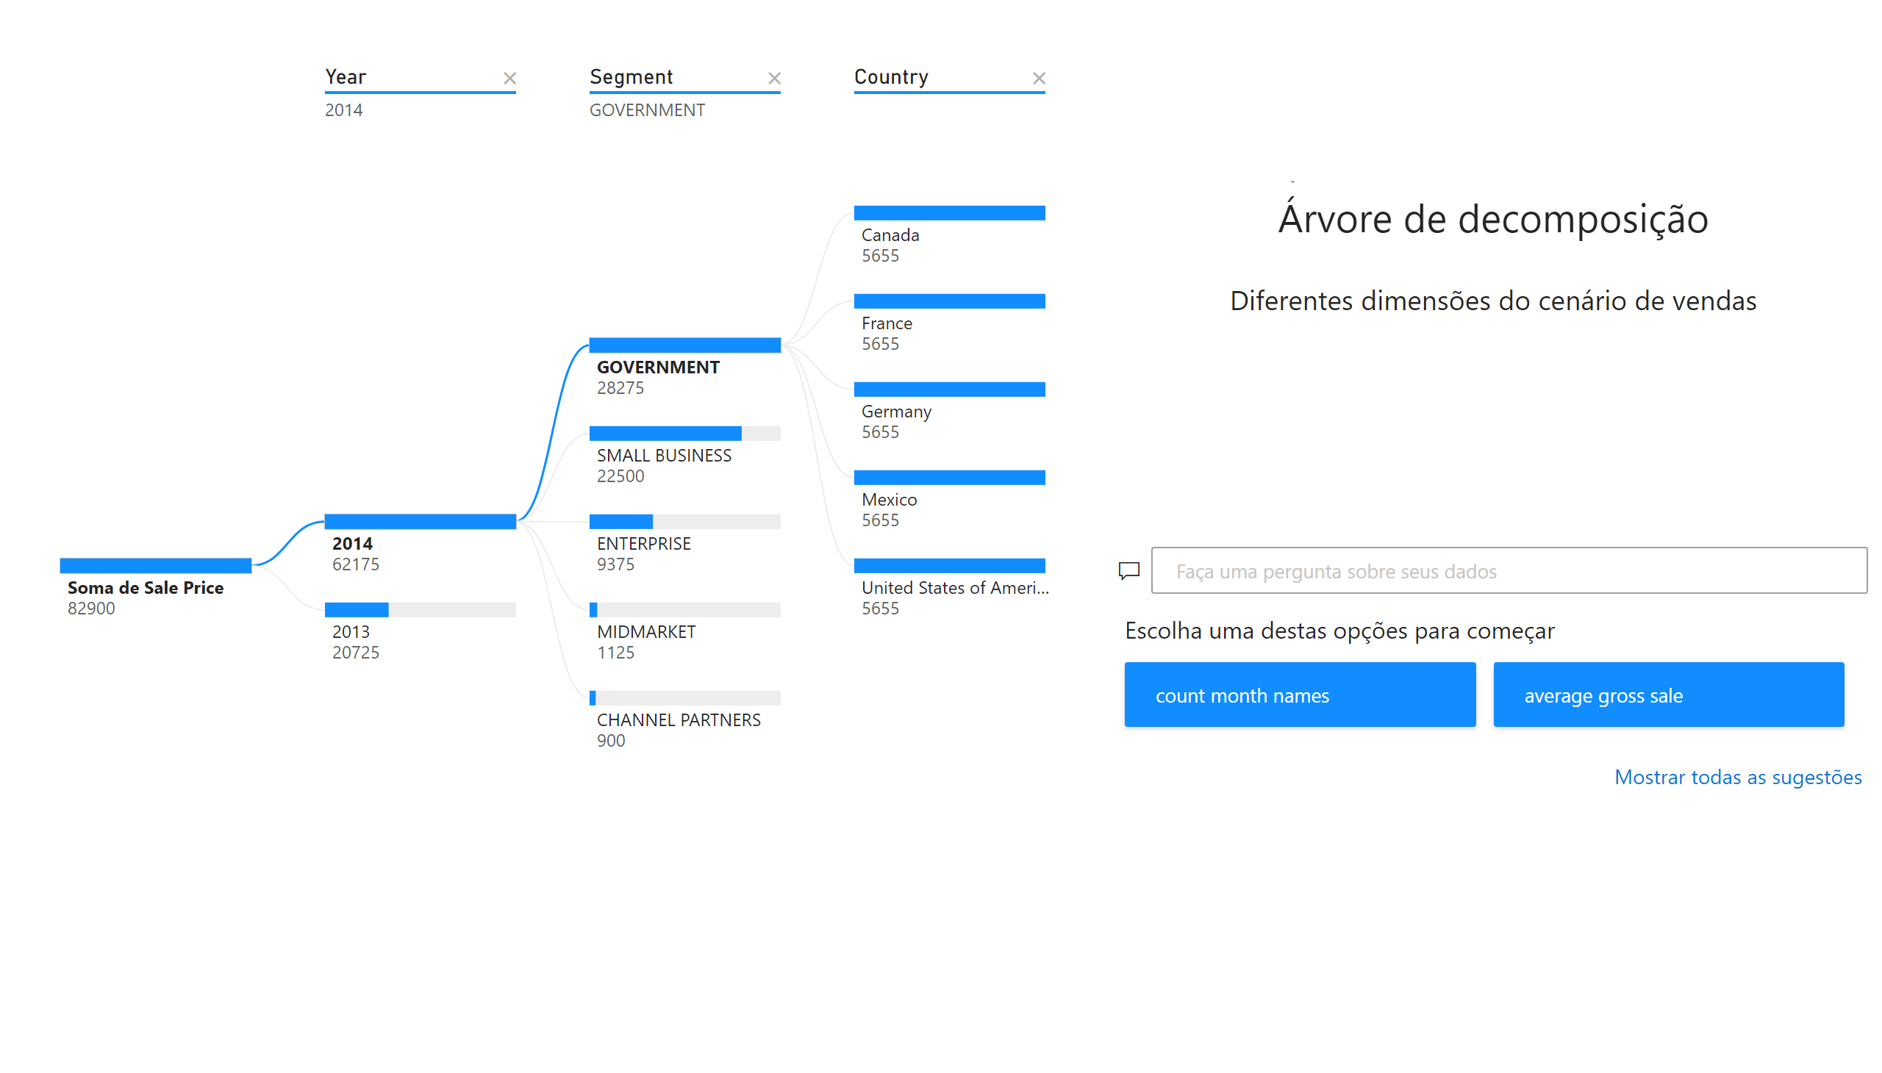
Página 7
Notes:
decompositionTreeVisual
No alt text provided
textbox
No alt text provided
textbox
No alt text provided
qnaVisual
No alt text provided
textbox
No alt text provided

Slide 10

Página 8
Notes:
kpi
No alt text provided
kpi
No alt text provided

Slide 11
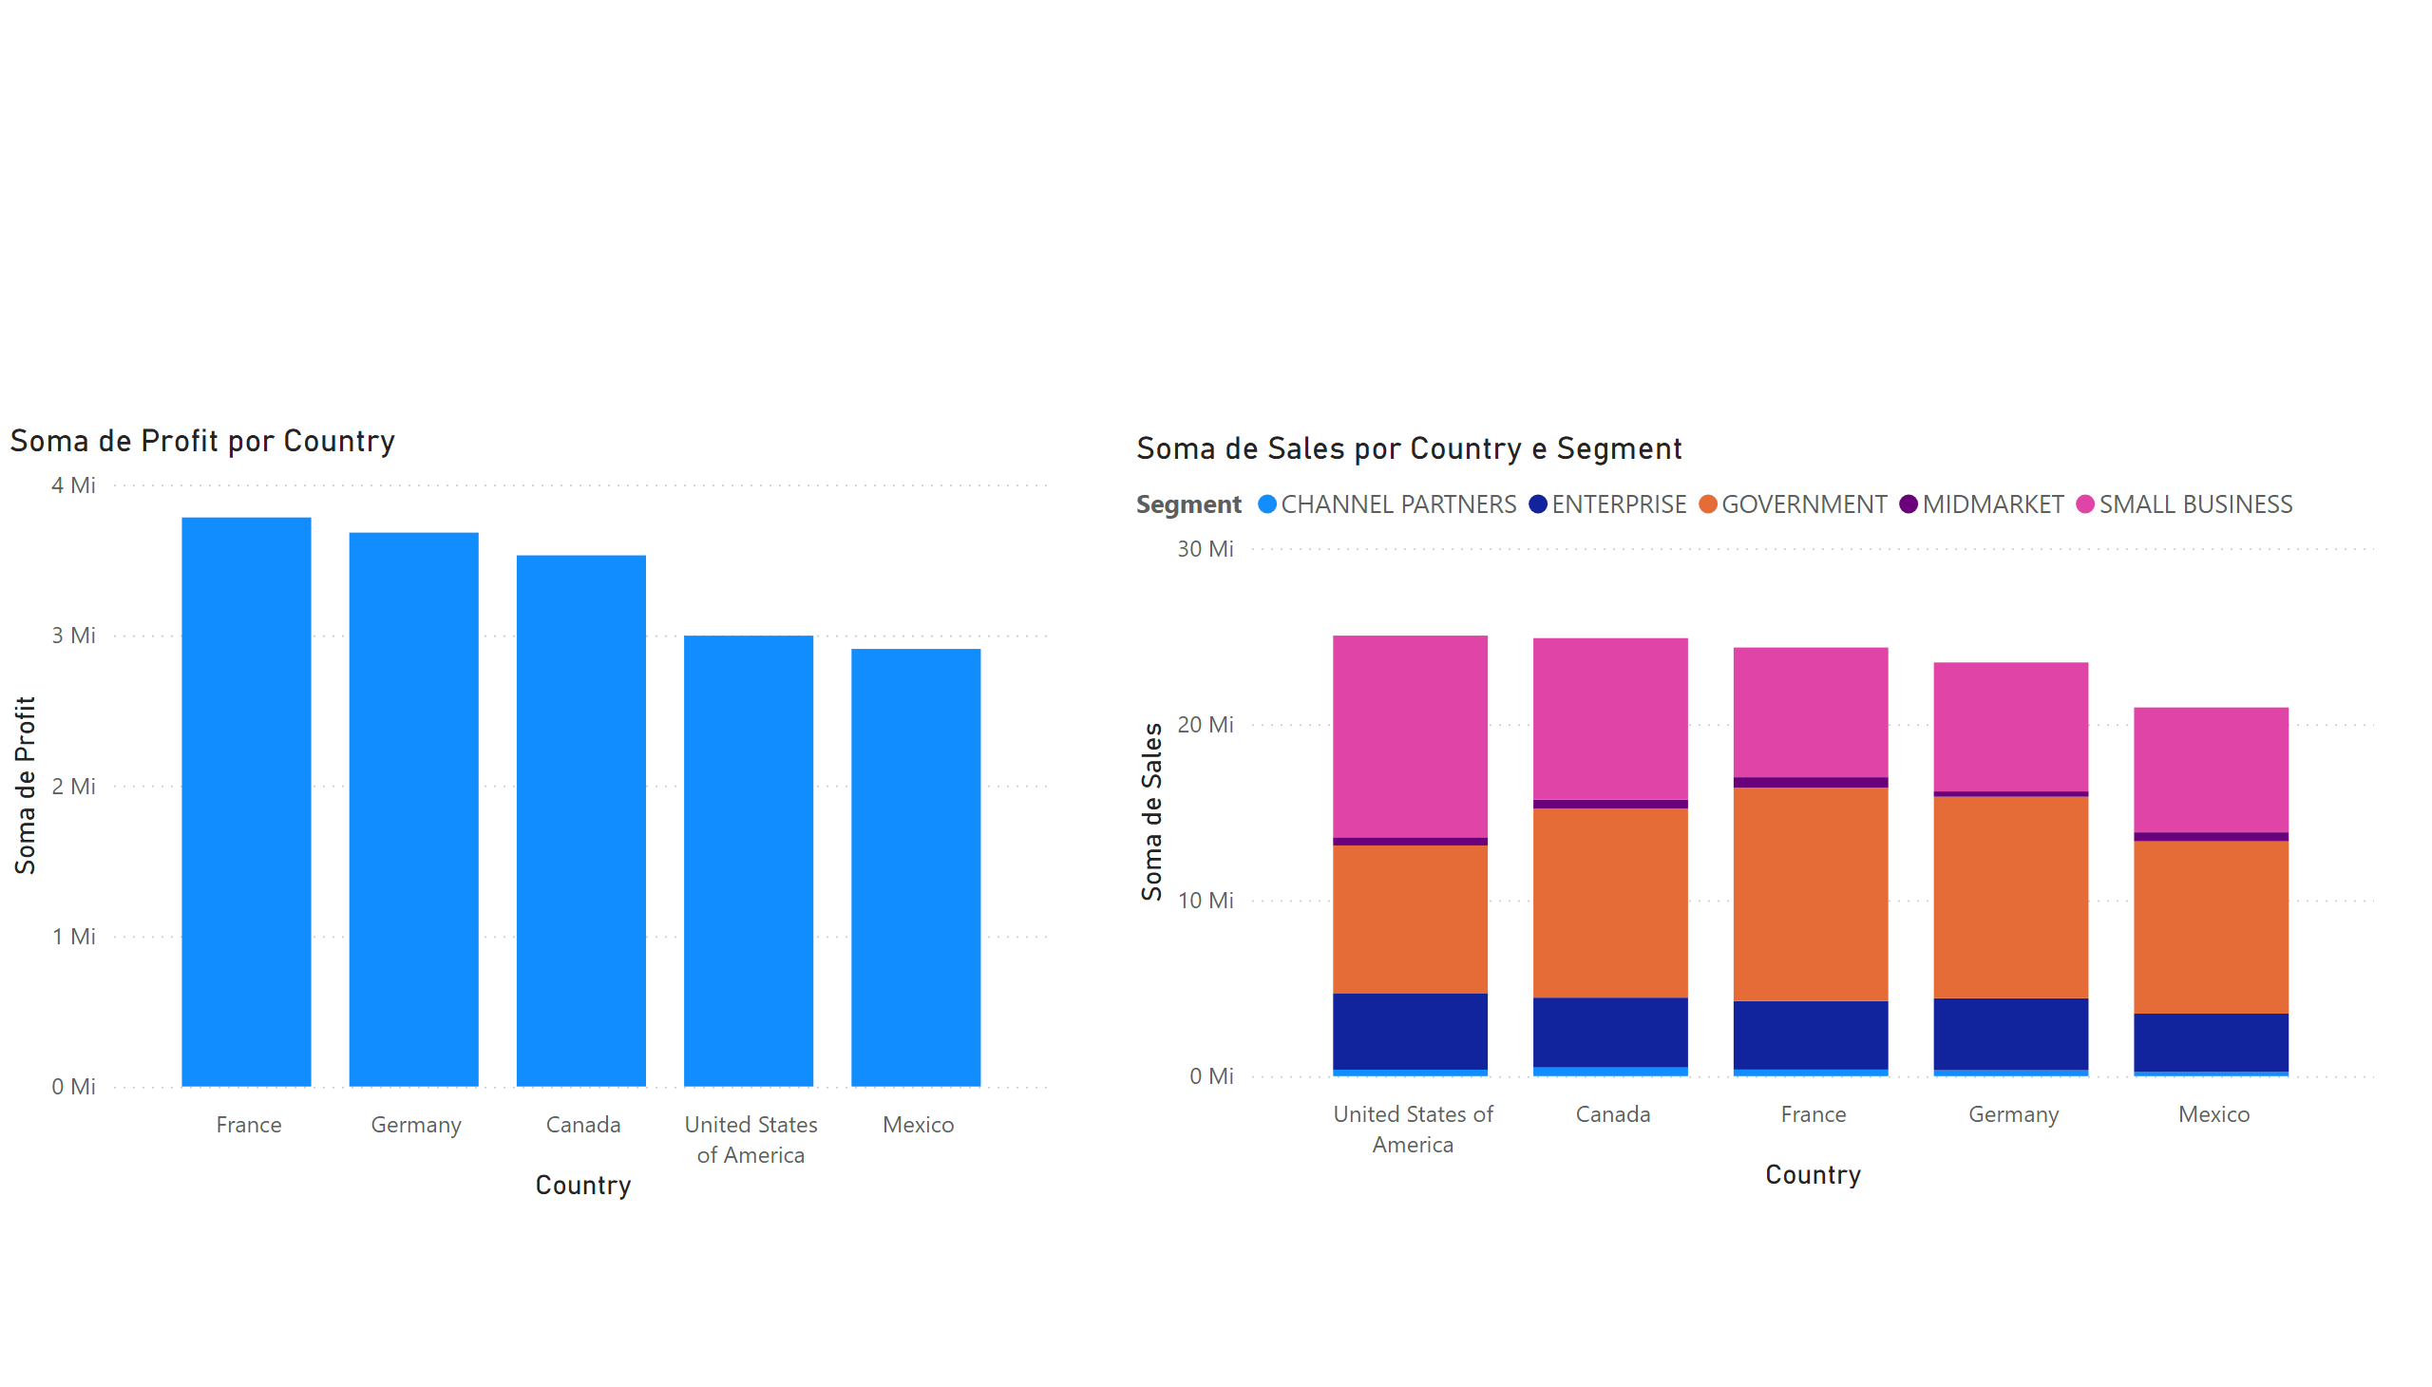
Página 9
Notes:
lineStackedColumnComboChart
No alt text provided
columnChart
No alt text provided

Slide 12
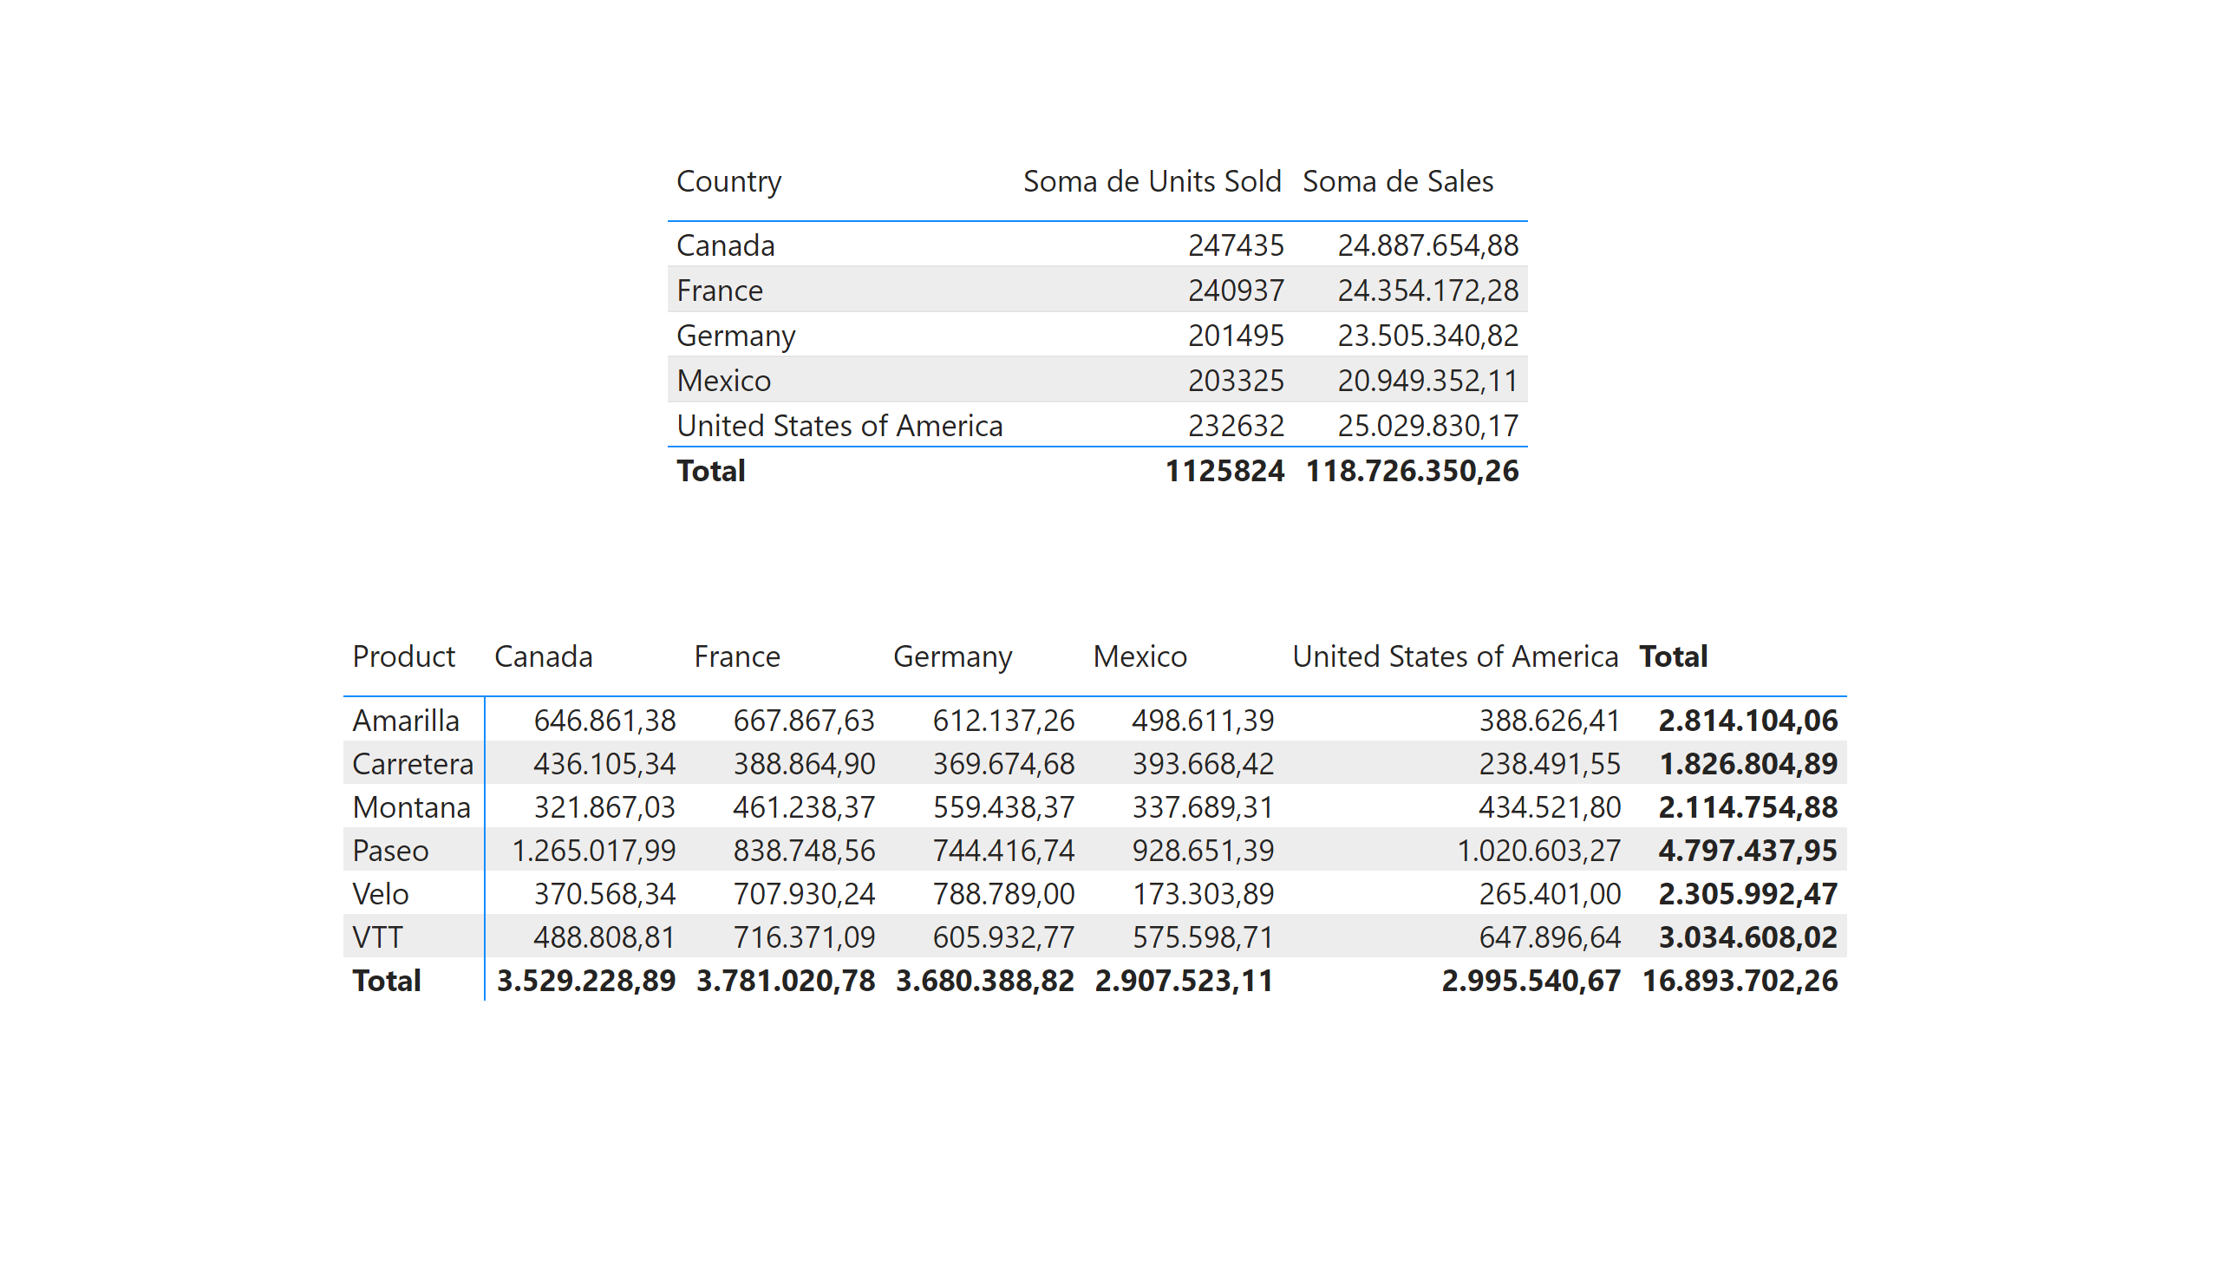
Página 10
Notes:
tableEx
No alt text provided
pivotTable
No alt text provided

Slide 13
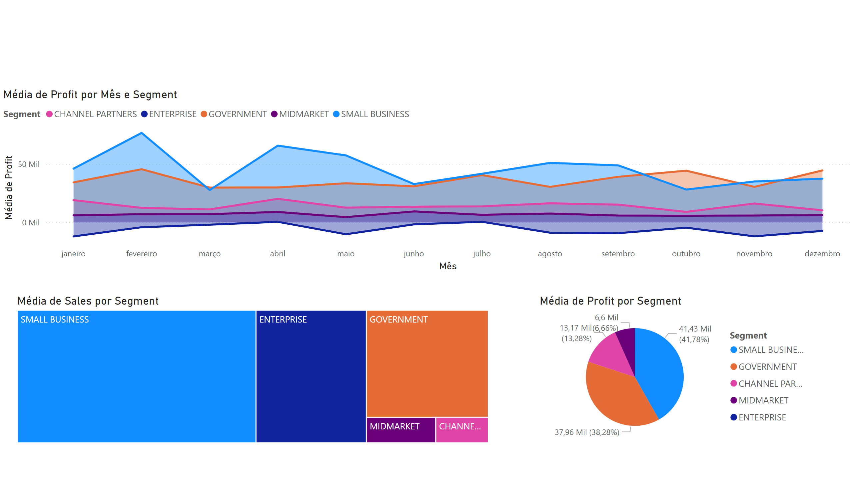
Página 11
Notes:
areaChart
No alt text provided
pieChart
No alt text provided
treemap
No alt text provided

Slide 14
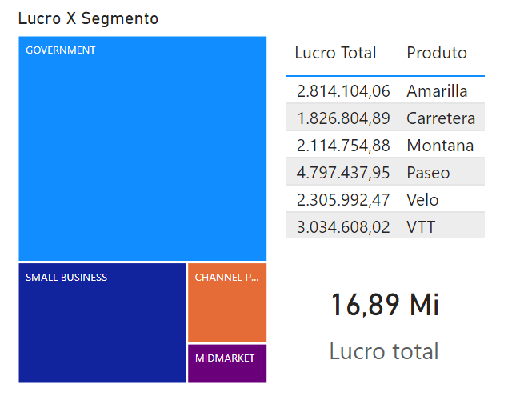
Dica de ferramenta 2
Notes:
Lucro X Segmento
No alt text provided
card
No alt text provided
tableEx
No alt text provided

