Slide 1
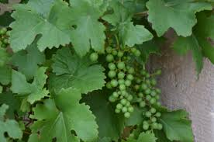
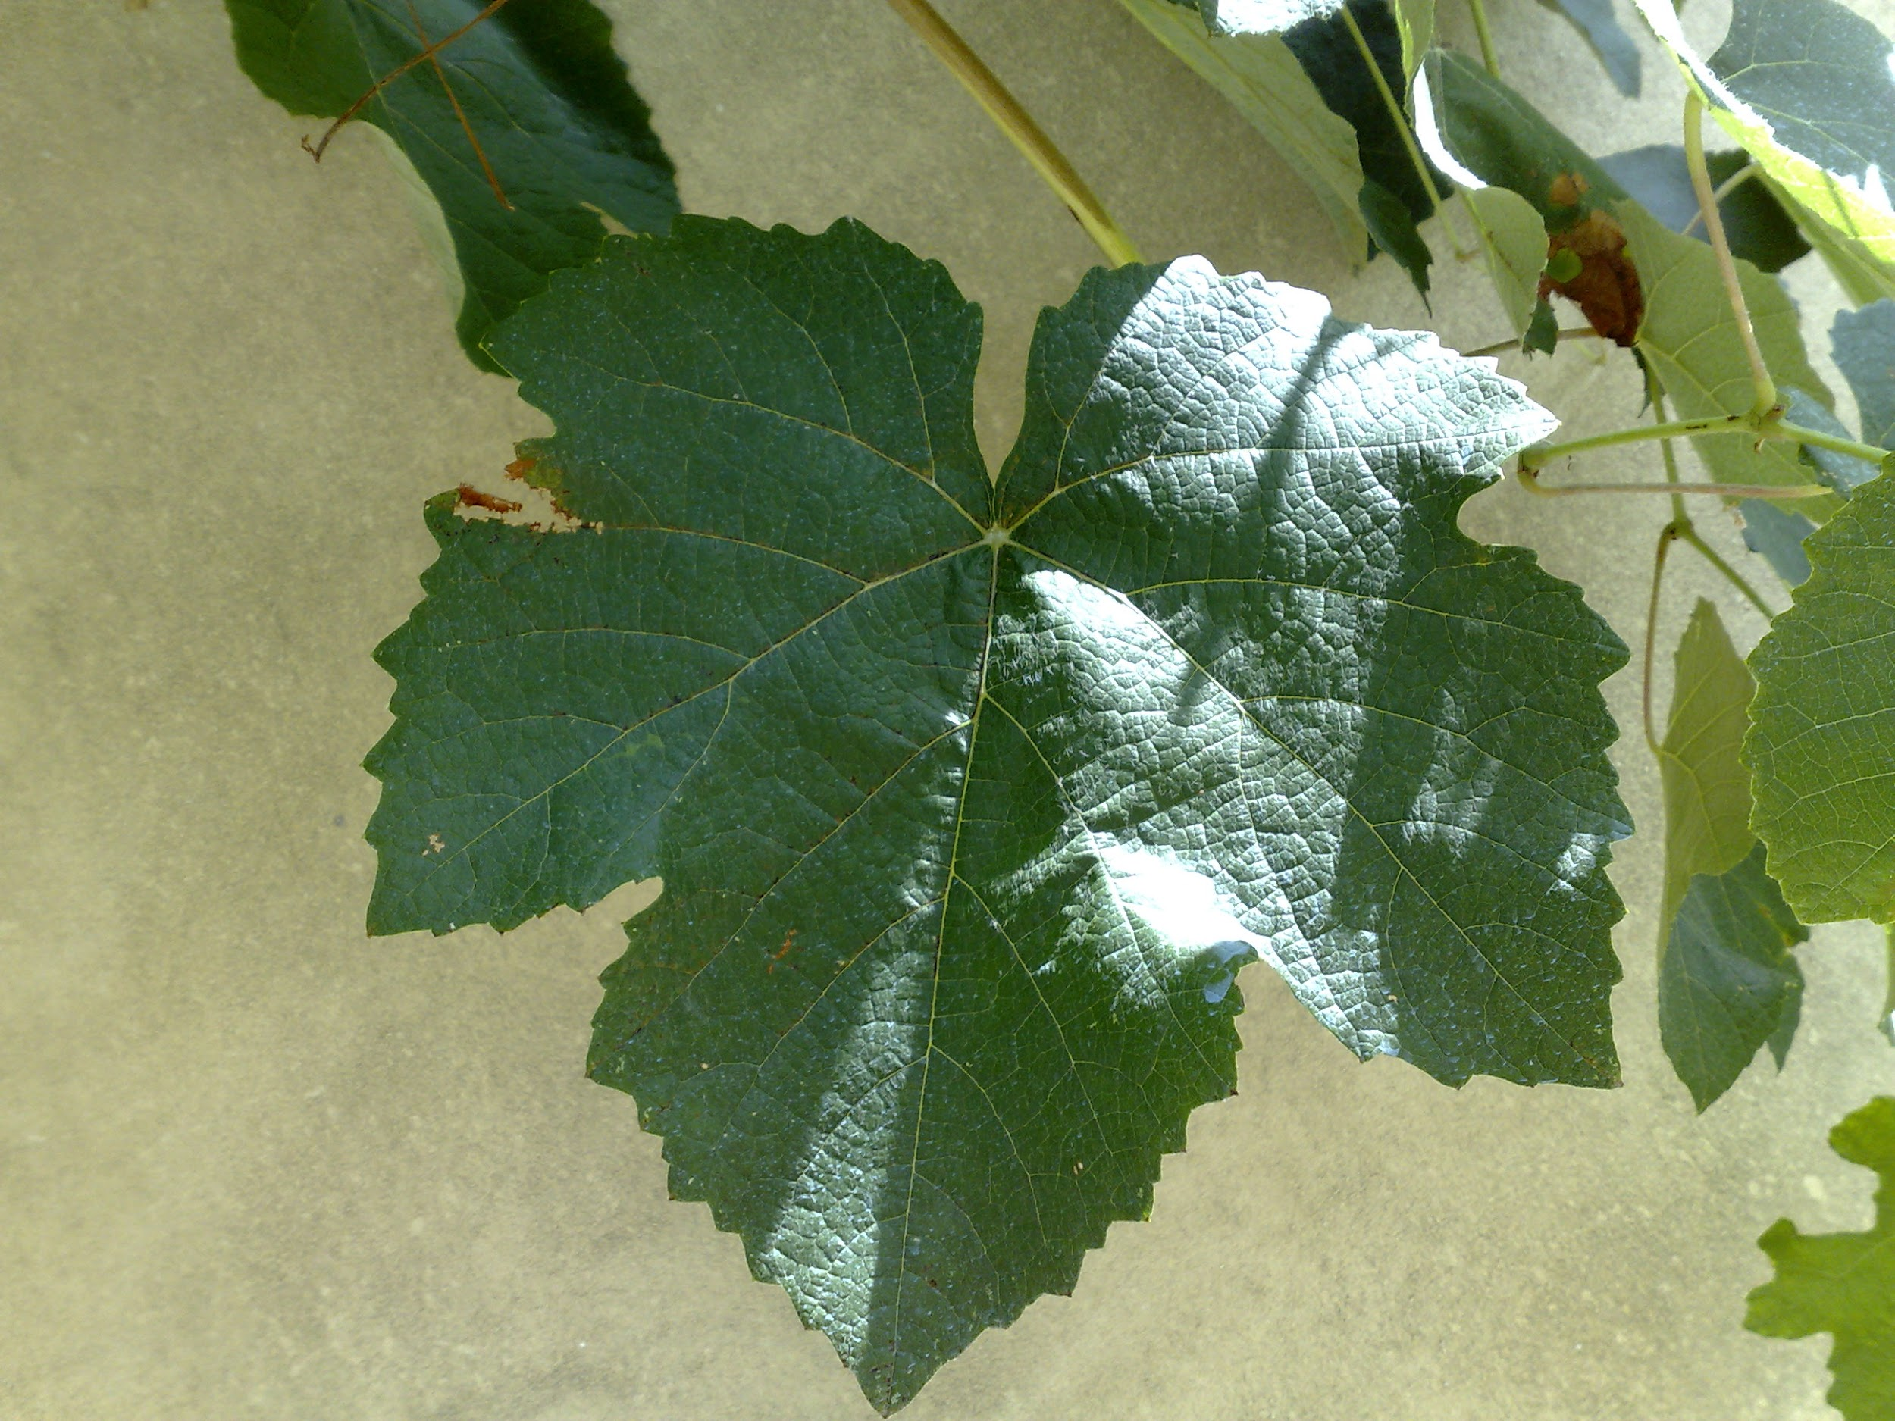
Plant disease detection using images
DIP Project - 2022
Igor Fontes
João Pedro Brito

Slide 2
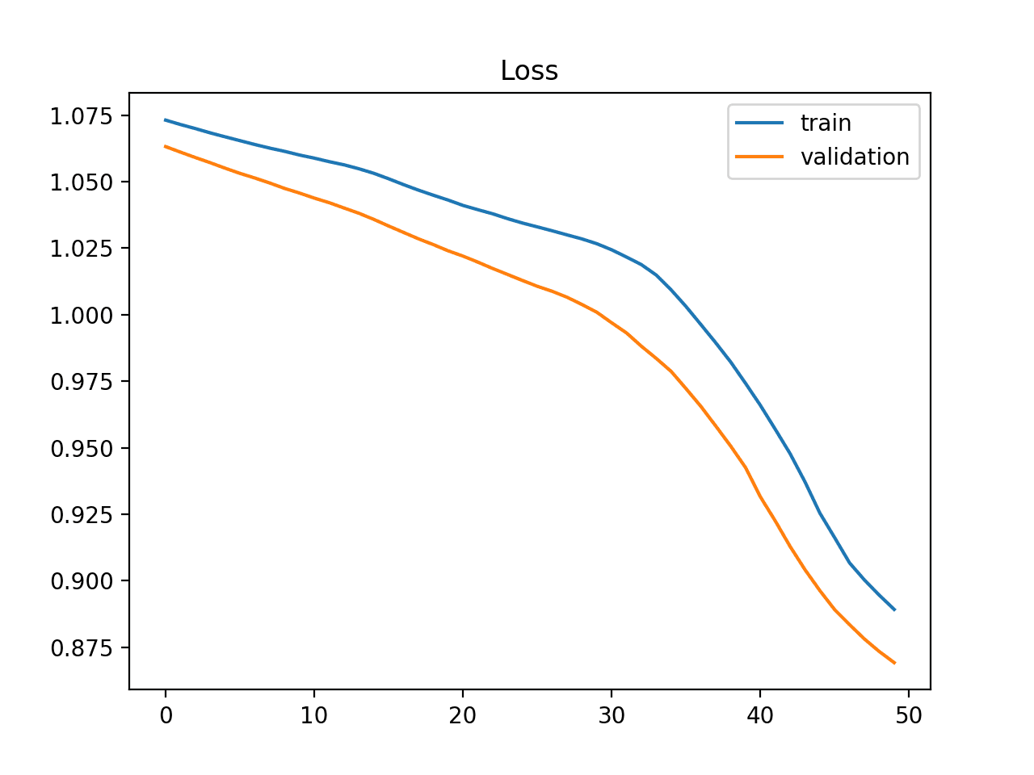
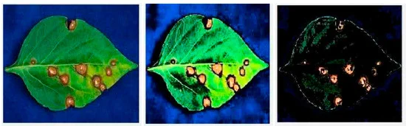
Introduction
Plant Disease Classification

Slide 3
Challenges
Detection of multiple infections in one or multiple sets of whole leaf samples.
Detection of multiple infections for multiple diseases.
Detection in several fruits of the same branch.
Computational Complexity (Time).
Complex environments with different real conditions.
Level of infection or determination of disease life cycle.
Segmentation sensitivity for an ROI.
The marks around and their shades in the identification of the fruits.

Slide 4
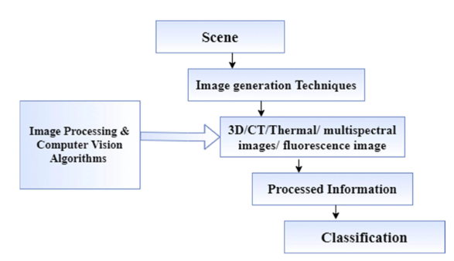
Image classification
Overview

Slide 5
Imaging methods
Thermal, hyperspectral, fluorescence, Multispectral, and 3D imaging

Slide 6
State of The Art (SOTA)

Slide 7
Image Classification
SVM, K-means clustering, Deep learning, and K-NN
Tian, K.; Li, J.; Zeng, J.; Evans, A.; Zhang, L. Segmentation of tomato leaf images based on adaptive clustering number of K-means algorithm. Comput. Electron. Agric. 2019, 165, 104962.
Ngugi, L.C.; Abdelwahab, M.M.; Abo-Zahhad, M. Recent advances in image processing techniques for automated leaf pest and disease recognition—A review. Inf. Process. Agric. 2020. (ROI Segmentation)
Sannakki, S.S.; Rajpurohit, V.S.; Nargund, V.B. SVM-DSD: SVM Based Diagnostic System for the Detection of Pomegranate Leaf Diseases.
Hossain, E.; Hossain, F.; Rahaman, M.A. A Color and Texture Based Approach for the Detection and Classification of Plant Leaf Disease Using KNN Classifier. In Proceedings of the 2019 International Conference on Electrical, Computer and Communication Engineering (ECCE), Cox’s Bazar, Bangladesh, 7–9 February 2019;

Slide 8
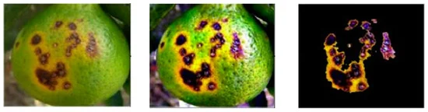
Image Processing
Sharif, M.; Khan, M.A.; Iqbal, Z.; Azam, M.F.; Lali, M.I.U.; Javed, M.Y. Detection and classification of citrus diseases in agriculture based on optimized weighted segmentation and feature selection. Comput. Electron. Agric. 2018, 150, 220–234.

Slide 9
Plant Disease Detection Using Image Processing and Machine Learning
Original paper
Article: Plant Disease Detection Using Image Processing and Machine Learning | Papers With Code

Slide 10
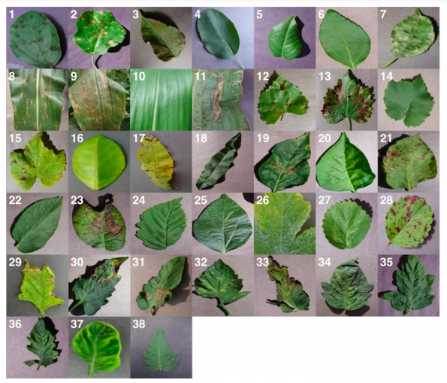
PlantVillage Dataset
The dataset consists of 87000 RGB images of healthy and unhealthy plant leaves having 38 classes.

Slide 11
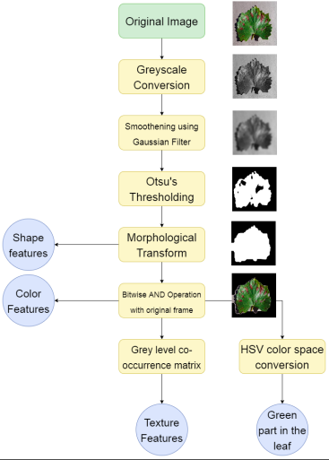
Data preprocessing and feature extraction

Slide 12
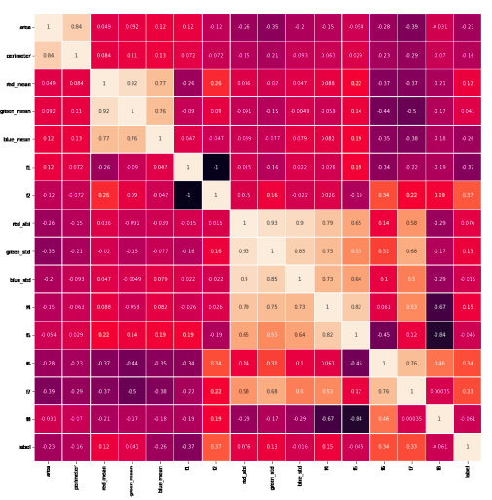
Feature selection
Correlation plot for Apple dataset

Slide 13
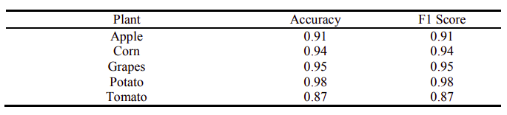
Classification Algorithm
Random forest classifier
K-fold cross validation

Slide 14
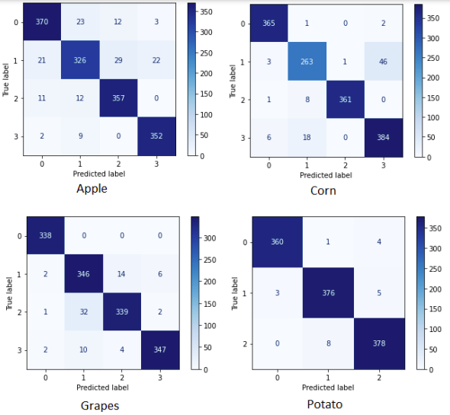
Classification Algorithm
Confusion matrices
F1-score
Precision
Recall

Slide 15
Original paper
Advantages
Provide feature analysis and selection
Explore diverse diseases and crops
Focus on image processing

Slide 16
Original paper
Limitations
Explore a specific group of classes from dataset
Other feature extraction and selection processes are not included

Slide 17
Possible improvements to include
Explore image filtering to improve classification
Evaluate the feature selection process
Explore alternative features from images

Slide 18
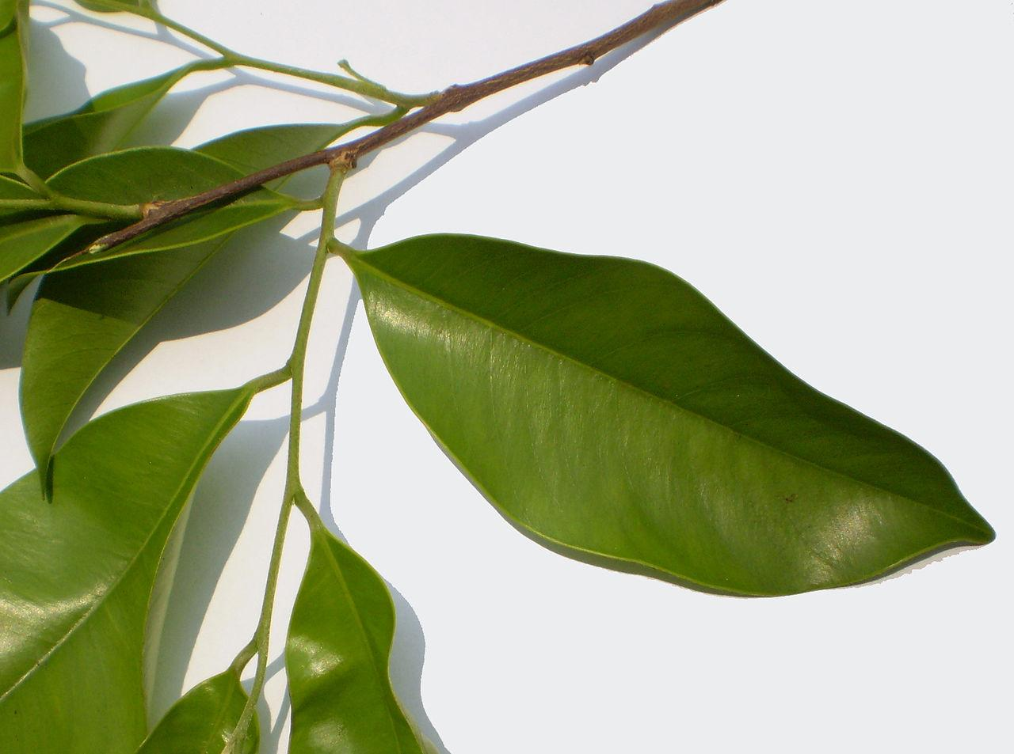
DIP Vídeo 1
Projeto
___

