Slide 1
SQL: top 10 best practices
Igor Gorbenko
Saint Petersburg
October 2018

Slide 2

About me
Igor Gorbenko
Lead Data Analyst, First Line Software
Professional interests:
RDBMS
Big Data
Data Analysis
Professional experience with SQL for more than 10 years

Slide 3
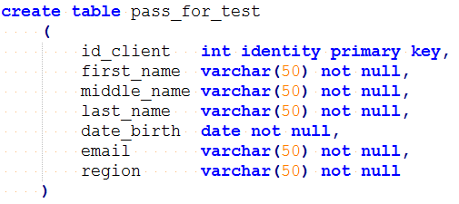
1. Table with random data
CROSS JOIN
Generating email addresses
Generating random birthdays

Slide 4
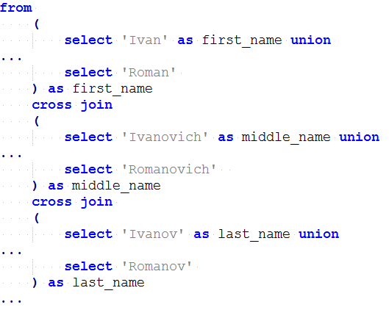
1. Table with random data
Generating random names

Slide 5
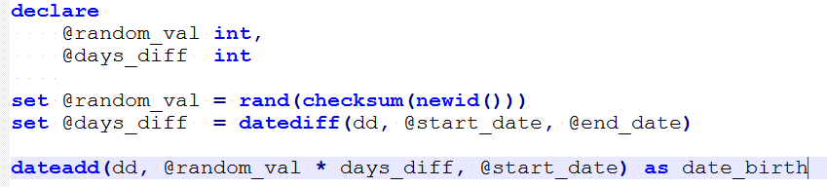
1. Table with random data
Generating random birthdays

Slide 6
1. Table with random data
Description of functions
Dateadd
new value by adding an interval to the specified date
Rand
pseudo-random value of float type from 0 to 1
Checksum
hash value from the list of its arguments
Newid
unique uniqueifier
Datediff
the difference between dates in days

Slide 7
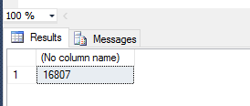
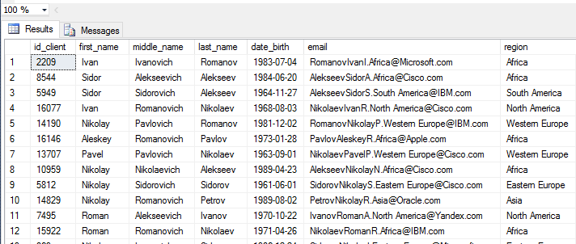
1. Table with random data
select count(*)
from pass_for_test
select top 100 *
from pass_for_test

Slide 8
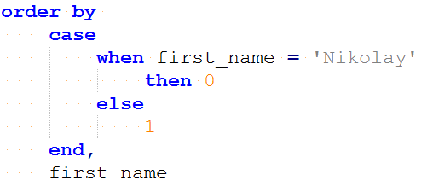
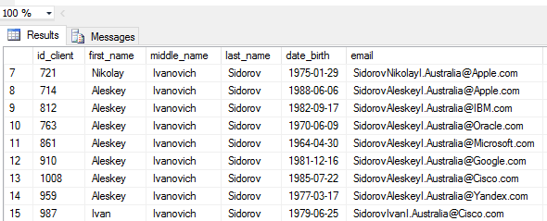
2. Specified sort

Slide 9
3. The closest birthday this week and the age of the client
Match the date of birth to the current year
Select the birthdays that were or will be in the current week
Sort based on the date matched to the current year

Slide 10
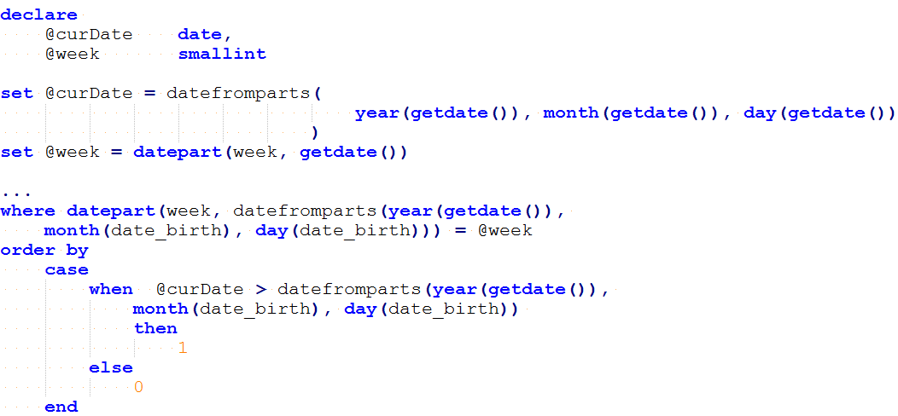
3. The closest birthday this week and the age of the client

Slide 11
3. The closest birthday this week and the age of the client
Description of functions
set datefirst 1
The first day of the week in the form of a number from 1 to 7
datepart
Return of the week number
datefromparts
Returns the date value corresponding to the specified date, month, and year

Slide 12
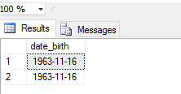
4. Updating Data Using Window Functions
select date_birth
from pass_for_test
where date_birth = '19631116'

Slide 13
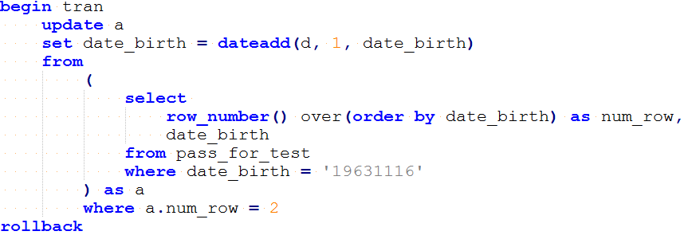
4. Updating Data Using Window Functions

Slide 14
4. Updating Data Using Window Functions
Description of functions
row_number() over(order by date_birth)
Returns the serial number of the row in the result set section, where 1 corresponds to the first line in each of the sections
The ORDER BY clause specifies a sequence in which strings are assigned unique numbers using the ROW_NUMBER function within the specified section

Slide 15
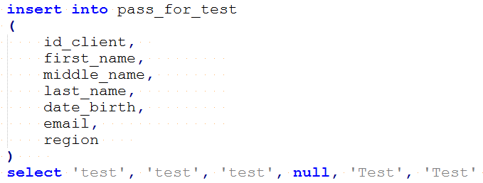
5. Error Handling
A trying to insert a NULL value...

Slide 16
5. Error Handling
The result of the operation is an ERROR

Slide 17
5. Error Handling
set nocount on;
begin try
begin tran
insert into pass_for_test
Select 'test', 'test', 'test', null, 'Test', 'Test'
if @@TRANCOUNT > 0
begin
select 'Commit transaction!'
commit tran;
end
end try
begin catch
select '!!! Error: ' + error_message();
Exec sp_Send_email;
if @@TRANCOUNT > 0
rollback tran;
end catch

Slide 18
5. Error Handling
The result of the script

Slide 19
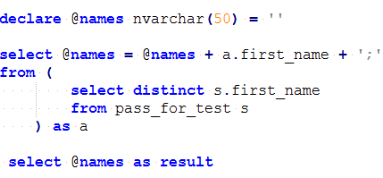
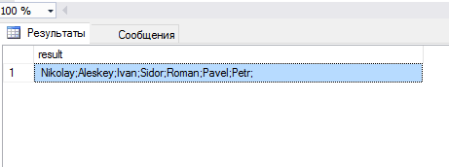
6. Returning the value of a column through a separator

Slide 20
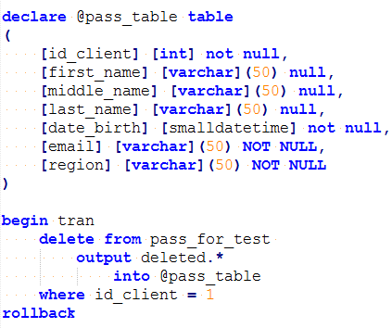
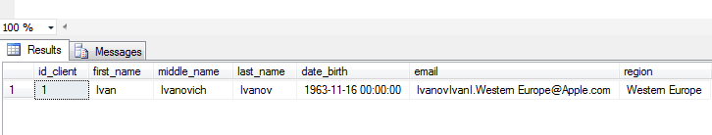
7. Returning changed rows

Slide 21
8. Checking the correctness of the email address
The best practice for verifying the correctness of the entered email address is sending a letter with a link on which the user must go to confirm his address
☺

Slide 22
8. Checking the correctness of the email address
select *
from pass_for_test
where email not like '_%@__%.__%'

Slide 23
9. Sorting ip-addresses
The solution of the task
Description
select ip_address
from ip_addresses
order by
cast('/' + ip_address + '/' as hierarchyid)
hierarchyid
is a variable-length data type used to represent a position in a hierarchy

Slide 24
10. Storing IP addresses in the database
The function of converting a string to binary (4)
create function dbo.fnbinaryipv4(@ip as varchar(15)) returns binary(4)
as
begin
declare @bin as binary(4)
select @bin = cast( cast( parsename( @ip, 4 ) as integer) as binary(1))
+ cast( cast( parsename( @ip, 3 ) as integer) as binary(1))
+ cast( cast( parsename( @ip, 2 ) as integer) as binary(1))
+ cast( cast( parsename( @ip, 1 ) as integer) as binary(1))
return @bin
end

Slide 25
10. Storing IP addresses in the database
The function of converting binary (4) to a string
create function dbo.fndisplayipv4(@ip as binary(4)) returns varchar(15)
as
begin
declare @str as varchar(15)
select @str = cast( cast( substring( @ip, 1, 1) as integer) as varchar(3) ) + '.'
+ cast( cast( substring( @ip, 2, 1) as integer) as varchar(3) ) + '.'
+ cast( cast( substring( @ip, 3, 1) as integer) as varchar(3) ) + '.'
+ cast( cast( substring( @ip, 4, 1) as integer) as varchar(3) );
return @str
end;

Slide 26
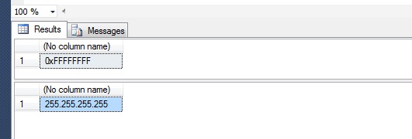
10. Storing IP addresses in the database
An example of use
The result
SELECT dbo.fnBinaryIPv4('255.255.255.255')
-- should return 0xFFFFFFFF
go
SELECT dbo.fnDisplayIPv4( 0xFFFFFFFF )
-- should return '255.255.255.255'
go

Slide 27
THANKS FOR YOUR ATTENTION!
https://github.com/igorgorbenko/sql_tips.git

