Slide 1

Programação em Microinformática
Desenvolvido para:
Igor Portugal
Ottoniel Matheus
Renan Fermino

Slide 2
HEAD
BOOTSTRAP
FONTAWESOME
Nome da Página e Decodificação
<link rel="stylesheet" href="https://use.fontawesome.com/releases/v5.0.13/css/all.css" integrity="sha384-DNOHZ68U8hZfKXOrtjWvjxusGo9WQnrNx2sqG0tfsghAvtVlRW3tvkXWZh58N9jp" crossorigin="anonymous">
<script src="https://code.jquery.com/jquery-3.3.1.slim.min.js" integrity="sha384-q8i/X+965DzO0rT7abK41JStQIAqVgRVzpbzo5smXKp4YfRvH+8abtTE1Pi6jizo" crossorigin="anonymous"></script>
<script src="https://cdnjs.cloudflare.com/ajax/libs/popper.js/1.14.3/umd/popper.min.js" integrity="sha384-ZMP7rVo3mIykV+2+9J3UJ46jBk0WLaUAdn689aCwoqbBJiSnjAK/l8WvCWPIPm49" crossorigin="anonymous"></script>
<script src="https://stackpath.bootstrapcdn.com/bootstrap/4.1.1/js/bootstrap.min.js" integrity="sha384-smHYKdLADwkXOn1EmN1qk/HfnUcbVRZyYmZ4qpPea6sjB/pTJ0euyQp0Mk8ck+5T" crossorigin="anonymous"></script>
<link rel="stylesheet" href="https://stackpath.bootstrapcdn.com/bootstrap/4.1.1/css/bootstrap.min.css" integrity="sha384-WskhaSGFgHYWDcbwN70/dfYBj47jz9qbsMId/iRN3ewGhXQFZCSftd1LZCfmhktB" crossorigin="anonymous">
<head>
<title>Alaska - Sorvetes Finos</title>
<meta charset="utf8">
ICONE E JQUERY
Folha de Estilo e Fonte
<link rel="icon" type="image/x-icon" href="IMGS/buffet.png">
<script src="http://code.jquery.com/jquery-latest.min.js" type="text/javascript"></script>
<link rel="stylesheet" href="style.css">
<link href="https://fonts.googleapis.com/css?family=Raleway" rel="stylesheet">

Slide 3

AINDA NO HEAD
USANDO JQUERY PARA LEVEZA NA ROLAGEM
<script>
jQuery(document).ready(function($) {
$(".scroll").click(function(event){
event.preventDefault();
var menuHeight = $('.header').innerHeight();
$('html,body').animate({scrollTop:$(this.hash).offset().top - menuHeight}, 600);
});
});
</script>

Slide 4
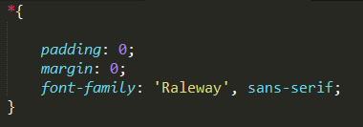

FOLHA DE ESTILO
APLICAÇOES:
IN-LINE
EXTERNA

Slide 5
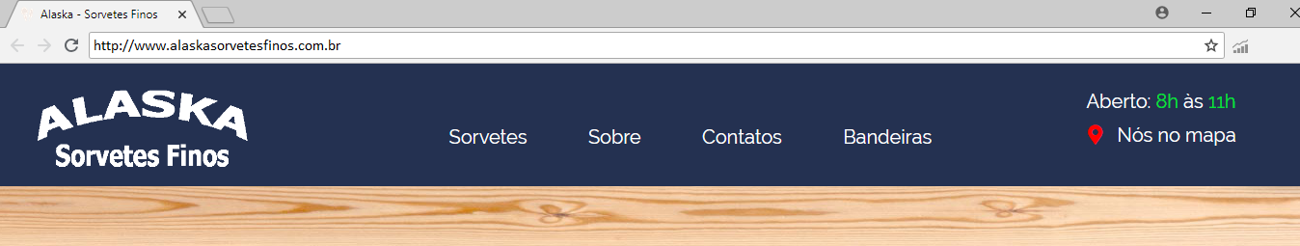
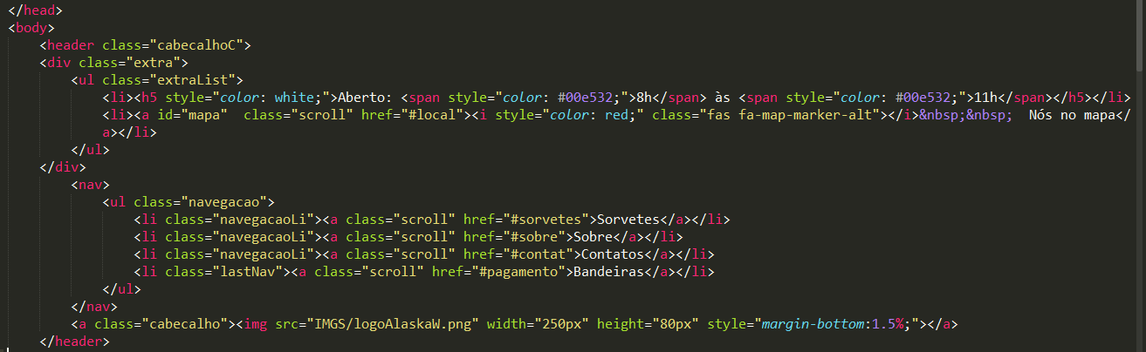

CABEÇALHO

Slide 6
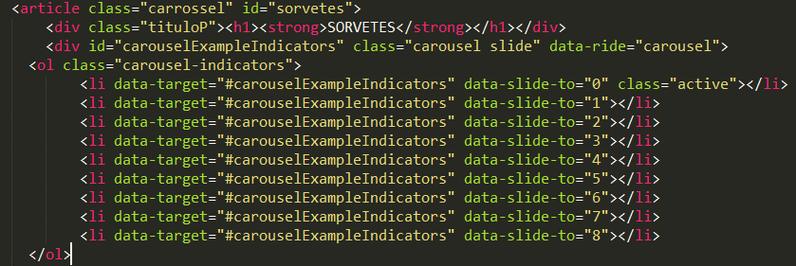
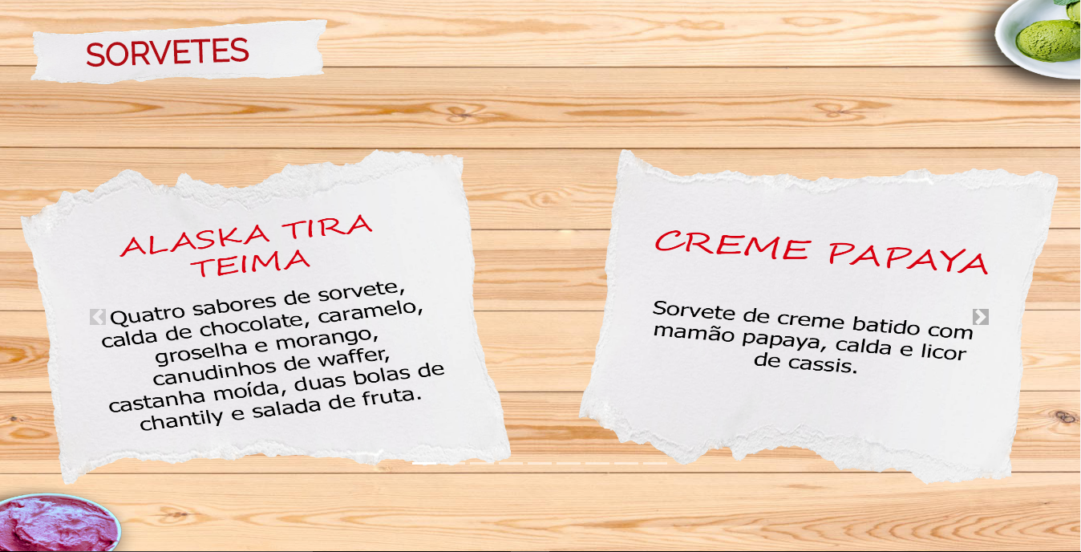
SLIDE/MENU

Slide 7
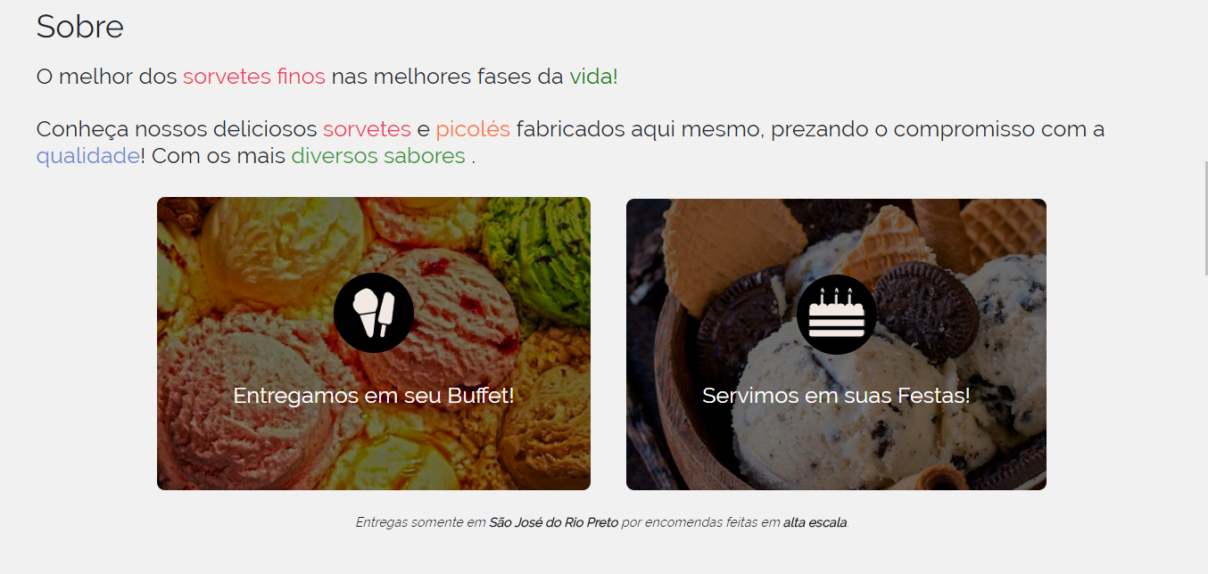
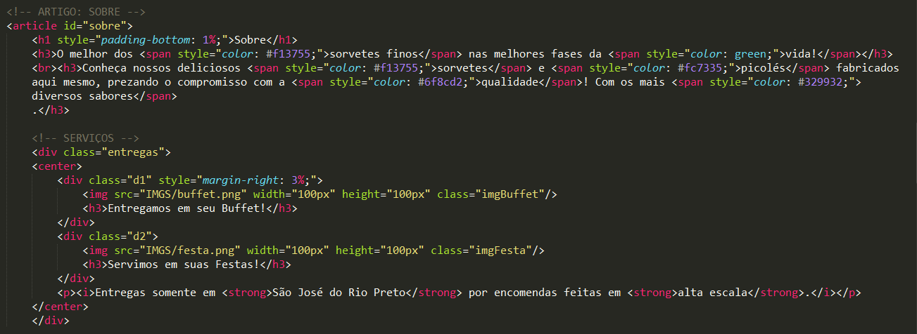
SOBRE

Slide 8
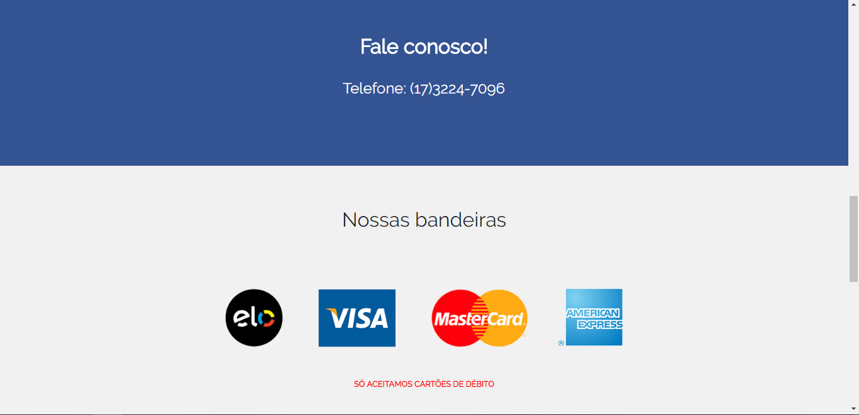
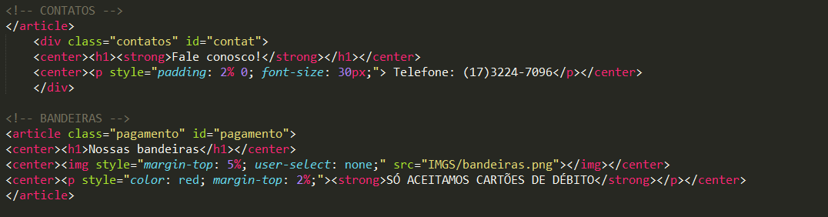
CONTATO E BANDEIRAS

Slide 9
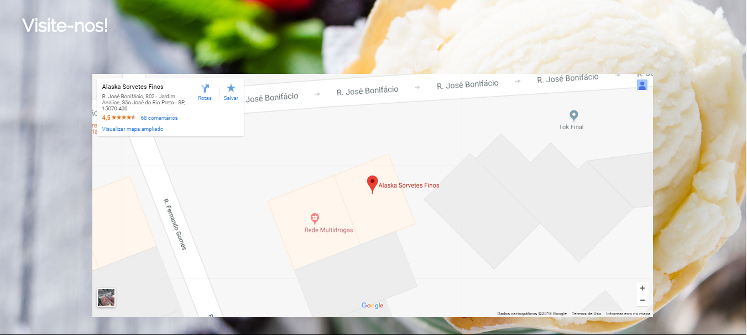
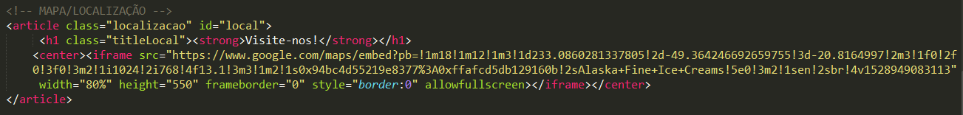
MAPA/LOCALIZAÇÃO

Slide 10
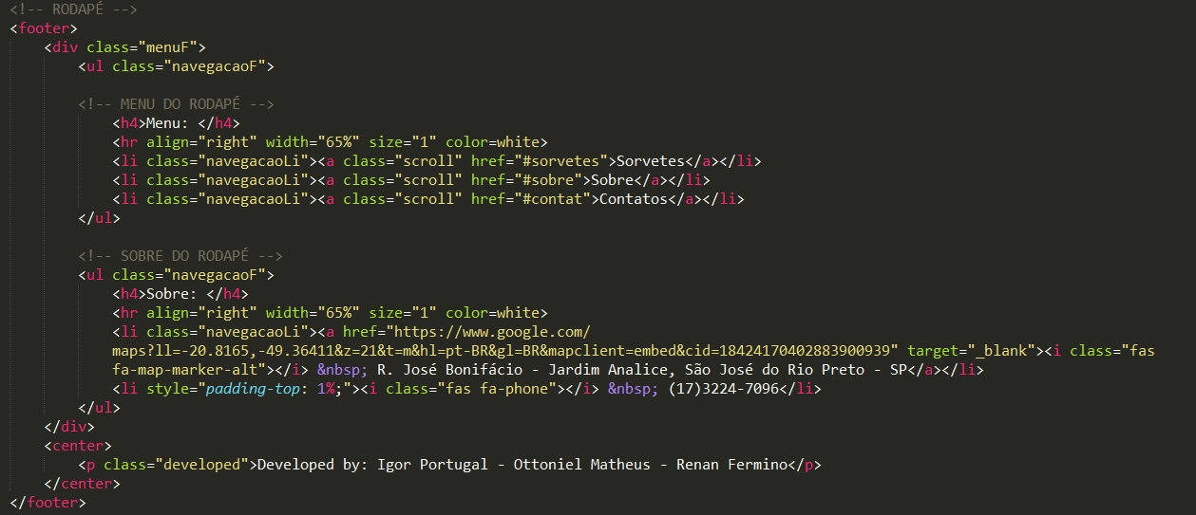
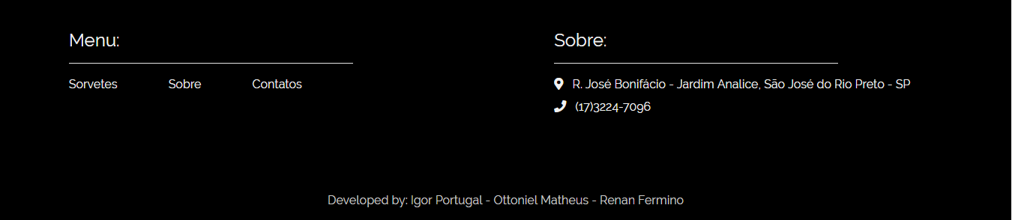
RODAPÉ

