Slide 1
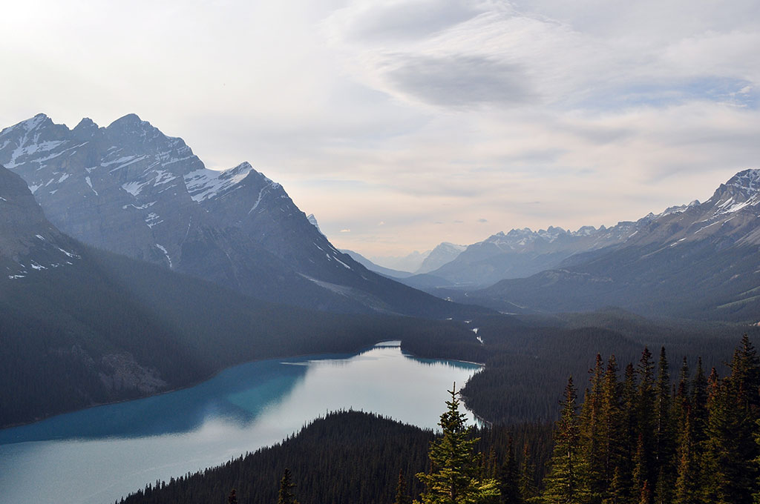

Azure Automation
Demo:
Create Graphical Workflow for automating VM management tasks
December 21, 2017

Slide 2
GOALS
Create an Automation account
Create a graphical Runbook
Publish the Runbook, run it and view the result

Slide 3
PREREQUISITES:
Active Azure subscription
Existing virtual machines
Notes:
P37 – divide into 2 slides

Slide 4
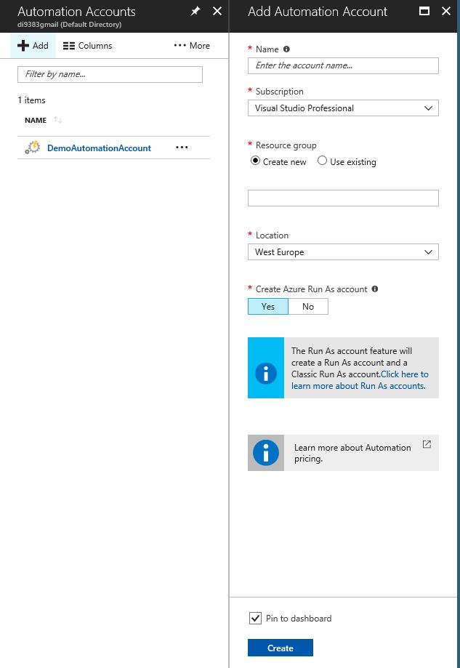
CREATE AN AUTOMATION ACCOUNT
Open Azure portal
Click on “More Services”
Type “Automation”
Choose “Automation Accounts”
Add a new one

Slide 5
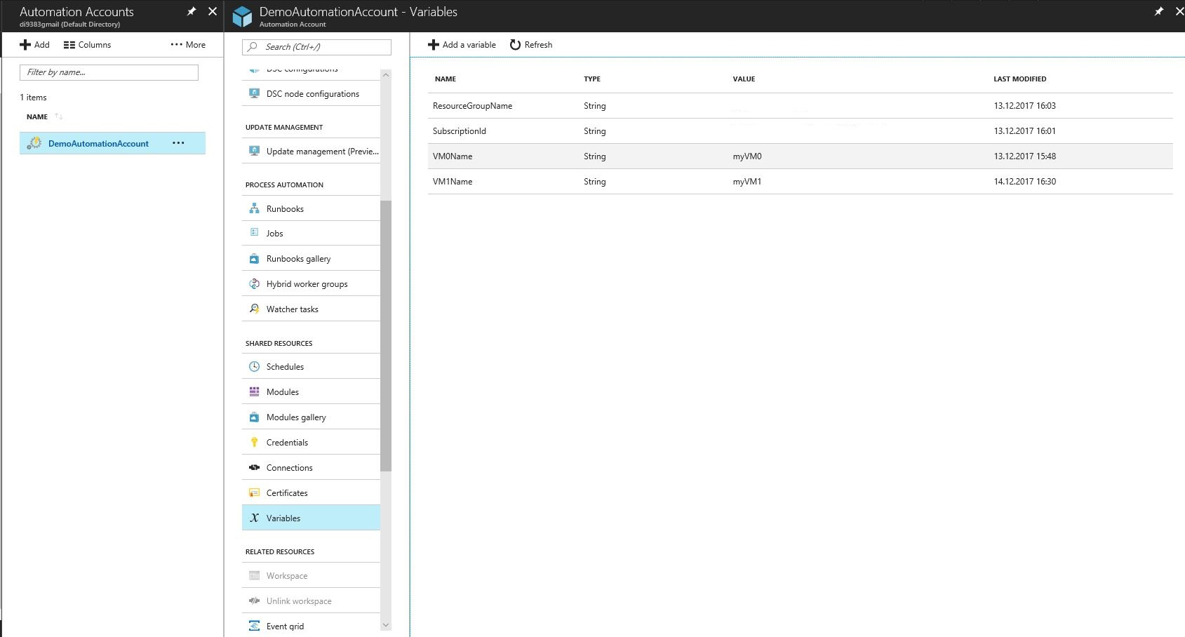
CREATE AN AUTOMATION ACCOUNT
Populate it with the following automation variables

Slide 6

CREATE a
Runbook and
Test the result

Slide 7
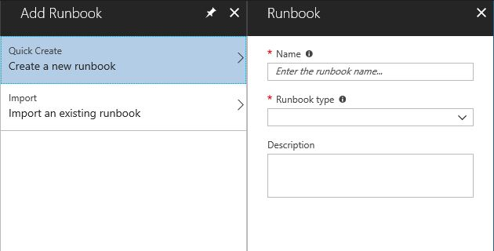
CREATE A GRAPHICAL RUNBOOK
Add a new Runbook, select Graphical Runbook type

Slide 8
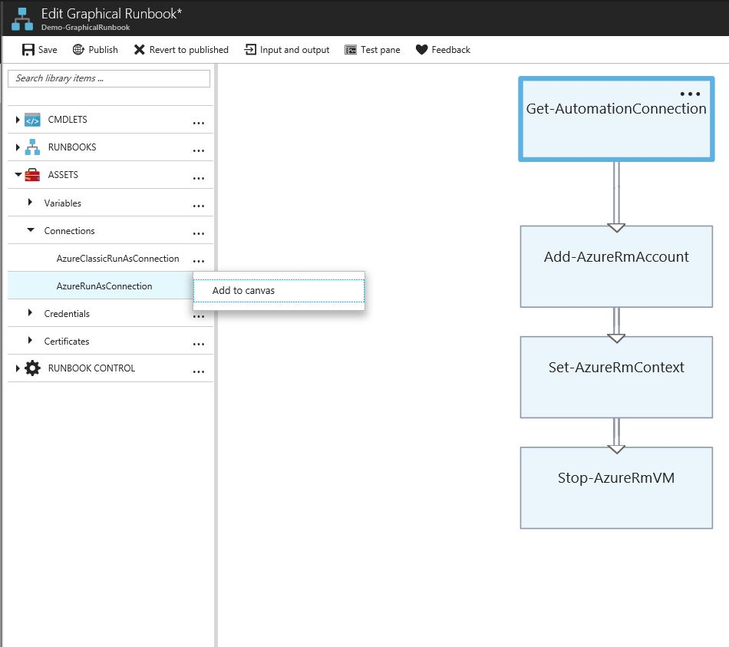
CREATE A GRAPHICAL RUNBOOK
Use menu from the left and “Add to canvas” button to add Assets and CMDLETs to your Runbook

Slide 9
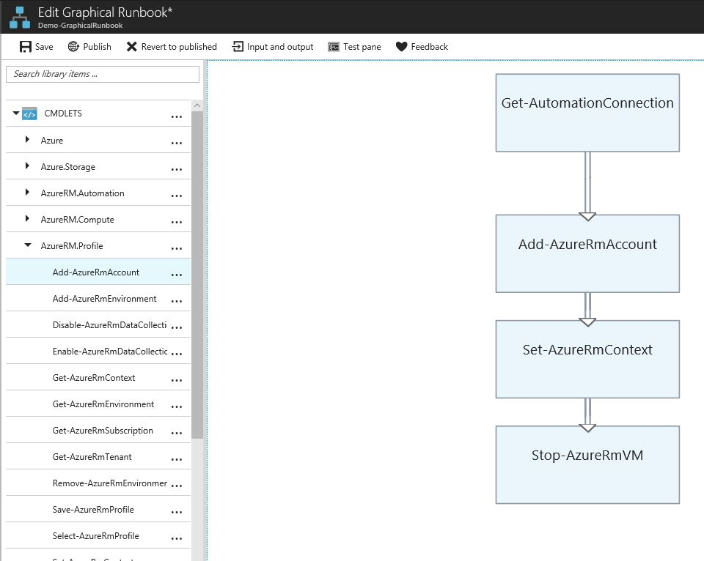
CREATE A GRAPHICAL RUNBOOK
You can choose cmdlets from the different AzureRM modules

Slide 10
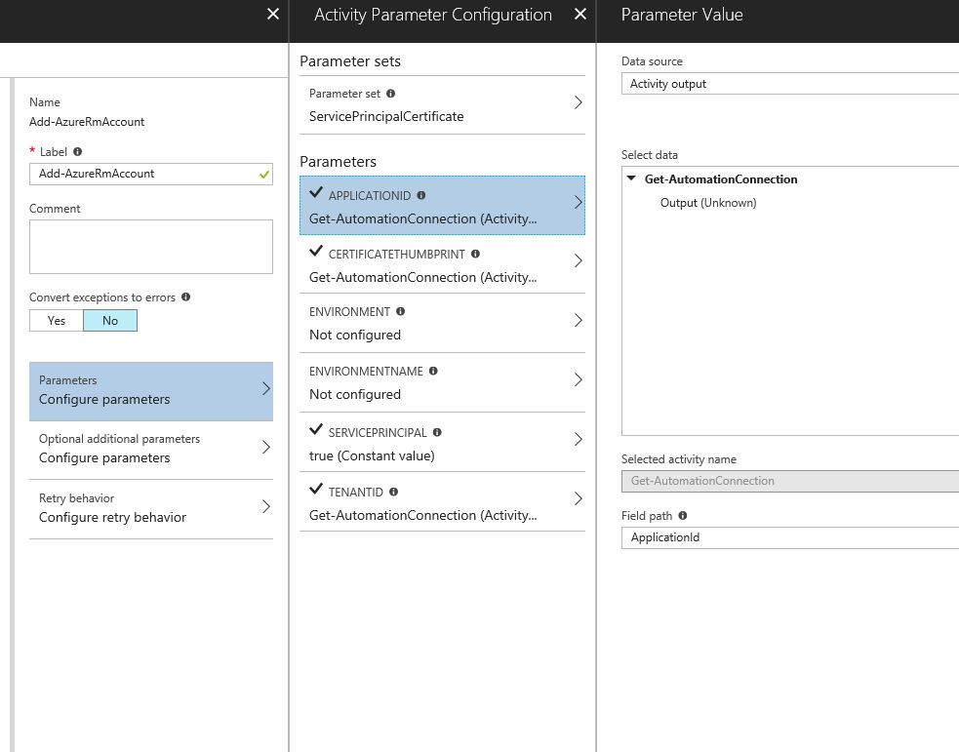
CREATE A GRAPHICAL RUNBOOK
Configure parameters of your cmdlets according to the following slides:

Slide 11
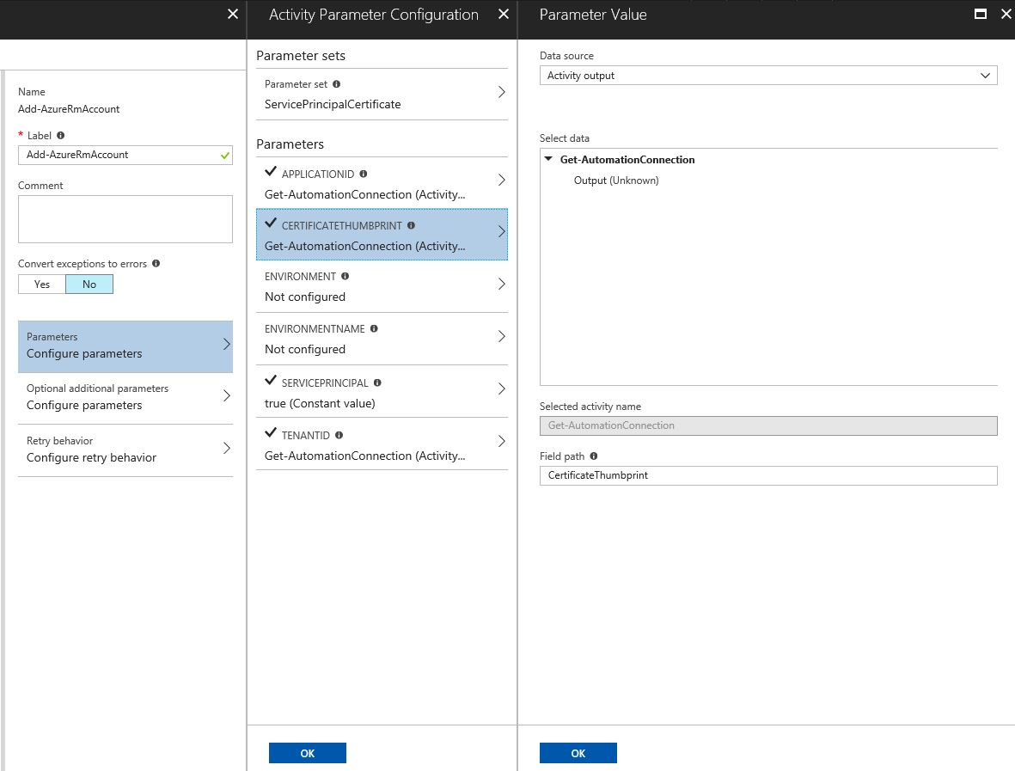
CREATE A GRAPHICAL RUNBOOK

Slide 12
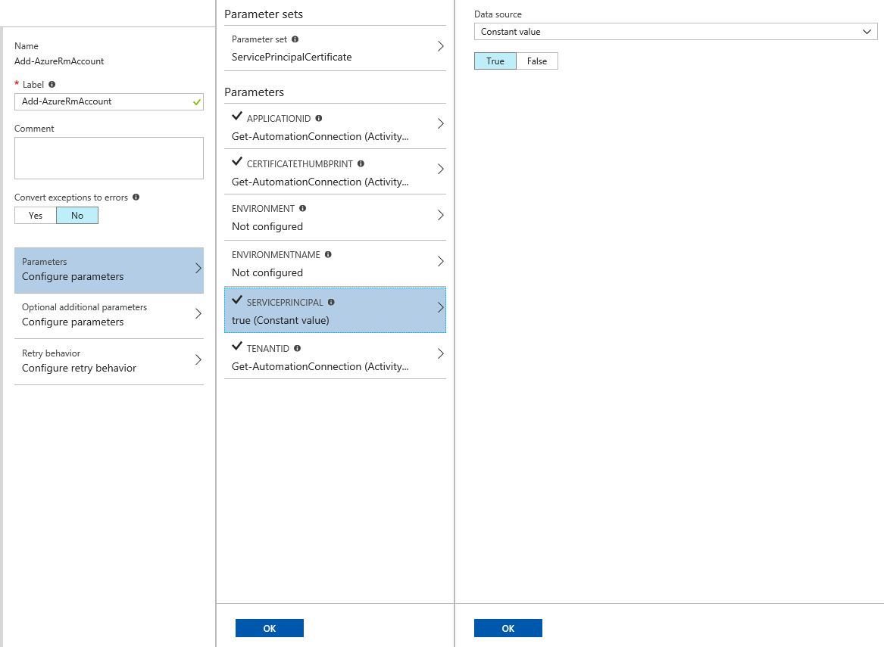
CREATE A GRAPHICAL RUNBOOK

Slide 13
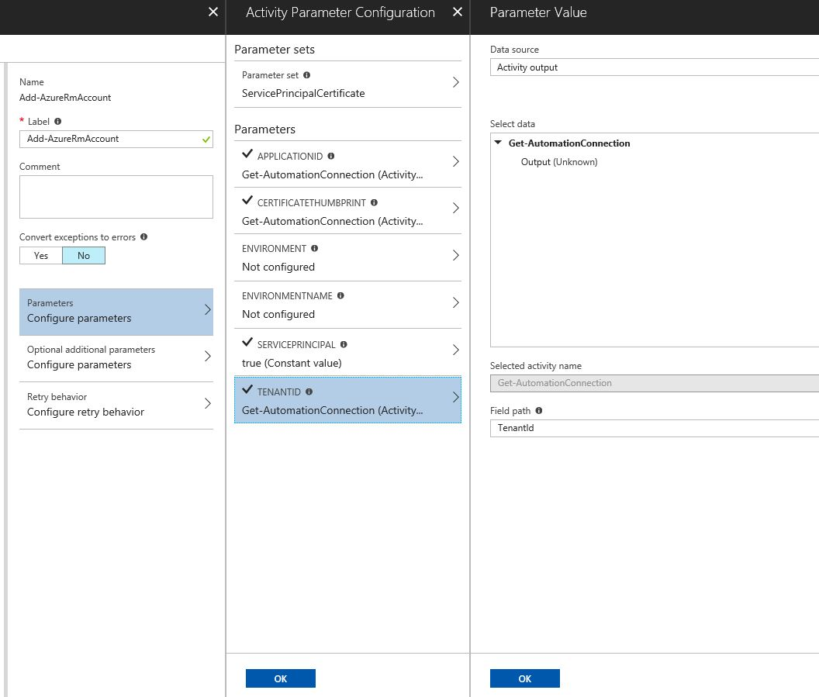
CREATE A GRAPHICAL RUNBOOK

Slide 14
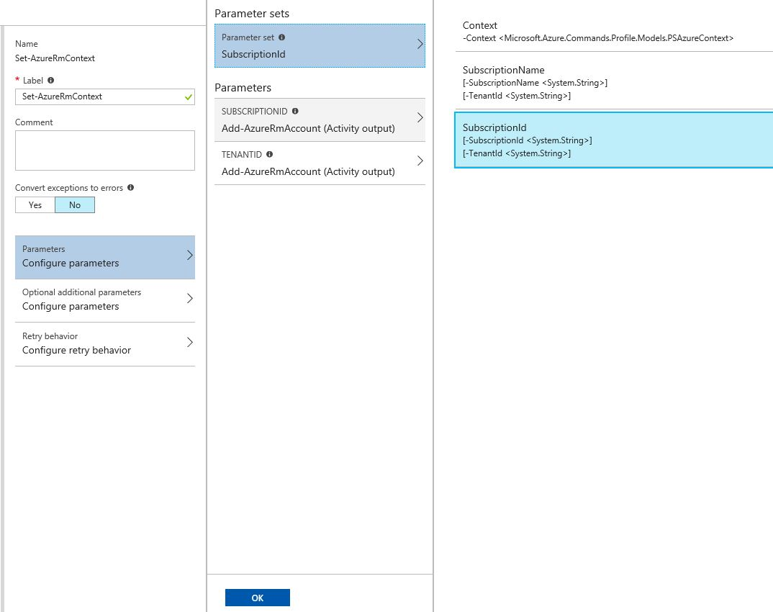
CREATE A GRAPHICAL RUNBOOK

Slide 15
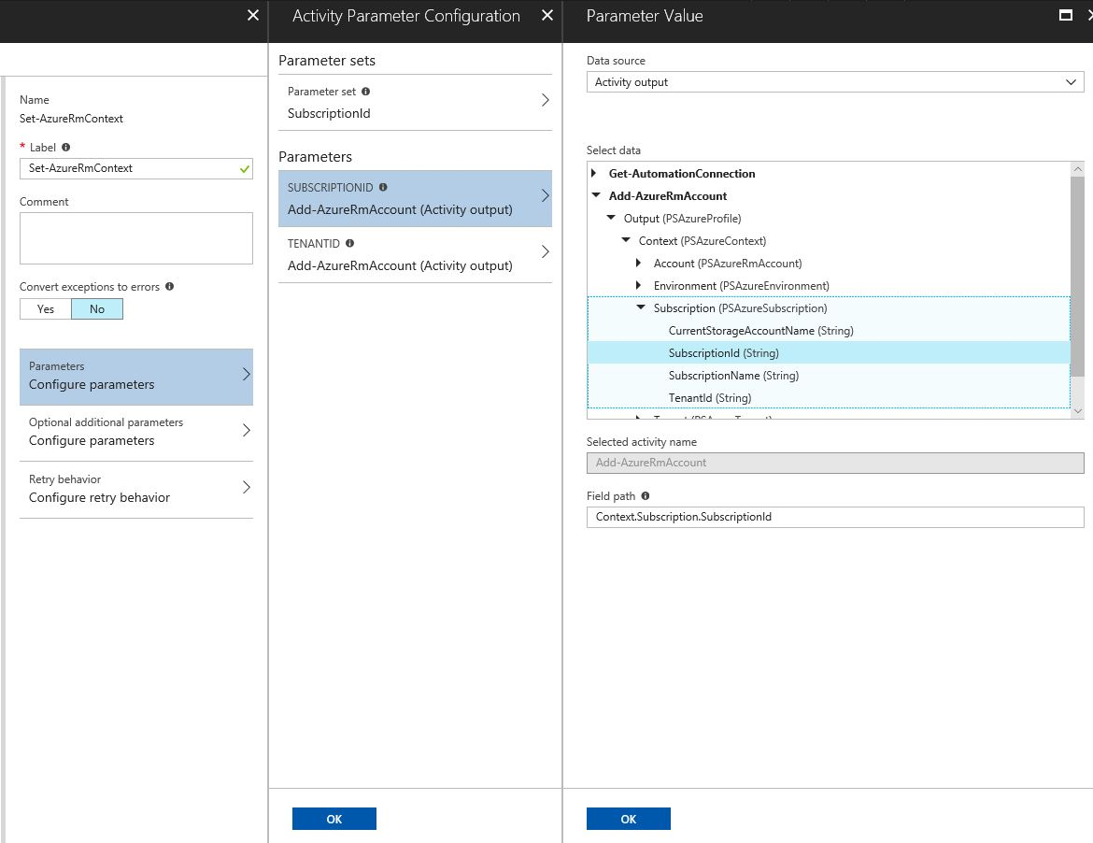
CREATE A GRAPHICAL RUNBOOK

Slide 16
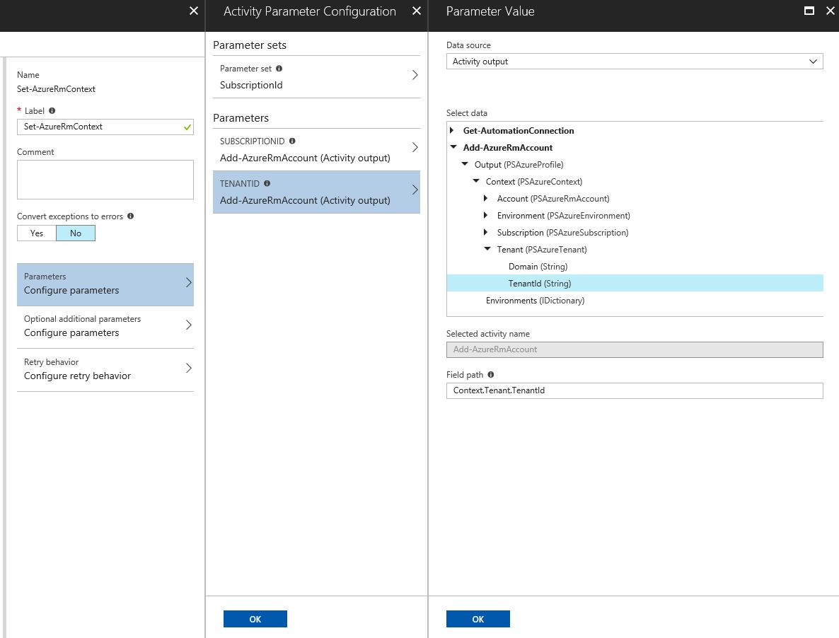
CREATE A GRAPHICAL RUNBOOK

Slide 17
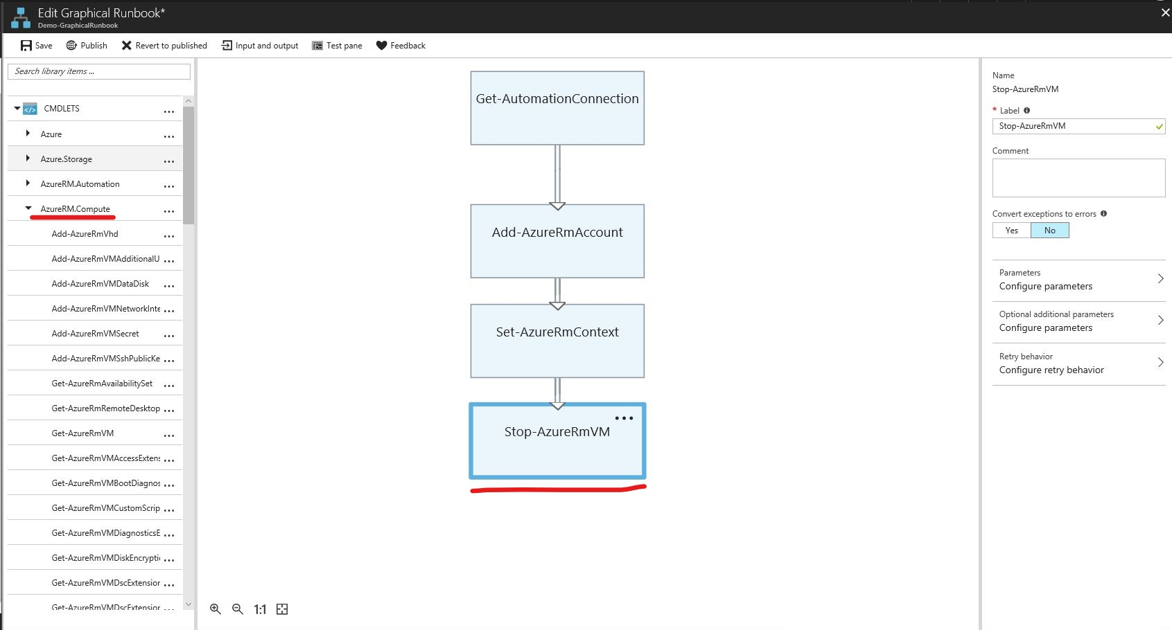
CREATE A GRAPHICAL RUNBOOK
Stop-AzureRmVm cmdlet can be found in AzureRM.Compute resource

Slide 18
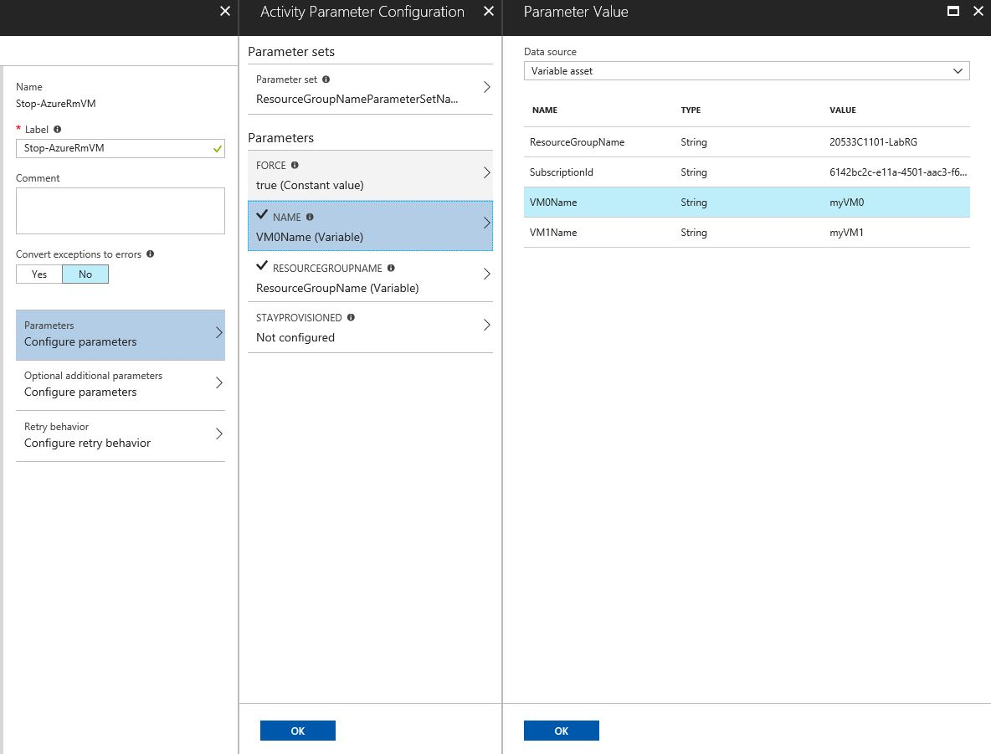
CREATE A GRAPHICAL RUNBOOK
Choose Variable asset in the Data source and populate the step with your automation variables

Slide 19
Publish your Runbook, execute it and look through the output.

Slide 20
End of the demo

