Slide 1
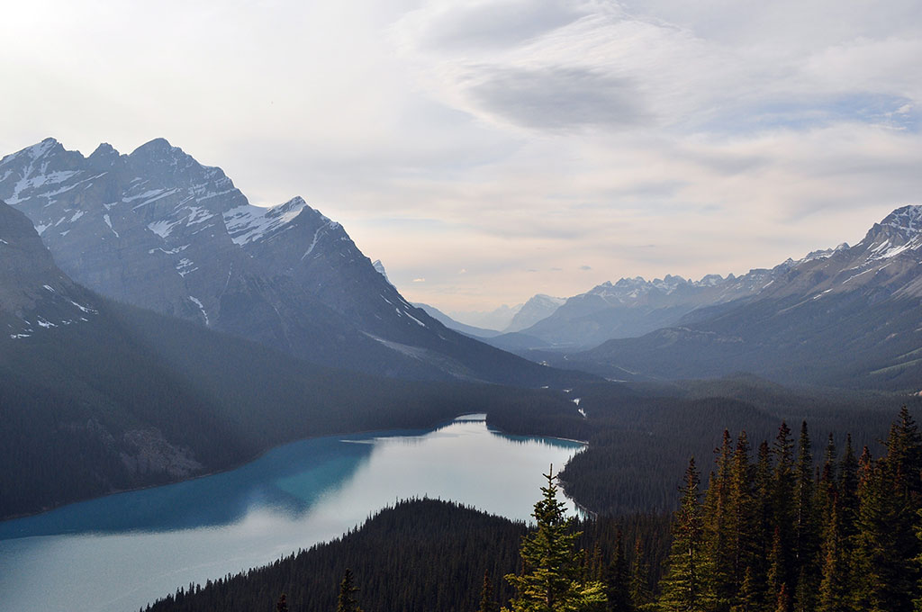

Azure Automation
Demo:
Getting started with Azure Automation DSC
January 4, 2018

Slide 2
GOALS
Create a DSC configuration
Upload and compile the configuration
Onboard a VM and assign a node configuration
Check the results

Slide 3
PREREQUISITES:
Active Azure subscription
An Azure Automation account
Existing virtual machines (running Windows Server 2008 R2 or later)
Notes:
P37 – divide into 2 slides

Slide 4
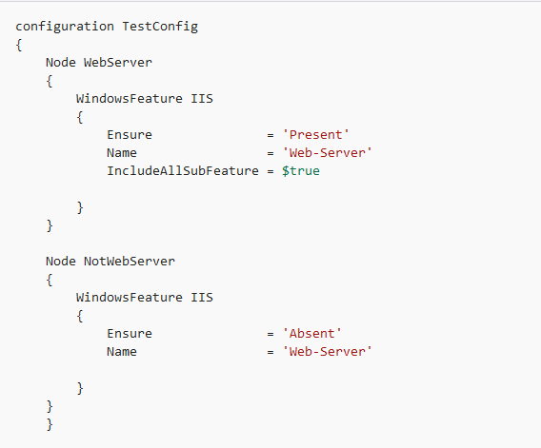
CREATE A DSC CONFIGURATION
Start the Windows PowerShell ISE
Type the following text

Slide 5

UPLOAD
AND COMPILE
THE CONFIGURATION

Slide 6
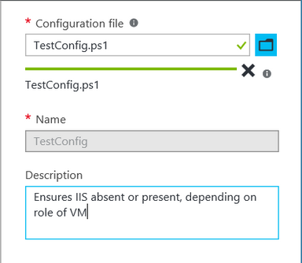
UPLOAD AND COMPILE THE CONFIGURATION
Sign in to the Azure portal
Go to the Automation account you have created
Click Add a configuration under DSC Configurations blade

Slide 7
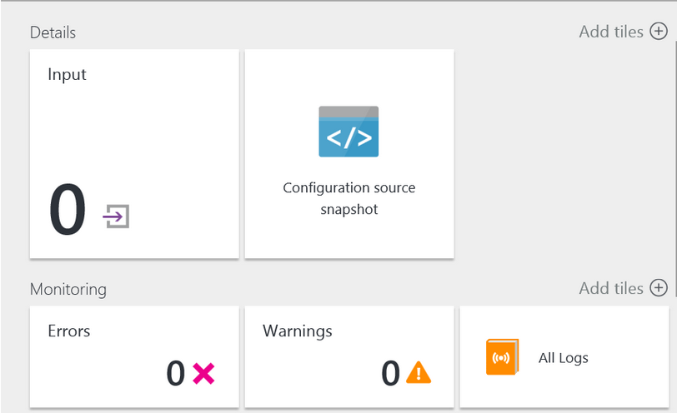
UPLOAD AND COMPILE THE CONFIGURATION
On the DSC Configurations blade click the name of the configuration uploaded and click Compile - Yes
On the Compilation jobs click on the job created and view the compilation results/errors if any

Slide 8
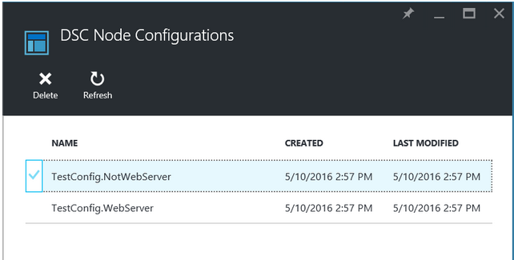
UPLOAD AND COMPILE THE CONFIGURATION
On the Automation account blade, click DSC Node Configurations and view the configurations created after the compilation job is finished

Slide 9
ONBOARD A VM
and assign a
node configuration

Slide 10
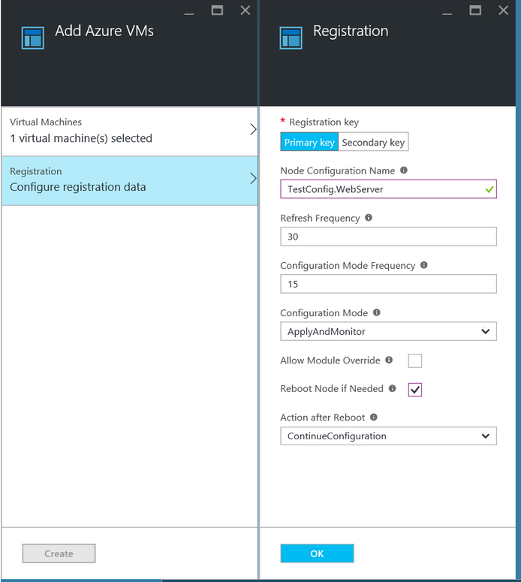
ONBOARD A VM AND ASSIGN A NODE CONFIGURATION
On the Automation account blade, click DSC Nodes
In the DSC Nodes blade, click Add Azure VM
Configure the registration as shown on the slide (use the exact name of a node configuration you’ve compiled)

Slide 11
CHECK the results

Slide 12
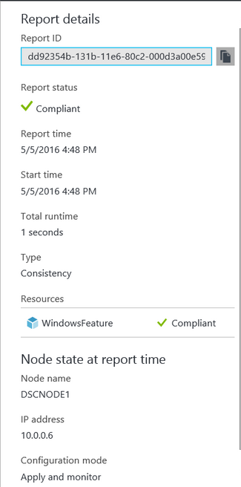
CHECK THE RESULTS
On the Automation account blade, click DSC Nodes
On the Reports tile, click on any of the reports in the list
Check whether the node is “Compliant”

Slide 13
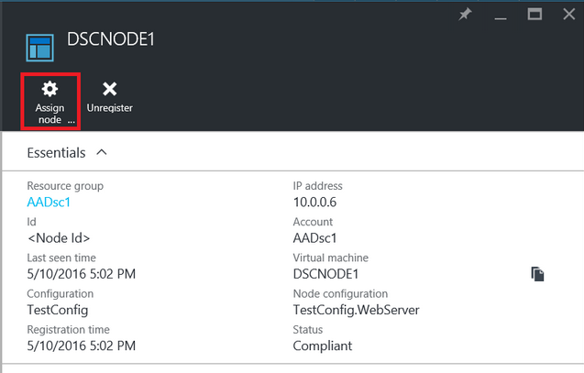
CHECK THE RESULTS
RDP to a VM and check if the Web-Server feature was added
Re-assign the node to the second compiled configuration (NotWebServer)
RDP to a VM and check if the Web-Server feature was removed

Slide 14
End of the demo

